Slide 1
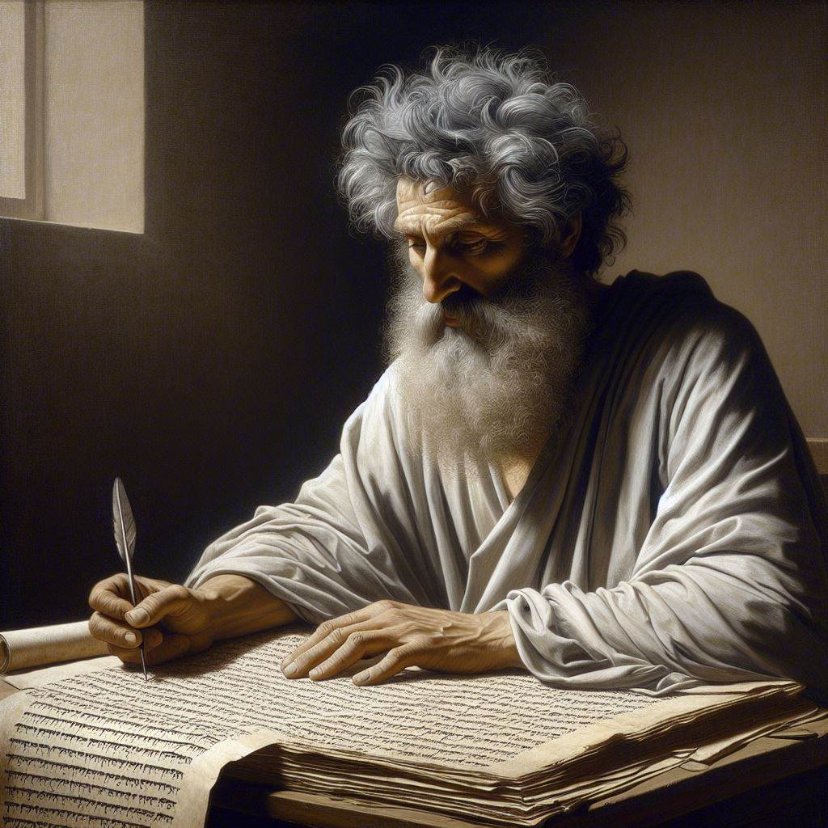
First John 3:1-10
‘Now we are children of God’
11 & 14 April 2024
Image by Dall-e 3

Slide 2
First John, discourse structure
Part 1: Our Fellowship with God 1.1 – 2.17
Part 2: Our Adversaries 2.18 – 3.18
Part 3: Our Christian Faith 3.19 – 5.5
Part 4: Our Confidence with God 5.6-21
V. Antichristian teachers 2.18-29
VI. Lawless sinners 3.1-10
VII. Those who Hate Christians 3.11-18

Slide 3
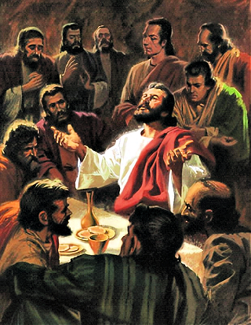
God is righteous, 2:29
²⁹ If you know that He is righteous, you know that everyone who practices righteousness also has been born of Him. (NASB, 2020)
Jesus prayed, “O righteous Father, although the world has not known You, yet I have known You.” John 17:25
²⁹ You know that God is absolutely righteous. You also know that God has rebirthed all who habitually do righteous things. (GJC, 2024)

Slide 4
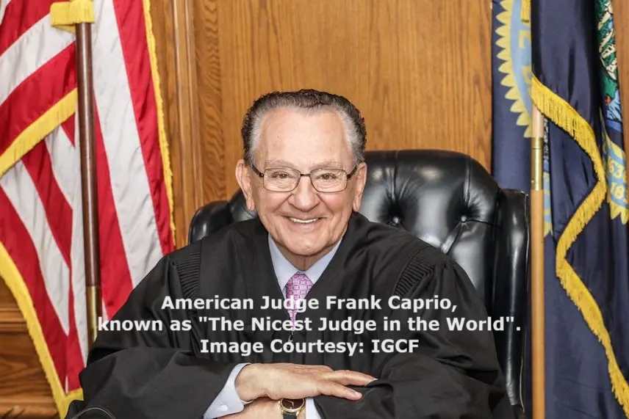
Righteous
● God himself is the moral standard.
● God does everything right, just and good.
● God’s laws are good for everybody.
● God rebirths humans to behave rightly.
● God will judge all humans’ behavior.
● Reborn humans can behave rightly.
● God will reward all humans’ righteous behavior.

Slide 5
A. God’s Children 3.1-3

Slide 6
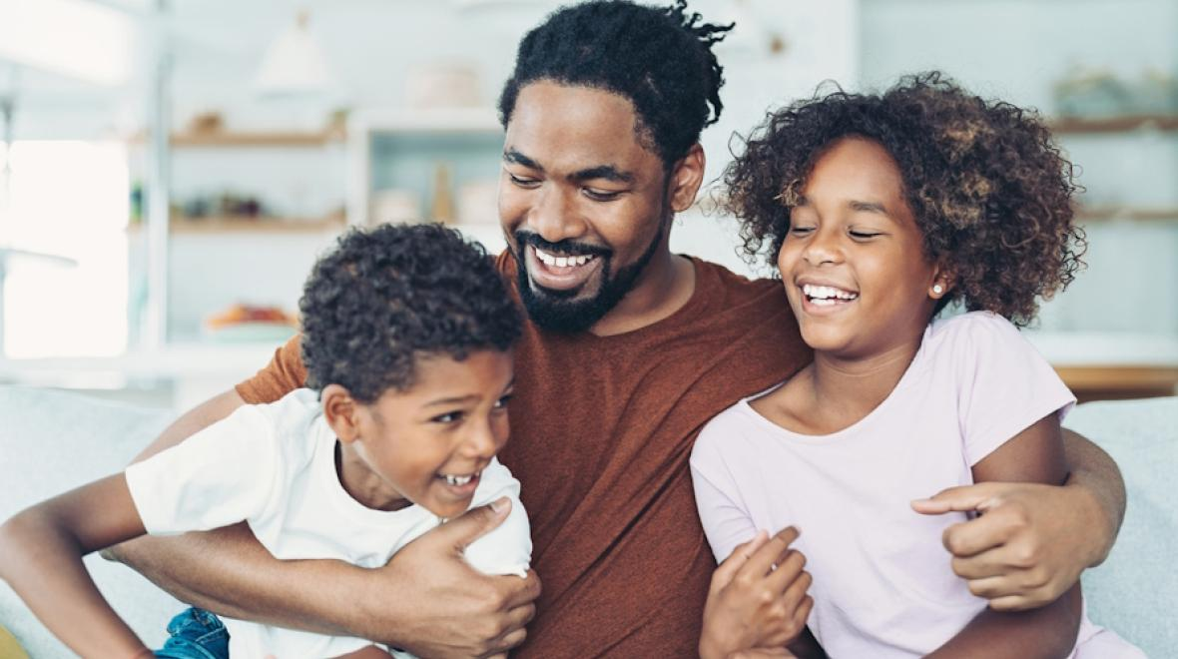
What we are, 3:1
^{1a} See how great a love the Father has given us, that we would be called children of God; and in fact we are.
“As many as received Him, to them He gave the right to become children of God, even to those who believe in His name.” John 1:12
^{1a} Consider how much love the Father loves us: he calls us his “children.” And that is what we are.

Slide 7
World does not know us, 3:1
^{1b} For this reason the world does not know us: because it did not know Him.
^{1b} Why do other people not recognize what we are? Because they do not know Him.
Jesus said, “You know neither Me nor My Father; if you knew Me, you would know My Father also.” John 8:19

Slide 8
Checklist to know God
0 I admit that I do not know God.
1 I accept that there might be a God.
2 I am willing to find out if there is a God.
3 Listen to others’ testimonials about God.
4 Evaluate evidence for a God.
5 Pray to God to see if something happens.
6 Ask God to make himself known to you.
7 Let God invade your life and experience.
8 Remain loyal to God, whatever the cost.

Slide 9
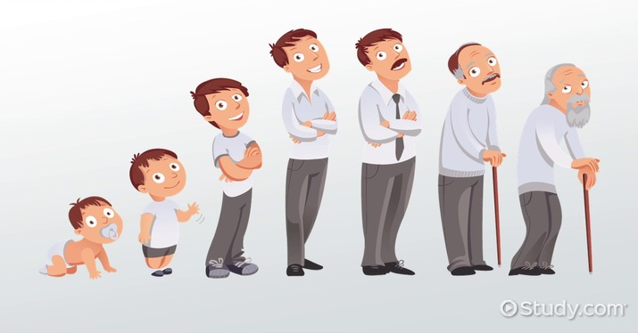
What we are, 3:2
^{2a} Beloved, now we are children of God, and it has not appeared as yet what we will be.
^{2a} We are already God’s children, and he loves us. But God has not yet shown what we will become.
“God so loved the world, that He gave His only Son, so that everyone who believes in Him will not perish, but have eternal life.” John 3:16

Slide 10
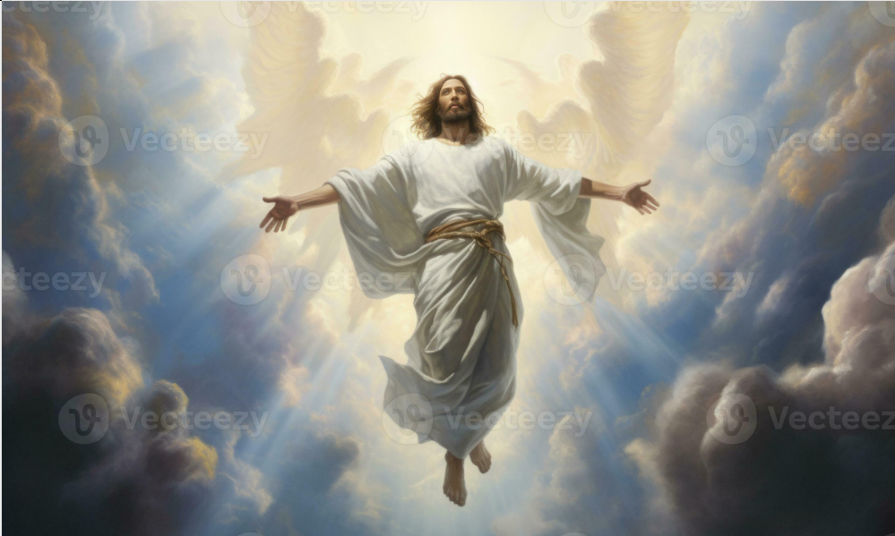
We will be like him, 3:2b
^{2b} We know that when He appears, we will be like Him, because we will see Him just as He is.
^{2b} We know that, when Jesus returns and appears, God will make us like him. We also know that we shall see him just as he really is.
“This perishable must put on the imperishable, and this mortal must put on immortality.” 1 Corinthians 15:53

Slide 11
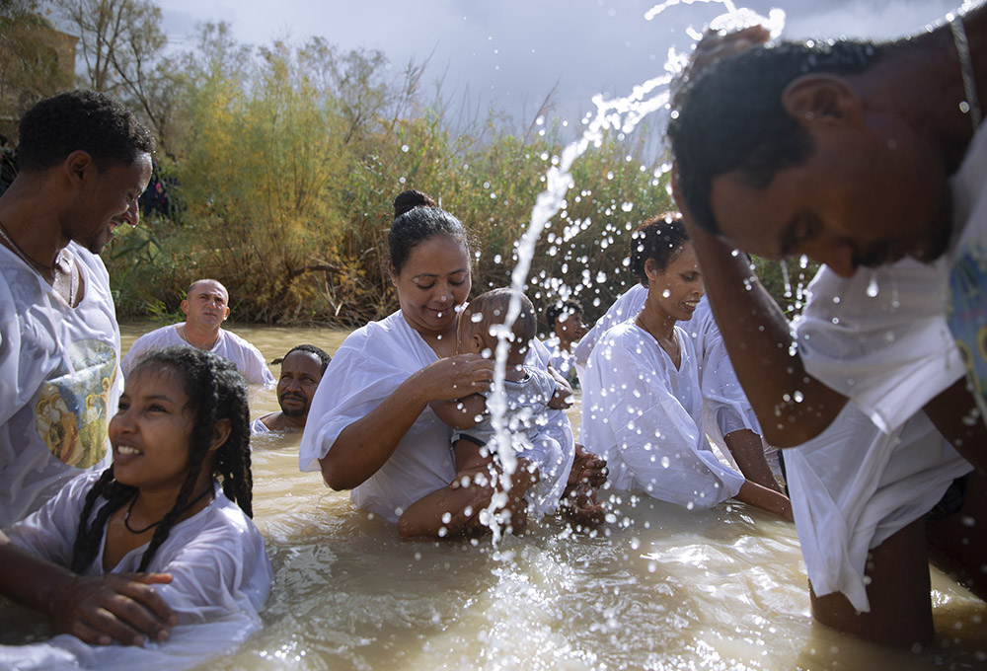
What we are, 3:2
³ And everyone who has this hope set on Him purifies himself, just as He is pure.
³ And everyone who has this hope in Jesus, keeps himself morally pure, just as Jesus is morally pure..
“Draw near to God and He will draw near to you. Cleanse your hands, you sinners; and purify your hearts, you double-minded.” James 4:8

Slide 12
B. Jesus and sinners
3:4-6

Slide 13
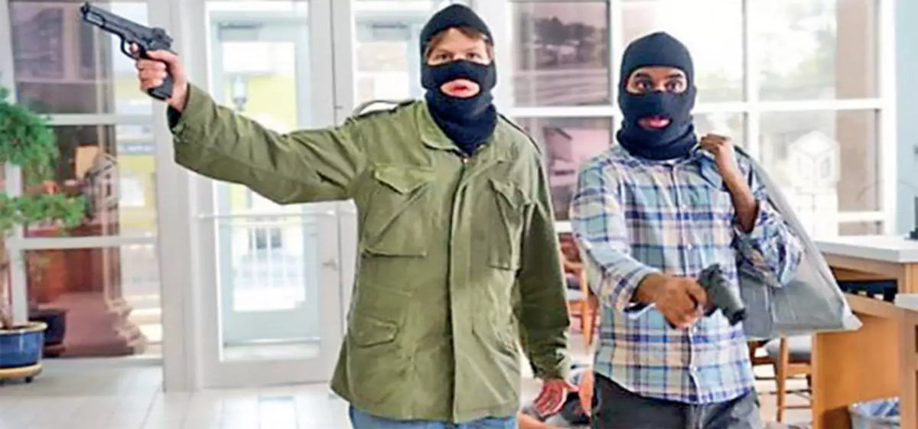
Lawlessness, 3:4
⁴ Everyone who practices sin also practices lawlessness; and sin is lawlessness.
⁴ Everyone who habitually practices sinful behavior, is violating God’s laws, because sinful behavior is the same as violating his laws.
Jesus asked, “Did Moses not give you the Law? And yet none of you carries out the Law.” John 7:19

Slide 14
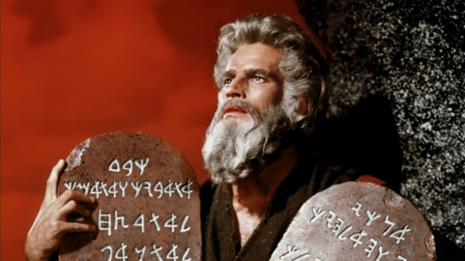
God’s basic laws for everyone
1 Honor Yahweh God above all others.
2 Treat others as you want to be treated.
3 Give everybody a day off every week.
4 Honor your father and mother.
5 Do not commit murder.
6 Do not commit immorality.
7 Do not steal.
8 Do not lie about others.
9 Do not desire others’ stuff or spouse.

Slide 15
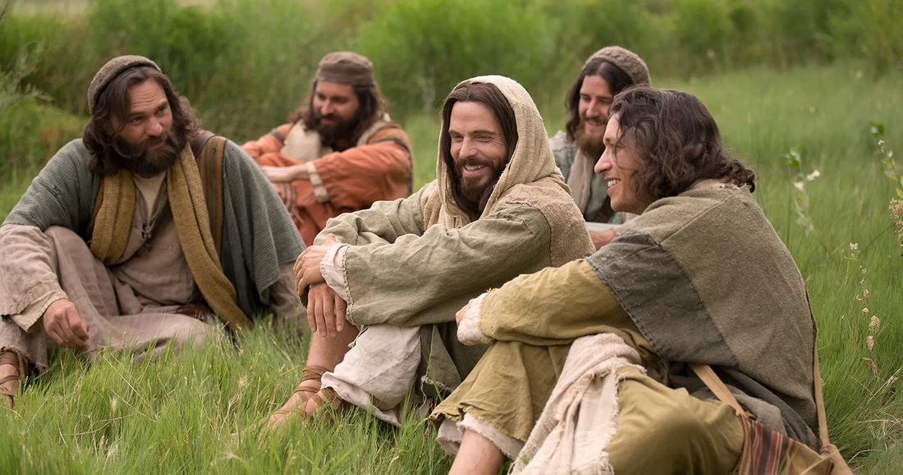
Jesus’ Ten Commandments
Repent.
Believe the Good News.
Receive the Holy Spirit.
Follow my teaching.
Baptize new followers.
Pray to God by my authority.
Love God, others, believers and enemies.
Remember my death.
Give freely.
Go teach others how to obey my commandments.

Slide 16
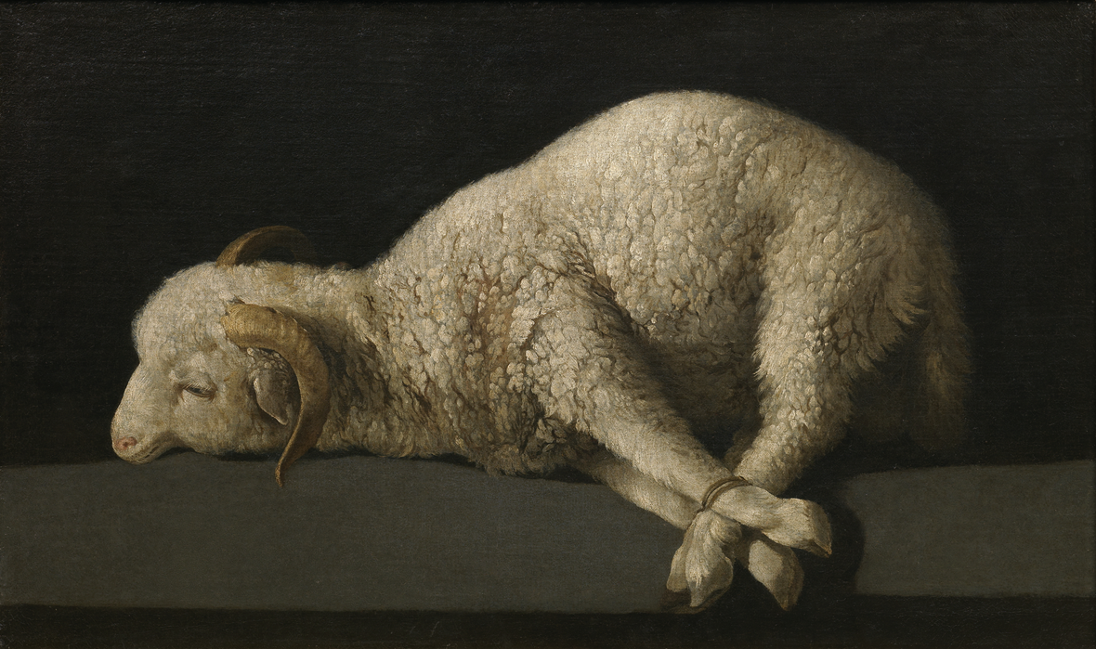
The lamb of God, 3:5
⁵ You know that He appeared in order to take away sins; and in Him there is no sin.
⁵ And we know that Jesus came the first time to remove people’s sins, and that he does not allow sins.
John saw Jesus and declared, “Here is the Lamb of God who takes away the sin of the world!” John 1:29

Slide 17
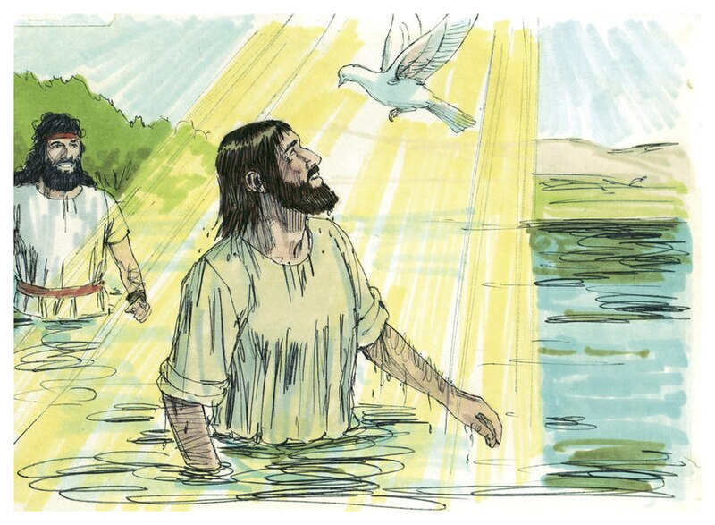
Remain faithful, 3:6
⁶ No one who remains in Him sins continually; no one who sins continually has seen Him or knows Him.
⁶ 6 Everyone who remains faithful to Jesus stops sinning habitually. Anyone who keeps on sinning habitually either never saw Jesus on earth, or has never come to know him experientially.
John said, “I myself have seen, and have testified that this is the Son of God.” John 1:34

Slide 18
C. The Righteous and sinners 3.7-10

Slide 19
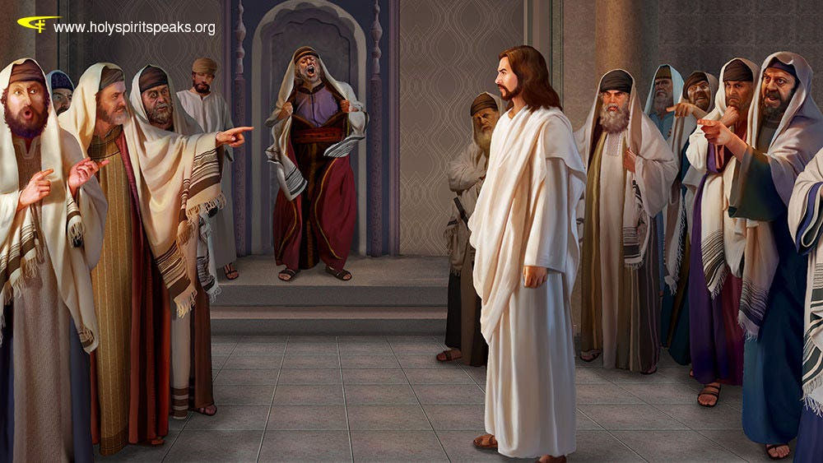
He is righteous, 3:7
⁷ Little children, make sure no one deceives you; the one who practices righteousness is righteous, just as He is righteous; …
⁷ Children, stop letting people deceive you. It is those who practice righteous behavior that are righteous before God, in the same way that Jesus himself is righteous before God.
Jesus asked, “Which one of you convicts Me of sin? If I speak truth, why do you not believe Me?” John 8:46

Slide 20
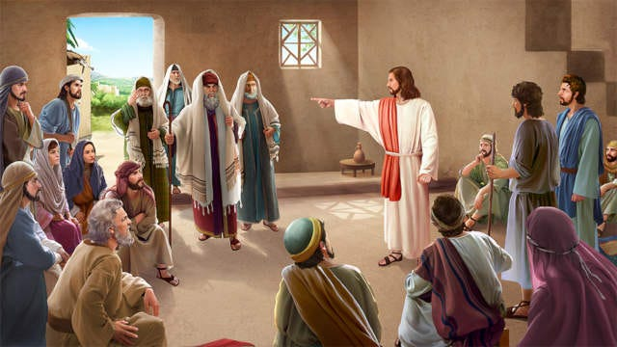
Destroy the devil’s works, 3:8
⁸ … the one who practices sin is of the devil; for the devil has been sinning from the beginning. The Son of God appeared for this purpose, to destroy the works of the devil.
⁸ Those who habitually practice sinful behavior belong to the devil, the same devil who has been sinning against God ever since the beginning. The Son of God came into the world to destroy what the devil does.
Jesus said, “You are of your father the devil, and you want to do the desires of your father. He was a murderer from the beginning.” John 8:44

Slide 21
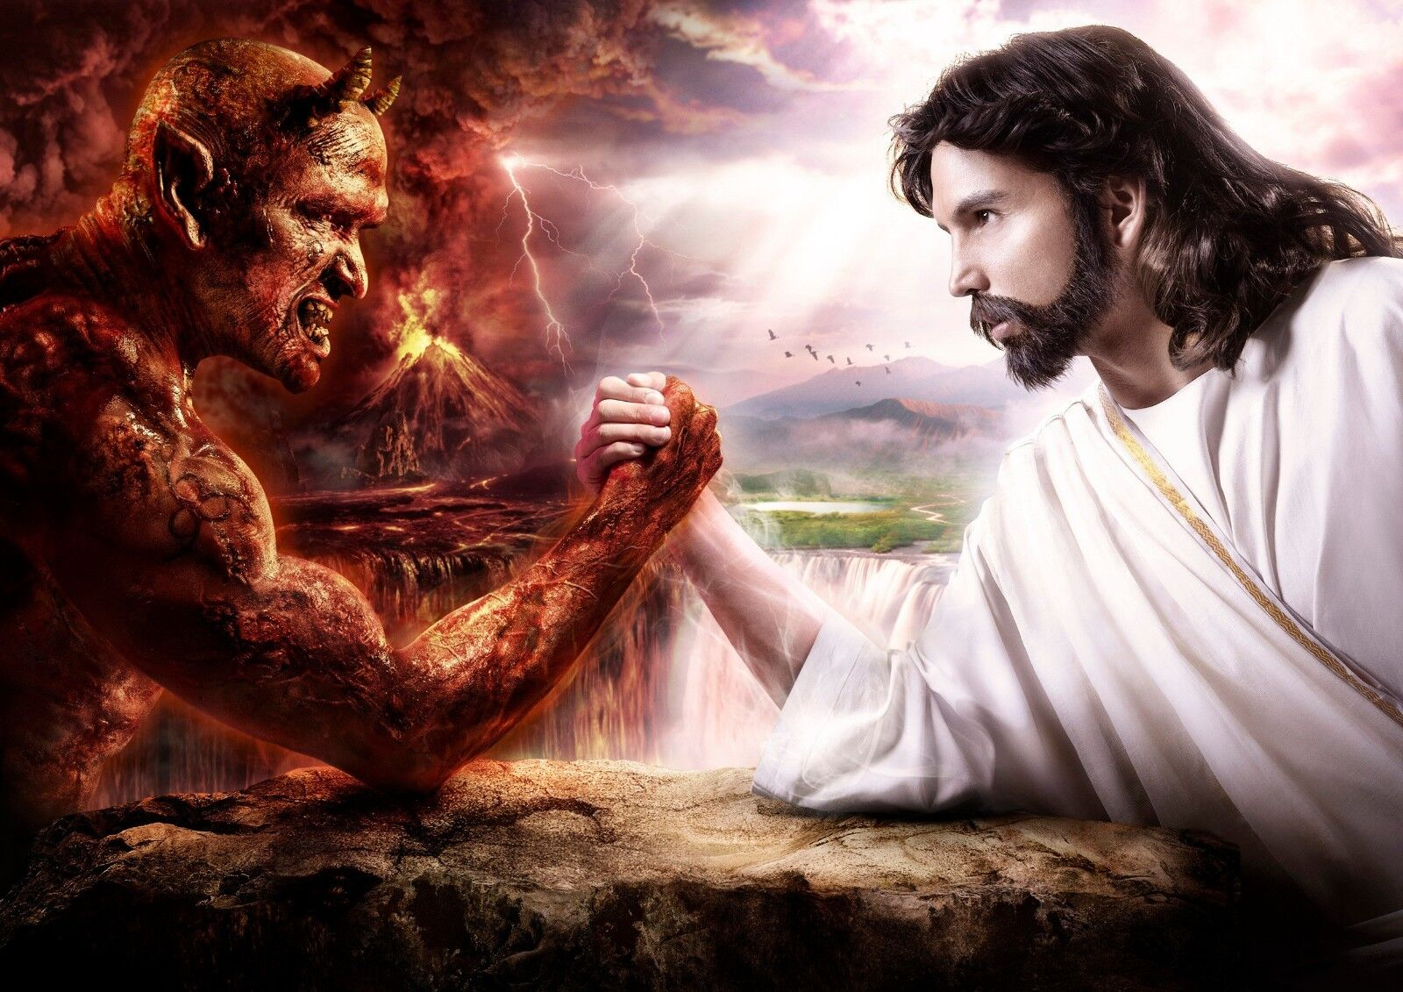
The devil The Savior
● Rebelled.
● Lies.
● Kills.
● Rules on earth.
● Hates humans.
● Tempts to sin.
● Torments guilty.
● God of the dead.
● Obeyed.
● Tells truth.
● Makes alive.
● Reigns from heaven.
● Loves the poor.
● Strengthens to resists.
● Rejoices the repentant.
● Lord of the living.

Slide 22
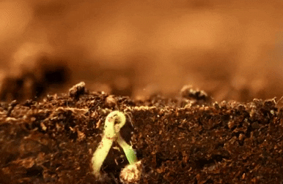
Born of God, 3:9
⁹ No one who has been born of God practices sin, because His seed remains in him; and he cannot sin continually, because he has been born of God.
⁹ All those whom God rebirths stop sinning habitually, because God’s “seed” remains in them. And they cannot keep on sinning habitually, because God has rebirthed them.
“You have been born anew, not of perishable but of imperishable seed, through the living and enduring word of God.” 1 Pet 1:23
“I treasure your word in my heart, so that I may not sin against you.” Psalm 119.11

Slide 23
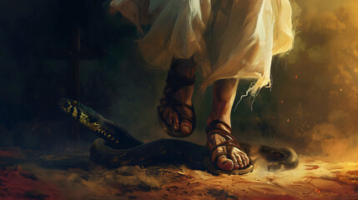
Born of God, 3:9
^{10a} By this the children of God and the children of the devil are obvious: anyone who does not practice righteousness is not of God, …
^{10a} How can we recognize who God’s children are, and who the devil’s children are? Here is how: all those who do not practice righteousness habitually do not belong to God, …
Moses wrote, “The LORD God said to the serpent, … I will put enmity between you and the woman, and between your seed and her seed.” Genesis 3:14-15

Slide 24
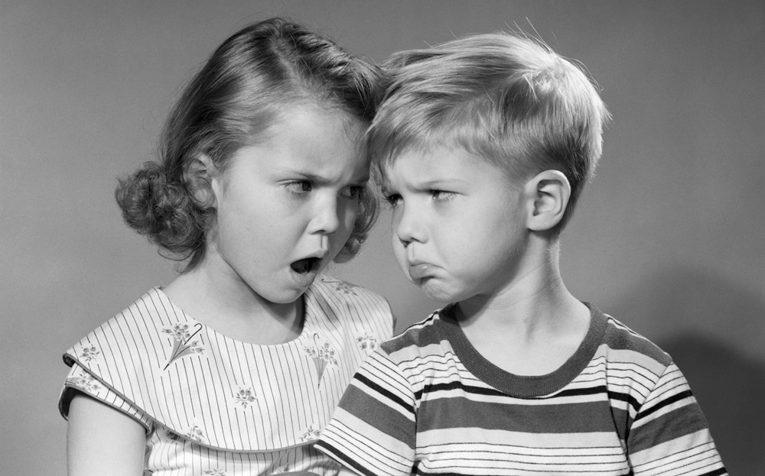
Who does not love, 3:10
^{10b} … nor the one who does not love his brother and sister.
^{10b} … nor do those who do not continue to love their fellow Christians.
Jesus said, “I am giving you a new commandment, that you love one another; just as I have loved you.” John 13:34

Slide 25
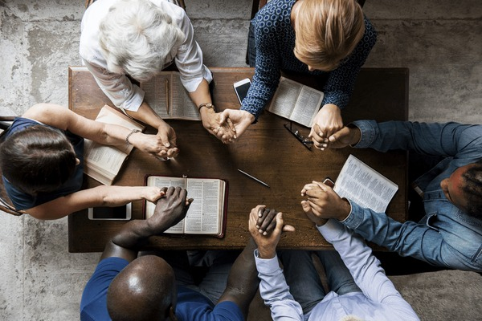
Christian love is not a feeling.
● Love places value on others.
● Love chooses to prefer others.
● Love defers to others’ wishes.
● Love supports others who are in need.
● Love serves others with spiritual gifts.
● Love forgives slights and offenses.
● Love sees potential in others.
● Love patiently waits for others to grow.
● Loves remains loyal over time.

Slide 26
Assignment
● Read 1 John 3:11-18 three times in different versions (www.biblehub.com).
● Visit http://1john.currah.download
● Compile your own insights to share with others next time.

