Slide 1

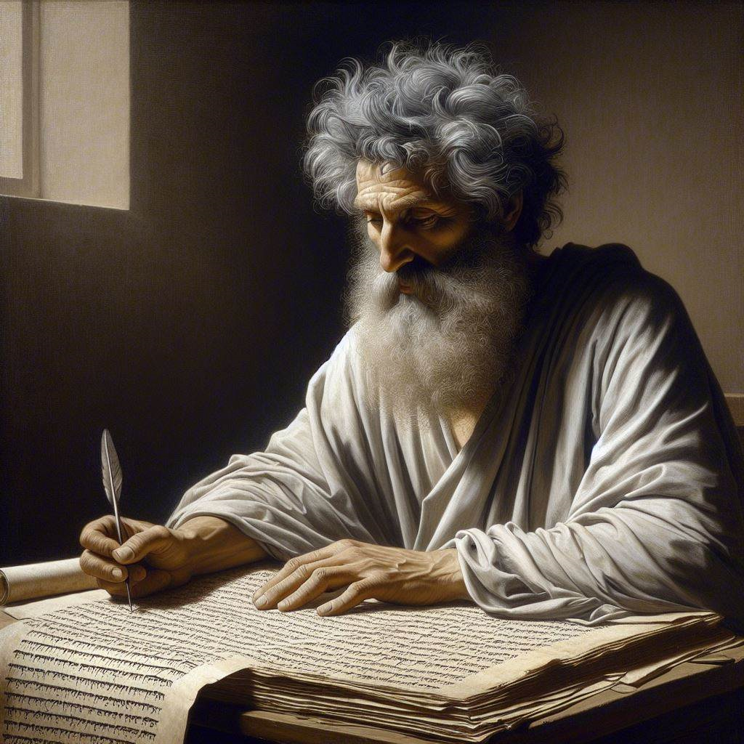
First John 4:14-21
‘‘Perfect love casts out fear”
09 & 12 May 2024
Image by Dall-e 3

Slide 2
First John, discourse structure
Part 3: Our Christian Faith 3.19 – 5.5
VIII. We Have Confidence 3.19-24
ΙX. We have God’s Spirit 4:1-6
X. We Have God’s Love 4.7-13
XI. We Have the Saviour 4.14-21
XII. We have the Christ 5.1-5

Slide 3
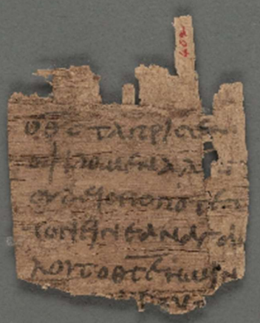
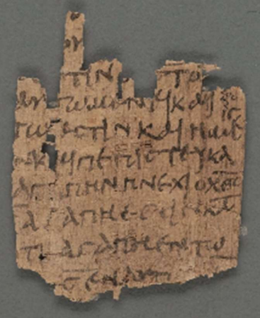
Greek Papyrus 09 = Oxyrhynchus 402
Greek
Egypt
AD 200-300
Papyrus
8X5.2 cm
Cambridge
Front: 1 John 4:11-12
Back: 1 John 4:14-17

Slide 4
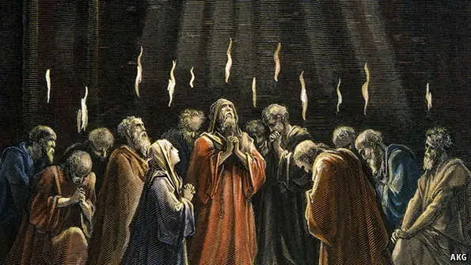
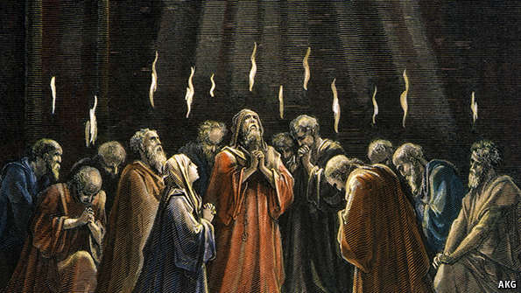
His Spirit
¹³ By this we know that we abide in [God] and he in us, because he has given {~gave} us of his Spirit. ESV
● “Know” = usually by experience
● “Abide” = stay with
● “In” = Gk en, relational particle
● “Of” ≈ Gk ek, ‘from’
● “Spirit” = himself, invisible person
“Here is how we experience God who lives in our faith community: He gives us things from his Holy Spirit.”

Slide 5
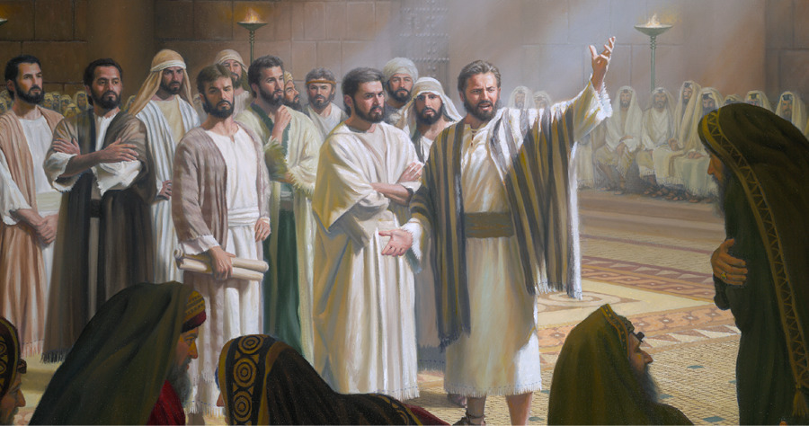
His Spirit
● testifies to our Spirit that we are his, Ro 8:16
● bears fruit = mature character, Ga 5:22-23
● gives gifts to speak, to serve, 1 Pe 4:10-11
● helps us to pray and to praise, 1 Co 14:15
● teaches what to say when needed, Lk 12:12
● warns of danger, Ac 2:11

Slide 6
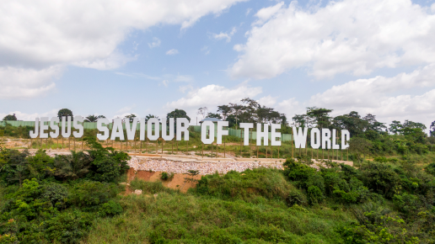

The Savior
¹⁴ And we have seen {~saw} and testify that the Father has sent his Son to be the Savior of the world.
● “Have seen” = we apostles = eyewitnesses.
● “Testify” = report what we witnessed.
● “Father” = Invisible God in heaven.
● “Son” = God in a visible body = Jesus.
● “Savior” = who rescues from devil & death.
● “World” = lost people.
“We apostles have seen Jesus, and we tell you what we saw: God came into the world as a man who is the Savior for everyone everywhere.”

Slide 7
Greek object complement
● “The Father sent the Son as Savior.”
● “The Son” with article ‘the’ = object of send.
● “Savior” without article = the Son’s identity.
● Jesus is greater than all prophets.
● No other religion has a Savior.

Slide 8
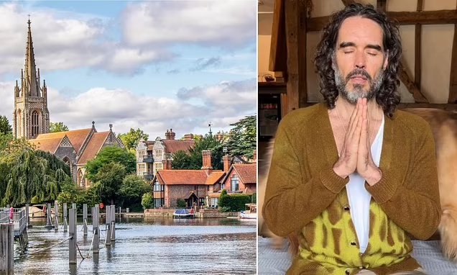

The Son of God
¹⁵ Whoever confesses that Jesus is the Son of God, God abides in him, and he in God.
● “Whoever” = No priest or religion required!
● “Confesses” = Believes and says so, especially by being baptized.
● “Son of God” = (a) born of a virgin; (b) the promised Messiah; (c) God who became a human being; (d) Trinitarian doctrine.
● “Abides” = remains connected, forever.

Slide 9
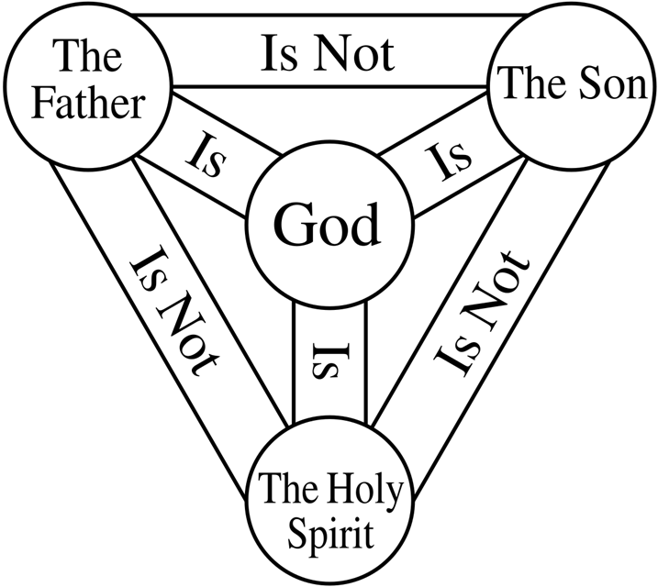
The Trinity
● Apostolic: Jesus is our great God & Savior.
● Latin: God wears three ‘persons’ (masks).
● Historical: God = Father + Son + Holy Spirit.
● Theological: But Father ≠ Son ≠ Holy Spirit.
Discuss:
Are any disbelievers Trinitarian?
Are most Catholics and Orthodox Trinitarian?
Are most evangelicals are Trinitarian?

Slide 10
What must we believe to be Christian?
● Jesus was born of a virgin?
● Jesus is the promised Messiah?
● Jesus is God who came as a human being?
● Jesus died and rose to save me?
● Jesus is the only Savior?
● Jesus is a member of the Holy Trinity?
● Jesus is Lord in heaven?
● Jesus will return as King over the world?
● Jesus _____________________________?

Slide 11
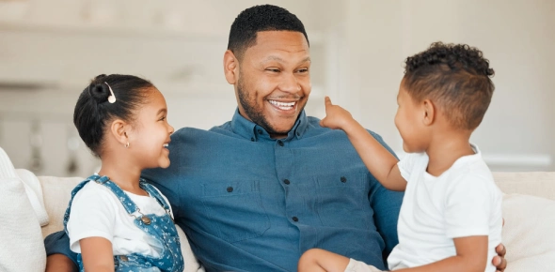
God is love
¹⁶ So we have come to know and to believe the love that God has for us. God is love, and whoever abides in love abides in God, and God abides in him.
“Since we experience God’s love, we believe he loves us. God loves us, and wants us to accept his love. Then he is pleased with us, and we with him.”
● “Know and believe” = experience & trust.
● “The God is love” ≠ ‘Love is God’.
● “In the love” = that love = God’s love for us.
➔ Let God help you feel his love for you!

Slide 12
God is love — how?
● He created us to know and enjoy him.
● He provides for all our needs.
● He gave to us laws that make life better.
● He came as Jesus to visit us and die for us.
● He comes to live with us by his Holy Spirit.
● He forgives us everything that we confess.
● He answers most of our prayers.
● He is preparing a place for us in heaven.
● He promises us everlasting life.

Slide 13
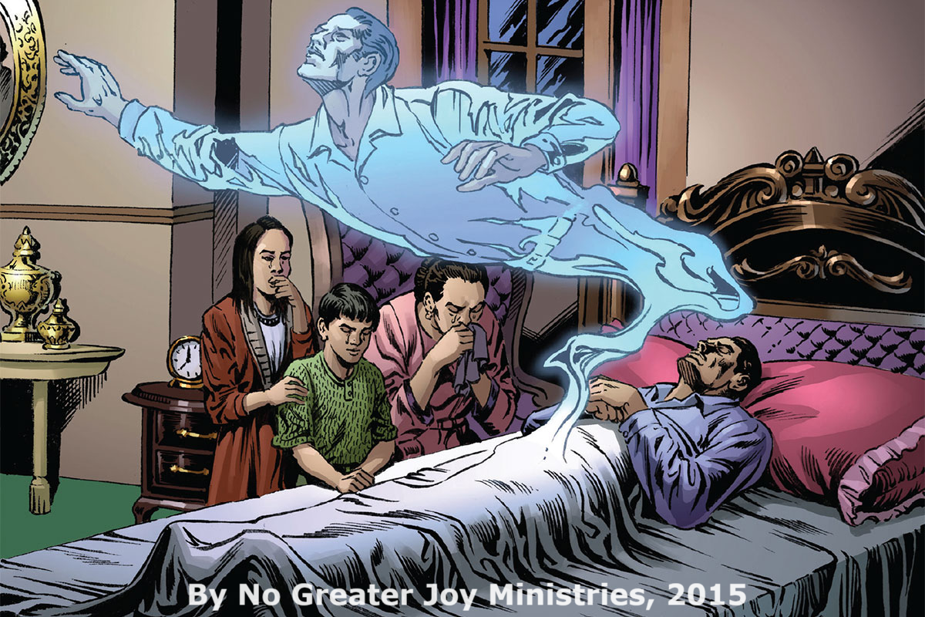

Confidence
¹⁷ By this is love perfected with us, so that we may have confidence for the day of judgment, because as he is so also are we in this world.
“Because he loves us, we have complete confidence that we will be safe when judgement day comes. Jesus is with God, and we are sure that we will be with God, too.”
● “The love” = that love that God has for us.
● “Is …” Gk = ‘has been perfected’.
● “May have” Purpose? Or result?
● “Confidence” = boldness, fearlessness.
● “As he is” = loyal to God, loving others.

Slide 14
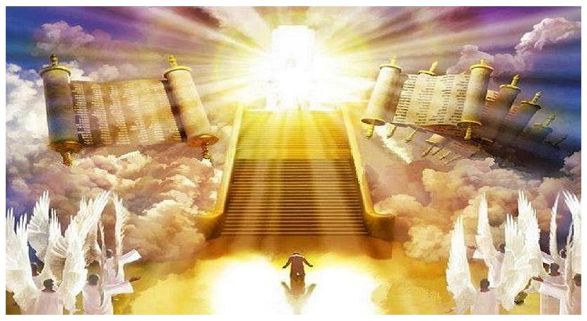
Day of Judgement
● What?
● When?
● Where?
● Who?
● Whom?
● Why?
● Whither?
Evaluate all that folk have done.
At the end of the age.
Before God’s throne.
Messiah Jesus.
All disbelievers.
God is just.
Everlasting death.

Slide 15
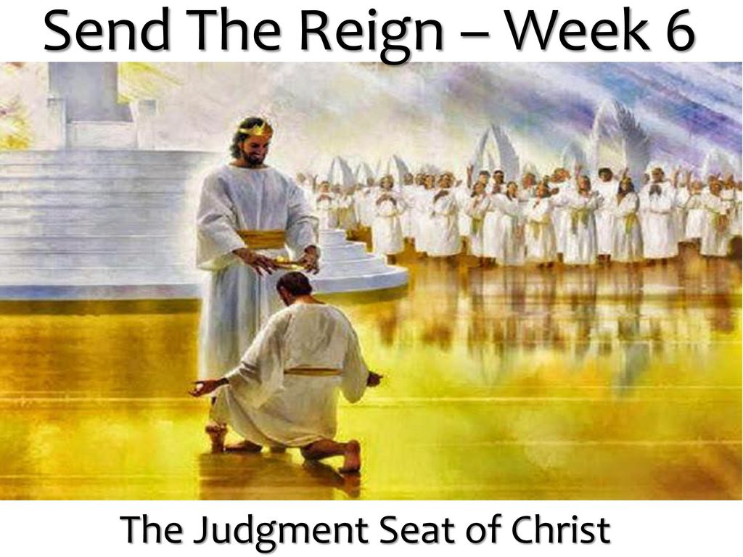
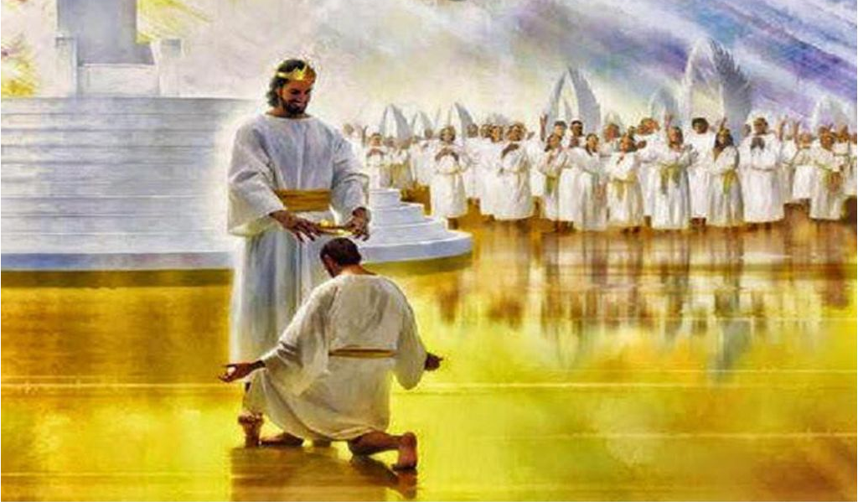
No fear
¹⁸ There is no fear in love, but perfect love casts out fear. For fear has to do with punishment, and whoever fears has not been perfected in love.
“Because God loves us Christians, we are not afraid. We are not afraid that God will punish us. If you are still afraid, then you do not know how much God loves us Christians.”
● “Fear” = afraid of death and hell.
● “Perfect” = verse 17: ‘has been perfected’.
● “Fears” = present tense: ‘is still fearful’.
● “Perfected” = ‘reached maturity’.

Slide 16
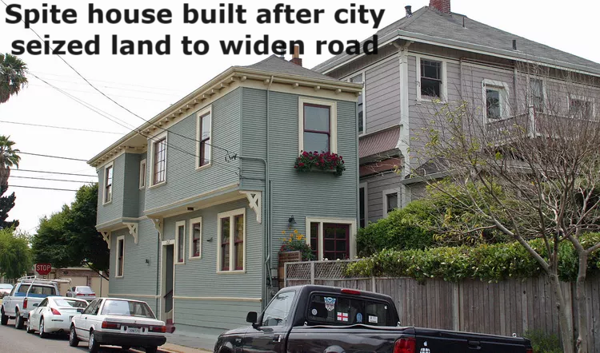

He first loved us
¹⁹ We love because he first loved us.
²⁰ If anyone says, “I love God,” and hates his brother, he is a liar; for he who does not love his brother whom he has seen cannot love God whom he has not seen.
“Because God loves us Christians, we also love our fellow Christians. If we despise other Christians, then we do not really love God either.”
1. “God first loved us.”
2. Now we love God.
3. We want to obey God.
4. So, we love Christians.
Gave us his Spirit.
Confident faith.
Joy from his Spirit.
A fruit of his Spirit.

Slide 17
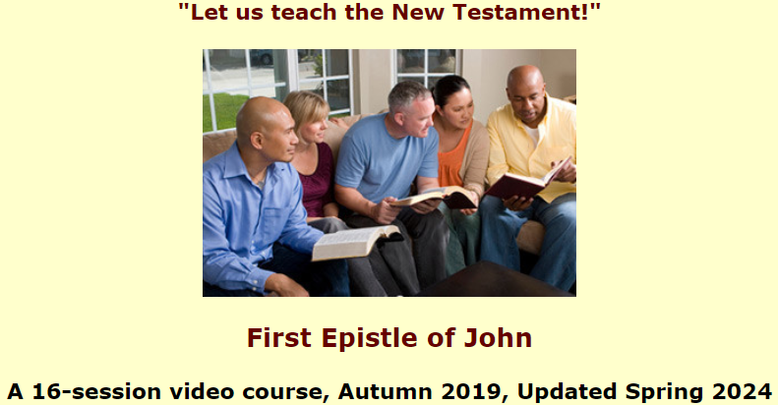
Assignment
● Read 5:1-5 three times in different versions (www.netbible.org).
● Visit http://1john.currah.download
● Compile your own insights to share with others next time.

