Slide 1

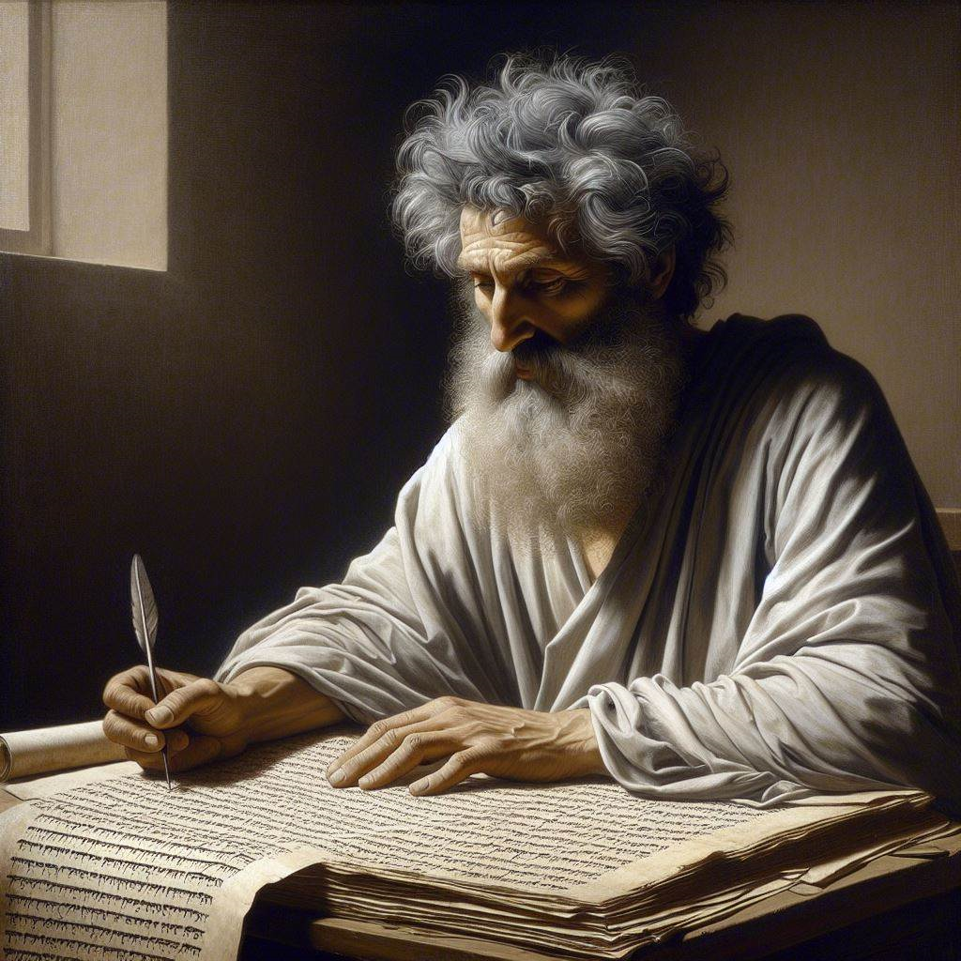
First John 5:5-12
‘‘God has given us eternal life”
23 & 26 May 2024
Image by Dall-e 3

Slide 2
First John, discourse structure
Part 1: Our Fellowship with God 1.1 – 2.17
Part 2: Our Adversaries 2.18 – 3.18
Part 3: Our Christian Faith 3.19 – 5.5
Part 4: Our Confidence with God 5.6-21
XIII. God’s Testimony to us 5.6-13
XΙV. Answered prayers 5.14-17
XV. Reasonable conclusions 5.18-21

Slide 3
1 John 5:5-12, Chiastic structure
5 Who is it that overcomes the world? Only the one who believes that Jesus is the Son of God.
6 This is the one who came by water and blood —Jesus Christ. He did not come by water only, but by water and blood.
And it is the Spirit who testifies, because the Spirit is the truth.
7 For there are three that testify: 8 the Spirit, the water and the blood; and the three are in agreement. `
9 We accept human testimony, but God’s testimony is greater because it is the testimony of God, which he has given about his Son.
10 Whoever believes in the Son of God accepts this testimony.
Whoever does not believe God has made him out to be a liar, because they have not believed the testimony God has given about his Son.
11 And this is the testimony: God has given us eternal life, and this life is in his Son.
12 Whoever has the Son has life; whoever does not have the Son of God does not have life.

Slide 4
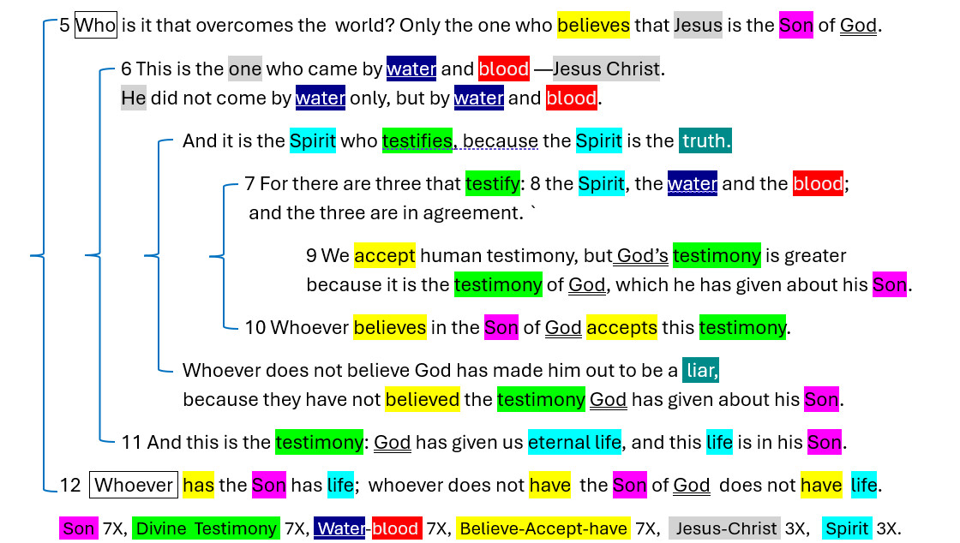

Slide 5
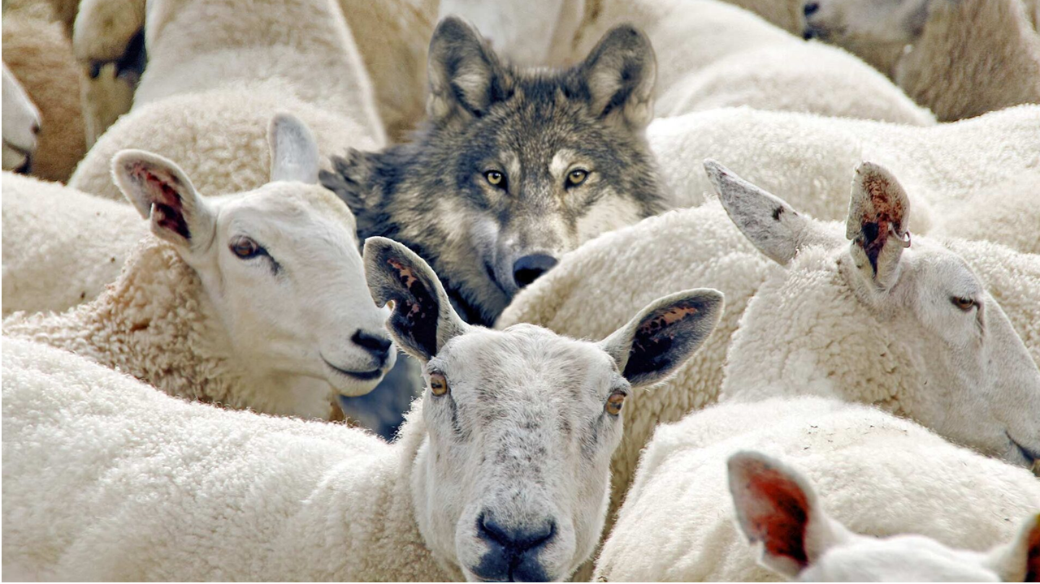
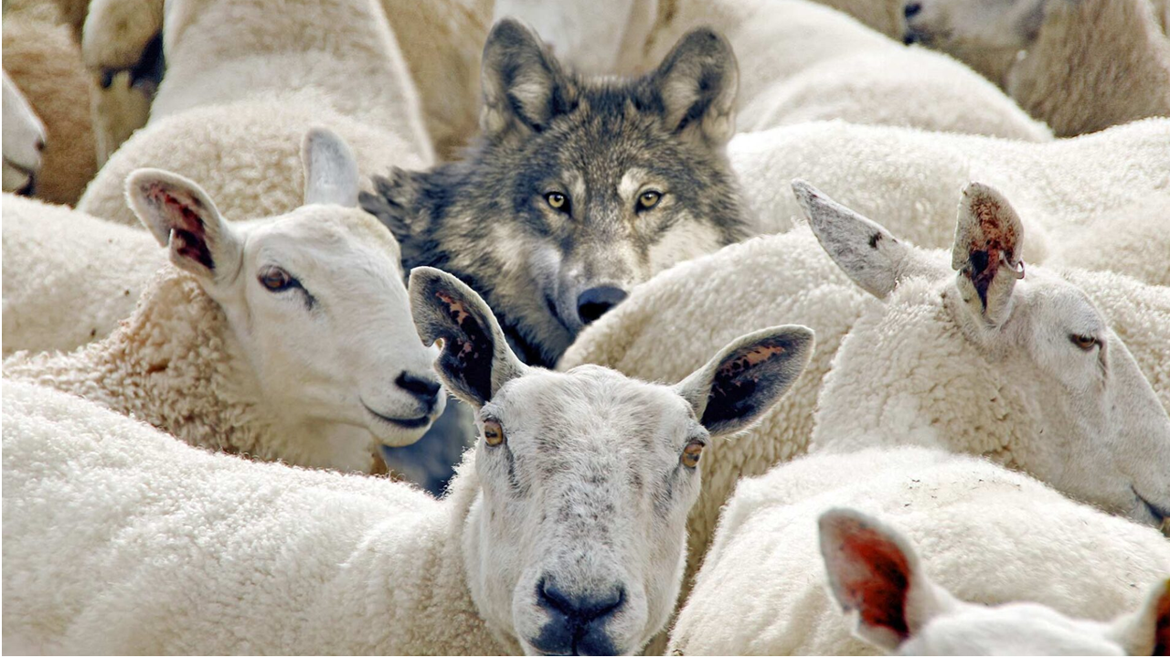
1 John 5:5
⁵ Who is it that overcomes the world? Only the one who believes that Jesus is the Son of God. NIV
● Overcomes:
● Son of God:
False teachers, persecution, martyrdom.
(1) Virgin born.
(2) God’s Messiah.
(3) God incarnate.
(4) Trinity.

Slide 6
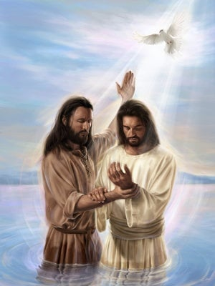
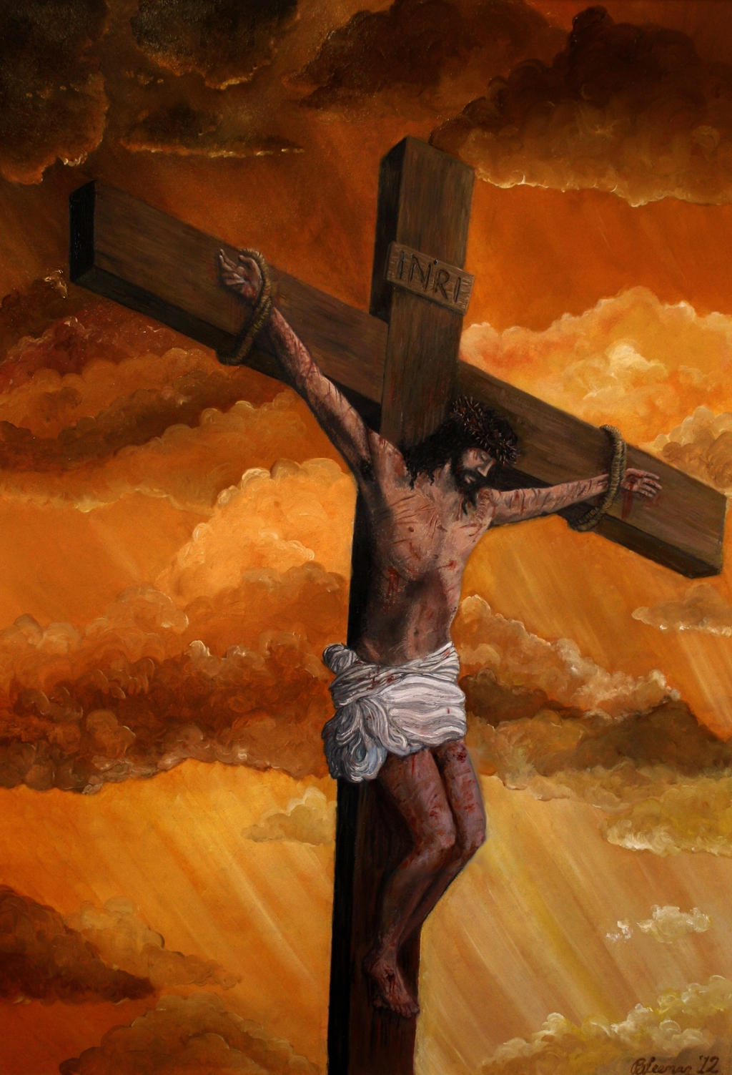
1 John 5:6a
⁶ This is the one who came by water and blood — Jesus Christ. He did not come by water only, but by water and blood.
● Water:
● Blood:
Baptism, when the Holy Spirit descended on Jesus.
Cross. The human Jesus = the divine Christ who died a physical death.

Slide 7
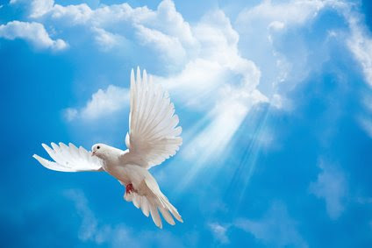
1 John 5:6b
And it is the Spirit who testifies, because the Spirit is the truth.
● Spirit:
● Testifies:
● The truth:
The Holy Spirit who descended on Jesus and empowered him.
(1) Jesus’ miracles.
(2) Coming at Pentecost.
(3) Jesus’ apostles’ witness.
(4) Witness to us Christians.
Jesus’ promise (John 16:13).

Slide 8
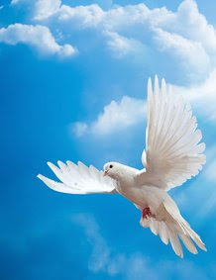
1 John 5:7-8
⁷ For there are three that testify: ⁸ the Spirit, the water and the blood; and the three are in agreement.
● Testify:
● Agree:
● Spirit:
Tell factual truth.
Support the same factual truth.
The Holy Spirit = the amazingly-powerful presence of God living in Christian communities.

Slide 9
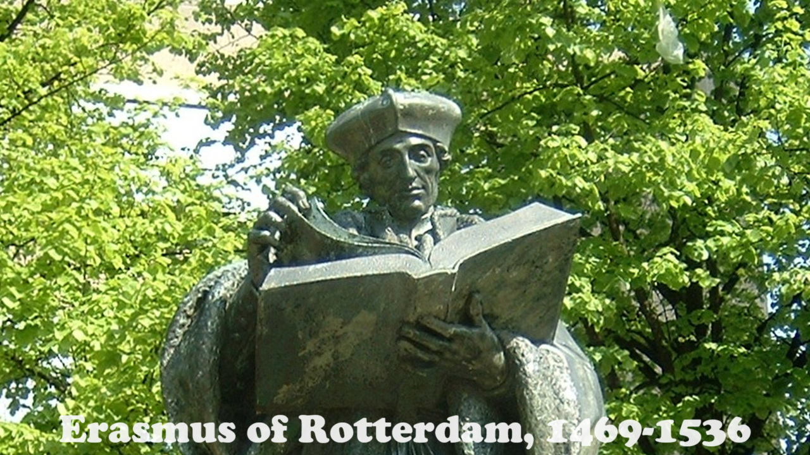

1 John 5:7-8 (Textus Receptus, KJV)
⁷ For there are three that testify {in heaven: the Father, the Word and the Holy Spirit, and these three are one.} ⁸ {And there are three that testify on earth:} the Spirit, the water and the blood; and the three are in agreement.
● Latin: Added in the 6th century.
● Greek: Added in the 16th century.
● If original, no one would have removed it.

Slide 10
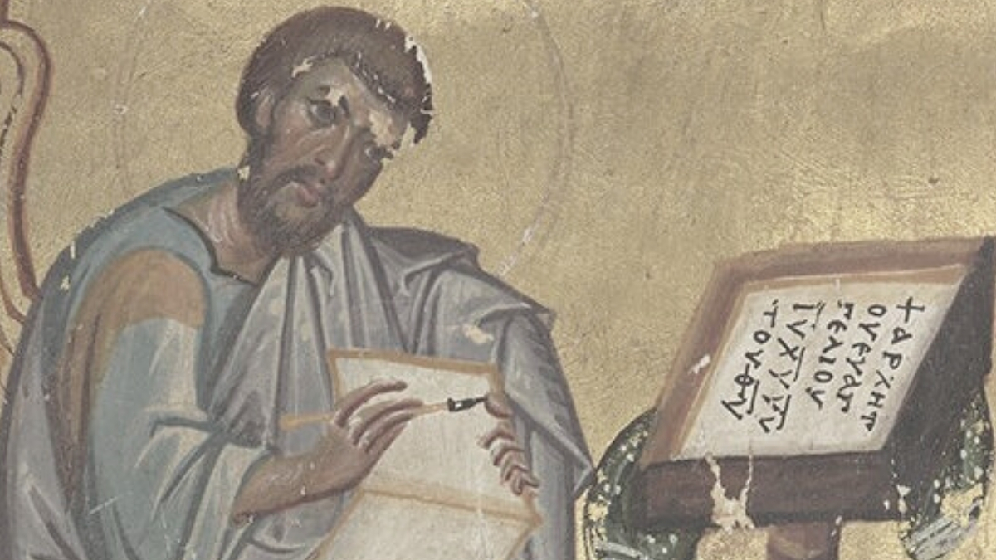
History of New Testament copies
1st century
Originals written, copied, distributed.
2nd to 15th
Copied, carried to cities. Ancient versions translated.
16th to 18th
Printed, published, revised, translated in Europe.
19th to 21st
Ancient copies compared, edited, translated everywhere.

Slide 11
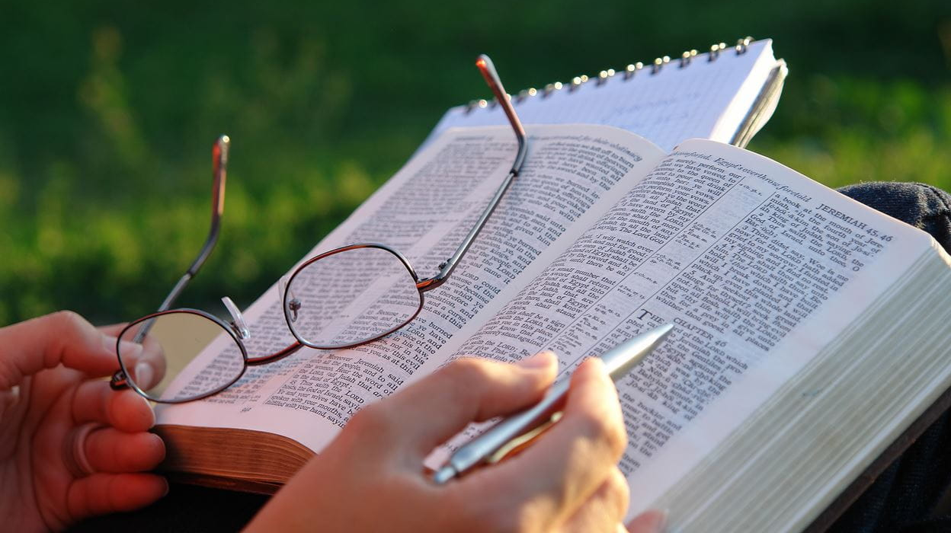

1 John 5:9
⁹ We accept human testimony, but God’s testimony is greater because it is the testimony of God, which he has given about his Son.
● Human:
● Greater:
● Given:
Jesus’ apostles (including John)
testified to what they had seen, heard and touched (1:1-2).
A voice heard at Jesus’ baptism, transfiguration, cross (Jn 12:28).

Slide 12
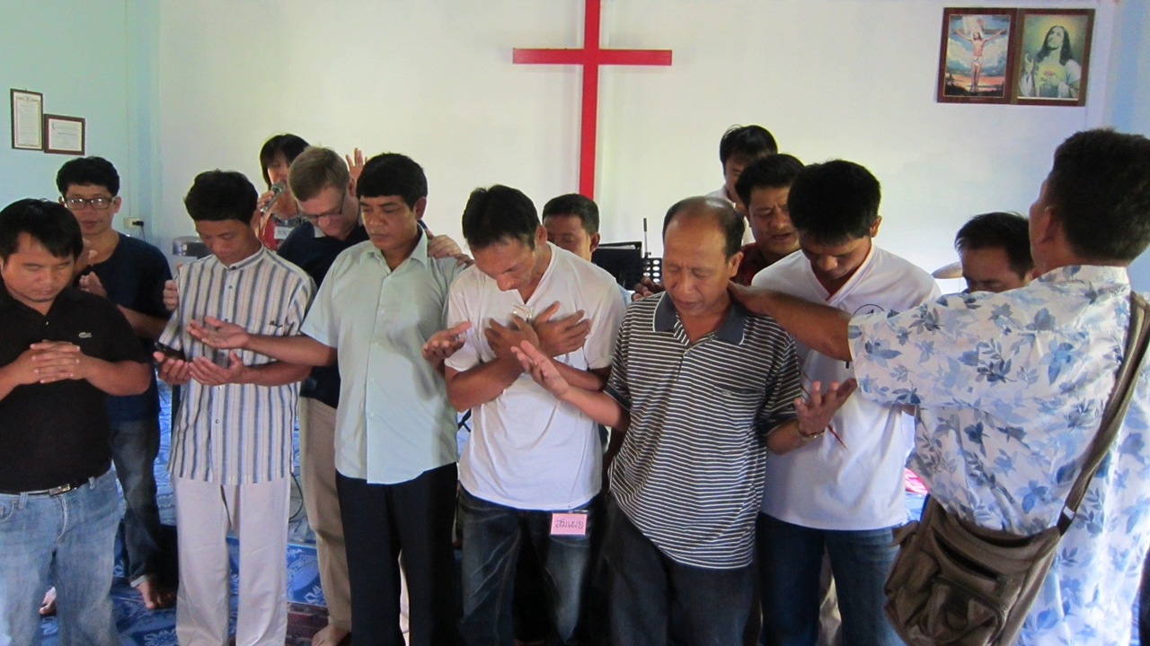

1 John 5:10a
¹⁰ Whoever believes in the Son of God accepts this testimony.
● Believes:
● Accepts:
● This:
(1) Trusts in the veracity of the apostles’ witness, (2) obeys Jesus’ commands, (3) lives for resurrection and eternal life.
Literally, “continually holds in him,” i.e., ‘as his own’?
The apostles’ factual testimony.

Slide 13
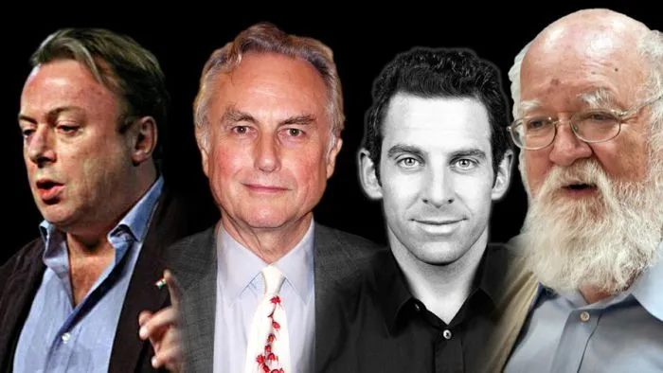
1 John 5:10b
Whoever does not believe God {~in the Son} has made him out to be a liar, because they have not believed the testimony God has given about his Son.
● Believe:
● Liar:
● Has …:
Continuous: keep on believing.
A deceiver? Or deceived?
To deny Christ = unpardonable.
Perfect tense = lasting result.

Slide 14
Three ancient errors
● Cerinthus:
● Docetists:
● Islam:
The Spirit came on Jesus at his baptism, making him the Christ, but departed from him before his death.
Jesus, being eternal, was neither human nor able to die.
“The Messiah, Jesus … they slew him not nor crucified him, but it appeared so” (Quran 4:157-158).

Slide 15
Evidences for a Creator God
● Logic of the First Cause.
● Biology implies a designer.
● Prayer that gets results.
● Life and resurrection of Jesus.
● Experience peace or joie.
● Apparent miracles.
● Biblical predictions fulfilled.
● Dreams and visions.

Slide 16
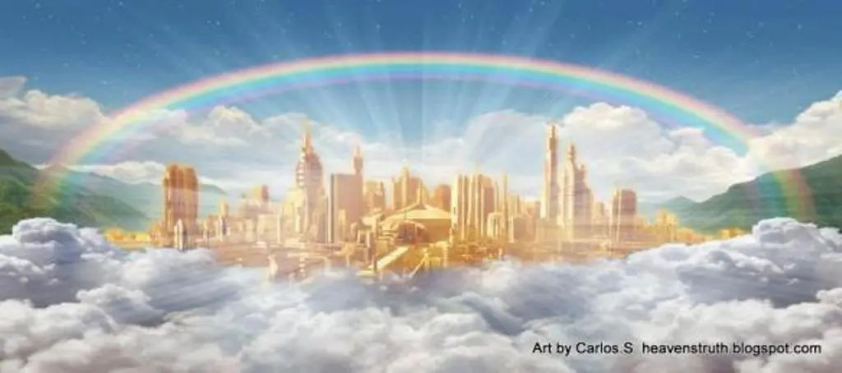

1 John 5:11
¹¹ And this is the testimony: God has given us eternal life, and this life is in his Son.
● Given:
● Us:
● Eternal:
● Life:
● Is in:
Aorist tense: timeless.
(a) Human beings. (b) Christian believers. (c) Who remain faithful.
Everlasting, ‘in the age to come’.
Intimacy with God.
“comes by faith” in his Son.

Slide 17
1 John 5:12
¹² Whoever has the Son has life; whoever does not have the Son of God does not have life.
● Has:
● Not:
● Son:
Keeps on holding to, believing.
Never believed or has turned away.
Human Jesus = The Divine Messiah who suffered a physical death.

Slide 18
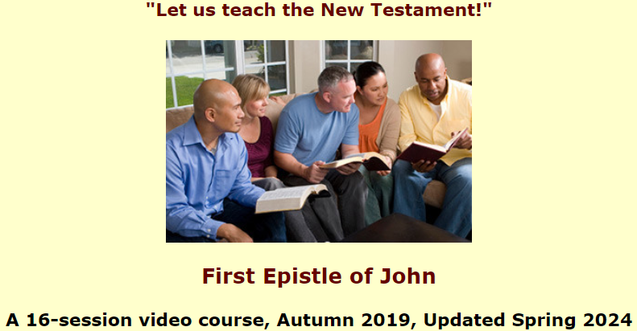
Assignment
● Read 5:13-17 three times in different versions (www.netbible.org).
● Visit http://1john.currah.download
● Compile your own insights to share with others next time.

