Slide 1

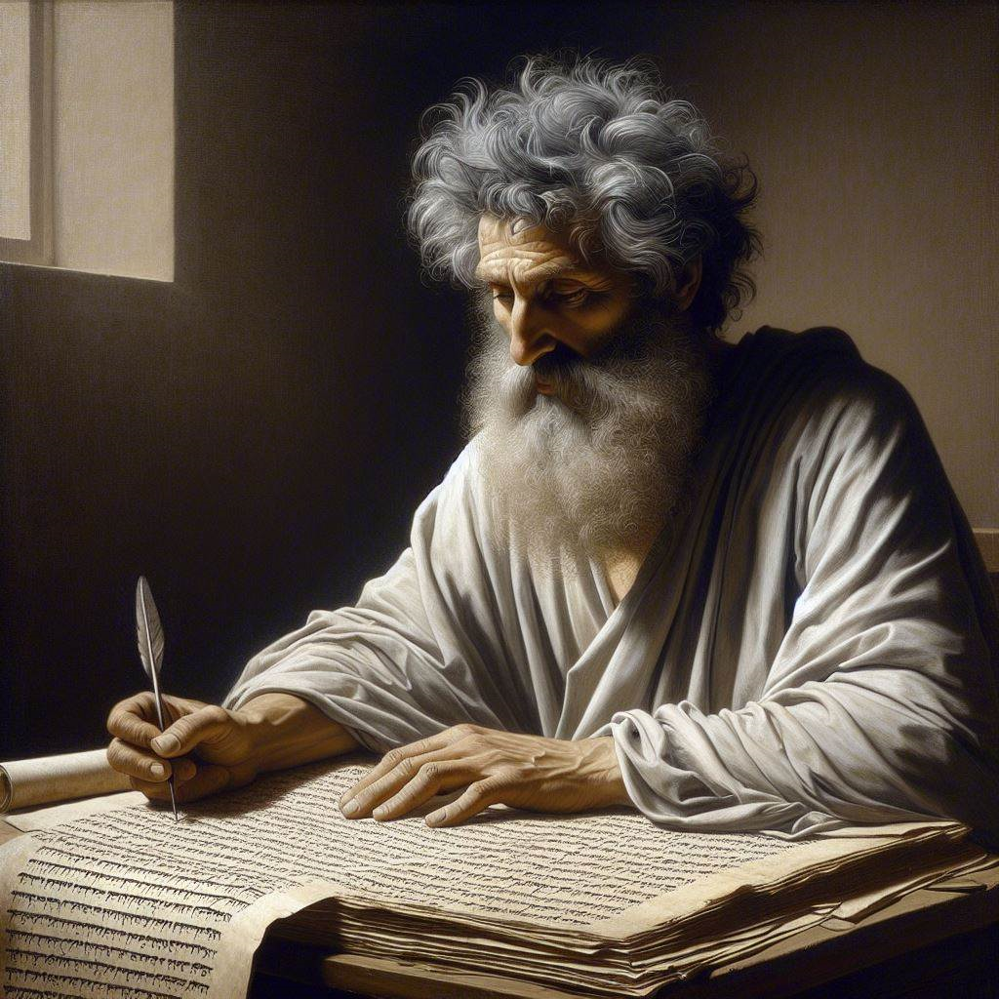
First John 5:13-17
‘‘God has given us eternal life”
30 May – 02 June 2024
Image by Dall-e 3

Slide 2
First John, discourse structure
Part 1: Our Fellowship with God 1.1 – 2.17
Part 2: Our Adversaries 2.18 – 3.18
Part 3: Our Christian Faith 3.19 – 5.5
Part 4: Our Confidence with God 5.6-21
XIII. God’s Testimony to us 5.6-13
XΙV. Answered prayers 5.14-17
XV. Reasonable conclusions 5.18-21

Slide 3
1 John 5:5-12, Chiastic structure
¹³ I write these things to you who believe in the name of the Son
of God so that you may know that you have eternal life.
¹⁴ This is the confidence we have in approaching God:
that if we ask anything according to his will, he hears us.
¹⁵ And if we know that he hears us—whatever we ask—
[then] we know that we have what we asked of him
¹⁶ If you see any brother or sister commit a sin that does not lead to death, you should pray and God will give them life
I refer to those whose sin does not lead to death.
There is a sin that leads to death.
I am not saying that you should pray about that.
¹⁷ All wrongdoing is sin, and there is sin that does not lead to death.

Slide 4
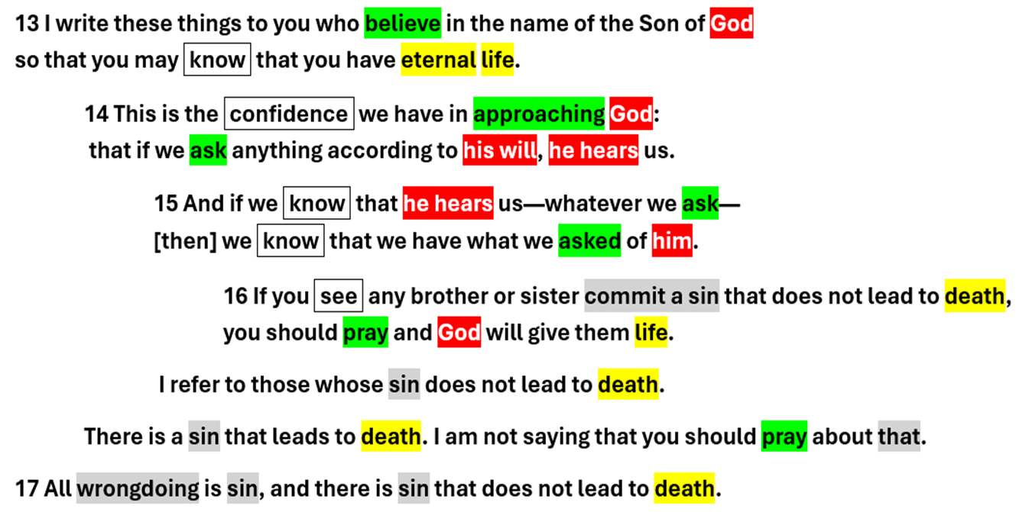

Slide 5
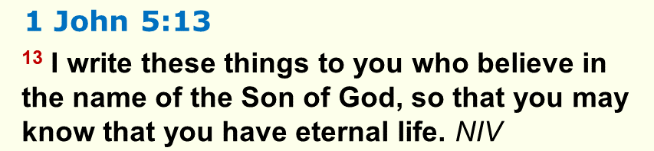
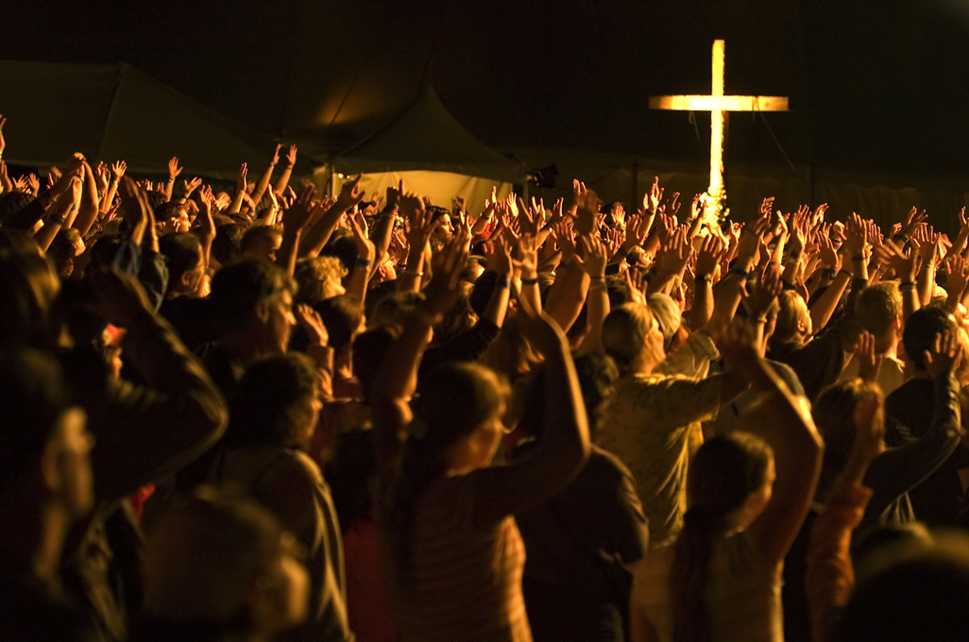
● Believe:
● Name:
● Know:
● Have:
● Eternal:
● Life:
Trust, to rely on, be loyal, affirm.
The person himself
Factual knowledge (“see”).
Present tense: Already
"Eons" = all ages to come.
Intimacy with God, growth, action.

Slide 6
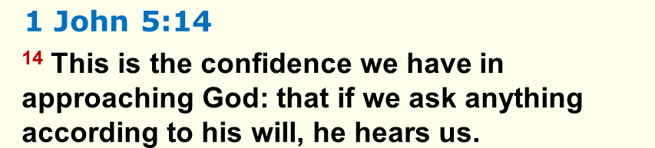
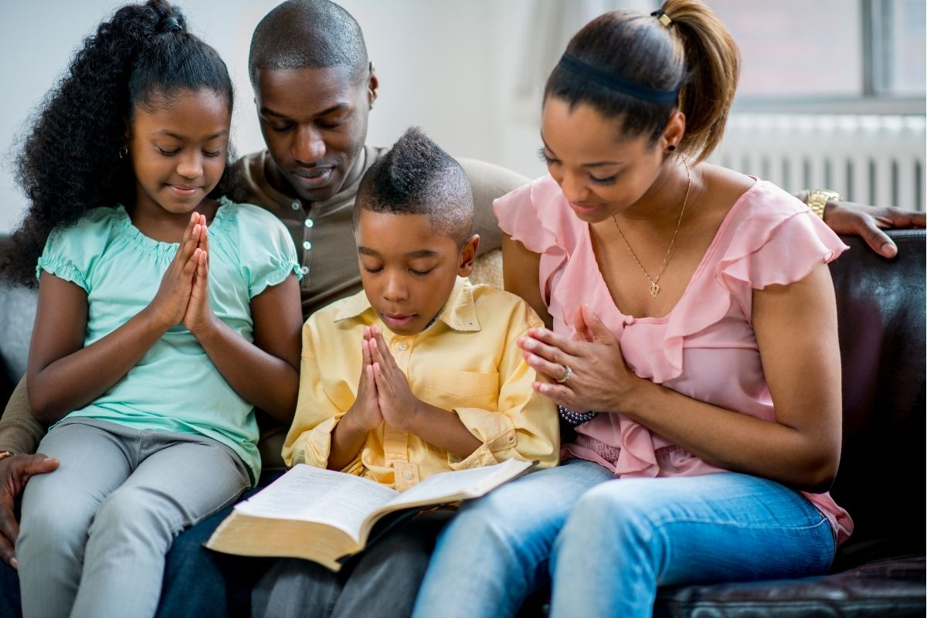
● Confidence:
● Approach:
● Ask:
● Will:
● Hear:
Boldness
"Facing" him.
Make requests.
(a) Decree, (b) standards, laws,
(c) promises, (d) guidance.
Listen, pay attention, ‘obey’.

Slide 7
“According to his will”
What is always his will, that we can count on?”
● Life for sinning Christians. 1 Jn 5.13
● Our daily food. Mt 6.11
● Forgiveness of sins. Mt 6.12, 1 Jn 1.9
● Wisdom for how to live. Js 1.12
● The Holy Spirit’s ‘fruit’, ‘gifts’. Lk 11.13
● Personal peace anytime. Ep 4.6-7
● Urgent needs. Ph 4.19
● Answers for hostile opponents. Lk 12.12

Slide 8
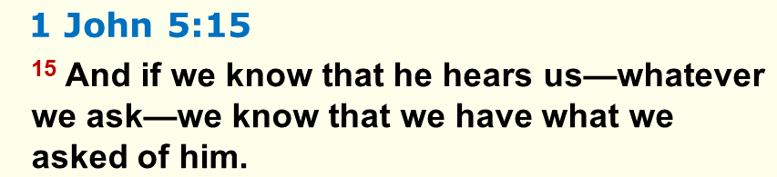
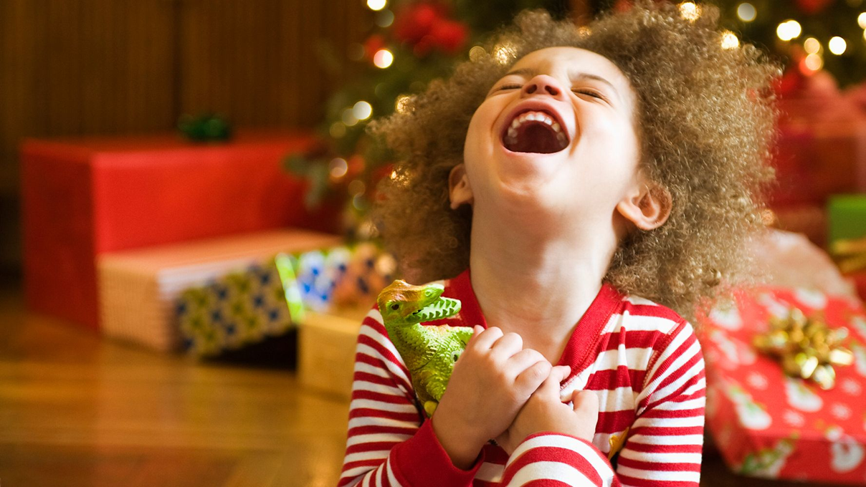
● Know:
● Hear:
● Whatever:
● Have:
● Asked:
Factual knowledge.
Pays attention.
Freedom to ask for anything.
Received, secured.
Specific, identifiable.

Slide 9
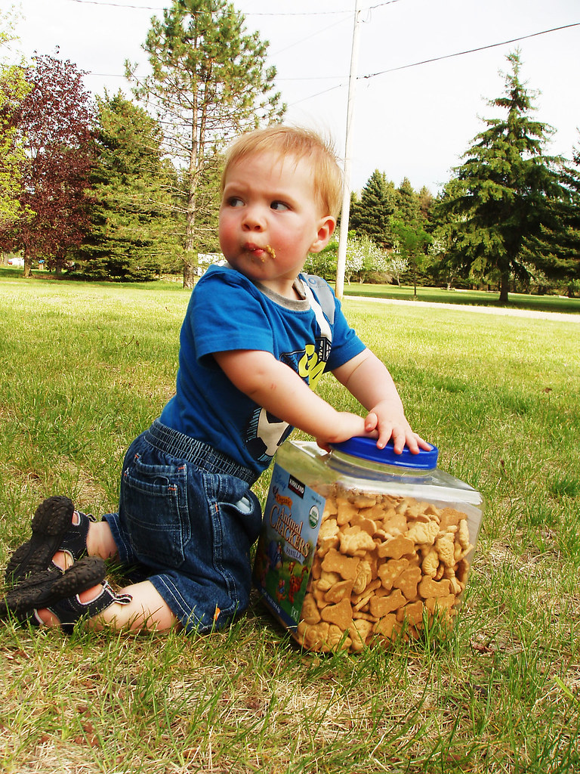
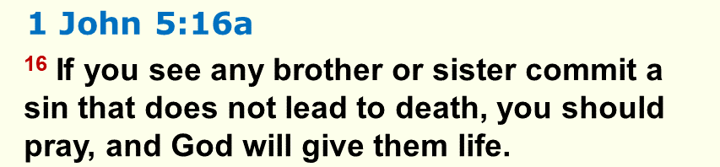
● Brother:
● Lead to:
● Death:
● You:
● Life:
Fellow Christian.
Consequence.
(a) Spiritual, (b) emotional,
(c) physical, (d) everlasting.
Singular, 'anyone': Christian.
Fellowship with God and with us.

Slide 10
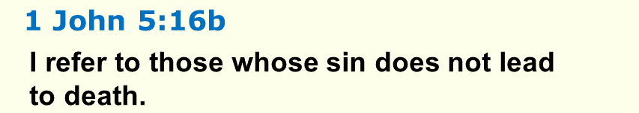
● Immaturity: juvenile attitudes.
● Bad habits, compulsive behaviour.
● Addictions (sugar, vices, alcohol, porn).
● Neglect of spiritual disciplines.
● Repented and confessed sins.
● Denominational or political beliefs.

Slide 11
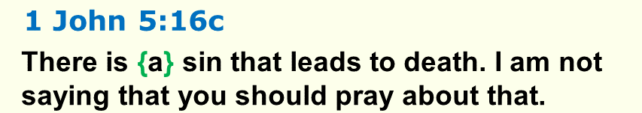
What sins cause everlasting death?
● Disbelief in God or in Jesus Christ.
● To refuse the truth and God's salvation.
● Willing service to Satan or to demons.
● Kidnapping, human trafficking.
● Mass murder, genocide, depopulation.

Slide 12
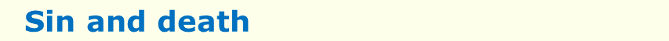
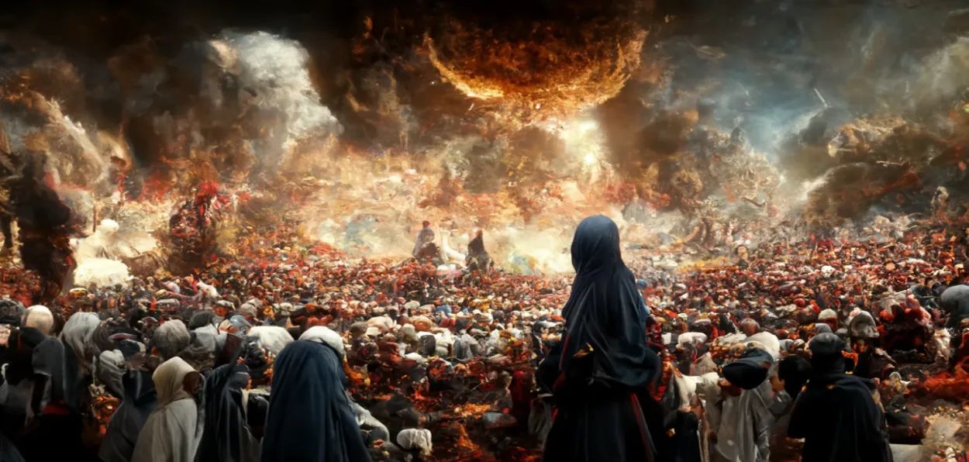
“The wages of sin is death, but the free gift of God is eternal life in Christ Jesus our Lord.” Romans 6:23
“Each person is tempted when he is lured and enticed by his own desire. Then desire when it has conceived gives birth to sin, and sin when it is fully grown brings forth death.”
James 1 : 14-15
“This is the second death, the lake of fire.” Revelation 21 :8

Slide 13
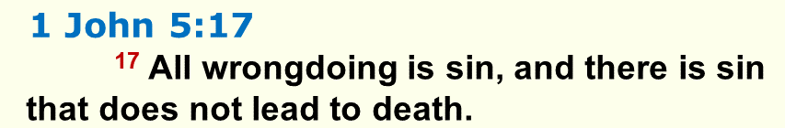
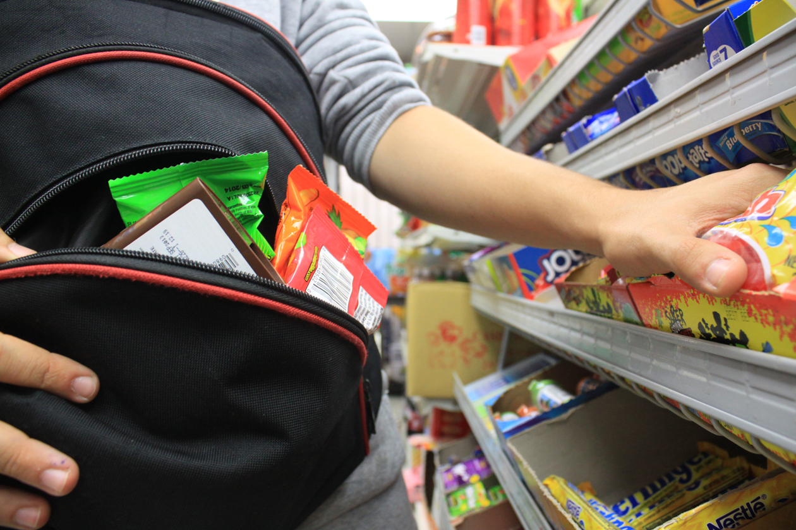
● Wrong:
● Sin:
● Excuses:
Violation of law, norms, morals.
Resultant offense, guilt, shame.
“It was a mistake.”
“He/she was misled.”
“They didn’t know any better.”
“This is our culture.”

Slide 14
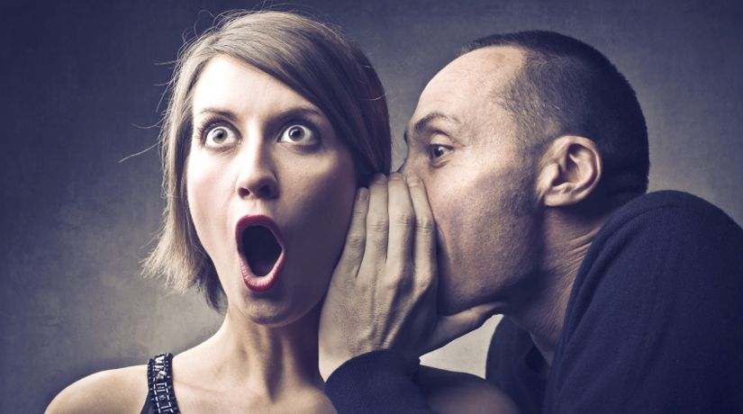
When you see a Christian in a sin
● Do not tell others (gossip).
● Silently pray for God to give them “life”.
● If they sinned against you, then go talk with them in private. They usually repent.
● Check your own similar behavior.
● Seek an opportunity to offer help, counsel.
● If you only ‘hear’ about a Christian’s sin, then stay quiet. It may no longer be true.

Slide 15
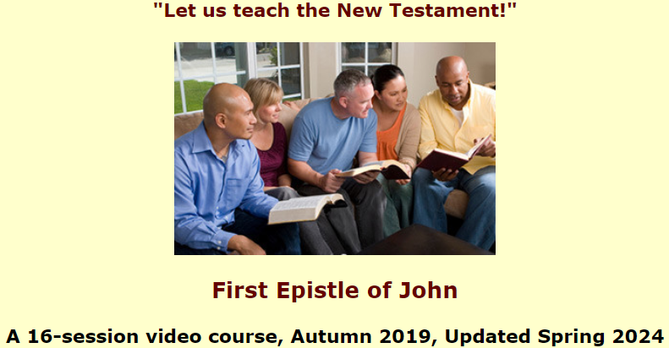
Assignment
● Read 5:18-21 three times in different versions (www.netbible.org).
● Visit http://1john.currah.download
● Compile your own insights to share with others next time.

