Slide 1

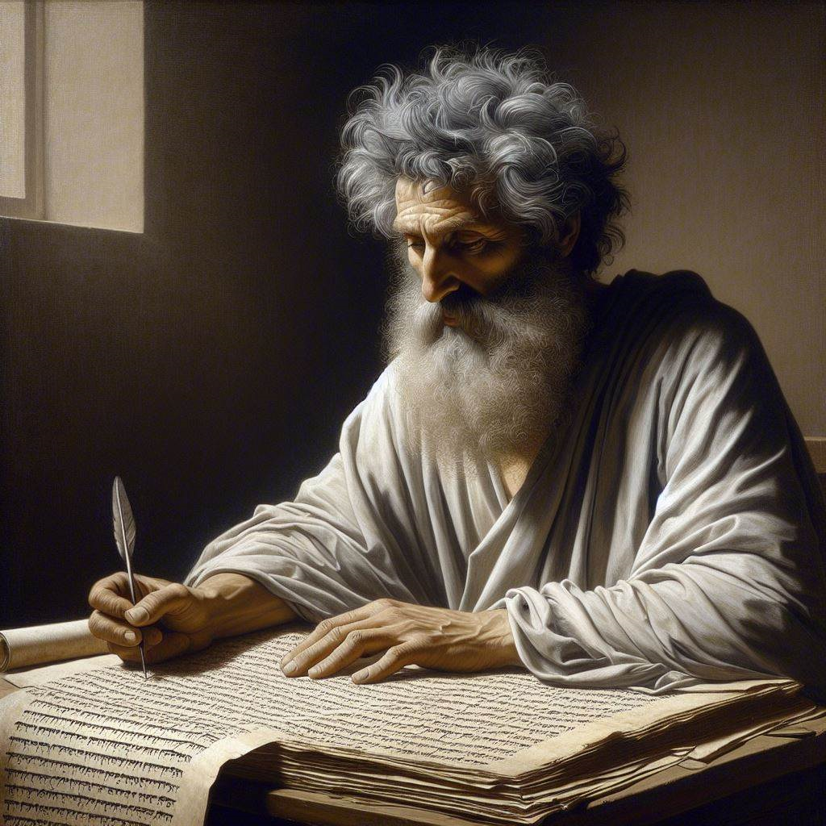
First John 5:18-21
‘‘This is the True God”
06 & 09 June 2024
Image by Dall-e 3

Slide 2
First John, discourse structure
Part 1: Our Fellowship with God 1.1 – 2.17
Part 2: Our Adversaries 2.18 – 3.18
Part 3: Our Christian Faith 3.19 – 5.5
Part 4: Our Confidence with God 5.6-21
XIII. God’s Testimony to us 5.6-13
XΙV. Answered prayers 5.14-17
XV. Reasonable conclusions 5.18-21

Slide 3
1 John 5:18-21, Chiastic structure
¹⁸ We know that everyone who has been born of God does not keep on sinning , but he who was born of God protects him[self], and the evil one does not touch him.
¹⁹ We know that we are from God, and the whole world lies in the power of the evil one .
²⁰ And we know that the Son of God has come and has given us understanding,
so that we may know him who is true;
and we are in him who is true, in his Son Jesus Christ.
He is the true God and eternal life.
²⁷ Little children, keep yourselves from idols.

Slide 4
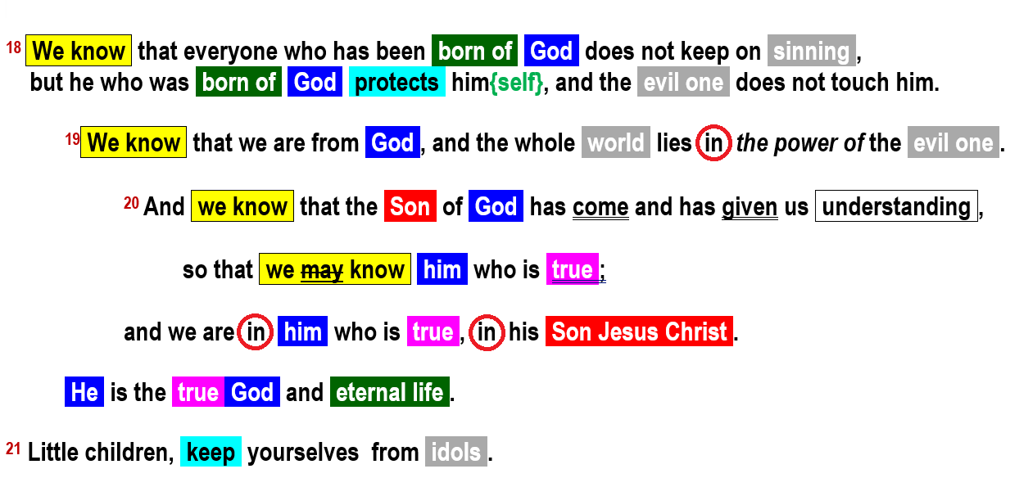
1 John 5:18-21, Chiastic structure

Slide 5
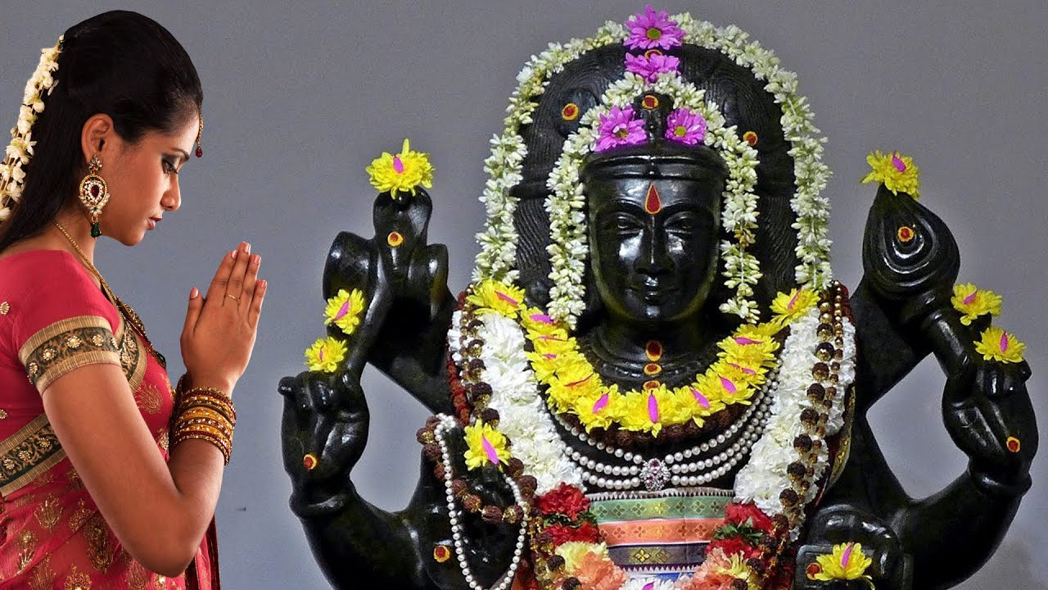
1 John 5:18a
¹⁸ We know that everyone who has been born of God does not keep on sinning, …
● We know:
● Born:
● Keep on:
● Sinning:
First of four ‘conclusions’.
New start, supernatural new life.
Continuous tense. We change!
In 1st John, sinning = denying that the human Jesus is the divine Christ = ‘Son of God’.

Slide 6

1 John 5:18b
but he who was born of God protects him, and the evil one does not touch him.
● Him:
● Born:
● Protect:
● Evil:
● Touch:
Two mss: ‘him’, rest: ‘himself’.
Jesus ➔‘him’. Believer ➔‘himself’.
Keeps (safe).
“The” + adjective ➔ noun.
‘Keep a hold on.’ Continuous tense. Middle voice = ‘for himself’.

Slide 7
1 John 5:18 ‘born from God’
Every-one who has-been-born from God not keeps-on-sinning,
but [contrasts sinning & keeping? Or born & born?]
Each-one who was-born from God keeps him(self),
and [change of subject]
the evil-one not keeps-on-holding him.

Slide 8
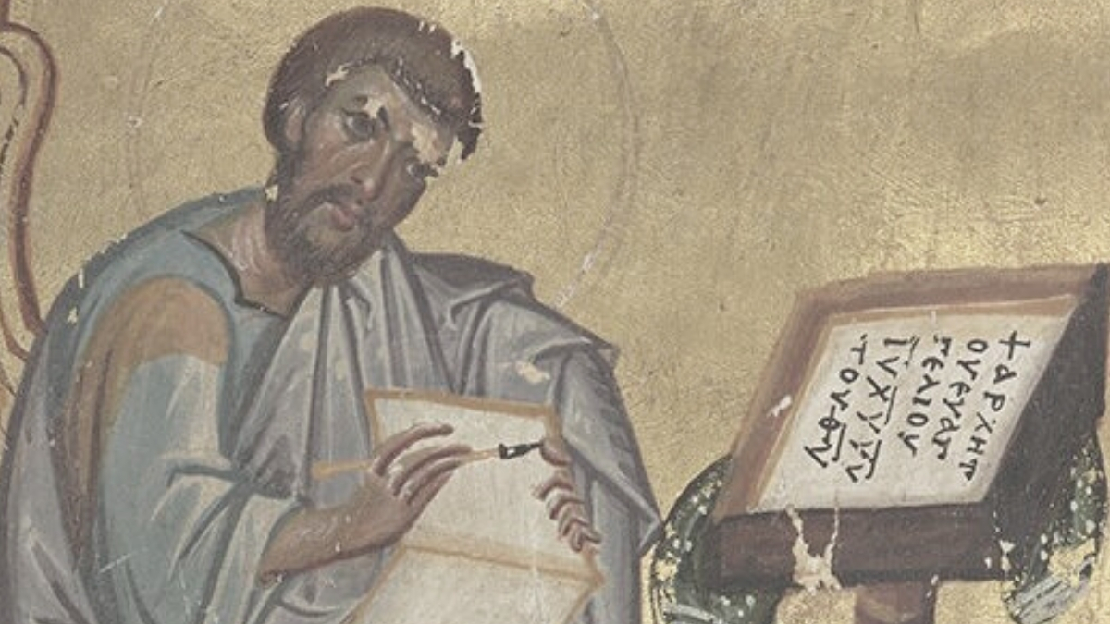
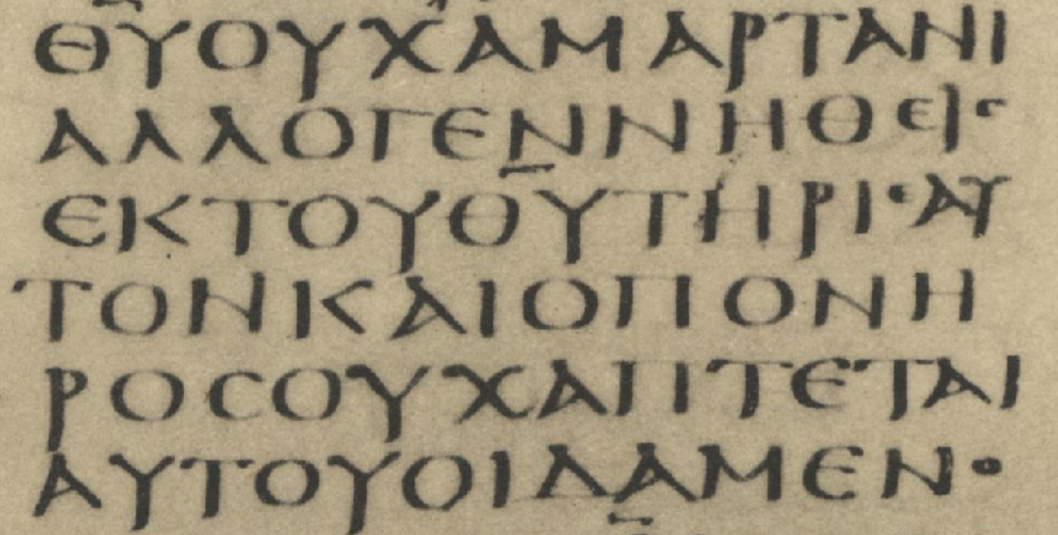
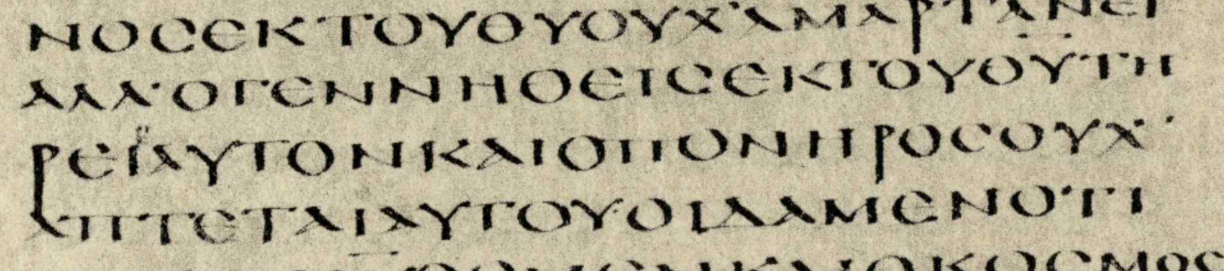
1 John 5:18b
Codex Sinaiticus, 4th century: ^{Ⲉ}AΥΤΟΝ
Codex Alexandrinus, 5th century ⲀΥΤΟΝ

Slide 9
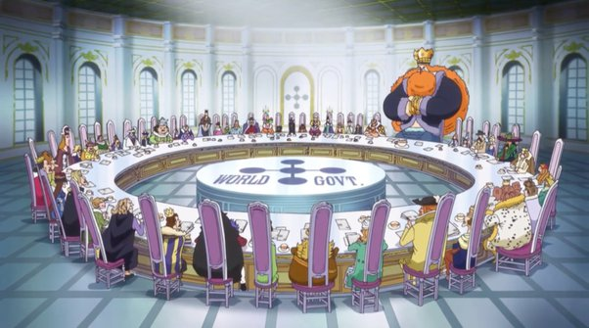
1 John 5:19
¹⁹ We know that we are from God, and the whole world lies in the power of the evil one.
● Know:
● From:
● World:
● Lies in:
● Evil:
Second ‘know’ = ‘see’ factual know.
Origin = reborn (verse 18).
Creation, human system.
Under domination
Pernicious: active, intentional evil.

Slide 10


1 John 5:20a
²⁰ And we know that the Son of God has come and has given us understanding, so that we may know him who is true.
● Know:
● Son:
● Under- stand:
● Know:
● True:
Third ‘know’ = ‘see’ factual know.
Messianic title. Jesus = the Christ.
Mind, intelligence, thinking. “Love the Lord with your … mind” Mk 12:30
Fourth know = by experience.
Contrast idols and religions.

Slide 11
‘Understanding’
Apostles’ testimony
Believe that Jesus = Messiah
Understand God’s Son has come
Experience God

Slide 12
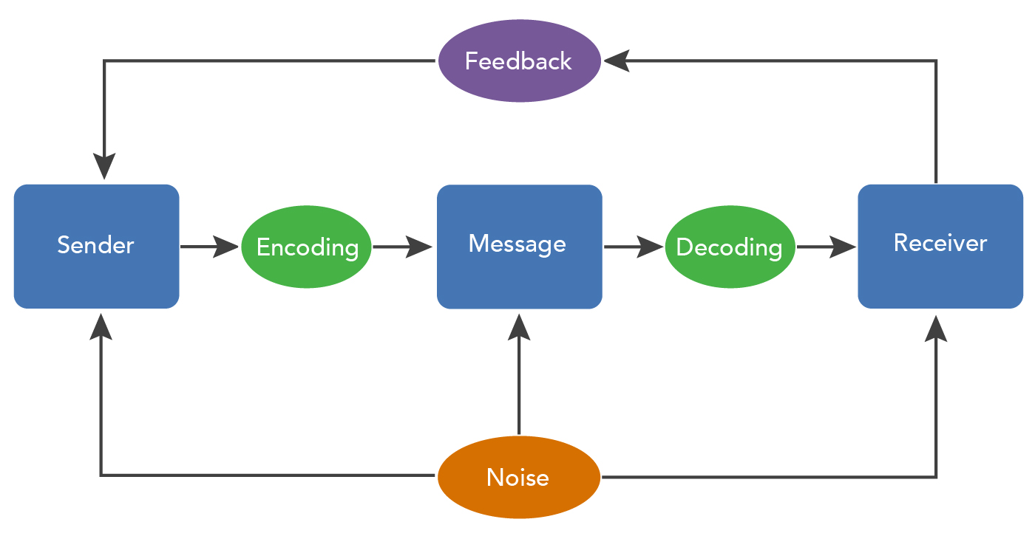
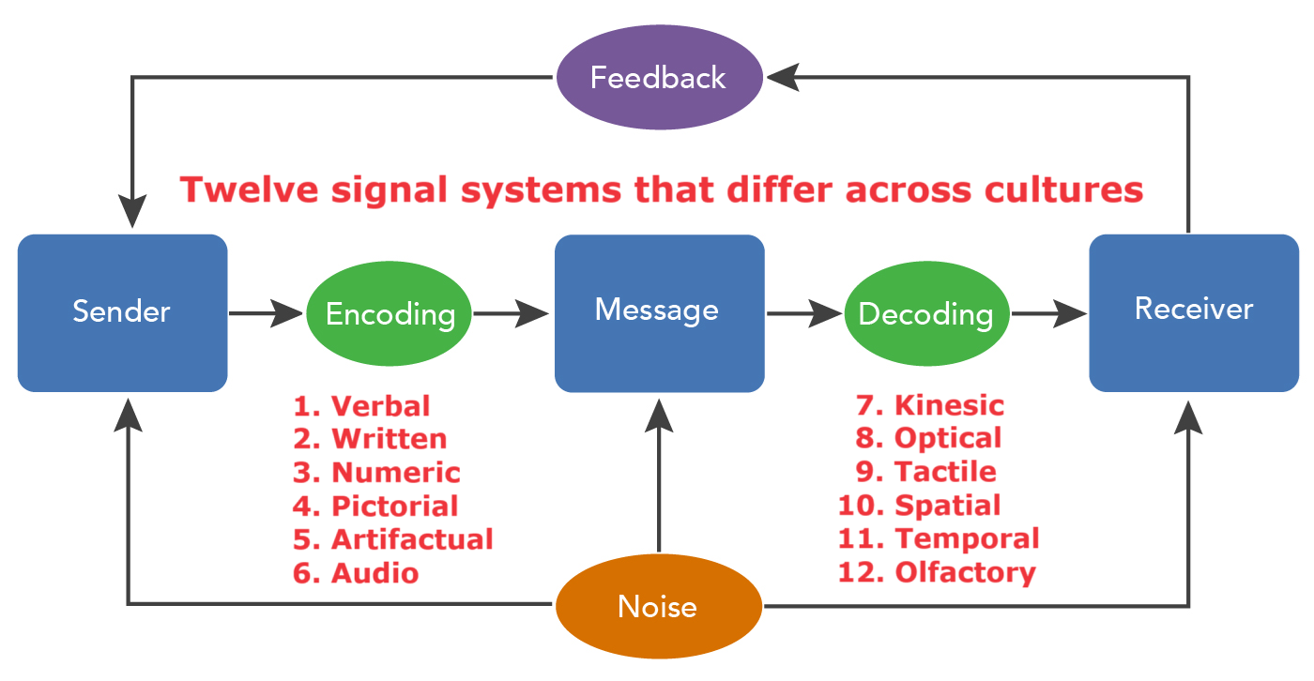
“The Communication Process” by Lumen Learning, CC BY 4.0

Slide 13
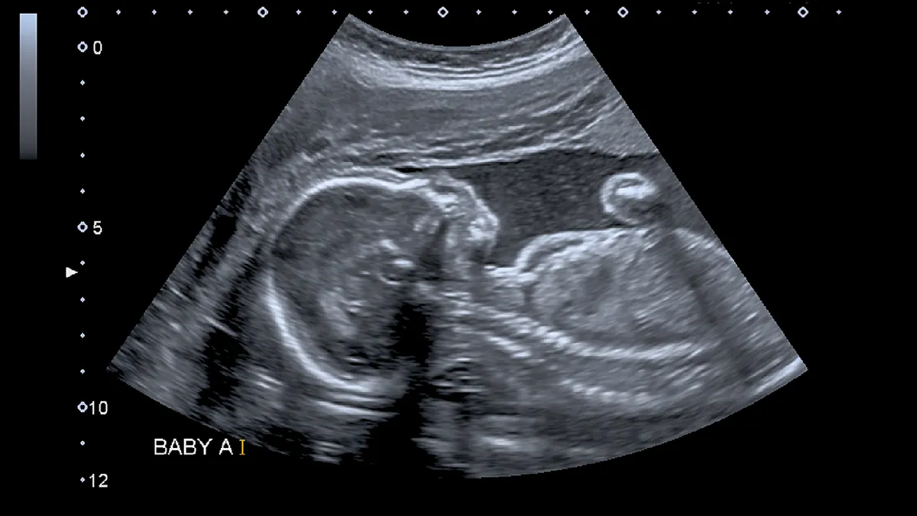
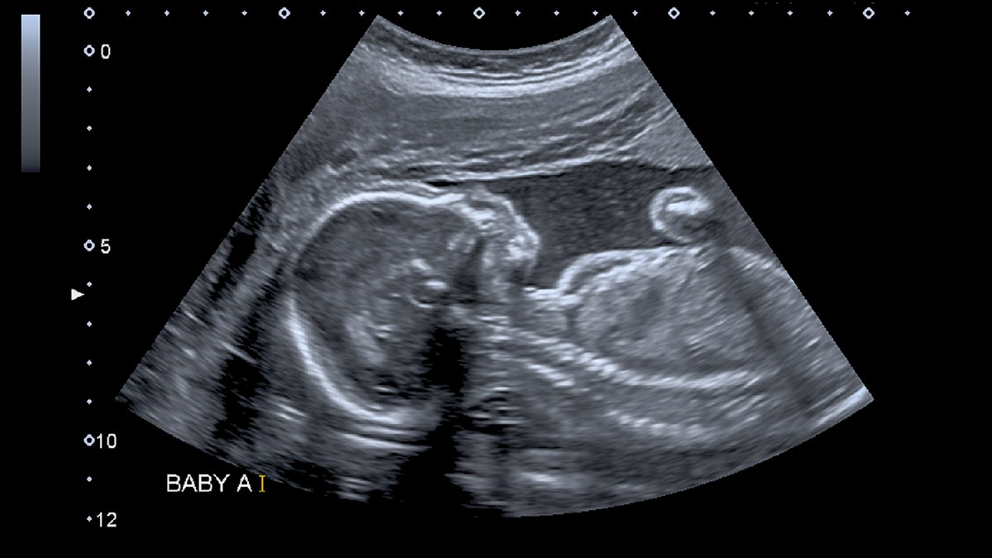
1 John 5:20b
… and we are in him who is true,
in his Son Jesus Christ.
● In:
● Him:
● True:
En = a relational particle with no specific meaning. To be ‘en’ a person = to be in relation with, to belong to.
God (5:19)? Or his Son (5:20)?
The unique, invisible Creator? Or
the crucified, risen Messiah/Christ?

Slide 14
1 John 5:20b
… and we are in him who is true, in his Son Jesus Christ.
● We:
● Son:
● Jesus:
● Christ:
(a) Jesus’ apostles,
(b) Ephesian Christians,
(c) Christian believers.
Psa 2:7; Mk 1:11; Jn 1:14; Hb 1:2.
Human name: Joshua ➔ Jesus.
Divine title: final prophet, priest, king.

Slide 15
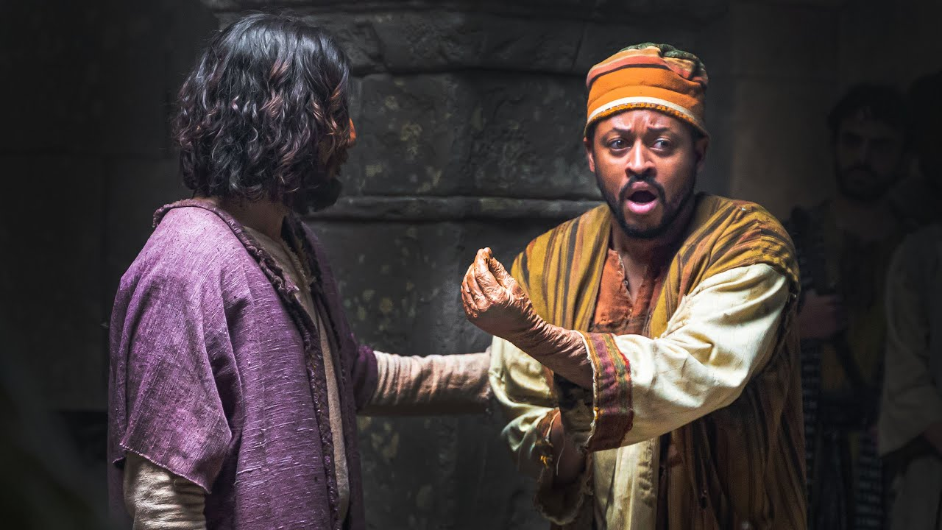
1 John 5:20c
… He is the true God and eternal life.
Jesus Christ “is”
● True God
● Eternal Life
● Righteous
● Advocate
● Son of God
● Understanding
● Word of life
● True Light
● Human flesh
● Only Son
● The Christ
● Lamb of God

Slide 16

1 John 5:21
²¹ Little children, keep yourselves from idols.
● Childen:
● Keep:
● Yourselves:
● Idols:
Susceptible to deceit.
Keep away, on your guard.
Plural = help each other.
Roman & Greek gods
Roman emperor’s image
Local sprites and deities
Religions and philosophies
Ourselves or possessions

Slide 17
Pliny the Younger, Epistles 10.96
“I have asked them if they were Christians. If they confessed, I asked them a second and third time, threatening them with punishment. If they persisted, I commanded them to be led away for punishment. There was no doubt that pertinacious and inflexible obstinacy ought to be punished, regardless of their confession. Some Roman citizens afflicted with a similar insanity were sent to Rome.” To Trajan, c. AD 110

Slide 18
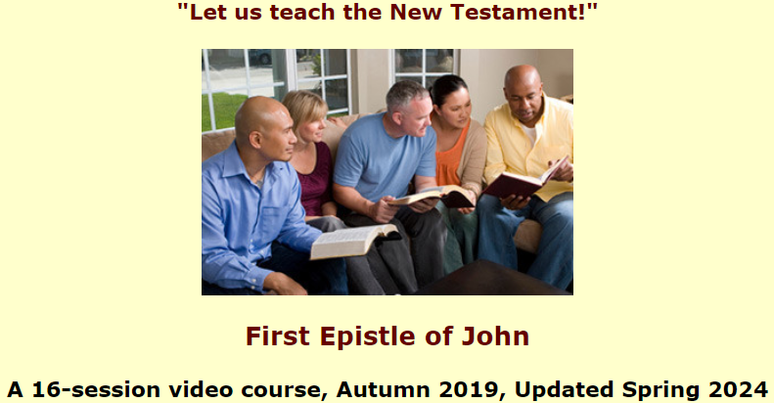
Assignment
● Read 2 John 1:1-13 three times in different versions (www.netbible.org).
● Visit http://1john.currah.download
● Write down your own insights to share them with others.

