Slide 1

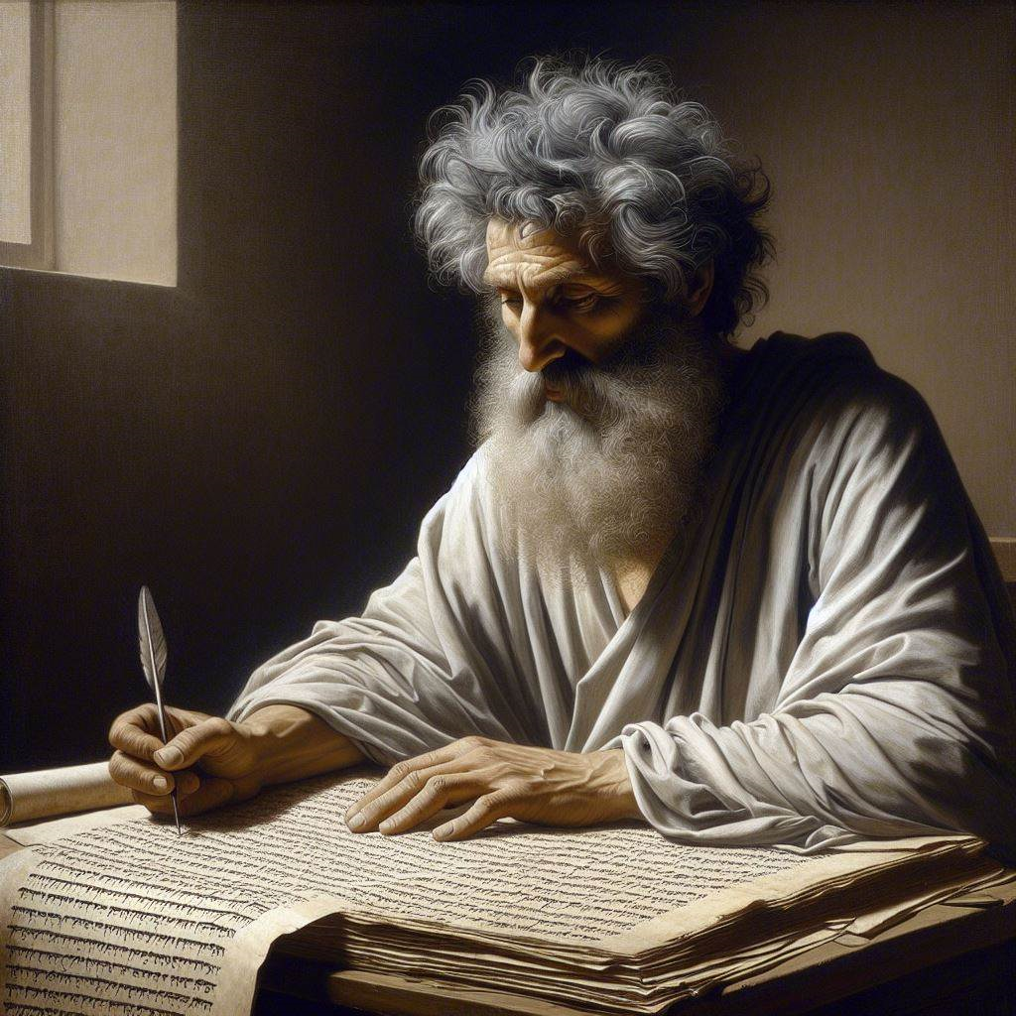
First Epistle of John
‘An Advocate with the Father’
14 & 17 March 2024
Image by Dall-e 3

Slide 2
First John, discourse structure
Part 1: Our Fellowship with God 1.1 – 2.17
Part 2: Our Adversaries 2.18 – 3.18
Part 3: Our Christian Faith 3.19 – 5.5
Part 4: Our Confidence with God 5.6-21
I. The Word of Life 1.1-4
II. The Original Message 1.5 – 2.2
III. The New Commandment 2.3-11
IV. The Will of God 1.12-19

Slide 3
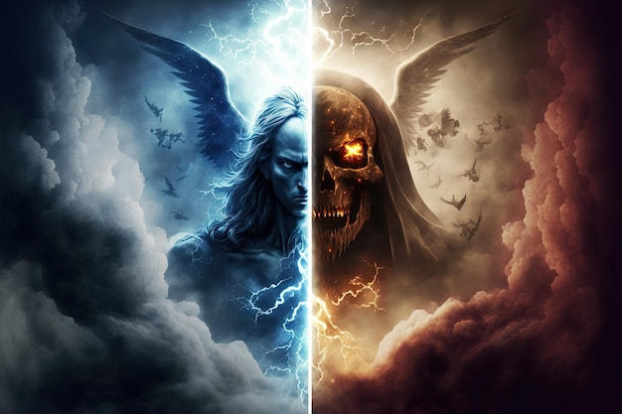
God is ‘light’
1 ⁵ This is the message we have heard from Him and announce to you, that God is Light, and in Him there is no darkness at all.
Jesus claimed, "He who sees Me sees the One who sent Me. I have come as Light into the world, so that everyone who believes in Me will not remain in darkness.” John 12:45-46
● Message:
● Light:
● Darkness:
Seen, heard, felt and announced.
Truth, goodness, and love.
Lies, evil, and hatred.
1 ⁵ Este es el mensaje que hemos oído de él y que anunciamos: Dios es luz y en él no hay ninguna oscuridad.
https://www.freepik.es/

Slide 4
God’s attributes/qualities
Non-communicable
● Free (independent)
● Not changing
● Eternal (forever)
● Everywhere
● Complete/unity
● Creator
● Planner (will)
Communicable
● Invisible Spirit
● All knowing
● All powerful
● Truth (never lies)
● Holy (dangerous)
● Love (giving)
● Wise (intelligent)

Slide 5
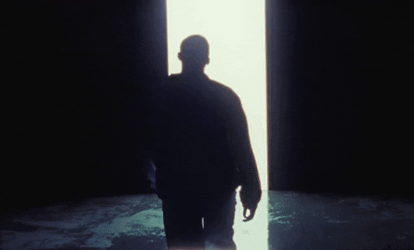
Walk in the Light
⁶ If we say that we have fellowship with Him and yet walk in the darkness, [then] we lie and do not practice the truth;
● Walk:
● Fellowship:
● Lie / truth:
How we live, believe, behave.
Belong, share, enjoy.
Both believe and behave.
⁶ Si afirmamos que tenemos comunión con él, pero vivimos en la oscuridad, mentimos y no ponemos en práctica la verdad.
https://giphy.com/

Slide 6
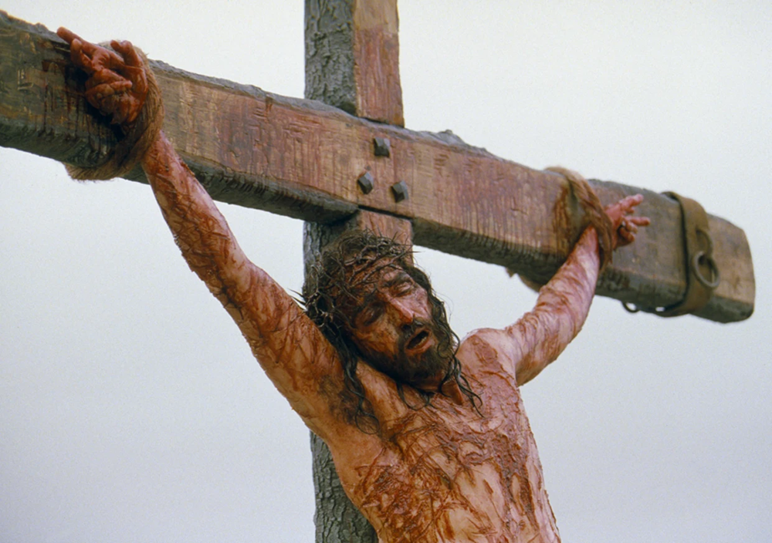
The blood of Jesus
⁷ but if we walk in the Light as He Himself is in the Light, we have fellowship with one another, and the blood of Jesus His Son cleanses us from all sin.
⁷ Pero si vivimos en la luz, así como él está en la luz, tenemos comunión unos con otros y la sangre de su Hijo Jesucristo nos limpia de todo pecado.
● Blood:
● Cleanses:
● Sin:
When he died on his cross.
Forgives and makes us new.
Everything bad we ever did.
Jim Caviezel portraying Jesus in "The Passion of the Christ"

Slide 7

Deceiving ourselves
⁸ If we say that we have no sin, [then] we are deceiving ourselves and the truth is not in us.
● Have sin:
● Deceive:
● Truth:
We were born able to sin.
Choose to tell or believe lies.
What God has said about us.
⁸ Si afirmamos que no tenemos pecado, nos engañamos a nosotros mismos y la verdad no está en nosotros.
https://klublr.com/ena/nooooooooooooooooo-gif

Slide 8
To have sin
● “Every intent of the thoughts of his heart was only evil continually” (Gen. 6:5).
● Jesus said, “You are evil” (Luke 11:13).
● “Sin … dwells in me” (Rom.7:17, 20).
● Everyone is born able to disobey God, and everyone will disobey God.
● Only God is perfect and is able not to sin.

Slide 9
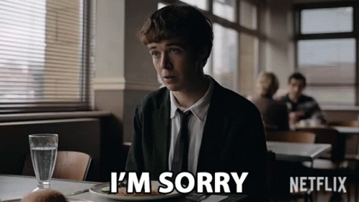
We confess our sins
⁹ If we confess our sins, [then] He is faithful and righteous, so that He will forgive us our sins and cleanse us from all unrighteousness.
● Confess:
● Faithful:
● Forgive:
● Cleanse:
Agree with what God says.
God keeps his promises.
God withholds punishment.
God treats us as his children.
⁸ Si confesamos nuestros pecados, Dios, que es fiel y justo, nos los perdonará y nos limpiará de toda maldad.

Slide 10

Deceiving ourselves
¹⁰ If we say that we have not sinned, [then] we make Him a liar and His word is not in us.
● Sinned:
● Liar:
● Word:
We have disobeyed God.
Either God has lied or we lied.
“The Word” = Jesus (1:1; 2:14).
¹⁰ Si afirmamos que no hemos pecado, lo hacemos pasar por mentiroso y su palabra no está en nosotros.
Maya Rudolph, www.icegif.com/gif/refuse/

Slide 11
We say that we have not sinned
Inner (mental) sins Outer (behavioral) sins
● Anger Abuse, violence
● Covet Theft, larceny
● Disloyal Apostacy, treachery
● Greed Fraud, deceit
● Hatred Murder, false testimony
● Lust Adultery, immorality
● Pride Scoffing, lying
● Stubborn Rebellion

Slide 12
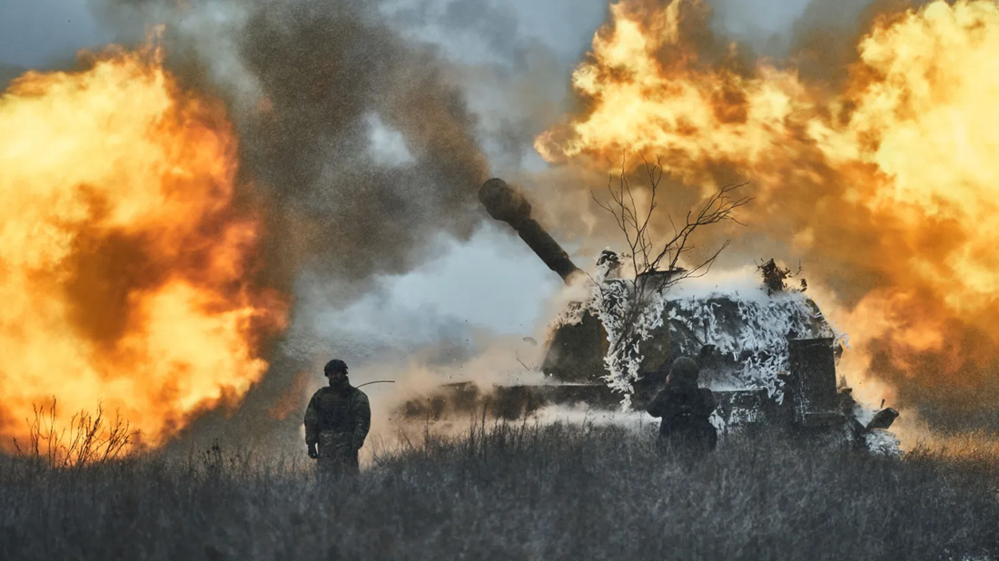
Societal sins that God will judge
Ethnic prejudice
War, invasion
Wealth confiscation
Mob action, violence
Gender confusion
Slavery, captivity
Prostitution
Abortion on demand
Child mutilation
Idolatry, priestcraft
Long imprisonment
Drug trafficking
Organized crime
Compounded usury
Ukraine, Feb. 18, 2023 (AP photo by Libkos).

Slide 13

You may not sin
2 ¹ My little children, I am writing these things to you so that you may not sin.
2 ¹ Mis queridos hijos, escribo estas cosas para que no pequen.
● Children:
● Writing:
● Not sin:
Young Christian believers.
Holy Scripture (the Bible).
Christians are able not to sin!
https://tenor.com/search/i-will-not-yield-gifs

Slide 14

We have an Advocate
And if anyone sins, we have an Advocate with the Father, Jesus Christ the righteous;.
● Anyone:
● Advocate:
● Father:
● Righteous:
Willingly, ignorantly, forced.
The only intercessor (1 Tim 2:5).
God sent his Son to save us.
God listens to him, accepts us.
Pero si alguno peca, tenemos ante el Padre a un intercesor, a Jesucristo, el Justo..
https://www.dreamstime.com/stock-photos-agreement-intermediary-image16188703

Slide 15
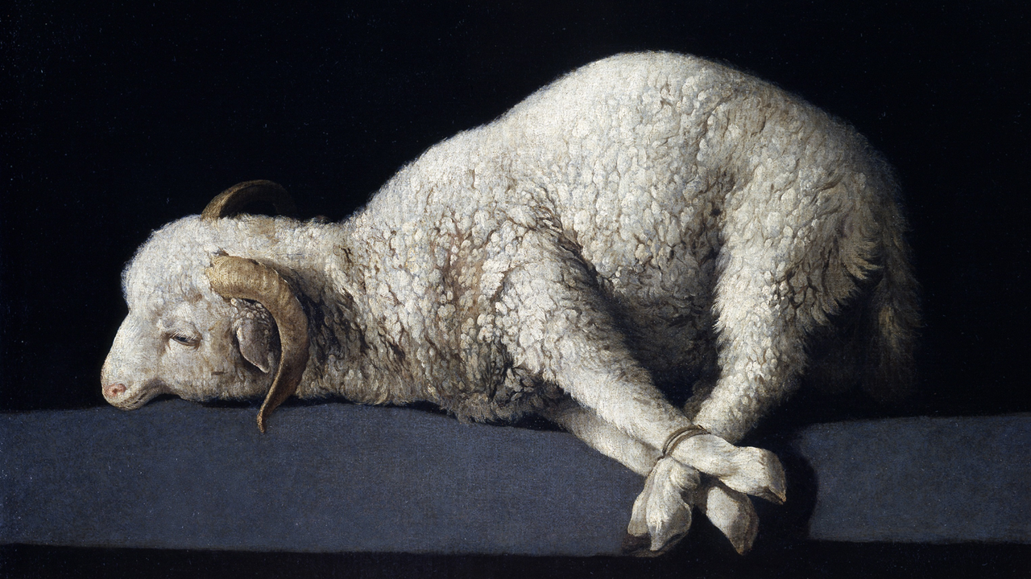
Propitiation (sacrifice)
² and He Himself is the propitiation [sacrifice] for our sins; and not for ours only, but also for the sins of the whole world.
● Propitiation for sins:
● Whole world:
Jesus’ death satisfies God’s holy wrath against sin.
Anyone may repent, believe and be saved!
² Él es el sacrificio por el perdón de nuestros pecados y no solo por los nuestros, sino por los de todo el mundo.

Slide 16
Seven Purposes of Jesus’ death
● Propitiation: Satisfy God’s justice.
● Expiation: Remove sinners’ guilt.
● Purification: Cleanse our way to God.
● Redemption: Set us free from the devil.
● Reconciliation: Establish friendship.
● Justification: God forgives the guilty.
● Demonstration: Show God’s love for us.

Slide 17
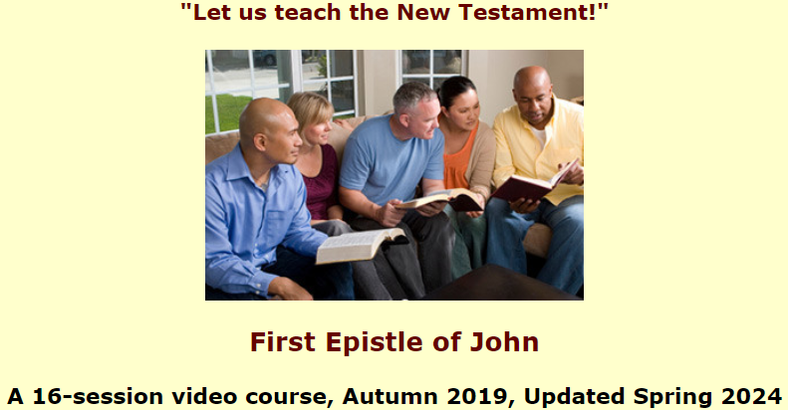
Assignment
● Read 1 John 2:3-11 three times in different versions (www.biblehub.com).
● Visit http://1john.currah.download
● Compile your own insights to share with others next time.

