Slide 1

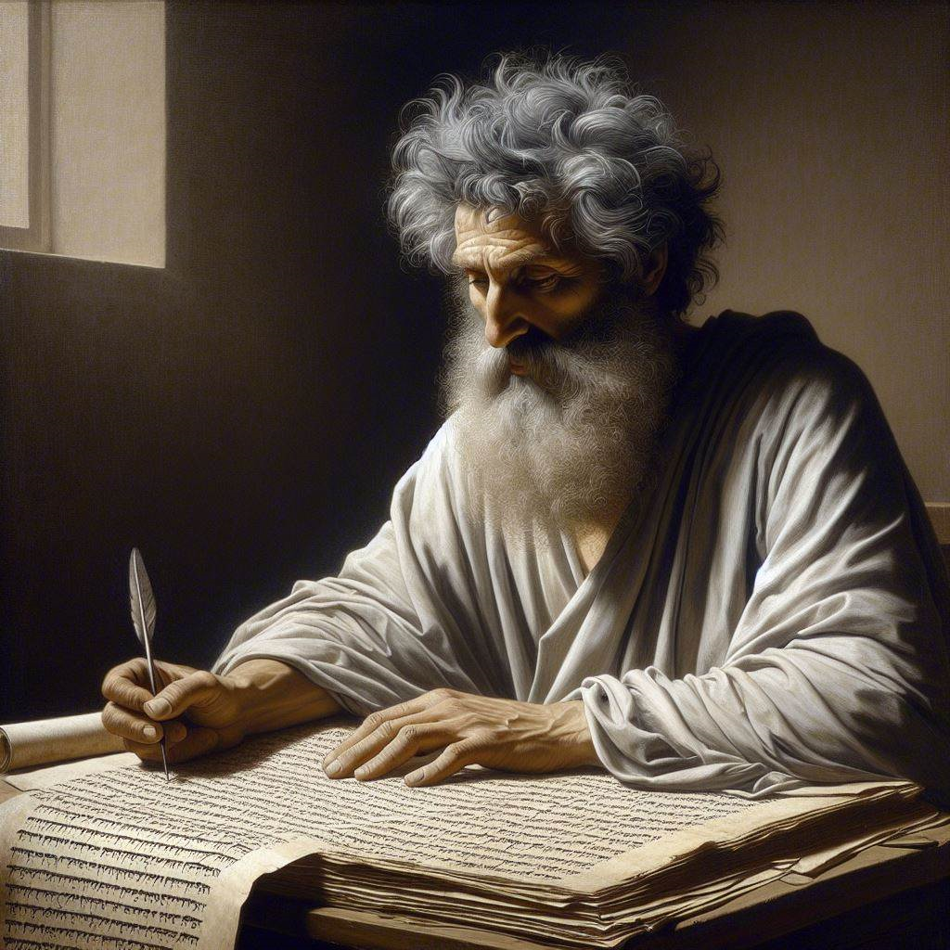
First Epistle of John 2:12-17
‘Who does the will of God’
28 & 31 March 2024
Image by Dall-e 3

Slide 2
First John, discourse structure
Part 1: Our Fellowship with God 1.1 – 2.17
Part 2: Our Adversaries 2.18 – 3.18
Part 3: Our Christian Faith 3.19 – 5.5
Part 4: Our Confidence with God 5.6-21
I. The Word of Life 1.1-4
II. The Original Message 1.5 – 2.2
III. The New Commandment 2.3-11
IV. The Will of God 2.12-17

Slide 3
A. Christians’ advantages 2.12-14

Slide 4
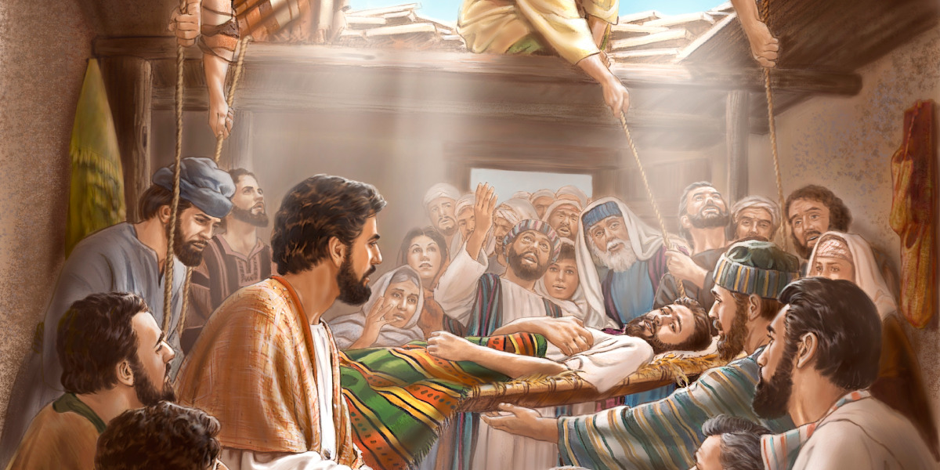
Sins forgiven, 2:12
¹² I am writing to you, little children, because your sins have been forgiven you on account of His name.
● Children:
● Forgiven:
● His name:
● Name:
See next slide.
Released from debt.
Whose name?
Reputation, authority, work.
Jesus said, “The Son of Man has authority on earth to forgive sins.” Luke 5:24

Slide 5
Three classes
Generation Pressure Blessing
● Children:
● Youth:
● Parents:
Youth Social Forgiven
Earners Economic Victory
Aged Despair Know Him
Are these
● Three groups or generations?
● Two groups of ‘children’: youth & parents?
● One group with same blessings for all?

Slide 6
When sins or debts are forgiven
● There is an offender or a debtor.
● There is an offended or a creditor.
● There is an offense or a debt.
Who suffers or pays?
● The offender has paid his debt.
● A defender has paid the debt.
● The offended takes the loss.

Slide 7
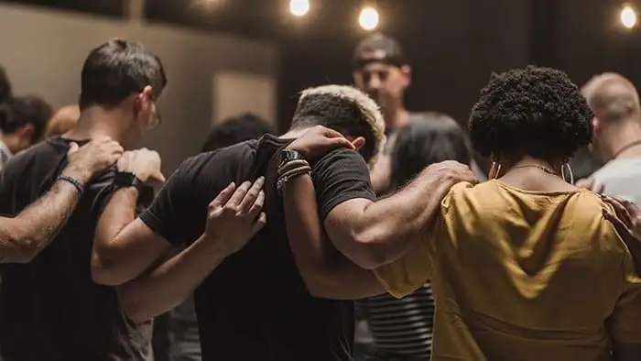

Overcome the devil, 2:13a
¹³ I am writing to you, fathers, because you know Him who has been from the beginning.
To know Him = experience his reality
● Holy Spirit
● Answers to prayers
● Divine wisdom
● Spiritual warfare
Jesus prayed, “This is eternal life, that they may know You, the only true God.” John 17:3
● Love, peace, joy ...
● Self control
● Spiritual gifts
● Sure of eternal life
Jesus Film Project

Slide 8
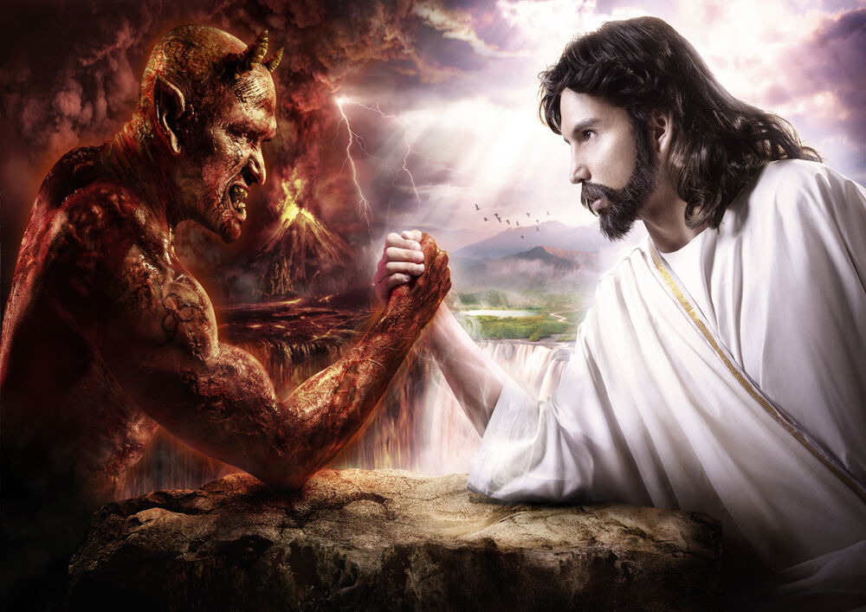
Overcome the devil, 2:13b
I am writing to you, young men, because you have overcome the evil one.
● Evil one:
● Overcome:
The devil, Satan, a powerful, fallen spirit who rules over the world.
Trust Jesus’ greater authority, resist idolatry, remain loyal to Jesus
Jesus promised, “In the world you have tribulation, but take courage; I have overcome the world.” Luke 22:30-31

Slide 9
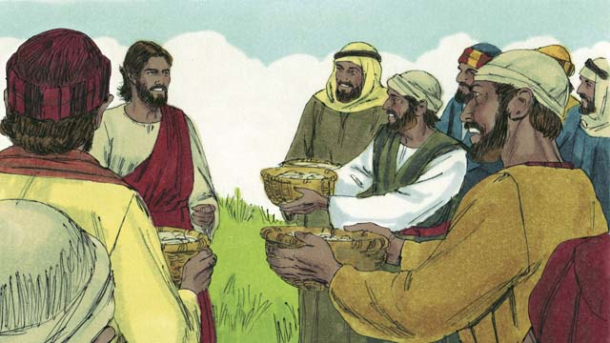
Know the Father, 2:13c-14a
I have written to you, children, because you know the Father. ¹⁴ I have written to you, fathers, because you know {Him who / that which} has been from the beginning.
● Fathers beget, bond
● Provide & protect
● Model & train
● Counsel & advise
● Correct & discipline
● Pray & worry
● Mate & support
● Inheritance & heritage
Jesus prayed, “This is eternal life, that they may know You, the only true God.” John 17:3

Slide 10
You are strong, 2: 14b
I have written to you, young men, because you are strong, and the word of God remains in you, and you have overcome the evil one.
● Strong:
● Word:
● Overcome:
● Evil one:
Nourishment & exercise.
Know, test, trust, defend it.
Struggle and prevail.
Everyone’s personal tempter.
Jesus said, “My mother and My brothers are these who hear the word {ºof God} and do it.” Luke 8:21

Slide 11
B. Christians’ Dangers 2.15-16

Slide 12


To love the world, 2:15
¹⁵ Do not love the world nor the things in the world. If anyone loves the world, the love of {the Father / God} is not in him.
Jesus said, “The world cannot hate you, but it hates Me because I testify of it, that its deeds are evil.” John 7:7
● Love:
● World:
● Deeds:
● Evil:
Admire, desire, acquire, require.
Human societies & their cultures.
Conspiracies ➔ theft and violence.
Destructive in effect or outcome.

Slide 13
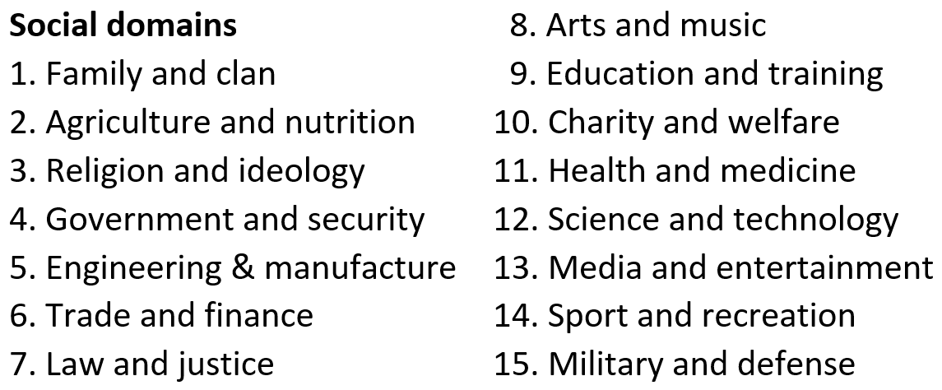
“Use the world … not make full use of it; for the form of this world is passing away.” 1 Cor 7:31

Slide 14

Lust of the flesh, 2:16
¹⁶ For all that is in the world, the lust of the flesh and the lust of the eyes and the boastful pride of life, is not from the Father, but is from the world.
Natural Social Spiritual
Food Wealth Secrets
Drink Authority Power
Sleep Status Protection
Sex Security Salvation
Jesus said, “Out of the heart of men, proceed the evil thoughts, … deeds of coveting … pride and foolishness. All these evil things proceed from within and defile the man.” Mark 7:21-23
“Wolf of Wall Street” Paramount Home Entertainment

Slide 15
B. Christians’ Reward 2.17

Slide 16
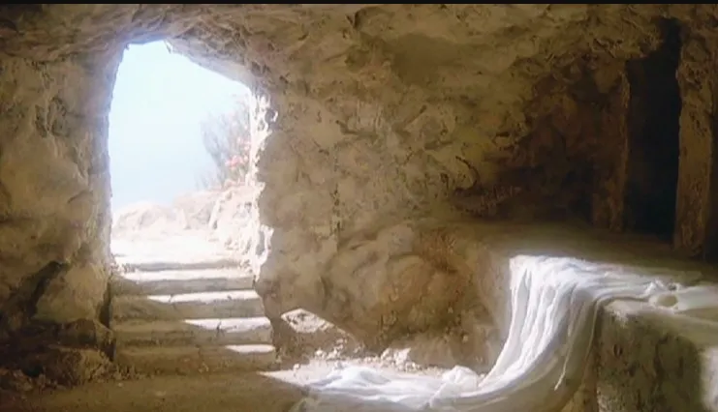

To live forever, 2:17
¹⁷ The world is passing away and also {ºits} lusts; but the one who does the will of God continues to live forever.
Jesus said, “This is the will of My Father, that everyone who beholds the Son and believes in Him will have eternal life, and I Myself will raise him up on the last day.” John 6:40
● Passing:
● Behold:
● Believe:
● Eternal:
Diminishing and disappearing.
Read or listen to the Gospels.
Trust and remain loyal.
Quality and quantity of life.

Slide 17
How is the ‘system’ passing away?
● Condemned to cease forever.
● Was once influenced by ‘Protestant’ values.
● Spirit rulers lose control over Christians.
● Every empire declines and succumbs.
● National economies collapse and fail.
● The entire global order will be replaced by Jesus’ kingdom, when he returns.

Slide 18
Everlasting life
● Is an intimate, loving life with Jesus.
Quality of life
● Freedom from sin
● Hope for the future
● Spiritual fruit
● Spiritual gifts
● Mutual love
Quantity of life
● Starts now
● Home in heaven
● Resurrection
● Jesus’ kingdom
● New sky and earth

Slide 19
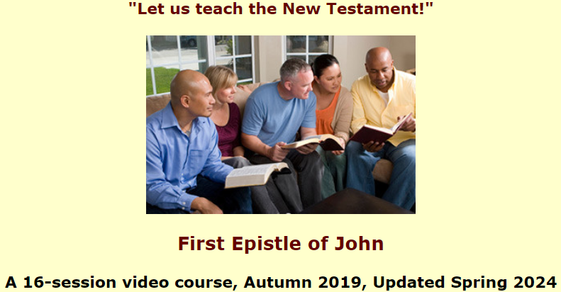
Assignment
● Read 1 John 2:18-29 three times in different versions (www.biblehub.com).
● Visit http://1john.currah.download
● Compile your own insights to share with others next time.

