Slide 1

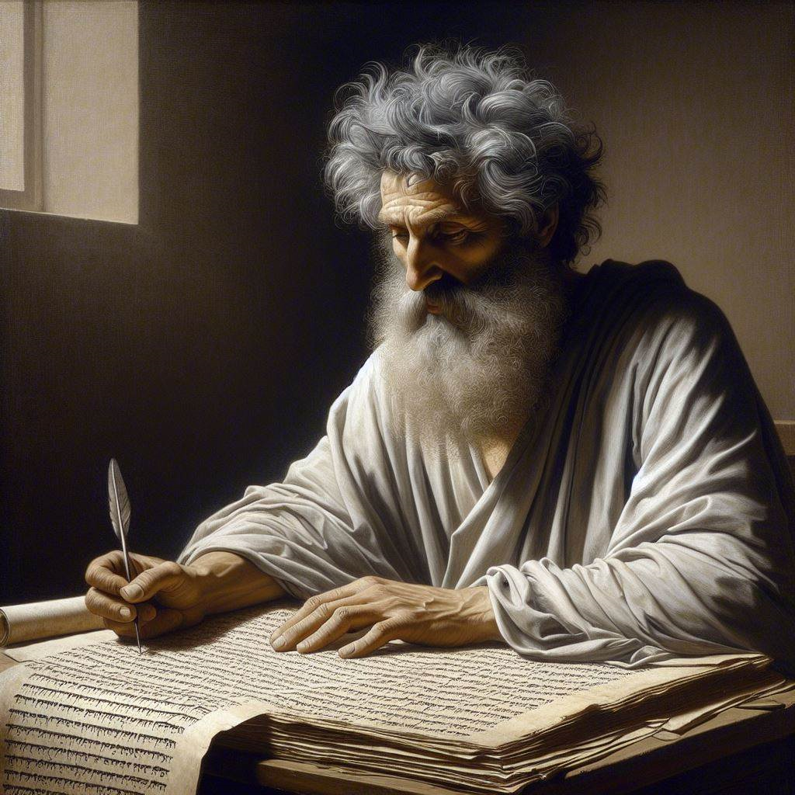
First John 2:18-29
‘The anointing from Him’
04 & 07 April 2024
Image by Dall-e 3

Slide 2
First John, discourse structure
Part 1: Our Fellowship with God 1.1 – 2.17
Part 2: Our Adversaries 2.18 – 3.18
Part 3: Our Christian Faith 3.19 – 5.5
Part 4: Our Confidence with God 5.6-21
  V. Antichristian teachers 2.18-29
  VI. Lawless sinners 3.1-10
  VII. Those who Hate Christians 3.11-18

Slide 3
A. Two types of Christian
2.18-20

Slide 4
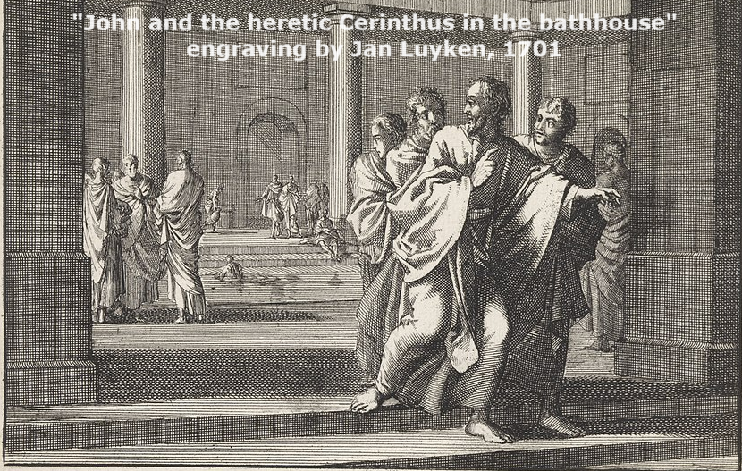

Cerinthus
● Contemporary with the Apostle John.
● Famous preacher and teacher.
● Use a modified Gospel of Matthew.
● A spirit, not God, created the world.
● Jesus was a natural-born man.
● Christ came on Jesus at his baptism, and left him at his crucifixion.
● One must obey the OT laws to be saved.
● A 1000 years of carnal pleasure.

Slide 5
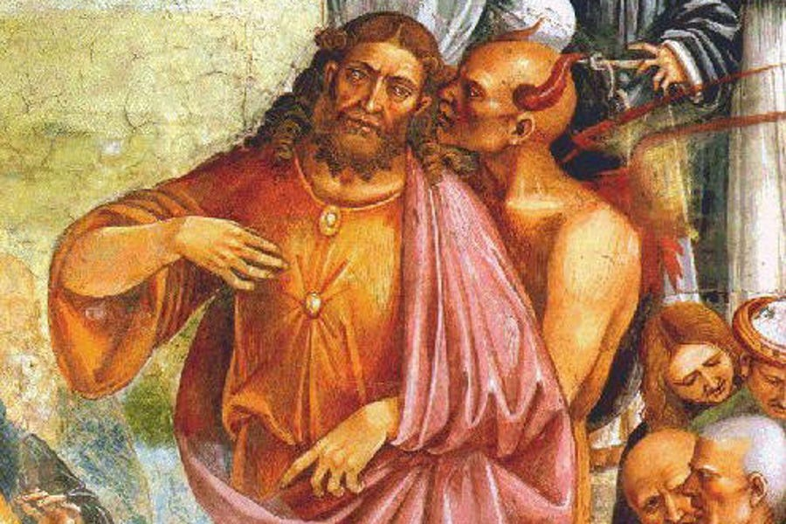
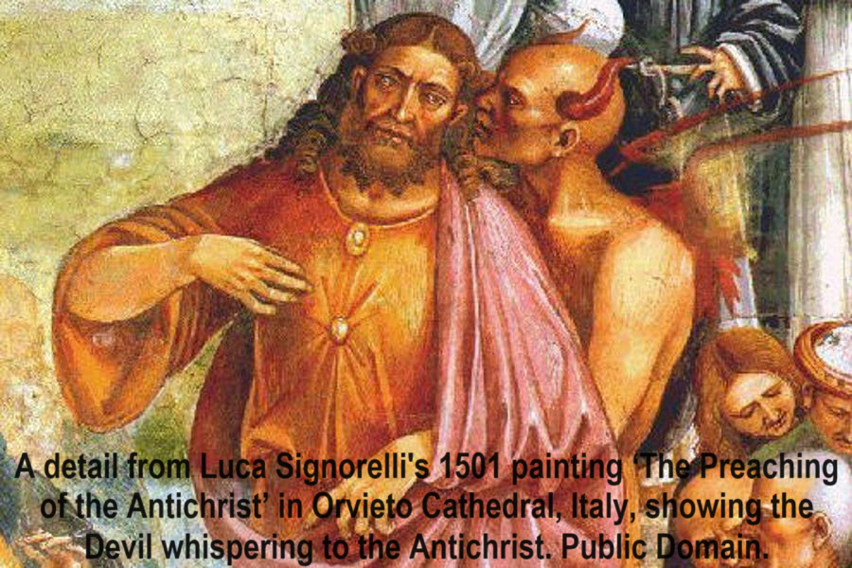
The last hour, 2:18-19
¹⁸ Children, it is the last hour; and just as you heard that {the} antichrist is coming, even now many antichrists have appeared; from this we know that it is the last hour.
¹⁹ They went out from us, but they were not really of us; for if they had been of us, they would have remained with us; but they went out, so that it would be evident that they all are not of us.
Jesus prayed, “I do not ask You
to take them out of the world, but to keep them from the evil one.” John 17:15

Slide 6
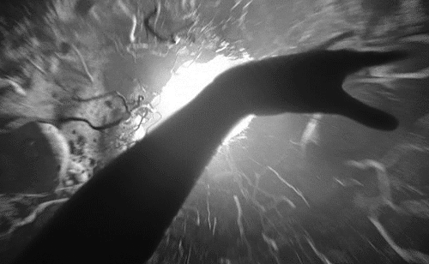
The last hour, 2:18-19
● Last hour:
● Antichrist:
● Antichrists:
● ‘Of us’:
“In these last days [God] has spoken … in His Son!” Hb 1:2
Adversary of the Messiah,
to appear in the last days.
All who teach that Jesus is not the Messiah (Christ). 2:22
‘From us’. Some claimed to be sent from the apostles.

Slide 7
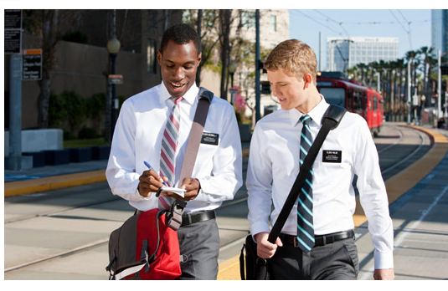
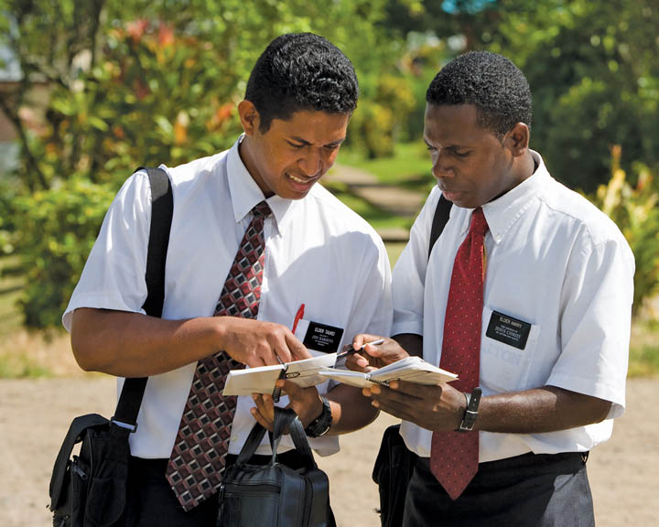
The antichrists
● They are many 18
● They left the Christians 19
● They are liars 21, 22
● They deny that Jesus is the Christ 22
● They deny the Father and the Son 22, 23
● They try to deceive Christians 26, 27

Slide 8
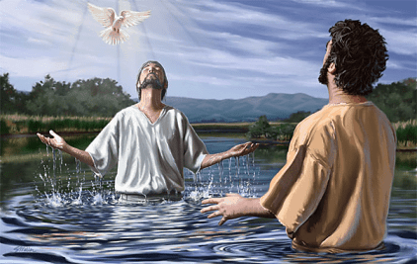
Anointing (χρισμα, chrisma), 2:20-21
²⁰ But you have an anointing from the Holy One, and you {all know / know everything}.
²¹ I have not written to you because you do not know the truth, but because you do know it, and because no lie is of the truth.
“These have been written so that you may believe that Jesus is the Christ, the Son of God; and that believing you may have life in His name.” John 17:15
● Anointing:
● Truth:
● Lie:
chrisma ≈ christos (Christ).
Jesus = the Christ.
Every lie parades as truth.

Slide 9
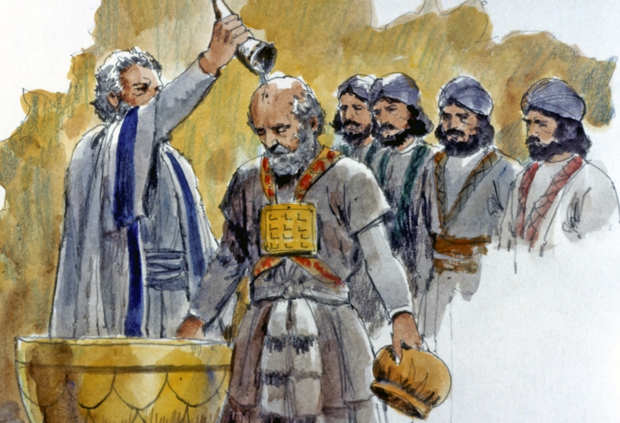
Anointing in the First Testament
● Jacob’s pillar Genesis 28:18
● Priests Exodus 30:30; costumes 29:29.
● Tent and covenant box Exodus 30:26; 40:9
● Tent furnishings Exodus 40:9
● Kings 1 Samuel 16:13-14
● No layman Exodus 30:31-33
The ‘anointing’ was a mixture of spiced oil.

Slide 10
The Anointing in 1st John
● Christians have received him 20
● He comes from the Holy One 20
● He gives knowledge 20
● He abides with Christians 27
● He teaches Christians 27
● He is true 27
The ‘anointing’ is the Holy Spirit

Slide 11
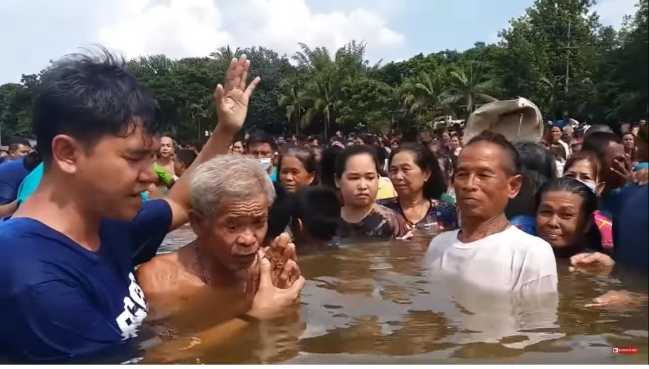
Who is the liar, 2:22-23
²² Who is the liar except the one who denies that Jesus is the Christ? This is the antichrist, the one who denies the Father and the Son. ²³ Whoever denies the Son does not have the Father; the one who confesses the Son has the Father also.
Jesus commanded, “Go … make disciples of all the nations, baptizing them in the name of the Father and the Son and the Holy Spirit.” Matt. 28:19
● Father:
● Son:
● Anointing:
True God invisible forever.
True God become visible man.
True God dwelling with us.

Slide 12
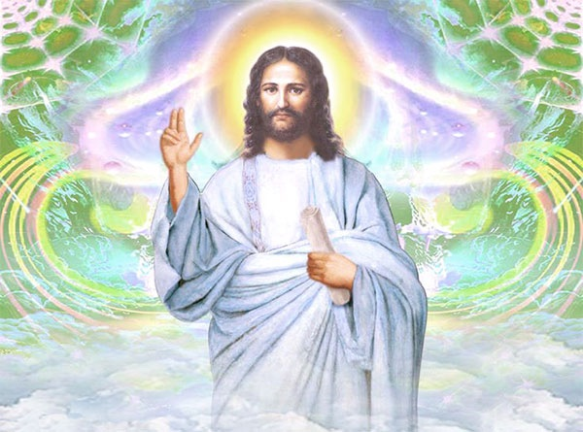
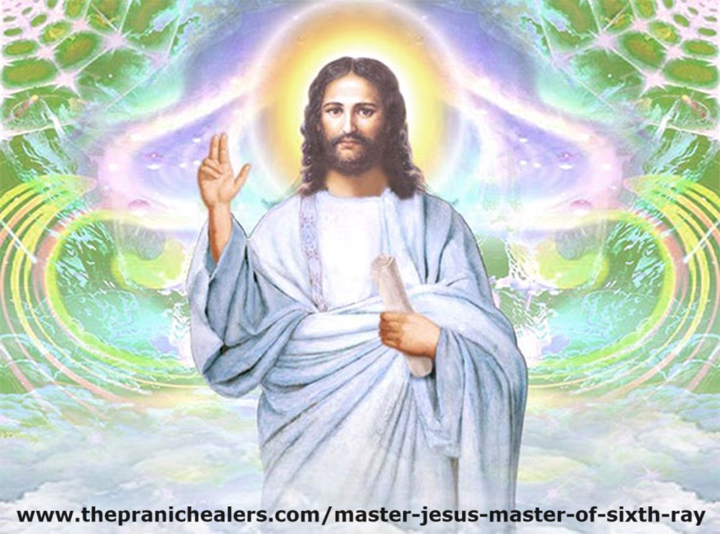
Major errors about Jesus Christ
● Jesus was only a man.
● Jesus was a rabbi.
● Jesus was a prophet.
● Jesus was a great master.
● Jesus was an angel.
● Jesus was an extraterrestrial alien.
Lie: the Spirit came temporarily, then left.

Slide 13
B. The faith that leads to life
2.24-25

Slide 14
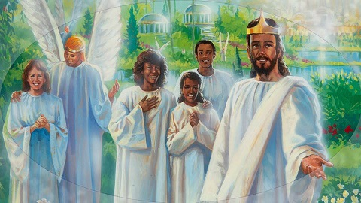
Eternal life, 2:24-25
²⁴ As for you, see that what you heard from the beginning remains in you. If what you heard from the beginning remains in you, you also will remain in the Son and in the Father. ²⁵ This is the promise which He Himself made to {us/you}: eternal life.
Jesus promised, “They follow Me; and I give eternal life to them, and they will never perish; and no one will snatch them out of My hand.” John 19:28
● Heard:
● Remains:
● Eternal:
Jesus’ teaching and promises.
Do not deny it nor abandon it.
Resurrection and live forever.

Slide 15
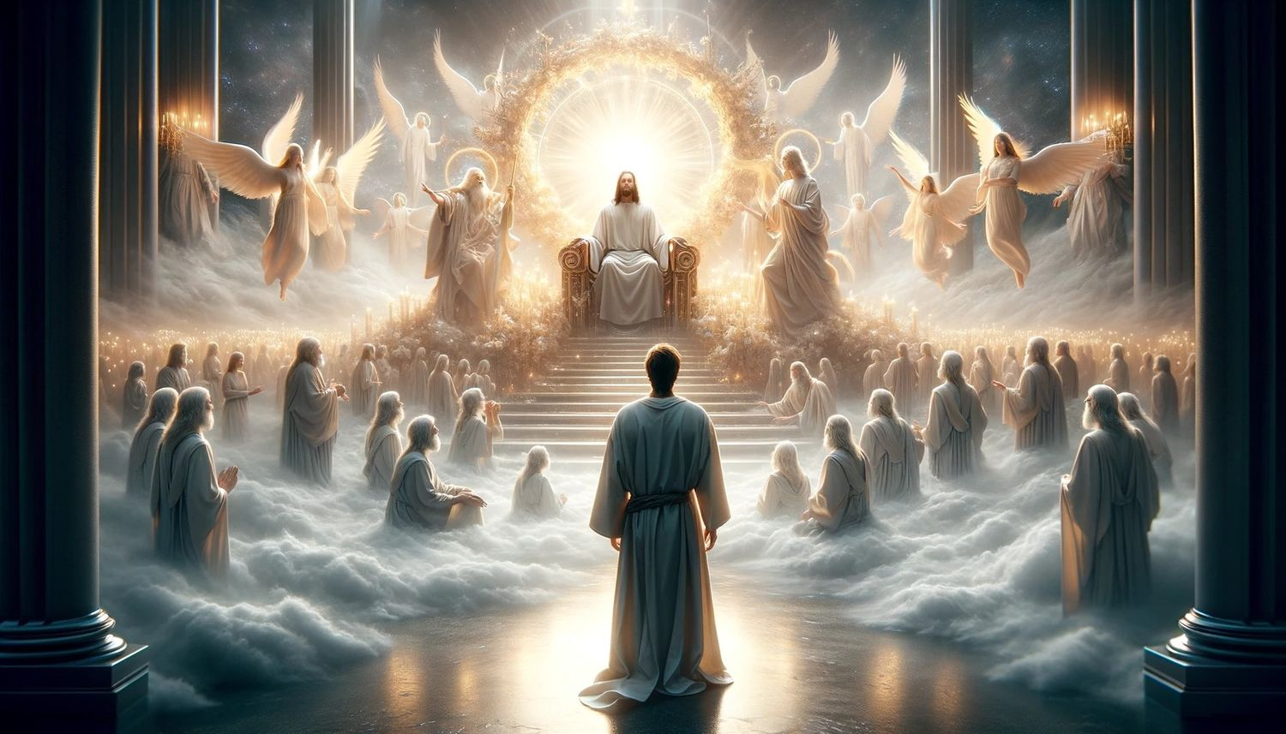
Everlasting life
● An intimate, loving life with Jesus, forever.
Quality of life
● Freedom from sin
● Hope for the future
● Spiritual fruit
● Spiritual gifts
● Mutual love
Quantity of life
● Starts now
● Home in heaven
● Resurrection
● Jesus’ kingdom
● New sky and earth

Slide 16
C. Christians’ Advantages
2.26-29

Slide 17
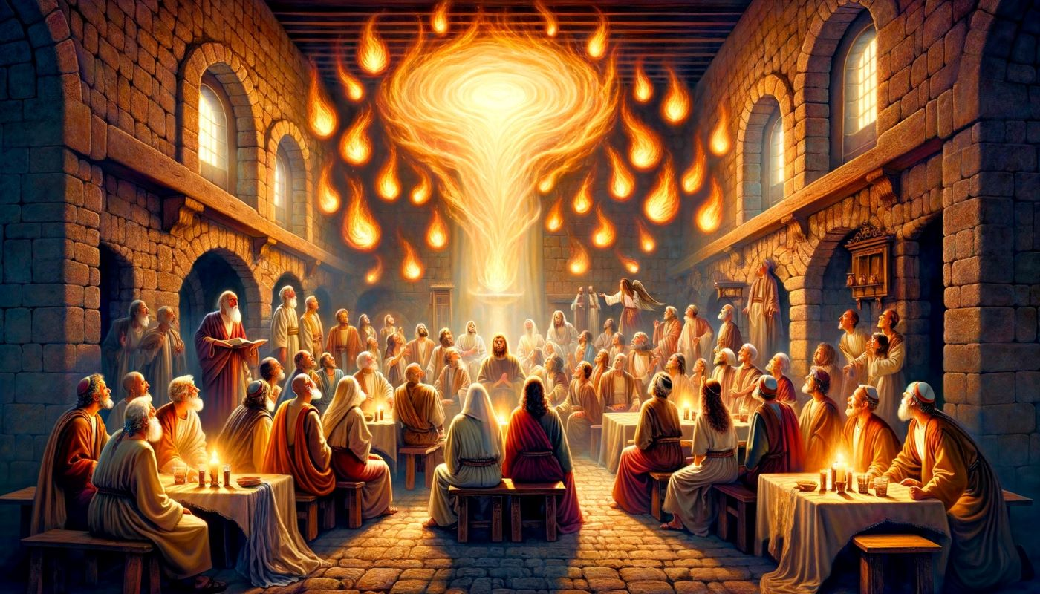
His anointing teaches you, 2:26-27
²⁶ These things I have written to you concerning those who are trying to deceive you. ²⁷ And as for you, the {anointing/gift} which you received from Him remains in you, and you have no need for anyone to teach you; but as His anointing teaches you about all things, and is true and is not a lie, and just as it has taught you, you remain in Him.
● Anointing (chrisma), gift (charisma).
Jesus promised, “the Holy Spirit, whom the Father will send in my name, will teach you everything and remind you of all that I have said to you.”
John 14:25

Slide 18

His anointing teaches you
● Written:
● Deceive:
● Teach:
● No need:
● Anointing:
Original New Testament books.
Substitute ideas and myths.
Authoritative persons & books.
Those who proclaim ‘new truth’.
Jesus at his baptism,
His apostles at Pentecost,
All Christian believers.

Slide 19


The Anointing (Holy Spirit) in us
1 Testifies that we are God’s children. Ro 8:16
2 Teaches us the truth about Jesus. 1 Jn 2:27
3 Produces changed character. Ga 5:22-25
4 Enables us to speak or to serve. 1 Pt 4:10-11
5 Guides the obedience. Ac 8:29
6 Calls to specific work. Ac 10:19
7 Joyful singing to the Lord. Ep 5:18-19
8 Prays through us without words. Ro 8:26

Slide 20

When He appears, 2:28-29
²⁸ Now, little children, remain in Him, so that when He appears, we may have confidence and not draw back from Him in shame at His coming. ²⁹ If you know that He is righteous, [then] you know that everyone who practices righteousness also has been born of Him.
● Shame: Strong sense of being rejected.
● Guilt: Sense of deserving punishment.
Jesus promised, “Seek first His kingdom and His righteousness, and all these things will be added to you.”
Matthew 6:33

Slide 21
Seven enduring Christian truths
● Apostolic testimony in written form.
● Jesus is the Christ, the promised Messiah.
● We have an anointing from the Father.
● God is both Father and Son.
● Jesus promised everlasting life.
● Those born of God practice righteousness.
● False teachers try to deceive Christians.

Slide 22

Assignment
● Read 1 John 3:1-10 three times in different versions (www.biblehub.com).
● Visit http://1john.currah.download
● Compile your own insights to share with others next time.

