Slide 1


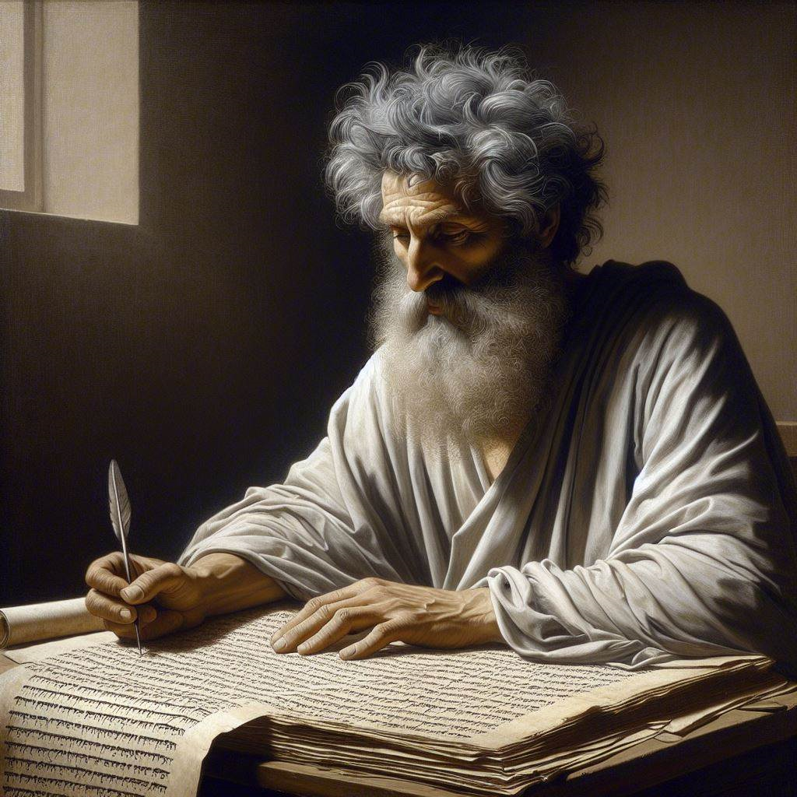
First John 3:11-18
‘The message which you have heard’
18 & 21 April 2024
Image by Dall-e 3

Slide 2
First John, discourse structure
Part 1: Our Fellowship with God 1.1 – 2.17
Part 2: Our Adversaries 2.18 – 3.18
Part 3: Our Christian Faith 3.19 – 5.5
Part 4: Our Confidence with God 5.6-21
V. Antichristian teachers 2.18-29
VI. Lawless sinners 3.1-10
VII. Those who hate Christians 3.11-18

Slide 3

Practice righteousness, 3:10
¹⁰ Anyone who does not practice righteousness is not of God, nor the one who does not love his brother and sister. (NASB, 2020)
¹⁰ All those who do not practice righteousness habitually do not belong to God, nor do those who do not continue to love their fellow Christians. (GJC, 2024)
Jesus said, “I am giving you a new commandment, that you love one another; just as I have loved you.” John 13:34

Slide 4


Reasons others hate & ridicule us
● They blame us for others’ past history.
● Their religions accuse us of evil deeds.
● Our beliefs contradict their beliefs.
● They know that we do not retaliate.
● We openly oppose their evil deeds.
● They fear we may side with their enemies.
● They lust after our children or youth.
● They are motivated by evil spirits.

Slide 5
A. The example of Cain 3.11-12

Slide 6
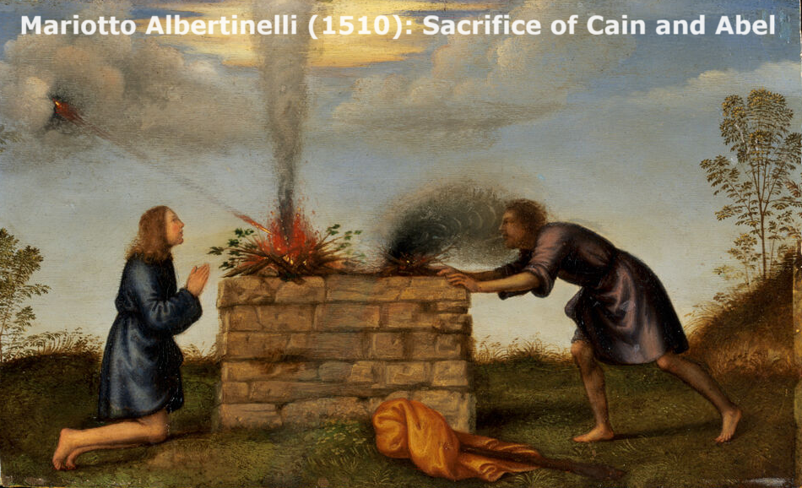

The example of Cain, 3.11-12a
¹¹ For this is the message which you have heard from the beginning, that we are to love one another; ^{12a} not as Cain, who was of the evil one and murdered his brother. (NASB, 2020)
“By faith Abel offered to God a better sacrifice than Cain, through which he obtained the testimony that he was righteous.” Hebrews 11:4
● Message: Jesus’ & his apostles’ teaching.
● Beginning: Eye & ear-witness accounts.
● Cain: Adam’s & eve’s first child.
● Brother: Abel, a righteous young man.

Slide 7
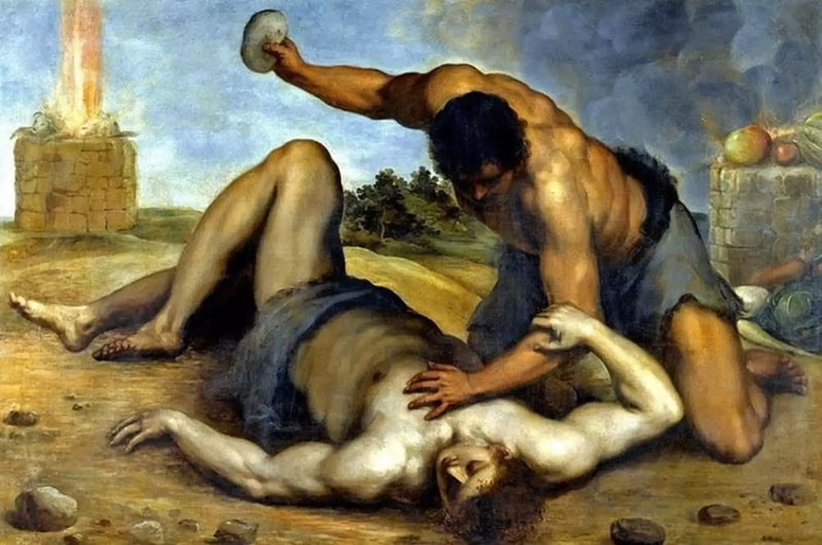

The example of Cain, 12b
^{12b} And for what reason did he murder him? Because his own deeds were evil, but his brother’s were righteous. (NASB, 2020)
● Reason: Premeditated, purposeful.
● Evil: ‘Pornicious,’ evil in action.
● Righteous: Obeying God’s rules.
‘Cain said to his brother Abel, “Let's go out to the field.” While they were in the field, Cain attacked his brother Abel and killed him.’ Genesis 4:8

Slide 8
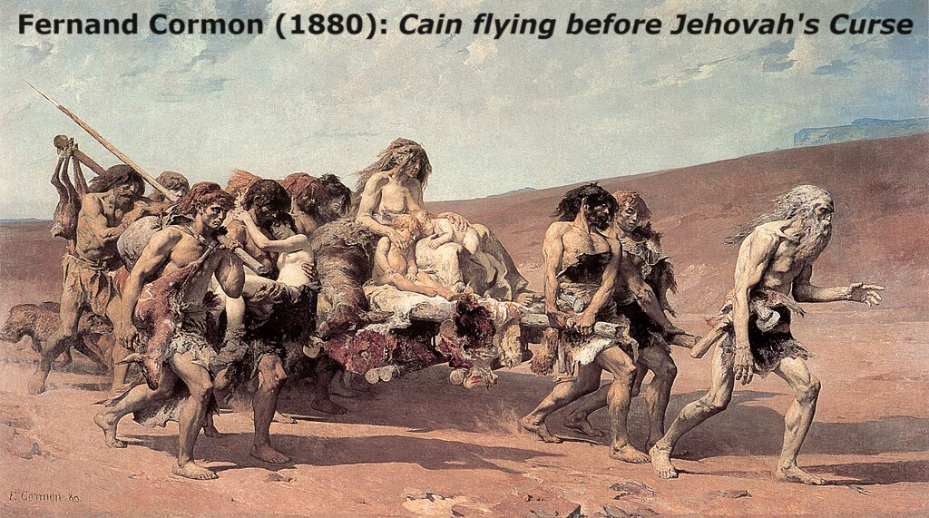

Cain ben Adam
● Firstborn son of Adam and Eve.
● Practiced sacrifice without real faith.
● Murdered his righteous brother Abel.
● Complained about his punishment.
● Yahweh protected him from others.
● Went away from Yahweh’s presence.
● Settled in the land of Nod, east of Eden.
● Married and fathered a son, Enoch.
● Founded a city named for his son, Enoch.

Slide 9
B. When they hate us
3:13-15

Slide 10
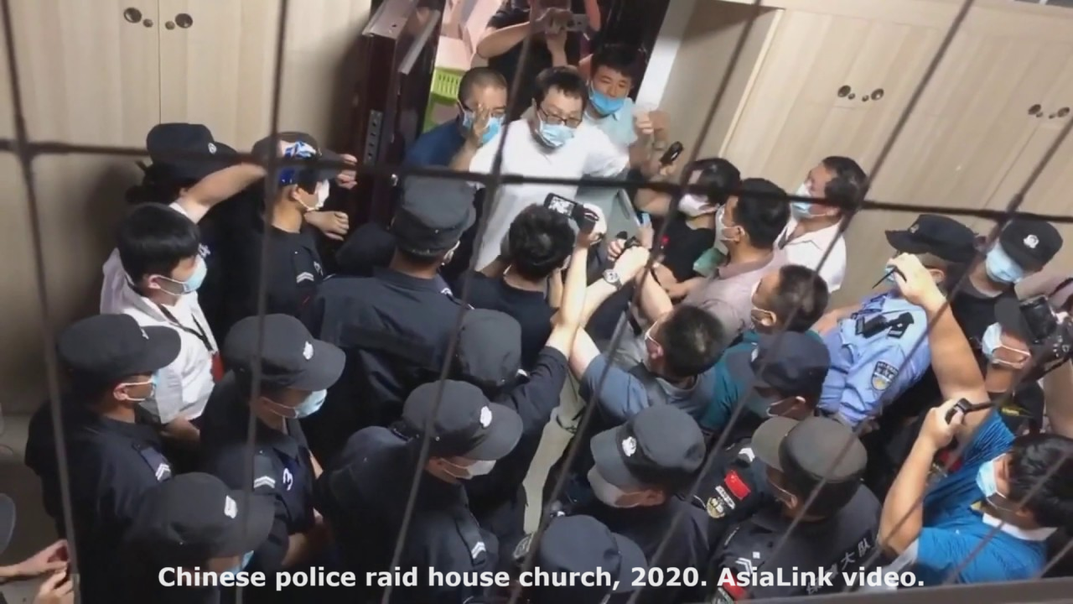

The world hates you, 3:13-14
¹³ Do not be surprised, brothers and sisters, if the world hates you. ¹⁴ We know that we have passed out of death into life, because we love the brothers and sisters. The one who does not love remains in death.
● World: the socio-political system.
● Hate: De-value, regard as inferior.
● Love: Value, treat as worthy.
● Death: No everlasting life, ruled by Satan.
Jesus said, “Blessed are you when people hate you… Love your enemies, do good to those who hate you.” John 17:25

Slide 11
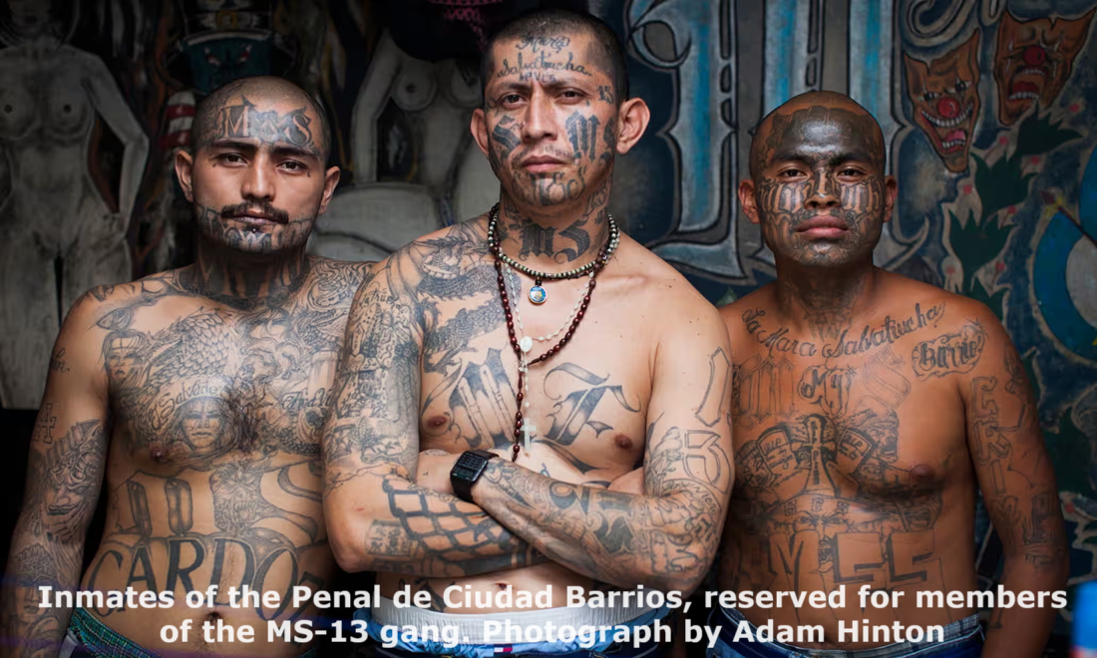

Hatred = murder, 3:15
¹⁵ Everyone who hates his brother or sister is a murderer, and you know that no murderer has eternal life remaining in him. (NASB, 2020)
● Murder: To desire or to cause death.
● Eternal life: Joy now, rewards in heaven, bodily resurrection, reign with Christ in his kingdom, become all that God intends.
Jesus explained, “Out of the heart come evil thoughts, murder, adultery, sexual immorality, theft, false witness, slander.” Matthew 15:19

Slide 12
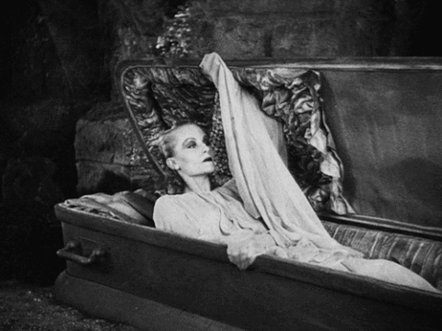

Everlasting life
● For the righteous, Mt 25:46.
● In the age to come, Lk 18:30.
● Through faith in Jesus, Jn 3:15-16.
● Passing from death into life, Jn 5:24.
● Raised to life on the last day, Jn 6:40, 54.
● Will never perish, Jn 10:28.
● The free gift from God, Ro 6:23.
● Promised by God who never lies, Ti1:2.

Slide 13
C. The righteous love 3.16-18

Slide 14
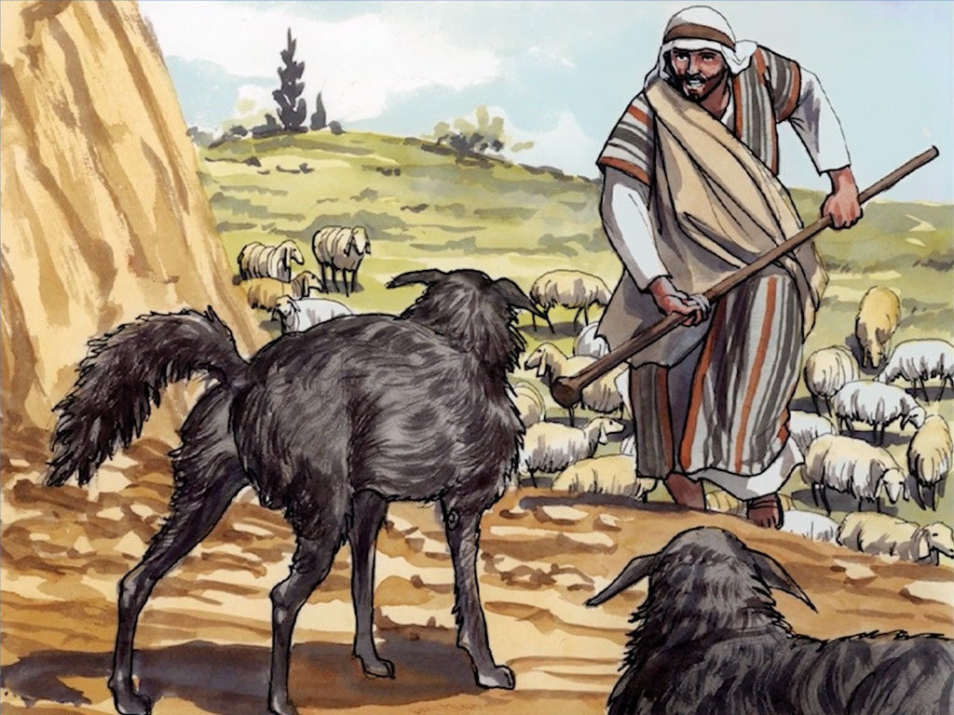

Lay down our lives, 3:16
¹⁶ We know love by this, that He laid down His life for us; and we ought to lay down our lives for the brothers and sisters.
● Lay down life:
(1) Die in order that others may live.
(2) Share goods with others who are in need.
(3) Give time to tell others about Jesus.
(4) Risk being insulted or falsely accused.
Jesus said, “I know the Father; and I lay down my life for the sheep… that I may take it up again.” John 10:15, 17

Slide 15
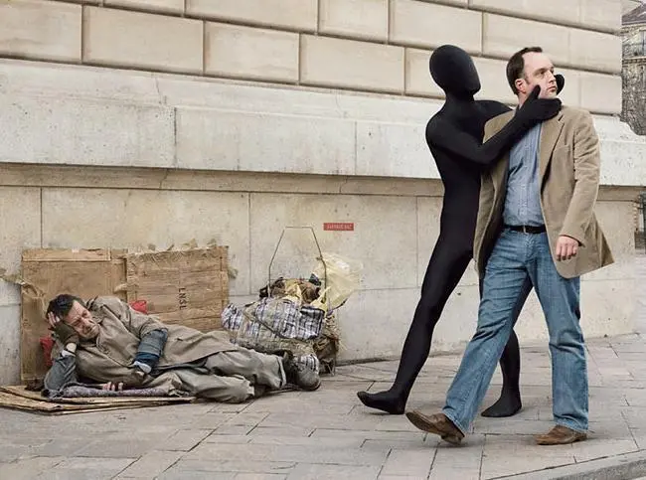

The love of God, 3:17
¹⁷ But whoever has worldly goods and sees his brother or sister in need, and closes his heart against him, how does the love of God remain in him? (NASB, 2020)
● Goods: Things that sustain life.
● Need: Endangered health, safety and life.
● Heart: (1) Bowels, (2) emotions.
● Love of God: His love for us, ours for him, or his kind of love for others?
Jesus taught, “Forgive, and you will be forgiven; give, and it will be given to you. ... For with the measure you use it will be measured back to you.” Luke 6:37-38

Slide 16
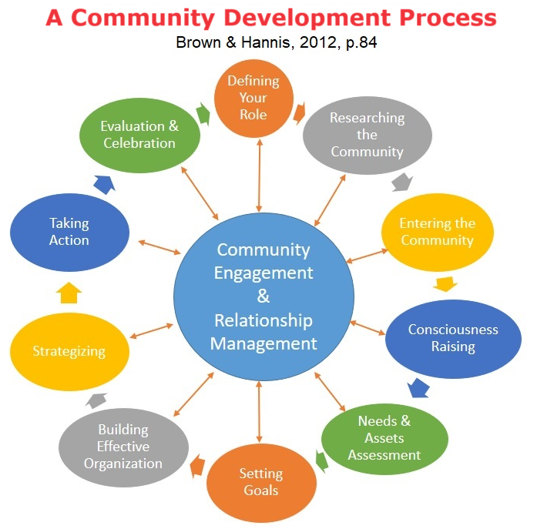
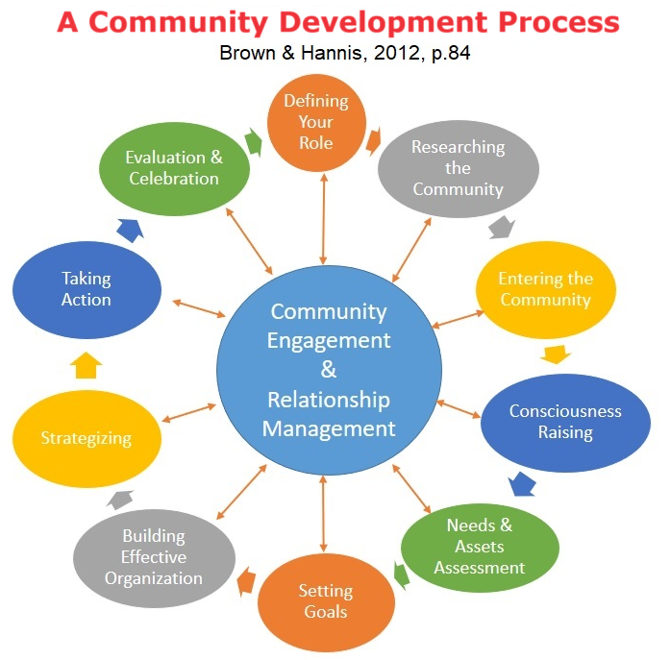
What inputs sustain human life?
● Nutritious food. Agriculture.
● Clean water. Hydrology.
● Secure shelter. Construction.
● Hygiene. Sanitation.
● Community. Security.
● Effective remedies. Health care.
● Life skills. Education.
● Reasons to live and to let live. Faith & hope.
● What more?

Slide 17
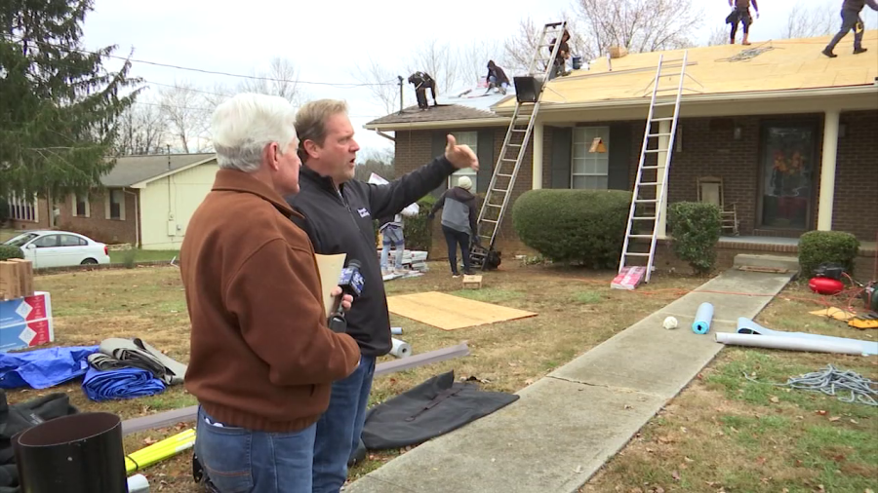
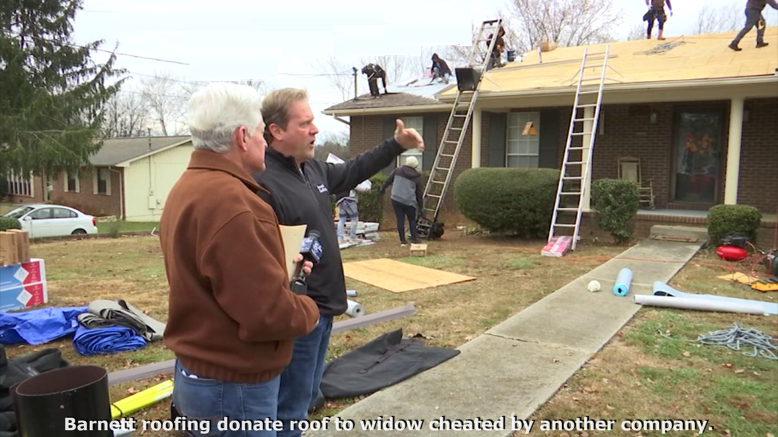
The righteous love, 3:18
¹⁸ Little children, let’s not love with word or with tongue, but in deed and truth. (NASB, 2020)
How could our congregation do more?
(1) Leverage our existing skills.
(2) Take an inventory of members’ skills.
(3) Ask to donate (up to) one day a month.
(4) Start small and grow.
(5) Do everything ‘in Jesus’ name’.
Paul wrote, “Insist on these things, so that those who have believed in God may be careful to devote themselves to good works. These things are excellent and profitable for people.” Titus 3:8

Slide 18
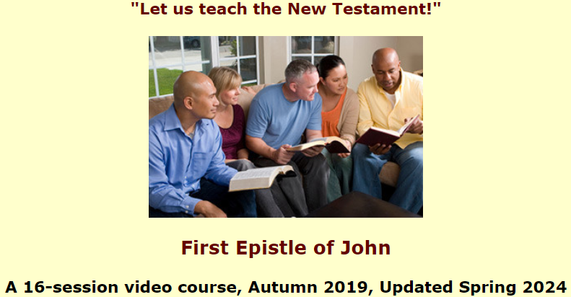
Assignment
● Read 1 John 3:19–4:6 three times in different versions (www.biblehub.com).
● Visit http://1john.currah.download
● Compile your own insights to share with others next time.

