Slide 1


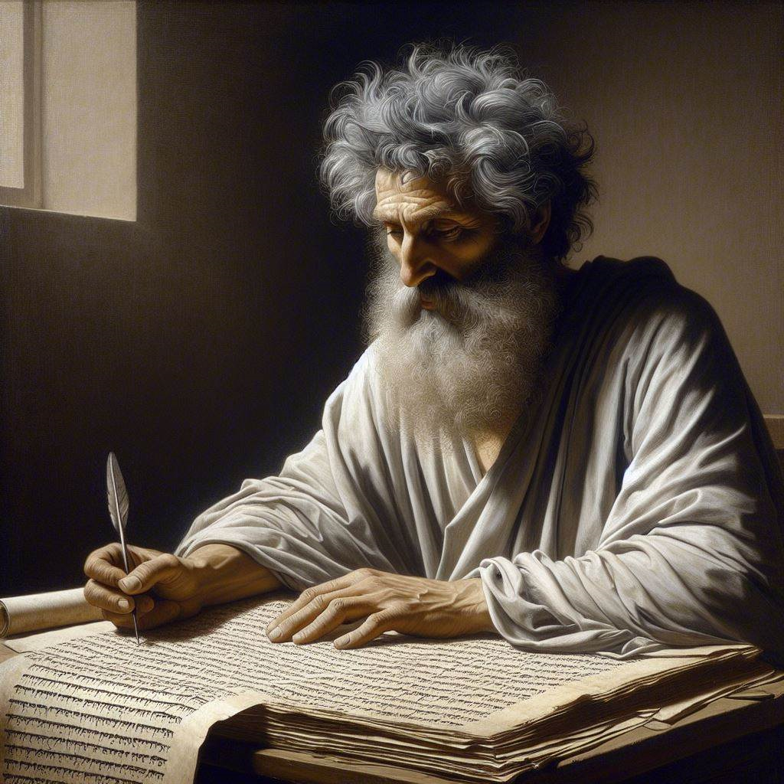
First John 3:19–4:6
‘‘We know that we belong to the truth’
25 & 28 April 2024
Image by Dall-e 3

Slide 2
First John, discourse structure
Part 3: Our Christian Faith 3.19 – 5.5
  VIII. We Have Assurance 3.19-24
  ΙX. We have God’s Spirit 4:1-6
  X. We Have God’s Love 4.7-13
  XI. We Have the Saviour 4.14-21
  XII. We have the Christ 5.1-5

Slide 3
A. We Have Confidence
3.19-24

Slide 4

The troubled heart, 3.19-20
¹⁹ This is how we know that we belong to the truth and how we set our hearts at rest in his presence: ²⁰ If our hearts condemn us, we know that God is greater than our hearts, and he knows everything. (NIV, 2011)
Jesus said, “Let not your hearts be troubled. Believe in God; believe also in me. … My peace I give to you. ... Let not your hearts be troubled, neither let them be afraid.” John 14:1, 27 ESV
● We may believe truth, but we do not own it.
● It is natural to feel shame or guilt,
● because we can hide nothing from God.
● But we calm those feelings with God’s help.

Slide 5
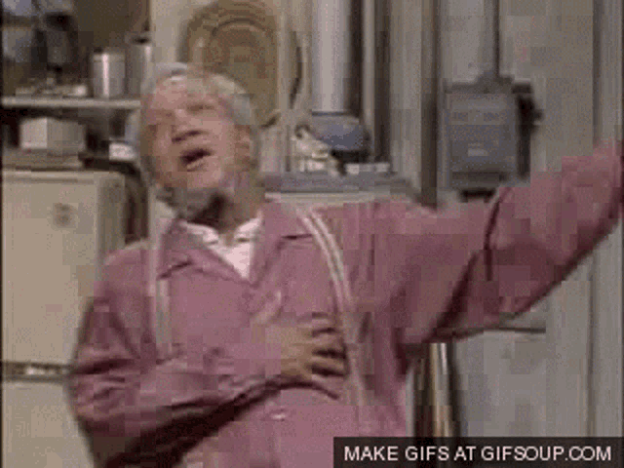
The confident heart, 3.21-22
²¹ Dear friends, if our hearts do not condemn us, [then] we have confidence before God, ²² and receive from him anything we ask, because we keep his commands and do what pleases him.
Jesus promised, “If you love me, you will keep my commandments. And I will ask the Father, and he will give you another Helper, to be with you forever, even the Spirit of truth” John 14:15-17 ESV
For power through prayer:
● Get confidence before God.
● Keep his commands.
● Do what pleases him.

Slide 6
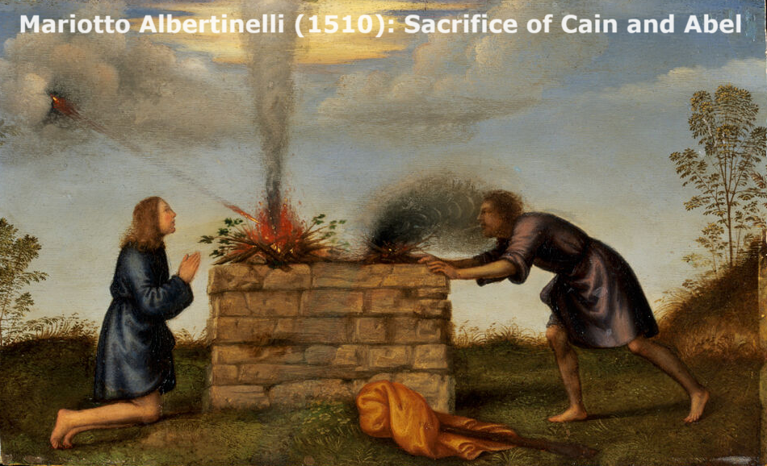
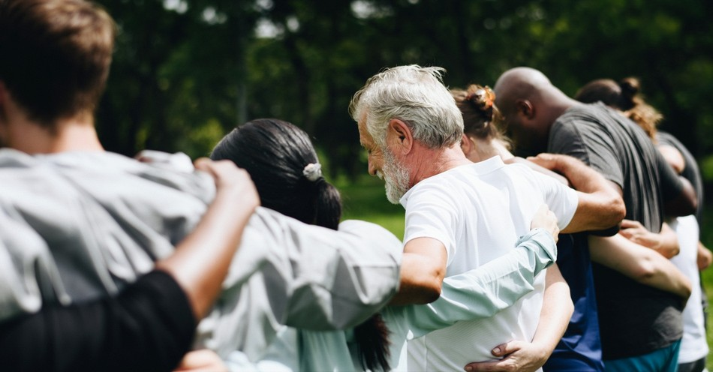
His commandments, 3.23-24a
²³ And this is his command: to believe in the name of his Son, Jesus Christ, and to love one another as he commanded us.
²⁴ The ones who keep God’s commands live in him, and he in them.
Jesus prayed, “This is eternal life, that they know you the only true God, and Jesus Christ whom you have sent.” John 17:3 ESV
● Command: How are two actions really only one command?
● Name:
Son (unique) = Jesus (human) = Christ (king forever).

Slide 7
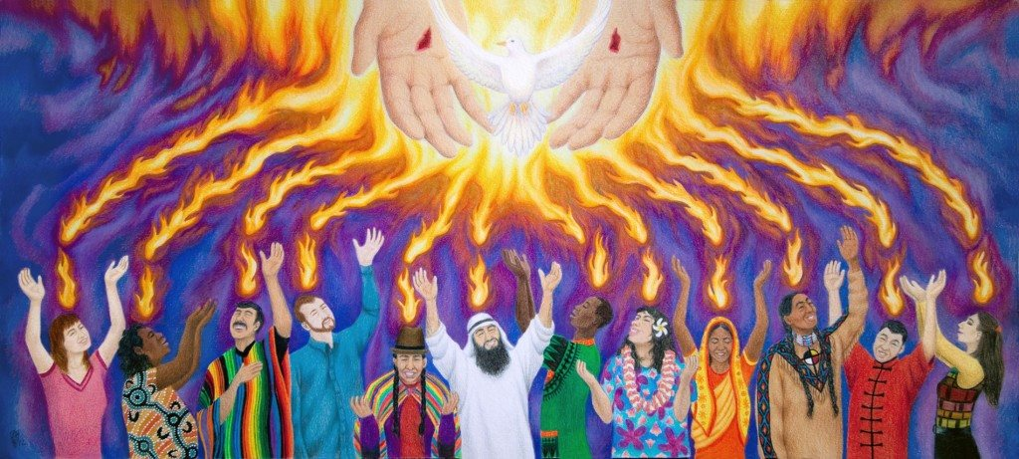
The Spirit whom he gave to us, 3.24b
^{24b} And this is how we know that he lives among us: We know it by the Spirit whom he gave to us.
Jesus promised, “The Spirit of truth…
he dwells with you and will be among you.” John 14:17
● Lives: ~Dwells. Real Presence. He likes us.
● Spirit: What are some ways in which God’s Spirit operates among us?
● Dwells: What are some ways in which our church could experience more of this?

Slide 8
B. We have God’s Spirit
4:1-6

Slide 9
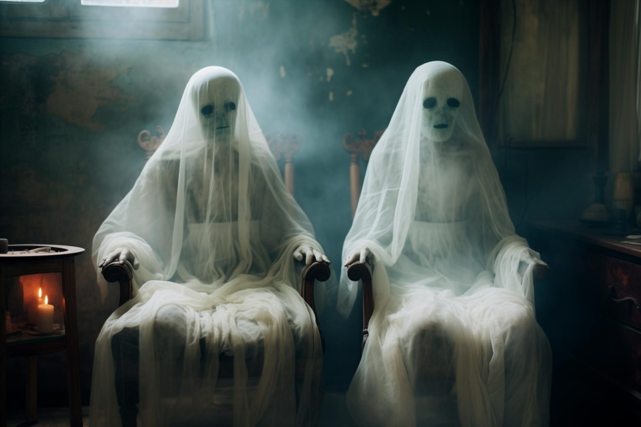

Test the spirits, 4.1
¹ Dear friends, do not believe every spirit, but test the spirits to see whether they are from God, because many false prophets have gone out into the world. (NIV, 2011)
Paul exhorted, “Do not quench
the Spirit. Do not despise prophecies, but test everything; hold fast what is good. Abstain from every form of evil.”
1 Thess. 5:19-21 ESV
● Test: How?
● The spirits: What are these?
● False prophets: Who were and are some of these?

Slide 10
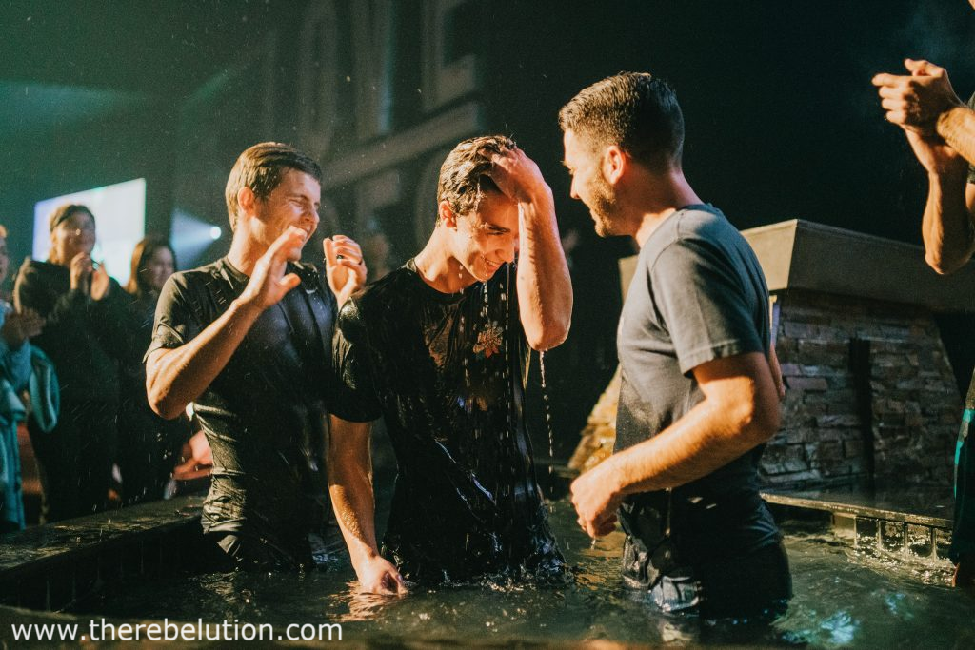

The Spirit of God, 4.2
² This is how you can recognize the Spirit of God: Every spirit that [confesses] that Jesus Christ has come in the flesh is from God, …
● Alternatively: Jesus is Christ come into the world in the flesh.
● Grammar: One confesses what a person is, not only something about that person.
● Logic: To say that Jesus Christ came …
Paul asserted, “no one can say
"Jesus is Lord" except in the Holy Spirit.” 1 Cor. 12:3

Slide 11
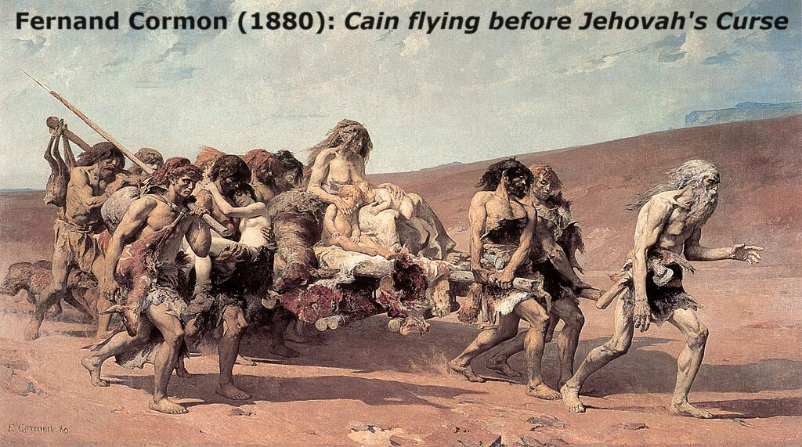
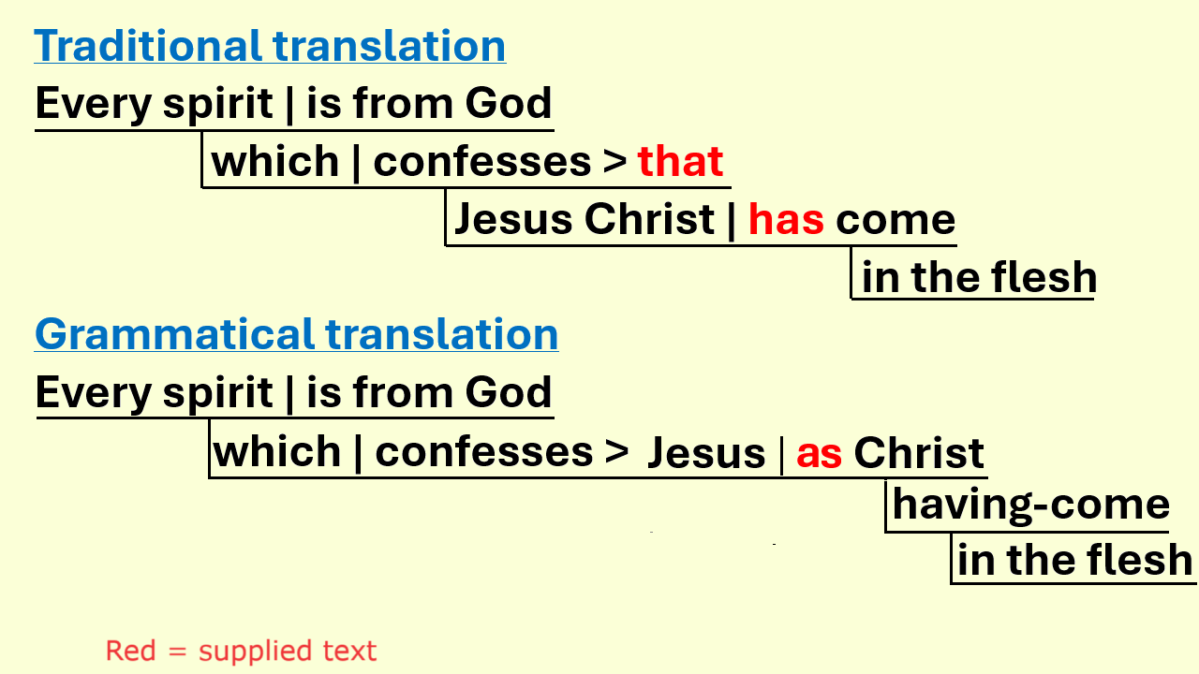
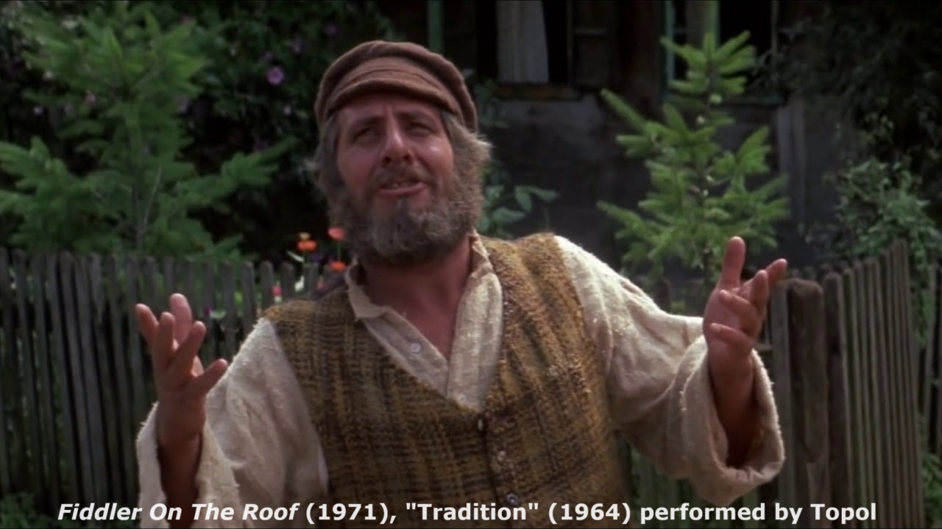

Slide 12
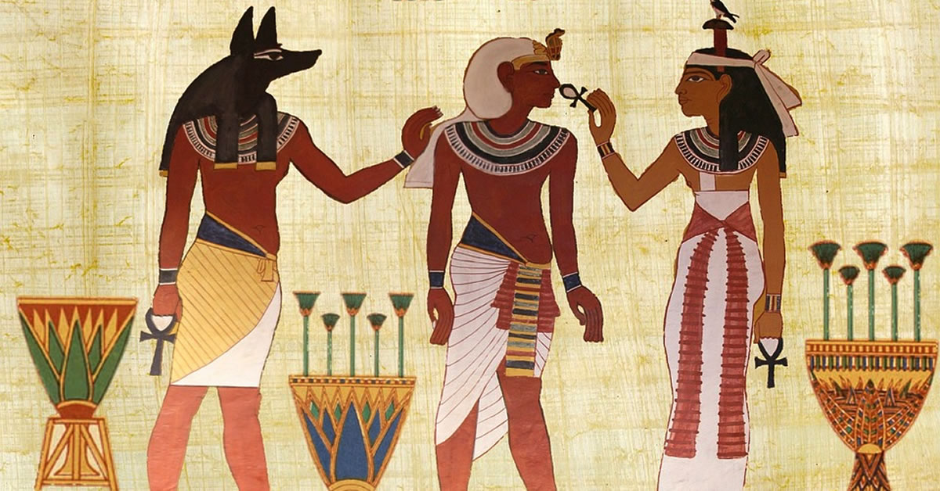
The antichrist, 4:3
³ … but every spirit that does not [confess] [this] Jesus is not from God. This is the spirit of the antichrist, which you have heard is coming and even now is already in the world.
● spirit: prophets, preachers, teachers, their message, and their inspiration.
● Grammar: “the Jesus” ➔ the Jesus who is Christ come in the flesh (verse 2).
Paul warned, “In later times some will depart from the faith by devoting themselves to deceitful spirits and teachings of demons” 1 Tim 4:1

Slide 13
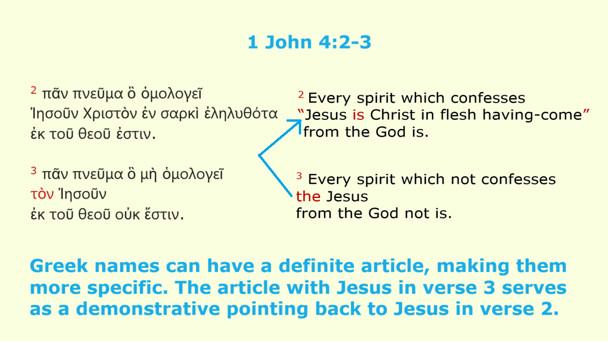

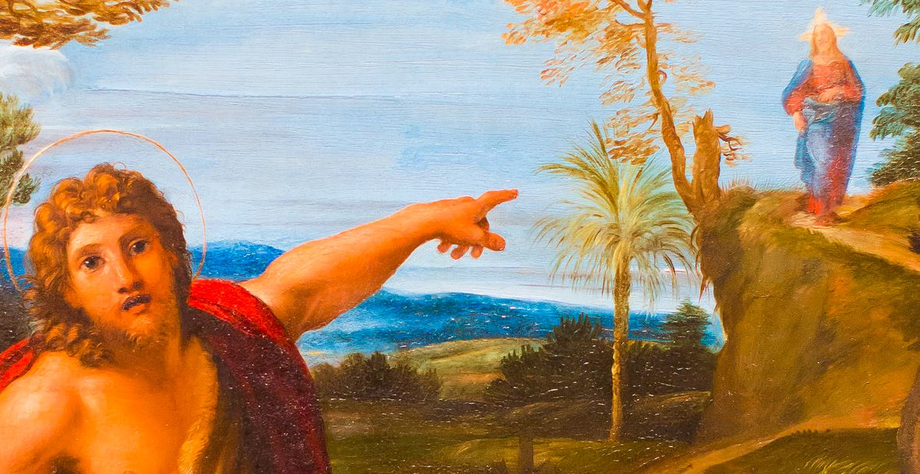

Slide 14
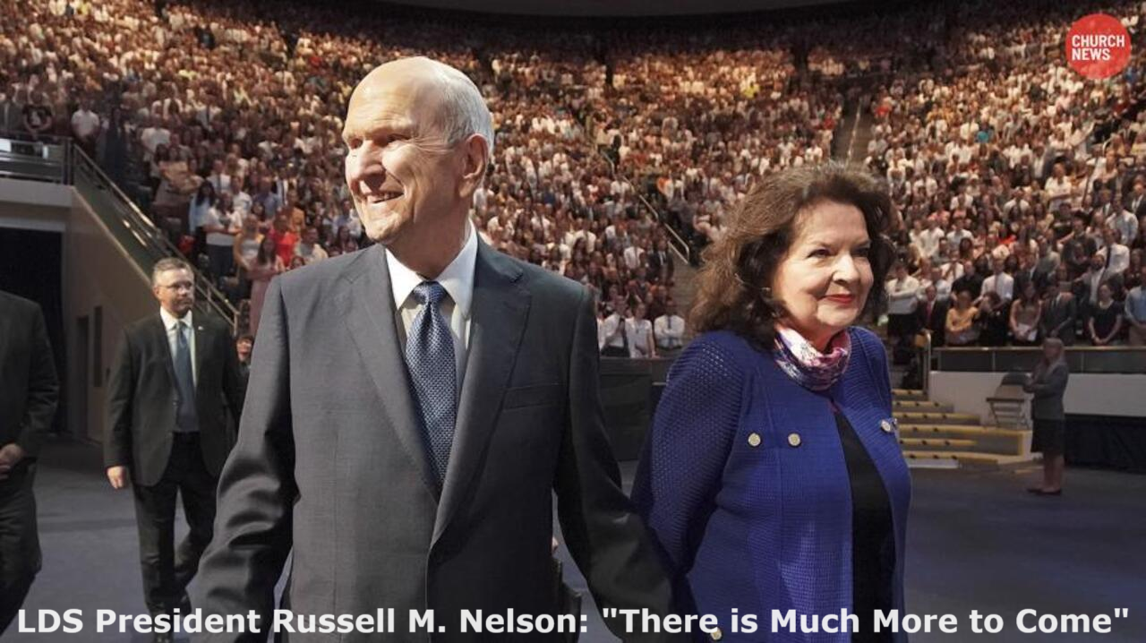

The one who is in you, 4:4-5
⁴ You, dear children, are from God and have overcome them, because the [Spirit] who is in you is greater than the [spirit] who is in the world. ⁵ They are from the world and therefore speak from the viewpoint of the world, and the world listens to them.
Jesus warned, “Many false prophets will arise and lead many astray.” Matthew 24:11
● You: who confess that Jesus is the Christ.
● They: who deny that Jesus is the Christ.
● We: who teach that Jesus is the Christ. 4:6

Slide 15
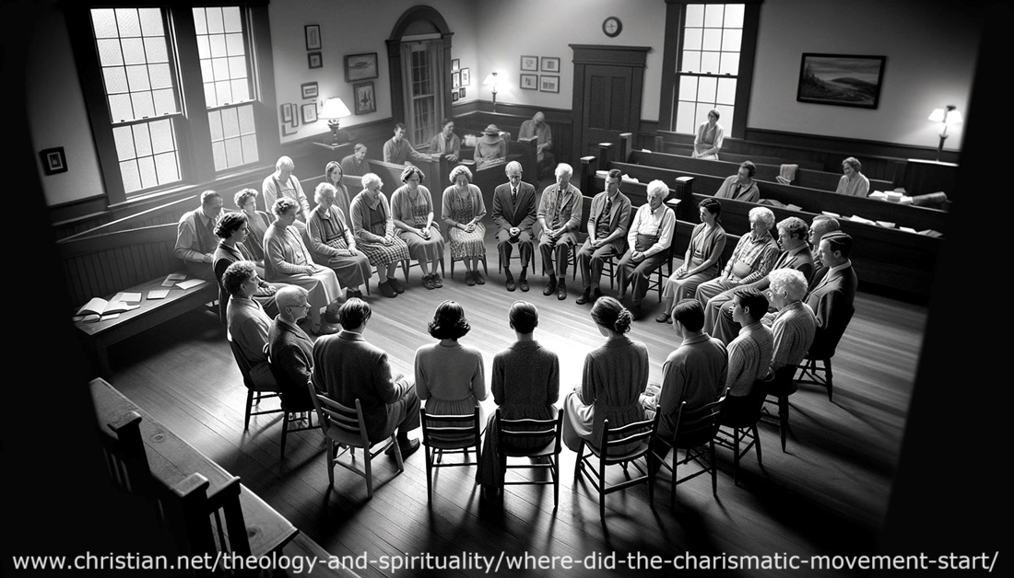

We recognize the Spirit, 4:6
⁶ We are from God, and whoever knows God listens to us; but whoever is not from God does not listen to us. This is how we recognize the Spirit of truth and the spirit of falsehood.
● We: Jesus apostles who lived with Jesus.
● Cerinthius:
Jesus promised, “I will ask the Father, and he will give you another Helper, to be with you forever, even the Spirit of truth.” John 14:16-17
taught that (a) Jesus was only human, (b) received the Christ at baptism, and (c) lost the Christ at his crucifixion.

Slide 16
Is the New Testament Scripture?
1. For Christians, it is the NT that designates the Hebrew Bible as "Scripture".
2. The term "Scripture" implies (a) source= inspiration and (b) result=authority.
3. Scripture came through the prophet Moses.
4. Moses foretold the coming of another “prophet like unto me.”
5. Messiah Yeshua‘ is the prophet like unto Moses (Ac 3:22, not M., not J. Smith).

Slide 17
Is the New Testament Scripture?
6. Yeshua‘ was inspired and his words remains authoritative.
7. Yeshua‘ promised his apostles that the Holy Spirit would remind them of all that he said, and would lead them unto “all truth.”
8. Thus, the apostles’ writings are inspired and authoritative.

Slide 18
Is the New Testament Scripture?
9. The early churches approved only writings that were authored by apostles, were approved by apostles, or contained apostolic teaching.
10. Therefore, each church has a ‘canon’ of inspired, authoritative, New Testament writings that it calls Scripture.

Slide 19
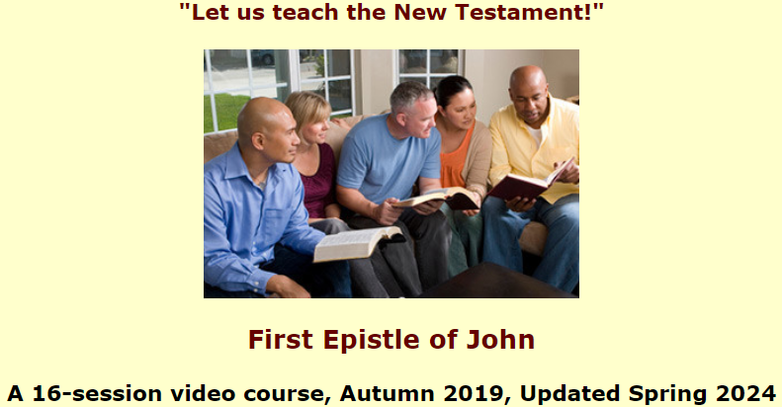
Assignment
● Read 1 John 4:7-12 three times in different versions (www.biblehub.com).
● Visit http://1john.currah.download
● Compile your own insights to share with others next time.

