Slide 1

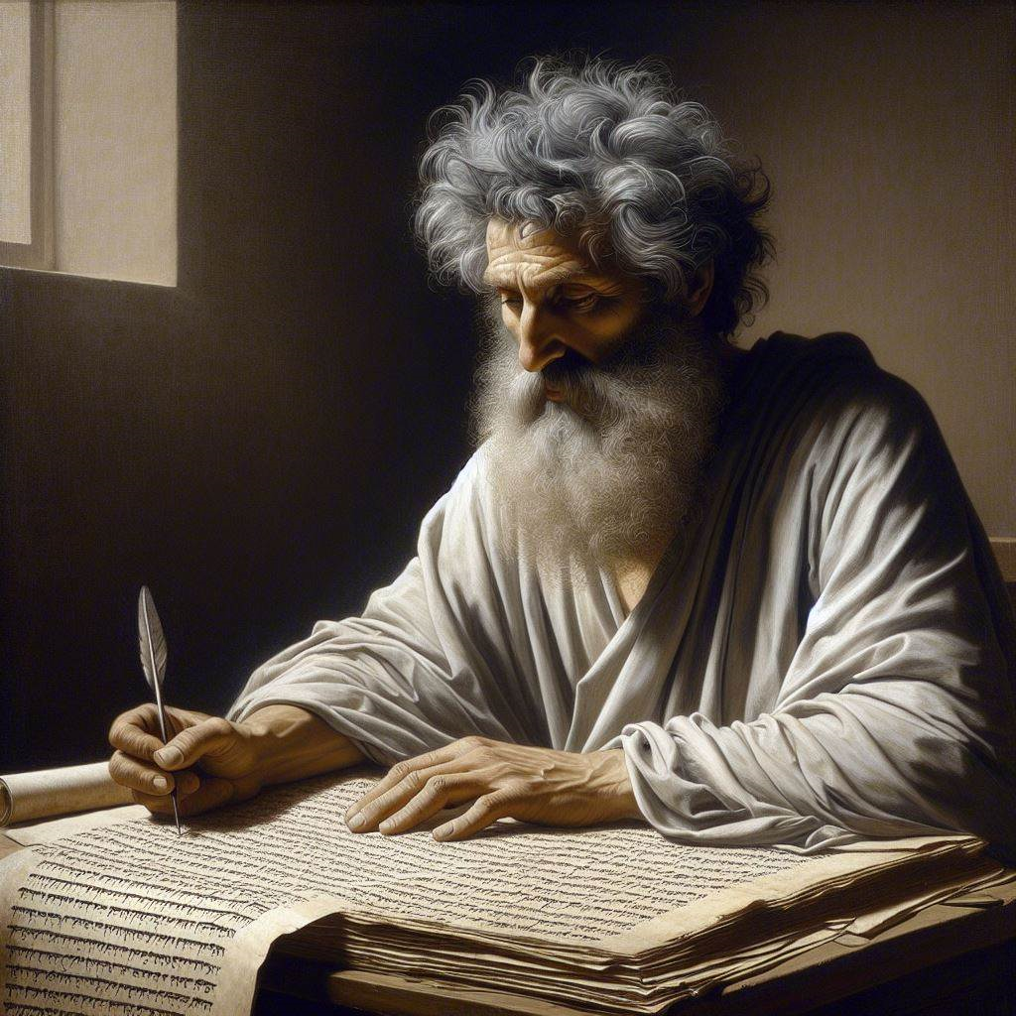
First John 4:7-12
‘‘God resides in us’
02 & 04 May 2024
Image by Dall-e 3

Slide 2
First John, discourse structure
Part 3: Our Christian Faith 3.19 – 5.5
  VIII. We Have Assurance 3.19-24
  ΙX. We have God’s Spirit 4:1-6
  X. We Have God’s Love 4.7-13
  XI. We Have the Saviour 4.14-21
  XII. We have the Christ 5.1-5

Slide 3
Literary chiasm(us)
● A literary device that presents a series
of ideas, and then repeats them in opposite order, found throughout the Bible. Wikipedia
● Repeated words and synonyms reveal inter-woven themes.
● The middle idea is usually the author’s key point.

Slide 4
Kinds of Bible translations
● Dynamic: ‘Brothers and sisters’. NLT
● Literal: ‘Confesses that Jesus Christ has come in the flesh.. NASB
● Scolarly: ‘Confesses Jesus as the Christ who has come in the flesh’. NET
● Stylistic: “Dear friends, …” NIV
● Sectarian: ‘The word was a god’. NWT
● Traditional: ‘Bishops over his church’. AV

Slide 5
1 John 4:7-12, chiasmic structure
^{7a} Dear friends, let us love one another …
^{7b} And everyone who loves has been fathered by God ...
⁸ The person who does not love does not know God …
⁹ By this the love of God is revealed in us …
¹⁰ In this is love: not that we have loved God …
¹¹ Dear friends … we also ought to love one another.
¹² If we love one another, … his love is perfected in us. NET

Slide 6
Group work using the chiasmus
1. Draw a circle around each “God” and “he”.
2. Draw a rectangle around each “love(d)”.
3. Draw a star around each “Son” and “him”.
4. Draw a circle around each “we” and “us”.
5. Underline each thing God does or did for us.
6. Double underline each “not” and each “one another” and “everyone”.

Slide 7
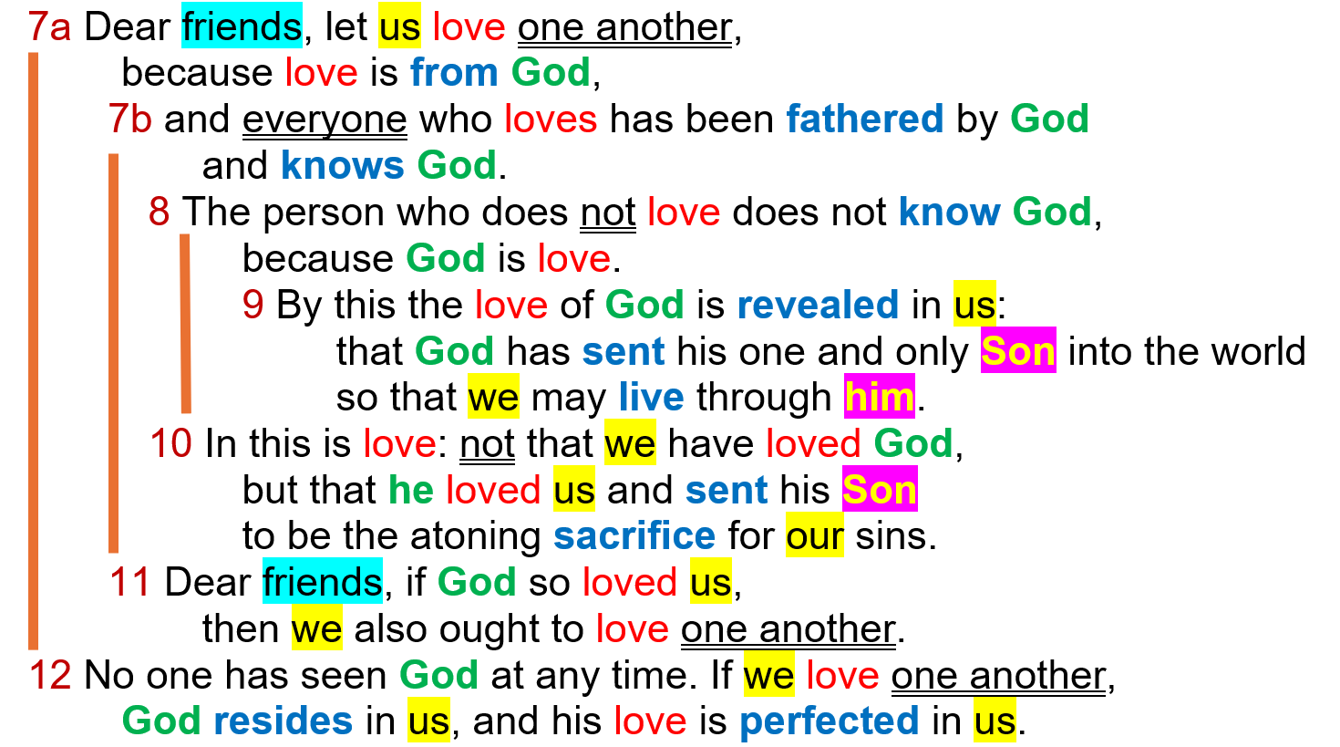

Slide 8
⁹ By this the love of God is revealed in us: that God has sent his one and only Son into the world so that we may live through him.
● “Love of God” = God’s love for us, our love for him, or a godly kind of love?
● “Is revealed” = aorist: a historical event.
● “In us” = ‘amongst us’ or ‘in our case’, not only a personal experience.
● “Us … we” = who?

Slide 9
⁹ By this the love of God is revealed in us: that God has sent his one and only Son into the world so that we may live through him.
● “Only” = monogené (one kind), not to be confused with monogennés (only begotten).
● “Son” = the promised Messiah. How do we know this?
● “Sent … live” = aorist verbs, the one historical, the other a general truth.

Slide 10
^{7a} Dear friends, let us love one another, because love is from God, …
● “Dear friends” = ‘beloved’. By whom?
● “Let us love” = continuous present tense. What is the point?
● “One another” = Who are included?
● “Love from God” = What does real love do?

Slide 11
¹² No one has seen God at any time. If we love one another, God resides in us, and his love is perfected in us.
● “No one has seen” = ‘No one ever saw’. Past perfect verb.
● 1st “God” = emphatic position. No ‘the’ = the divine nature.
2nd “God” = ‘the/that God’.

Slide 12
¹² No one has seen God at any time. If we love one another, God resides in us, and his love is perfected in us.
● “If” = 2nd class condition. May or may not be fulfilled.
● “We love … resides” = present continuous.
● “Perfected” = past perfect passive

Slide 13
^{7b} and everyone who loves {God} has been fathered by God and knows God.
● {God} = inserted in one 5th century manuscript.
● “Who loves” = continuous present tense. Whom?
● “Has been fathered” = ‘past perfect’ event with lasting effect.

Slide 14
¹¹ Dear friends, if God so loved us, then we also ought to love one another.
● “If” = 1st class condition. “Since…
● “Also” = Who else?
● “Beloved … we …us … one another”
= Who? Whom?

Slide 15
¹⁰ In this is {God’s} love: not that we {have} loved God, but that he loved us and sent his Son to be the atoning sacrifice for our sins.
● {God’s} = one 5th century manuscript and some later ones.
● “We … he” = emphatic pronouns.
● “We have loved” = past perfect tense.

Slide 16
¹⁰ In this is {God’s} love: not that we {have} loved God, but that he loved us and sent his Son to be the atoning sacrifice for our sins..
● {Have} = most manuscripts. ‘We loved’ in two 5th cent. mss and later ones. ‘He loved’ in one 5th cent. ms.
● “Loved … sent” = aorist verbs. Meaning what?

Slide 17
¹⁰ In this is {God’s} love: not that we {have} loved God, but that he loved us and sent his Son to be the atoning sacrifice for our sins.
● “Atoning sacrifice” = hisasmos: propitiation, satisfaction: God’s holiness is satisfied with/by Jesus.
● What other terms for Jesus’ sacrifice have we studied in previous lessons?
● “In us” = ‘among us’ or ‘in our case’, not only a personal experience.

Slide 18

Assignment
● Read 1 John–4:13-21 three times in different versions (www.biblehub.com).
● Visit http://1john.currah.download
● Compile your own insights to share with others next time.

