Slide 1

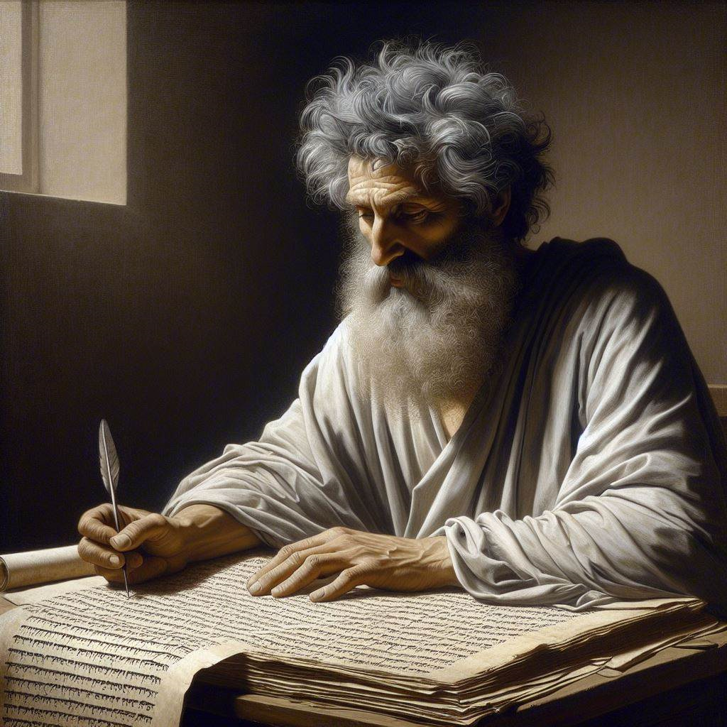
First Epistle of John
‘Concerning the Word of Life’
March–June 2024
Image by Dall-e 3

Slide 2

First John, Preview
● Projected text read aloud
● Discussion format
● Historical background
● Logical outline
● Theological summaries
● Online video previews
http://1john.currah.download

Slide 3
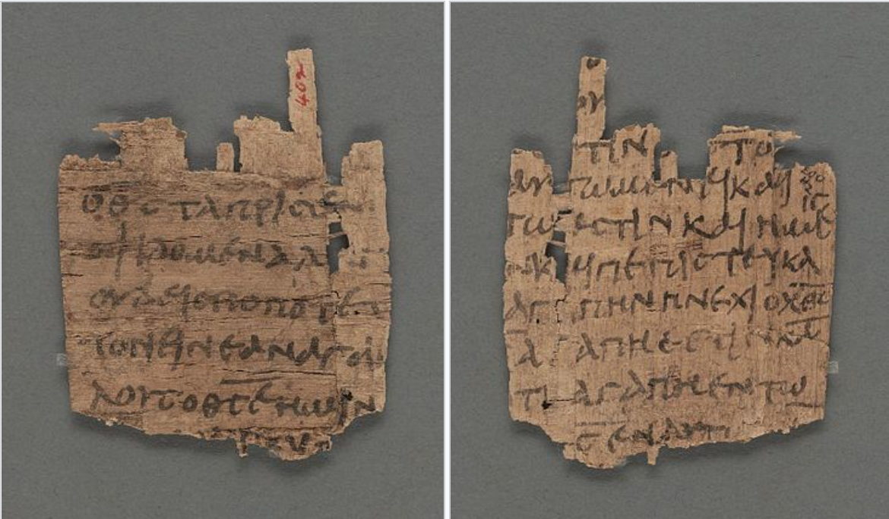
Greek Papyrus 9
3rd century (200s)
... the Savior of the world. If anyone confesses that Jesus is the Son of God, God abides in him, and he in God. And we have come to know and believe the love that God has for us. God is love; whoever abides in love abides in God, and God in him. In this way... 4:14-17
… if God so loved us, we also ought to love one another. No one has ever seen God; but if we love one another, God remains in us…
4:11-12
Recto (front)
Verso (back)

Slide 4

First John, discourse structure
Part 1: Our Fellowship with God 1.1 – 2.17
Part 2: Our Adversaries 2.18 – 3.18
Part 3: Our Christian Faith 3.19 – 5.5
Part 4: Our Confidence with God 5.6-21

