Slide 1
The Life of Christ in Stereo

Slide 2
Session 1: Chapters 1 and 2
● Please, read or listen to the assigned chapters before you proceed.
● You may do so in the book, with the Android app, or on the web site.
● Download the app and view resources at:
http://locis.site

Slide 3
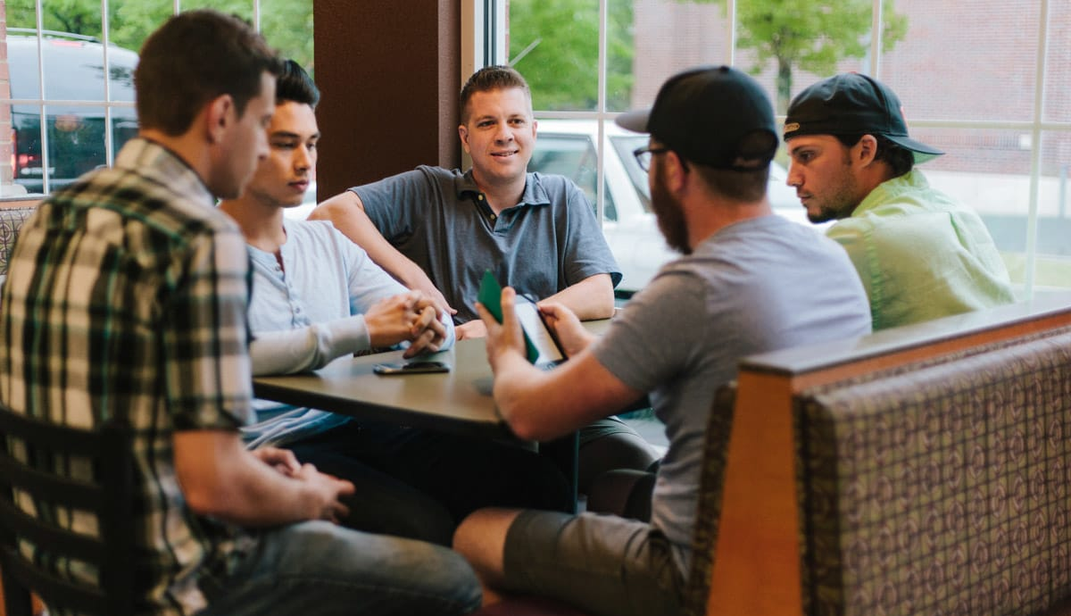
What did you learn?
● If you are in a group, then allow each one to tell one important idea which they learned from their reading.
● If there is enough time, then anyone may tell a second idea, after the others have told their first idea.
● They may also reply to each other’s queries and objections.

Slide 4
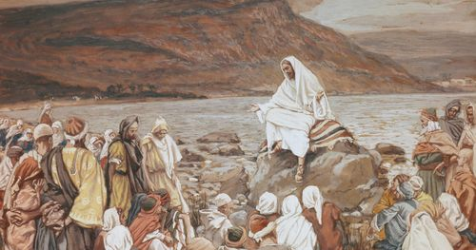
What did Jesus say?
From the passage which they read for today’s session, let each one tell one thing that Jesus said:
● A teaching: something to believe.
● A promise: something to receive.
● A command: something to obey.
● A warning: something to avoid.
Afterwards, they may tell another thing.

Slide 5
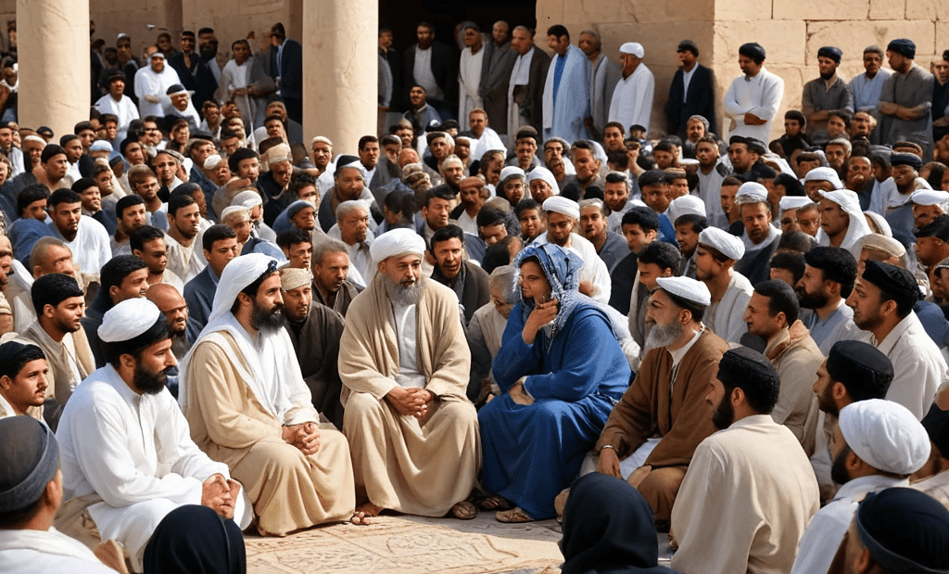
Understand Jesus’ teaching
● Most people understood his teaching.
● If not, then he told them the meaning.
● Jesus had four audiences: (a) leaders, (b) crowds, (c) disciples, (d) apostles.
● Jesus often answered current issues.
● He was proving himself the Messiah.
● He often warned about the Roman invasion of AD 70 and afterwards.

Slide 6
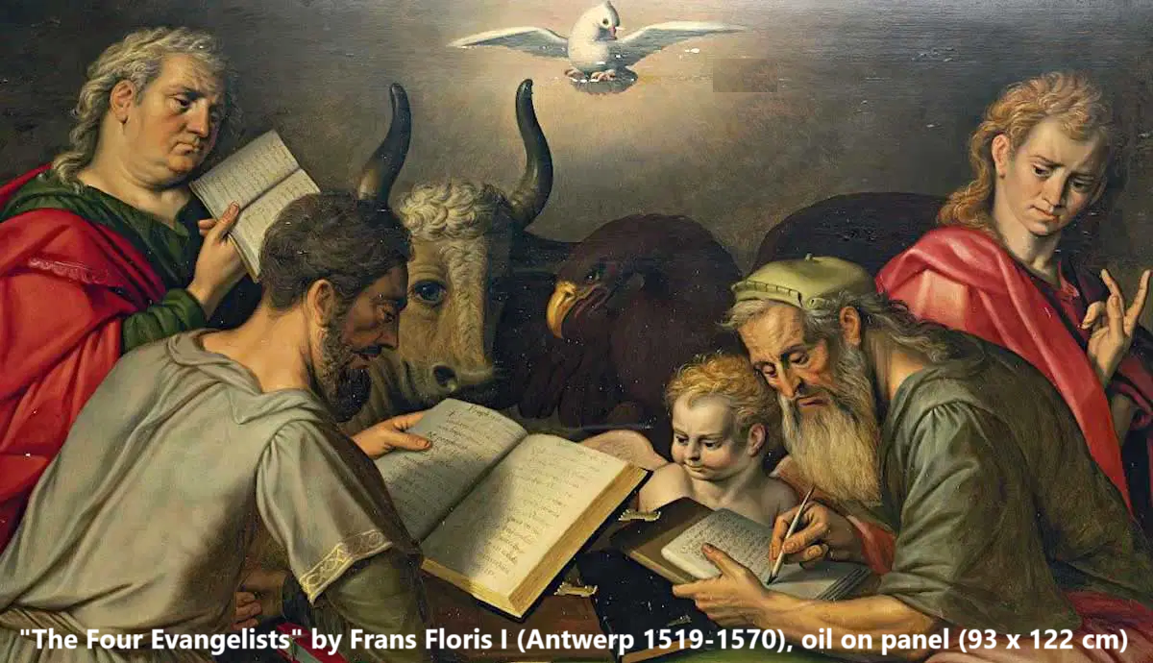
Traditional Gospel distinctives
● Matthew: Jesus = the Son of David
● Mark: Jesus = the Lord’s Servant
● Luke: Jesus = the Son of Man
● John: Jesus = the Son of God
● Matthew: Written for Judeans
● Mark: Written for Romans
● Luke: Written for Greeks & Hellenists
● John: Written for all

Slide 8
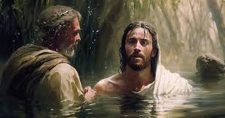
Chronologies of Jesus ministry
● Two-year: AD 28–29
● Three-year: AD 27–29
● Four-year: AD 27–30
● LOCIS: Spring AD 29 – Spring AD 33. See Cheney, Appendix IV, pp 226-236. (There was an eclipse during Passover in AD 33.)

Slide 9
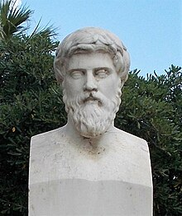
Differences in the Gospels
“The [Gospel] writers used the same compositional devices as the biographer Plutarch [AD 46–119] employed when he reworked the same material in more than one of his biographies.” R. Bauckmam in Why are there Differences in the Gospels by M.R. Licona, Oxford, 2017.
Plutarch, Greek biographer, AD 46–119

Slide 10
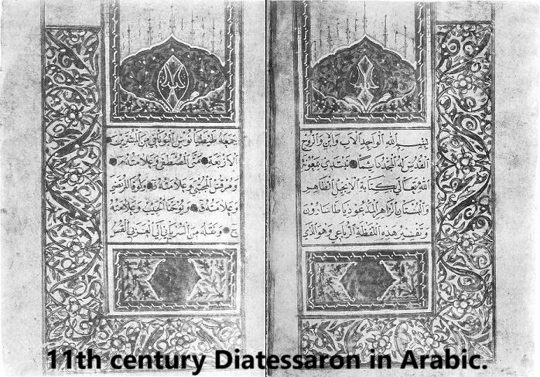
Other blended versions
● Tatian combined the Gospels in his Diatessaron* in the Syriac language, between AD 160 and 175. Others translated this into different languages, notably Armenian and Arabic. (*‘Through Four’.)
● Most modern ‘harmonies’ consist in four parallel columns.

Slide 11
Intro, #2, The ‘Logos’ (John 1)
¹ In the beginning was the Word, and the Word was with God, and the Word was God. …
¹⁴ And the Word became flesh and dwelt among us, and we have seen his glory, glory as of the only Son from the Father…

Slide 12
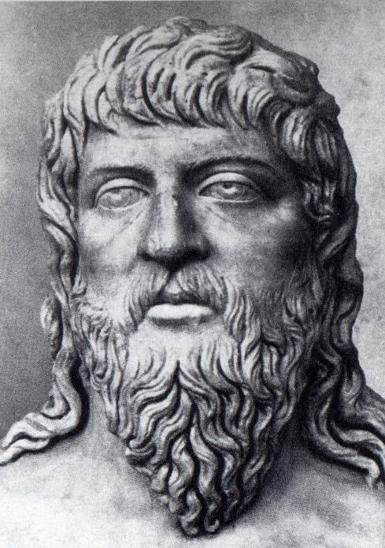
Heraclitus (6th century BCE)
● The Logos (Word) was a symbol of divine reason that ordered the universe and was accessible to those who listened to it.
● The Stoics later viewed the Logos as a universal principle that permeated the cosmos, giving it order and meaning.

Slide 13
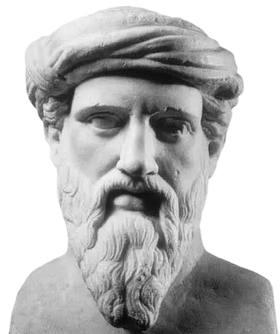
Philo of Alexandra (c. 20 BC–AD 50)
● The Logos (Word) is an intermediary between God and the cosmos, serving as both the agent of creation and the means through which humans can understand God.
● The Logos is the Angel of the LORD, acting as mediator between humans and God.

Slide 14
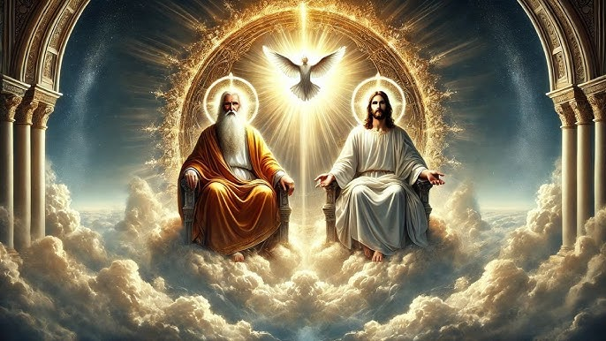
Two Yahwehs in the OT?
“Thrones were placed… The Ancient … took his seat… One like a son of man came… before him. To him was given dominion and glory…” Daniel 7:9-14
“They saw the God of Israel. There was under his feet … a pavement of sapphire stone.” Exodus 24:10

Slide 15
Two Yahwehs in the OT?
“I send an angel before you… Obey his voice… for my name is in him Exodus 23:30-31
“The angel of the LORD … said, ‘I will never break my covenant with you’.” Judges 2:1

Slide 16
New World mistranslation, John 1
ὁ λόγος ἦν πρὸς τὸν θεόν, καὶ θεὸς ἦν ὁ λόγος.
“the Logos was with the God, and God was the Logos.” GJC
“the Word was with God, and the Word was a god.” NWT
“the Word was with God, and the Word was God.” ESV

Slide 17
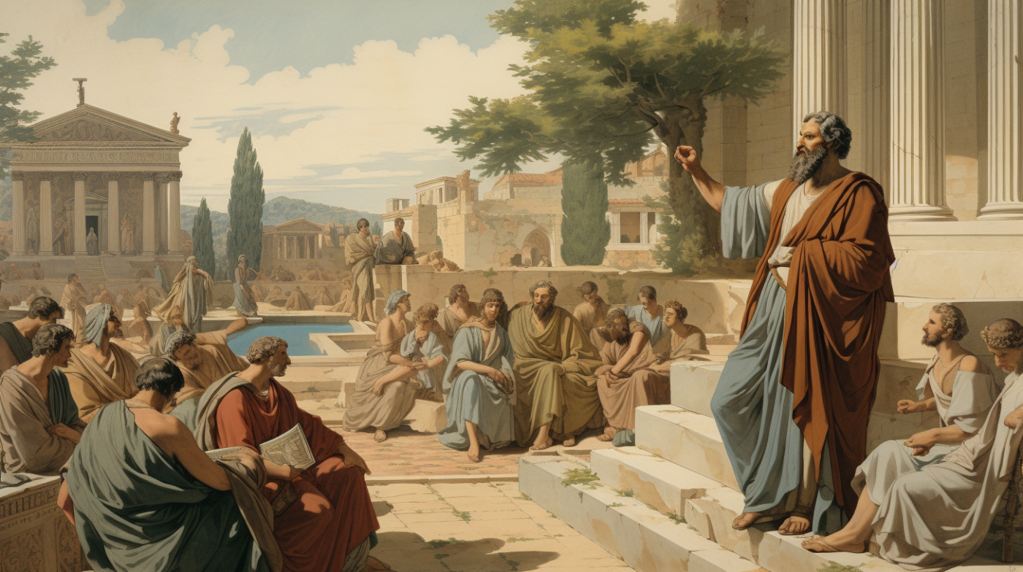
Greek grammar rule
In a declarative sentence where one noun is defined by another with a verb of being (to be, to become, etc.), the subject noun may have a definite article ‘the’ and the predicate noun does not.
● “The Word was God.” Jn 1:1
● “The Word became flesh.” Jn 1:14

Slide 18
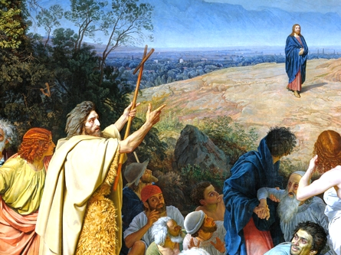
Part I, Chapter 1, # 5 (Lk 1:16-17)
Many of the children of Israel will he (John) turn to the Lord their God. And he will go before him in the spirit and power of Elijah, to ‘turn the heart of the fathers to the children’ [Mal 3:6], and the disobedient to the wisdom of the righteous, to prepare for the Lord a people made ready for him [Isa 40:3-5].

Slide 19
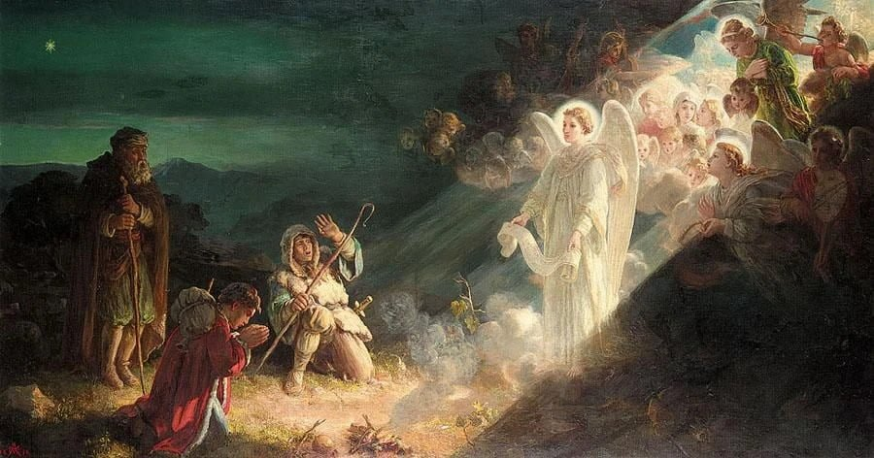
Chapter 2, #10 (Lk 2:9-12)
An angel of the Lord stood beside them, and the glory of the Lord shone round about them… “Unto you is born this day a Savior, who is Christ the Lord, born in the city of David! And this will be the sign for you: you will find a babe, wrapped in swaddling clothes, lying in a manger.”

Slide 20
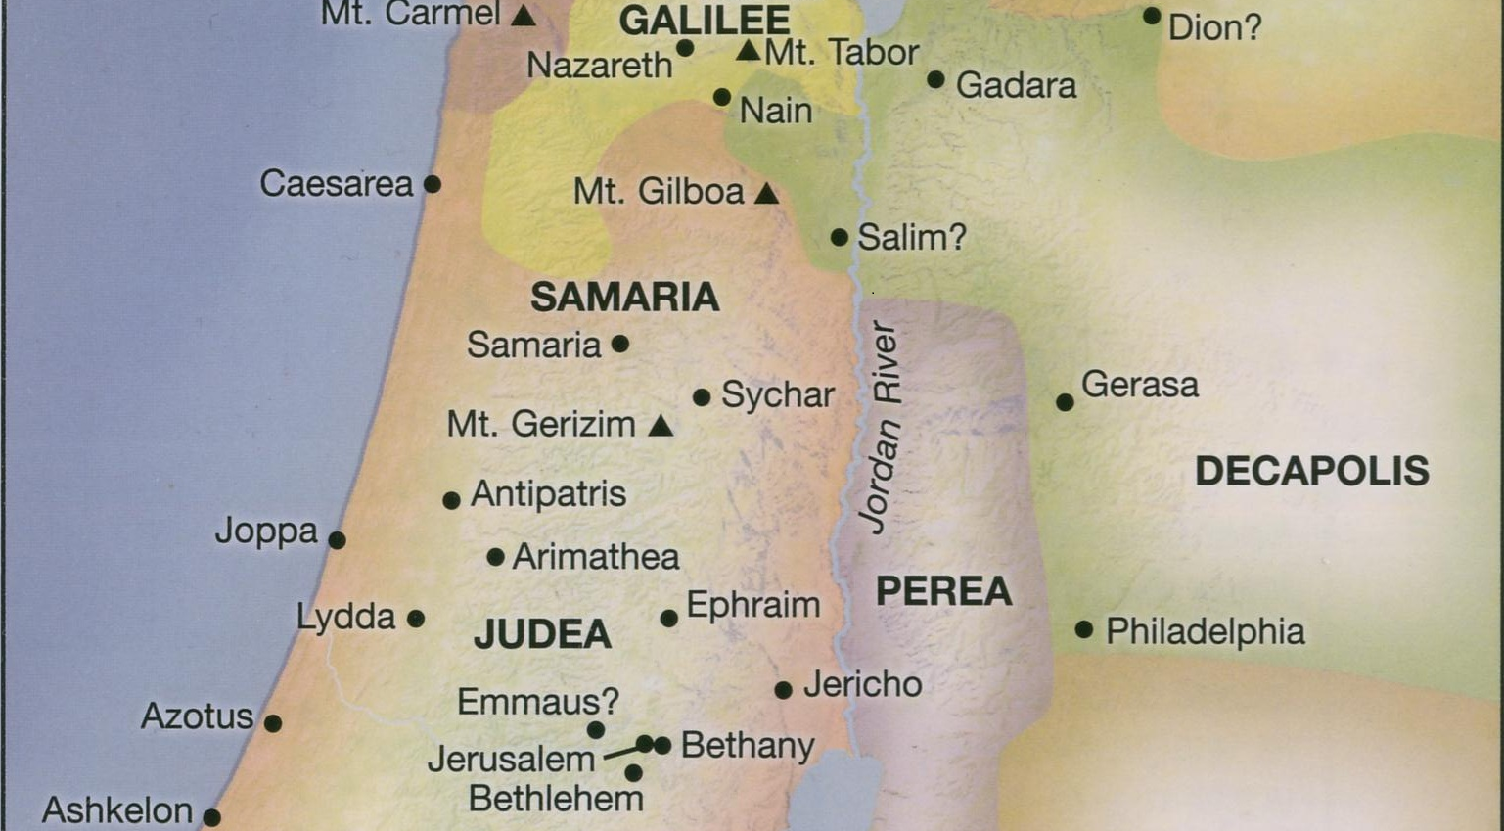
Life of Jesus Timeline Rose Publishing, 2020

Slide 21
“A Savior who is Christ the Lord”
σωτὴρ ὅς ἐστιν χριστὸς κύριος
savior who is chist lord
● No definite articles ‘the’.
● If proper Greek, then ‘who’ = subject, ‘is’ = verb, ‘christ’ & ‘lord’ = predicate nouns meaning “the Christ, the Lord”.
● Whose Lord? Rom 16:18; Col 3:24

Slide 22
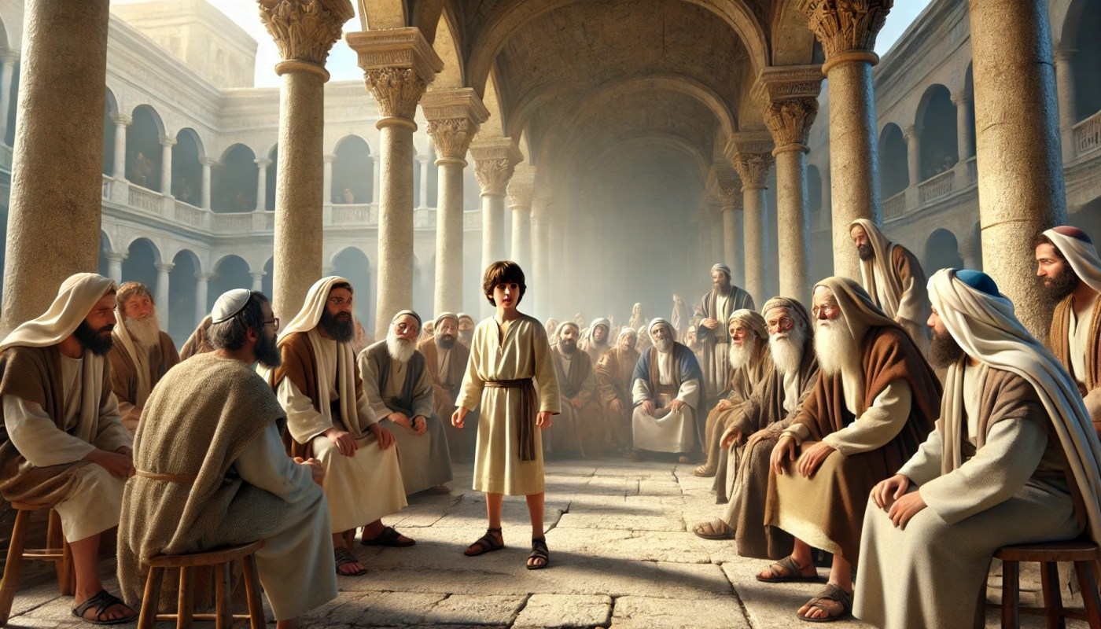
Chapter 2, #13 (Lk 2:40) Age 1
The young child grew and became strong, filled with wisdom; and God’s favor rested upon him.
Chapter 2, #14 (Lk 2:51-52) Age 12
He … was subject to them. And his mother treasured all these matters in her heart. And Jesus increased in wisdom and stature, and in favor with God and men.

Slide 23
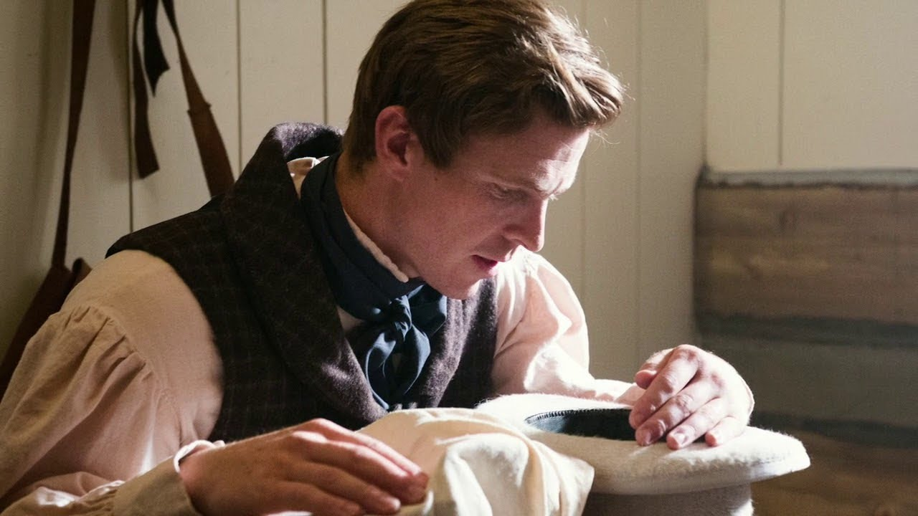
Christianity’s origins
● Contemplation and intuition?
● Ancient myths and legends?
● Spirit messages, dreams and visions?
● Nature gods and annual calendars?
● Magic, mysteries and miracles?
Jesus
● Fulfilled Scriptural types & predictions.
● Demonstrated divine power.

Slide 24
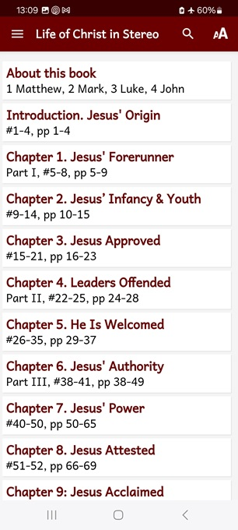
Assignment
● Visit LOCIS.site
● Read or listen to chapters 3 and 4, sections 15 to 25.
● Be ready to share your insights, queries and objections.

Slide 25
Title
¹ Verse
● Text

