Slide 1
The Life of Christ in Stereo

Slide 2
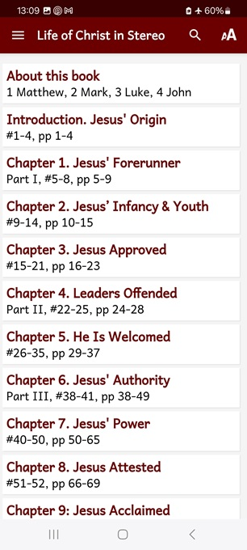
Session 3: Chapter5, ##26–35
● What did you learn that was helpful?
● What did you read that was important?
● What questions do you have about what you read?

Slide 3
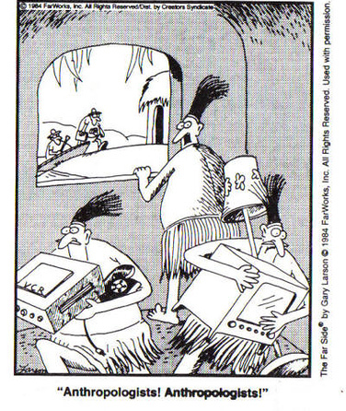
Requirements of scientific history
Ethnographers and biographers must record and report: ● Span (times, dates, periods, eras).
● Space (places, regions, countries).
● Society (individuals, groups, ethnies).
● Sources (persons, documents, evidence, deductions).

Slide 4
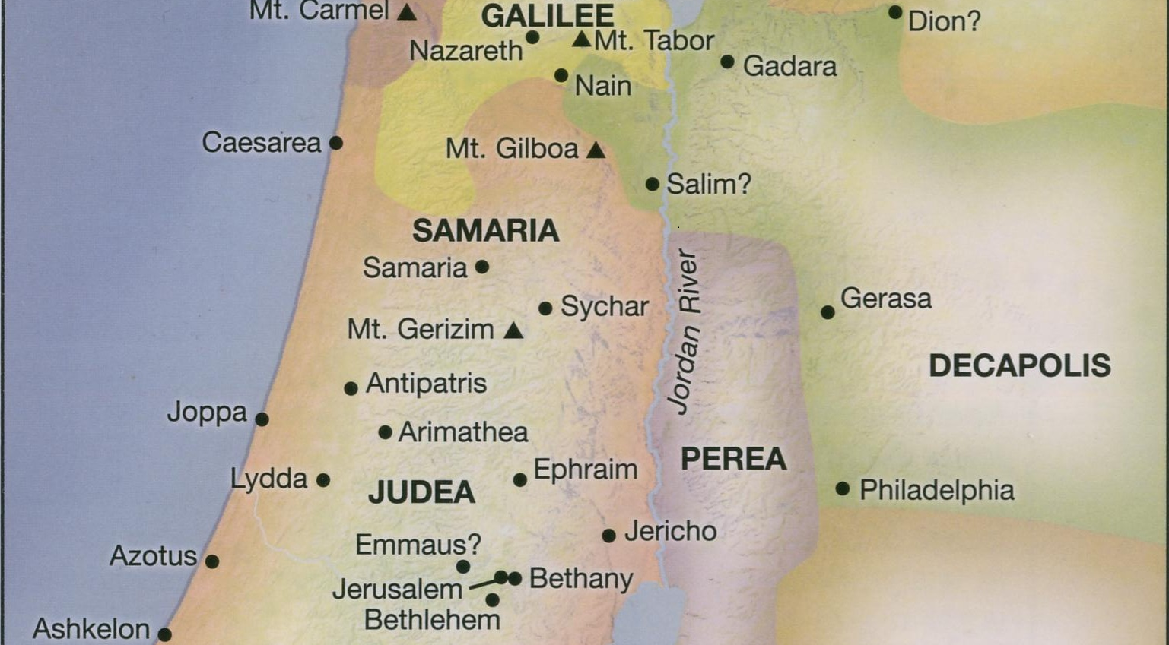
Life of Jesus Timeline Rose Publishing, 2020

Slide 5
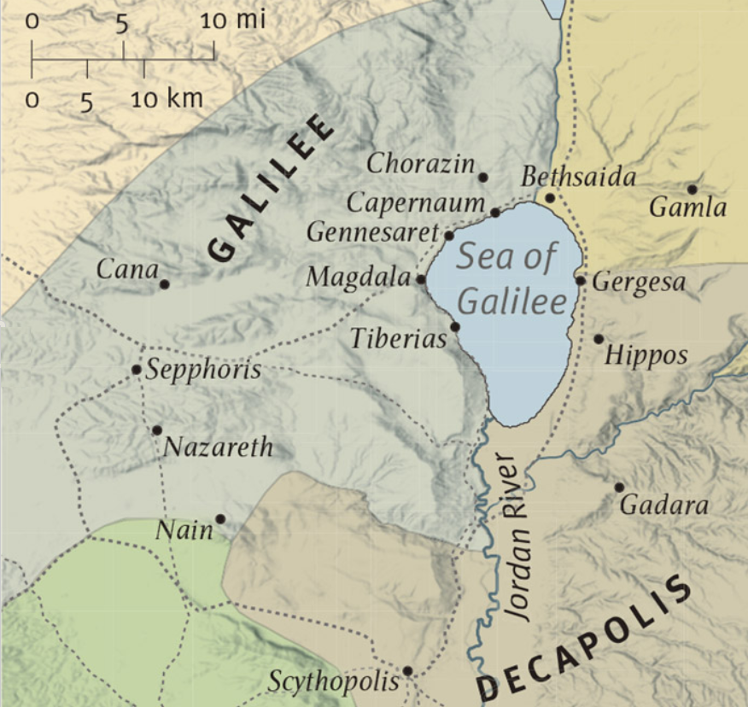
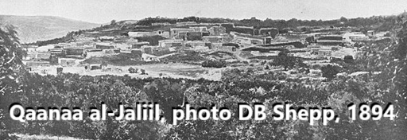
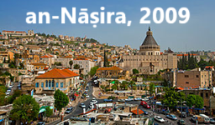
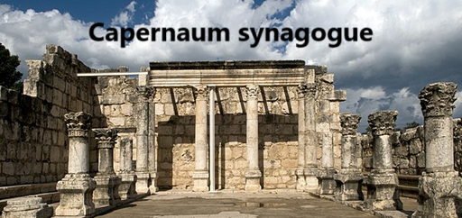
Bible Maps, Rose Publishing, 2008

Slide 6
#26, “Unless you see signs”
Now there was a certain court officer in Capernaum whose son was sick. When he heard that Jesus had come from Judea into Galilee, he journeyed to him and besought him to come down and restore his son, for he was about to die.
● Court official: Under Herod Antipas, who was Tetrarch from 1 BC till AD 39.

Slide 7
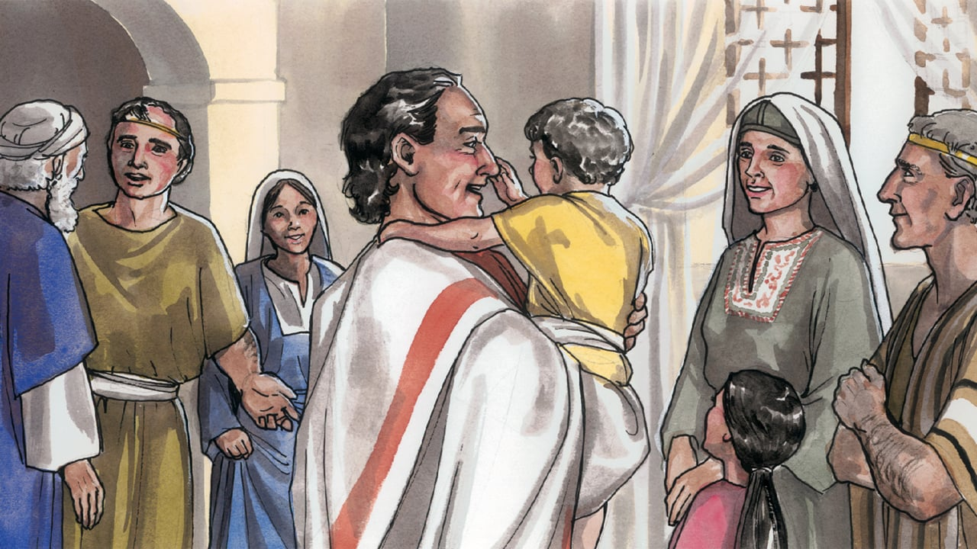
#26, “Unless you see signs”
Jesus said therefore to him, “Unless you people see miraculous signs and wonders, you will not at all believe.” The court officer said to him, “Sir, do come down before my child dies!” Jesus said to him, “Go — your son is living.”
● Hendiadys: ‘Signs and wonders’ = wonderous signs = miracles.

Slide 8
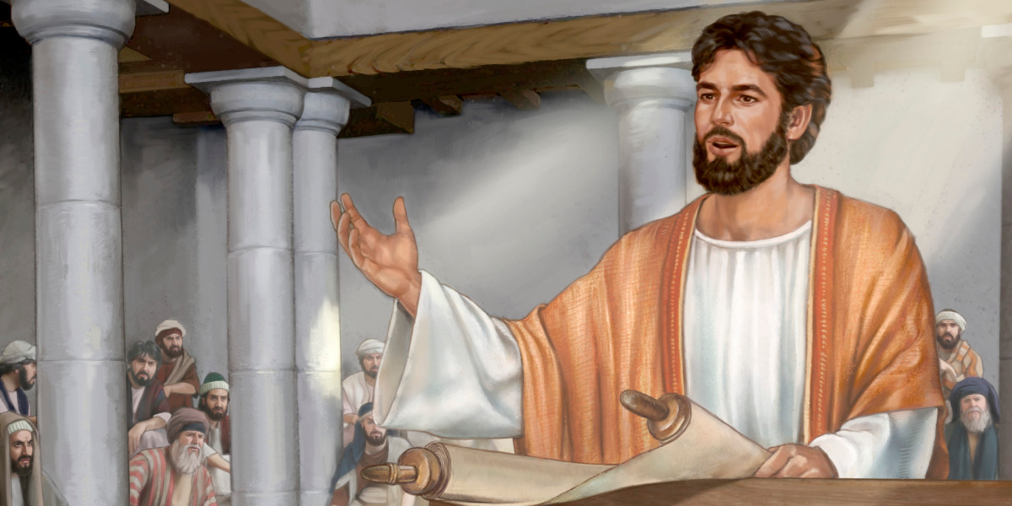
#27, “this scripture is fulfilled”
Then came he to Nazareth, where he had been brought up… He went into the synagogue on the Sabbath. And he stood up to read, … the prophet Isaiah; and when he had unrolled the scroll, he found the place where it was written: …
● Synagogue: Read, discuss, and teach the Older Testament Scriptures.

Slide 9
#27, “this scripture is fulfilled”
“The Spirit of the Lord is upon me:
because of this he has anointed me
To publish glad news to the lowly has he sent me, to restore those broken in heart:
to proclaim deliverance to the captives,
and recovery of sight to the blind …
● Anointed: Greek verb form of ‘Christ’, translated from Hebrew ‘Messiah’.

Slide 10
#27, “this scripture is fulfilled”
And he began to speak to them: “Today has this scripture been fulfilled — in the things of which you have heard... Verily I say to you, that no prophet is
acceptable in his home town.”
They rose up and thrust him out of the city… But he … went his way.
● Heard: Miracles done in other towns.

Slide 11
# 28, “Repent and believe!”
And leaving Nazareth, he went down and dwelt at Capernaum… From that time Jesus began to preach, …
“The time is fulfilled, and the Kingdom of God has drawn near. Repent, and believe the Glad News! For the Kingdom of heaven is at hand.”
● At hand: Offered to Israel.

Slide 13
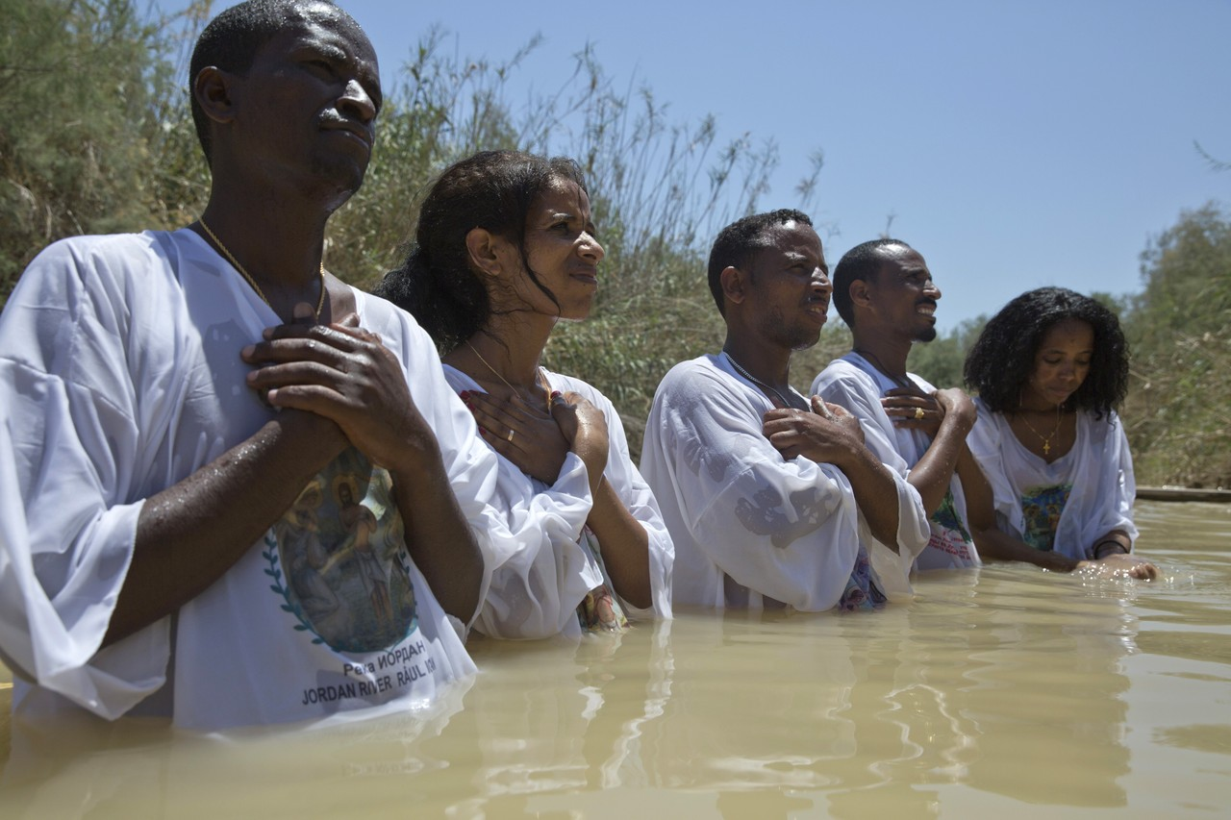
John & Jesus on how to repent
OUR PART
● We admit to God our past sins.
● We speak our faith in Jesus.
● Christians baptize us with water.
GOD’S PART
● He forgives us everything.
● He gives to us with his Holy Spirit.
● He enables us to lead a new life.

Slide 14
The five damning sins (Rev. 9:20-21)
1 Disbelief: False religion, deny Christ.
2 Sorcery: Magic, illicit drug traffic.
3 Murder: Forbidden, willful killing.
4 Immorality: Having forbidden sex.
5 Theft: Robbery, fraud, cruel slavery.
Not:
● Bad habits.
● Accidents.
● Ignorance.
● Innocent victims.

Slide 15
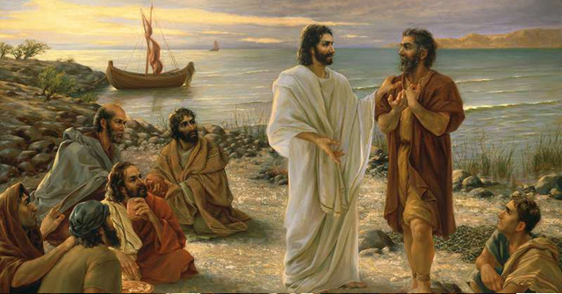
#29, “Fishers of men”
Now as he was walking by the Sea of Galilee, he saw Simon called Peter, and Andrew his brother, casting a net into the sea; for they were commercial fishermen. And Jesus said to them,
“Come, follow me, and I will make you fishermen — of men!” And immediately they left their nets and followed him.

Slide 16
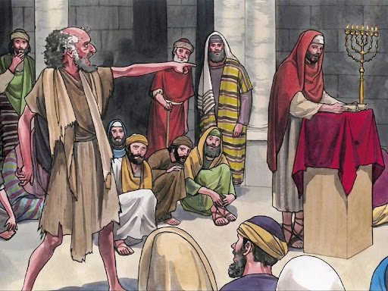
#30, “Come out of him!”
There was in their synagogue a man possessed with a spirit of an unclean demon, and it cried out with a loud voice … But Jesus rebuked it, saying,
“Be quiet, and come out of him.” … He
commands even the unclean spirits, and they obey him.
● Obey: Rebuke evil by Jesus’ authority.

Slide 17
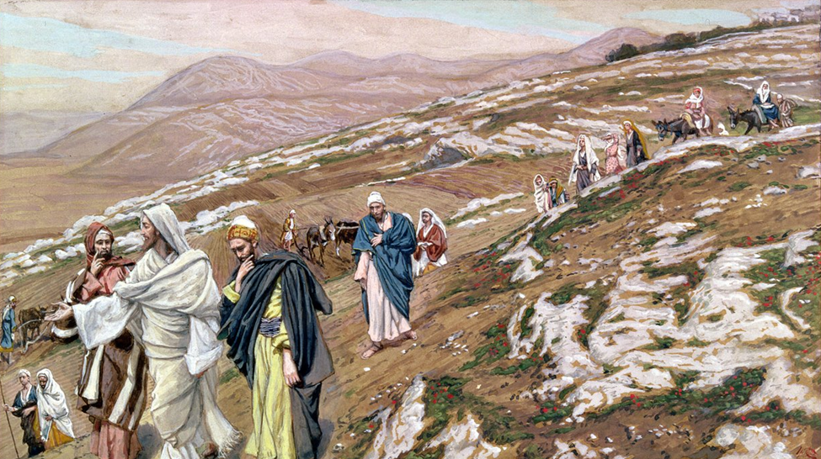
#31, “Preach the Glad News”
And the crowds were looking for him, and came upon him and attempted to stay him from leaving them. But he said to them,
“I must preach the Glad News, the Kingdom of God, to the other cities also, it is for this that I have been sent forth.”
● Kingdom: The King was there!

Slide 18
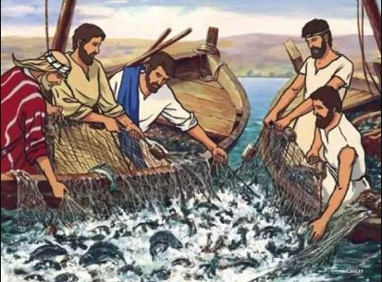
#32, “Fear not”
He said to Simon, “Launch out to
where it is deep, and let down your nets for a catch.” … They enclosed a huge number of fish… When Simon Peter saw it, he fell down at Jesus ‘knees, saying,
“Depart from me, for I am a sinful man, Lord!” … “Fear not; you will henceforth catch men.”

Slide 19
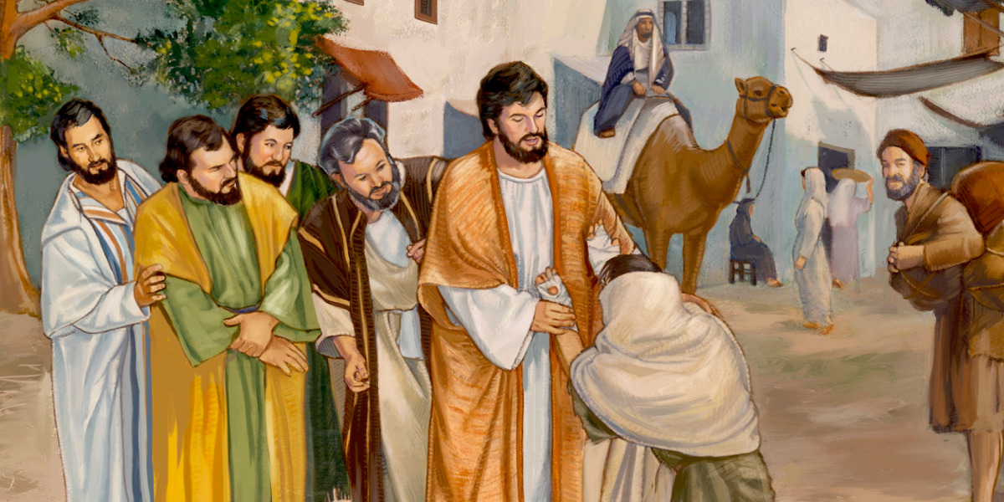
#33, “I am willing”
A man who was full of leprosy, … came to him, beseeching him, and kneeling down, he fell on his face and worshiped, saying, “Lord, if you are willing, you can make me clean.”
And Jesus, moved with compassion, reached out his hand and touched him, saying to him, “I am willing; be cleansed.”

Slide 20
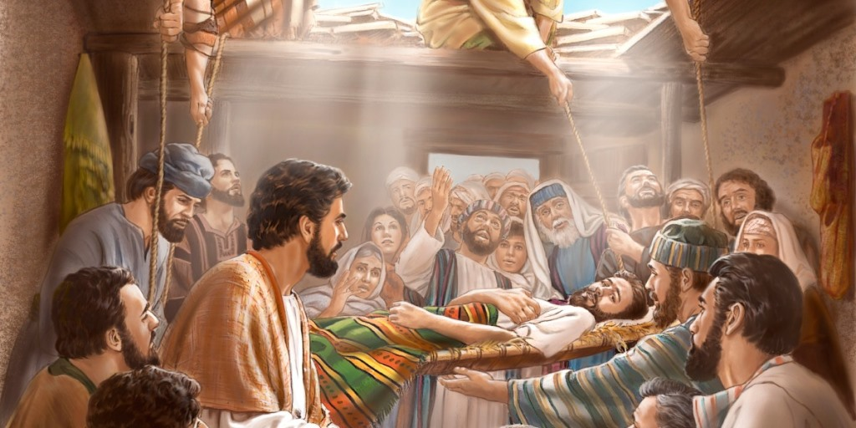
#34, “Your sins are forgiven”
Seeing their faith, he said to the paralytic, “Take courage, young man. Your sins are forgiven you.” …
“That you may know that the Son of man has authority on the earth to forgive sins … I say to you, arise, and take up your pallet and go home.”
● Faith: How does on ‘see’ faith?

Slide 21
What must we do?
From these words of Jesus,
● What will you abandon?
● What will you believe?
● What will you receive?
● What will you obey?

Slide 22
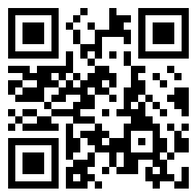
Assignment
● Visit LOCIS.site
● Read or listen to chapter 6, sections 38 through 41.
● Be ready to share your insights, queries and objections.

