Slide 1
The Life of Christ in Stereo

Slide 2
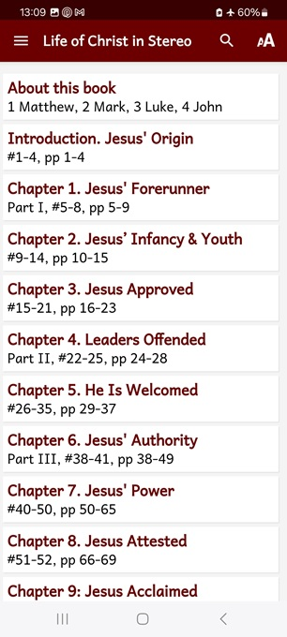
Session 4: Chapter 6, ##36-39
● What did you learn that was helpful?
● What did you read that was important?
● What questions do you have about what you read?

Slide 3
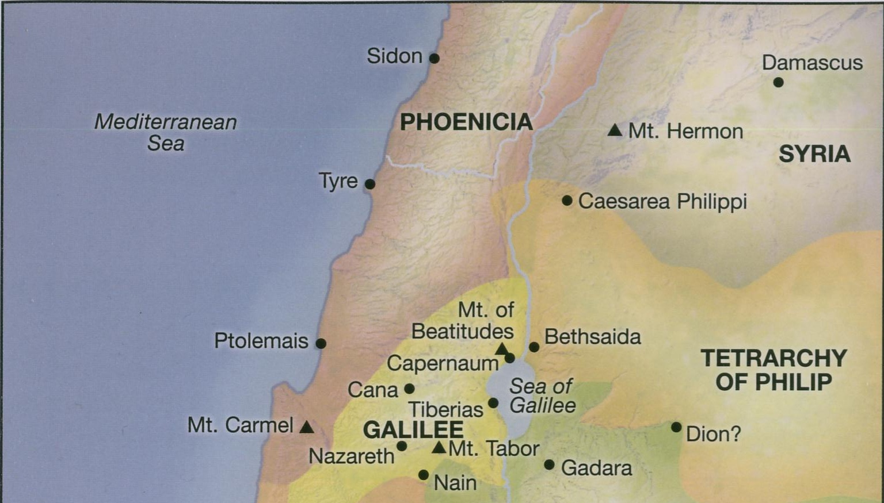

Slide 4
Purposes of blessings and curses
● Eras: Mark major transitions in biblical history.
● Values: Tell what is most important to do in God’s kingdom.
● Promises: Give testable ‘proofs’ for biblical truth claims.
● Memorable: Prove easier to remember than logical discourses.

Slide 5
New eras begin with new blessings
● Eden: God blessed them…, “Be fruitful … multiply … fill the earth, subdue it.
● Abraham: I will bless you …, so that you will be a blessing.
● Israel: The LORD your God … will love you, bless you, and multiply you.
● Church: Bless, for to this you were called, that you may obtain a blessing.

Slide 6
Blessings in the Proverbs
● Blessed is he whose help is the God of Jacob, whose hope is in the LORD!
● Blessed is he who is generous to the poor!
● Blessed is he who keeps the law!
● Blessed is he who trusts in the LORD!
● Blessed is he who comes in the name of the LORD!

Slide 7
Blessings in the Psalms
● Blessed are those who dwell in your house, ever singing your praise!
● Blessed are those whose strength is in you!
● Blessed are those … who walk in the law of the LORD!
● Blessed are those … who seek him with their whole heart!

Slide 8
Woes in the Older Testament
● Woe to those who … run after strong drink!
● Woe to those who call evil good and good evil!
● Woe to those who are wise in their own eyes!
● Woe to those who devise wickedness and work evil!

Slide 9
What do Jesus’ blessings mean…
● For me as an individual?
● For my family?
● For our church?
● For our wider community?
● For our nation’s policies?

Slide 10
Whom does Jesus approve? (Lk. 6)
“Blessed are you who are poor! For yours is the Kingdom of God.
“Blessed are you who hunger now! For you shall be satisfied.
“Blessed are you who weep now! For you shall laugh.
● Blessed: “favored, fortunate, happy, privileged recipient of divine favor.”

Slide 11
Whom does Jesus warn? (Luke 5)
“Woe to you who are rich! For you are receiving your comfort.”
“Woe to you who are surfeited [full]! For you shall suffer hunger.”
“Woe to you who are merry now! For you shall lament and weep.”
● Woe: “A state of intense hardship or distress.” BDAG Gk-En Lexicon

Slide 12
Whom does Jesus warn? (Luke 6)
“Woe to you when all shall speak well of you! For their fathers did the same to the false prophets.”
● False prophets: “Those who pretend to receive messages from God, which they write in books or preach for money, power and prestige.”

Slide 13
More blessings from Jesus (Matt 5)
“Blessed are the lowly in spirit. For theirs is the Kingdom of heaven.
“Blessed are they who mourn. For they shall be comforted.
“Blessed are the meek. For they shall inherit the earth.
● Meek: Considerate, unassuming. Free of anger or vengeance.

Slide 14
More blessings from Jesus (Matt 5)
“Blessed are they who are persecuted for righteousness’ sake. For theirs is the Kingdom of heaven.
“Blessed are you when men shall hate you, and revile and persecute you, and say falsely all kinds of evil against you because of Me…

Slide 15
More blessings from Jesus (Matt 5)
... when they shall excommunicate you, and denounce your name as evil, because of the Son of man.
“Rejoice in that day, and leap for joy, for behold, your reward is great in heaven. For their fathers did these things to the prophets who were before you.”

Slide 16
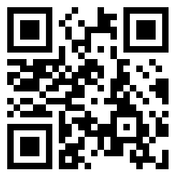
Assignment
● Visit LOCIS.site
● Read or listen to chapter 7, sections 40 through 50.
● Be ready to share your insights, queries and objections.

