Slide 1
The Life of Christ in Stereo

Slide 2
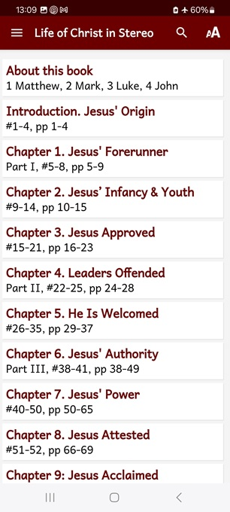
Session 5: Chapter 7, ##40–50
● What did you learn that was new, helpful, or important?
● What questions do you have about what you read?

Slide 3
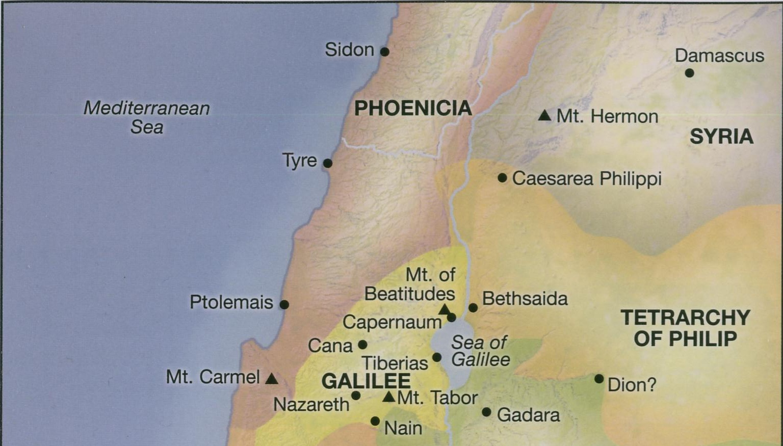
Hills
Capernaum
Nain
Touring
Sea
Gadara

Slide 4
Seven phases of Jesus’ Life
1 Announced by heaven & by John (1-3)
2 Early teaching and miracles (4-5)
3 Public fame and favor (6-9)
4 Early rejections (10-12)
5 Moving towards the cross (13-17)
6 Final days at Jerusalem (18-19)
7 Crucifixion and resurrection (20-21)

Slide 5
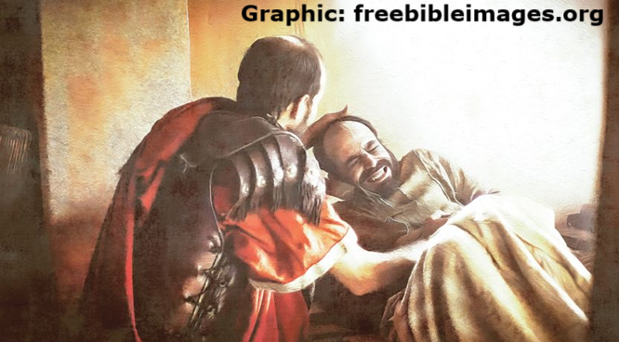
A Centurion’s Extraordinary Faith
¹ And when he had come down from the mountain, great multitudes followed him, ³ and he went into Capernaum.
Now a certain slave boy, who belonged to a centurion and was very dear to him, was sick and at the point of dying.

Slide 6
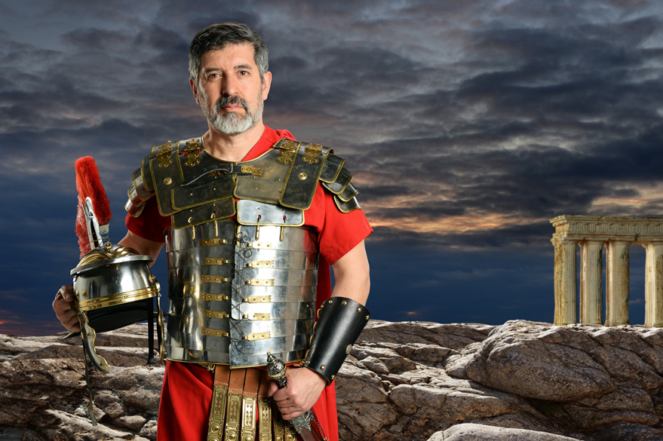
Centurion
● Meaning : Officer over 100 men.
● Authority: Over 60 men.
● Ethnicity: Probably Greek Syrian.
● Responsibly: Recruit, train, command.
● Career: 20 years.
● Status: Not allowed to marry.
● Reward: Land and an income.
● Allowed: Own slaves and hire servants.

Slide 7
A Centurion’s Extraordinary Faith
³ And the centurion, on hearing of Jesus ¹ when he came into Capernaum, ³ sent to him some of the elders of the Jews, begging him to come and heal his servant, ¹ and saying,
“Lord, my servant is at the house, lying paralyzed, in terrible torment.”
● Lord: Honorific term for superiors.

Slide 8
A Centurion’s Extraordinary Faith
³ But when he was now not far from the house, the centurion ¹ in answer ³ sent friends to him, telling him,
“Trouble not, Lord, for I am not worthy to have you come under my roof — for which reason I thought myself unfit to come to you. Instead, speak but a word, and my servant will be healed.

Slide 9
A Centurion’s Extraordinary Faith
³ “For I, too, am a man invested with authority, and have soldiers under myself and I say to one, ‘Go, ‘and he goes, and to another, ‘Come, ‘and he comes, and to my slave boy, ‘Do this, ‘and he does it.”
Now when Jesus heard these things, he marveled at him, and turning to the multitude behind him, said, …

Slide 10
A Centurion’s Extraordinary Faith
¹ “Verily, I say to you, not even in Israel have I found such extraordinary faith! And I say to YOU, that many shall come from the east and west, and dine with Abraham and Isaac and Jacob in the Kingdom of heaven; but the sons of the Kingdom shall be cast out into the outer darkness, where there shall be wailing…”

Slide 12
Kingdom of God/Heaven in the OT
● Eternal: “His kingdom rules over all,” Psalm 103:19.
● Messianic: “A son is given… Of his government and of peace there will be no end, on the throne of David and over his kingdom … forevermore,” Isaiah 9:6-7

Slide 13
Kingdom of God/Heaven in the NT
● Present: “The kingdom of God is not a matter of eating and drinking but of righteousness and peace and joy in the Holy Spirit,” Romans 14:17.
● Future: “The kingdom of our God and the authority of his Christ,” Rev. 12:10.

Slide 14
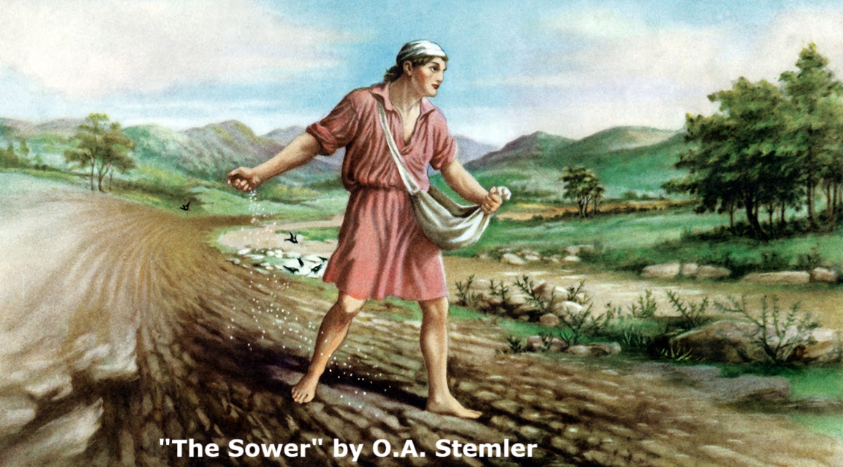
Jesus’ parable about the Kingdom
² “Hearken! Lo, the sower went forth to sow ³ his seed. ² And it came to pass as he sowed, that some fell upon the roadside; ³ and it was trampled on, and the birds of the air ² came and devoured it. ¹ And some fell on the rocky places, ² where it had not much earth; …

Slide 15
Jesus’ parable about the Kingdom
² “and it sprouted up at once, as it had no depth of earth, but when the sun rose, it was scorched, and because it had no root ³ and lacked moisture, it withered away. And some fell into the midst of the thorns; and the thorns sprang up with it and choked it, ² and it produced no returns.

Slide 16
Jesus’ parable about the Kingdom
² “But some fell into the good soil; and growing up and increasing, it brought forth results, some thirtyfold, some sixty, and some a hundredfold.”
³ And when he had said these things, he exclaimed ² to them, “He who has ears to hear, let him hear!”

Slide 17
Jesus’ parable about the Kingdom
² Now when he was alone, they who were about him, with the twelve ¹ disciples, came and ³ asked him, saying, “What does this parable mean?
² Then said he to them, “Do you not understand this parable? … ¹ Hear therefore the parable of the sower; ³ the message of the parable is this: …

Slide 18
Jesus’ parable about the Kingdom
³ “The seed is the Word of God; … ¹ When anyone hears the Word of the Kingdom and does not comprehend it, then ² at once Satan, ¹ the wicked one, comes and snatches away what was sown in his heart, ³ lest he should believe and be saved. ¹ This is he who received seed upon the roadside.

Slide 19
Jesus’ parable about the Kingdom
² “And likewise ¹ he who received seed on the rocky places, this is he who hears the Word and at once receives it gladly; yet he has no root in himself, and ³ believes and ² continues only a little while.
Then later, when adversity arises, or persecution on account of the Word, he … ³ falls away.

Slide 20
Jesus’ parable about the Kingdom
² “He also who received seed among the thorns is he who, ³ on hearing ² the Word, ³ goes his way; ² and the cares of this world ³ and the pleasures of life,
² the seductiveness of riches, and passionate desires for other things, enter in and choke the Word and it is made unfruitful …

Slide 21
Jesus’ parable about the Kingdom
¹ “But he who received seed upon the good soil is he who, ³ hearing the Word in an honest and good heart, ² welcomes ¹ and understands it ³ and holds it fast,
and with patience ¹ bears fruit indeed and brings forth, ² some thirtyfold, some sixty, and some a hundredfold.”

Slide 22
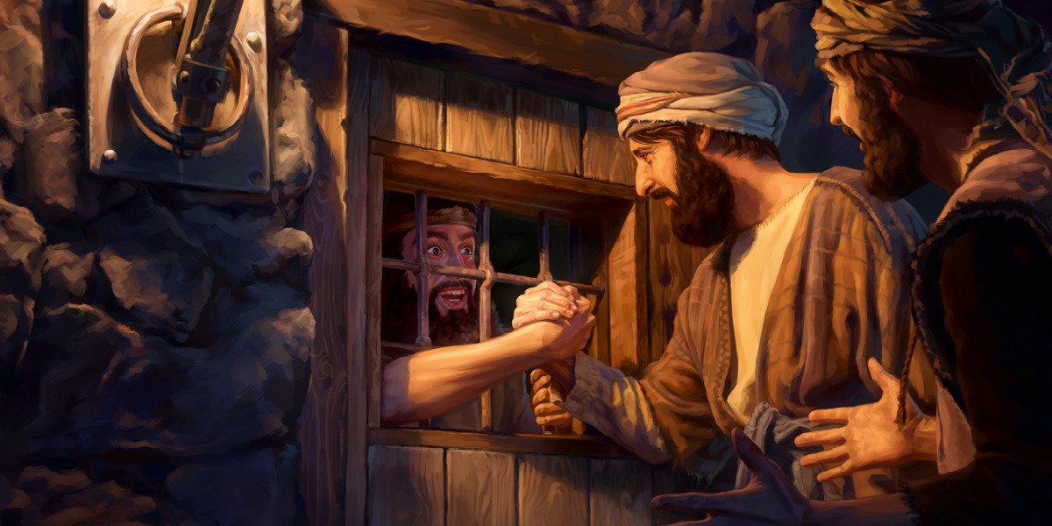
Jesus’ answer to John the baptizer
³ Now the disciples of John brought him word ¹ in the prison ³ of all these ¹ works of the Messiah. ³ Then John, summoning a certain two of his disciples, sent them to Jesus, saying to him,
“Are you that One who is coming? Or are we to look for another?”

Slide 23
Jesus’ answer to John the baptizer
³ But in that same hour he healed many from their diseases and afflictions and evil spirits, and to many who were blind he granted sight.
So Jesus answering said to them, “Go and report to John the things you have seen and heard. ¹ The blind are receiving sight, …

Slide 24
Jesus’ answer to John the baptizer
the crippled are walking, the lepers are being cleansed, and the deaf are hearing, the dead are being raised, and the lowly are being told the Glad News.
And blessed is he who does not stumble because of Me!”

Slide 25
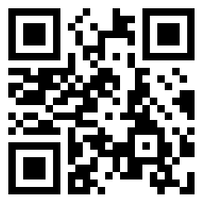
Assignment
● Visit LOCIS.site
● Read or listen to chapters 8 & 9, sections 51 through 56.
● Be ready to share your insights, queries and objections.

Slide 26
Centurian
● ...: ...
● ...: ...
● ...: ...
● ...: ...

