Slide 1
The Life of Christ in Stereo

Slide 2
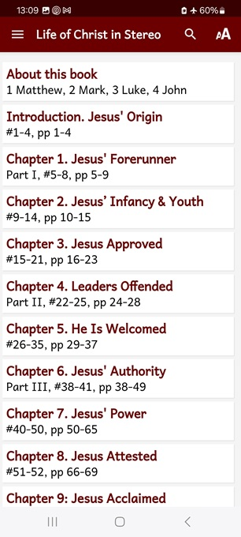
Session 6: Chapter 8-9, ##51-56
● What did you learn that was new, helpful, or important?
● What questions do you have about what you read?

Slide 3
Seven phases of Jesus’ Life
1 Announced by heaven & by John (1-3)
2 Early teaching and miracles (4-5)
3 Public fame and favor (6-9)
4 Early rejections (10-12)
5 Moving towards the cross (13-17)
6 Final days at Jerusalem (18-19)
7 Crucifixion and resurrection (20-21)

Slide 4
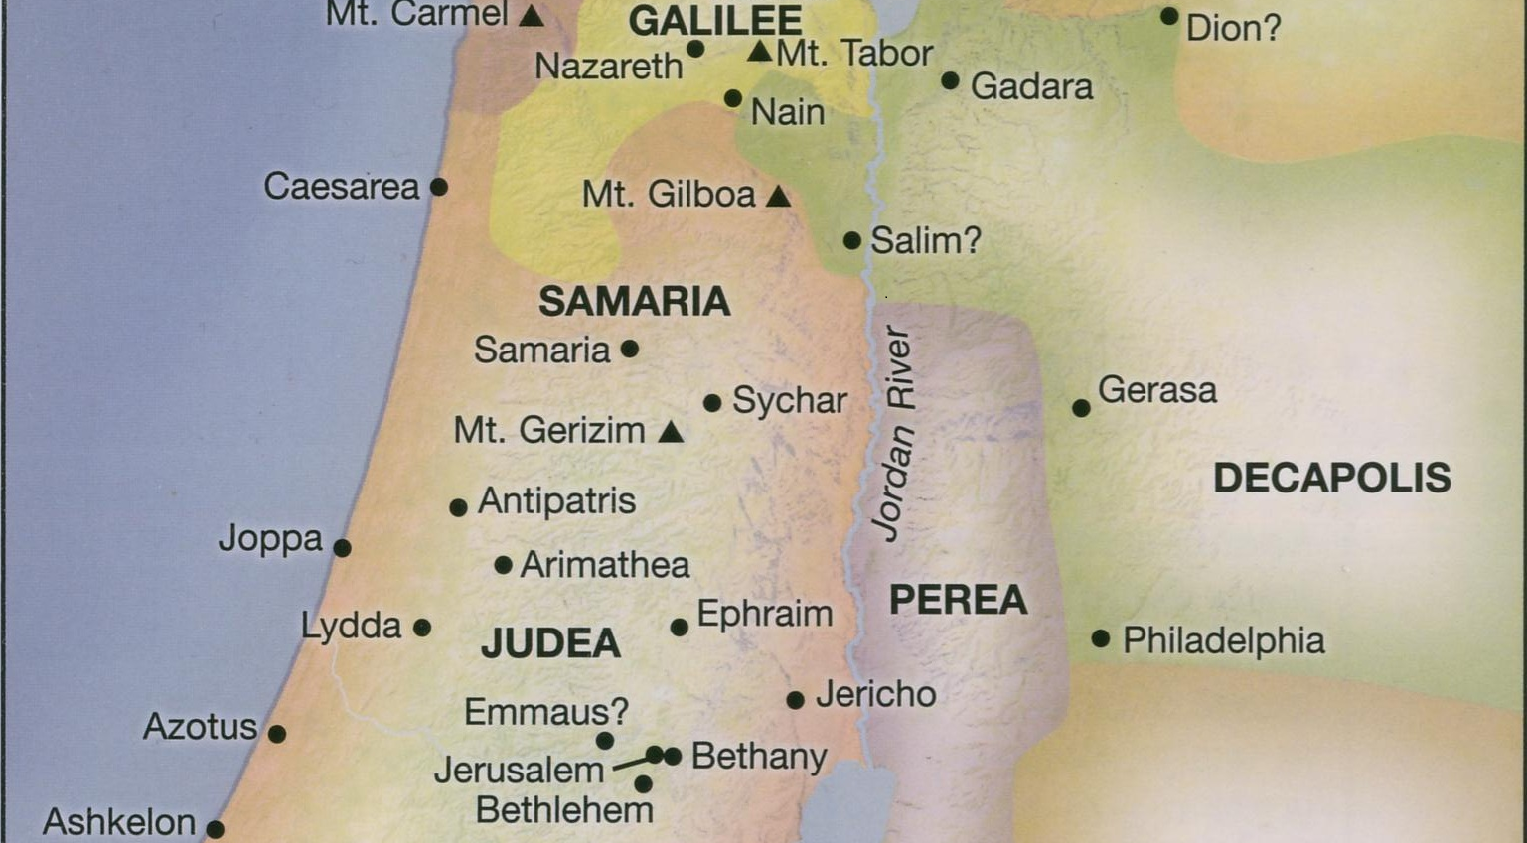
● Galilee
● Jerusalem
● Return
● 6 months
● Passover
Life of Jesus Timeline Rose Publishing, 2020

Slide 5
John 5:1-4
There was a feast of the Jews, and Jesus went up to Jerusalem. Now there is in Jerusalem by the Sheep Gate a pool called in the Hebrew tongue Bethesda, which has five entrance-ways.
In these lay a crowd of afflicted folk, the blind, the crippled, the paralyzed, …
● Feast: Tabernacles, Autumn, 29 CE.
● Verse 4: Spurious. 5th-century insertion.

Slide 6
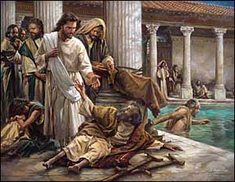
John 5:5-6
A certain man was there who had been an invalid for thirty-eight years. Jesus saw him lying there and, knowing that he had been a long time in that plight, said to him, “Do you wish to get well?”
● Wish: Not everyone wishes to get well!

Slide 7
John 5:7-9
The afflicted man answered him, “Sir, I have no man, when the water is troubled, to put me into the pool; and while I am coming someone else steps down before me.
Jesus said to him, “Rise; take up your pallet and walk.” And immediately the man was made well, and he picked up his pallet and started walking.

Slide 8
John 5:10-11
But that day was the Sabbath; so the Jews said to the healed man, ‘It is the Sabbath; it is unlawful for you to carry the pallet.”
He answered them, “The man who made me well, he said to me, ‘Take up your pallet and walk!’”
● Sabbath: Jewish legal day of rest.

Slide 9
John 5:12-13
They asked him therefore, “Who is this man who said to you, ‘Take up your pallet and walk’?”
But the healed man did not know who it was; for Jesus had betaken himself away, because of the throng in the place.
● Throng: Why did this matter?

Slide 10
John 5:14-15
Later Jesus found him in the temple, and he said to him, “Behold, you have been healed; sin no more, lest some worse thing befall you.”
The man departed, and told the Jews that it was Jesus who had made him well.
● Temple: Its vast courtyard.
● Sin … worse: Such as what?

Slide 11
John 5:16
For this reason the Jews continued persecuting Jesus and seeking to kill him, because he was doing such things on the Sabbath.
● Jews: Or Judeans, religious leaders. Most Jews admired Jesus.
● Persecute: Prosecute hatefully.
● Kill: A major indicator of depravity.

Slide 12
John 5:17-18
But Jesus answered them. “My Father is continuing to work until now; I, too, am working.”
The Jews because of this kept seeking all the more to kill him, for not only was he “breaking the Sabbath” but was also calling God his own Father, “making himself equal with God.”
● Equal: isos, equivalent quality/quantity.

Slide 13
John 5:19-20
Jesus therefore answered and said to them, “Verily, verily, I say to you, the Son can do nothing from himself, but only what he may see the Father doing; for whatever things He is doing, the Son does likewise.
For the Father loves the Son, and shows him all the things he himself is doing.

Slide 14
John 5:20-21
“And greater works than these will he show him, so that you may marvel. For as the Father raises up the dead and makes them alive, so the Son also makes alive whom he will.
● Query: Whom did the Father raise?
● Query: Whom will the Son raise?

Slide 15
John 5:22-23
“For not even is the Father judging anyone, but he has given all judgment to the Son, so that all men should honor the Son even as they honor the Father.
He who is not honoring the Son is not honoring the Father who sent him.
● Query: How do Jesus’ words make all religions invalid?

Slide 16
John 5:24
“Verily, verily, I say to you, he who hears my Word and believes Him who sent me, has everlasting life and does not come into judgment but has passed out of death into life.
● Death: What kind of death?
● Judgment: What kind of judgment?
● Life: What kind of life?

Slide 17
John 5:25-26
“Verily, verily, I say to you, that an hour is coming, and now is, when the dead will hear the voice of the Son of God, and those who have heard will live.
For as the Father has life in himself, so he granted the Son also to have life in himself; …
● Son of God: A Jewish title for Messiah.

Slide 18
John 5:27-29
… and he gave him authority to administer judgment, because he is the Son of man. Marvel not at this, for an hour is coming when all who are in the graves will hear his voice and come forth, they who have done good unto resurrection of life, and they who have done evil unto resurrection of judgment.

Slide 19
John 5:27-29
● Hour: Any short period of time.
● Good: Greek, ‘the good things’.
● Bad: Greek, ‘the evil things’.
● Resurrection: Cause dead people to come back to life forever.
● Life: Live forever in your improved body in Jesus’ kingdom.
● Condemnation: Whatever you deserve.

Slide 20
Four witnesses to Jesus
How Jesus knew that he was the Messiah.
● John: Identified Jesus as the one who baptizes in the Holy Spirit.
● Works: He was able to perform signs.
● God’s voice: Spoke to him at his baptism, sending him the Holy Spirit.
● Scriptures: Jesus was fulfilling OT prophecies about the Messiah.

Slide 21
John 5:30
“From myself I can do nothing; according as I hear, I judge. And my judgment is righteous, because I seek not my own will but the will of the Father who sent me.
● Nothing: How is Jesus lesser than God?
● Because: What does this explain?
● Will: Revealed purpose or desire.

Slide 22
John 5:31-33
If I testify in my own behalf, my testimony ‘is not true’? There is another who testifies of me, and I know that the witness which he bears of me is true; you yourselves have sent to John, and he has borne witness to the truth.
● John: What was John saying to crowds about Jesus?

Slide 23
John 5:34-35
Not that my credentials are from a man, but I say these things that you might be saved. He was the lamp, a burning and shining one, and you were willing to rejoice a short while in his light.
● Saved: From what? And to what?
What in the immediate context?

Slide 24
John 5:36
“But I have a greater attestation than John’s; for the works which the Father gave me to accomplish, the very works which I am doing, bear witness of me that the Father has sent me.
● Works: What was Jesus doing in public which proved who he is?

Slide 25
John 5:37-38
“And the Father who sent me has himself borne witness of me. His voice you have never heard and his form you have not seen — and his Word you do not have abiding in you, because the One whom He sent you believe not!
● Works: Who had heard the Father’s voice, according to the Gospels?

Slide 26
John 5:39
“You search the Scriptures, because in them you think to have eternal life — and it is they that bear witness of Me! And you are unwilling to come to me that you might have life.
● Works: Which OT texts can you cite which tell about the coming Messiah?

Slide 27
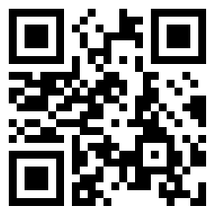
Assignment
● Visit LOCIS.site
● Read or listen to chapters 10 & 11, sections 57 through 63.
● Be ready to share your insights, queries and objections.

