Slide 1
The Life of Christ in Stereo

Slide 2
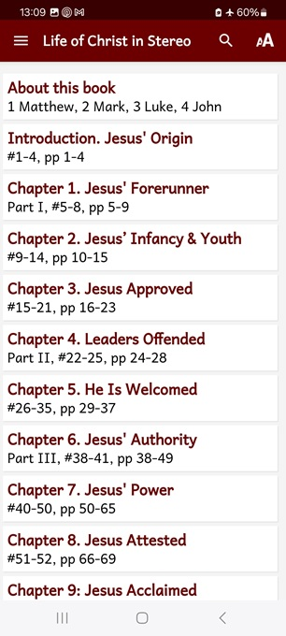
Session 7: LOCIS Chapters 10 & 11
● What did you learn that was new, helpful, or important?
● What questions do you have about what you read?

Slide 3
Seven phases of Jesus’ Life
1 Announced by heaven & by John (1-3)
2 Early teaching and miracles (4-5)
3 Public fame and favor (6-9)
4 Early rejections (10-12)
5 Moving towards the cross (13-17)
6 Final days at Jerusalem (18-19)
7 Crucifixion and resurrection (20-21)

Slide 4
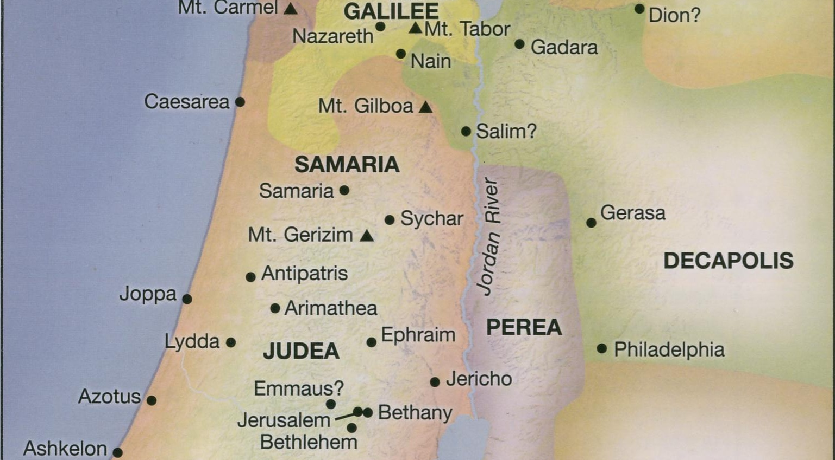
● Judeans
● Scribes
● Pharisees
● Sadducees
● Disciples
Life of Jesus Timeline Rose Publishing, 2020

Slide 5
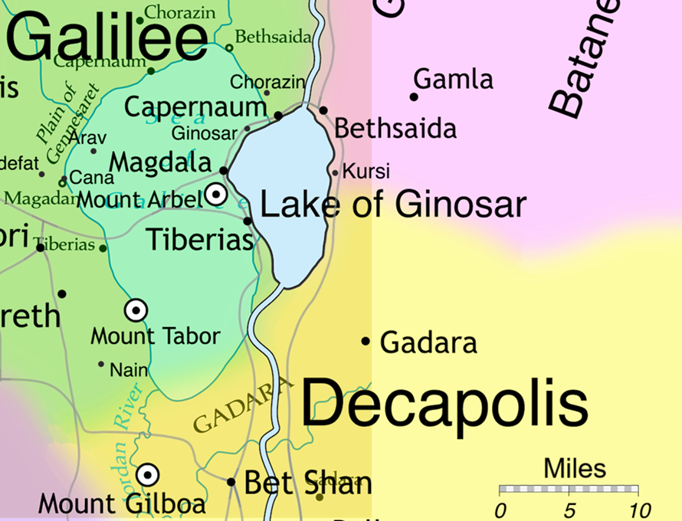

Slide 6
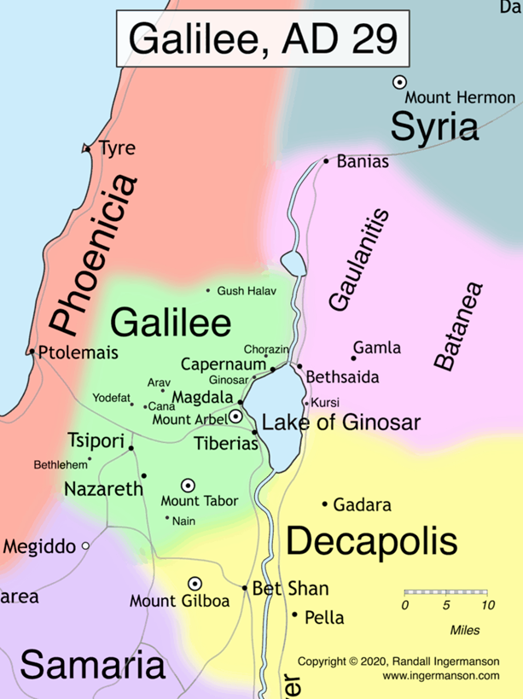
LOCIS 10, #57, p 80
⁴ And Jesus said to them, “I am the Bread of life.” …
The Jews ‘began therefore to mutter against him, because he said, “I am the Bread which came down out of heaven,” and they kept saying, “He is Jesus, the son of Joseph!”
● Jews: Leaders from Judea province.
● Joseph: An ordinary man.

Slide 7
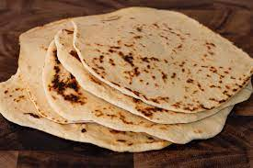
LOCIS 10, #57, p 81
“I am the Living Bread which came down out of heaven. If anyone eat of this Bread, he shall live forever. Moreover, the Bread that I will give is my flesh…”
The Jews therefore began to dispute with one another, saying. “He cannot give us his flesh to eat?”
● Flesh: Metaphor = Food becomes life.

Slide 8
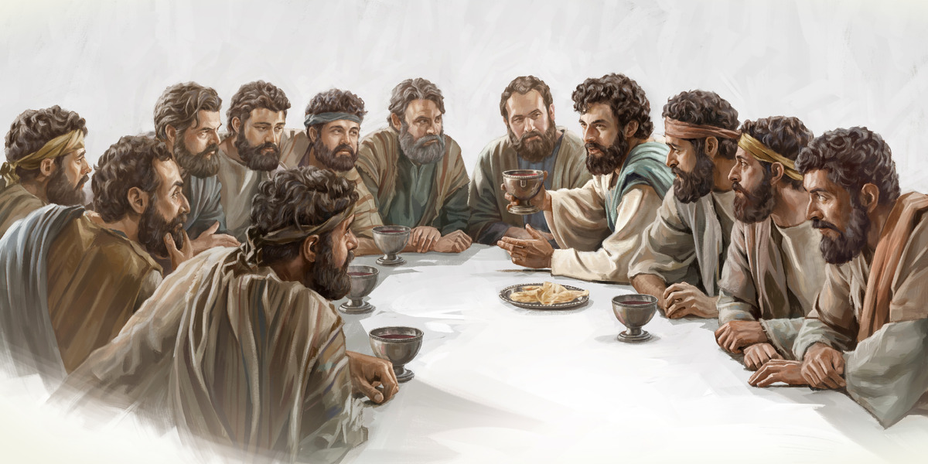
LOCIS 10, #57, p 81
“My flesh is food indeed and my blood is drink indeed… He who eats this Bread shall live forever.”
… Many of his disciples therefore … said, “This is a difficult message; who can accept it?”
“There are some of you who believe not!”
● Live: Now, heaven, raised, kingdom.
● Disciples: Some followers turn away.

Slide 9
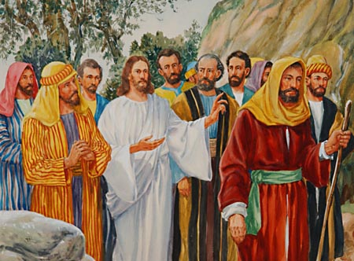
LOCIS 10, #57, p 81
From that time many of his disciples turned back and no longer went about with him. Jesus therefore said to the twelve, “Do you also wish to go away?”
Then Simon Peter answered him, “Lord, to whom shall we go? You have words of eternal life!”
● Life: Jesus alone gives everlasting life.

Slide 10
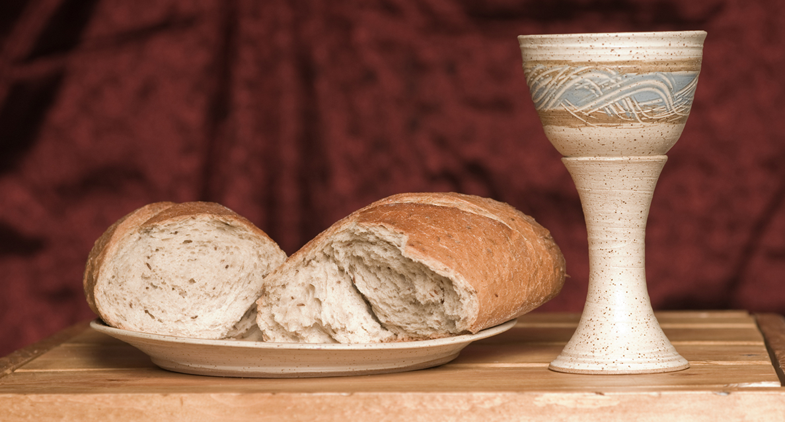
Theories of the eucharist
● Transubstantiation: The bread and wine become Jesus’ flesh and blood.
● Consubstantiation: Jesus’ flesh and blood accompany the bread and wine.
● Nonsubstantiation: The bread and wine are symbols of Jesus’ flesh and blood.
All theories agree that it is a memorial of Jesus instead of a Passover sheep.

Slide 11
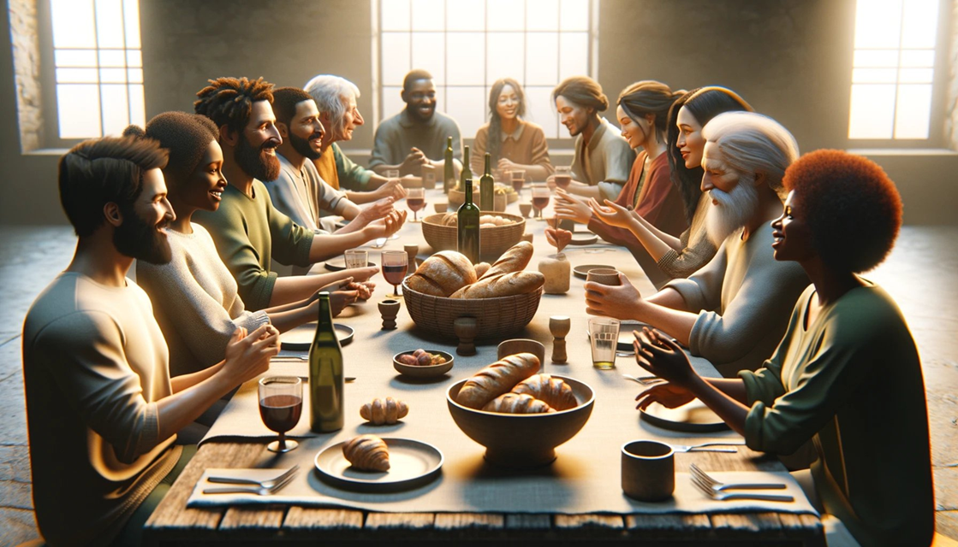
Enjoy the Lord’s table!
“The cup of blessing that we bless, is a participation in the blood of Christ. The bread that we break is a participation in the body of Christ!” 1 Cor. 10.16
Let the Holy Spirit minister to you as you partake of the Lord’s Table. Enjoy forgiveness and renewed life!

Slide 12
LOCIS 10, #58, p 82
⁴ Even after these things Jesus kept going about in Galilee for he was unwilling to go about in Judea, because the Jews were seeking to kill him.
² Then there assembled about him the Pharisees, and some of the scribes, who had come from Jerusalem…
● Jerusalem: Investigate fake messiahs.

Slide 13
LOCIS 10, #58, p 82
² The Pharisees and the scribes accordingly asked him. ¹ “Why do your disciples disregard the tradition of the elders? For they do not purify their hands before eating.”
² But he … said to them, ¹ “You hypocrites! … disregarding the commandment of God you hold to the tradition of men!”

Slide 14
The Jew Trypho, early 2nd century
“Sir, these and such like passages of Scripture [Dan. 7:9-28, etc.] compel us to await one who is great and glorious, and takes over the everlasting kingdom from the Ancient of Days as the Son of Man.
Your so-called Messiah is without honour and glory, and is … under the curse…, for he was crucified.”

Slide 15
LOCIS 11, #62, p 86
¹ Jesus … ² with his disciples went to the district of Dalmanutha, ¹ to the neighborhood of Magdala.
Then came forth to him the Pharisees and Sadducees,
² and they began to cavil at him, demanding ¹ that he show them a miraculous sign from heaven, ² making a test of him.

Slide 16
LOCIS 11, #62, p 86
¹ “You hypocrites, the face of the sky you indeed know how to read, but the signs of the times you cannot recognize!”
… No sign will be given … but the sign of the prophet Jonah.”
● Signs: Point to a greater reality.
● Times: Same Greek words as in the Greek OT (Septuagint) Daniel 9:24-26.

Slide 18
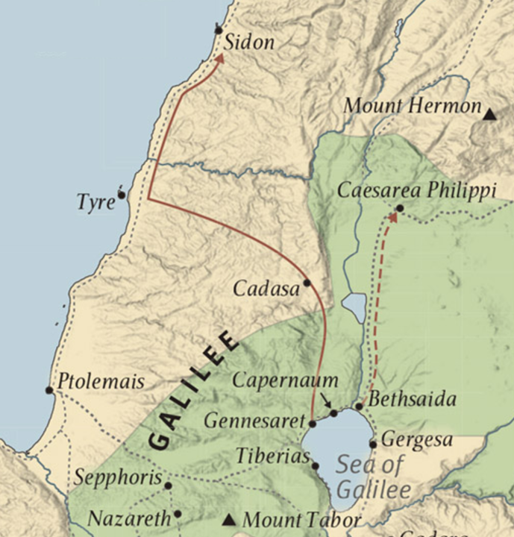
LOCIS 11, #59, p 84
¹ Then Jesus ² arose from that place and journeyed off into the region of Tyre and Sidon.
¹ A Canaanite woman of that region, ² whose small daughter had an unclean spirit, having heard of him came and fell at his feet.
● Canaanite: Original pagans.
● Unclean: Something had defiled her.

Slide 19
LOCIS 11, #59, p 84
² And the woman was a Gentile, a Syro-Phoenician by race, ¹ but she cried to him, saying,
“Have pity on me. Lord. Son of David. My daughter is sorely afflicted with a demon.”
● Gentile: Syro-Phoenician.
● Son of David: Jewish Messiah.
● Demon: Local folk know the difference.

Slide 20
LOCIS 11, #59, p 84
² And she begged him to cast out the demon from her daughter. ¹ But he answered her not a word; and his disciples came and besought him, saying,
“Dismiss her, for she is crying after us.”
● Begged: Insistent prayer. Try it.
● Answered: Why not?
● Dismiss: Attitude towards pagans.

Slide 21
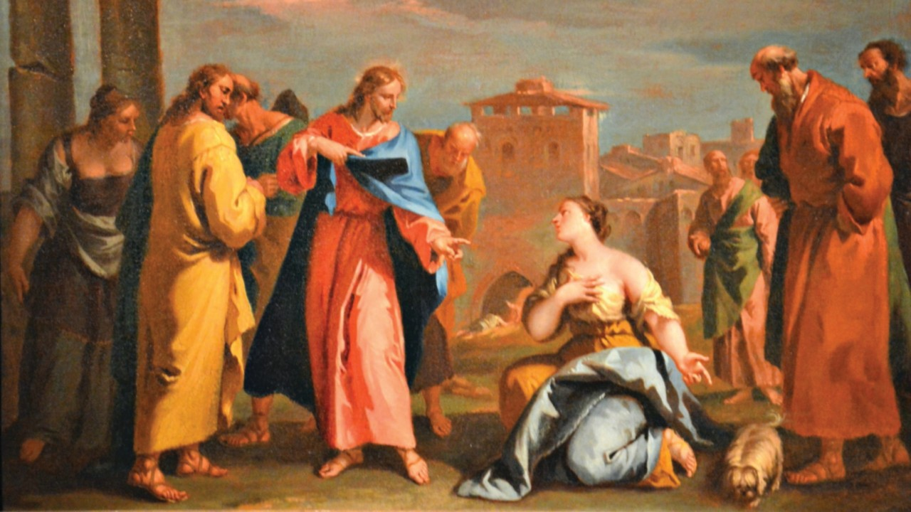
LOCIS 11, #59, p 84
Then he answering said, “I was not sent but to the lost sheep of the house of Israel.”
But she made obeisance to him, saying, “Lord, help me!”
● Answer: To whom?
● Lost: To whom?
● Obeisance: Bow down before authority.
● Help: Whom? Why herself?

Slide 22
LOCIS 11, #59, p 84
² And Jesus said to her, “Let the children get filled up first; for it is not good to take the children’s bread and throw it to the little dogs.”
But she answered and said to him, “Oh yes, Lord! For even the little dogs eat of the children’s crumbs ¹ that fall from their masters ‘table.”

Slide 23
LOCIS 11, #59, p 84
¹ Then Jesus answering said to her, “O woman, great is your faith! ² For this answer ¹ your request is granted.
² Go your way; the demon has gone out from your daughter.”
● Faith: Subject? Or object?
● Great: What did she believe? Trust?
● Request: What was her attitude?

Slide 24
Assignment
● Visit LOCIS.site
● Read or listen to chapter 12, sections 64 through 70.
● Be ready to share your insights, queries and objections.

