Slide 1
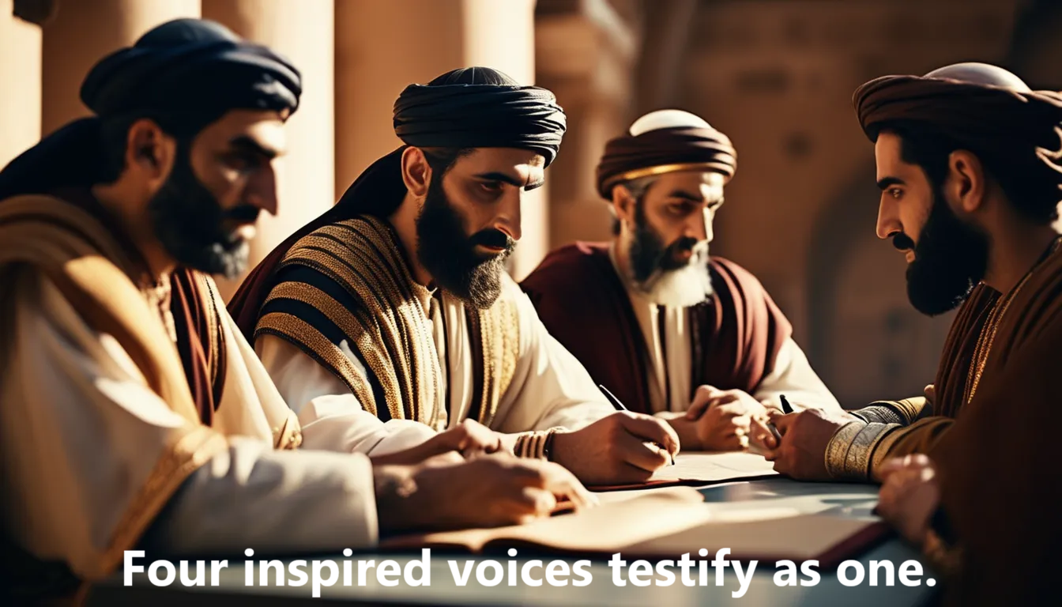
The Life of Christ in Stereo

Slide 2



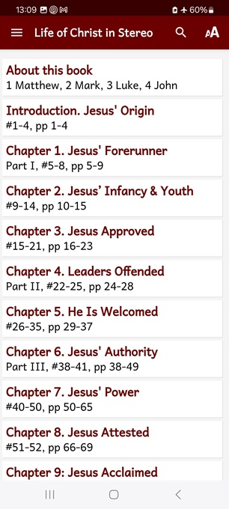
Session 8: LOCIS Chapter 12, 64-70
● What did you learn that was new, helpful, or important?
● What questions do you have about what you read?

Slide 3
Seven phases of Jesus’ Life
1 Announced by heaven & by John (1-3)
2 Early teaching and miracles (4-5)
3 Public fame and favor (6-9)
4 Early rejections (10-12)
5 Moving towards the cross (13-17)
6 Final days at Jerusalem (18-19)
7 Crucifixion and resurrection (20-21)

Slide 4
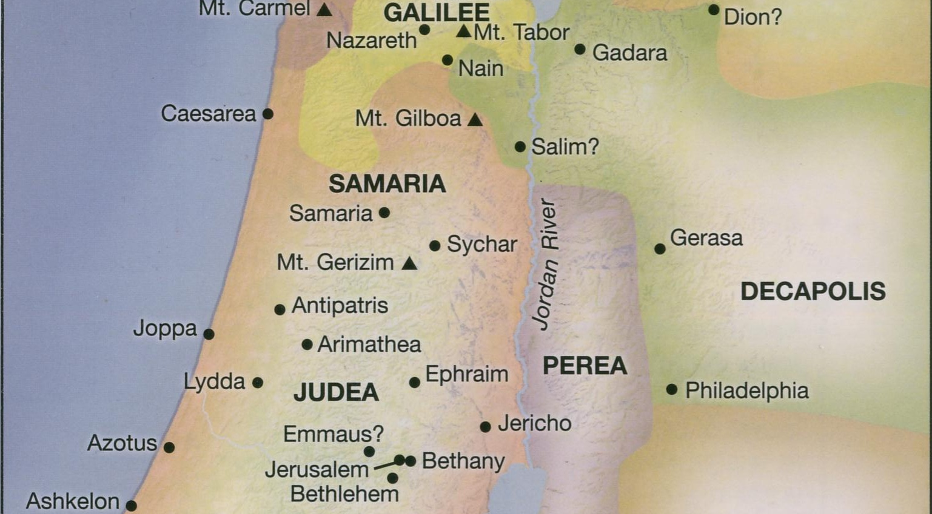
● Judea
● Tabernacles
● Judeans
● Pharisees
● “I AM”
Life of Jesus Timeline
Rose Publishing, 2020

Slide 5
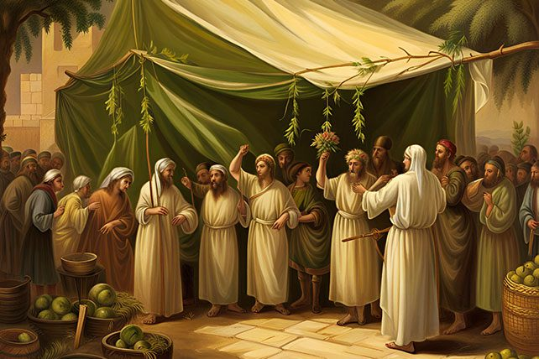
LOCIS #64 = John 7 NETbible.org
² Now the Jewish Feast of Shelters was near.
¹⁰ When his brothers had gone up to the feast, then Jesus himself also went up, not openly but in secret. ¹¹ So the Jewish leaders were looking for him at the feast, asking, “Where is he?”

Slide 6
LOCIS #65 = John 7 NETbible.org
¹⁴ When the feast was half over, Jesus went up to the temple courts and began to teach…
¹⁶ “My teaching is not from me, but from the one who sent me. ¹⁷ If anyone wants to do God’s will, he will know about my teaching, whether it is from God or whether I speak from my own authority.”

Slide 7
LOCIS #65 = John 7 NETbible.org
³² The chief priests and the Pharisees sent officers to arrest him. ³³ Then Jesus said, “I will be with you for only a little while longer, and then I am going to the one who sent me.
³⁴ You will look for me but will not find me, and where I am you cannot come.”
● Find: Fake tombs of Jesus.

Slide 8
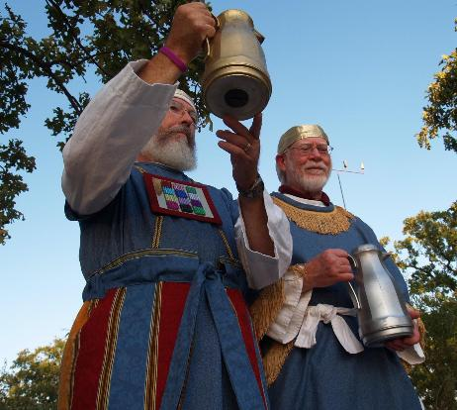
LOCIS #66 = John 7 NETbible.org
³⁷ On the last day of the feast,
the greatest day, Jesus stood up and shouted out, “If anyone is thirsty, let him come to me, and ³⁸ let the one who believes in me drink.
Just as the scripture says, ‘From within him will flow rivers of living water.’”
● Scripture: From whom? Isaiah 58:11

Slide 9
LOCIS #66 = John 7 NETbible.org
³⁹ (Now he said this about the Spirit, whom those who believed in him were going to receive, for the Spirit had not yet been given,
because Jesus was not yet glorified.)
● Spirit: God living in and amongst us.
● Glorified: Resurrected and ascended.

Slide 10
LOCIS #68 = John 8 NETbible.org
²¹ Then Jesus said to them again, “I am going away, and you will look for me but will die in your sin. Where I am going you cannot come…
²³ “You people are from this world; I am not from this world. ²⁴ Thus I told you that you will die in your sins. For unless you believe that I am he, you will die in your sins.”

Slide 11

Exodus chapter 3
¹⁴ God said to Moses, “I AM that
I AM.” And he said, “You must say this to the Israelites, ‘I AM has sent me to you.’”
● Hebrew: אֶהְיֶה, ^{ʔ}ehyeh, “I-am who I-am”.
● Septuagint: Ἐγώ εἰμι ὁ ὤν,
egō eimi ho ōn.
“I AM the Existing One…
Say, ‘The Existing-One sent me’.”

Slide 12
LOCIS #68 = John 8 NETbible.org
²⁸ Then Jesus said, “When you lift up the Son of Man, then you will know that
I am he… ²⁹ And the one who sent me is with me. He has not left me alone, because I always do those things that please him.”
³⁰ While he was saying these things, many people believed in him.
● Lift up: On cross, from tomb, into sky.

Slide 13
LOCIS #68 = John 8 NETbible.org
⁵¹ “If anyone obeys my teaching,
he will never see death.”
⁵² Then the Judeans responded… “Both Abraham and the prophets died… ⁵³ Who do you claim to be?” ...
⁵⁸ Jesus said to them,
“I tell you the solemn truth, before Abraham came into existence, I am!”
● I AM: Liar? Lunatic? Or Lord?

Slide 14
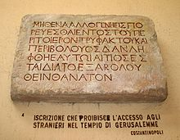
LOCIS #68 = John 8 NETbible.org
⁵⁹ Then they picked up stones to throw at Jesus, but he was hidden from them and went out from the temple area.
Temple Warning inscription
“No stranger is to enter within the balustrade round the temple and enclosure. Whoever is caught will be himself responsible for his ensuing death.” —Wikipedia

Slide 15
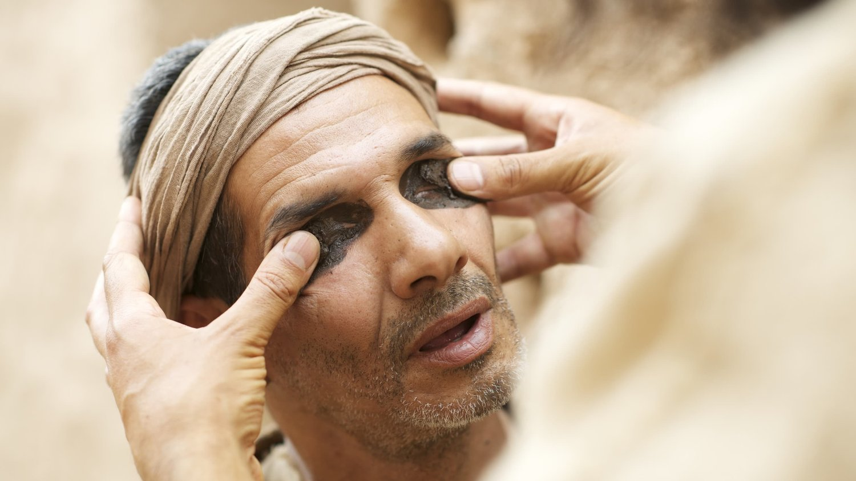
LOCIS #69 = John 9 NETbible.org
¹ Now as Jesus was passing by,
he saw a man who had been blind from birth. ² His disciples asked him, “Rabbi, who committed the sin that caused him to be born blind, this man or his parents?”
³ Jesus answered, “Neither this man nor his parents sinned, but [let] the acts of God be revealed!” [hina+subjunctive]

Slide 16
LOCIS #69 = John 9 NETbible.org
⁵ “As long as I am in the world, I am the light of the world.” ⁶ Having said this, he spat on the ground and made some mud with the saliva. He smeared the mud on the blind man’s eyes ⁷ and said to him, “Go wash in the pool of Siloam” …
So
the blind man went away and washed, and came back seeing.
● …: …
● …: …

Slide 17
LOCIS #69 = John 9 NETbible.org
⁸ Then the neighbors and the people who had seen him previously as a beggar began saying, “Is this not the man who used to sit and beg?” ⁹ Some people said, “This is the man!” while others said, “No, but he looks like him.”
The man himself kept insisting, “I am !” [egō eimi]

Slide 18
LOCIS #70 = John 10 NETbible.org
²⁸ I give them eternal life, and they will never perish; no one will snatch them from my hand.
²⁹ My Father, who has given them to me, is greater than all, and no one can snatch them from my Father’s hand. ³⁰ The Father and I are one.”
● One: neuter pronoun ≠ same person.

Slide 19
LOCIS #70 = John 10 NETbible.org
³³ The Jewish leaders replied, “We are not going to stone you for a good deed but for blasphemy, because you, a man, are claiming to be God.”
● Stone: Kill with heavy stones.
● Blasphemy: To insult God or to lie about him.
● Claim: They understood Jesus’ intent.

Slide 20
LOCIS #70 = John 10 NETbible.org
³⁴ Jesus answered, “Is it not written in your law, ‘I said, you are gods’?
³⁶ “Do you say about the one whom the Father set apart and sent into the world, ‘You are blaspheming,’ because I said, ‘I am the Son of God’?”
● Law: Psalm 82:6; 86:8; Deut 32:8 (DSS)

Slide 21
Psalm 82:6
¹ God has taken his place in the divine council; in the midst of the gods he holds judgment…
⁶ I said, "You are gods, sons of the Most High, all of you;
● God: Elohim with singlular verb.
● gods: elohim with plural modifiers.

Slide 22
Psalm 86
⁸ There is none like you among the gods, O Lord [Adonay], nor are there any works like yours.
Deuteronomy 32
⁸ The Most High gave [to] the nations their inheritance, … according to the number of the sons of God [DSS, LXX].

Slide 23
LOCIS #70 = John 10 NETbible.org
³⁸ Even if you do not believe me, believe the deeds, so that you may come to know and understand that I am in the Father and the Father is in me.”
³⁹ Then they attempted again to seize him, but he escaped their clutches.
● Deeds: Healing the lame and the blind.
● In: Purpose, action, or metaphysical?

Slide 24
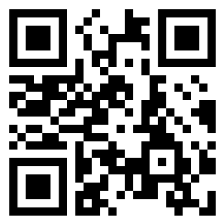
Assignment
● Visit LOCIS.site
● Read or listen to chapters
13 & 14, sections 71–91.
● Be ready to share your
insights, queries
and objections.

Slide 25
…
⁴ …
…
● …: …
● …: …

