Slide 1
The Life of Christ in Stereo

Slide 2
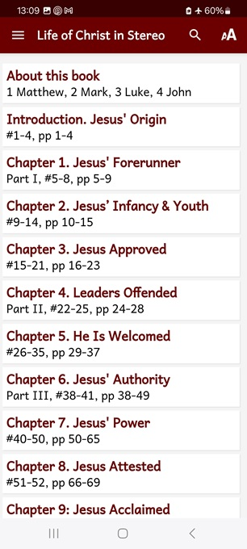
Session 9: LOCIS Chapters 13 & 14
March AD 32 through July AD 32
● What did you learn that was new, helpful, or important?
● What questions do you have about what you read?

Slide 3
Seven phases of Jesus’ Life
1 Announced by heaven & by John (1-3)
2 Early teaching and miracles (4-5)
3 Public fame and favor (6-9)
4 Early rejections (10-12)
5 Moving towards the cross (13-17)
6 Final days at Jerusalem (18-19)
7 Crucifixion and resurrection (20-21)

Slide 4
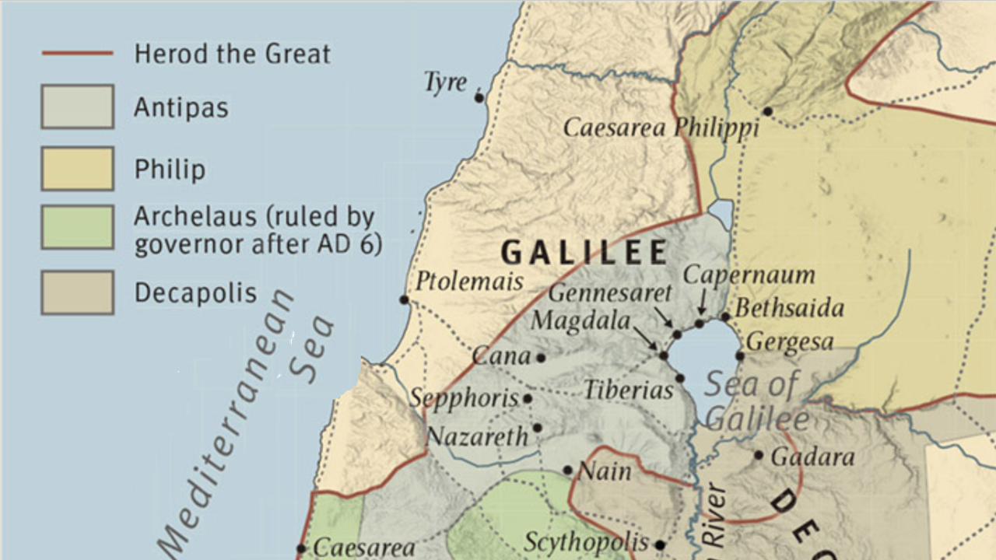

Slide 6
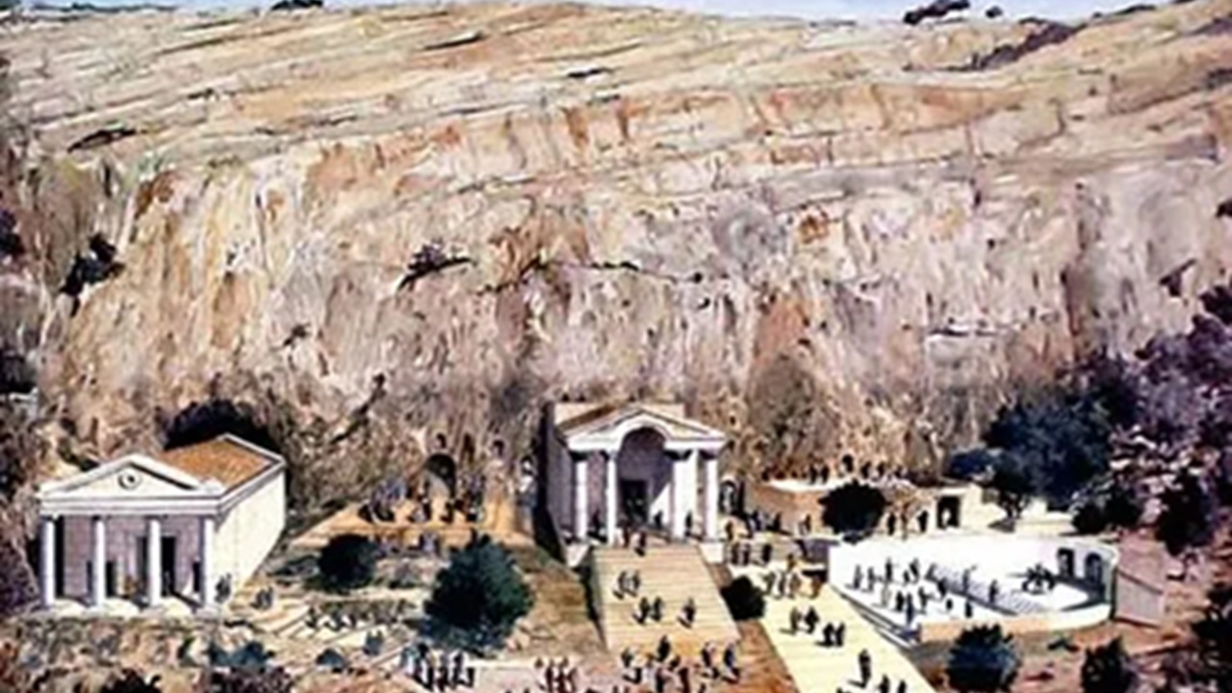

Slide 7
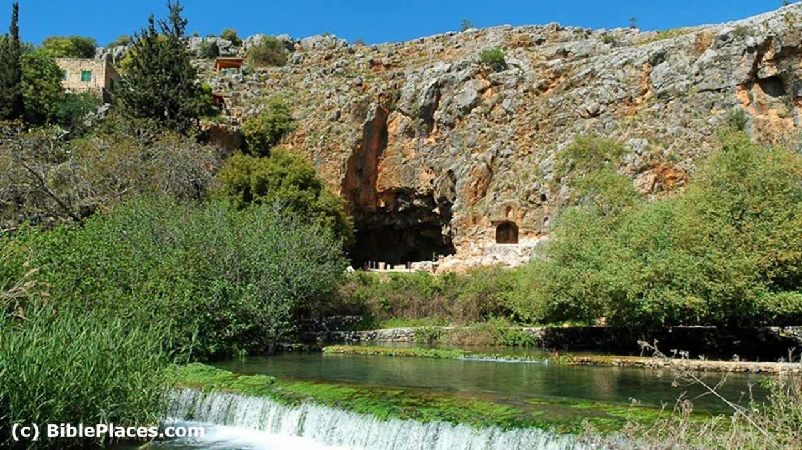

Slide 8
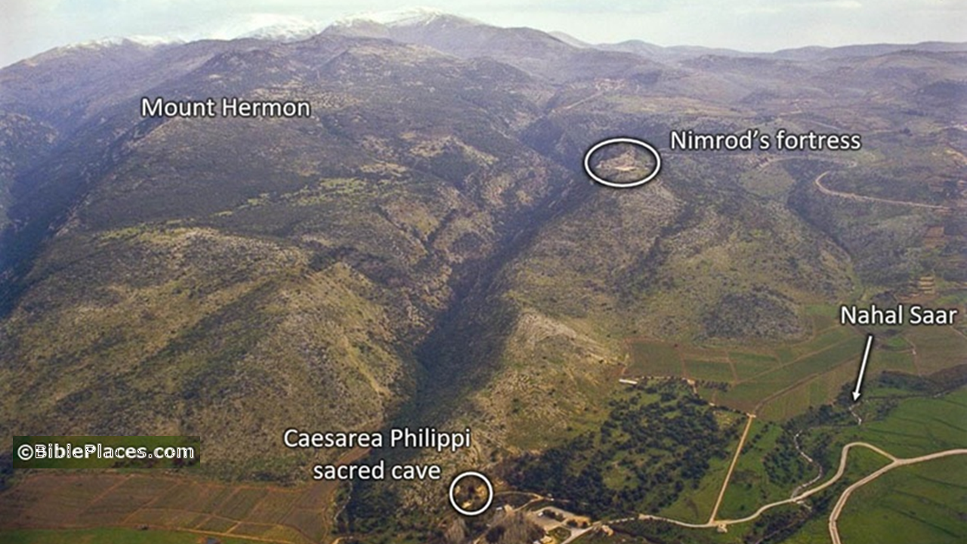

Slide 9
LOCIS #71, Mt 16, Mk 8, Lk 9
Jesus and his disciples … went to the villages of Caesarea Philippi. …
The disciples were with him, and he asked them, “Who do people say that I, the Son of Man, am?”
● Caesarea: Named for a pagan Emperor.
● Philip: Herodian (Arab) king.
● Son of Man: The conquering Messiah.

Slide 10
Who was/is Jesus?
“Some say John the Baptist,” they answered. “Others say Elijah, and still others say Jeremiah, or that some ancient prophet has reappeared.”
● Religions: Prophet, holy man, master.
● Cults: Angel, deified man, avatar.
● Atheists: Did not exist. Deluded rabbi.
● Answer: Messiah, Savior, and Lord.

Slide 11
“But you,” he said to them—”who do you say I am?”
Simon Peter answered, “You are the Messiah, the Son of the living God.”
● Messiah: Anointed son of King David.
● Son of God: A title for the Messiah whom God himself promised to send.

Slide 12
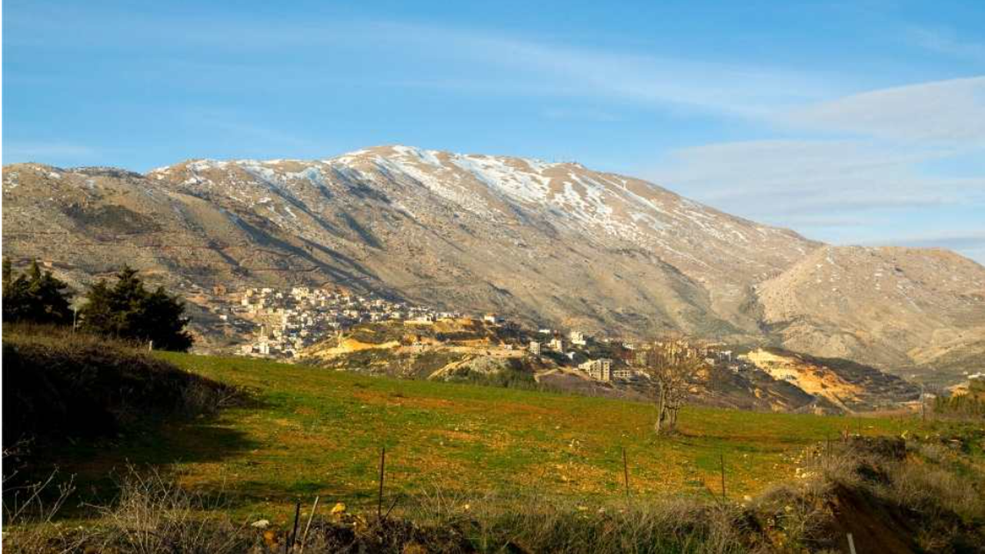
“Blessed are you, Simon son of Jonah!” Jesus said. “Flesh and blood did not reveal this to you, but my Father in heaven.
And I tell you that you are Peter, and on this rock I will build my church. All the gates of hell will not overcome it.
● Peter/rock: Petros / petra (Mt. Hermon).
● Gates of Hell: Pagan gods and demons.
● Church: OT = Israel; NT = All Christians.

Slide 13
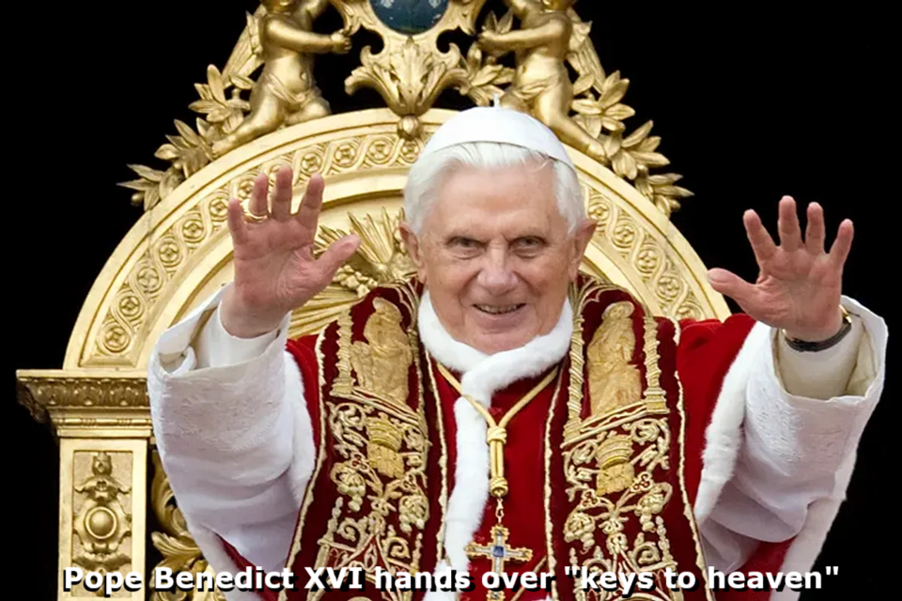
I will give you the keys to the kingdom of heaven. Whatever you bind on earth will have been bound in heaven, and what-ever you release on earth will have been released in heaven.”
● Keys: Allow in the faithful.
● Kingdom: Messiah’s future government.
● Bind/loose: Bind demons, loose people.
● Earth/heaven: Divine authority.

Slide 14
Matthew 18:18ff. “Truly, I say to you, whatever you bind on earth shall be bound in heaven, and whatever you loose on earth shall be loosed in heaven.
Again I say to you, if two of you agree on earth about anything they ask, it will be done for them by my Father in heaven.
● You: Plural = you apostles, or you all.
● Ask: Ask and watch for answers.

Slide 15
LOCIS #71, Mt 16, Mk 8, Lk 9
At that time he strictly warned his disciples to tell no one that he was the Messiah.
● Why? This had been his central claim!
● Messiah: The awaited King.
● Son of Man: The conqueror.
● Servant: Who suffers for our sins.

Slide 16
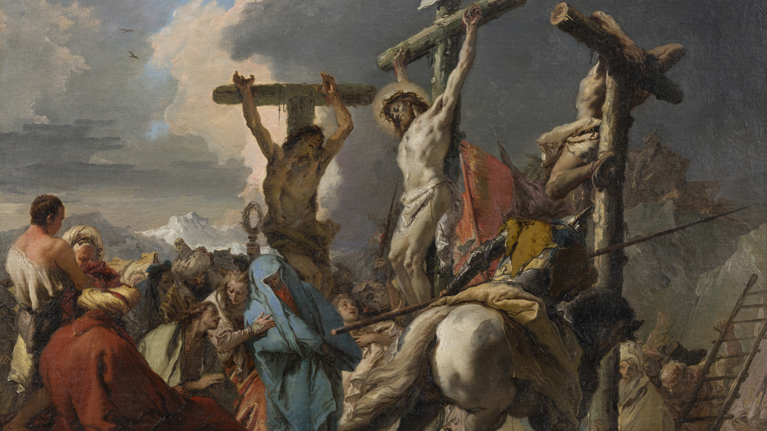
From that time on Jesus began to tell his disciples that he must travel to Jerusalem.
“The Son of Man must suffer many things and be rejected by the elders and chief priests and teachers of the law. He must be killed, and on the third day be raised again.” He said all this publicly.
● Must: What for?

Slide 17
Six days later Jesus took Peter and James and his brother John up on a high mountain so they could pray by themselves.
As he was praying, his appearance changed and he was transformed before their eyes.
● Mountain: Hermon, where the ‘sons of God came down, corrupted human beings and fathered Nephilim giants.

Slide 18
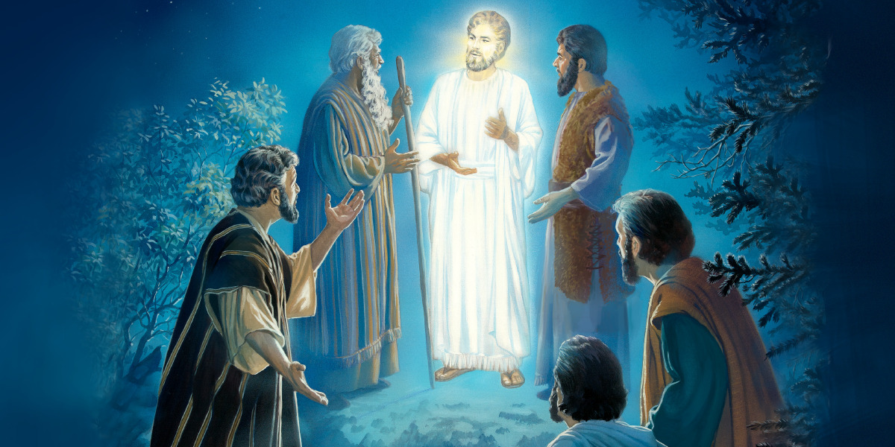
Suddenly two men—Moses and Elijah—appeared before them.
They also were shining, and they talked with Jesus about his coming departure which would occur in Jerusalem.
● Moses: Law. Predicted final prophet.
● Elijah: Was to appear again before the final Messenger came. Mal. 4:5f (3:23f)

Slide 19
Even as he was speaking, a bright cloud appeared overhead and covered them. They grew more frightened as the cloud enveloped them.
Suddenly a voice from the cloud said, “This is my beloved Son, in whom I delight. Listen to him!”
● Cloud: Presence of God’s glory.
● Son: Their faith will soon be challenged.

Slide 20
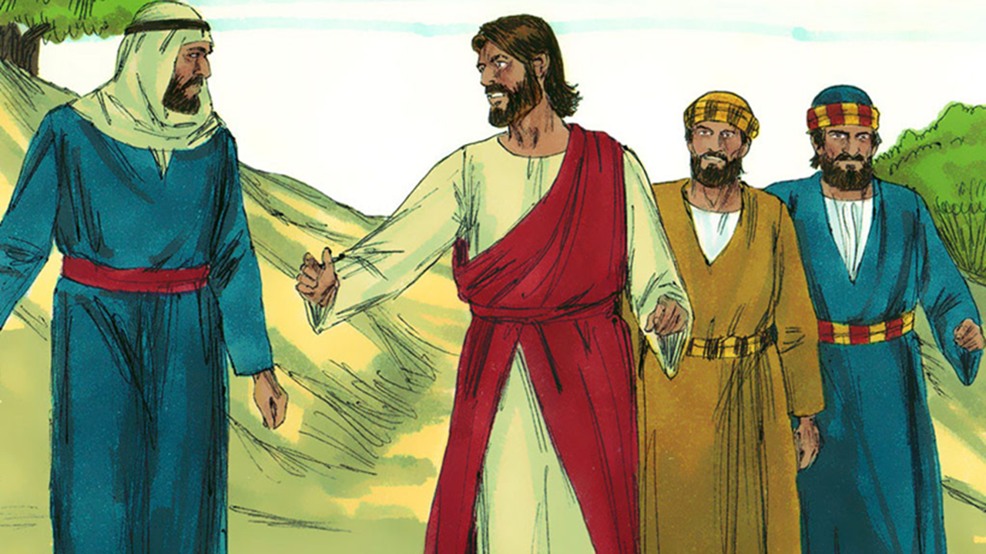
As they made their way down the mountain, Jesus told them not to tell anyone what they had seen until the Son of Man had risen from the dead.
So they kept quiet, telling no one at the time what they had seen and what Jesus had said. Among themselves they discussed what “rising from the dead” might mean.

Slide 21
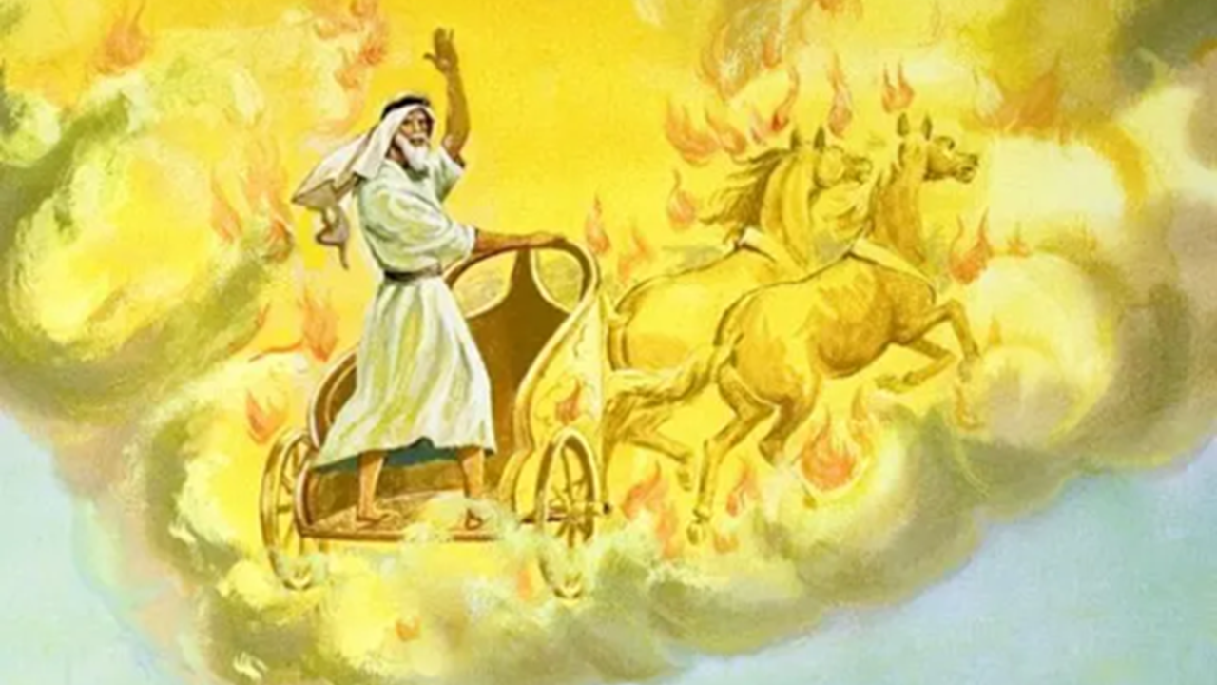
They also asked Jesus, “Why do the teachers of the law say that Elijah must come first?”
“Elijah is certainly coming first,” he answered, “and he will put all things in order. … Elijah already has come, yet they failed to recognize him and instead did to him anything they wanted—just as it was predicted.

Slide 22
They will subject the Son of Man to the same sort of suffering. Do you remember what is predicted about the Son of Man? It is written that he will suffer many things and be despised.”
Finally the disciples understood that he had spoken to them about John the Baptist.
● John: How did he suffer?

Slide 23
14 Biblical titles for Messiah
1 Anointed: Messiah/Christ. 1 Sam 2:10.
2 Branch: Jer. 23:5
3 David: Hos. 3:5
4 God: Isa. 9:6
5 Holy One: Psa. 16:10
6 King: Zech. 9:9

Slide 24
7 My Lord: Psa. 110:1
8 The LORD: Yahweh. Zech. 14:3-4
9 Prophet: Deut. 18:15
10 Righteous One: Isa. 53:11
11 Ruler: Mic. 5:2
12 Servant: Isa. 4:1
13 Shepherd: Ezek. 37:24
14 Son of Man: Dan. 7:13

Slide 26
Assignment
● Visit LOCIS.site
● Read or listen to chapter 15, sections 92-105.
● Be ready to share your insights, queries and objections.

