Slide 1
The Life of Christ in Stereo

Slide 2
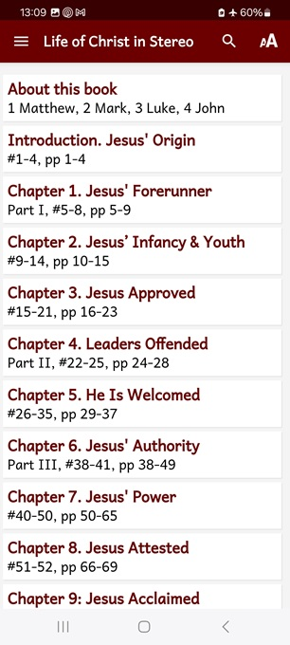
Session 10: Chapter 15, ##92-105
Towards Jerusalem, Spring AD 32
● What did you learn that was new, helpful, or important?
● What questions do you have about what you read?

Slide 3
Seven phases of Jesus’ Life
1 Announced by heaven & by John (1-3)
2 Early teaching and miracles (4-5)
3 Public fame and favor (6-9)
4 Early rejections (10-12)
5 Moving towards the cross (13-17)
6 Final days at Jerusalem (18-19)
7 Crucifixion and resurrection (20-21)

Slide 4
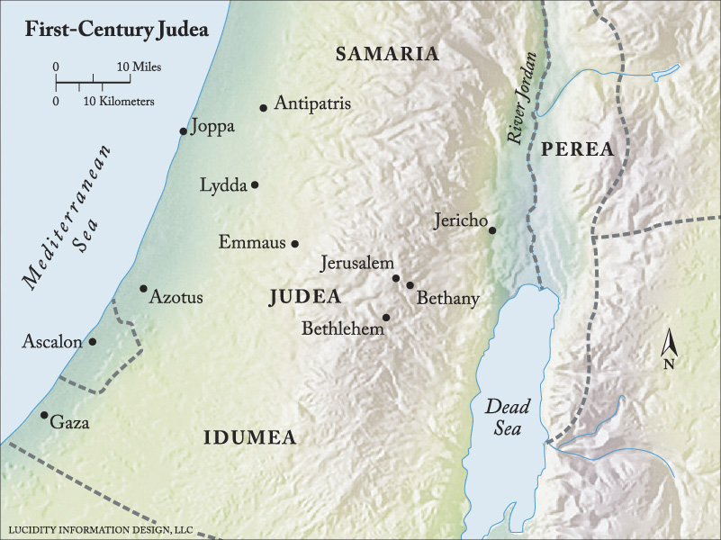

Slide 5
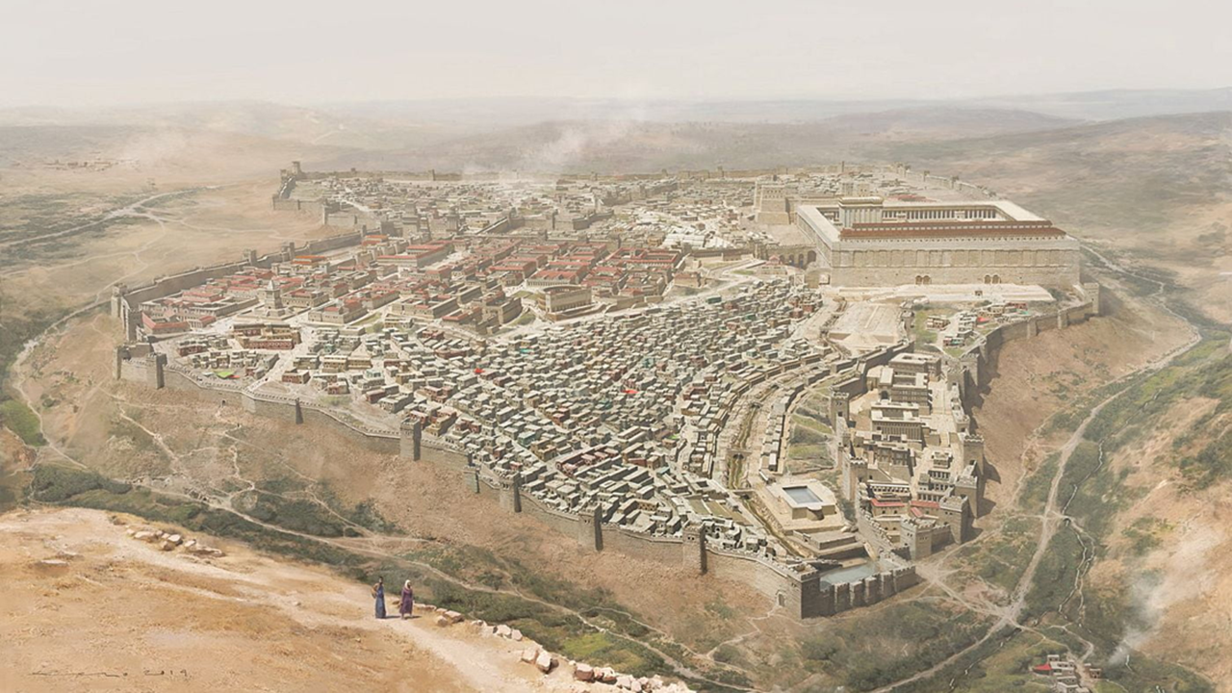
“O Jerusalem, Jerusalem!”
“The city that kills the prophets…! How often would I have gathered your children together… and you were not willing!”
And he said to them, “Strive to enter through the narrow door. For many, I tell you, will seek to enter and will not be able.”

Slide 6
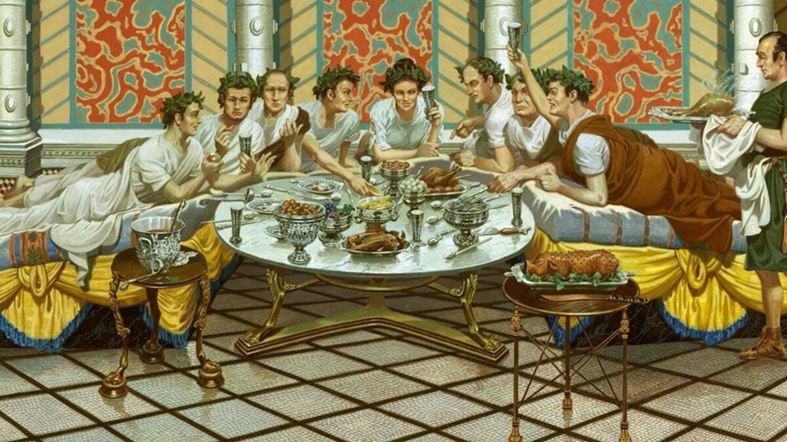
The Great Banquet
“Everyone who exalts himself will be humbled, and he who humbles himself will be exalted.
‘Go out to the highways and hedges and compel people to come in, that my house may be filled. For I tell you, none of those men who were invited shall taste my banquet.’”

Slide 7
The Cost of Discipleship
“If anyone comes to me and does not hate his own father and mother and wife and children and brothers and sisters, yes, and even his own life, he cannot be my disciple.”
“Whoever does not bear his own cross and come after me cannot be my disciple.”

Slide 8
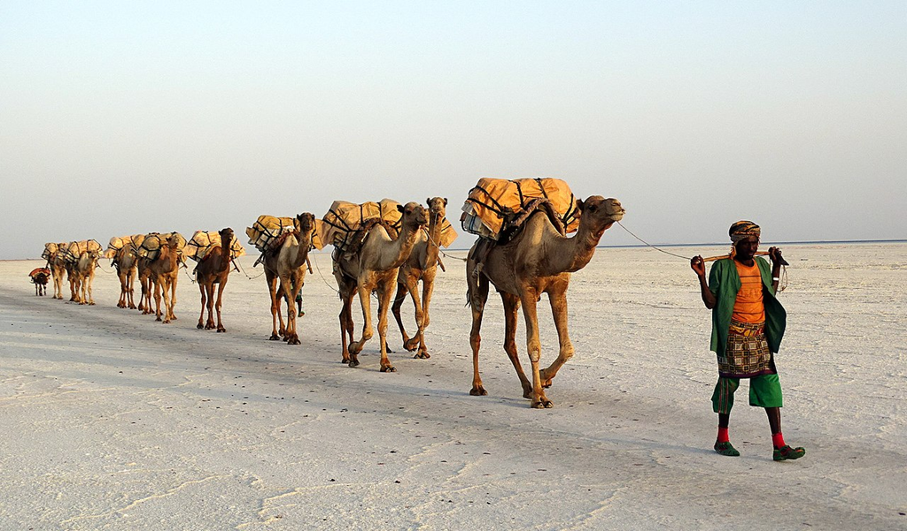
Salt Without Taste Is Worthless
“Salt is good, but if salt has lost its taste, how shall its saltiness be restored? It is of no use either for the soil or for the manure pile. It is thrown away.”
“He who has ears to hear, let him hear.”
● Salt: Rock salt may leave impurities when its sodium chloride leaches out.

Slide 9
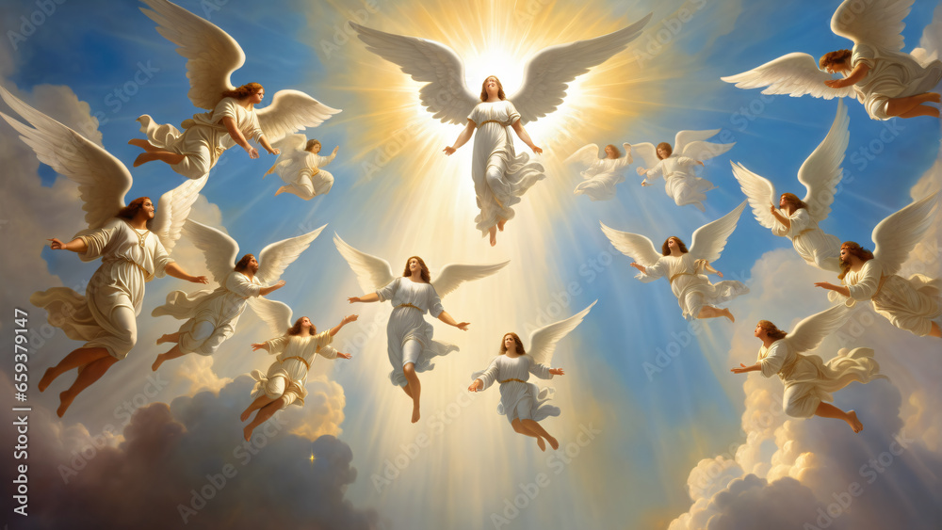
A lost sheep, a lost coin
“There will be more joy in heaven over one sinner who repents than over ninety-nine righteous persons who need no repentance.
“There is joy before the angels of God over one sinner who repents.”
● Joy: Who rejoices in heaven?

Slide 10
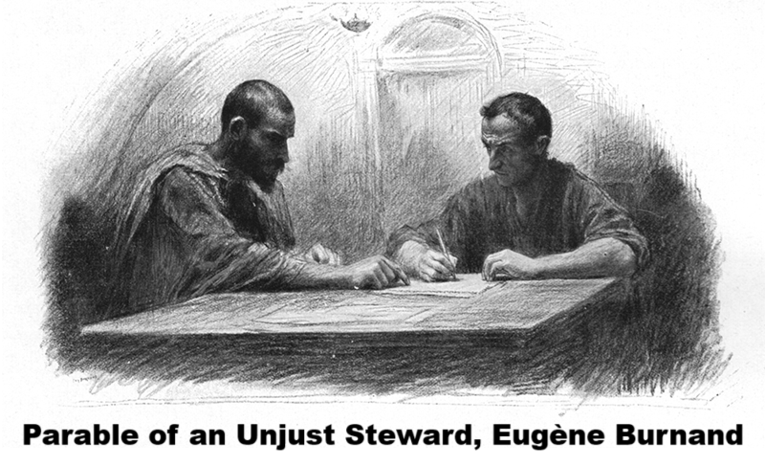
A dishonest manager
“One who is faithful in a very little is also faithful in much, and one who is dishonest in a very little is also dishonest in much…
No servant can serve two masters, for either he will hate the one and love the other, or he will be devoted to the one and despise the other. You cannot serve God and money.”

Slide 11
If your brother sins…
“Temptations to sin are sure to come, but woe to the one through whom they come!”
“If your brother sins, rebuke him, and if he repents, forgive him, and if he sins against you seven times in the day, and turns to you seven times, saying, ‘I repent,’ [then] you must forgive him.”

Slide 12
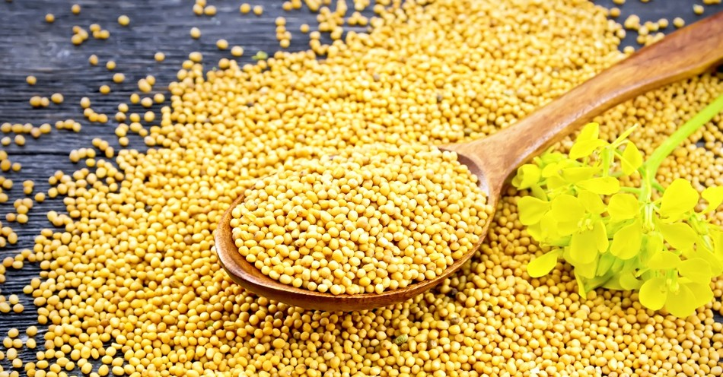
“Increase our faith”
The apostles said to the Lord, “Increase our faith!”
And the Lord said, “If you had faith like a grain of mustard seed, you could say to this mulberry tree, ‘Be uprooted and planted in the sea,’ and it would obey you.”

Slide 13
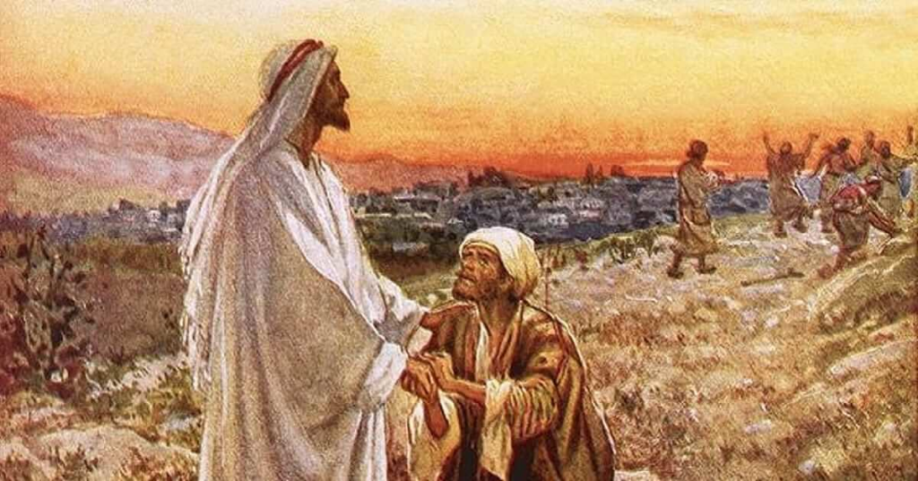
Jesus Cleanses Ten Lepers
He was a Samaritan. Then Jesus answered, “Were not ten cleansed? Where are the nine? Was no one found to return and give praise to God except this foreigner?”
And [Jesus] said to him, “Rise and go your way; your faith has made you well.”

Slide 14
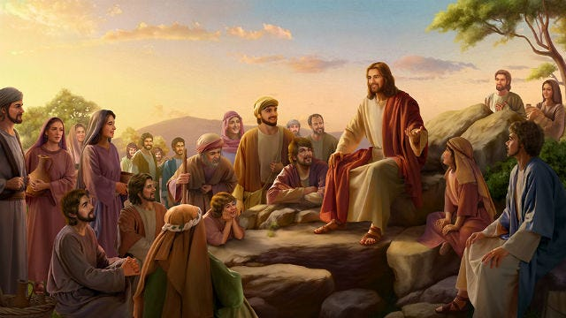
The coming of the Kingdom
Being asked by the Pharisees when the kingdom of God would come, he answered them, “The kingdom of God is not coming in ways that can be observed, nor will they say, ‘Look, here it is!’ or ‘There!’
for behold, the kingdom of God is in the midst of you.”
● Midst: The King was there!

Slide 16
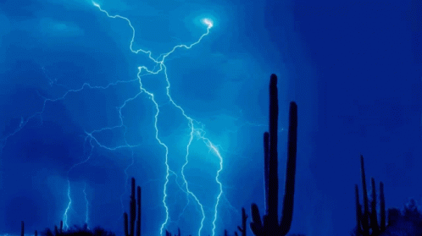
The coming of the Son of Man
“The days are coming when you will desire to see one of the days of the Son of Man… As the lightning flashes and lights up the sky from one side to the other, so will the Son of Man be in his day.
But first he must suffer many things and be rejected by this generation.
● Generation: Those then alive.

Slide 17
The coming of justice
“Will not God give justice to his elect, who cry to him day and night? Will he delay long over them? I tell you, he will give justice to them speedily.
“Nevertheless, when the Son of Man comes, will he find faith on earth?”
● Speedily: When?

Slide 18
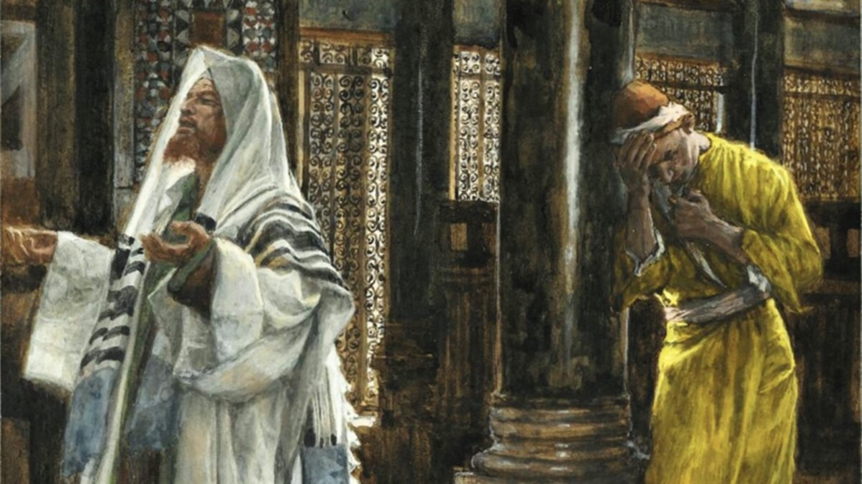
Who will be exalted?
[Jesus] also told this parable to some who trusted in themselves that they were righteous, and treated others with contempt:
“Two men went up into the temple to pray, one a Pharisee and the other a tax collector…
● Pharisee: Admired by religious folk.
● Tax collector: Despised by most folk.

Slide 19
Repentance, not religion
The Pharisee, standing by himself, prayed thus: ‘God, I thank you that I am not like other men, extortioners, unjust, adulterers, or even like this tax collector.
I fast twice a week; I give tithes of all that I get.’
● Fasting: Not commanded. Lev. 16:29 (?)
● Tithing: Commanded to feed the needy.

Slide 20
But the tax collector, standing far off, would not even lift up his eyes to heaven, but beat his breast, saying, ‘God, be merciful to me, a sinner!’
I tell you, this man went down to his house justified, rather than the other. For everyone who exalts himself will be humbled, but the one who humbles himself will be exalted.”
● Merciful: Gk, ‘be reconciled’ with me.

Slide 21
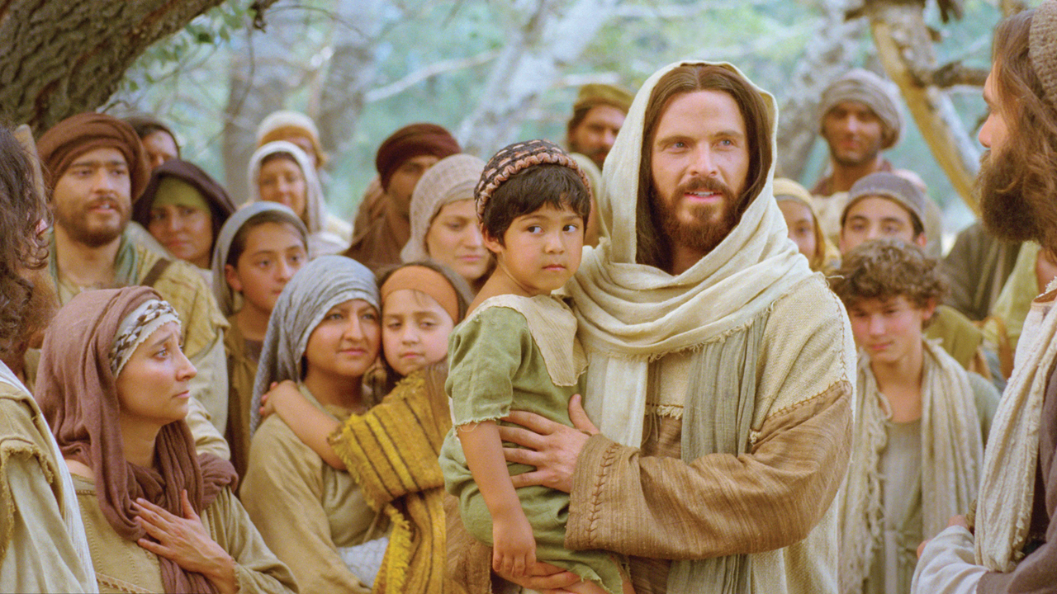
Now they were bringing even infants to him that he might touch them. And when the disciples saw it, they rebuked them. But Jesus called them to him, saying,
“Let the children come to me, and do not hinder them, for to such belongs the kingdom of God… Whoever does not receive the kingdom of God like a child shall not enter it.”

Slide 22
Assignment
● Visit LOCIS.site
● Read or listen to chapters 16 & 17, sections 106-115.
● Be ready to share your insights, queries and objections.

Slide 23
…
…
…
● …: …

Slide 24
…
1 …: ….
2 …: …
3 …: …
4 …: …
5 …: …
6 …: …

