Slide 1
The Life of Christ in Stereo

Slide 2
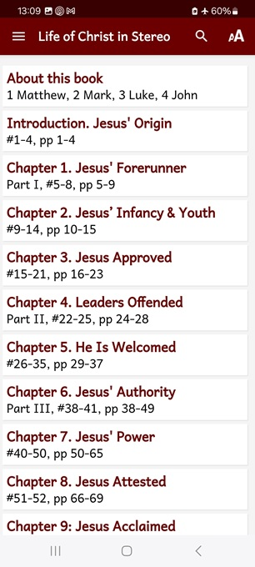
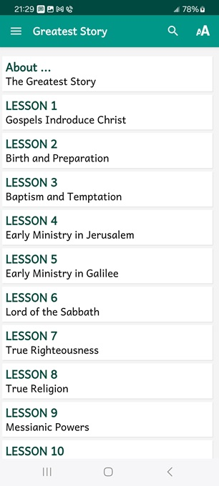
Session 11, March 20th & 23rd
LOCIS 16 & 17 or Greatest Story 20
“On the Way to Jerusalem”
Autumn AD 32 through Spring AD 33
● What did you learn that was new, helpful, or important?
● What questions do you have about what you read?

Slide 3
Seven phases of Jesus’ Life
1 Announced by heaven & by John (1-3)
2 Early teaching and miracles (4-5)
3 Public fame and favor (6-9)
4 Early rejections (10-12)
5 Moving towards the cross (13-17)
6 Final days at Jerusalem (18-19)
7 Crucifixion and resurrection (20-21)

Slide 4
Apparent order of events
1 Jesus claims equality with the Father.
2 Judean leaders seek to harm him.
3 He escapes beyond the Jordan (Jn 10).
4 He returns to Jericho (Mt, Mk, Lk).
5 He comes to Bethany (Jn 11).
6 He raises Lazarus back to life.
7 He escapes to Ephraim town.
● LOCIS has Bethany before Jericho.

Slide 5
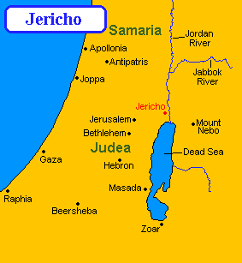
Jerusalem–Jericho, 20 miles, 30 kms

Slide 6
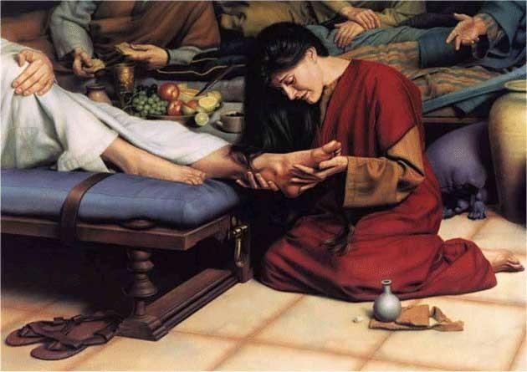
Gospel of John 11:16-44 TGS
A man named Lazarus was sick. He was from Bethany, the village of Mary and her sister Martha.
(This was the same Mary who anointed the Lord with ointment and wiped his feet with her hair. It was her brother Lazarus who was sick.)
● Bethany: 2 mi. or 3 km. from Jerusalem

Slide 7
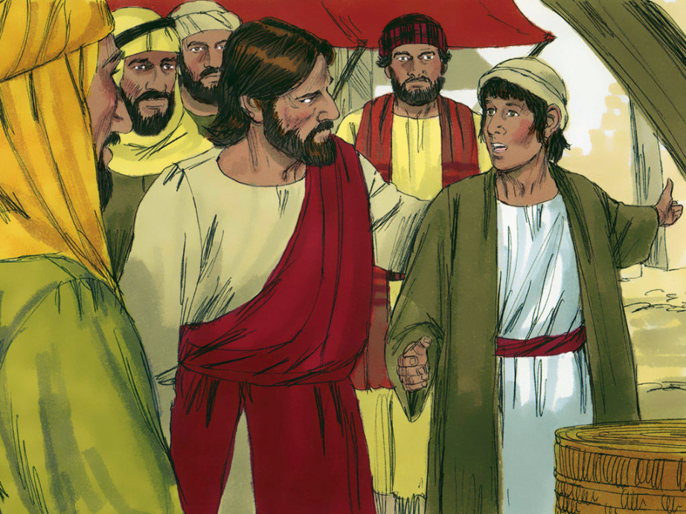
The sisters sent word to Jesus, “Lord, the one you love is sick.” When Jesus heard this, he said, “This sickness will not end in death. Instead it will show the glory of God, and through it the Son of Man will be glorified.” …
Jesus … stayed two more days where he was. Afterward he said to his disciples, “Let’s return to Judea.”

Slide 8
“Rabbi,” the disciples replied, “not long ago the [Judeans] were trying to stone you. Why are you going there again? …
Then he added, “Our friend Lazarus has fallen asleep. I am going to wake him up.” “Lord, if he has fallen asleep, he’ll get better.” Jesus had spoken of his death, but his disciples thought he was talking about literal sleep.

Slide 9
Then Jesus said to them plainly, “Lazarus is dead. And for your sake I’m glad I wasn’t there. Now you will have the opportunity to believe. But let us go to him.”
Thomas (also called Didymus) said to his fellow disciples, “Let’s go, too, so we may die with him.”
● Didymus: “Twin”. (Modern ‘ditto’.)

Slide 10
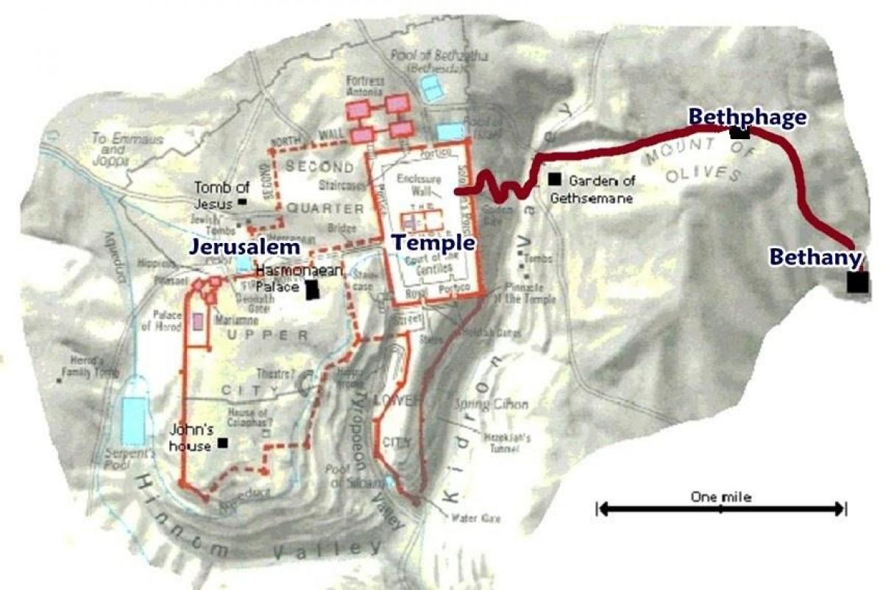
When Jesus arrived, he found that Lazarus … had been in the tomb for four days. Since Bethany was near Jerusalem (less than two miles away) … [Judeans] had come to Martha and Mary to comfort them about their brother’s death.
As soon as Martha heard that Jesus was coming, she hurried out to meet him, while Mary continued sitting in the house.

Slide 11
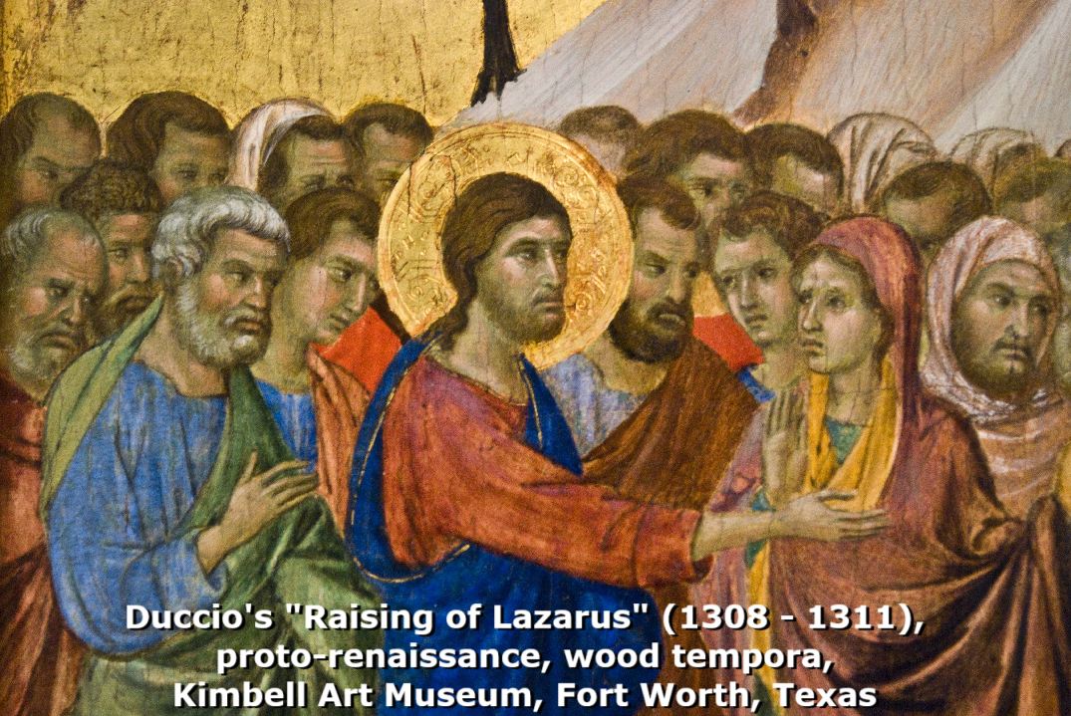
Martha said to Jesus, “Lord, if you had been here my brother would not have died! Yet even now I know that God will give you anything you ask for.”
Jesus said to her, “Your brother will rise again.” “I know that he will rise again in the resurrection at the end of time,” Martha replied.
● Resurrection: When all will live again.

Slide 12
Our future as Christian believers
1 Die and go be with the Lord.
2 ‘Interim’ bodies in heaven.
3 New Jerusalem rejoicing with angels.
4 Return with Jesus in the sky.
5 Resurrected with glorified bodies.
6 Rewards for good done on earth.
7 Reign with Jesus for 1000 years.
8 Live with him on a new earth forever.

Slide 13
Jesus said to her, “I am the resurrection and the life. Whoever believes in me will live, even if he should die. And whoever lives and believes in me shall never die. Do you believe this?”
“Yes, Lord!” she answered. “I, too, have believed that you’re the Messiah, the Son of God who was to come into the world.”

Slide 14
… When the [Judeans] who had come to the house to comfort Mary saw her get up quickly and leave, they followed her, thinking she was going to the tomb to weep there.
As soon as Mary reached Jesus, she fell at his feet. “Lord,” she said, “if you had been here my brother would not have died.”
● If: Different sister, same reproof.

Slide 15
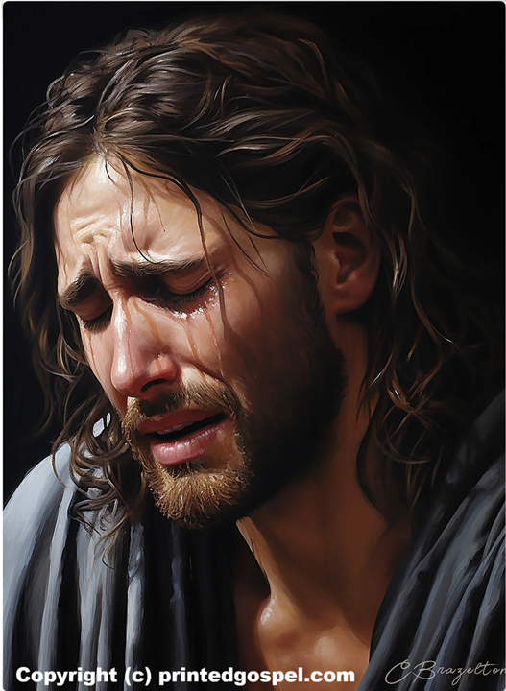
When Jesus saw both her and the [Judeans] weeping, he sighed deeply and was troubled. “Where have you laid him?” he asked. “Lord, come and see,” they answered. Jesus wept.
Yet some of the [Judeans] remarked, “Couldn’t the man who gave sight to the blind have kept this man from dying?”
● Why did Jesus allow Lazarus to die?

Slide 16
Why Jesus let Lazarus die
● To reveal his divine power over death.
● To prefigure his own resurrection (after three days dead in a tomb).
● To provoke hostile authorities to take action against him in Jerusalem.
● To comfort us when we pray for sick folk who die anyway.
● To strengthen our hope in him.

Slide 17
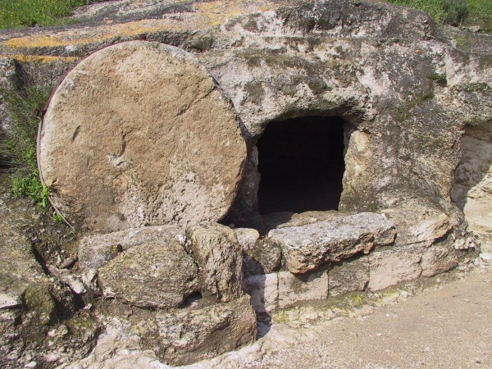
Jesus sighed deeply once more as he came to the tomb. It was a cave, with a stone covering the entrance. “Take away the stone,” Jesus said.
“Lord, by this time there is a stench,” replied Martha, the dead man’s sister. “It’s been four days.”
● Cave: Cool and safe from beasts.
● Stone: Against stench and thieves.

Slide 18
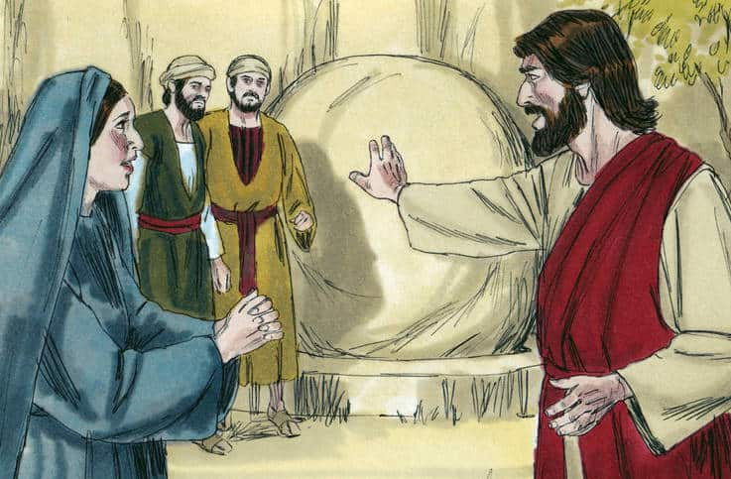
“Didn’t I tell you,” said Jesus, “that if you believe, you would see the glory of God?” So they removed the stone from the place they had laid the dead man.
Jesus looked up to heaven and said, “Father, I thank you that you heard me. I knew you always hear me, but I said it because of the crowd standing here, so they may believe you really sent me.”

Slide 19
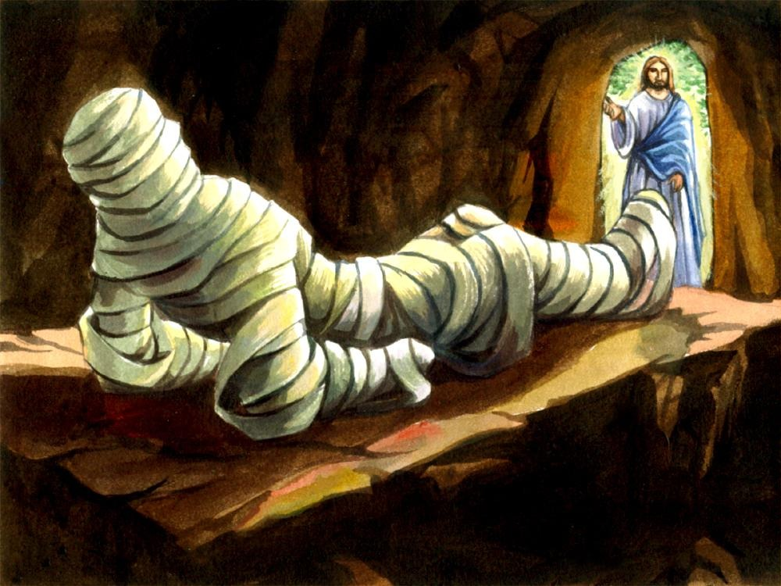
Then Jesus shouted, “Lazarus, come out!”
The one who had been dead came out, wrapped tightly from head to toe in strips of linen, and his face wrapped in a cloth.
“Take off the grave clothes,” Jesus said to the people there, “and let him go.”
● Resurrection: To receive a glorified body.
● Resuscitation: To come back to life.

Slide 20
Many of the Judeans who visited Mary and saw what Jesus did believed in him.
But others went to the Pharisees and told them what Jesus had done.
The chief priests and the Pharisees called a meeting and said, “What are we accomplishing? This man is performing many miracles.
● Assess: Strengths and threats.

Slide 21
Leaders’ assessment measures
Situational analysis
● Strengths
● Weaknesses
● Opportunities
● Threats
What must change?
Needed change assessment
● Important and urgent
● Important, not urgent
● Urgent, not important
● Neither urgent nor important
Whom to appoint?

Slide 22
If we let him continue, everyone will believe in him, and the Romans will come and take away both our temple and our nation.
Basic human motives
● Hope: Strive for a better future.
● Anger: Strike against enemies.
● Loss: Seek to restore losses.
● Fear: Seek to avoid losses.

Slide 23
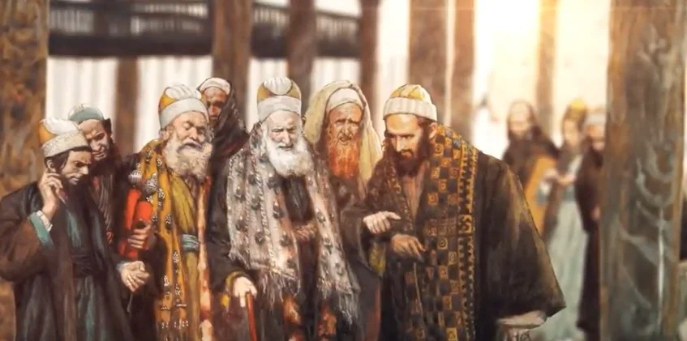
One of them, named Caiaphas, was high priest that year. “You know nothing!” he told them. “You don’t see that it’s necessary for one man to die for the people so the whole nation won’t be destroyed.”
● Jesus had not yet become “the Apostle and High Priest whom we confess” (Hebrews 3:1).

Slide 24
He did not say this on his own, but as high priest that year he was prophesying that Jesus would die on behalf of the nation.
Four biblical offices
● Prophet: Speak to people for God.
● Priest: Speak to God for people.
● King: Rule over people for God.
● Sage: Train people to live for God.

Slide 25
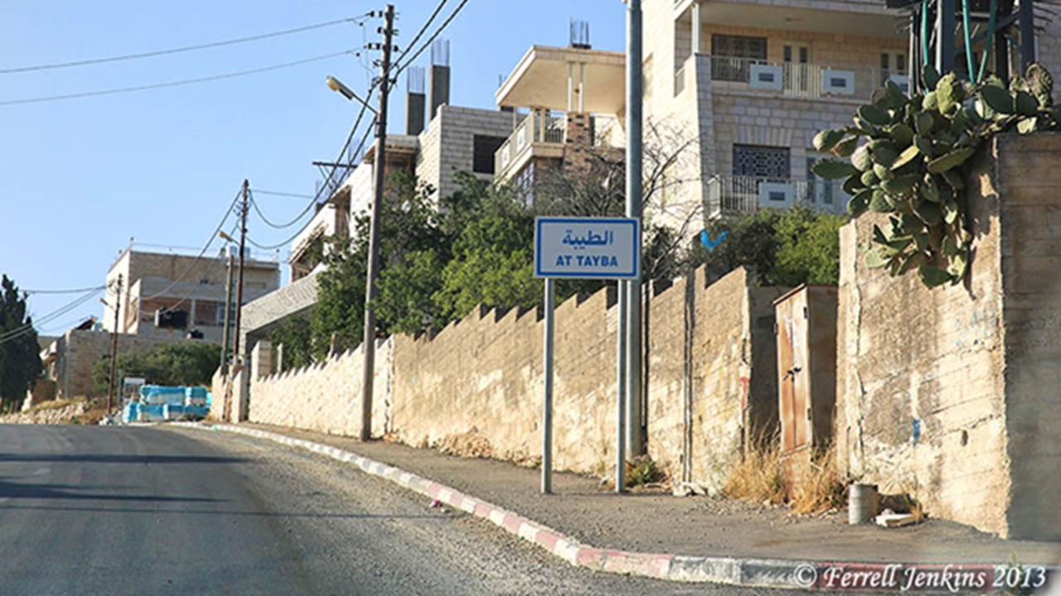
From that day on they discussed how they might kill him. That is why Jesus stopped walking around openly among the [Judeans] and instead left and went to the town of Ephraim, in the region near the desert.
● Ephraim: Possibly ancient Ophra or Afra, today al-Tayib (الطيبه), a town about 15 miles north of Jerusalem.

Slide 26
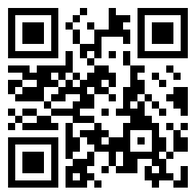
Assignment
● Visit LOCIS.site
● Read or listen to LOCIS chapter 18a or Greatest Story lesson 21.
● Be ready to share your insights, queries and objections.

