Slide 1
The Life of Christ in Stereo

Slide 2
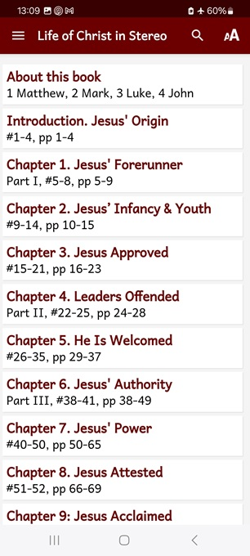
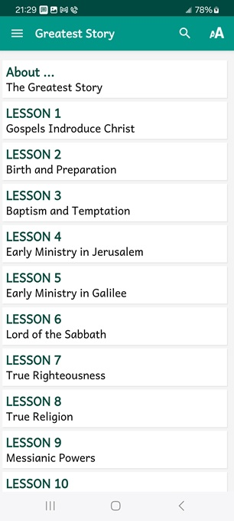
LOCIS session 13, ## 127-132
If you gather in a group, then pose these queries after viewing each slide.
● What did you learn that was new, helpful, or important?
● What questions do you have about what you read?

Slide 3
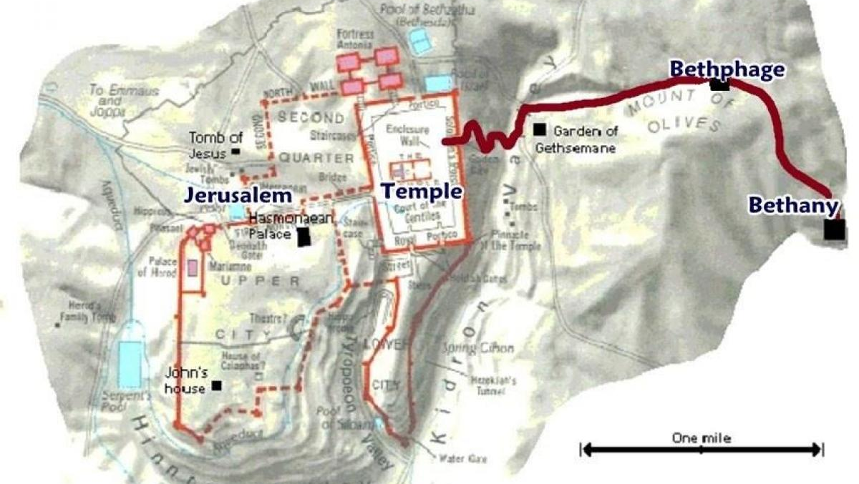
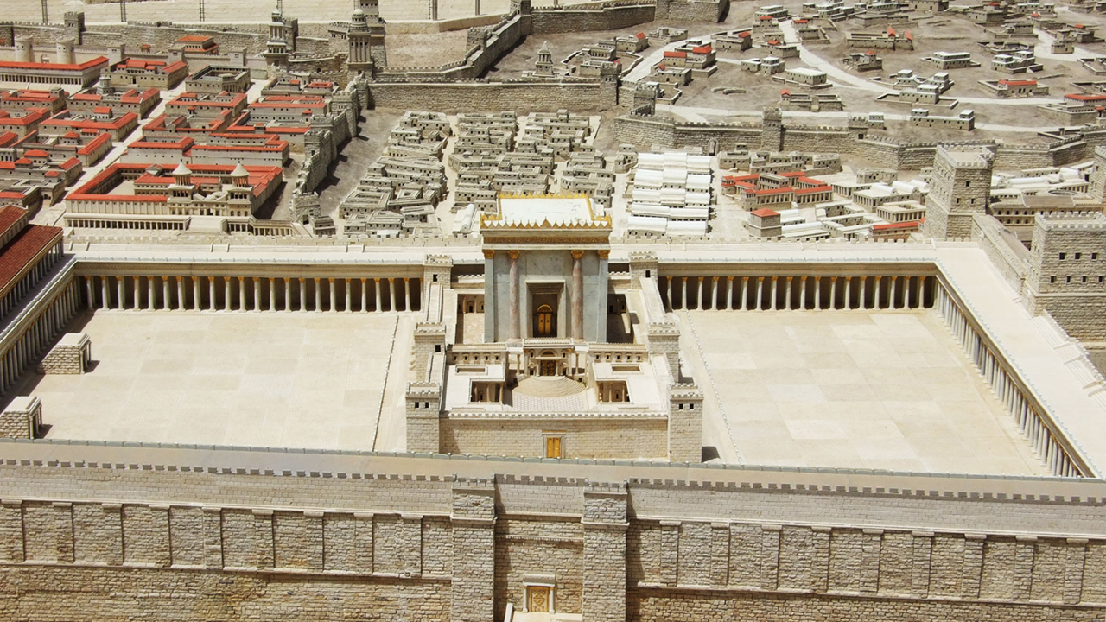
Seven phases of Jesus’ Life
1 Announced by heaven & by John (1-3)
2 Early teaching and miracles (4-5)
3 Public fame and favor (6-9)
4 Early rejections (10-12)
5 Moving towards the cross (13-17)
6 Final days at Jerusalem (18-19)
7 Crucifixion and resurrection (20-21)

Slide 4
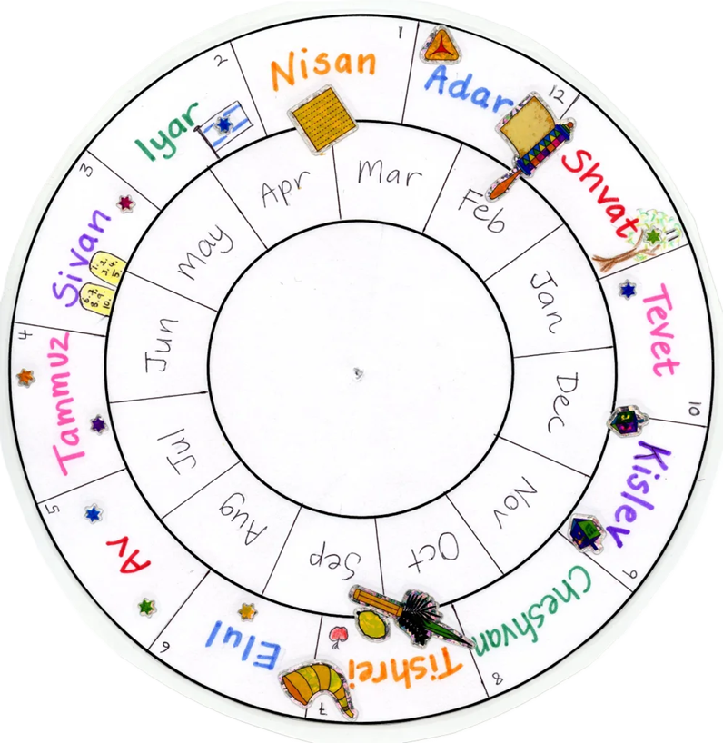
Apparent Calendar
● Wednesday, March 31st and Thursday, April 1st, AD 33 =
● Nisan 12th &13th, 3793.
● He teaches each day in Jerusalem, foretelling the city’s invasion.
● He passes nights on the Mount of Olives with the annual pilgrims.

Slide 5
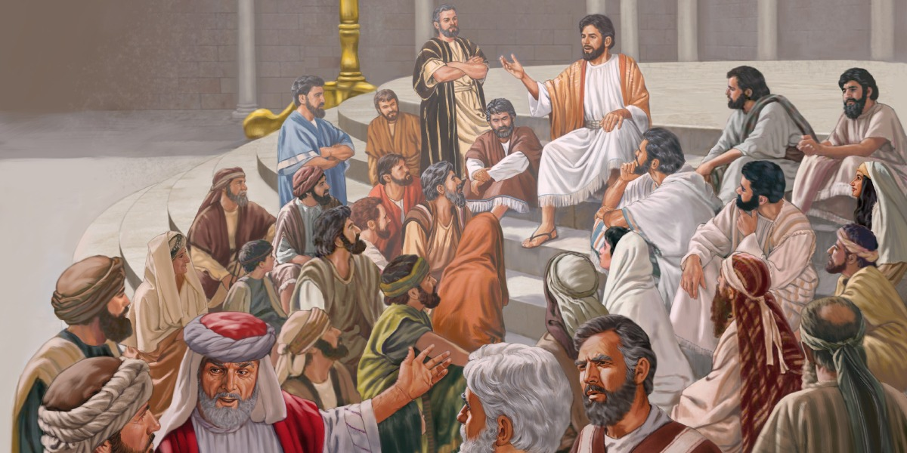
#127 ¹ While the Pharisees were assembled together ² and Jesus was teaching in the temple, ¹ he put to them a question, “What do you think concerning the Messiah? Whose son is he?”
They replied to him, “The son of David.”
● Pharisees: Religious experts
● Messiah: Awaited national savior-king
● David: Ancient Israelite king

Slide 6
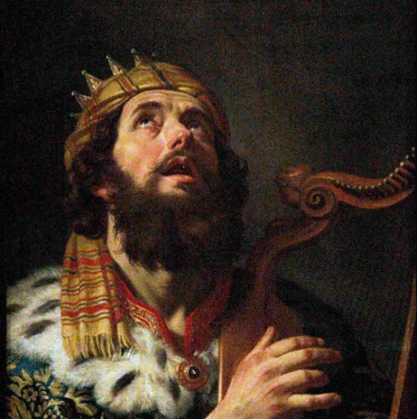
³ But he said, ² “How can the scribes say that the Messiah is David’s son? ¹ How then does David in the Spirit call him ‘Lord’? ² For David himself said by the Holy Spirit ³ in the Psalms [110:1],
‘The Lord ^{Yahweh} said to my Lord ^{Adon},
Sit thou at my right hand,
till I make thine enemies thy footstool.’
● Adon: Any social superior.

Slide 7
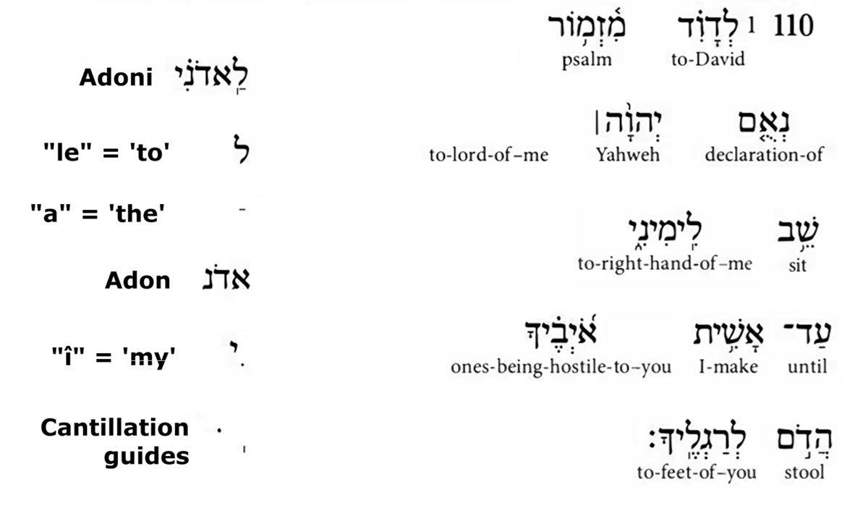

Slide 8
³ Therefore David ² himself ³ is calling him ‘Lord, ‘so how is he then his son?”
¹ No one could answer him a word, nor from that day dared anyone to ask him another question. ² And the great crowd of common folk listened to him gladly.
● How: Although a physical descendent, Messiah was Yahweh in human form.

Slide 9
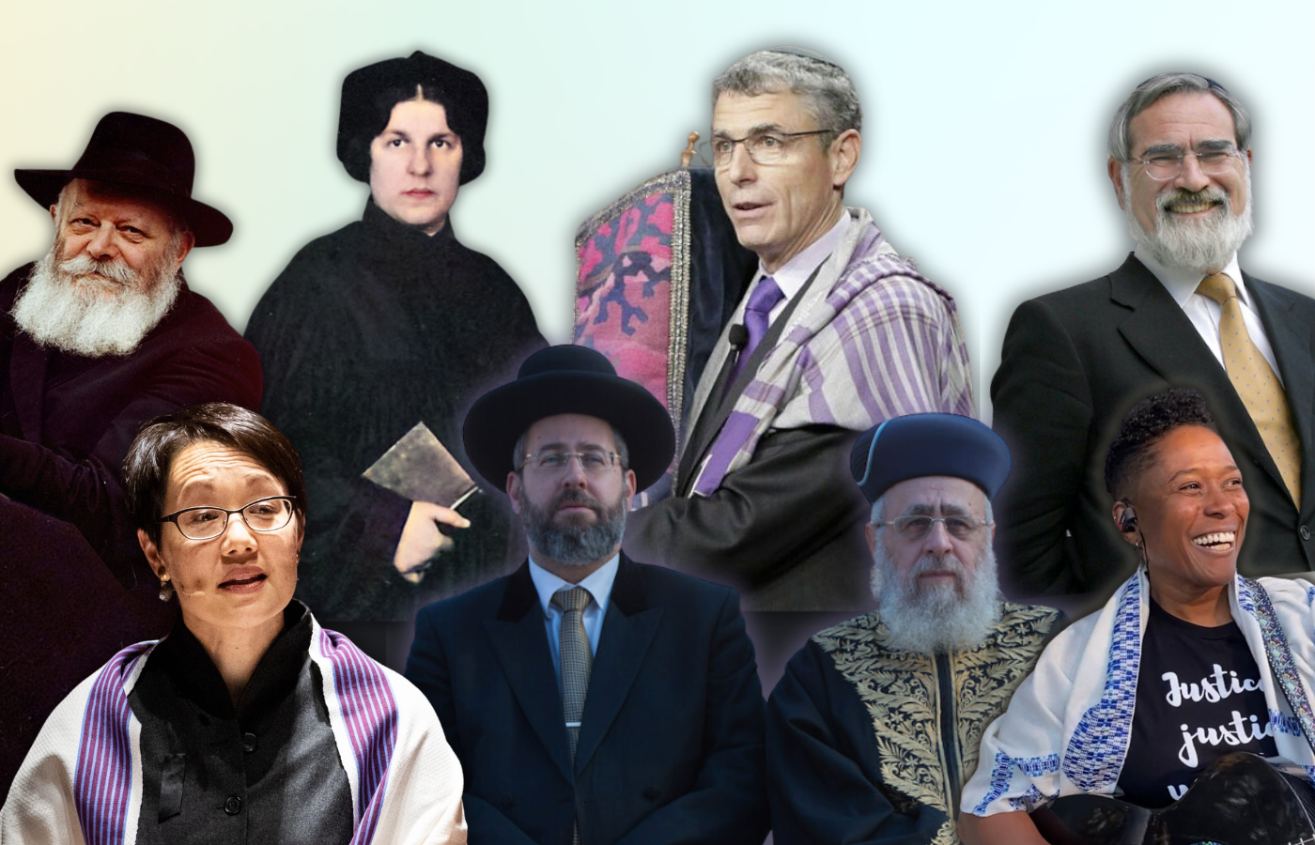
#128 Do not you be called ‘Rabbi;’ for One is your Teacher, the Christ, and you yourselves are all brethren. And call not anyone on earth your Father; for One is your Father, He who is in heaven.
Neither be called masters; for One is your Master, the Christ.
● Christ: Greek word = Hebrew Messiah
● Rabbi, father, master: Honorific titles

Slide 10
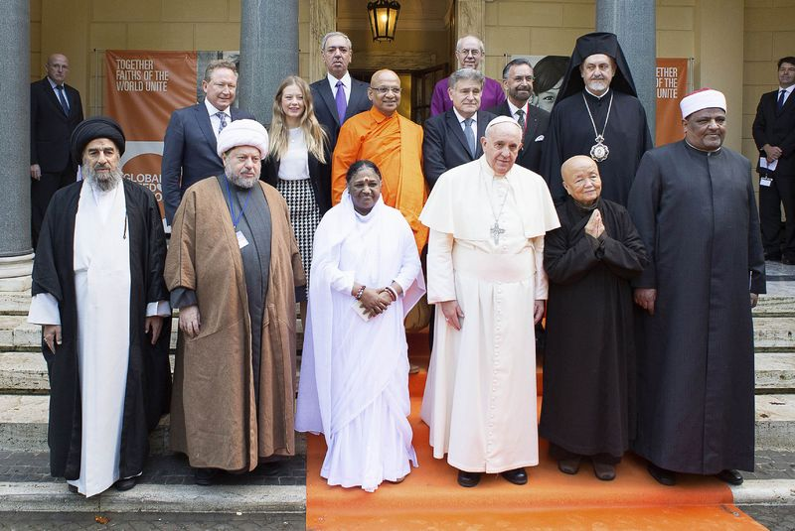
Honored titles in religion
1 Rabbi: Judaism
3 Teacher: Greco-Roman philosophy
2 Christ/Messiah: Christianity
4 Father: Catholicism & Orthodoxy
5 Master: Hinduism & Buddhism
● We learn together from Jesus (Bible).

Slide 11
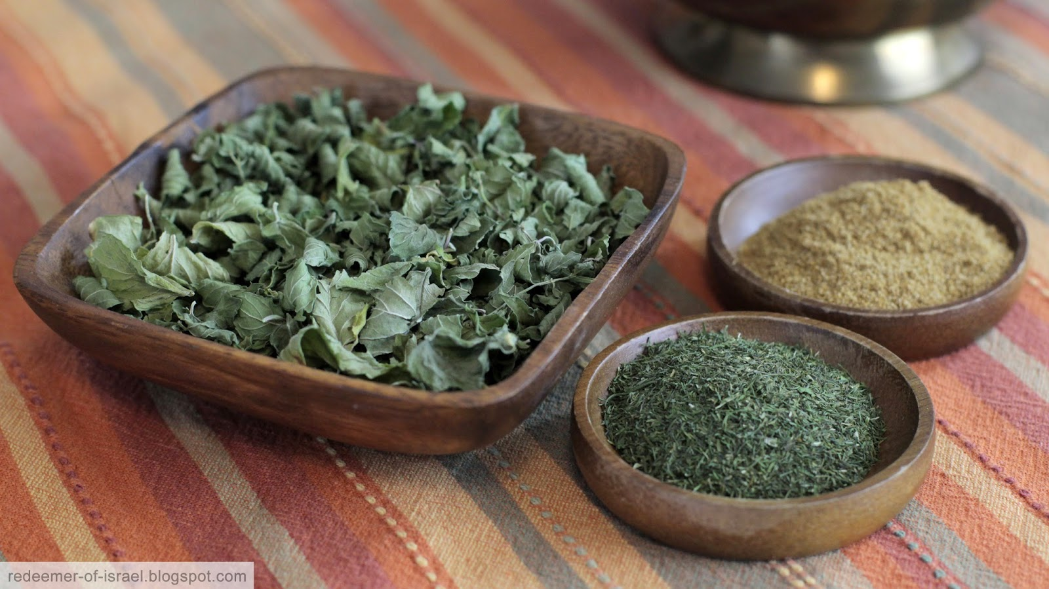
“Woe to you, scribes and Pharisees — hypocrites! For you pay tithes of mint and dill and cumin, but have ignored the weightier things of the law — justice, mercy, and fidelity.”
● Justice: Give what each one deserves.
● Mercy: Give what each one needs.
● Fidelity: Give what each one hopes.

Slide 12
Biblical trilogies
● Social:
● Spiritual:
● Divine: ● Political:
● Realms:
● Gifts:
● Leaders:
● Saved:
Justice, mercy, and fidelity.
Faith, hope and love.
Father, Son and Spirit.
Prophet, priest and king.
Heaven, earth and grave.
Speaking, serving and signs.
Elders, pastors and deacons.
Repent, believe and baptism.

Slide 13
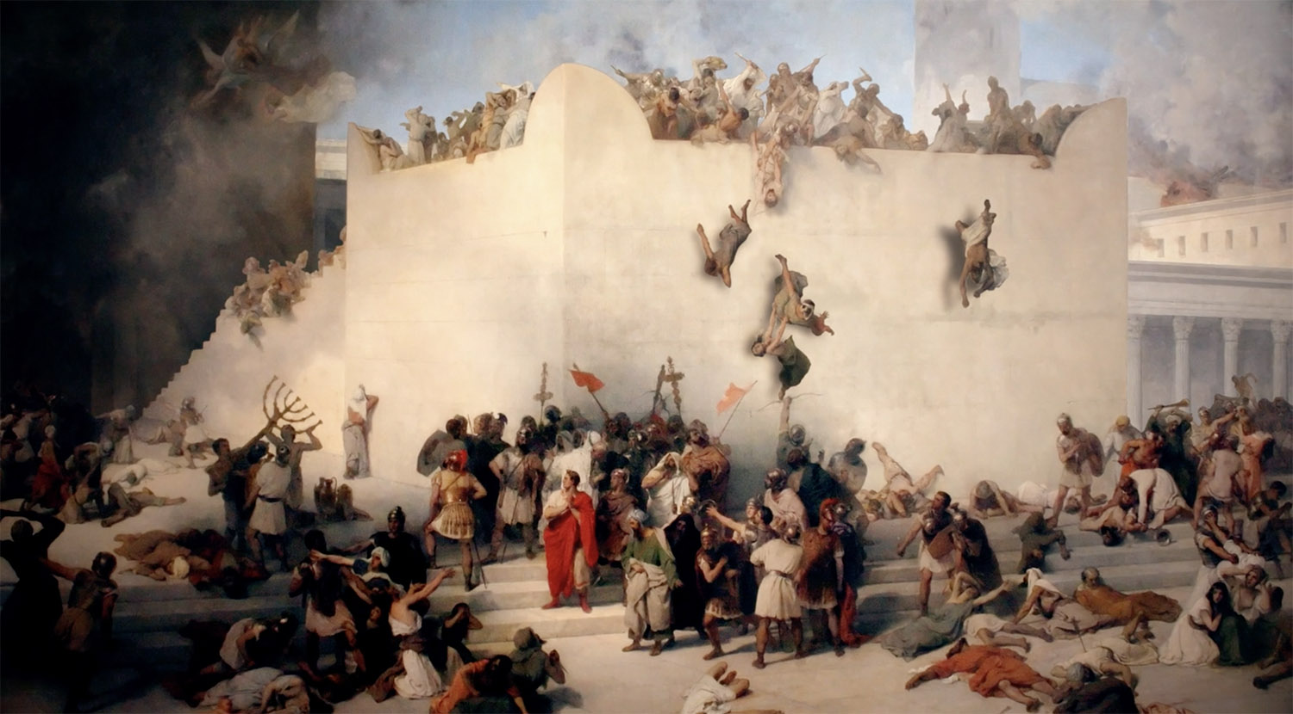
“You appear outwardly to men to be righteous, but within are full of hypocrisy and iniquity…
You serpents, you offspring of vipers, how shall you escape being sentenced to Gehenna?
“All these things shall come upon this generation.”
● Gehenna : Burning pit outside the city. Metaphor of a coming Roman invasion.

Slide 14
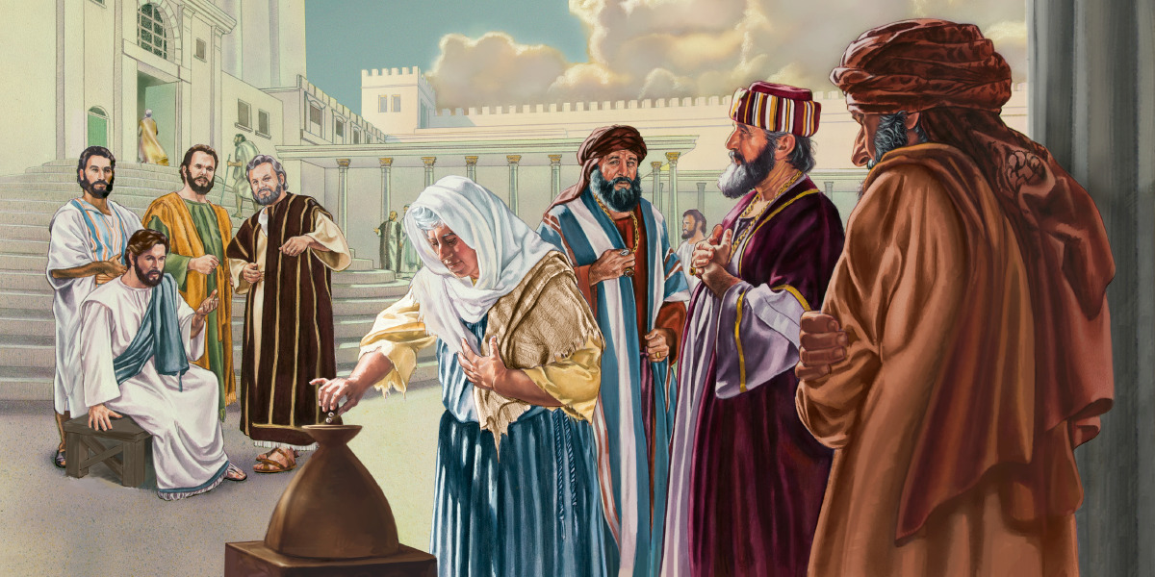
#129 ² And Jesus sat down across from the treasury, and he beheld how the people were dropping money into the chest and many who were rich were putting in much.
³ But looking up, he also saw a certain poor widow placing therein two tiny copper coins ² which make less than a cent.
● Chest: Donation box for offerings.

Slide 15
And he called to him his disciples and said to them, ³ “Of a truth, I say to you, this poor widow has put in more ² than all those who contributed to the treasury.
For they all contributed out of their abundance ³ into the offerings for God, ² but she out of her poverty put in everything she had, even her whole livelihood.”

Slide 16
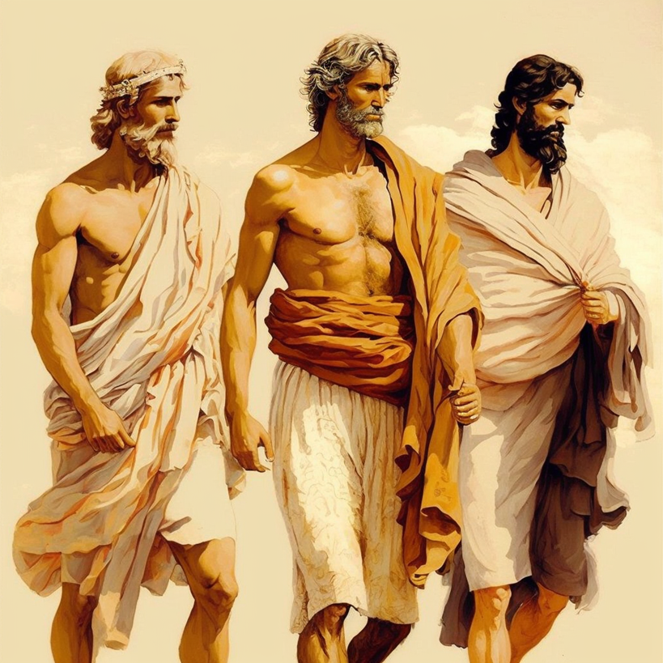
#130 ⁴ Certain Greeks … approached Philip, saying, “Sir, we would see Jesus.” … Andrew and Philip told Jesus.
Jesus answered them, saying, “The hour has come for the Son of man to be glorified. … He who loves his life shall lose it, but he who hates his life in this world shall keep it unto life eternal.”
● Glorified: a) Reveal, b) honor, c) exalt.

Slide 17
“If anyone serves me, let him follow Me; and where I am, there shall also my servant be. And if anyone serves me, him will the Father honor.
“Now has my soul been troubled; and what shall I say — ‘Father, save me from this hour’? No! Because of this came I to this hour. Father, glorify thy name!”
● Father: Jesus’ usual title for God.

Slide 18
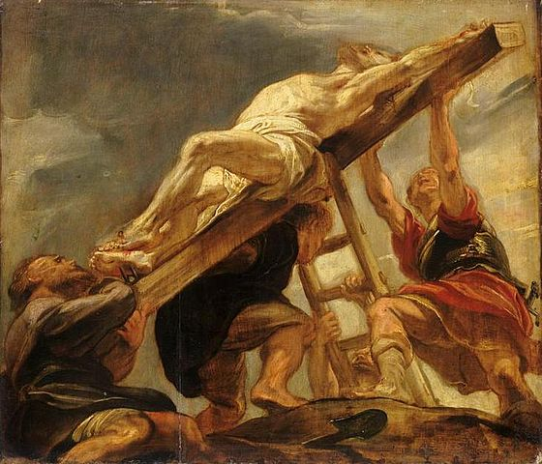
There came therefore a Voice from heaven: “I BOTH GLORIFIED IT AND WILL GLORIFY IT AGAIN.”
“Now is the condemnation of this world; now shall the ruler of this world be cast out! And I, when I am lifted up from the earth, will draw all men to myself.”
● All men: Both Jews and Gentiles who repent, believe, are baptized, & persevere.

Slide 19
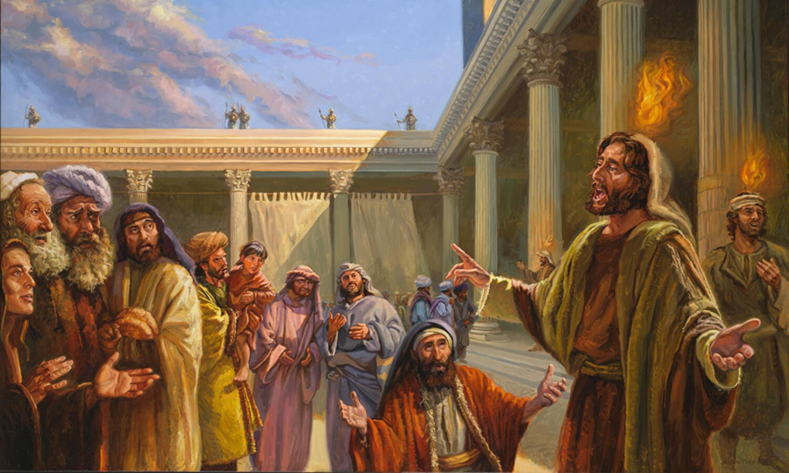
Three times God spoke publicly
1 Baptism: “This is my beloved Son!”
2 Cross: “I shall glorify it again!”
3 Spirit: “They began to speak in other tongues as the Spirit gave them utterance!”
“There are three that testify: the Spirit and the water and the blood; and these three agree.” 1 John 5:7-8

Slide 20
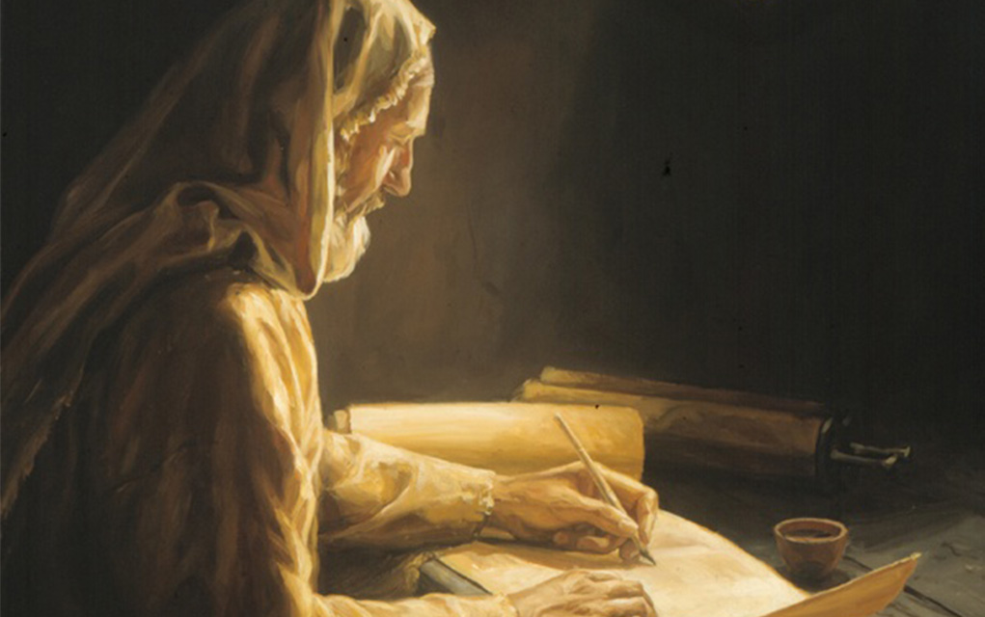
#131 ⁴ Although he had wrought so many signs in their presence, they did not believe upon him; that there might be fulfilled the word of the prophet Isaiah, which he uttered:
“Lord who has believed our report?
And to whom has the arm of the Lord been revealed:”
● That: Greek hina = reason or result.

Slide 21
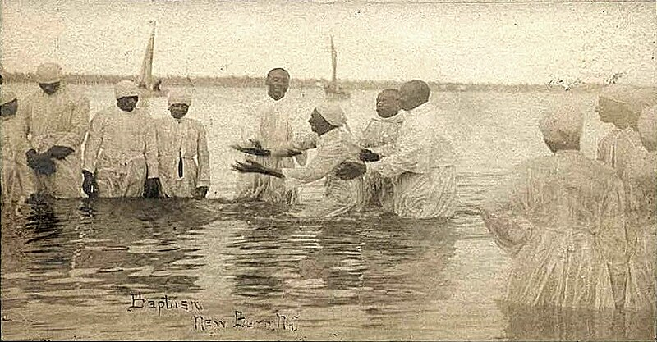
⁴ Nevertheless indeed many even of the rulers did believe upon him, though because of the Pharisees they did not confess…
for they loved the approval of men more than the approval of God.
“If you confess with your mouth that Jesus is Lord and believe in your heart that God raised him from the dead, you will be saved.” Romans10:10

Slide 22
Assignment
● Visit LOCIS.site
● Read or listen to LOCIS chapter 19 or Greatest Story lesson 23.
● Be ready to share your insights, queries and objections.

Slide 23
Slow ways to gain pew sitters
● Birth and baptize children.
● Contemporary media and music.
● Remodel buildings and parking lots.
● Free handouts for the poor.
● Preach & teach easy messages.
● Food, fun and fairs.
Discuss: How to have a continual influx of new believers and disciples?

Slide 24
…
…
…
● …: …

Slide 25
…
1 …: ….
2 …: …
3 …: …
4 …: …
5 …: …
6 …: …

