Slide 1
The Life of Christ in Stereo

Slide 2
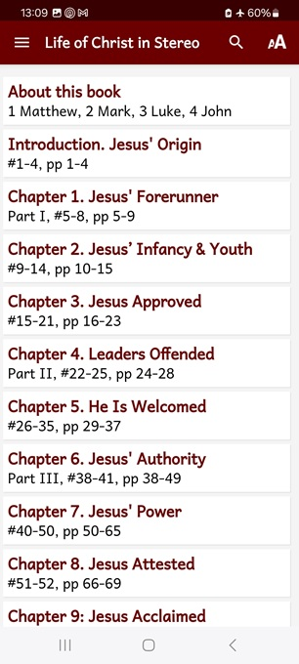
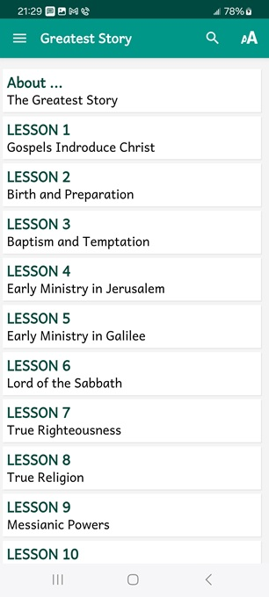
LOCIS session 14, ##133-142
If you gather in a group, then pose these queries after viewing each slide.
● What did you learn that was new, helpful, or important?
● What questions do you have about what you read?

Slide 3
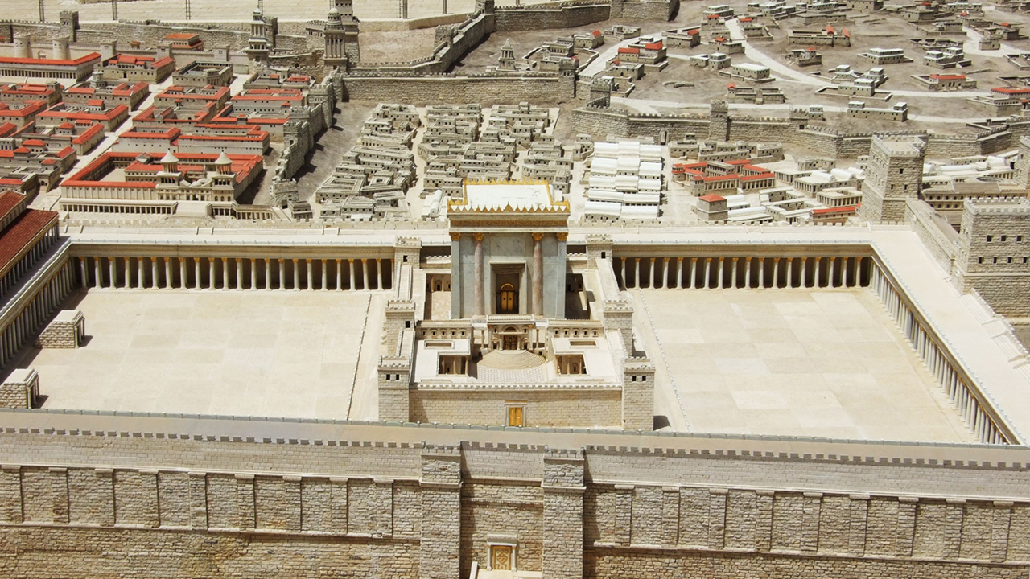
Seven phases of Jesus’ Life
1 Announced by heaven & by John (1-3)
2 Early teaching and miracles (4-5)
3 Public fame and favor (6-9)
4 Early rejections (10-12)
5 Moving towards the cross (13-17)
6 Final days at Jerusalem (18-19)
7 Crucifixion and resurrection (20-21)

Slide 4
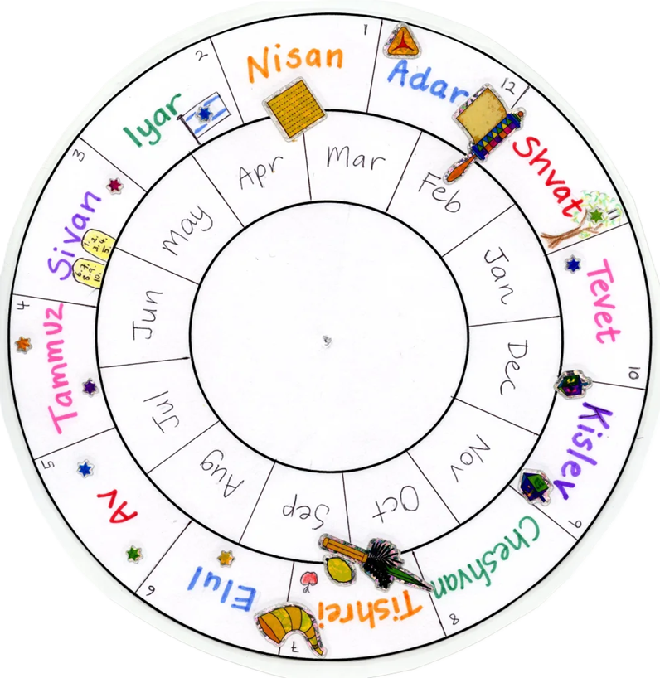
Apparent Calendar
● Thursday, April 1, AD 33 = Nisan 12th.
● Preparing for his death.
● Final conversations with his apostles.

Slide 5
#133 The Passover and the Feast of Unleavened Bread were two days away. When Jesus was finished saying these things, he told his disciples, “You know the Passover is coming in two days, and then the Son of Man will be handed over to be crucified.”
● Two days: Passover = first day of Unleavened Bread

Slide 6
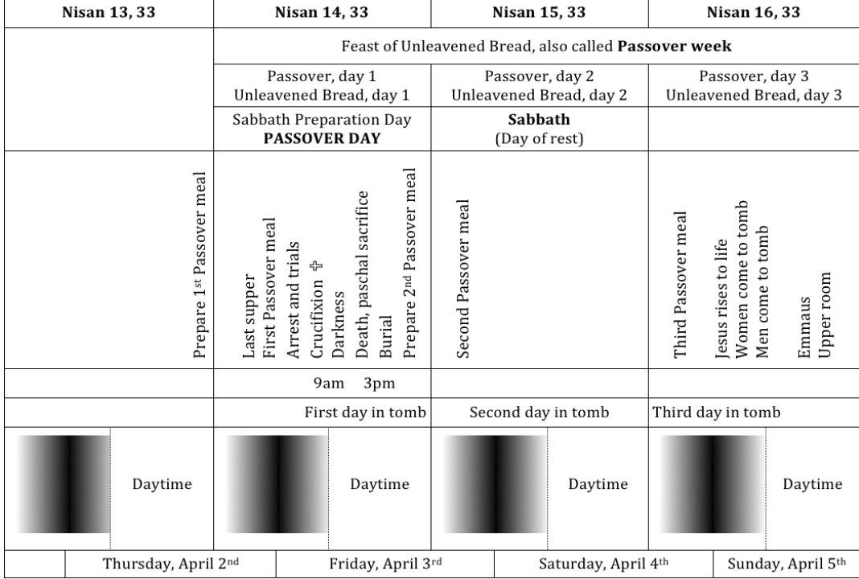
A Passover meal was celebrated several times in the week, and preparations were made each day before sundown.
On Nisan 13th, Jesus’ disciples prepared a Passover meal that he and they took early on Nisan 14th.
Also on Nisan 14th, the date of Jesus’ crucifixion, folk prepared a Passover meal served early on Nisan 15th.

Slide 7
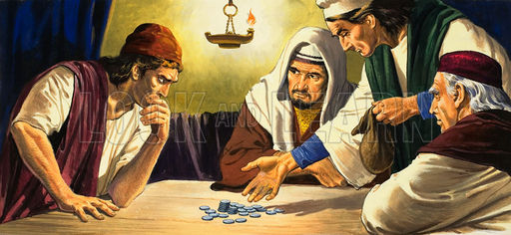
Then Satan entered into Judas Iscariot, one of the twelve. He left to consult with the chief priests and the captains about how he might betray Jesus to them. He said to them, “What will you give me if I hand him over to you?
They were delighted when they heard this, and promised to give him money. He agreed.
● Satan: ‘World rulers’ crucified Christ.

Slide 8
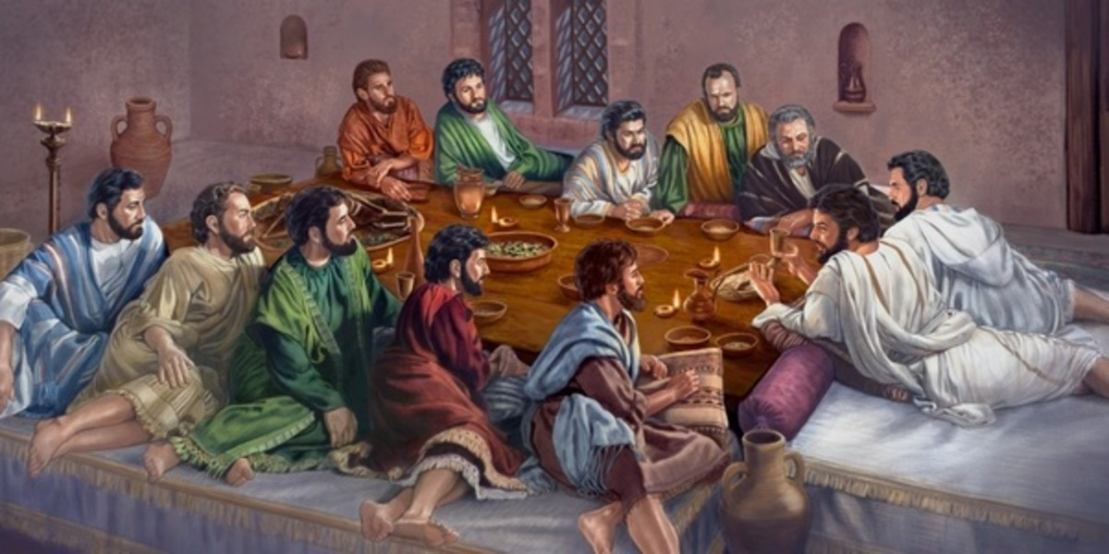
#134 When the first day of the Feast of Unleavened Bread arrived—the day the Passover lamb had to be killed—the disciples came to Jesus.
He sent Peter and John, telling them, “Go and prepare the Passover meal for us.”
When it was evening, Jesus came with the twelve. At the appointed time he reclined at the table with the apostles.

Slide 9
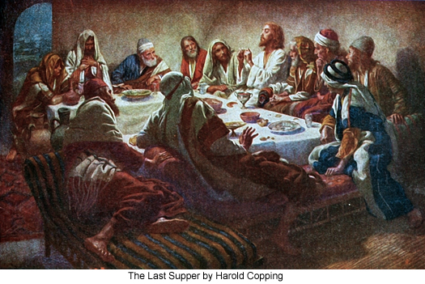
He told them, “I have earnestly desired to eat this Passover with you before I suffer. For I tell you I will not observe it again until it finds fulfilment in the kingdom of God.”
Then he took the cup and gave thanks, and said, “I tell you I will not drink at all from the fruit of the vine until the kingdom of God comes.”

Slide 10
The Kingdom in Scripture
1 Eternal: God reigns!
2 National: Israel under Torah law.
3 Divine: King Jesus “amongst you”.
4 Spiritual: Willing submission to Christ.
5 Messianic: “1000 years” on earth.
6 Everlasting: New heaven and earth.

Slide 11
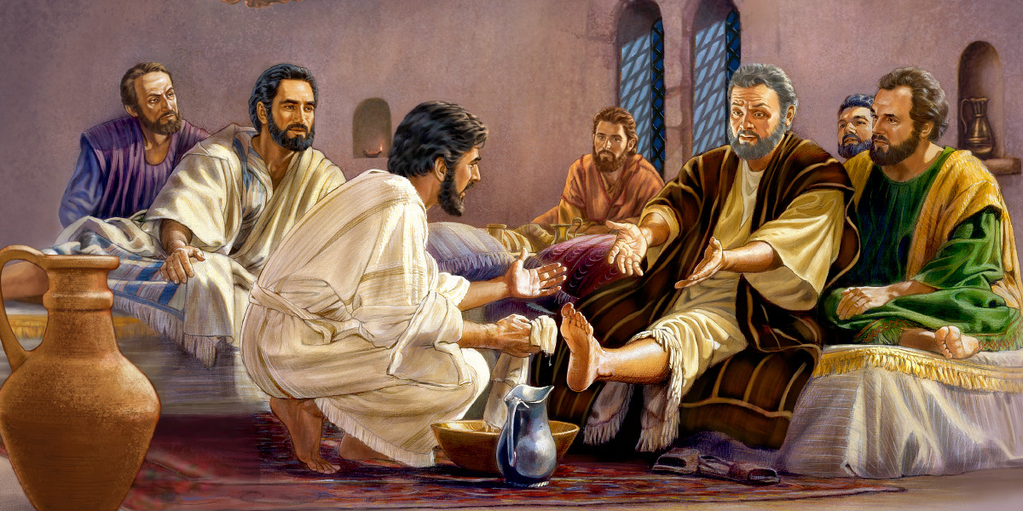
#135 Jesus … got up from the supper, took off his outer clothing, and wrapped a towel around his waist. Then he poured water into a basin and began to wash the disciples’ feet, wiping them with the towel around his waist.
He said … “You also ought to wash each other’s feet. I gave you an example — you should do as I have done to you.”

Slide 12
Foot washing beliefs & practices
● Example: Just serve one another.
● Sacrament: Priests do this for others.
● Ordinance: Practice this annually.
● Ministry: For those who repent of sin.
● Cleansing: Following exorcism.
● Culture: We now wear shoes.
● Humility: A show of humility or equality.

Slide 13
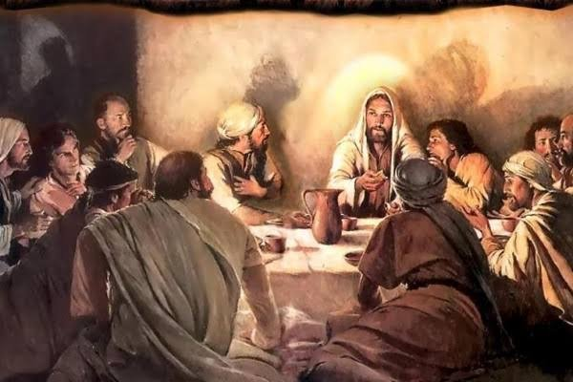
#137 As they were eating, Jesus took the bread and blessed it. When he had given thanks, he broke it and gave it to the disciples. “Take it and eat it,” he told them.
“This is my body, which is given for you. Do this to remember me.”
● Bless: Consecrate to God.
● Thanks: Greek, eucharist.
● Remember: The ‘new’ Passover lamb.

Slide 14
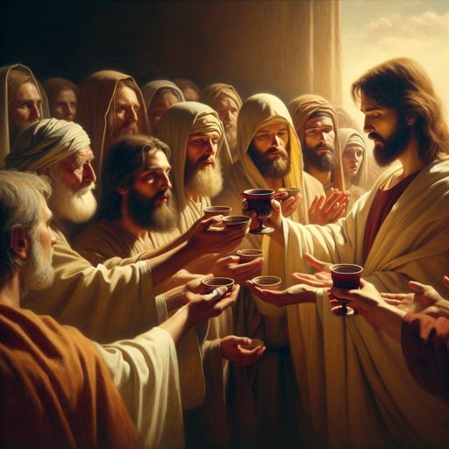
In the same way after the supper he took a cup. When he had given thanks, he gave it to them and said, “Drink from it, all of you.” And they all drank from it.
He told them, “This cup which is poured out for you is my blood of the new covenant, which is poured out on behalf of many people for the forgiveness of sins.

Slide 15
Communion beliefs and practices
● Transubstantiation: Physical change.
● Consubstantiation: Physical presence.
● Nonsubstantiation: No physicality.
Other beliefs
● Spiritual presence in the event.
● Symbolical, only a mental memorial.
● Private faith without elements.
YouTube channel: “Ready for Harvest.”

Slide 16
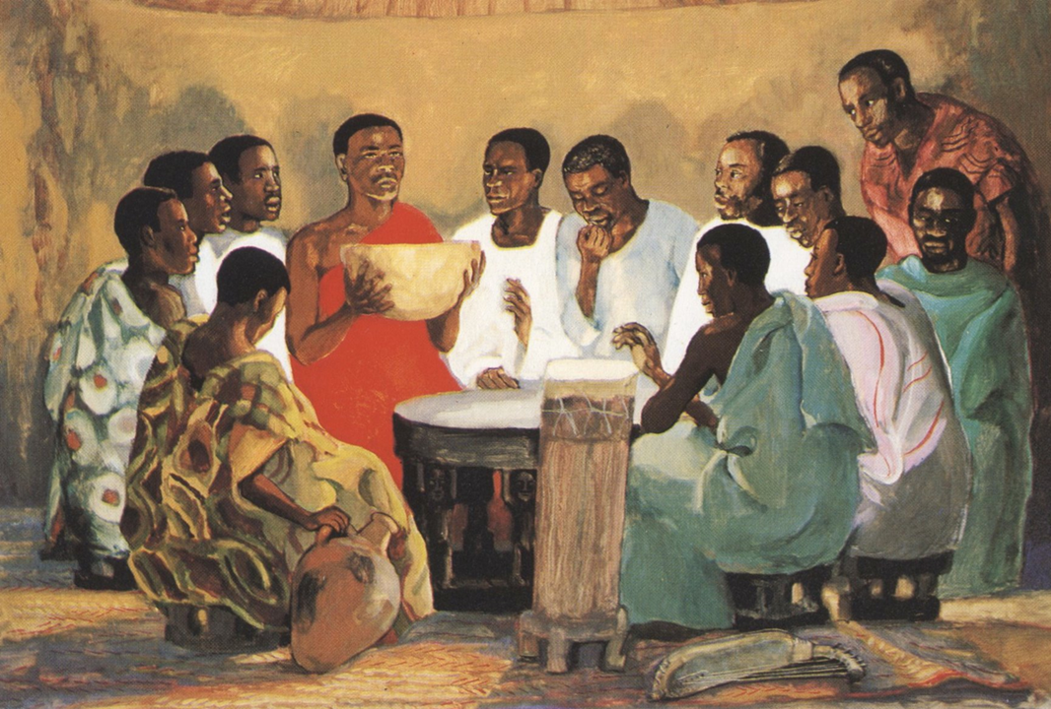
Communion services
(Regardless of official theology.)
● Pray: Ask for spiritual results.
● Preach: Jesus’ death and resurrection.
● Promise: Verses on forgiveness.
● Prepare: Confess sins and failures.
● Practice: Share bread and cup(*).
● Praise: Thanks for renewed life.
(*) Or culturally-acceptable substitutes.

Slide 17
In communion services, do not:
● Criticize: Others’ beliefs & practices. Teach differences and denominational theology in catechism & bible classes.
● Take a collection: Avoid all appearance of selling God’s grace for money.
● Destroy faith: By denying any grace or work of the Holy Spirit in this ‘symbol’ or ‘remembrance’.

Slide 18
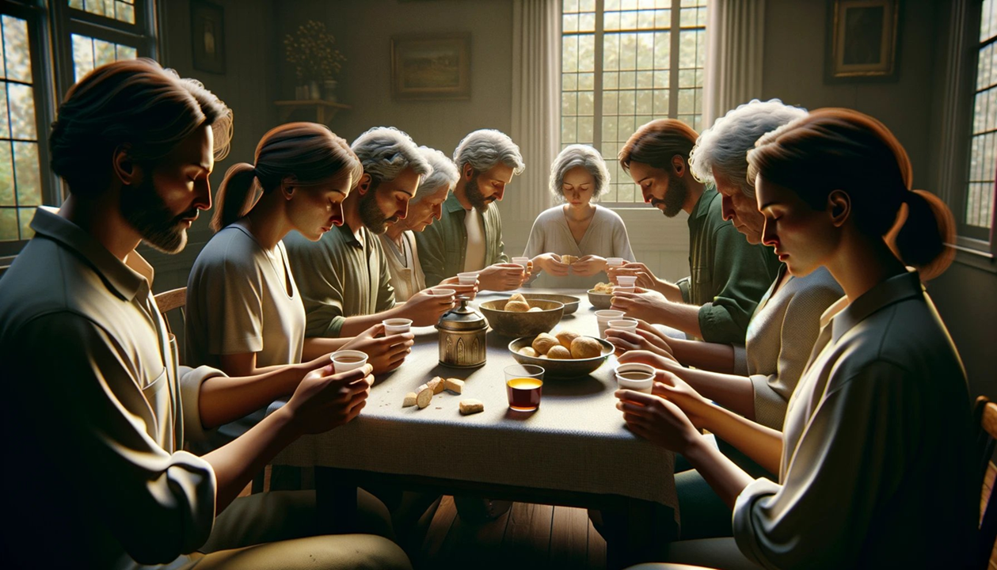
In communion services, do:
● Confess: Admit to God my sins, failures, and filthy or cruel thoughts.
● Forgive: Other’s offenses against me.
● Partake: The bread and cup.
● Receive: Forgiveness and renewal.
● Praise: Jesus for his loving sacrifice.
● Expect: Power and help from God.
● Repeat: Take communion often.

Slide 19
#138 An argument arose among them about who was considered the greatest. So Jesus said to them…
“I am giving you a new commandment: You must love each other. Love each other just as I have loved you. Everyone will know you are my disciples if you love each other.”
● Disciples: Obey their master’s orders.

Slide 20
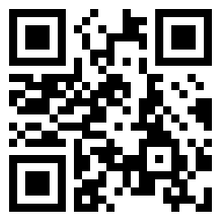
Assignment
● Visit LOCIS.site
● Read or listen to LOCIS chapter 20 or Greatest Story lesson 24.
● Be ready to share your insights, queries and objections.

Slide 21
…
…
● …: …

