Slide 1
The Life of Christ in Stereo

Slide 2
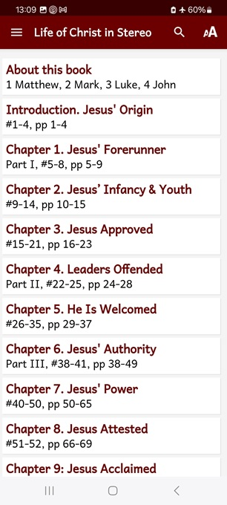
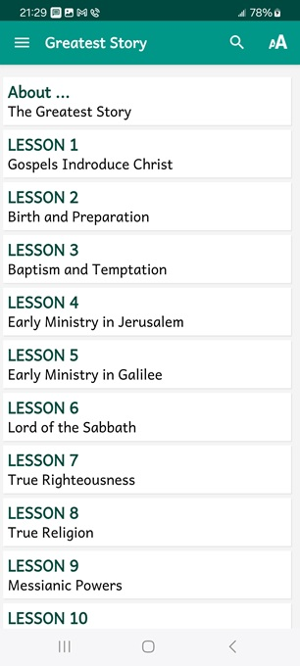
LOCIS session 15, ##143-160
Part VII, The Consummation
Chapter 20, “Hour of Darkness”
● What did you learn that was new, helpful, or important?
● What questions do you have about what you read?

Slide 3
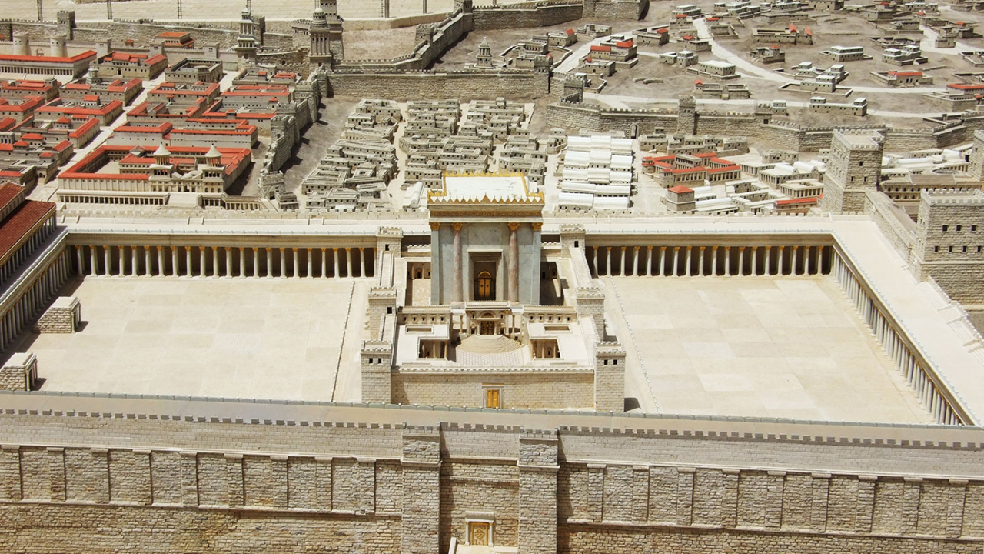
Seven phases of Jesus’ Life
1 Announced by heaven & by John (1-3)
2 Early teaching and miracles (4-5)
3 Public fame and favor (6-9)
4 Early rejections (10-12)
5 Moving towards the cross (13-17)
6 Final days at Jerusalem (18-19)
7 Crucifixion and resurrection (20-21)

Slide 4
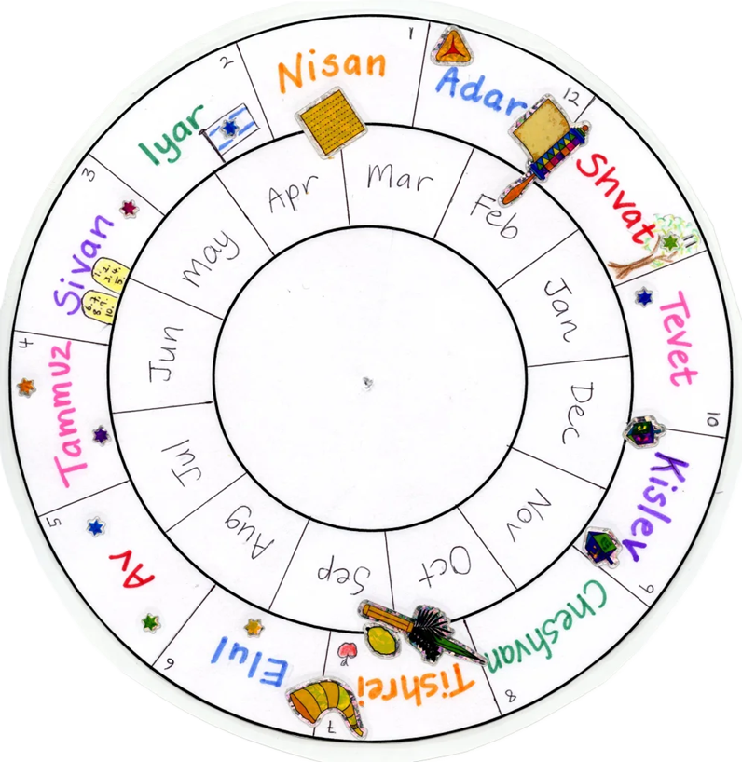
Apparent Calendar
● Friday, April 2, AD 33 = Nisan 13th.
● Condemned to be crucified.
● Crucifixion and death.

Slide 5
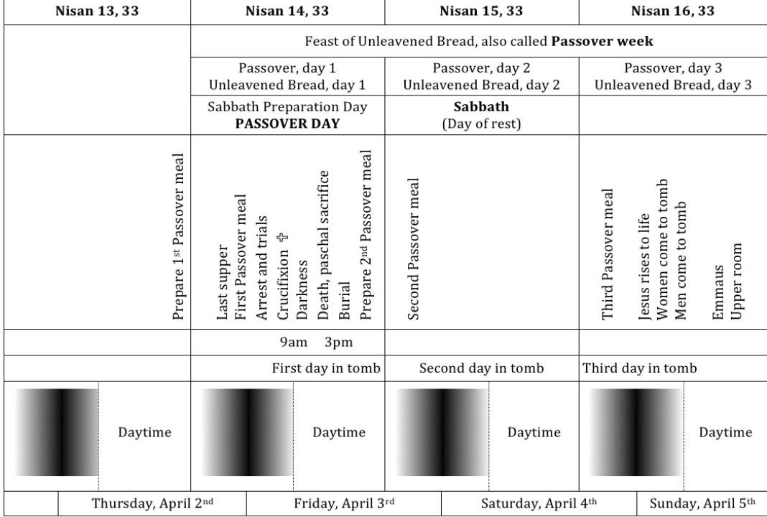

Slide 6
Al-Koran, surat 4, 7th century AD
“That they said (in boast), ‘We killed Christ Jesus the son of Mary, the Messenger of Allah’—but they killed him not, nor crucified him, but so it was made to appear to them.”
وَقَوْلِهِمْ إِنَّا قَتَلْنَا الْمَسِيحَ عِيسَى ابْنَ مَرْيَمَ رَسُولَ اللَّهِ وَمَا قَتَلُوهُ وَمَا صَلَبُوهُ ۖ وَلَٰكِن شُبِّهَ لَهُمْ

Slide 7
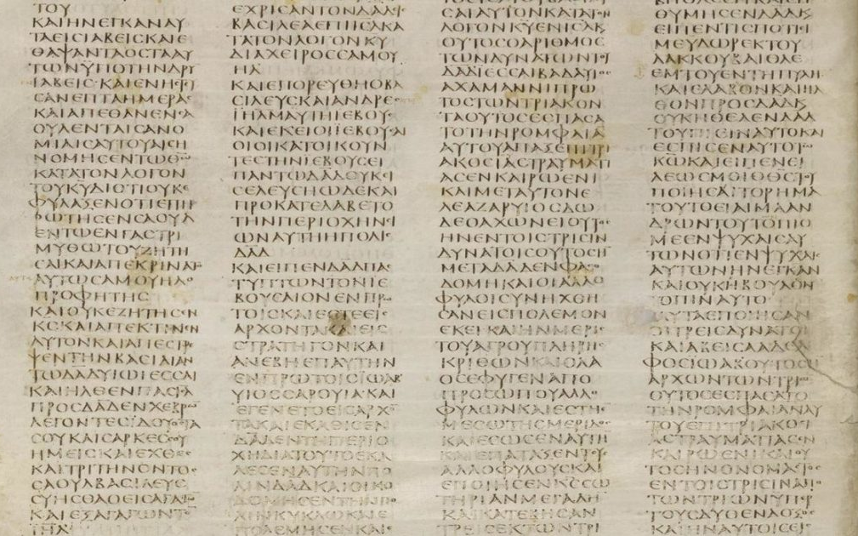
NT Gospels, 1st century AD
● Compiled by Jesus’ contemporaries.
● From eye & ear testimonies.
● And widely-circulated materials.
● Facts not contested by enemies.
● Form a coherent narrative.
● Copied & recopied 1000s of times.
● Quickly translated in other languages.
● 5000 manuscripts exist to this day.

Slide 8
While we view the slides, reading the biblical text, recall any Scriptures which explain how Jesus’ death benefits God and us human beings.
Be ready to share one or two points afterwards.

Slide 9
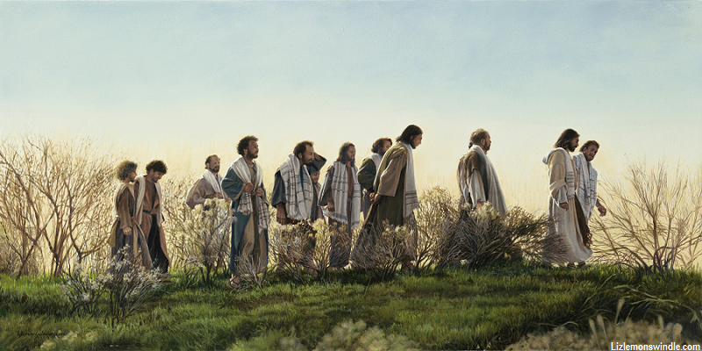
“We are going up to Jerusalem,” he said, “and everything the prophets have written about the Son of Man will come true.
He will be betrayed to the chief priests and the teachers of the law, and they will condemn him to death and hand him over to the Gentiles to be crucified.
● Will be: Jesus foretold his own death.

Slide 10
The Passover and the feast of Unleavened Bread were two days away. When Jesus was finished saying these things, he told his disciples,
“You know the Passover is coming in two days, and then the Son of Man will be handed over to be crucified.”
● Two days: Foretold the place & day.

Slide 11
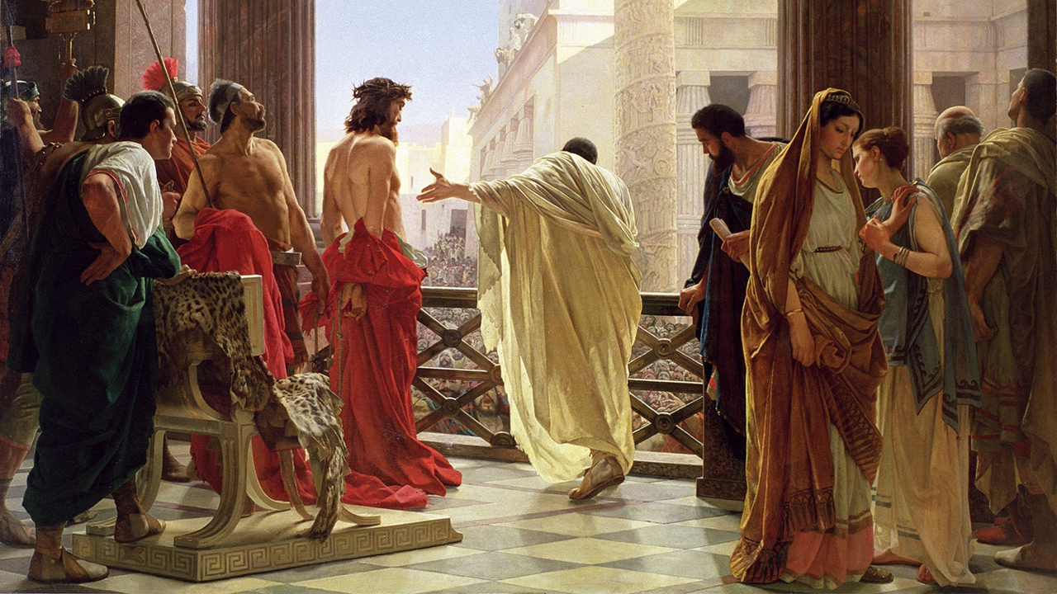
Pilate wanted to release Jesus, he said to them once more, “Then what should I do with Jesus who is called ‘Messiah,’ whom you call ‘King of the Jews’?”
Again they all shouted, “Let him be crucified!” They continued crying out, “Crucify! Crucify him!”
● They all: Jewish leaders.

Slide 12
“By our law he ought to die, because he claimed to be the Son of God.”
Pilate … returned to the judgment hall and said to Jesus, “Where do you come from?” Jesus gave no answer.
“You refuse to talk to me?” Pilate said. “Don’t you know I have authority to crucify you—or to release you?”

Slide 13
Pilate … wanting to satisfy the crowd … gave in to their demands about Jesus and handed him over to be crucified….
When they finished ridiculing him, the soldiers stripped him of the cloak and the purple garments, and gave him his own clothing. Then they led him out to crucify him.
● Purple: Mocking him as a fake ‘king’.

Slide 14
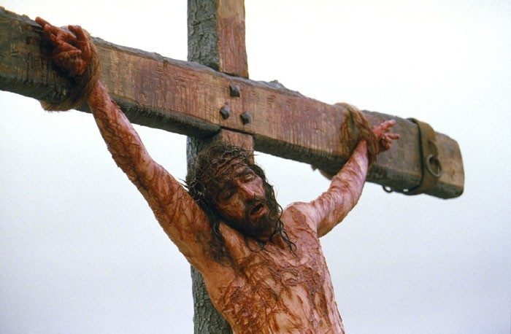
Two others, who were criminals, were led away with him to be executed…. They brought him to the place called the Skull (or in the Jewish language, “Golgotha.”
There, at nine o’clock, they crucified him.
Along with him they crucified the criminals, two robbers.

Slide 15
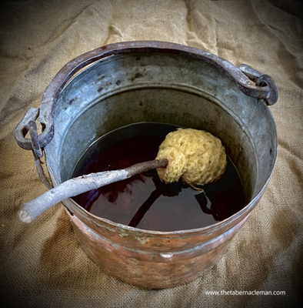
He took a sponge, filled it with the wine, put it on a hyssop stalk, and lifted it to Jesus’ mouth… Jesus again cried out in a loud voice, “It is finished!”
Then he bowed his head. “Father,” he said, “into your hands I commit my spirit.”
After saying these words, he yielded up his spirit.

Slide 16
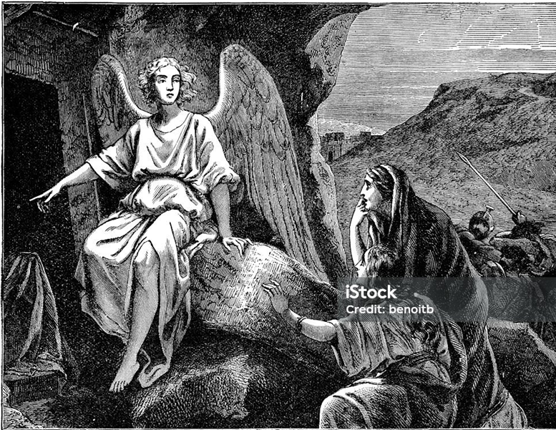
Then the angel said to them, “Don’t be afraid; don’t be overcome. I know you are looking for Jesus of Nazareth, who was crucified. Why do you look for the living among the dead?
Remember that he said to you while he was still in Galilee, ‘The Son of Man must be handed over to sinful men, and be crucified, and on the third day rise again.”

Slide 17
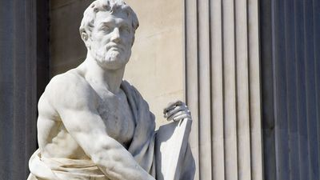
Roman historian: Caius Cornelius Tacitus, c. 55–118 CE
“Nero substituted as culprits and punished in the most unusual ways those hated for their shameful acts … whom the crowd called ‘Chrestians’.
The founder of this name, Christ, had been executed in the reign of Tiberius by the procurator Pontius Pilate.”

Slide 18
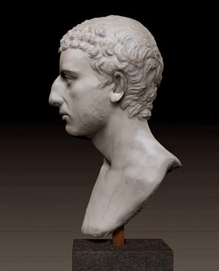
A Jewish priest: Flavius (Yosef) Josephus, c. 37–100 CE,
Jewish Antiquities XVIII.63–64
“Jesus, a wise man … a teacher of such people as accept the truth gladly. He won over many Jews and many of the Greeks.
When Pilate, upon hearing him accused by men of the highest standing among us, had condemned him to be crucified.”

Slide 19
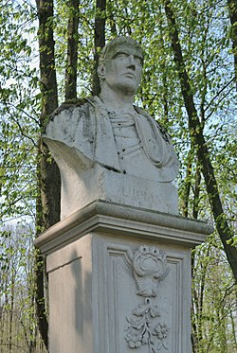
A Greek satirist: Lucian of Samosata, c. 115–200 CE
“The Christians, you know, worship a man to this day,–the distinguished personage who introduced their novel rites, and was crucified on that account.
From the moment that they are converted, … [they] worship the crucified sage, and live after his laws.”

Slide 20
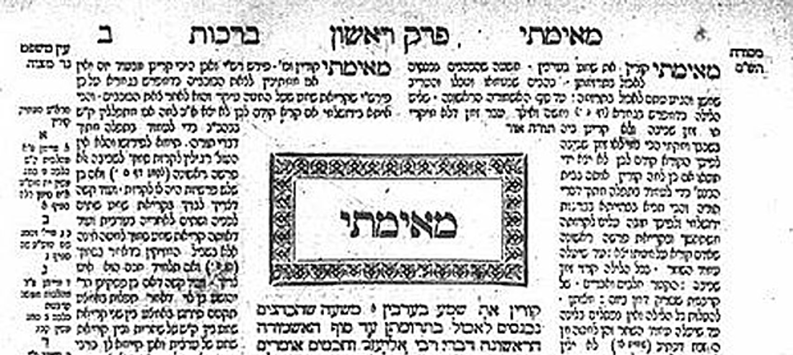
Babylonian Talmud, Sanhedrin 43a-b, circa 490 CE
“On Passover Eve, they hanged Yeshu ...
because he practiced sorcery, incited (idolatry), and lead the Jewish people astray.”
● Hanged: On a cross.
● Yeshu: An acrostic curse, used to this day to slander Jesus.

Slide 21
Summary
● The prophetic Scriptures foretold the Messiah’s redemptive death.
● Jesus foretold the date, place, and manner of his own death.
● Angels at his tomb affirmed the same.
● The Gospels record eyewitnesses.
● Ancient historians considered Jesus’ execution a known fact.

Slide 22
Conclusion
● Cults that hold Jesus to be an angel deny his human, bodily death.
● Holy books which deny that Jesus was crucified are historically mistaken.
● Liberal Christians who hold to the ‘swoon’ theory will be damned.
● Those who consider Jesus to be a deluded, crucified rabbi, are lost.

Slide 23
Jesus’ death by crucifixion
● Proves that he was a human being.
● Exonerates God who forgives sinners.
● Secures God’s forgiveness for all who remain faithful to Jesus.
● Frees believers from Satan’s power over the fallen human race.
● Releases God’s power to break human addictions and evil habits.

Slide 24
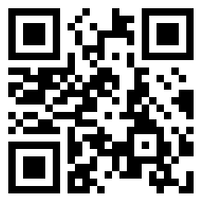
Assignment
● Visit LOCIS.site
● Read or listen to LOCIS chapter 21 or Greatest Story lesson 26.
● Be ready to share your insights, queries and objections.

Slide 25
…
…
…
● …: …

Slide 26
…
…
● …: …

