Slide 1
The Life of Christ in Stereo

Slide 2
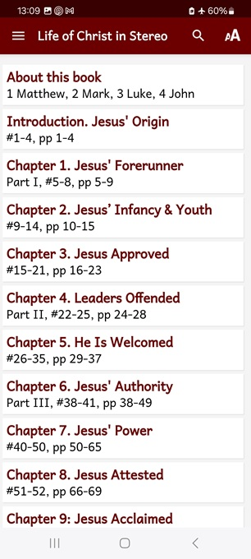
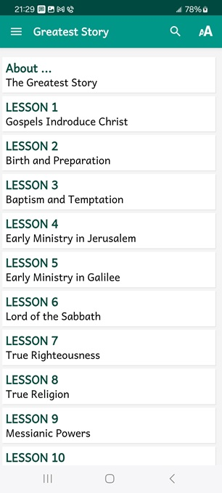
LOCIS session 16, ##161-168
Part VII, The Consummation
Chapter 21, “Risen Victorious”
● What did you learn that was new, helpful, or important?
● What questions do you have about what you read?

Slide 3
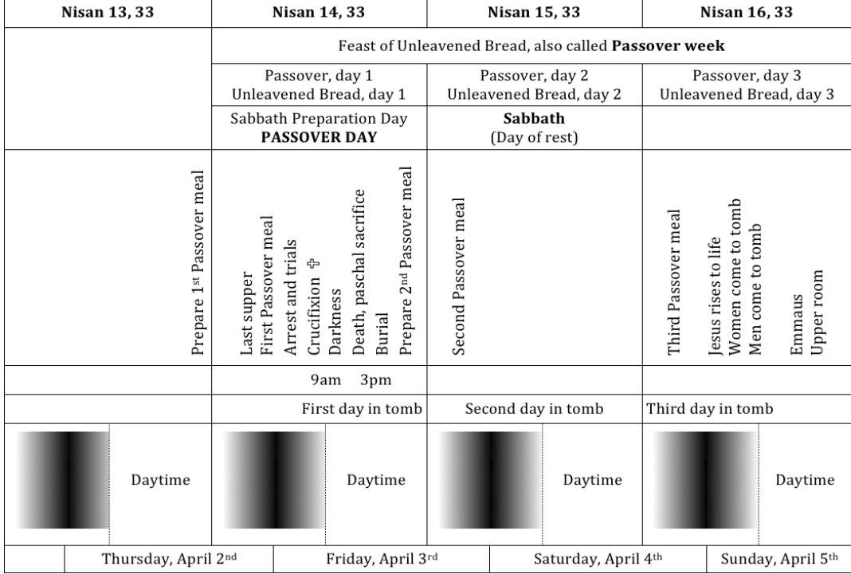

Slide 4
While we view the slides, reading the biblical text, recall any Scriptures which explain how Jesus’ resurrection benefits God, him or us human beings.
Be ready to share one or two points afterwards.

Slide 5
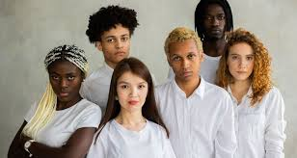
Seven appearances in the Gospels
1 Mary Magdalene
2 Joanna and Mary, Jame’s mother
3 Clopas and companion
4 Disciples in Jerusalem (1st)
5 Disciples with Thomas (2nd)
6 Disciples at Lake Tiberius (3rd)
7 Disciples plus 500 in Galilee
● Disciples: Jesus’ appointed apostles.

Slide 6
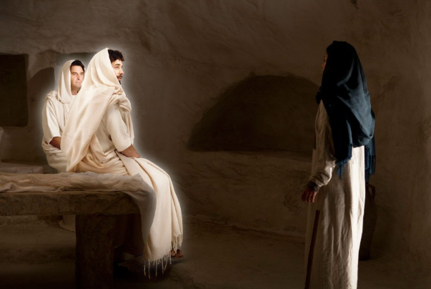
Mary Magdalene
She saw two angels in white sitting where the body of Jesus had lain, one angel at the head and the other at the feet. “Woman,” they asked her, “why are you weeping?
● Two: Why?

Slide 7
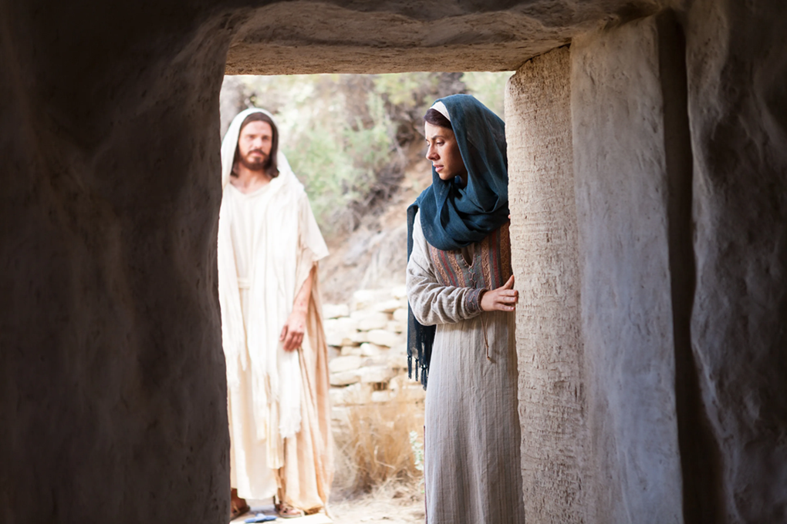
She turned and saw Jesus standing there. But she didn’t know it was he.
“Woman,” Jesus asked her, “why are you weeping? Who are you looking for?”
“Mary,” Jesus said. She turned toward him and said, “Rabboni!” (which means, “dear Teacher!”).
● Turned: Why twice?

Slide 8
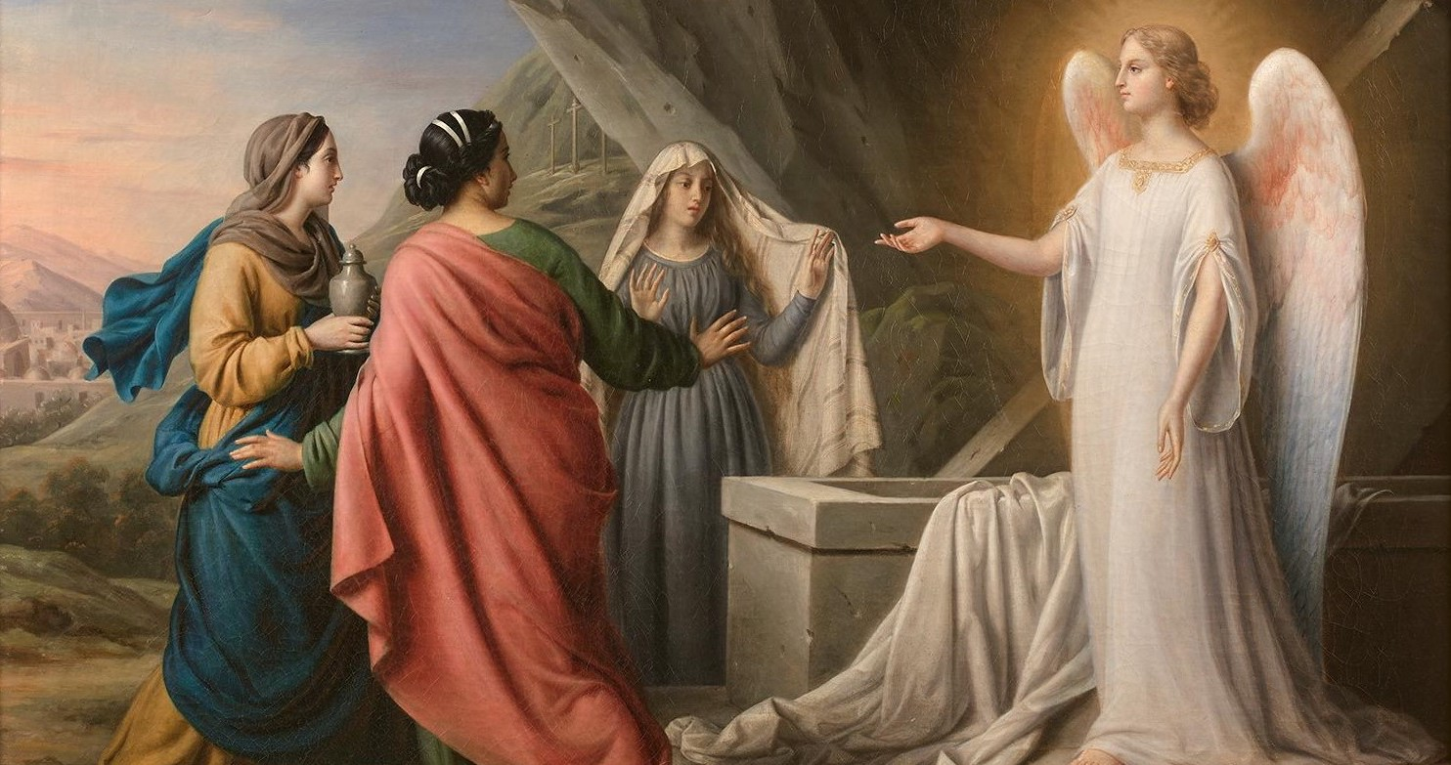
Joanna and Mary, Jame’s mother
They did not find the body of the Lord Jesus. … The angel said to them, “I know you are looking for Jesus of Nazareth, who was crucified. Why do you look for the living among the dead?
“He isn’t here, because he has risen, just as he said he would.”
● Said: When? Where? To whom?

Slide 9
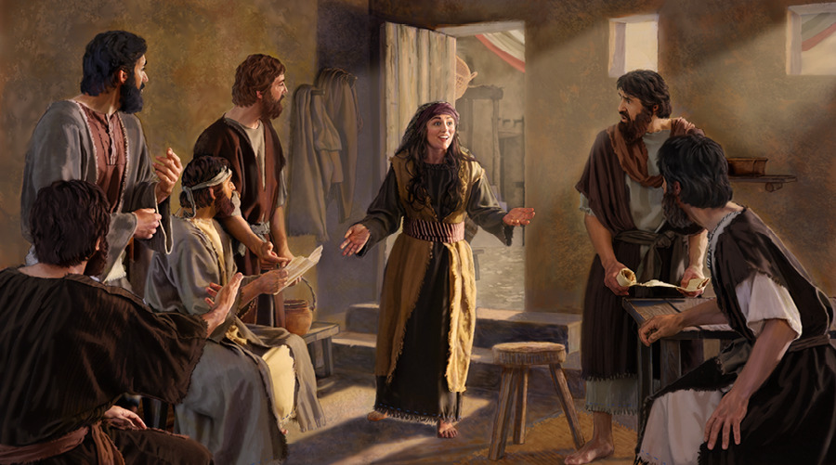
They left quickly and fled from the tomb, trembling with astonishment. … Then they began to run to tell his disciples.
As they were on their way, Jesus met them and said, “Rejoice! … Go tell my brothers to go to Galilee, and there they will see me.”
● Brothers: Who?

Slide 10
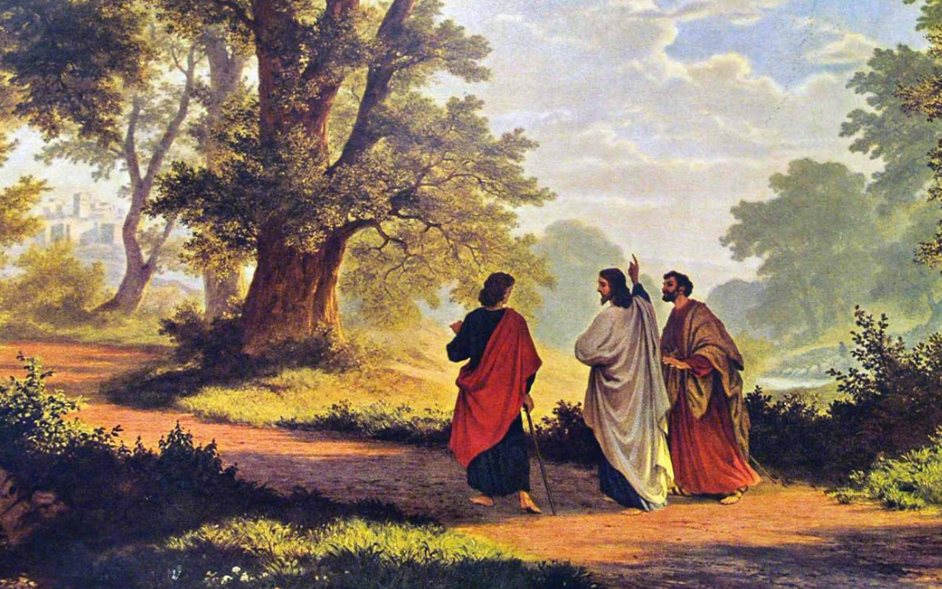
Cleopas and companion
Jesus himself approached and walked with them.
[Jesus] said to them, Was it not necessary for the Messiah to suffer these things and then enter into his glory?”
● Necessary: Why?

Slide 11
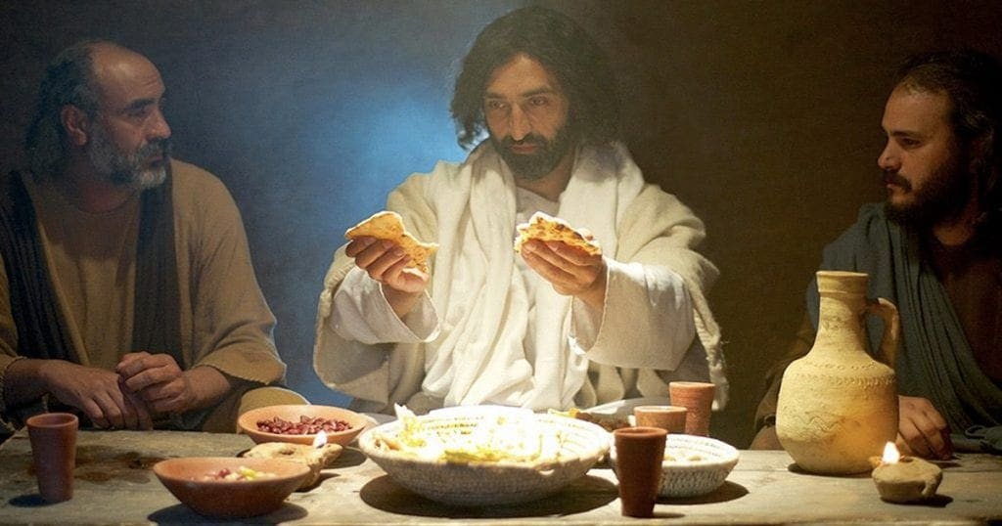
[Jesus] took the bread and blessed and broke it.
Their eyes were opened, and they knew who he was. Then he vanished from their sight.
They … recognized Jesus when he broke the bread.
● Bread: Why is this important?

Slide 12
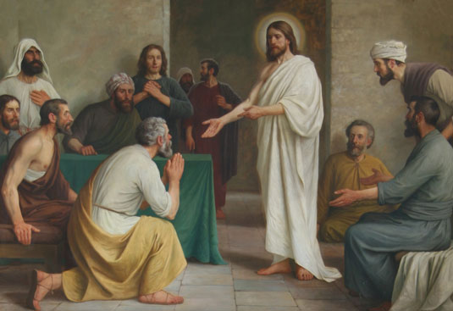
Some disciples in Jerusalem
Jesus himself came and stood among them and said to them, “Peace to you!
Touch me and see! A ghost doesn’t have flesh and bones, as you see I have.” When he had said this, he showed them his hands and feet and side.
● Ghost: phantasma.
● Touch: Why? 1 John 1:1

Slide 13
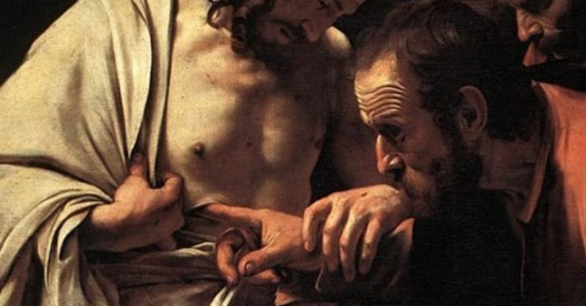
Thomas
[Jesus] said to Thomas, “Put your finger here and look at my hands, and take your hand and press it into my side, and stop doubting and believe.”
“You have believed me,” Jesus said to Thomas, “because you have seen me. Blessed are those who have not seen and yet have believed.”

Slide 14
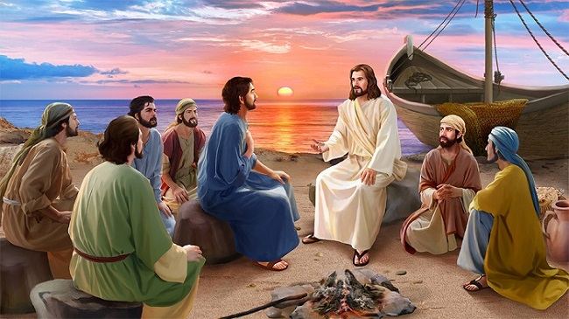
Jesus’ disciples, Lake Tiberius
Jesus revealed himself to the disciples again, this time at the Sea of Tiberias.
They knew it was the Lord. Jesus took the bread and gave it to them, and did the same with the fish.
This was the third time Jesus was revealed to his disciples after rising from the dead.

Slide 15
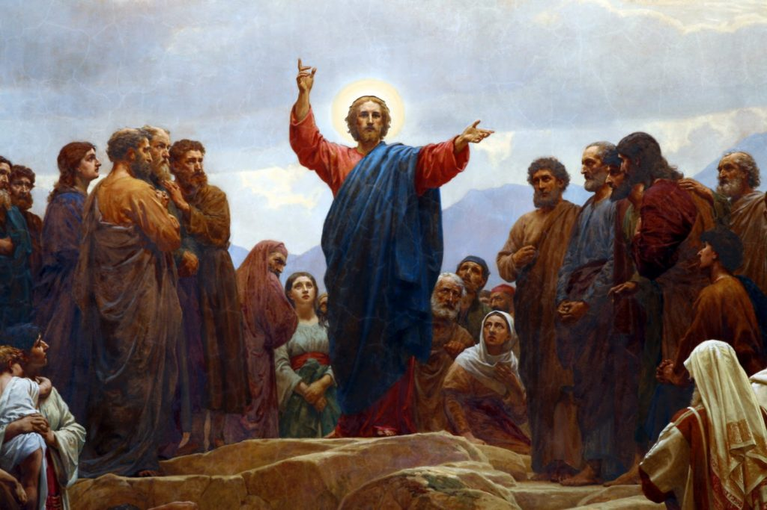
The eleven, plus 500 more
The eleven disciples went to Galilee to the mountain specified by Jesus. When they saw him, they worshiped him, though some doubted.
Jesus approached them and said, “All authority has been given to me in heaven and on earth.
● Heaven & earth: Deut. 4:39

Slide 16
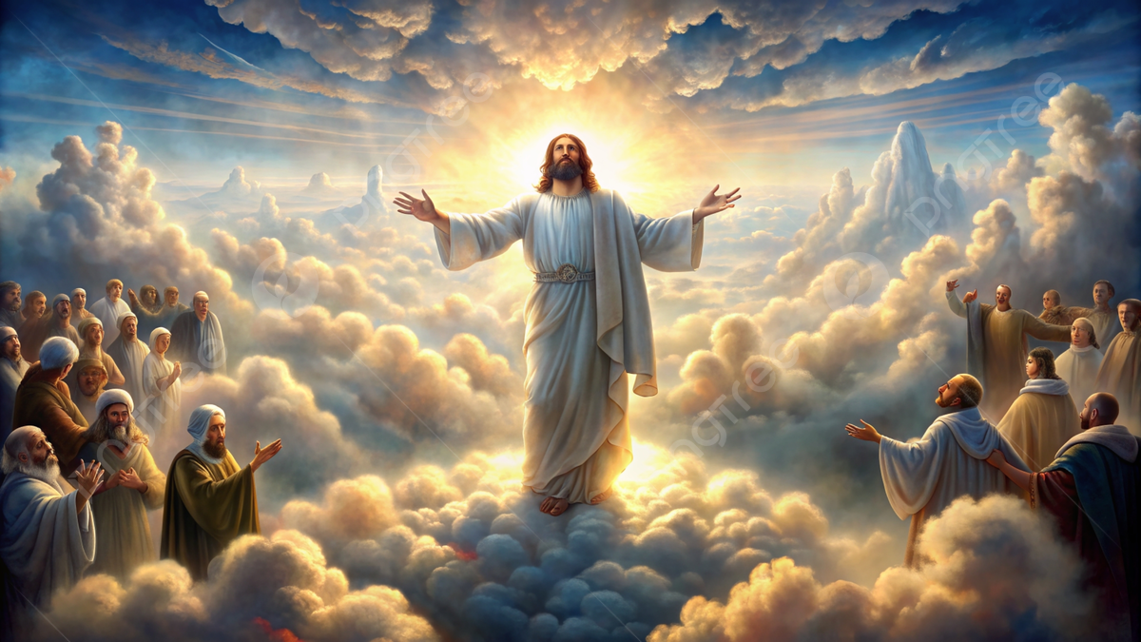
“This is what was written,” he said to them, “that the Messiah had to suffer and rise from the dead on the third day, and that repentance and forgiveness of sins must be proclaimed in his name to all the nations.” …
As he was blessing them, he was taken from them and was carried up to heaven.
● What is missing from most evangelism?

Slide 18
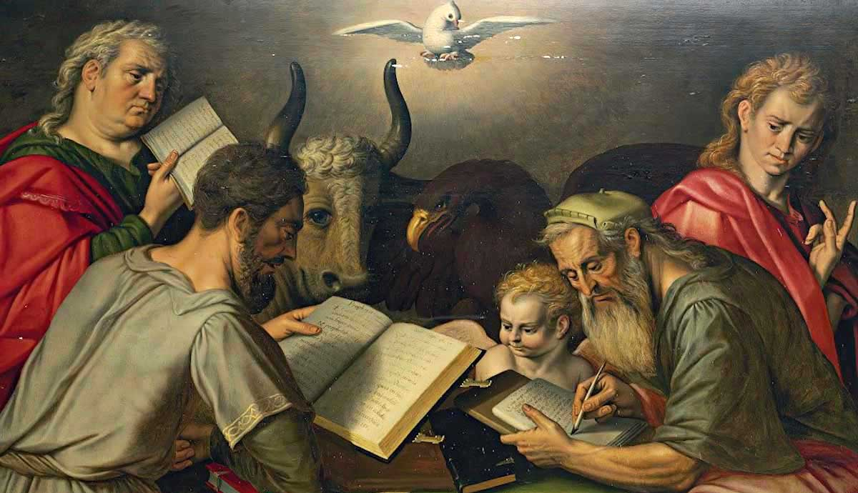
What makes these texts credible?
● These were eye, ear and touch witnesses.
● Many suffered death for their witness, knowing it to be true.
● They and their contemporaries compiled and wrote these accounts.
● Hundreds of ancient translations and manuscript copies exist to this day.

Slide 19
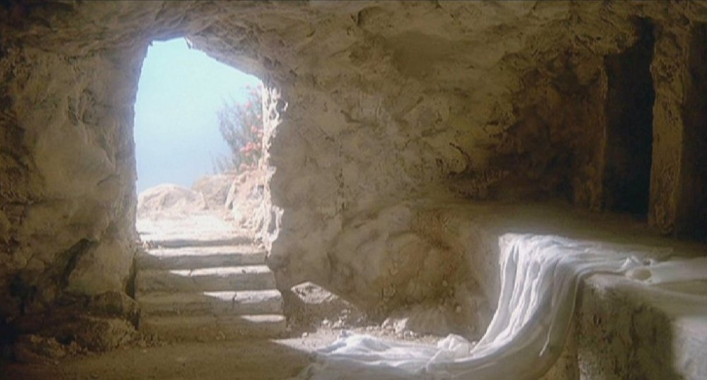
What does this say about Jesus?
● He is risen!
● He is victor over death.
● He is identified as the Messiah.
● He fulfilled messianic predictions.
● He has gone into ‘heaven’.
● He assures us of our resurrection.
● He will return alive to reign forever.
● What more?

Slide 20
What Romans says about this
1 Jesus is declared Son of God. 1:4
2 Raised for our justification. 4:24
3 We walk in newness of life. 6:4
4 United with him in baptism. 6:5
5 Sin has no dominion over us. 6:14

Slide 21
What Romans says about this
6 We ‘bear fruit’ for God. 7:4
7 Life for our mortal bodies. 8:11a
8 His Spirit dwells in us. 8:11b
9 Jesus is interceding for us. 8:34
10 Believing this, we will be saved. 10:9

Slide 22
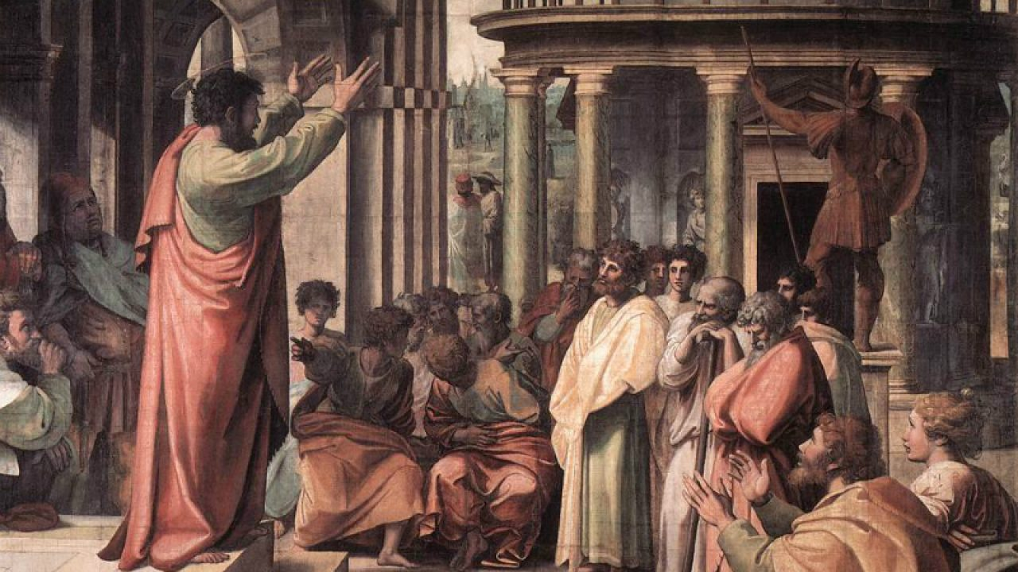
The Original Apostolic Gospel
● Jesus commanded his followers to announce this good news.
● God fulfilled the prophets’ predictions about his Messiah.
● Jesus performed powerful miracles.
● Men crucified Jesus, the righteous one.
● God raised Jesus to life, the third day.

Slide 23
The Original Apostolic Gospel
● Eyewitnesses saw Jesus alive again.
● God will one day judge everyone.
● God commands everyone to repent.
● God forgives all who believe, and will raise them to everlasting life.
● God gives his Holy Spirit to those who obey Jesus commands.

