Slide 1
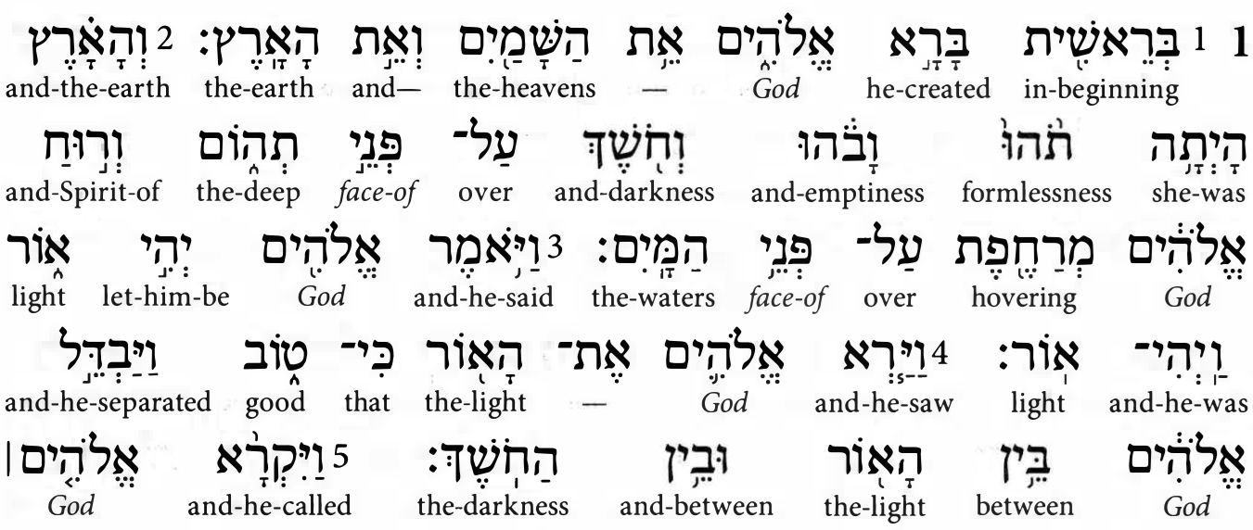
Genesis 1:1
An Alternate Translation
The Hebrew-English Interlinear ESV Old Testament, Crossway (2013), CC4

Slide 2
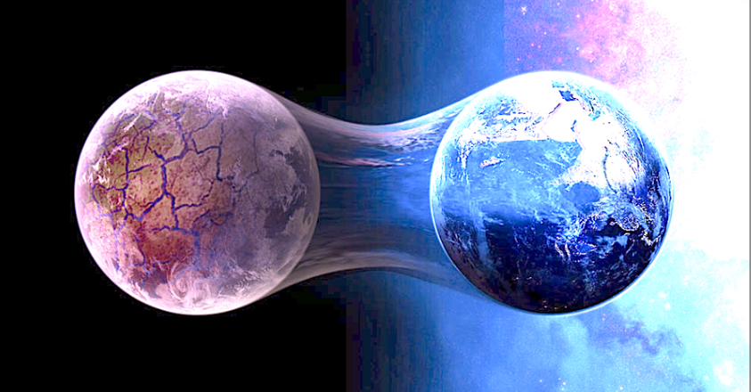
Bible believers
God created the sky, earth, and creatures, in six days, about 6000 years ago.
The sky and earth already existed, when God created Eden and creatures, in six days, between 6000 and 10,000 year ago.
Two main biblical creationist views
● Young earth: God created the sky, earth, and creatures, in six days, about 6000 years ago.
● Old earth: The sky and earth already existed, when God created Eden and creatures, in six days, between 6000 and 10,000 year ago.

Slide 3
Genesis 1:1-5 ESV
In the beginning, God created
In the beginning, God created the heavens and the earth. The earth was without form and void, and darkness was over the face of the deep...
And God said, “Let there be light,” and there was light... And there was evening and there was morning, the first day.

Slide 4
The Bible asserts:
● One God (Elohim plural with singular verb.)
● One Creator (No other gods, co-creators.)
● A beginning (Created—bârâ’ only of God.)
● Space (The heavens, sky and beyond.)
● Matter (Earth and sea.)
● Light (Darkness ➔ light. Source?)
● Time (Evening and morning.)

Slide 5
Traditional creation order
1. There was nothing.
2. God created everything in six days.
3. The new earth was dark and empty.
4. God created light on day 1.
5. God created everything else on earth in five days.

Slide 6
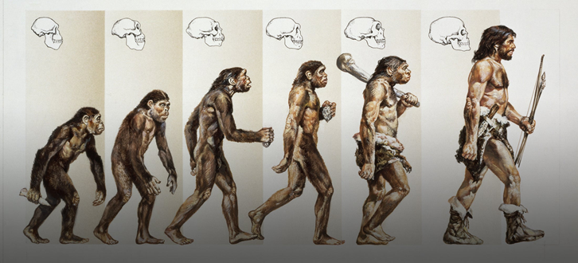
Modern scientific creation order
1. Once, there was nothing.
2. Suddenly, matter and energy happened.
3. Life evolved on earth over millions of years.
4. Ignorant people imagined that a God or gods made everything.
5. Science informed us that there are no gods (or no Bible God).

Slide 7
Genesis 1:1-5 NRSV
When God began to create
When God began to create the heavens and the earth, the earth was complete chaos, and darkness covered the face of the deep… Then God said, “Let there be light,” and there was light… And there was evening and there was morning, the first day.

Slide 8
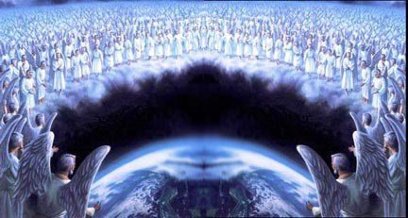
Alternate creation order
1. The Sky and earth were already there.
2. The old earth was or became dark and empty.
3. God caused light to shine on day 1.
4. God created everything on earth in five days.
5. Angels were already there, watching God create Eden and the creatures.

Slide 9
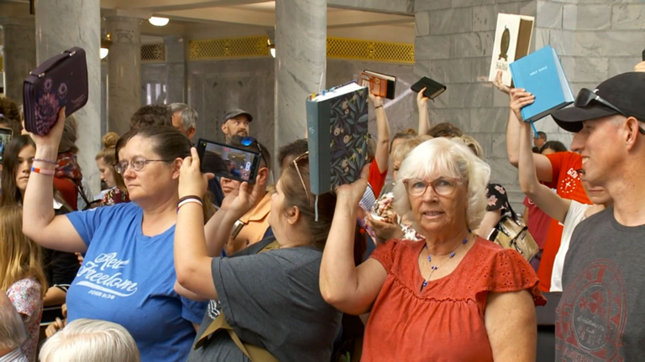
Which is right?
● ESV: In the beginning, God created the heavens and the earth.
● NRSV: When God began to create the heavens and the earth, …

Slide 10
Genesis 1:1 Hebrew (Masoretic text)
Bè-ré’shît bârâ’ ‘Elohîm ‘ét hâ-shâmayîm wè-’ét hâ-’ârèts.
Old consonantal text (no vowels, no cantillation)
Very old Paleo-Hebrew (before Babylonian captivity)

Slide 11
“In the beginning” Bereshit (1)
● Before 6th century BCE:
● After 5th century BCE:
● After 10th century CE:
“Bè-ré’shît” This word has three parts:
1. A noun: ro’sh which means ‘head’.
2. An ending: ît which makes it ‘beginning’.
3. A prefix: bè which makes it adverbial.
NOTE: This has no definite article ‘the’.

Slide 12
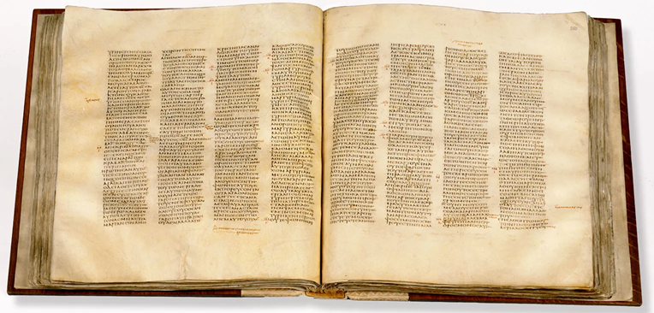
“In the beginning” Bereshit (2)
When the Jews translated verse 1 into Greek, in the third century BCE, they wrote “In beginning” (Ἐν ἀρχῇ, En arché), not “In the beginning” (Ἐν τῇ ἀρχῇ, En té arché).
When the Apostle John wrote John 1:1, the borrowed En arché from Gen. 1:1 in Greek. He was perhaps hinting: “When he began to create all things, he already was.”

Slide 13
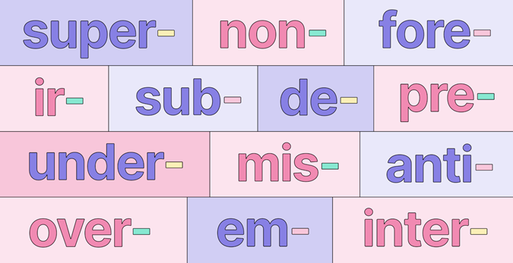
Main Hebrew noun prefixes
ב bè = locality or instrument.
ה hâ = definite article: ‘the’.
כ kè = comparison: ‘like’.
ל lè = existence or direction: ‘towards’.
מ mi = source: ‘from’.
ו wè = conjunction: ‘and’ or clause marker.
ראשׁית+ב = bè+ré’shît = In/At beginning = ‘When he began to …’

Slide 14
Construct relations in Hebrew (1)
● When a noun is followed by text that completes it, and the noun has no article ‘the’, then they are in a ‘construct’ relation.
● If they are both nouns, then in English we connect them with the genitive: “of”.
● For example: deber ha-nabi
= “word the prophet”
= “the word of the prophet”
or “the prophet’s word.”

Slide 15
For example (Jer. 26:1)
● Transliteration: Bereshit mmlkwt Ihwikim …
● Text: In-beginning reign Jehoiakim …
● Literally: “At the beginning of the reign of King Jehoiakim, …”
● Translation: “When King Jehoiakim began to reign, …”
● Observation: This is a ‘construct’ relation between two nouns: beginning and reign.

Slide 16
Young-earth creationists
● They appeal to the traditional translation of Genesis 1:1, “In the beginning, God created.”
● This is because they believe that God created the sky and the earth on day one of the creation week.
● They consider the alternate translation to be done by ‘liberals’ who require millions of years for evolution.

Slide 17
Old-earth creationists
● They appeal to the alternate translation of Genesis 1:1, “When God began to create.”
● This is because they believe that God had already created the sky and the earth on day one of the creation week.
● They consider the traditional translation to be done by ‘fundamentalists’ who require a six-day creation of everything.

Slide 18
Conclusion
● The alternative better expresses Hebrew grammar which is ignored by tradition.
● It explains how angels were present while God ‘created’ the heavens and earth.
● It allows for long geological ages and expansion of the universe.
● It still affirms a six-day special creation of ‘sky and earth’ prepared for human beings.

Slide 19
But wait! Four problems
1. In Genesis 1:1 there is no second noun for a construct relation!
2. Genesis 1:2 begins with ‘And’, requiring a separate sentence!
3. There may actually be a definite article ‘the’ in bereshit (in the beginning)!
4. All the conservative, standard, Bible versions retain the traditional translation!

Slide 20
(1) No second noun for a construct
Reply
● Construct relations can occur between a noun and a subject-verb clause.
● For example: In Hosea 1:2, the Hebrew says, “Beginning Yahweh spoke to-Hosea.”
● The NRSV translates this: “When the LORD first spoke through Hosea…”

Slide 21
(2) Verses 2, 3, 4 begin with ‘And’.
Reply
● Genesis 1–6 has 140 verses. 126 of those verses begin with ‘wè’. This is normal
● Hebrew ‘wè’ is sometimes a conjunction ‘and’ or ‘or’, other times a clause marker.
● 135 of those verses have two halves, and most of those halves begin with ‘wè’.
● English often does not translate ‘wè’.

Slide 22
(3) ‘Beginning” may have a ‘the’.
Issue: The prefix ‘b’ can include ‘the’ when it keeps the article’s vowel.
Reply
● That could be the case in consonantal texts which have no vowels.
● Possibly, bè+hâ+resh’it ➔ bâresh’it.
● But the Masoretic Hebrew text has vowels, and in Genesis 1:1 ‘bè’ has its own vowel.

Slide 23
(4) Most Bibles say, ‘In the beginning’
Issue: All 40 versions on biblehub.com have the traditional text. Are the all wrong?
Reply
● They are not wrong; they are traditional.
● Bible publishers translate for conservative Christians who reject evolutionism.
● Bible publishers seek to avoid controversy.
● Bible publishers want to evangelize, and the traditional translation seems sufficient.

