Slide 1
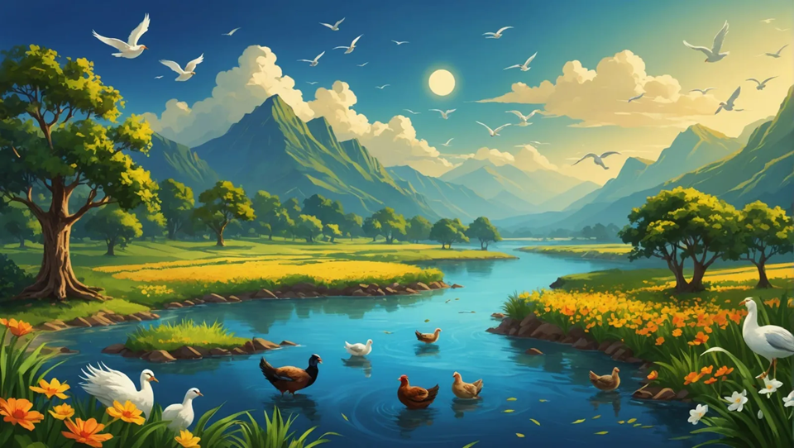
“Multiply and fill the earth”
Are we destroying the planet?
Mid-2024

Slide 2
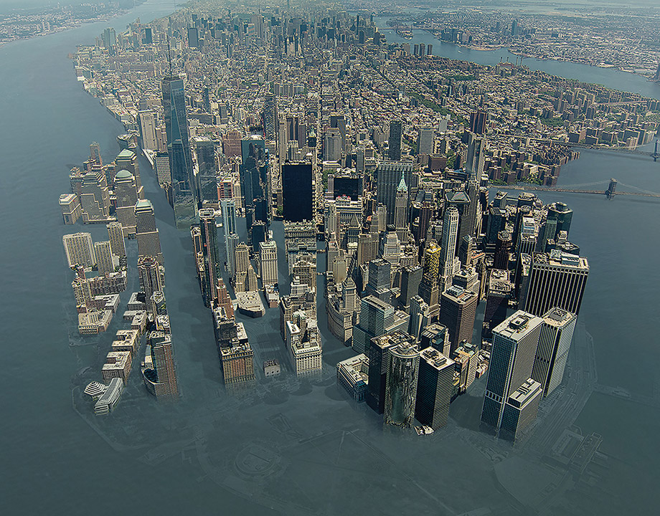
Will we drown? Or starve?
● Temperatures are rising!
● Glaciers are melting!
● Storms are increasing!
● Wildlife are dying!
● Soils are depleted!
● Clean water is disappearing!
● Diseases are spreading!
● Food supplies are collapsing!
https://www.asme.org/topics-resources/content/defending-infrastructure-against-sea-level-rise

Slide 3
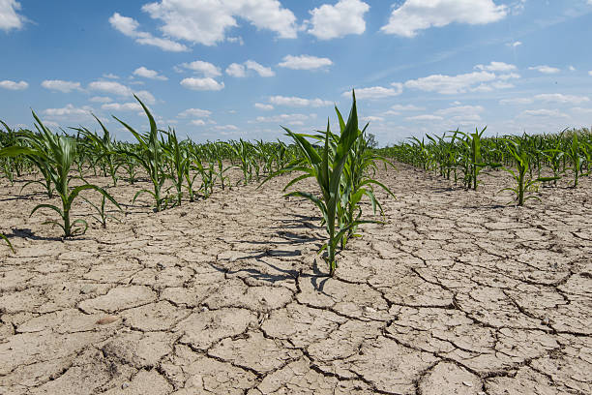
Last week
● Idaho State shut of ground water to 6,400 users, affecting 500,000 acres of farmland!
● Ostensibly, to conserve scare water.
● The water was diverted to cobalt mines!
● Owned by Australian Jervois Mining!
● Why did they not wait until after the crops were ready for harvest?

Slide 4
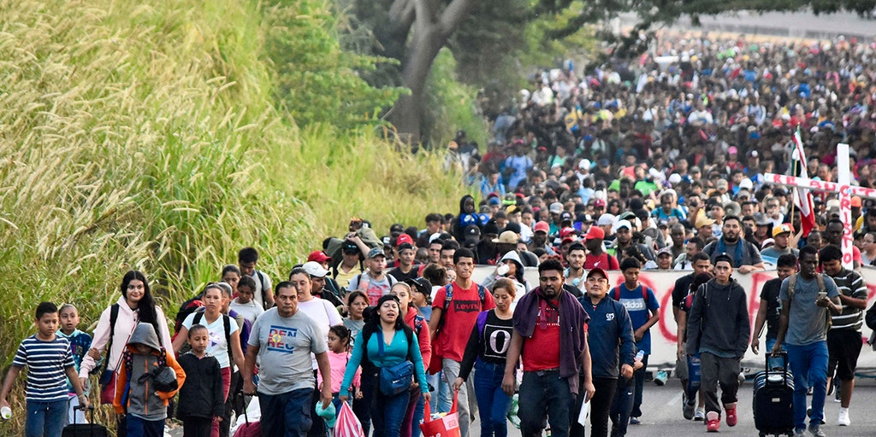
Over-population results
● Air, water and soil pollution
● Transmittable diseases, pandemics
● Food insecurity, social collapse
● Water scarcity
● Mass migration, invasion
● Loss of eco-systems, animal life
● Social chaos and violence
● What else?

Slide 5
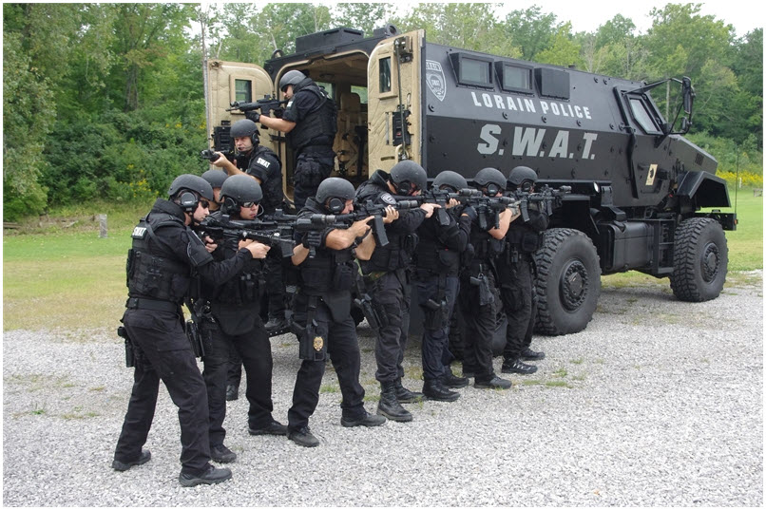
Over-population solutions
● Electronic & camera surveillance
● Central planning and authority
● Strong government and police
● Food and water conservation
● Economic justice, redistribution
● Media censorship, message control
● Eco-system protection
● Drastic de-population efforts
The Lorain, Ohio, Police Department Special Weapons and Tactics (SWAT) Team

Slide 6
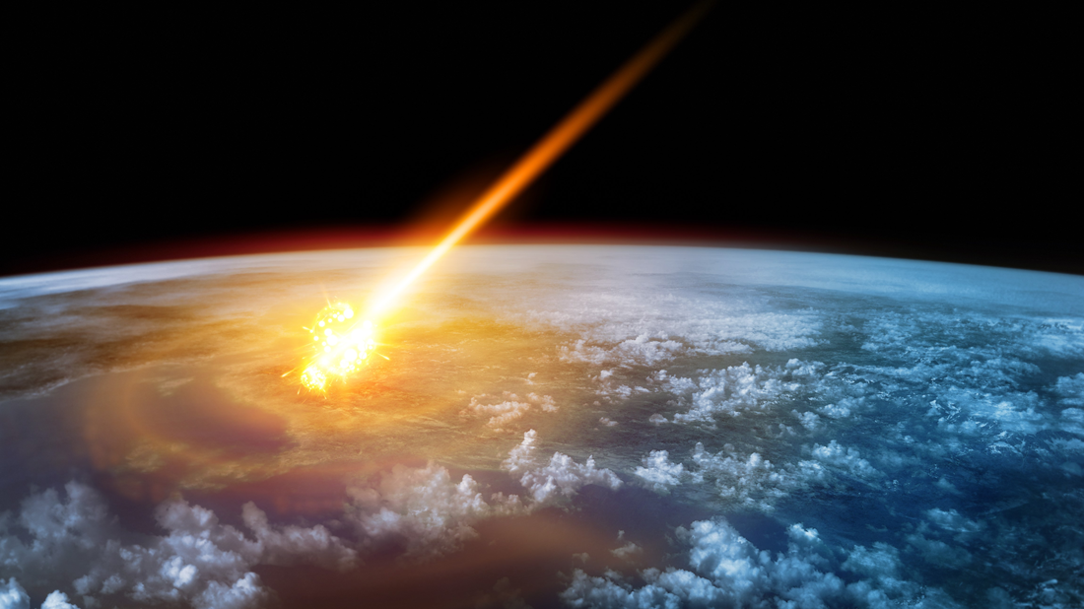
Historical de-population
● Volcanoes and meteorites.
● Ice ages leading to malnutrition.
● Catastrophic flooding.
● Aggressive wildlife.
● Invasion, war and mass homicide.
● Plagues and pandemics.
● Social collapse and anarchy.
● What else?

Slide 7
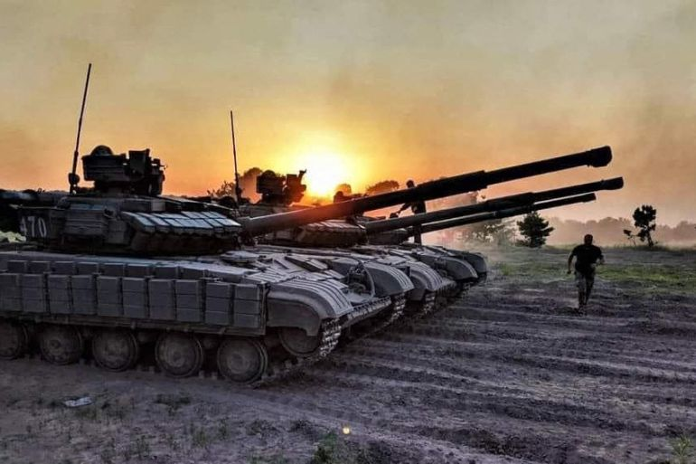
Potential de-population tactics
● Foment wars, invasions, genocide.
● Manufacture foods lacking nutrients.
● Keep ‘health care’ expensive.
● Promote homosexuality & transgender.
● Provide pre- and post-natal abortion.
● Mandate injections that reduce fertility.
● Strengthen lethal pathogens, e.g., viri.
● What else?

Slide 8
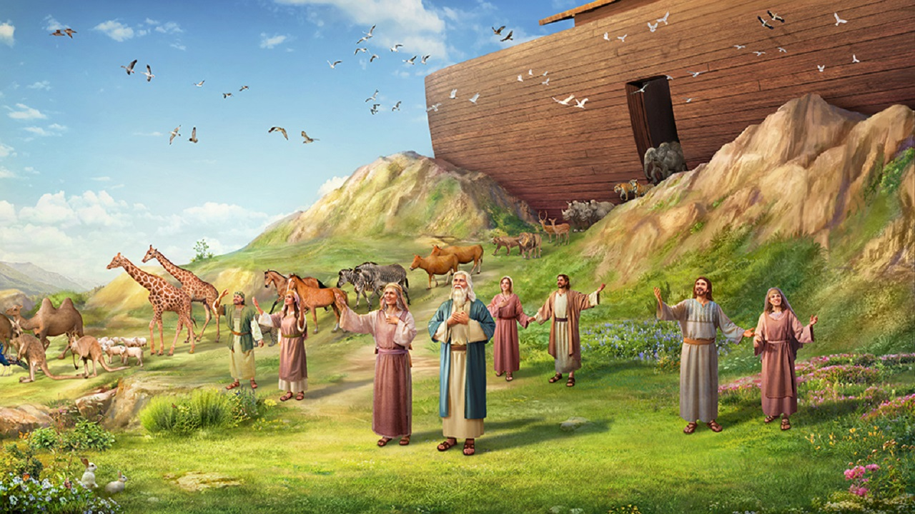
What has God said?
“Whoever sheds the blood of a human, by a human shall that person’s blood be shed, for in his own image God made humans.
“And you, be fruitful and multiply, abound on the earth and have dominion over it.” Genesis 9:6-7

Slide 9
Implications for human beings
● Humans must not willfully kill humans.
● Humans must punish willful homicide.
● Humans must give account to God.
● Humans must reproduce, responsibly.
● Humans must increase in number.
● Humans must populate the earth.
● Humans must manage earth resources
● What else?

Slide 10
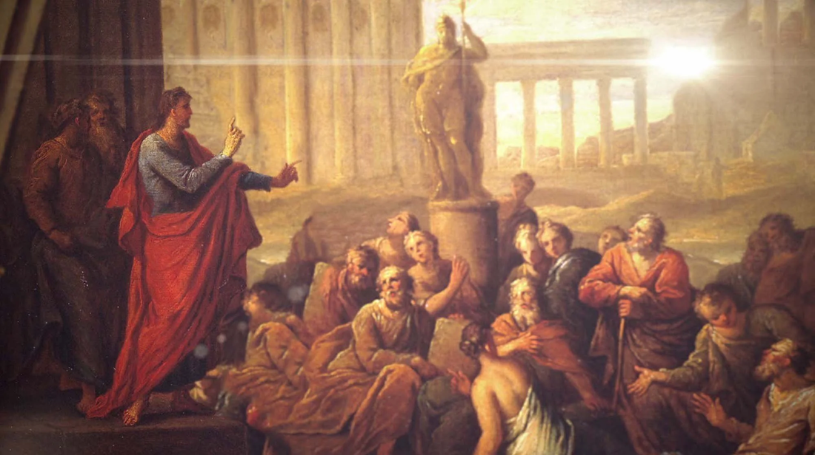
What has God said to everyone?
“The times of ignorance God over-looked, but now he commands all people everywhere to repent, because he has fixed a day on which he will judge the world in righteousness by a man whom he has appointed;
and of this he has given assurance to all by raising him from the dead.” Acts 17:30-31

Slide 11
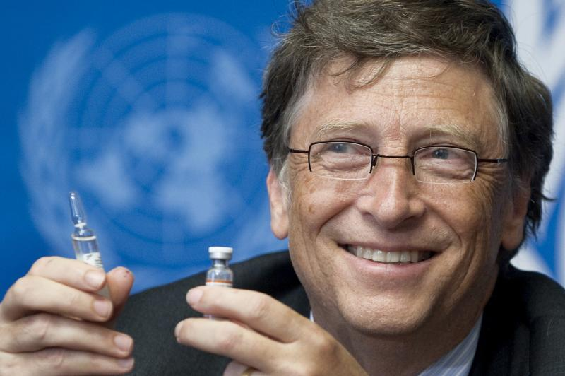
Human beings must
● Manage earth’s resources better.
● Respect and protect all human life.
● Expose and oppose de-population.
● Prevent and stop wars (not win them).
● Ban de-population bio-weapons.
● Stop homicidal psychopaths.
● Strengthen community defense.
● Promote mother-child health care.

Slide 12
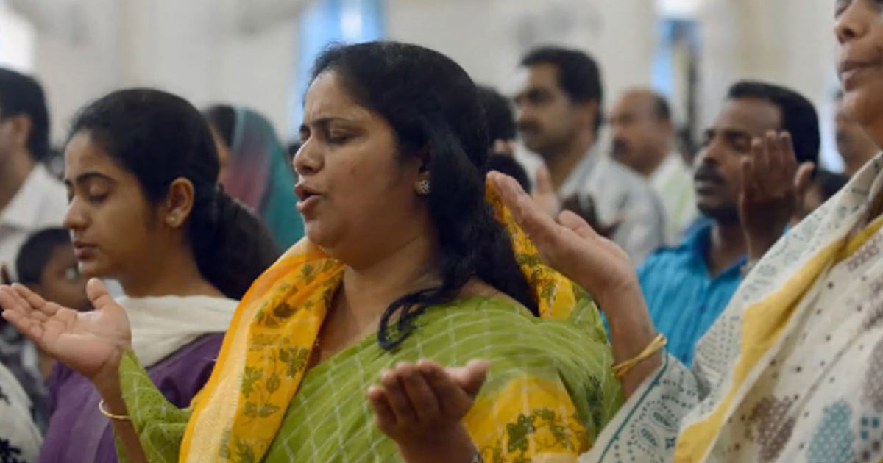
What does Scripture say?
“The saying is trustworthy, and I want you to insist on these things, so that those who have believed in God may be careful to devote themselves to good works.
These things are excellent and profitable for people.” Titus 3:8

Slide 13
Christians must
● Marry and start families, repsponsibly.
● Protect children and the elderly.
● Labor and produce nutritious food.
● Protest wars, genocide, and invasions.
● Forbid homosexuality, transgenderism.
● Master the sciences and engineering.
● Practice environmental responsibility.
● Denounce murderous de-population.

Slide 14
Churches must
● Sanctify marriages and childbearing.
● Teach and preach biblical morality.
● Include repentance in evangelism.
● Forbid homosexuality, transgenderism.
● Exclude members who practice or advocate for perverted behavior.
● Condemn and protest child mutilation .
● Extend God’s grace to the repentant.

Slide 15
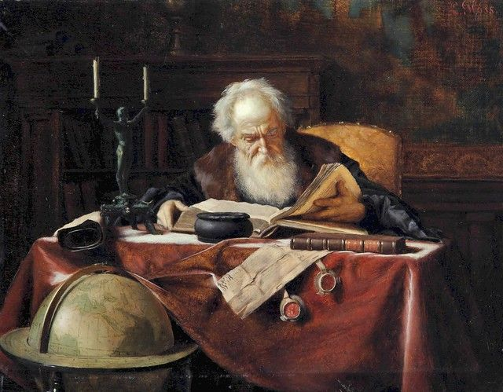
What shall we teachers do?
● Choose an urgent social issue.
● Learn what others are saying, reading one or more secular books.
● Read one or more Christian books.
● Collect materials and web links.
● Summarize and store materials & links.
● Search Scripture and theology, pray.
● Outline, present, defend arguments.
A Scholar in His Study
Ludwig Gloss, 1851-1903, Oostenrijk

