Slide 1
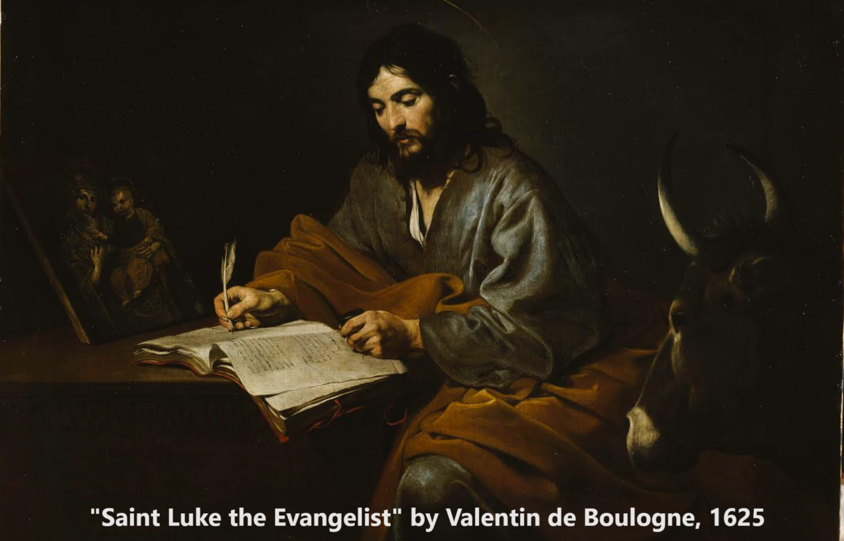
The Gospel of Luke 1:5-80
Gabriel announces John’s and Jesus’ births
21 & 24 September 2023

Slide 2
Structure of Luke’s Gospel
1 Preface: Sponsor, method and purpose.
2 Birth narratives: Dawn of the promised new era.
3 John’s mission: Introduce the Messiah.
4 Jesus’ mission: Resist temptation and hostility.
5 Journey: Messianic signs and teaching. Luke 9:51
6 Jerusalem: Confront Israelite and Roman rulers.
7 Crucifixion: Last supper, arrest, trials, death.
8 Resurrection: Alive, appearance, and proofs.
9 Ascension: Gives Holy Spirit, mission to nations.

Slide 3
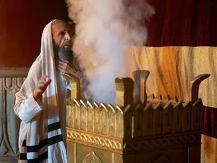
Message to Israel
● The messianic age has begun!
● Prophets’ predictions have been fulfilled!
● The messiah’s forerunner has run!
● The messiah has come!
As evidenced by
● Angelic appearances and messages.
● Miraculous conceptions.
● Holy Spirit-inspired prophecies.
● The appearance of John and of Jesus.

Slide 4
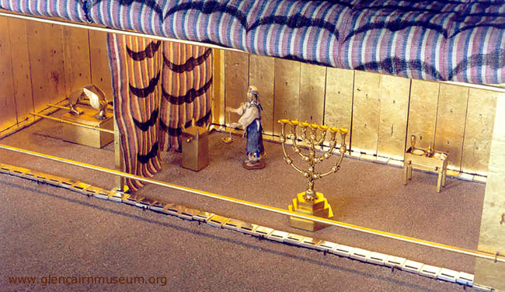
Luke 1:5-7
⁵ In the time of Herod king of Judea there was a priest named Zechariah, who belonged to the priestly division of Abijah; his wife Elizabeth was also a descendant of Aaron. ⁶ Both of them were righteous in the sight of God, observing all the Lord’s commands and decrees blamelessly. ⁷ But they were childless because Elizabeth was not able to conceive, and they were both very old.

Slide 5
Luke 1:5-7
● Herod may have died in 1 CE.
● John and Jesus were likely born between
2 BC and 1 CE.
● Righteous in God’s opinion, without law: Noah (Gen 6:9), Abraham (Gen 17:1) and Job (Job 1:1).
● The righteous by faith seek to please God.
● Priestly divisions served twice a year for two weeks. All divisions together during festivals.

Slide 6
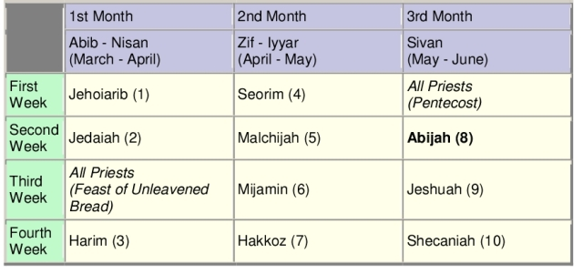
Luke 1:8-10
⁸ Once when Zechariah’s division was on duty and he was serving as priest before God, ⁹ he was chosen by lot, according to the custom of the priesthood, to go into the temple of the Lord and burn incense. ¹⁰ And when the time for the burning of incense came, all the assembled worshipers were praying outside.

Slide 7
Luke 1:8-10
● Abijah was the eighth course, serving May 26-29 in 3 BCE. 1 Chron 24:7-18
● Since there were so many priests in 3 BCE, individuals were chosen by lot to serve at temple.
● A priest burned incense before the AM sacrifice and after the PM sacrifice. He entered the holy space, placed embers on an altar, threw incense on them, said a blessing, turned round, and left.

Slide 8
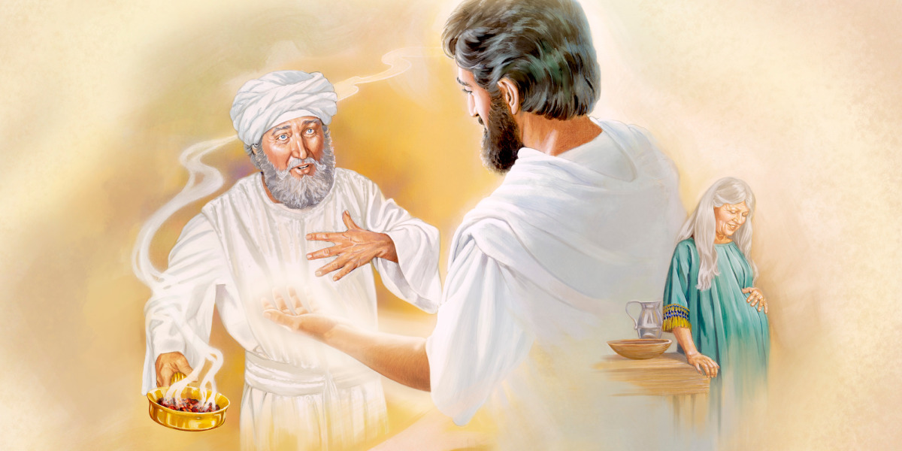
Luke 1:11-15
⁸ Then an angel of the Lord appeared to him, standing at the right side of the altar of incense. ¹² When Zechariah saw him, he was startled and was gripped with fear. ¹³ But the angel said to him:
“Do not be afraid, Zechariah; your prayer has been heard. Your wife Elizabeth will bear you a son, and you are to call him John. ¹⁴ He will be a joy and delight to you, and many will rejoice because of his birth, ¹⁵ for he will be great in the sight of the Lord.

Slide 9
Luke 1:11-15
● “Angel of the LORD” in the Hebrew Bible was an audible, visible appearance of Yahweh. But here he is named Gabriel (v 19).
● Angels announce births: Gen 16:11; 17:19; Is 7:14
● “John” derives from the Hebrew name יוֹחָנָן
(Yô-ḥanan) meaning "Yahweh is gracious.”
● He who names a child claims the child as his own.
● “Great” = esteemed and respected as in 2 Ki 5:1.

Slide 10
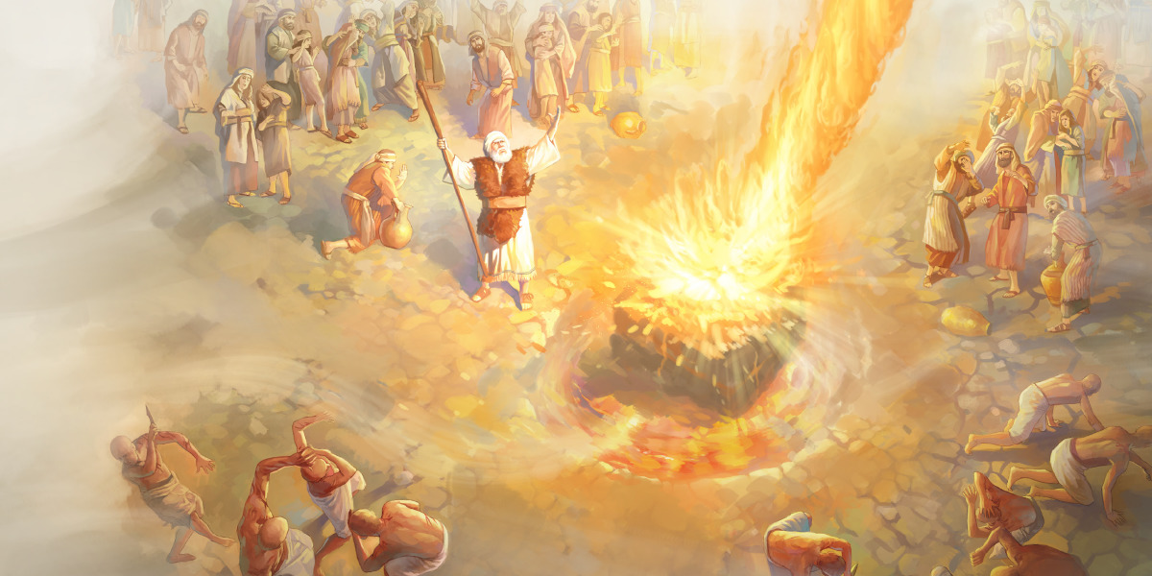
Luke 1:15-17
¹⁵ He is never to take wine or other fermented drink, and he will be filled with the Holy Spirit even before he is born. ¹⁶ He will bring back many of the people of Israel to the Lord their God. ¹⁷ And he will go on before the Lord, in the spirit and power of Elijah, to turn the hearts of the parents to their children and the disobedient to the wisdom of the righteous—to make ready a people prepared for the Lord.”

Slide 11
Malachi 4:5-6 [Heb. 3:23-24]
⁵ “See, I will send the prophet Elijah to you before that great and dreadful day of the LORD comes. ⁶ He will turn the hearts of the parents to their children, and the hearts of the children to their parents; [lest I] come and strike the land with total destruction.”
● How did Jesus know that Jerusalem would be destroyed within a life time?

Slide 12
Luke 1:15-17
● John 1:21 They asked him, “Are you Elijah?" He replied, “I am not.”
● Matthew 11:14 “If you are willing to accept it, he [John] is Elijah who is to come.”

Slide 13
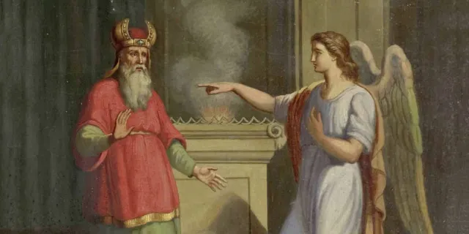
Luke 1:18-20
¹⁸ Zechariah asked the angel, “How can I be sure of this? I am an old man and my wife is well along in years.” ¹⁹ The angel said to him, “I am Gabriel. I stand in the presence of God, and I have been sent to speak to you and to tell you this good news. ²⁰ And now you will be silent and not able to speak until the day this happens, because you did not believe my words, which will come true at their appointed time.”

Slide 14
Luke 1:18-20
● Gabriel: גַּבְרִיאֵל Gaḇrīʾēl, singular possessive form of the Hebrew noun גֶּבֶר (gever) meaning “man, hero”, and אֵל (^{ʔ}Ēl), meaning “God.”
● Daniel 8:16; 9:21, “insight and understanding.”
● Four named ‘archangels’ in the Book of Enoch:
Michael, Raphael, Gabriel and Phanuel. “These are the four angels of the Lord.” 1 Enoch 40:9-10

Slide 15
Zecharia Mary
12 the vision's recipient is troubled
13 do not be afraid
13 reason for miracle
13 child's name (John)
15 child will be great
15 filled with the Holy Spirit
16-17 mission: make ready
18 question
19-20 proof or explanation
20 Zechariah muted for unbelief
80 child grows
29 the vision's recipient is troubled
30 do not be afraid
30 reason for miracle
31 child's name (Jesus)
32 child will be great
35 conceived by the Holy Spirit
32-33 mission: reign forever
34 question
35-37 proof or explanation
38, 45 Mary praised for faith
2:40, 52 child grows
Adapted from IVP Bible Backgrounds Commentary

Slide 16
Luke 1:26-29
²⁶ In the sixth month of Elizabeth’s pregnancy, God sent the angel Gabriel to Nazareth, a town in Galilee, ²⁷ to a virgin pledged to be married to a man named Joseph, a descendant of David. The virgin’s name was Mary. ²⁸ The angel went to her and said, “Greetings, you who are highly favored! The Lord is with you.” ²⁹ Mary was greatly troubled at his words and wondered what kind of greeting this might be.

Slide 17
Luke 1:26-29
Mary
● Virgin: Neither married nor pregnant.
● Name: מרים Maryam. From an Egyptian word meaning ‘beloved’.
● Betrothed: to Joseph, a descendant of king David.

Slide 18
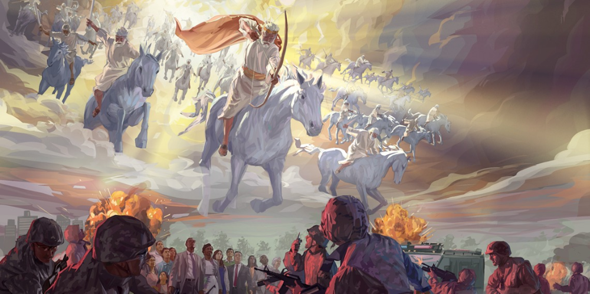
Luke 1:30-33
³⁰ But the angel said to her, “Do not be afraid, Mary; you have found favor with God. ³¹ You will conceive and give birth to a son, and you are to call him Jesus. ³² He will be great and will be called the Son of the Most High. The Lord God will give him the throne of his father David, ³³ and he will reign over Jacob’s descendants forever; his kingdom will never end.”

Slide 19
Luke 1:26-29
Mary
● ‘Highly favored’: perfect, passive, feminine participle, ‘having been (and still) graced’.
● Will conceive and give birth to a son.
● Will call him Jesus = Joshua = Yehošu^{ʕ} = “Yahweh saves!”
● He who names a child claims the child as his own.

Slide 20
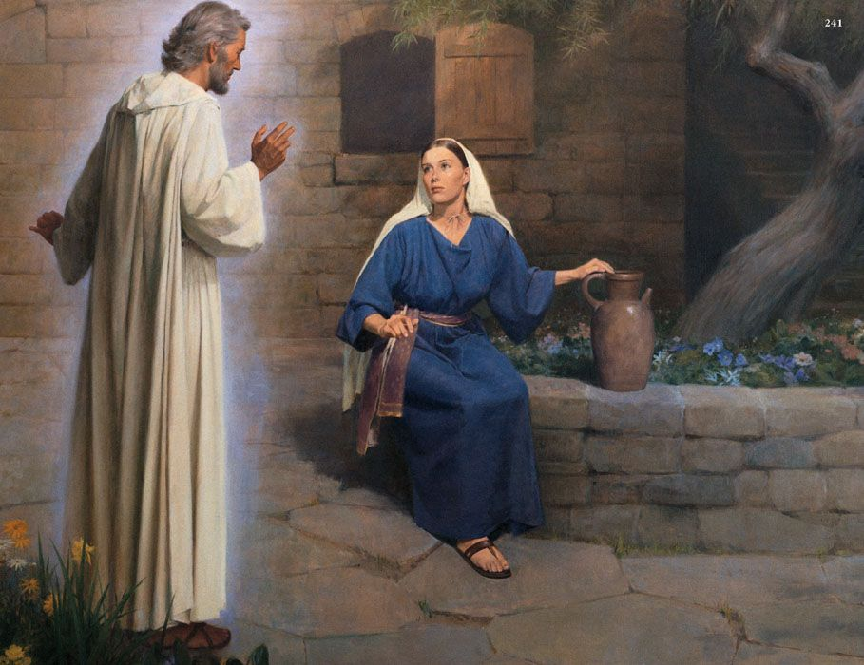
Luke 1:34-38
³⁴ “How will this be,” Mary asked the angel, “since I am a virgin?” ³⁵ The angel answered, “The Holy Spirit will come on you, and the power of the Most High will overshadow you. So the holy one
to be born will be called the Son of God. … ³⁷ For
no word from God will ever fail.” ³⁸ “I am the Lord’s servant,” Mary answered. “May your word to me
be fulfilled.” Then the angel left her.

Slide 21
Luke 1:34-38
● I am a virgin: Lit., “I know no male.”
● The Holy Spirit: Isa. 63:10-11 = Yahweh.
● Holy one: ‘the holy thing-being-begotten’, neuter ptc. ≈ perhaps anticipating paidion, child, servant.
● Son of God: huios = offspring who inherits.

Slide 22
Jesus in Luke 1
1. Jesus named by the Father. 31
2. Great (in semitic style, ‘greatest’). 32
3. Son of the Most High. 32 A messianic title.
4. The throne of his ancestor David. 32
5. Will reign over Jacob/Israel. 33
6. His kingdom will never end. 33 from Dan 7:14
7. The Holy (child) to be born. 35
8. Will be called ‘Son of God’. 35

Slide 23
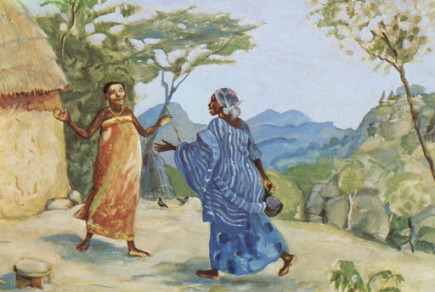
Luke 1:41-45
⁴¹ When Elizabeth heard Mary’s greeting, the baby leaped in her womb, and Elizabeth was filled with the Holy Spirit. ⁴² In a loud voice she exclaimed: “Blessed are you among women, and blessed is the child you will bear! ⁴³ But why am I so favored, that the mother of my Lord should come to me? … ⁴⁵ Blessed is she who has believed that the Lord would fulfill his promises to her!”

Slide 24
Luke 1:41-45
● Filled with the Holy Spirit: Elizabeth 1st in the NT!
● Blessed: Perf. pass. ptcs., “having been approved.”
● Child: Lit., ‘fruit of thy womb’.
● I am so favoured: Lit., ‘whence to me this, that…’
● Blessed: Lit., ‘happy’, the same blessing that Jesus pronounced over all who faithfully follow him.

Slide 25
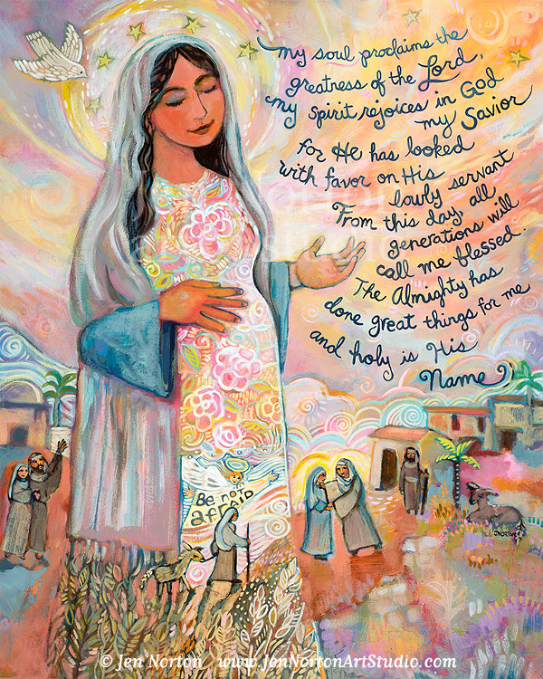
Luke 1:46-55 Mary’s song
⁴⁶ And Mary said: “My soul glorifies the Lord ⁴⁷ and my spirit rejoices in God my Savior, ⁴⁸ for he has been mindful of the humble state of his servant. From now on all generations will call me blessed …
● Probably uttered in palestinian Aramaic.
● God my Savior: Immaculate conception doubtful.
● Call me blessed: Act. Verb = We call Mary blessed; it is not she who blesses us as co-redemptrix.
● Verb tenses: past, present and future.

Slide 26
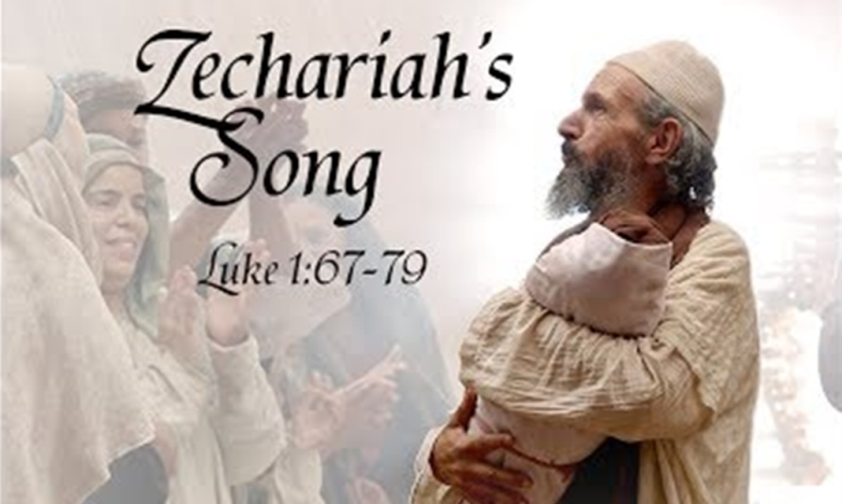
Luke 1:67-79 Zecharia’s song
⁶⁷ His father Zechariah was filled with the Holy Spirit and prophesied: ⁶⁸ “Praise be to the Lord, the God of Israel, because he has come to his people and redeemed them. ⁶⁹ He has raised up a horn of salvation for us in the house of his servant David… ⁷⁶ And you, my child, will be called a prophet of the Most High; for you will go on before the Lord to prepare the way for him, ⁷⁷ to give … the knowledge of salvation through the forgiveness of their sins.

Slide 27
Luke 1:67-79 Zecharia’s song
● Prophesied: The primary sign of the Holy Spirit is prophecy, to speak revealed truth forthrightly!
● Horn: Common trope for ‘powerful’.
● David: the Israelite king to whom Yahweh had promised a perpetual reign over Israel.
● Prophet: There had been no authentic prophet in Israel for several centuries.
● Salvation: Forgiven sins … path of peace.

Slide 28
Inferences from Luke 1
● Malachi: No prophet had risen in Israel since the fifth century BCE.
● Holy Spirit: Yahweh had departed from the temple, from Jerusalem and from Judea in the sixth century BCE. He is now returned.
● Prophecy: Elizabeth, Zecharia and Mary prophesied when filled with the Holy Spirit.
● Herod: We now live under two regimes, that of human politics, and that of the Holy Spirit.

Slide 29
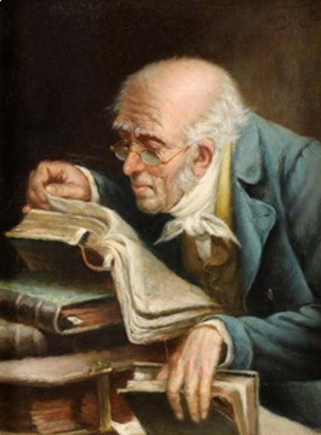
Summary
● What truths will you affirm?
● What promises will you claim?
● What commands will you obey?
Assignment
● Read: Gospel of Luke, chapter 2.
● Visit: www.luke.currah.download
● Compile: insights, queries and observations.

