Slide 1
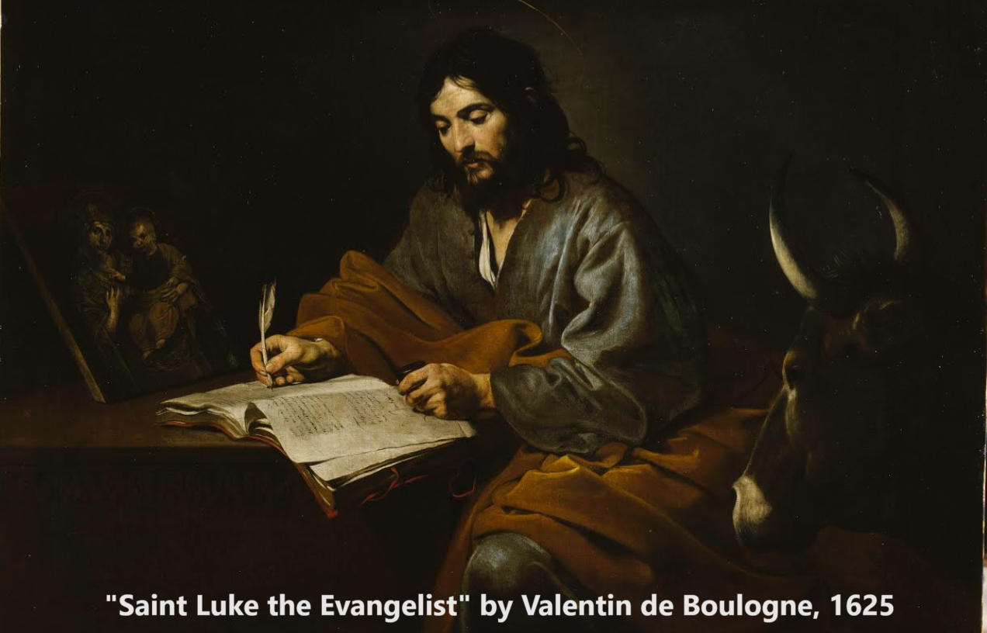
Gospel of Luke 11:14–12:12
‘By the finger of God’
03 & 07 December 2023

Slide 2
Structure of Luke’s Gospel
1 Preface: Sponsor, method and purpose.
2 Birth narratives: Dawn of the promised new era.
3 John’s mission: Introduce the Messiah.
4 Jesus’ mission: Messiah’s message and work.
5 Journey to death: Messianic signs and teaching.
6 Jerusalem: Confront Israelite and Roman rulers.
7 Crucifixion: Last supper, arrest, trials, death.
8 Resurrection: Alive, appearance, and proofs.
9 Ascension: Gives Holy Spirit, mission to nations.

Slide 3
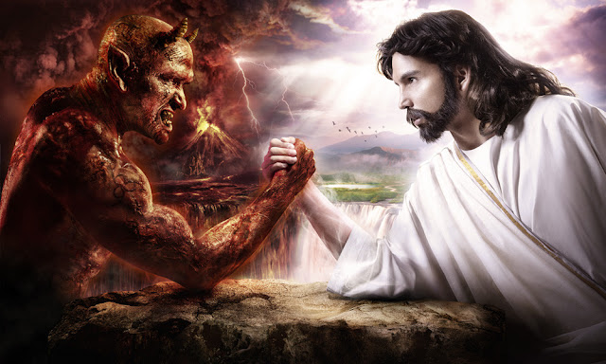
Jesus proves greater than the devil
1. Than demons 11.14-26
2. Than doctrine 11.27-28
3. Than dogma 11.29-32
4. Than darkness 11.33-36
5. Than duties 11.37-44
6. Than deceit 11.45-53
7. Than duplicity 12.1-3
8. Than death 12.4-7
9. Than dread 12.8-10
10. Than doubt 12.11-12

Slide 4
Jesus is greater than demons Luke 11:14-26

Slide 5
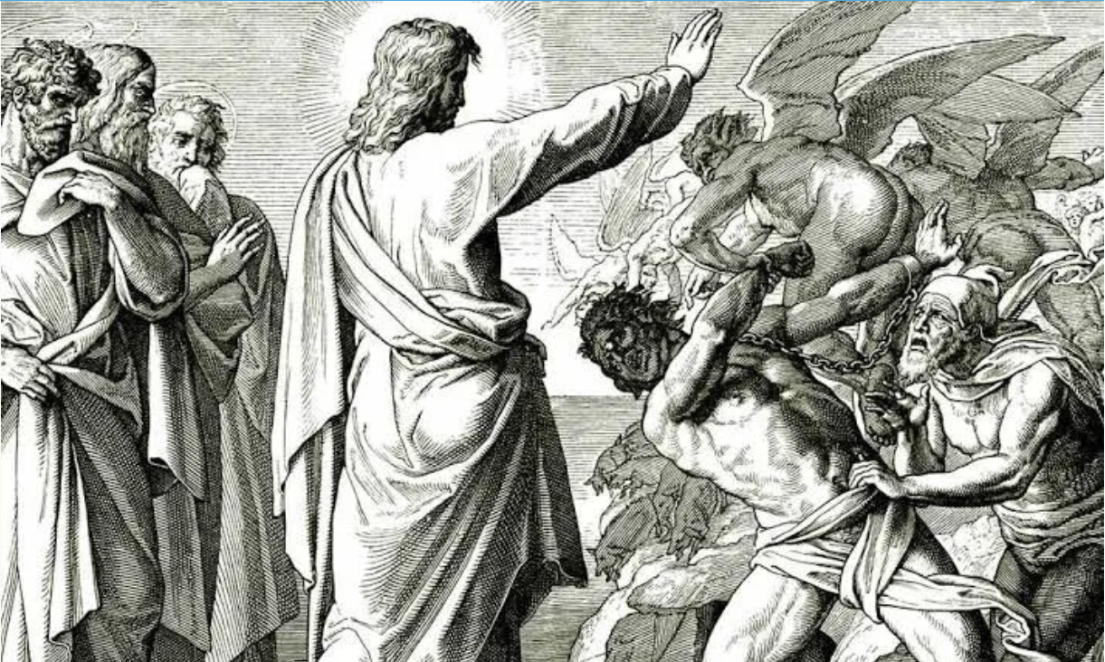
Jesus greater than demons
¹⁴ Jesus was driving out a demon that was mute.* When the demon left, the man who had been mute spoke, and the crowd was amazed.
¹⁵ But some of them said, “By Beelzebul, the prince of demons, he is driving out demons.” ¹⁶ Others tested him by asking for a sign from heaven.
* Some manuscripts read, “a mute demon”.

Slide 6
Jesus greater than demons
● Beelzebul = Baal-zebub” (2 Kings 1:2) = “Belial” (2 Cor 6:15) =Beliar = Mastema = Sammael = the prince of demons.
● Judean accusations against Jesus and his apostles doing miracles by Satan’s power continued through the second century.
● So, just what are demons? Psychosis? Rebel angels? Human ghosts? Bodiless creatures? ‘Impure spirits’.

Slide 7
Jesus is greater than demons
¹⁷ Jesus knew their thoughts and said to them:… ¹⁹ Now if I drive out demons by Beelzebul,* by whom do your followers drive them out? So then, they will be your judges. ²⁰ But if** I drive out demons by the finger*** of God, then the kingdom of God has come upon you. * Some manuscrits & versions read ‘Beelzebub’. ** 1st class condition = assumed to be true. *** Pharaoh’s magicians about Moses’ miracles (Exodus 8:19).

Slide 8
Jesus greater than demons
● Ba‘al: Lord, master, husband, boss (Hebrew and cognate semitic languages).
● Ba‘al-zəbûl: ‘Lord of heaven/dwelling’ (a Philistine god).
● Ba‘al-zəbûb: ‘Lord of flies’ (Ugaritic, Greek), since files were known to carry disease.
Ba’al statue (photo public domain). Casting a lightning bolt.

Slide 9
Jesus is greater than demons
²¹ “When a strong man, fully armed, guards his own house, his possessions are safe. ²² But when someone greater attacks and overpowers him, he takes away the armor in which the man trusted and divides up his plunder.
²³ “Whoever is not with me is against me, and whoever does not gather with me scatters. Some manuscripts read ‘scatters me.’

Slide 10
The strong man and the greater man Interpretations
● Humans (who give in to temptation) can be invaded by a strong demon.
● Jesus overpowers demons, setting humans free from them.
● Religious leaders try rule over folk, until Jesus comes along and frees folk from religion.

Slide 11
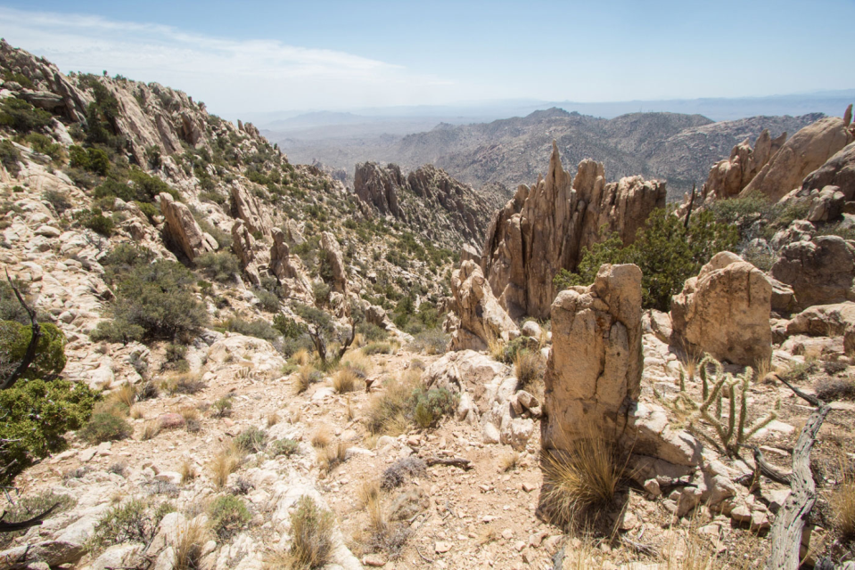
Jesus is greater than demons
²⁴ “When an impure spirit comes out of a person, it goes through arid places seeking rest and does not find it. Then it says, ‘I will return to the house I left.’ … ²⁶ Then* it goes and takes seven other spirits more wicked than itself, and they go in and live there. And the final condition of that person is worse than the first.” *Some manuscripts omit ‘Then’.

Slide 12
The strong man and the greater man
● Religions try to reform folk, sometimes by expelling demons, other times through counselling or acts of repentance.
● This provides temporary relief.
● However, impure spirits or harmful habits can return, stronger than before.
● So, God’s Holy Spirit comes and lives in those who put their faith in Jesus.

Slide 13
Jesus is greater than doctrine Luke 11:27-28

Slide 14
Jesus is greater than doctrine
²⁷ As Jesus was saying these things,* a woman in the crowd called out, “Blessed is the mother who gave you birth and nursed you.”
²⁸ He replied, “Blessed rather are those who hear the word of God and obey it.” * One 3rd century manuscript omits ‘these things’.

Slide 15
Jesus’ mother (Mary)
● “Blessed is the mother” = ‘veneration’. Some churches pray to Mary.
● Mary herself declared, “All generations will call me blessed!” (Luke 1:48).
● Mary gave only one command: “Do whatever [Jesus] tells you” (John 2:5).
● Jesus countered: “Blessed rather are those who hear the word of God and obey it.” v. 28

Slide 16
Jesus is greater than dogma Luke 11:29-32

Slide 17
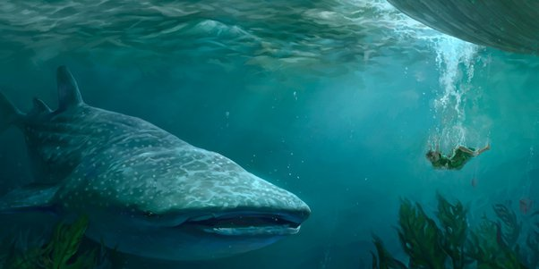
Jesus is greater than dogma
²⁹ As the crowds increased, Jesus said, “This is a wicked generation. It asks for a sign, but none will be given it except the sign of Jonah. ³⁰ For as Jonah was a sign to the Ninevites, so also will the Son of Man be to this generation.

Slide 18
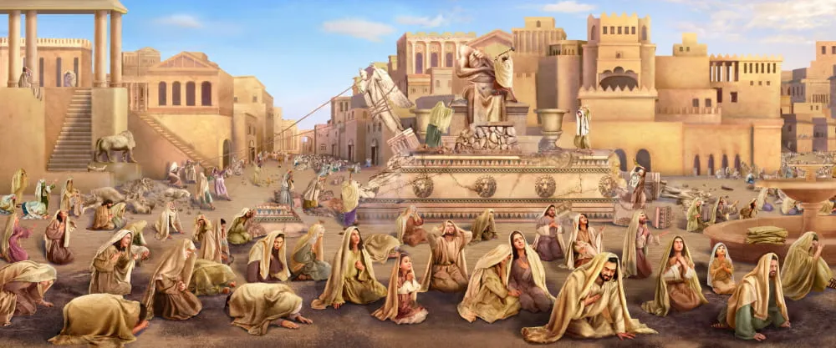
Jesus is greater than dogma
³² The men of Nineveh will stand up at the judgment with this generation and condemn it, for they repented at the preaching of Jonah; and now something greater than Jonah is here.

Slide 19
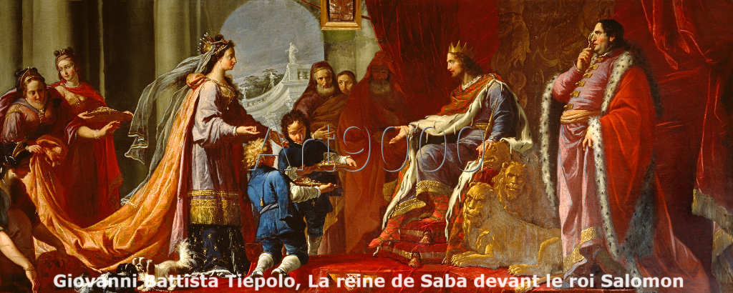
Jesus is greater than dogma
³¹ The Queen of the South will rise at the judgment with the people of this generation and condemn them, for she came from the ends of the earth to listen to Solomon’s wisdom; and now something greater than Solomon is here.

Slide 20
Jesus is greater than dogma
● Jonah was believed to have been swallowed by a great fish for three days.
● Ninevah City’s population repented, when Jonah warned them of God’s wrath.
● The queen of Sheba came to Jerusalem to learn wisdom from King Solomon.
● Jesus makes himself greater than both Jonah and Solomon.
● The Ninevites and the queen were Gentiles.

Slide 21
Jesus is greater than darkness Luke 11:33-36

Slide 22
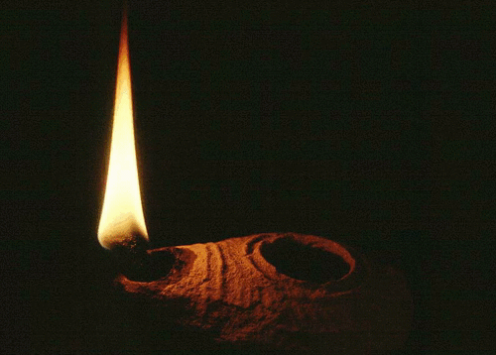
Jesus is greater than darkness
³³ “No one lights a lamp and puts it in a place where it will be hidden, or under a bowl.* Instead they put it on its stand, so that those who come in may see the light. ³⁴ Your eye is the lamp of your body. When your eyes are healthy, your whole body also is full of light.
*One 3rd century manuscript & others omit ‘or under a bowl’.

Slide 23
Jesus is greater than darkness
But when they are unhealthy, your body also is full of darkness. ³⁵ See to it, then, that the light within you is not darkness.
³⁶ Therefore, if your whole body is full of light, and no part of it dark, it will be just as full of light as when a lamp shines its light on you.”

Slide 24
“Unhealthy eyes”
● “A man with an evil eye hastens after riches.” Proverbs 28:22 NKJV
● “The Greek for unhealthy here implies stingy” NIV marginal note at verse 34.
● Jesus condemned those who leveraged religion to gain economic advantage.
● Politicians and bankers seek to impose global governance by leveraging finance and money supplies.

Slide 25
Jesus is greater than duties Luke 11:37-53

Slide 26
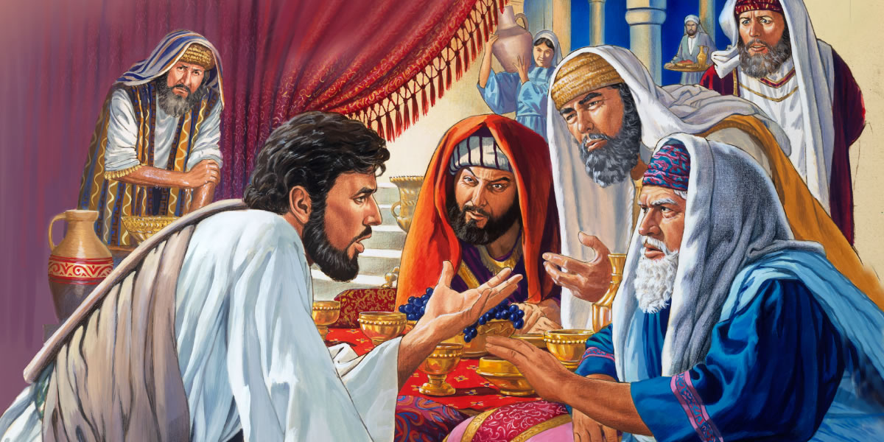
Jesus is greater than duties
³⁷ When Jesus had finished speaking, a Pharisee invited him to eat with him; so he went in and reclined at the table. ³⁸ But the Pharisee was surprised when he noticed that Jesus did not first wash before the meal.

Slide 27
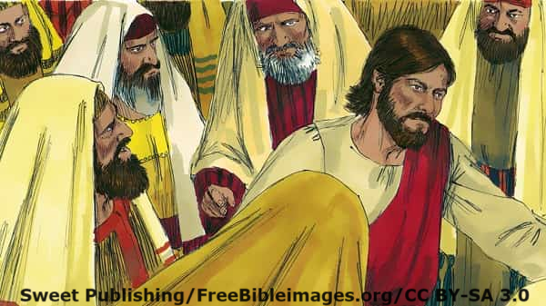
Jesus is greater than duties
⁵³ When Jesus went outside, the Pharisees and the teachers of the law began to oppose him fiercely and to besiege him with questions, ⁵⁴ waiting to catch him in something he might say.

Slide 28
Jesus is greater than duties
● In ministerial circles, such chaps are affectionately called ‘doctrine inspectors’, for they are constantly listening for errors in others’ messages and teaching.
● Religions require you to perform rituals, to keep rules, and to share your riches.
● Jesus, releases us from hell after death, from our bad habits during our life time, and from religious requirements.

Slide 29
Jesus is greater than duplicity Luke 12:1-3

Slide 30
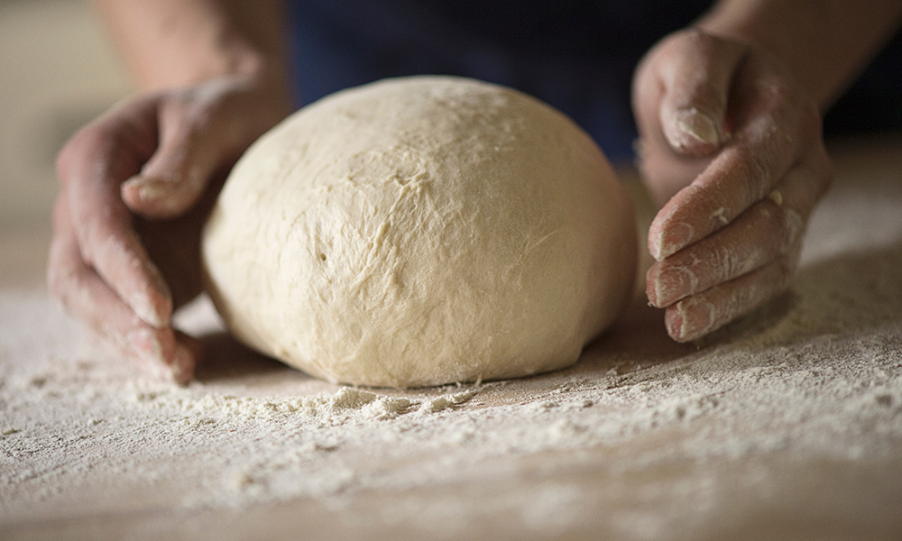
Jesus is greater than duplicity
¹ Meanwhile, when a crowd of many thousands* had gathered, so that they were trampling on one another, Jesus began to speak first to his disciples, saying: “Be on your guard against the yeast of the Pharisees, which is hypocrisy. * One 3rd century manuscript reads ‘of people’.

Slide 31
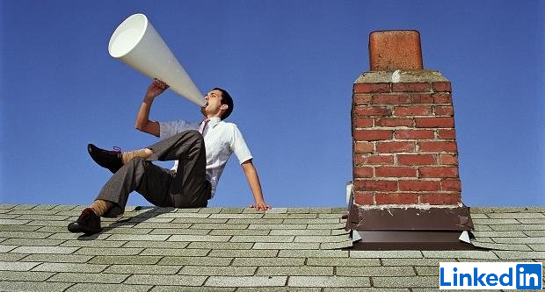
Jesus is greater than duplicity
² There is nothing concealed that will not be disclosed, or hidden that will not be made known.* ³ What you have said in the dark will be heard in the daylight, and what you have whispered in the ear in the inner rooms will be proclaimed from the roofs.
* One 3rd century manuscript omits ‘or hidden that will not be made known’.

Slide 32
Jesus is greater than duplicity
● Hypocracy: Pretending to be something that we know is not real. (This is different from being a weak example of what we are.)
● If you become a secret Christian, then eventually, others will find out.
● If it is dangerous to become a Christian, then baptize new believers in secret, and let the Lord decide when they should become exposed, if ever.

Slide 33
Jesus is greater than death Luke 12:4-7

Slide 34
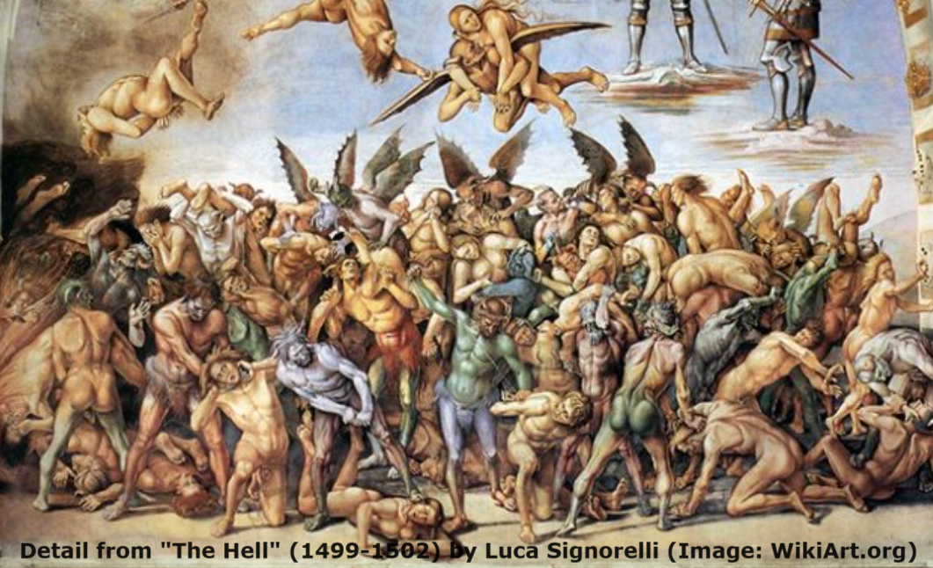
Jesus is greater than death
⁴ “I tell you, my friends, do not be afraid of those who kill the body and after that can do no more. ⁵ But I will show you whom you should fear: Fear* him who, after your body has been killed, has authority to throw you into hell. Yes, I tell you, fear him.
* Two 4th century manuscripts omit “fear”.

Slide 35
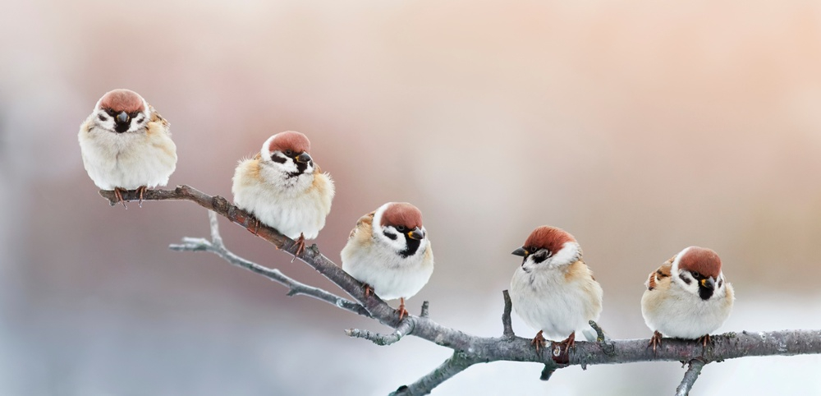
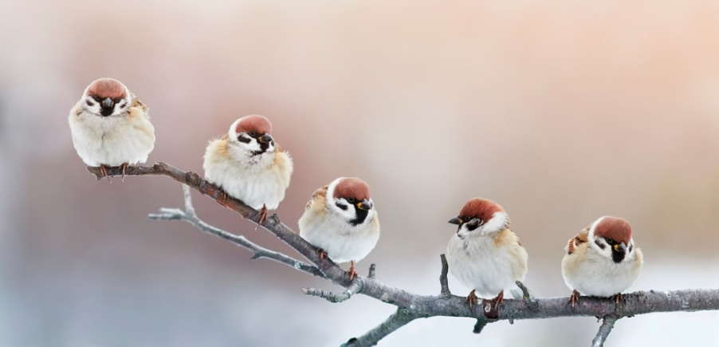
Jesus is greater than death
⁶ Are not five sparrows sold for two pennies? Yet not one of them is forgotten by God. ⁷ Indeed, the very hairs of your head are all numbered. Don’t be afraid; you are worth more than many sparrows.

Slide 36
Death
● Yahweh God created us to live with him.
● Our ancestors chose to obey the devil, causing physical death for all humans.
● If we repent and obey God, then he forgives us, promising to raise us to life someday.
● Jesus died and rose back to life, showing that there really is life after death.
● For those who refuse Christ, there will be a second death, separated from God forever.

Slide 37
Jesus is greater than dread Luke 12:8-10

Slide 38
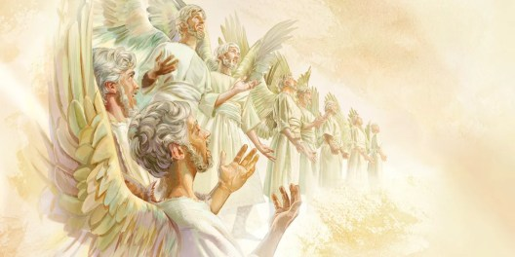
Jesus is greater than dread
⁸ “I tell you, whoever publicly acknow-ledges* me before others, the Son of Man will also acknowledge before the angels of God. ⁹ But whoever disowns me before others will be disowned before the angels of God.
* A 4th and a 5th century manuscripts read, ‘keeps on acknowledging’.

Slide 39
Jesus is greater than dread
¹⁰ And everyone who speaks a word against the Son of Man* will be forgiven, but anyone who blasphemes against the Holy Spirit will not be forgiven.
* This title (from Daniel 7) was applied to the promised Messiah who was to become king of the world forever.

Slide 40
Jesus is greater than dread
● One can easily misunderstand ‘the Son of Man,” so this is forgivable.
● “The Holy Spirit” was generally believed to be Yahweh’s invisible Spirit in the world.
● To worship another god in place of the Holy Creator God requires repentance.
● But to consciously, purposefully scorn or disparage the Holy Creator God may prove a one-way road to being scorned, in turn.

Slide 41
Jesus is greater than doubt Luke 12:11-12

Slide 42
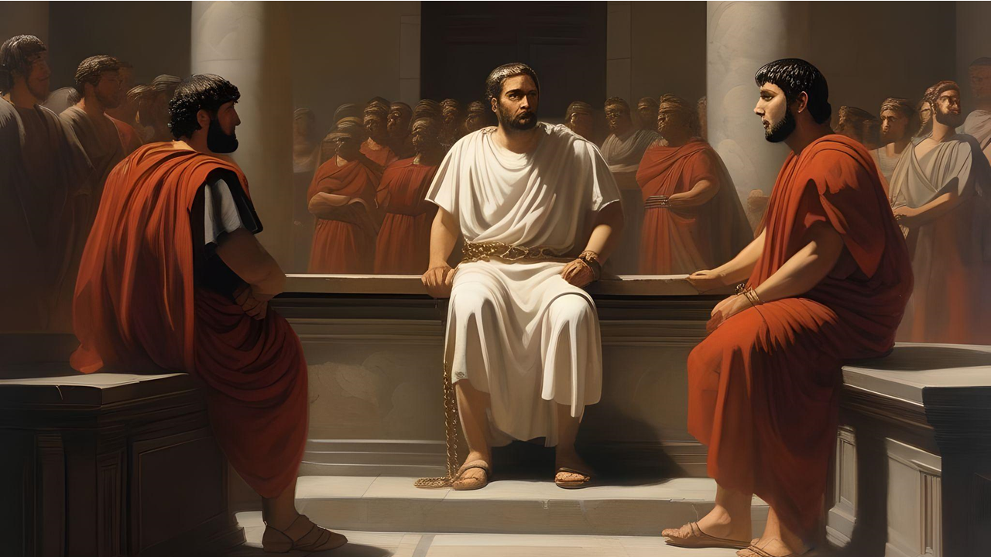
Jesus is greater than doubt
¹¹ “When you are brought before synagogues, rulers and authorities, do not worry* about how you will defend yourselves or what you will say, ¹² for the Holy Spirit will teach you at that time what** you should say.” * Two 5th centure manuscripts and others read, “stop worrying.” ** Some versions read “how or what.”

Slide 43
To hear from the Holy Spirit
● Listen to gifted teachers.
● Read the Bible carefully.
● Ask for wisdom, expecting insight.
● Sense needs and solutions.
● Have a dream, a vision or imagination.
Advice
● Never violate known truth or conscience.
● Always honor Jesus; obey his commands.
● Let others critique your ideas.

Slide 44
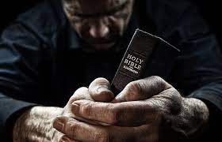
Discover
● Truths to affirm?
● Promises to claim?
● Commands to obey?
Assignment
● Read: Luke 12:13-59
● Visit: luke.currah.download
● Compile: insights, queries & observations.

