Slide 1
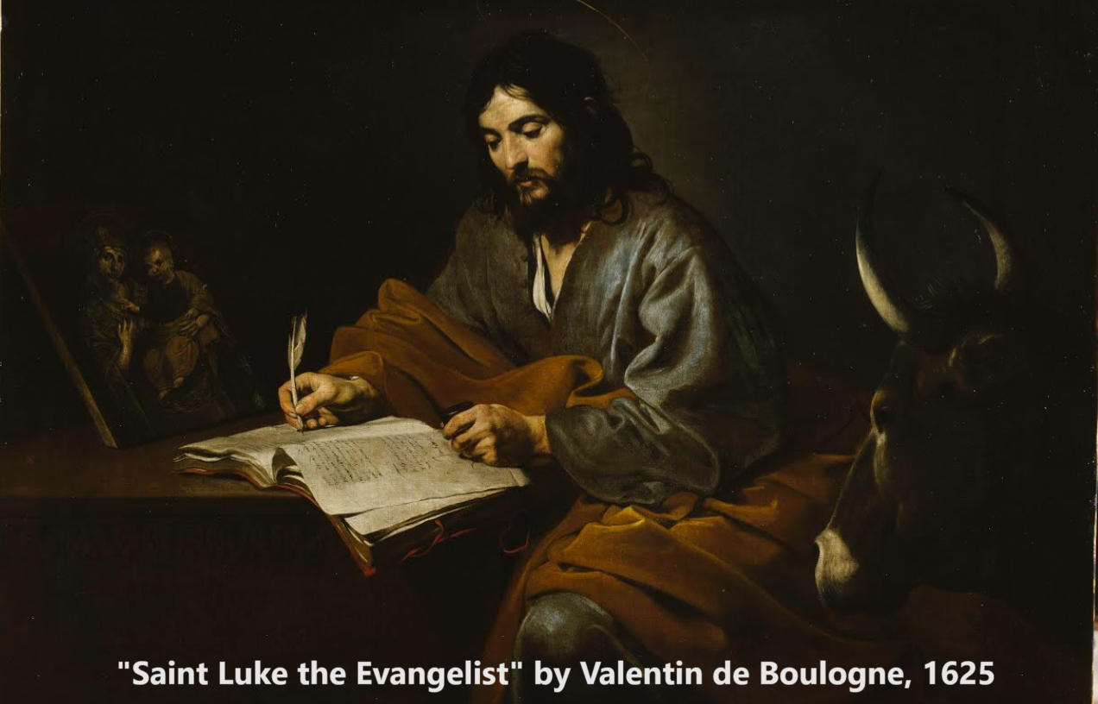
Gospel of Luke 12:13–59
‘How then shall we live?’
10 & 14 December 2023

Slide 2
Structure of Luke’s Gospel
1 Preface: Sponsor, method and purpose.
2 Birth narratives: Dawn of the promised new era.
3 John’s mission: Introduce the Messiah.
4 Jesus’ mission: Messiah’s message and work.
5 Journey to death: Messianic signs and teaching.
6 Jerusalem: Confront Israelite and Roman rulers.
7 Crucifixion: Last supper, arrest, trials, death.
8 Resurrection: Alive, appearance, and proofs.
9 Ascension: Gives Holy Spirit, mission to nations.

Slide 3
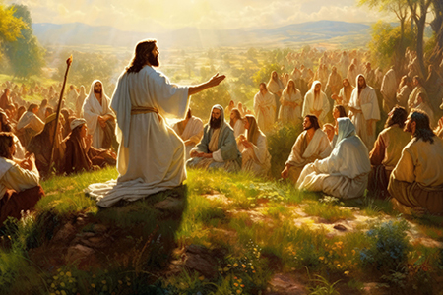
How to live between Jesus’ comings
1. Jesus’ advice for the public 12:13-21
2. Jesus’ advice for disciples 12:22-40
3. Jesus’ advice for everyone 12:41-48
4. More advice for disciples 12:49-53
5. More advice for the public12:37-44

Slide 4
Jesus’ advice for the public 12:13-21

Slide 5
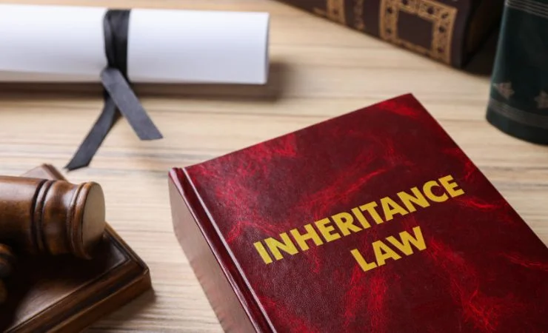
Guard against all kinds of greed
¹³ Someone in the crowd said to him, “Teacher, tell my brother to divide the inheritance with me.”
¹⁴ Jesus replied, “Man, who appointed me a judge or an arbiter between you?” ¹⁵ Then he said to them, “Watch out! Be on your guard against all kinds of greed; life does not consist in an abundance of possessions.”

Slide 6
Guard against all kinds of greed
● Humour: Who made me arbitrator?
● Inheritance: To distribute possessions per cultural or legal rules.
● Greed: To desire more, or to seek more than what one needs or possesses.
● Query: “A good man leaves an inheritance to his children's children” (Pro. 13:22).

Slide 7
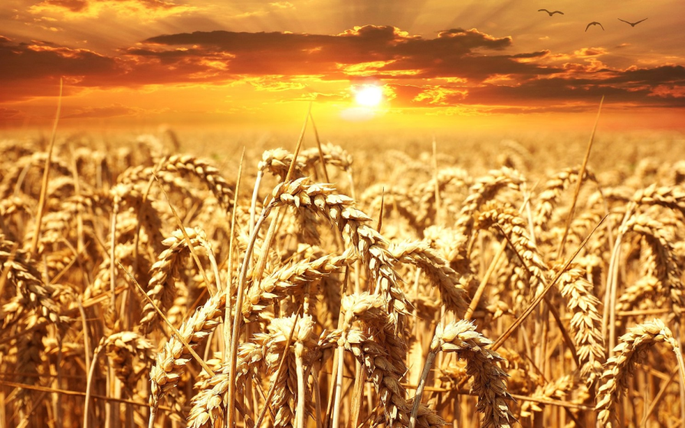
What shall I do?
¹⁶ And he told them this parable: “The ground of a certain rich man yielded an abundant harvest. ¹⁷ He thought to himself, ‘What shall I do? I have no place to store my crops.’

Slide 8
What shall I do?
● Surplus: What are some biblical examples of abundant harvests?
● Query: What ought to be done with a surplus harvest?
● Danger: Low-priced food in local markets can destroy small farmers’ livelihood!

Slide 9
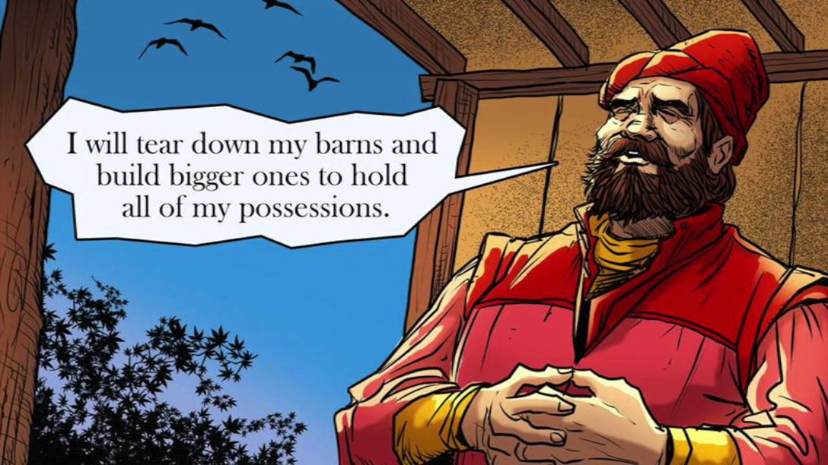
I shall do this
¹⁸ “Then he said, ‘This is what I shall do. I will tear down my barns and build bigger ones, and there I will store my surplus grain.
¹⁹ And I’ll say to myself, “You have plenty of grain laid up for many years. Take life easy; eat, drink and be merry.”’
● Query: What was this man’s main sin?

Slide 10
You fool!
²⁰ “But God said to him, ‘You fool! This very night your life will be demanded from you. Then who will get what you have prepared for yourself?’
²¹ “This is how it will be with those who store up things for themselves but are not rich toward God.”* *Three 4th & 5th centuries manuscripts omit verse 21. Later ones insert: “Who has ears, let him hear.”

Slide 11
You fool!
● Fool: aphron = “lack of prudence or good judgment, foolish, ignorant” (BDAG).
● Query: What is every rich man’s main concern about his inheritors?
● Scripture: “What use is money in the hand of a fool, since he has no intention of acquiring wisdom?” (Pro. 17:16).

Slide 12
Jesus’ advice for disciples 12:22-40

Slide 13
Worry
²² Then Jesus said to his* disciples: “Therefore I tell you, do not worry about your life, what you will eat; or about your body, what you will wear…
²⁵ Who of you by worrying can add a single hour to your life? ²⁶ Since you cannot do this very little thing, why do you worry about the rest? *Two ancient manuscripts omit “his.” It is original.

Slide 14
On material wealth
● Jesus: Avoid becoming greedy.
● Greeks: Acquire needs and seek no more.
● Cynics: Own nothing.
● Essenes: Communal sharing.
● Paul: Be content with food and cover.
● Europeans: Conquer, exploit colonies.
● Asians: Exploit labour for national wealth.
● Americans: Exploit the world’s resources.
● Africans: Ensure each one’s fair share.

Slide 15
Your Father knows
²⁸ God clothes the grass of the field, which is here today, and tomorrow is thrown into the fire, how much more will he clothe you—you of little faith! ²⁹ And do not set your heart on what you will eat or drink; do not worry about it. ³⁰ For the pagan world runs after all such things, and your Father knows that you need them.

Slide 16
Your Father knows
● Query: In what ways have we learned from world, to worry about our material needs?
● Query: What is the fundamental Christian value related to meeting material needs?
● Query: What are some other basic human needs that ensure survival and health?
● Query: What about lazy Christians?
“If anyone is not willing to work, [then] let him not eat” (2 Thess. 3:10).

Slide 17
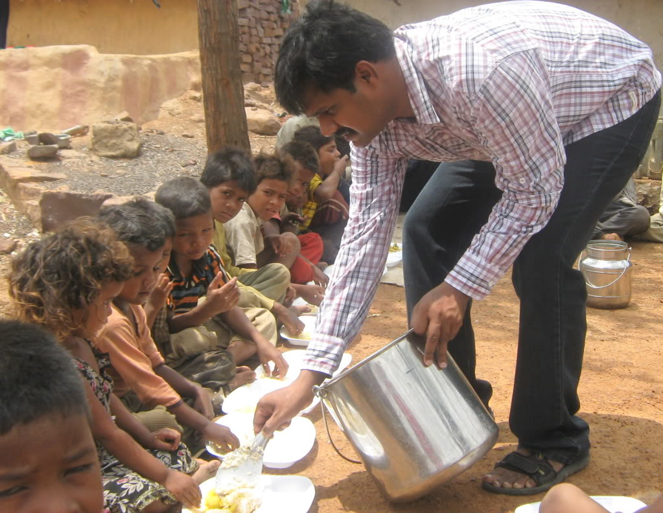
Seek God’s Kingdom
³¹ But seek his kingdom*, and these things will be given to you as well.
³² “Do not be afraid, little flock, for your Father has been pleased to give you the kingdom. *Several mss from the 3rd century and later read, “seek the kingdom of God.”

Slide 18
The Son of Man will come
³³ Sell your possessions and give to the poor.* *“give to the poor” in Greek is a singular noun meaning “give benevolence,” which is to meet others’ urgent needs.
● Query: Who in Scripture did this?
● Query: Which possessions were Israelites not allowed to sell?

Slide 19
The Son of Man will come
³⁹ But understand this: If the owner of the house had known at what hour the thief was coming, he would* not have let his house be broken into. ⁴⁰ You also must be ready, because the Son of Man will come at an hour when you do not expect him.” *Some manuscripts from the 4th century and after insert here part of Matthew 24:43.

Slide 20
The Son of Man will come!
● Query: What current events require that Jesus return sometime soon?
● Promise: “The Son of Man will come!”
● Caution: “At an hour when you do not expect him.”
● Hour: “3 a point of time as an occasion for an event, time” (BDAG, Grk-Eng Lexicon).

Slide 21
Jesus’ advice for everyone 12:41-48

Slide 22
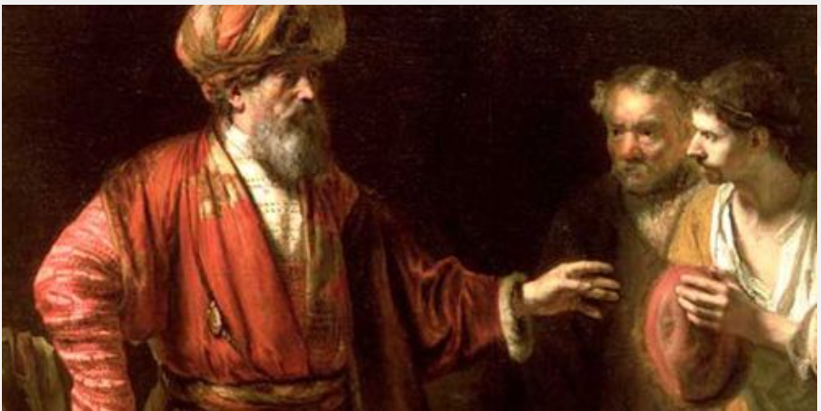
A faithful, wise manager
⁴¹ Peter asked, “Lord, are you telling this parable to us, or to everyone?”
⁴² The Lord answered, “Who then is the faithful and wise manager, whom the master puts in charge of his servants to give them their food allowance at the proper time?

Slide 23
All his possessions
⁴³ It will be good for that servant whom the master finds doing so when he returns. ⁴⁴ Truly I tell you, he will put him in charge of all his possessions.
● Query: What does this teach about life in the kingdom after Jesus’ return?
● Query: How can many persons all be in charge of all Jesus’ possessions?

Slide 24
In charge of all his possessions
● Query: If Jesus has millions of faithful servants, then how could he put them all in charge of all his possessions.
● Reply 1: Each one in charge of a small part.
● Reply 2: Jesus was speaking of himself.
● Reply 3: Jesus was employing hyperbole?
● Reply 4: We believers are collectively the ‘good servant’ in contrast to the wicked generation that rejected him.

Slide 25
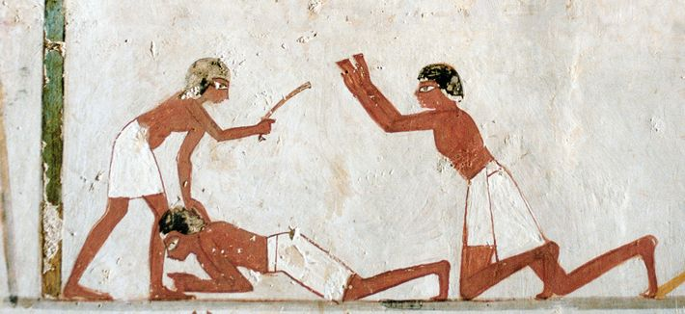
Things deserving punishment
⁴⁷ “The servant who knows the master’s will and does not get ready or does not do what the master wants will be beaten with many blows. ⁴⁸ But the one who does not know and does things deserving punishment will be beaten with few blows. From everyone who has been given much, much will be demanded.

Slide 26
Godly judgement must be as merciful as justice allows, and no harsher than what justice requires.

Slide 27
More advice for disciples 12:49-53

Slide 28
Fire on the earth… baptism
⁴⁹ “I have come to bring fire on the earth, and how I wish it were already kindled! ⁵⁰ But I have a baptism to undergo, and what constraint I am under until it is completed!
● Fire: An ancient symbol for end-times judgement against the wicked.
● Baptism: An ancient rite symbolizing cleansing from sin or from evil.

Slide 29
Division
⁵¹ Do you think I came to bring peace on earth? No, I tell you, but division. ⁵² From now on there will be five in one family divided against each other… ⁵³ They will be divided, father against son and son against father, mother against daughter and daughter against mother, mother-in-law against daughter-in-law and daughter-in-law against mother-in-law.”

Slide 30
Daughter-in-law
● Patrilocal: Brides usually came to dwell with their husbands’ family.
Matrilocal? “A man shall leave his father and his mother and hold fast to his wife” (Gen. 2:24).
● Division: Disagreements over what?
● Tactics: How to minimize family discord over faith in Jesus?

Slide 31
More advice for the public 12:37-44

Slide 32
Interpret the times
⁵⁴ He said to the crowd: “When you see a cloud rising in the west, immediately you say, ‘It’s going to rain,’ and it does. ⁵⁵ And when the south wind blows, you say, ‘It’s going to be hot,’ and it is. ⁵⁶ Hypocrites! You know how to interpret the appearance of the earth and the sky. How is it that you don’t know how to interpret this present time?

Slide 33
How is it that you do not …
In verse 56, equally ancient manuscripts from the 3rd century and later read:
● How do you not interpret…?
● How do you not know (how) to interpret…?
Either scribes inserted “know” to conform to the preceding clause (“you know how”), or they omitted the word to heighten Jesus’ criticism (“you do not”).

Slide 34
Interpret the present time
● West: Clouds formed over the Sea were laden with moisture, bringing rain.
● South: Winds from the south carried hot air from the Arabian desert.
● Query: How could folk in Jesus’ day have better interpreted the time? By what signs?
Qumran cited corruption in the temple system.
Some rabbis calculated Daniel’s 70 ‘weeks’.
Jesus was doing the works of the Messiah!

Slide 35
Nine views on Daniel’s 70 ‘weeks’
Red: From King Artaxerxes’ “decree” for Ezra to return to Judea in 458 BCE, 70 weeks (70x7=490) years) extend to 33 CE.
http://currah.download/pages/jesus

Slide 36
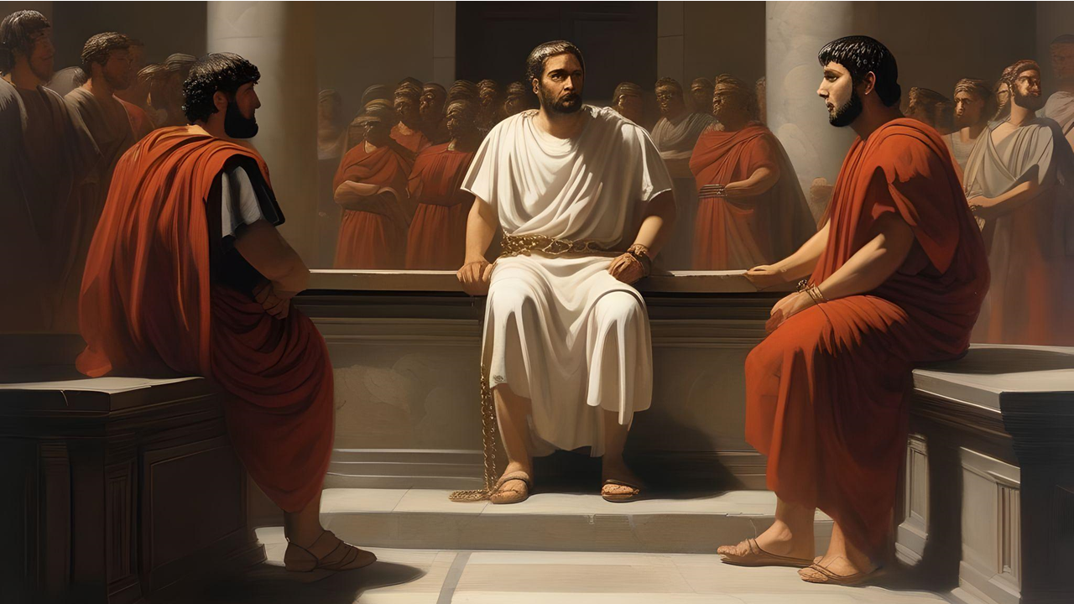
Be reconciled on the way
⁵⁷ “Why don’t you judge for yourselves what is right? ⁵⁸ As you are going with your adversary to the magistrate, try hard to be reconciled on the way, or your adversary may drag you off to the judge, and the judge turn you over to the officer, and the officer throw you into prison. ⁵⁹ I tell you, you will not get out until you have paid the last penny.”

Slide 37
“Be reconciled on the way”
● Adversary: Creditor demanding money.
● Magistrate: Social or religious leader.
● Judge: Decides verdict and consequence.
● Officer: Bailiff in charge of a jail.
● Query: Why did Jesus tell this illustration? What did it mean to his hearers?
● Until: Can one’s relatives pay to get him out of hell?

Slide 38
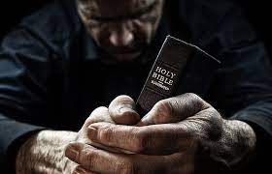
Discover
● Truths to affirm?
● Promises to claim?
● Commands to obey?
Assignment
● Read: Luke 13:1–14:14
● Visit: luke.currah.download
● Compile: insights, queries & observations.

