Slide 1
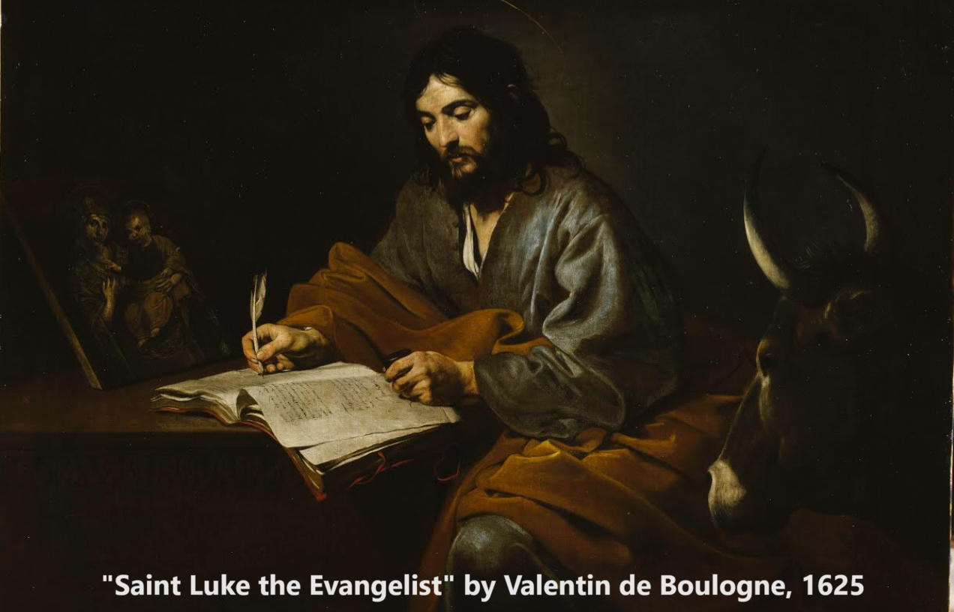
Gospel of Luke 13:1–14:14
‘The Resurrection of the Righteous’
17 & 22 December 2023

Slide 2
Structure of Luke’s Gospel
1 Preface: Sponsor, method and purpose.
2 Birth narratives: Dawn of the promised new era.
3 John’s mission: Introduce the Messiah.
4 Jesus’ mission: Messiah’s message and work.
5 Journey to death: Messianic signs and teaching.
6 Jerusalem: Confront Israelite and Roman rulers.
7 Crucifixion: Last supper, arrest, trials, death.
8 Resurrection: Alive, appearance, and proofs.
9 Ascension: Gives Holy Spirit, mission to nations.

Slide 3
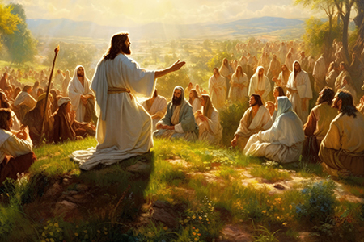
Jesus on the near and far futures
1. Jesus’ Warning: “You will likewise perish” (Luke 13:5-35).
2. Jesus’ Promise: “the resurrection of the righteous” (Luke 14:1-14).

Slide 4
Jesus’ Warning Luke 13:1-35

Slide 5
Repent or perish
13 ¹ Now there were some present at that time who told Jesus about the Galileans whose blood Pilate had mixed with their sacrifices. ² Jesus answered, “Do you think that these Galileans were worse sinners than all the other Galileans because they suffered this way? ³ I tell you, no! But unless you repent, you too will all perish.

Slide 6
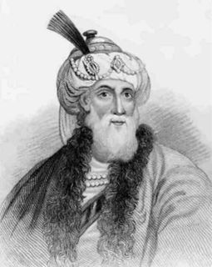
Flavius Josephus, Antiquities 18:3:1-2
“Pilate undertook to bring a stream of water to Jerusalem, from 25 miles away. He financed it with sacred money [from the temple]. Several thousand Jews got together, and protested against him…
“So Pilate disguised a great number of his soldiers in plain clothes, who carried daggers under their garments, and sent them to a place where they surrounded them…”
Flavius Josephus (c. 37–100 CE), Roman–Jewish historian and military leader. He wrote Antiquities in c. 95 CE.

Slide 7
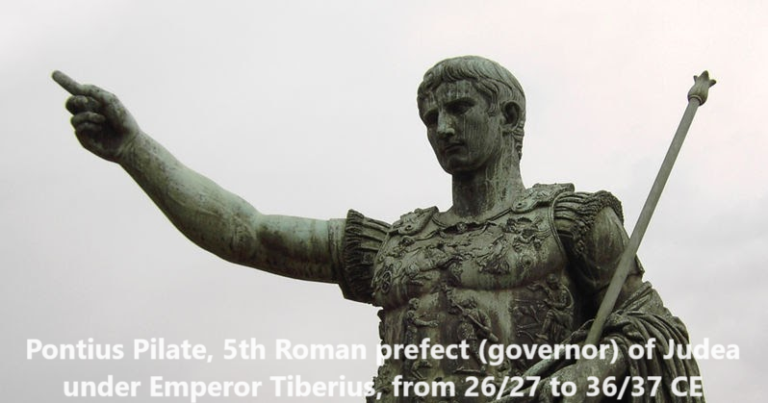
Repent or perish
13 ¹ Now there were some present at that time who told Jesus about the Galileans whose blood Pilate had mixed with their sacrifices. ² Jesus answered, “Do you think that these Galileans were worse sinners than all the other Galileans because they suffered this way? ³ I tell you, no! But unless you repent, you too will all perish.”

Slide 8
Repent or perish
● Repent: Turn away from former behaviour and beliefs, to embrace new behaviour and new beliefs.
● Example: Stop breaking God’s laws, and start trusting Jesus to change me.
● Perish: Two meanings: (1) to die physically.
(2) to go to hell forever. (See John 3:16.)

Slide 9
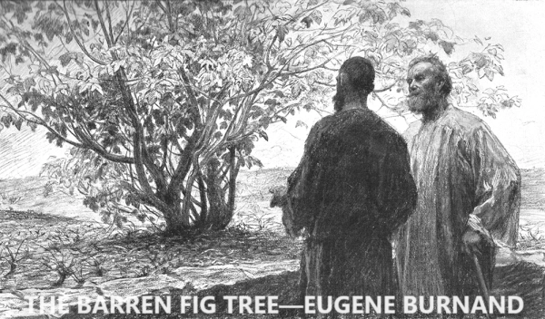
Four-year chronology
⁶ Then he told this parable: “A man had a fig tree growing in his vineyard, and he went to look for fruit on it but did not find any.
⁷ So he said to the man who took care of the vineyard, ‘For three years now I’ve been coming to look for fruit on this fig tree and haven’t found any. Cut it down! Why should it use up the soil?’

Slide 10
Four-year chronology
⁸ “‘Sir,’ the man replied, ‘leave it alone for one more year, and I shall dig around it and fertilize it. ⁹ If it bears fruit next year, then fine! If not, then cut it down.’”
Year
4/1 BCE: Jesus born.
29 CE: Jesus baptized, begins work.
29-32 CE: Jesus’ three years of work.
32-33 CE: Jesus’ fourth year of work.

Slide 11
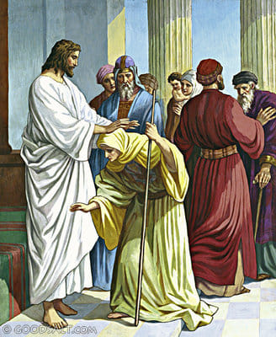
Jesus violates religious rules
¹⁰ On a Sabbath Jesus was teaching in one of the synagogues, ¹¹ and a woman was there who had been crippled by a spirit for eighteen years. She was bent over and could not straighten up at all.
¹² When Jesus saw her, he called her forward and said to her, ‘Woman, you are set free from your infirmity.’ ¹³ Then he put his hands on her, and immediately she straightened up and praised God.

Slide 12
Jesus violates religious rules
● Sabbath: From Friday sunset until Saturday sunset.
● Work: Human work was strictly limited, but not God’s work.
● Early: Christians attended synagogue on the Sabbath day, and worshipped Jesus Saturday evening (=start of the 7th day).

Slide 13
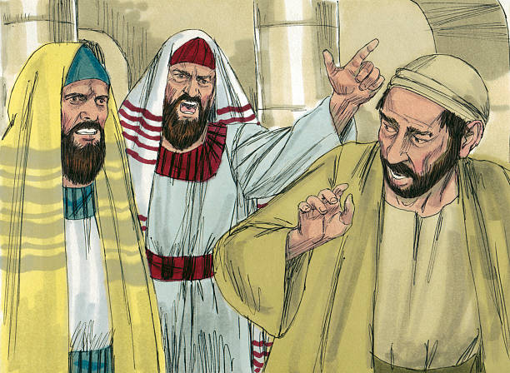
Jesus violates religious rules
¹⁴ Indignant because Jesus had healed on the Sabbath, the synagogue leader said to the people, “There are six days for work. So come and be healed on those days, not on the Sabbath.”
¹⁵ The Lord answered him, “You hypocrites! Doesn’t each of you on the Sabbath untie your ox or donkey from the stall and lead it out to give it water?

Slide 14
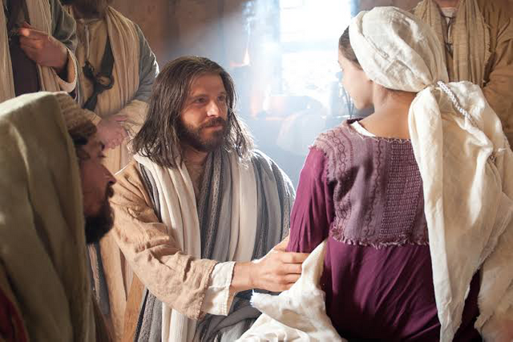
Jesus violates religious rules
¹⁶ Then should not this woman, a daughter of Abraham, whom Satan has kept bound for eighteen long years, be set free on the Sabbath day from what bound her?”
¹⁷ When he said this, all his opponents were humiliated, but the people were delighted with all the wonderful things he was doing.

Slide 15
Jesus violates religious rules
● Daughter of Abraham: To whom God had revealed his promises 2000 years earlier!
● Satan kept bound: Jesus has power to release humans from spiritual bondage!
● His opponents: Religious leaders are the main opponents to Jesus, everywhere.
● People delighted: We ordinary folk may freely experience Jesus’ kindness.

Slide 16
American forms of bondage
● Drugs: Constant fixation on obtaining one’s next ‘hit’ ➔ broken health, poverty, and early death.
● Debt: Compounded interest ➔ years of deprivation, of wasted labour, and of lost opportunities.
● Porn: Constant obsession ➔ perversion & abuse.
● Religion: Mythic beliefs, ceremonies, odd customs ➔ schism, discrimination, & sometimes violence.
● Body: Diets, exercises, surgeries, steroids ➔ weight gain, depression, early death.
● Food: Sugars, grains, oils, meats, dairy ➔ hunger, snacking, obesity, diabetes, cancers, strokes.

Slide 17
To be saved
²² Then Jesus went through the towns and villages, teaching as he made his way to Jerusalem. ²³ Someone asked him, “Lord, are only a few people going to be saved?”
“To be saved”: (1) Be healed from disease.
(2) Be rescued from political domination.
(3) Be raised from death at the end times.
(4) Be forgiven and receive Jesus’ Spirit.

Slide 18
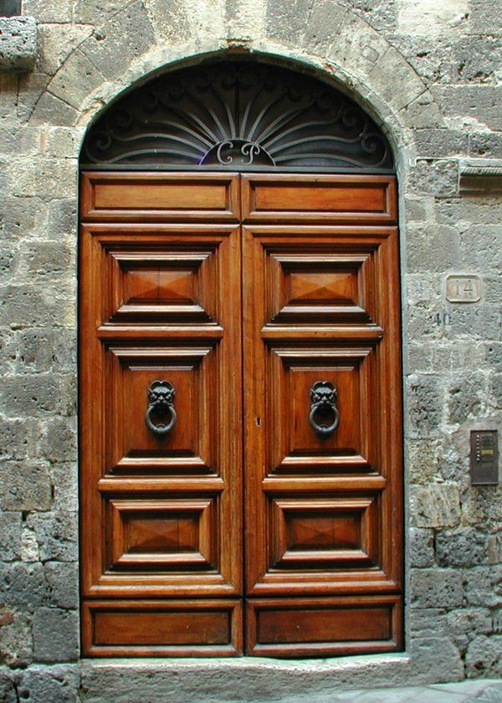
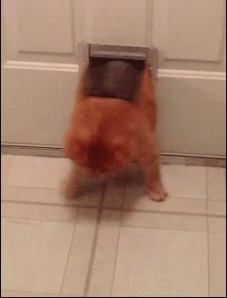
The narrow door
He said to them, ²⁴ “Make every effort to enter through the narrow door, because many, I tell you, will try to enter and will not be able to. ²⁵ Once the owner of the house gets up and closes the door, you will stand outside knocking and pleading, ‘Sir, open the door for us.’

Slide 19
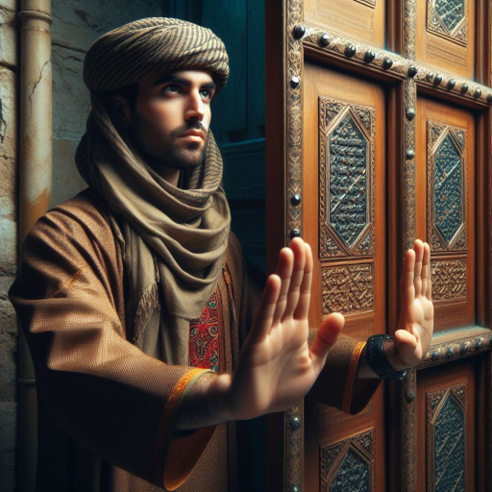
The narrow door
The ‘narrow door’ in ancient Middle Eastern architecture refers to a small door in a large door that was used for everyday access. The main door was only opened for special occasions or ceremonies. Only those who were known to the door-keeper were allowed to enter by the narrow door.
Free image generated by Bing, 16-Dec-2023

Slide 20
The narrow door
“But he will answer, ‘I don’t know you or where you come from.’
²⁶ “Then you will say, ‘We ate and drank with you, and you taught in our streets.’
²⁷ “But he will reply, ‘I don’t know you or where you come from. Away from me, all you evildoers!’
● Get to know Jesus now, while you still can!

Slide 21
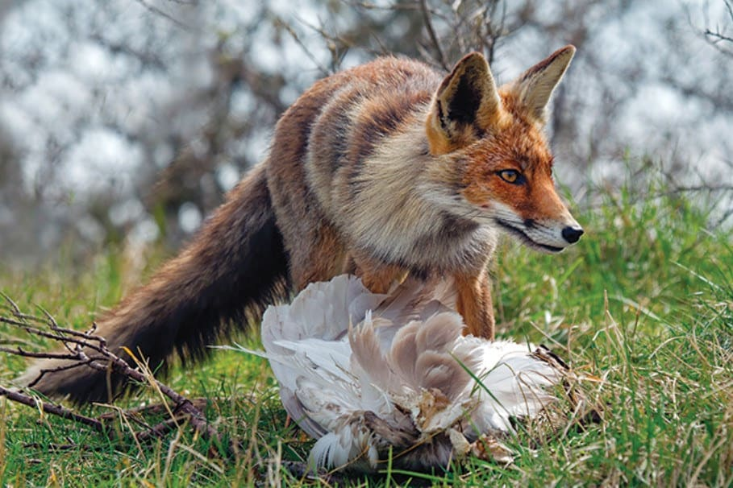
That fox!
³¹ At that time some Pharisees came to Jesus and said to him, “Leave this place and go somewhere else. Herod wants to kill you.”
³² He replied, “Go tell that fox, ‘I will keep on driving out demons and healing people today and tomorrow, and on the third day I will reach my goal.’ ³³ … for surely no prophet can die outside Jerusalem!

Slide 22
That fox!
● Foxes: were known for their destruction, not their wiles.
● Herod Antipas: Appointed tetrarch, he ruled over Galilee and Perea until 39 CE. It was he who beheaded John the Baptist.
● Prophet die: The ancient prophets foretold Jesus’ death, Jesus predicted his death, eye-witnesses reported his death. He died to forgive our sins; then he rose to life.

Slide 23
Jesus’ promise 14:1-14

Slide 24
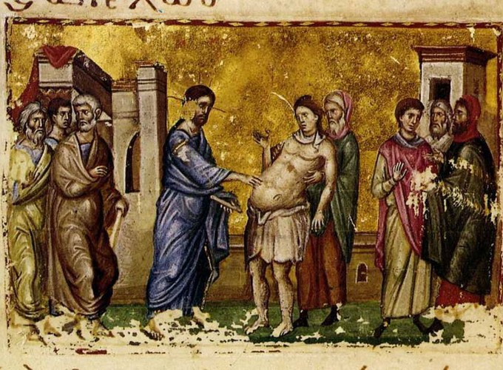
Is it lawful?
14 ¹ One Sabbath, when Jesus went to eat in the house of a prominent Pharisee, he was being carefully watched. ² There in front of him was a man suffering from abnormal swelling of his body.
³ Jesus asked the Pharisees and experts in the law, “Is it lawful to heal on the Sabbath or not?” ⁴ But they remained silent. So taking hold of the man, he healed him and sent him on his way.

Slide 25
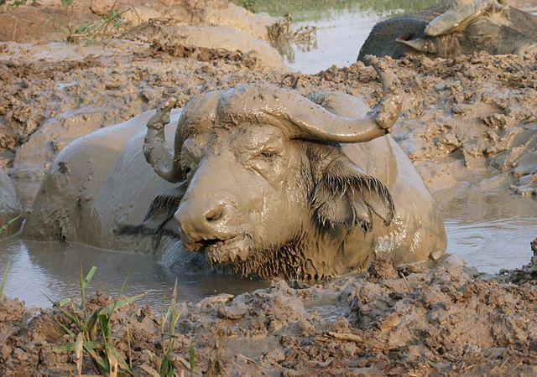
Is it lawful?
⁵ Then he asked them, “If one of you has a child or an ox that falls into a well on the Sabbath day, will you not immediately pull it out?” ⁶ And they had nothing to say.
● Why did they have nothing to say?
Wikimedia

Slide 26
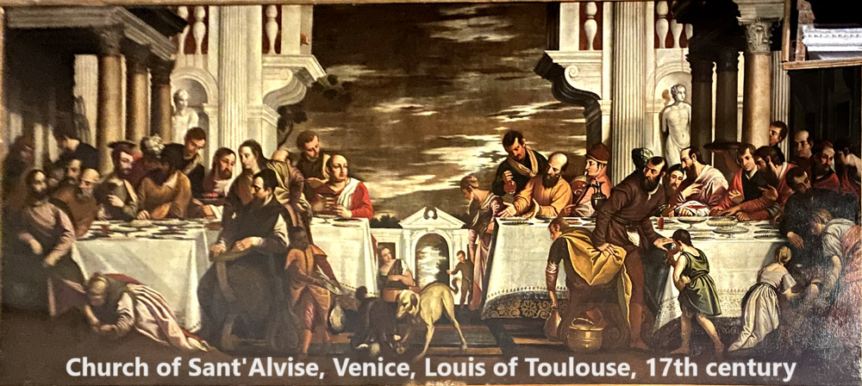
The place of honour
⁷ When he noticed how the guests picked the places of honor at the table, he told them this parable: ⁸ “When someone invites you to a wedding feast, do not take the place of honour, for a person more distinguished than you may have been invited.
⁹ If so, the host who invited both of you will come and say to you, ‘Give this person your seat.’ Then, humiliated, you will have to take the least important place.

Slide 27
The place of honour
¹⁰ But when you are invited, take the lowest place, so that when your host comes, he will say to you, ‘Friend, move up to a better place.’ Then you will be honored in the presence of all the other guests. ¹¹ For all those who exalt themselves will be humbled, and those who humble themselves will be exalted.”

Slide 28
The place of honour
● Query: What is the difference between ascribed honour and achieved honour?
● Query: In what ways do we show public honour in our society?
● Query: In what ways will Jesus show more honour to some than to others in his Kingdom “feast”?

Slide 29
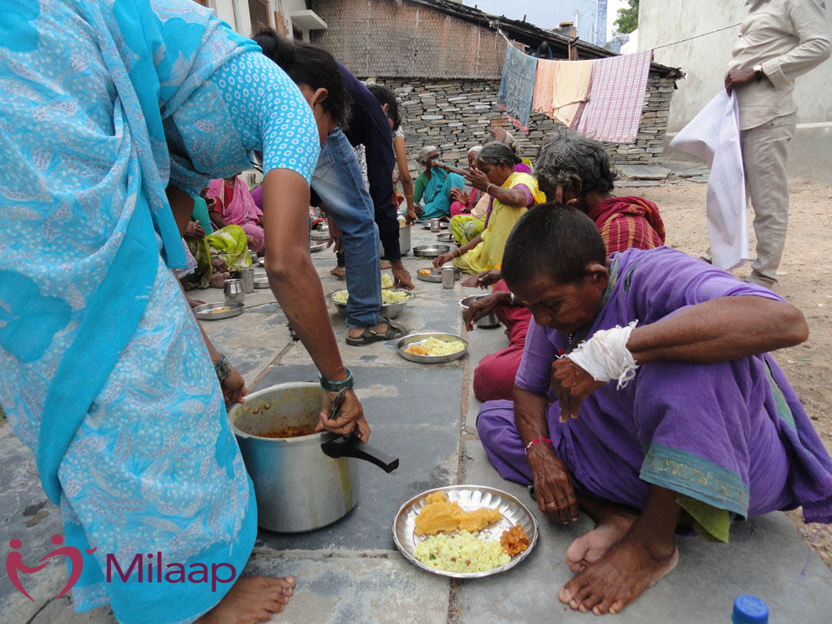
The place of honour
¹² Then Jesus said to his host, “When you give a luncheon or dinner, do not invite your friends, your brothers or sisters, your relatives, or your rich neighbors; if you do, they may invite you back and so you will be repaid.
¹³ But when you give a banquet, invite the poor, the crippled, the lame, the blind, ¹⁴ and you will be blessed...

Slide 30
The place of honour
Although they cannot repay you, you will be repaid at the resurrection of the righteous.”
● Query 1: Who will repay you?
● Query 2: What is resurrection?
● Query 3: How many resurrections are there to be?

Slide 31
The two-resurrection theory
Jesus taught that, “an hour is coming when all who are in their graves will hear his voice and come out — those who have done what is good will rise to live, and those who have done what is evil will rise to be condemned.” John 5:28-29
● Resurrection: When the dead live again.
● Good/bad: As described by Jesus, not by human opinion, nor by social norms.

Slide 32
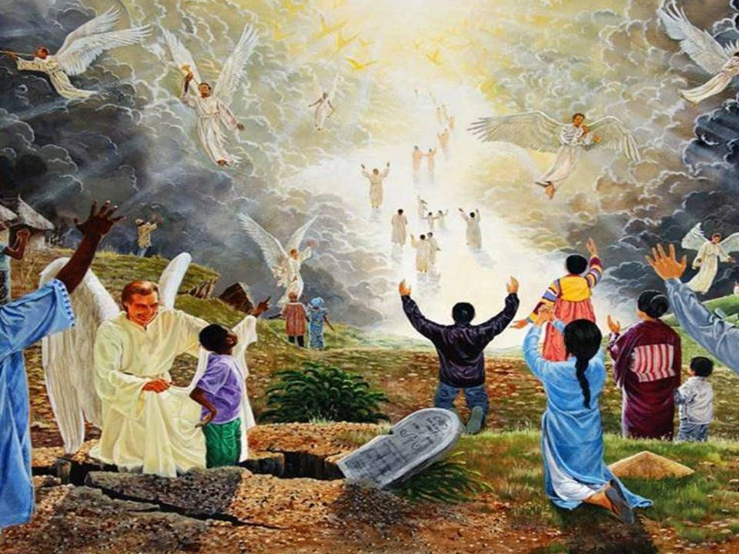
Two resurrections
John foresaw: “They came to life and reigned with Christ a thousand years (The rest of the dead did not come to life until the thousand years were ended.) This is the first resurrection.
Blessed and holy are those who share in the first resurrection. The second death has no power over them, but they … will reign with him for a thousand years. Revelation 20:5-6

Slide 33
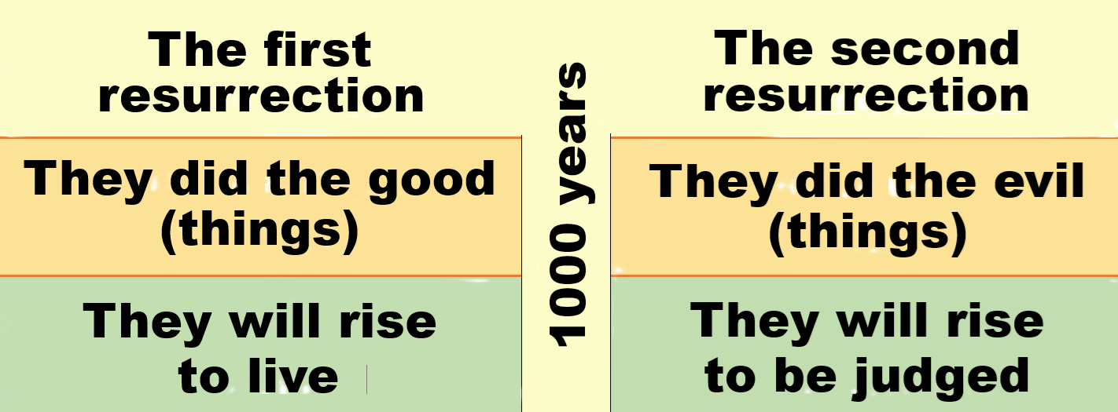

Slide 34
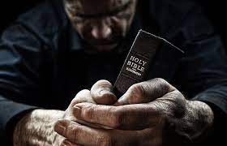
Discover
● Truths to affirm?
● Promises to claim?
● Commands to obey?
Assignment
● Read: Luke 14:15–15:32
● Visit: luke.currah.download
● Compile: insights, queries & observations.

