Slide 1
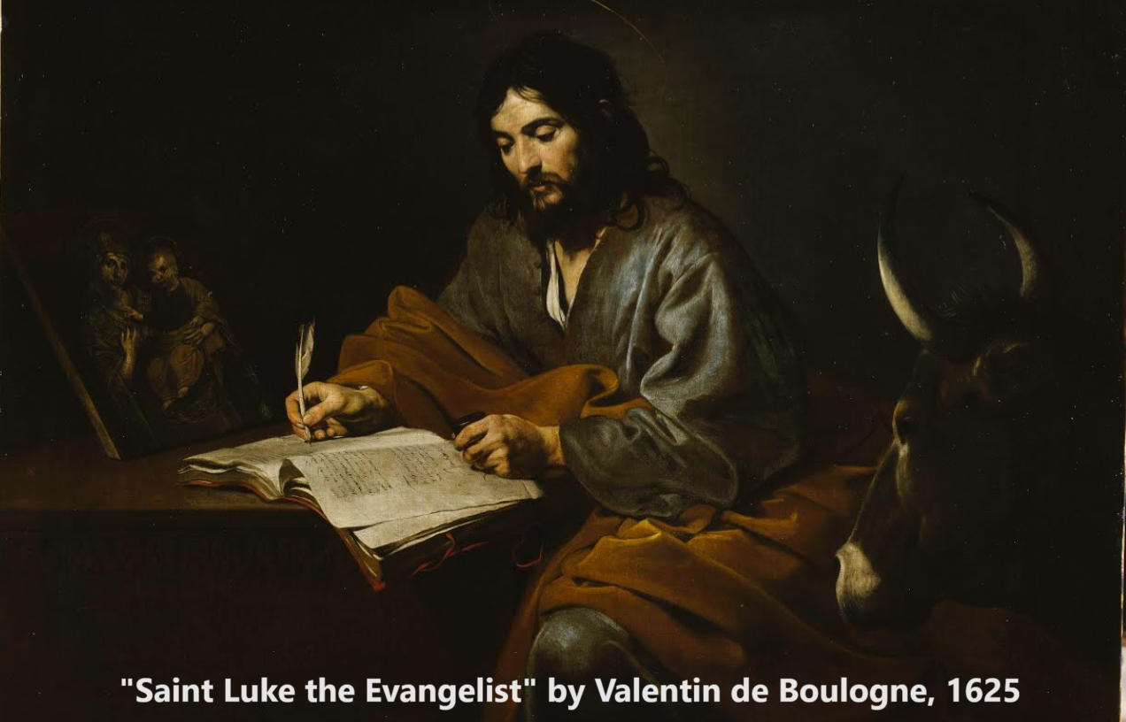
The Gospel of Luke 3:1–4:13
John presents the Messiah to Israel
05 & 09 October 2023

Slide 2
Structure of Luke’s Gospel
1 Preface: Sponsor, method and purpose.
2 Birth narratives: Dawn of the promised new era.
3 John’s mission: Introduce the Messiah.
4 Jesus’ mission: Resist temptation and hostility.
5 Journey: Messianic signs and teaching. Luke 9:51
6 Jerusalem: Confront Israelite and Roman rulers.
7 Crucifixion: Last supper, arrest, trials, death.
8 Resurrection: Alive, appearance, and proofs.
9 Ascension: Gives Holy Spirit, mission to nations.

Slide 3
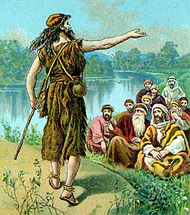
John (Yohanan) the baptizer
● Gabriel announced his conception & his name.
● Filled with the Holy Spirit from the womb.
● Righteous, elderly parents.
● From a priestly lineage.
● Grew up in the wilderness.
● Came in the ‘spirit’ of Elijah.
● A prophet of the Most High.
● To prepare the way for the Lord.
● Salvation by repentance & forgiveness of sins.

Slide 4
Major themes
● God’s wrath comes upon wicked nations.
● God forgives those who repent (who admit their wrongdoing, and who are willing to change).
● God wants to ‘save’ both Jews and Gentiles.
● God wants us to share with the needy, to deal truthfully with others, and to be content.
● Jesus is the Messiah (King) whom Jews were expecting to come rescue their nation.
● Jesus has brought the age of the Holy Spirit.

Slide 5
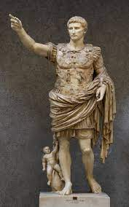
Luke 3:1-2
¹ In the fifteenth year of the reign of Tiberius Caesar—when Pontius Pilate was governor of Judea, Herod tetrarch of Galilee, his brother Philip tetrarch of Iturea and Traconitis, and Lysanias tetrarch of Abilene— ² during the high-priesthood of Annas and Caiaphas, …

Slide 6
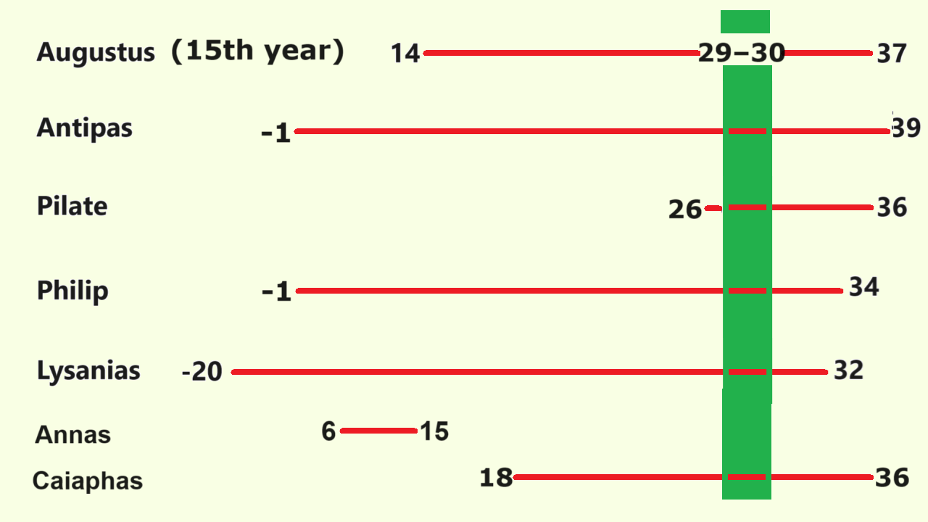

Slide 7
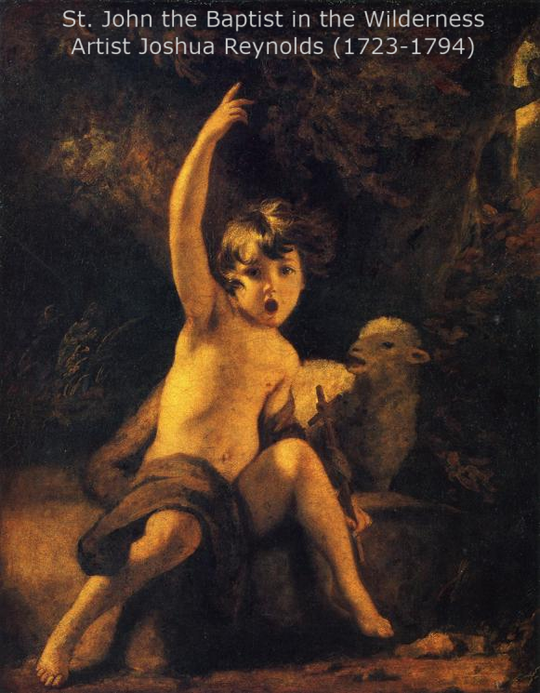
Luke 3:2-4
… the word of God came to John son of Zechariah in the wilderness. ³ He went into all the country around the Jordan, preaching a baptism of repentance for the forgiveness of sins. ⁴ As it is written in the book of the words of Isaiah the prophet: …

Slide 8
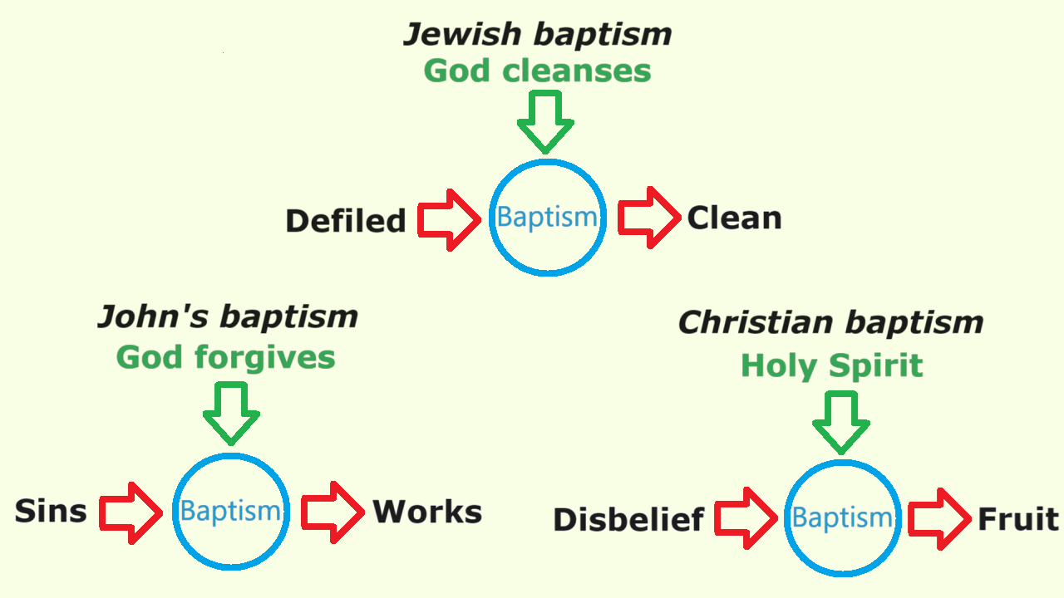

Slide 9
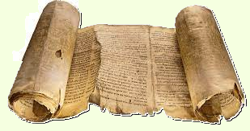
Luke 3:4-6 (Isaiah 40:3-5)
“A voice of one calling in the wilderness,
Prepare the way for the Lord, make straight paths for him.
⁵ Every valley shall be filled in, every mountain and hill made low.
The crooked roads shall become straight, the rough ways smooth.
⁶ And all people will see God’s salvation.’”

Slide 10
Isaiah 40:5
Septuagint & NT
⁵ Then the glory of the Lord shall appear, and all flesh shall see the salvation of God, because the Lord has spoken.”
Hebrew
⁵ Then the glory of the LORD shall be revealed, and all flesh shall see it together, for the mouth of the LORD has spoken.”

Slide 11
Luke 3:7-8
⁷ John said to the crowds coming out to be baptized by him, “You brood of vipers! Who warned you to flee from the coming wrath? ⁸ Produce fruit in keeping with repentance. And do not begin to say to yourselves, ‘We have Abraham as our father.’ For I tell you that out of these stones God can raise up children for Abraham.

Slide 12
Luke 3:7-8
● Vipers were commonly believed to eat their way out of their mother’s womb.
● Some believed that God would save them because they were his ‘chosen people’.
● However, election does not guarantee salvation!
● Greek myth of Deucalion and Pyrrha: following the flood, survivors made humans from stones.
● In Aramaic, kephas means stone or rock, and kaphas means human being or person.

Slide 13
Luke 3:7-8
● In the Hebrew Scriptures, God chose Israel as a special nation to bring Gentile nations to Him.
● In ancient times, some Gentiles became Israelites through conversion to Israel’s God, Yahweh.
● In Israelite society, those who rejected Yahweh were excluded from the nation.
● In the New Testament Scriptures, all who believe in Jesus, Israel’s Messiah, become God’s people.

Slide 14
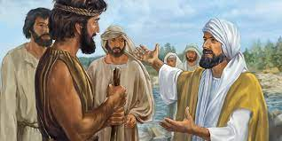
Luke 3:9-11
⁹ The ax is already at the root of the trees, and every tree that does not produce good fruit will be cut down and thrown into the fire.”
¹⁰ “What should we do then?” the crowd asked.
¹¹ John answered, “Anyone who has two shirts should share with the one who has none, and anyone who has food should do the same.”

Slide 15
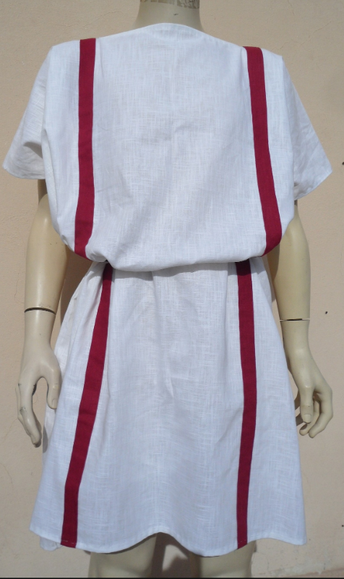
Luke 3:9-11
● ‘thrown into the fire’. Destructive judgement. See vv. 16-17
● ‘two shirts’. Outer tunic. Most poor folk would have only one tunic.
● What does love do, when it has means?

Slide 16
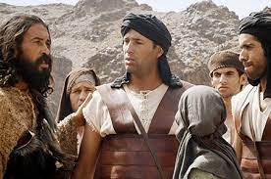
Luke 3:12-14
¹² Even tax collectors came to be baptized. “Teacher,” they asked, “what should we do?”
¹³ “Don’t collect any more than you are required to,” he told them.
¹⁴ Then some soldiers asked him, “And what should we do?”
He replied, “Don’t extort money and don’t accuse people falsely — be content with your pay.”

Slide 17
Luke 3:12-14
● Most people considered tax gatherers to be dishonest or traitors.
● Israelite soldiers were tax police, and Roman soldiers were foreign invaders.
● What points of God’s Law was John applying to prove someone’s repentance?
You must not steal.
You must not give false testimony.
You must love your neighbor.

Slide 18
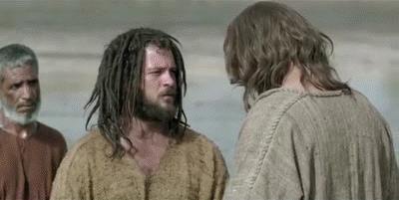
Luke 3:15-16
¹⁵ The people were waiting expectantly and were all wondering in their hearts if John might possibly be the Messiah. ¹⁶ John answered them all, “I baptize you with water. But one who is more powerful than I will come, the straps of whose sandals I am not worthy to untie. He will baptize you with the Holy Spirit …

Slide 19
Promised by the ancient prophets
● “I will pour my Spirit on your offspring and my blessing on your children.” Isa 44:3
● “I will no longer hide my face from them, when I pour out my Spirit on … Israel.” Ezek 29:39
● “I will pour out my Spirit on all kinds of people. Your sons and daughters will prophesy. Your elderly … young men.” Joel 2:28

Slide 20
Baptism in/by/with the Holy Spirit
● Jesus did not baptize in the Holy Spirit until after he rose back to life.
● He baptized Jews in the Spirit in Acts 2.
● He baptized Gentiles in the Spirit in Acts 10.
● He baptized John’s disciples in the Spirit in Acts 19, when they believed in Jesus.
● Thus, ‘we have all been baptized in one Spirit … Jews or Gentiles.’ 1 Cor. 12:13
● Keep being filled with the Spirit. Eph. 5:18.

Slide 21
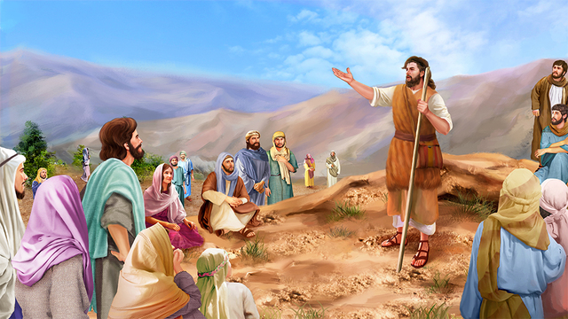
Luke 3:16-18
… and fire.
¹⁷ His winnowing fork is in his hand to clear his threshing floor and to gather the wheat into his barn, but he will burn up the chaff with unquenchable fire.” ¹⁸ And with many other words John exhorted the people and proclaimed the good news to them.

Slide 22
Luke 3:16-18
● To be ‘baptized with fire’ means to fall under divine judgement.
● ‘unquenchable fire’ means to be lost forever without faith in Jesus.
Today, ‘the good news’:
● God forgives those who trust in Jesus,
● sends his Holy Spirit to live with them,
● and gives to them ever-lasting life.

Slide 23
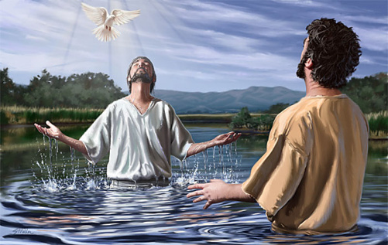
Luke 3:21-22
²¹ When all the people were being baptized, Jesus was baptized too. And as he was praying, heaven was opened ²² and the Holy Spirit descended on him in bodily form like a dove. And a voice came from heaven: “You are my Son, whom I love; with you I am well pleased.”

Slide 24
Luke 3:21-22
● Visual bird: For what purpose?
● Vocal words: For whose benefit?
● God gave his Holy Spirit to Jesus, so that Jesus could give the Spirit to all those who put their trust in Jesus.

Slide 25
Luke 3:23-38
He was the son, so it was thought, of Joseph,
the son of Heli, ²⁴ the son of Matthat, the son of Levi, the son of Melki, …
³⁸ the son of Enosh, the son of Seth, the son of Adam, the son of God.
Greek: ²³ Jesus … being son, as [although] he-was-being-considered (of) Joseph, of-the Heli, of-the Matthat, … of-the Adam, of-the God.

Slide 27
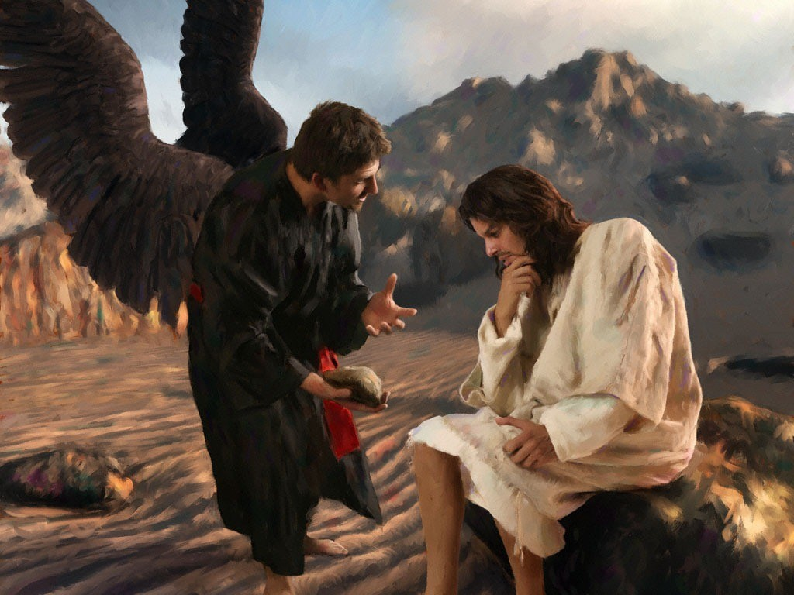
Luke 4:1-4
¹ Jesus, full of the Holy Spirit, left the Jordan and was led by the Spirit into the wilderness, ² where for forty days he was tempted by the devil. He ate nothing during those days, and at the end of them he was hungry.
³ The devil said to him, “If you are the Son of God, tell this stone to become bread.”
⁴ Jesus answered, “It is written: ‘Man shall not live on bread alone.’”

Slide 28
Luke 4:1-4
● Does spirituality keep us free from temptation?
● Why did Jesus refuse to make bread for himself when he was hungry?

Slide 29
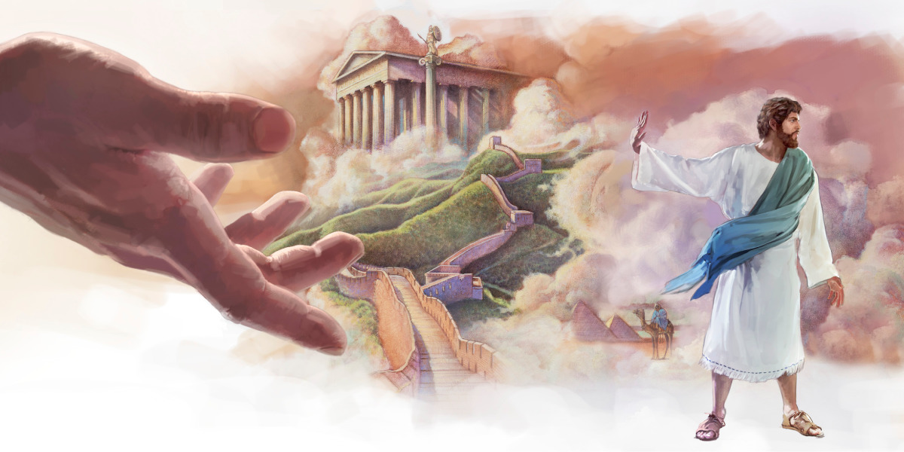
Luke 4:5-8
⁵ The devil led him up to a high place and showed him in an instant all the kingdoms of the world. ⁶ And he said to him, “I will give you all their authority and splendor; it has been given to me, and I can give it to anyone I want to. ⁷ If you worship me, it will all be yours.”
⁸ Jesus answered, “It is written: ‘Worship the Lord your God and serve him only.’”

Slide 30
Luke 4:5-8
● Why did Jesus refuse the devil’s offer of free ‘authority and splendor’?
● What motivates billionaires, bankers and globalists to seek ‘authority and splendor’?

Slide 31
Adam=natural human | Jesus=divine man
God is Adam’s Creator God is Jesus’ Father
He failed when tempted He prevailed
We commit evil deeds He died for our sins
We all must die He died and rose
We repent of our evil He has redeemed us
We have faith in Jesus He remains faithful to us
We now have hope He promises to raise us
We love one another His Spirit dwells with us
We inherit God’s kingdom He reigns as King

Slide 32
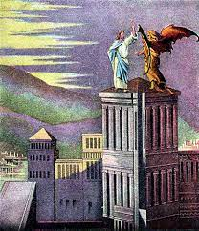
Luke 4:9-11
⁹ The devil led him to Jerusalem and had him stand on the highest point of the temple. “If you are the Son of God,” he said, “throw yourself down from here. ¹⁰ For it is written:
“‘He will command his angels concerning youto guard you carefully;
¹¹ they will lift you up in their hands, so that you will not strike your foot against a stone.’”

Slide 33
Luke 4:12-13
¹² Jesus answered, “It is said: ‘Do not put the Lord your God to the test.’”
¹³ When the devil had finished all this tempting, he left him until an opportune time.
Why not test God?
● Trust his promises!
● Fear his warnings!

Slide 34
Everyone is tempted by evil
● What are we to do, when we feel strongly attracted by anything that we know is wrong, or to which we have no right?

Slide 35
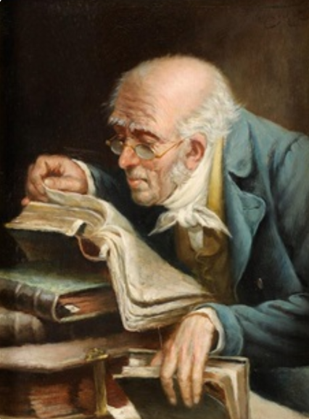
Summary
● What truths will you affirm?
● What promises will you claim?
● What commands will you obey?
Assignment
● Read: Gospel of Luke 4:14–5:11
● Visit: www.luke.currah.download
● Compile: insights, queries and observations.

