Slide 1
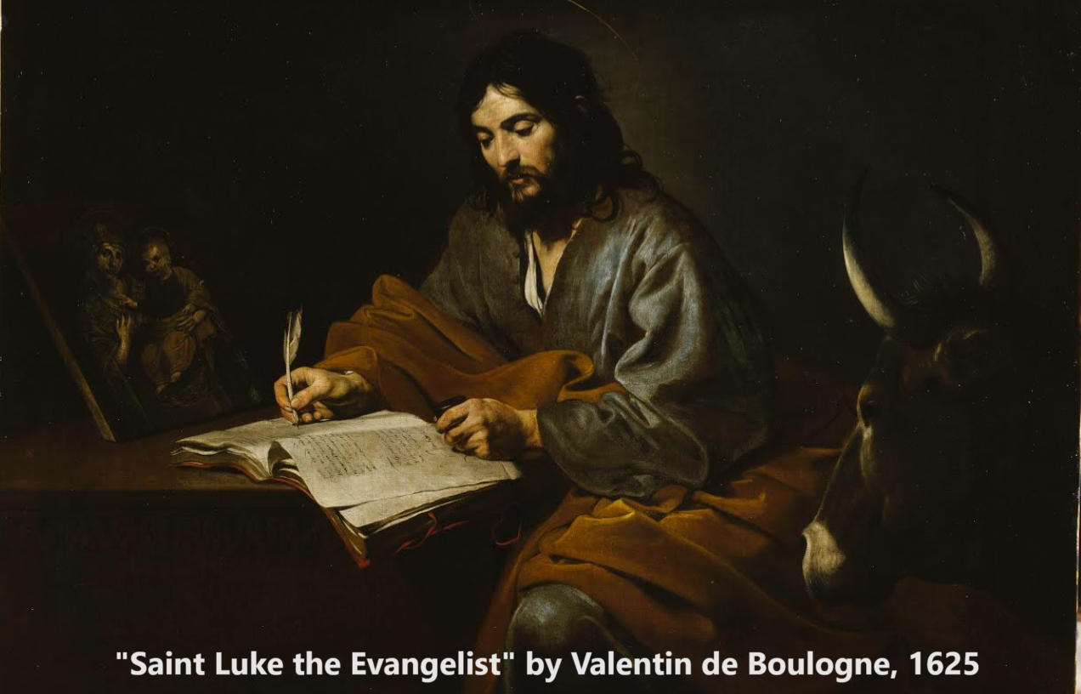
The Gospel of Luke 4:14–5:11
Messiah begins his public work
12 & 15 October 2023

Slide 2
Structure of Luke’s Gospel
1 Preface: Sponsor, method and purpose.
2 Birth narratives: Dawn of the promised new era.
3 John’s mission: Introduce the Messiah.
4 Jesus’ mission: Messiah’s message and work.
5 Journey: Messianic signs and teaching. Luke 9:51
6 Jerusalem: Confront Israelite and Roman rulers.
7 Crucifixion: Last supper, arrest, trials, death.
8 Resurrection: Alive, appearance, and proofs.
9 Ascension: Gives Holy Spirit, mission to nations.

Slide 3
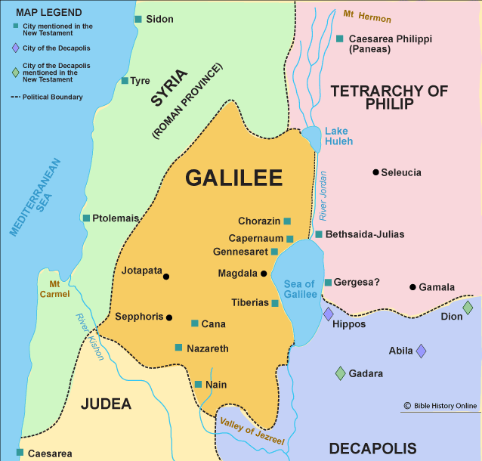
Luke 4:14-15, 31-32
¹⁴ Jesus returned to Galilee in the power of the Spirit, and news about him spread through the whole countryside. ¹⁵ He was teaching in their synagogues, and everyone praised him…
³¹ He went down to Capernaum, a town in Galilee, and on the Sabbath he taught the people. ³² They were amazed at his teaching, because his words had authority.

Slide 4
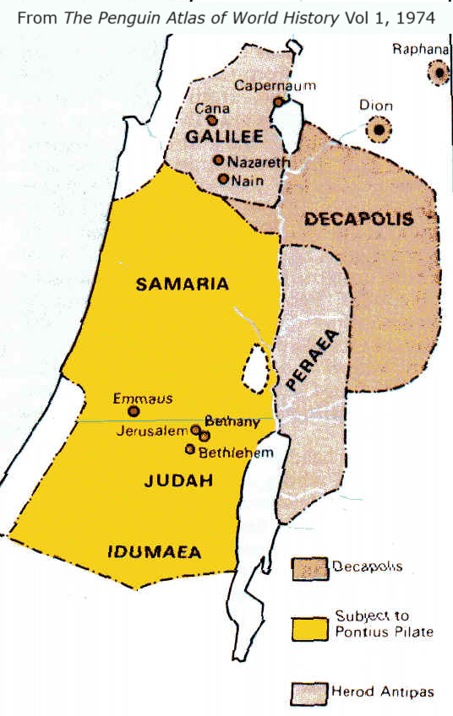
Order of events in Luke
1 Galilee: Region north of Judea and Samaria.
2 Capernaum: Teach in synagogue. Cast out demon.
3 Peter’s home: Many come for healing.
4 Leave: “I must go proclaim the Kingdom of God.”
5 Nazareth: First public rejection in his hometown.
6 Call of Peter: Peter becomes a full-time disciple.
● Chronology: Life of Christ in Stereo by Cheney.
● Luke: Focus on Peter for Paul’s churches.
● 1 Cor 3.22: “whether Paul or Apollos or Cephas.”

Slide 5
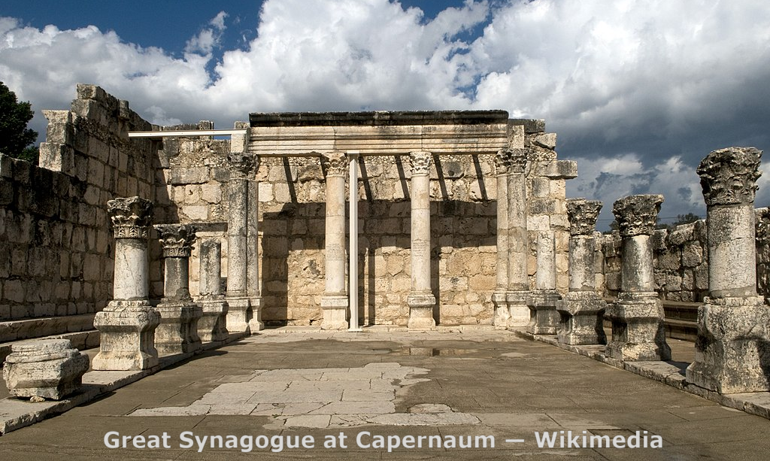
Luke 4:33-35
³³ In the synagogue there was a man possessed by a demon, an impure spirit. He cried out at the top of his voice, ³⁴ “Go away! What do you want with us, Jesus of Nazareth? Have you come to destroy us? I know who you are —the Holy One of God!” ³⁵ “Be quiet!” Jesus said sternly. “Come out of him!”

Slide 6
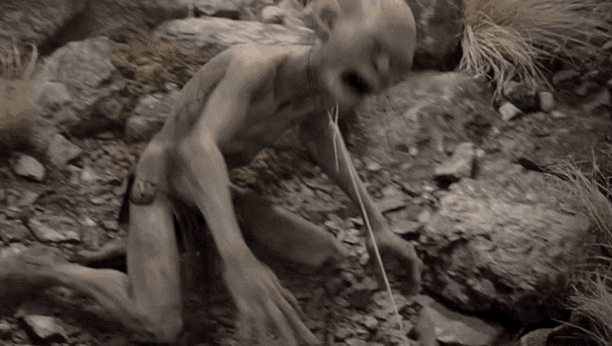
Luke 4:35-37
Then the demon threw the man down before them all and came out without injuring him.
³⁶ All the people were amazed and said to each other, “What words these are! With authority and power he gives orders to impure spirits and they come out!” ³⁷ And the news about him spread throughout the surrounding area.

Slide 7
Works of Messiah in the Hebrew Bible
1 Scripture: See “31 Biblical Predictions about a Coming One” www.luke.currah.download
2 Healing: “You will not fear the terror of the night, nor the arrow that flies by day, nor the pestilence that stalks in darkness, nor the destruction that wastes at noonday.” Psa. 91
3 Reign as King: In the royal lineage of David.
4 Spirit of God: Gives the Holy Spirit.
5 Peace: A new heaven and on a new earth.

Slide 8
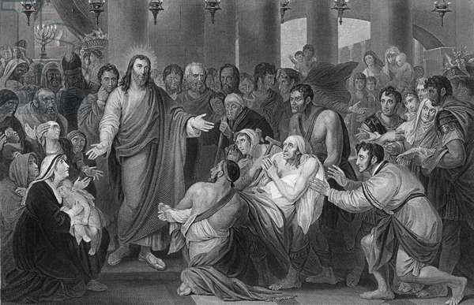
Luke 4:38-40
³⁸ Jesus left the synagogue and went to the home of Simon. Now Simon’s mother-in-law was suffering from a high fever, and they asked Jesus to help her. ³⁹ So he bent over her and rebuked the fever, and it left her. She got up at once and began to wait on them.
⁴⁰ At sunset, the people brought to Jesus all who had various kinds of sickness, and laying his hands on each one, he healed them.

Slide 9
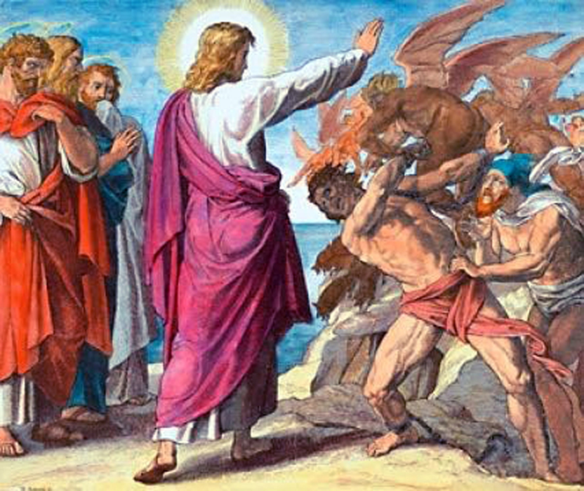
Luke 4:41-42
⁴¹ Moreover, demons came out of many people, shouting, “You are the Son of God!” But he rebuked them and would not allow them to speak, because they knew he was the Messiah.
⁴² At daybreak, Jesus went out to a solitary place. The people were looking for him and when they came to where he was, they tried to keep him from leaving them.

Slide 10
Luke 4:43-44
⁴³ But he said, “I must proclaim the good news of the kingdom of God to the other towns also, because that is why I was sent.”
⁴⁴ And he kept on preaching in the synagogues of Judea.
● of Judea: Ioudaias (3rd century).
● of the Jews: Ioudaiôn (5th century)
● of Galilee: Galilaias (5th century)
● their: autôn (4th century)

Slide 11
Judea, Judaea, Judah
● A son of Jacob, son Isaac, son of Abraham.
● An iron-age kingdom, the “House of David.”
● Territory inhabited by the tribe of Judah.
● A Babylonia province: Judeans = Jews.
● The Hasmonean & Herodian kingdom.
● A Roman province after 63 BCE.
● A term for Judea, Samaria, and Idumea.
● In 132 CE, the Romains merged Judaea with Galilee to form Palestina.

Slide 12
The Kingdom of God
● Jesus’ “good news” message. 4:43
● Accompanied by divine healing. 9:2
● Believers would it see before they die. 9:27
● Has “come near you.” 10:9, 11
● Has “come upon you.” 11:20
● Also yet future. 13:28-29; 21:31
● Was arriving without signs. 17:20
● Is Jesus in our midst. 17:21
● The Kingdom is where King Messiah goes!

Slide 13
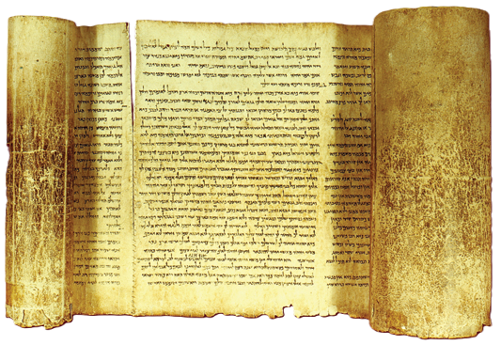
Luke 4:16-17
¹⁶ He went to Nazareth, where he had been brought up, and on the Sabbath day he went into the synagogue, as was his custom. He stood up to read, ¹⁷ and the scroll of the prophet Isaiah was handed to him. Unrolling it, he found the place where it is written: …

Slide 14
Luke 4:18-19 (Isaiah 61:1-2)
¹⁸ “The Spirit of the Lord is on me, because he has anointed me to proclaim good news to the poor.
He has sent me to proclaim freedom for the prisoners, and recovery of sight for the blind,
to set the oppressed free, ¹⁹ to proclaim the year of the Lord’s favor.”

Slide 15
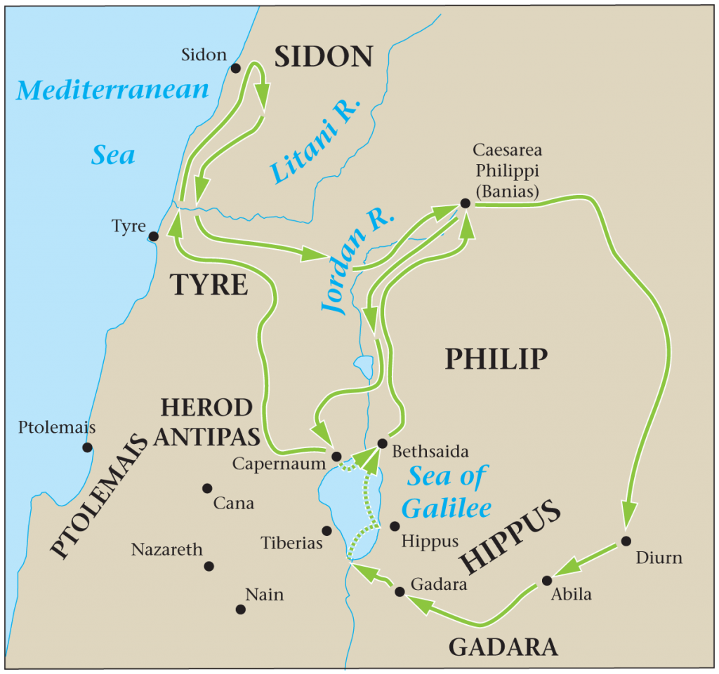
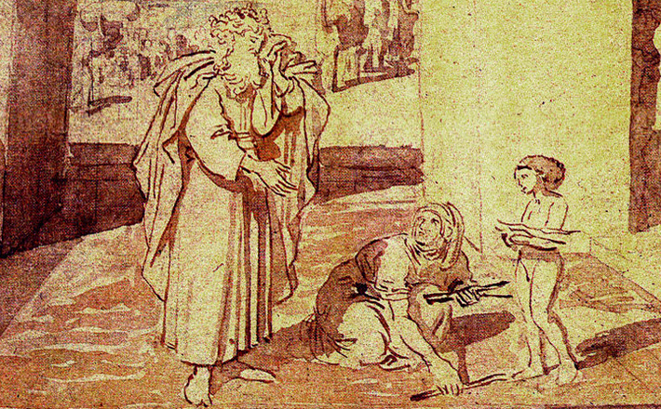
Luke 4:24-26
²⁴ “Truly I tell you,” he continued, “no prophet is accepted in his hometown. ²⁵ I assure you that there were many widows in Israel in Elijah’s time, when the sky was shut for three and a half years and there was a severe famine throughout the land. ²⁶ Yet Elijah was not sent to any of them, but to a widow in Zarephath in the region of Sidon.

Slide 16
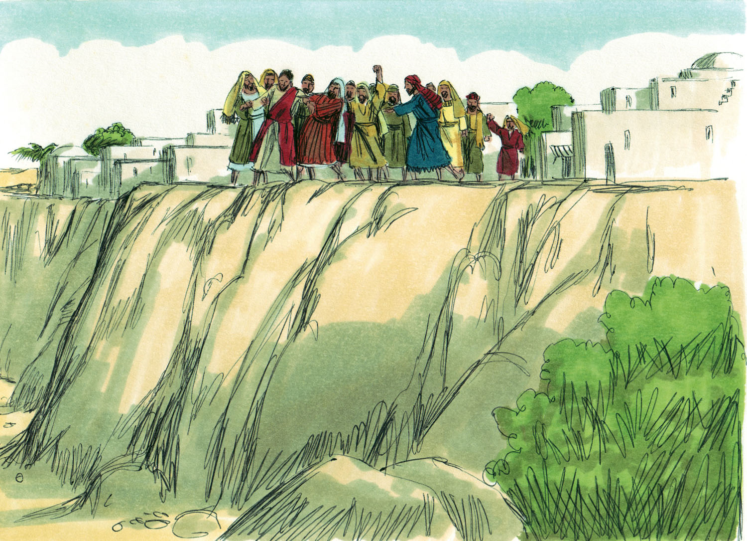
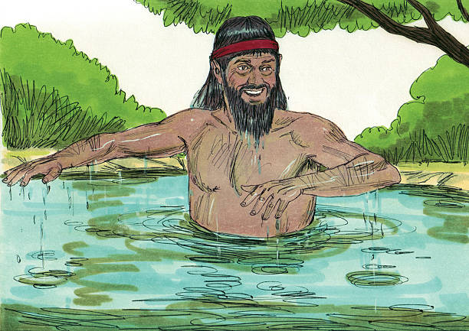
Luke 4:27-30
²⁷ And there were many in Israel with leprosy in the time of Elisha the prophet, yet not one of them was cleansed—only Naaman the Syrian.”
²⁸ All the people in the synagogue were furious when they heard this. ²⁹ They got up, drove him out of the town, and took him to the brow of the hill on which the town was built, in order to throw him off the cliff. ³⁰ But he walked right through the crowd and went on his way.

Slide 18
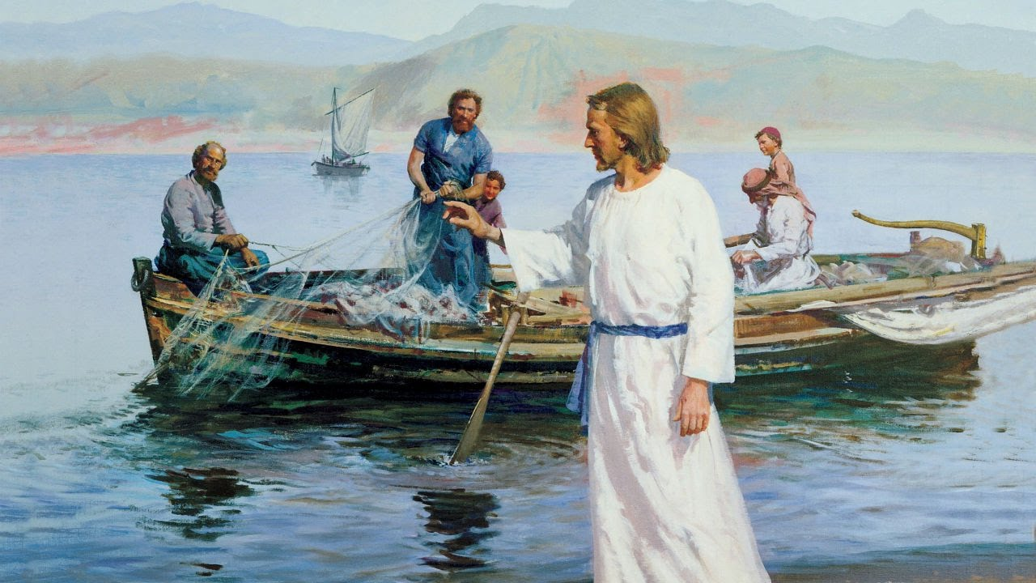
Luke 5:1-3
¹ One day as Jesus was standing by the Lake of Gennesaret, the people were crowding around him and listening to the word of God. ² He saw at the water’s edge two boats, left there by the fishermen, who were washing their nets.
³ He got into one of the boats, the one belonging to Simon, and asked him to put out a little from shore. Then he sat down and taught the people from the boat.

Slide 19
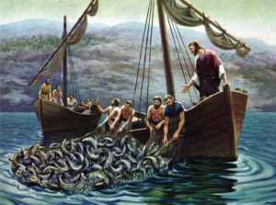
Luke 5:4-6
⁴ When he had finished speaking, he said to Simon, “Put out into deep water, and let down the nets for a catch.”
⁵ Simon answered, “Master, we’ve worked hard all night and haven’t caught anything. But because you say so, I will let down the nets.” ⁶ When they had done so, they caught such a large number of fish that their nets began to break.

Slide 20
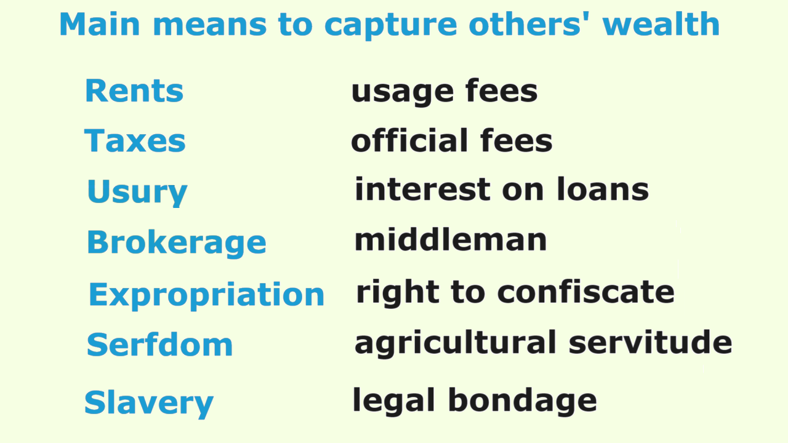

Slide 21
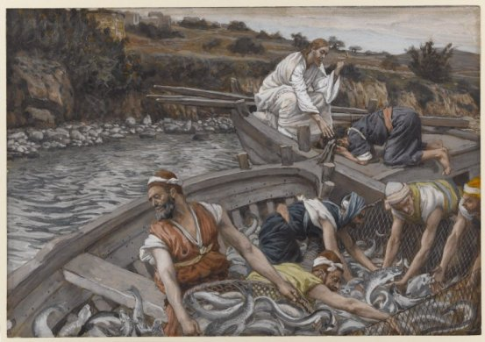
Luke 5:8-11
⁸ When Simon Peter saw this, he fell at Jesus’ knees and said, “Go away from me, Lord; I am a sinful man!” ⁹ For he and all his companions were astonished at the catch of fish they had taken, ¹⁰ … Then Jesus said to Simon, “Don’t be afraid; from now on you will fish for people.” ¹¹ So they pulled their boats up on shore, left everything and followed him.

Slide 22
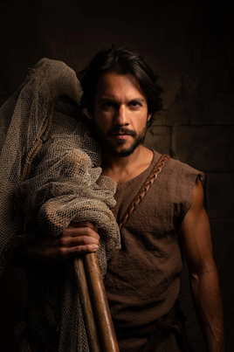
Peter’s transformation
1 Occupied with life’s demands.
2 Listened to Jesus teaching.
3 Doubtful but willing to try.
4 Astonished at outcome.
5 Repents of his own evil.
6 Reassured by Jesus’ promise.
7 Left his economic security.
8 Followed Jesus at all costs.

Slide 23
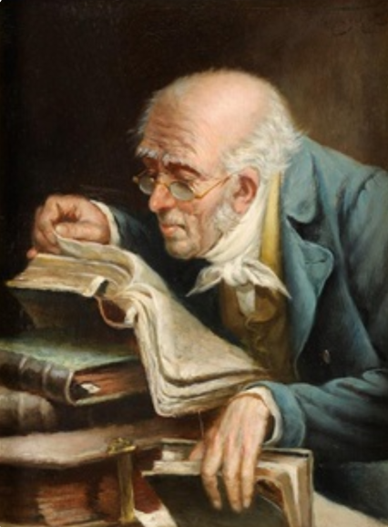
Summary
● What truths will you affirm?
● What promises will you claim?
● What commands will you obey?
Assignment
● Read: Gospel of Luke 5:12–6:19
● Visit: www.luke.currah.download
● Compile: insights, queries and observations.

