Slide 1
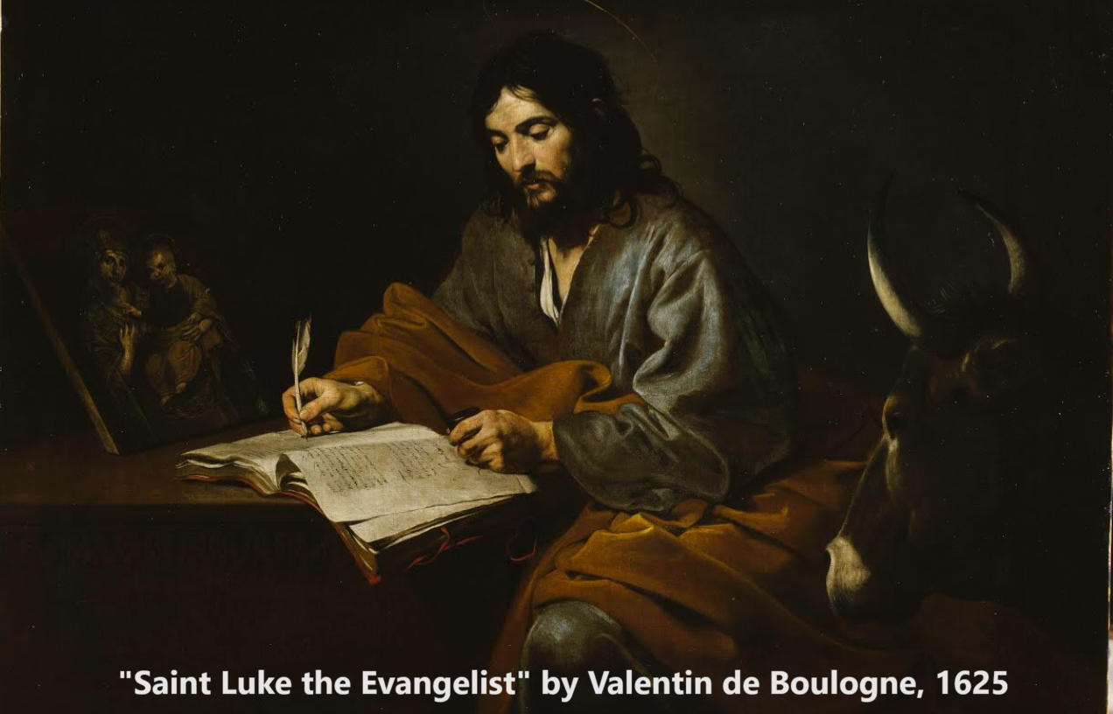
The Gospel of Luke 5:12–6:19
Messiah teaches real religion
19 & 22 October 2023

Slide 2
Structure of Luke’s Gospel
1 Preface: Sponsor, method and purpose.
2 Birth narratives: Dawn of the promised new era.
3 John’s mission: Introduce the Messiah.
4 Jesus’ mission: Messiah’s message and work.
5 Journey: Messianic signs and teaching. Luke 9:51
6 Jerusalem: Confront Israelite and Roman rulers.
7 Crucifixion: Last supper, arrest, trials, death.
8 Resurrection: Alive, appearance, and proofs.
9 Ascension: Gives Holy Spirit, mission to nations.

Slide 3
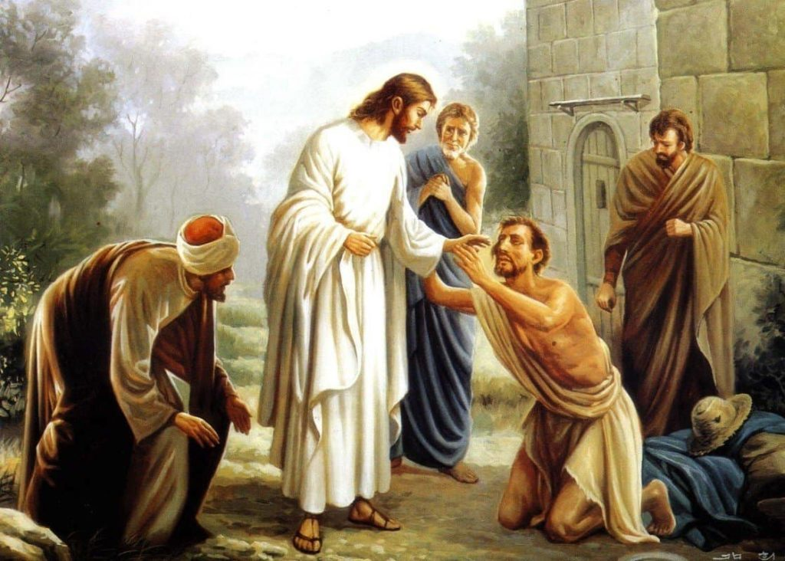
Luke 5:12-13
¹² While Jesus was in one of the towns, a man came along who was covered with leprosy. When he saw Jesus, he fell with his face to the ground and begged him, “Lord, if you are willing, you can make me clean.”
¹³ Jesus reached out his hand and touched the man. “I am willing,” he said. “Be clean!” And immediately the leprosy left him.

Slide 4
Real healing
● Speak to Jesus: “If you are willing.” Lk 5:12
● Call for the elders, confess sins, anoint with oil, and pray with faith. Ja 5:13-16
● Adopt a ‘biblical’ diet of non-inflammatory, whole, plant-based foods. Gn 1:29
● Consult with a medical professional before, during, and after making changes. Mt 9:12
● Avoid refined sugar, tobacco, vaping, alcohol, and chemical additives.

Slide 5
Luke 5:14-16
¹⁴ Then Jesus ordered him, “Don’t tell anyone, but go, show yourself to the priest and offer the sacrifices that Moses commanded for your cleansing, as a testimony to them.”
¹⁵ Yet the news about him spread all the more, so that crowds of people came to hear him and to be healed of their sicknesses. ¹⁶ But Jesus often withdrew to lonely places and prayed.

Slide 6
Real prayer
● Is neither boring nor difficult. Lk 5:16
● Involves as much listening and visioning as speaking. Ac 10:9-16
● Give thanks for recent answers. Co 4:2
● Repent of any recent sins. 1 Jn 1:9
● Make bold, audacious, ‘god-sized’ requests, for God is never offended. Phl 4:6
● (In groups, do not bore others, rehearsing details that God already knows.)

Slide 7
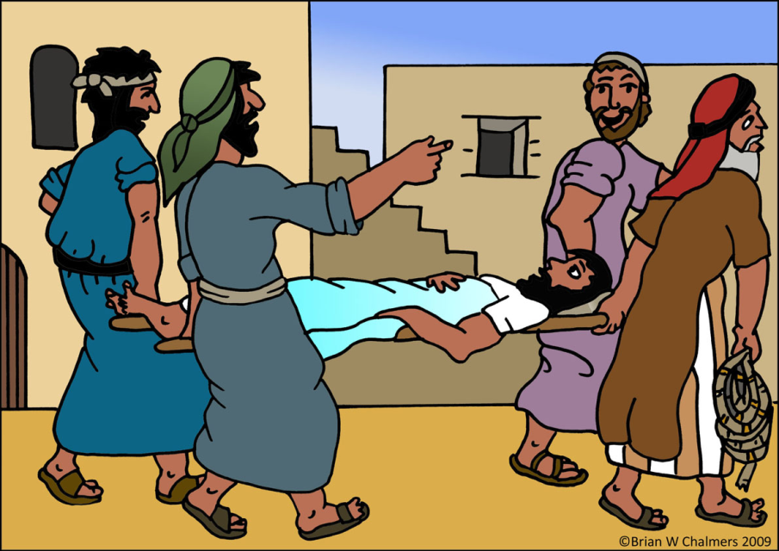
Luke 5:17-18
¹⁷ One day Jesus was teaching, and Pharisees and teachers of the law were sitting there. They had come from every village of Galilee and from Judea and Jerusalem. And the power of the Lord was with Jesus to heal the sick. ¹⁸ Some men came carrying a paralyzed man on a mat and tried to take him into the house to lay him before Jesus.

Slide 8
Real teaching
● Helpful, credible or verifiable content.
● Engages learners in discovery.
● Meets needs, answers questions.
● Includes learning goals and action steps.
● Fills a ‘CAP gap’ = leads to needed cognitive, affective and practical change.
● Respects cultural ‘learning styles’.
● Includes data, proofs, tested outcomes.

Slide 9
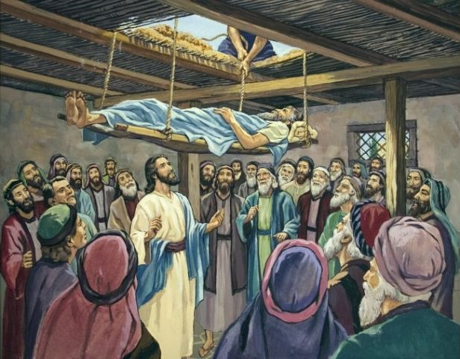
Luke 5:19-20
¹⁹ When they could not find a way to do this because of the crowd, they went up on the roof and lowered him on his mat through the tiles into the middle of the crowd, right in front of Jesus.
²⁰ When Jesus saw their faith, he said, “Friend, your sins are forgiven.”

Slide 10
Real forgiveness
● Real offenses were committed.
● The forgiver pays the cost.
● The forgiven is released from debt/guilt.
● Former friendship is renewed.
● Exploiters are left powerless.
● Further offenses can be avoided.
● Standards of right/wrong are upheld.
● A pattern is set for others to follow.

Slide 11
Luke 5:21-22
²¹ The Pharisees and the teachers of the law began thinking to themselves, “Who is this fellow who speaks blasphemy? Who can forgive sins but God alone?”
²² Jesus knew what they were thinking and asked, “Why are you thinking these things in your hearts? ²³ Which is easier: to say, ‘Your sins are forgiven,’ or to say, ‘Get up and walk’?

Slide 12
Luke 5:24-26
²⁴ But I want you to know that the Son of Man has authority on earth to forgive sins.” So he said to the paralyzed man, “I tell you, get up, take your mat and go home.” ²⁵ Immediately he stood up in front of them, took what he had been lying on and went home praising God. ²⁶ Everyone was amazed and gave praise to God.

Slide 13
“The Son of Man”
Biblical usage
1 Natural: Any human being. Ez 1:1-8
2 Personal: Jesus in his humanity. Mt 11.19
3 Public: Jesus as Messiah. Mt 16:13-16
4 Prophetic: The divine being who comes with clouds, ‘like/as a son of man’. Dn 7¹³⁻¹⁴
● Jesus used the phrase for himself in all its usages.

Slide 14
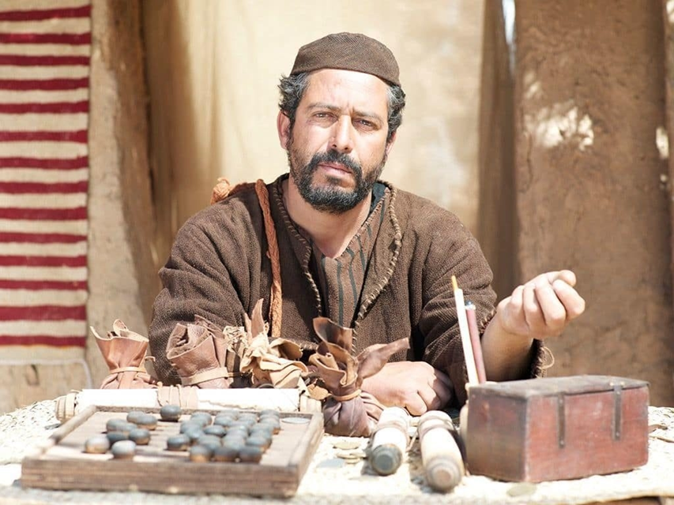
Luke 5:27-29
²⁷ After this, Jesus went out and saw a tax collector by the name of Levi sitting at his tax booth. “Follow me,” Jesus said to him, ²⁸ and Levi got up, left everything and followed him.
²⁹ Then Levi held a great banquet for Jesus at his house, and a large crowd of tax collectors and others were eating with them.

Slide 15
Real followers
● Suffer loss of former privileges/pleasures.
● Count the cost and compare the rewards.
● Obey their lord’s commandments.
● Gain their lord’s approval/companionship.
● Tell the truth about their lord’s deeds.
● Exercise their lord’s power & authority.
● Invite others to enjoy the same calling.
● Support abuse from their lord’s enemies.
● Will share in their lord’s future glory.

Slide 16
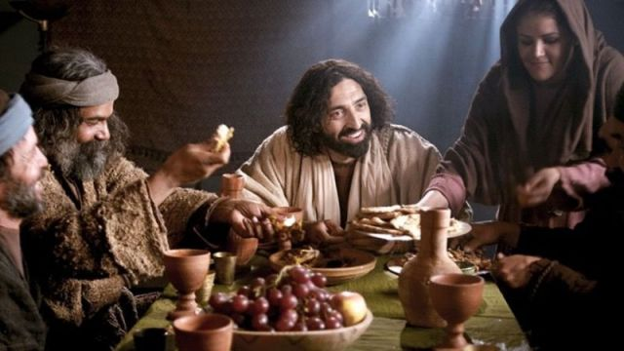
Luke 5:30-32
³⁰ But the Pharisees and the teachers of the law who belonged to their sect complained to his disciples, “Why do you eat and drink with tax collectors and sinners?”
³¹ Jesus answered them, “It is not the healthy who need a doctor, but the sick. ³² I have not come to call the righteous, but sinners to repentance.”

Slide 17
Real sinners and righteous
Sinners
● All who are not yet repentant and forgiven.
● Remain powerless to change themselves.
● Have no inheritance in God’s kingdom.
Righteous
● Have repented and been ‘born again’.
● Live to please God, and to do what’s right.
● Have hope of enjoying everlasting life.

Slide 18
Luke 5:30-32
³³ They said to him, “John’s disciples often fast and pray, and so do the disciples of the Pharisees, but yours go on eating and drinking.”
³⁴ Jesus answered, “Can you make the friends of the bridegroom fast while he is with them? ³⁵ But the time will come when the bridegroom will be taken from them; in those days they will fast.”

Slide 19
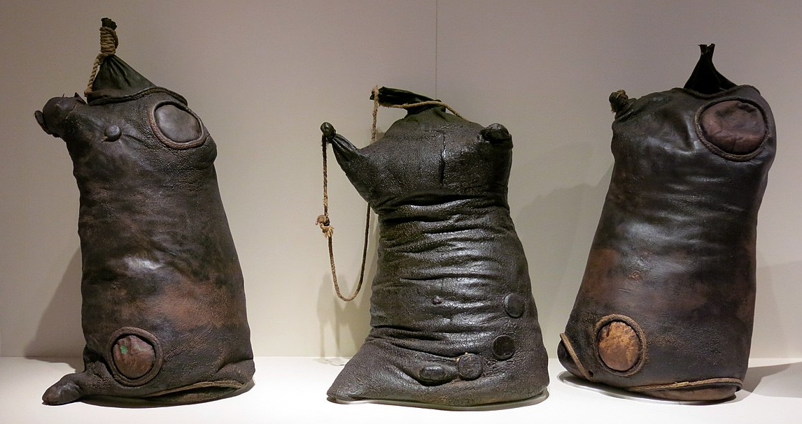
Luke 5:36-38
³⁶ He told them this parable: “No one tears a piece out of a new garment to patch an old one. Otherwise, they will have torn the new garment, and the patch from the new will not match the old. ³⁷ And no one pours new wine into old wineskins. Otherwise, the new wine will burst the skins; the wine will run out and the wineskins will be ruined. ³⁸ No, new wine must be poured into new wineskins.

Slide 20
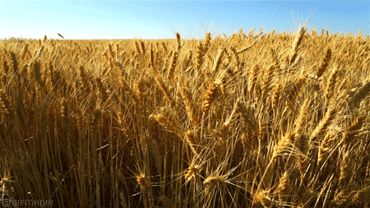
Luke 6:1-3
¹ One Sabbath Jesus was going through the grainfields, and his disciples began to pick some heads of grain, rub them in their hands and eat the kernels. ² Some of the Pharisees asked, “Why are you doing what is unlawful on the Sabbath?”
³ Jesus answered them, “Have you never read what David did when he and his companions were hungry?

Slide 21
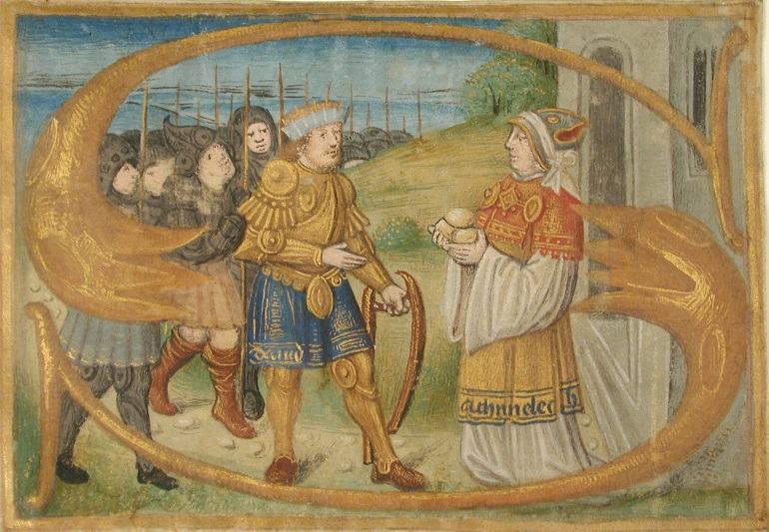
Luke 6:4-5
⁴ He entered the house of God, and taking the consecrated bread, he ate what is lawful only for priests to eat. And he also gave some to his companions.” ⁵ Then Jesus said to them, “The Son of Man is Lord of the Sabbath.”
“The Sabbath was made for humans, not humans for the Sabbath.” John 9:27

Slide 22
Religions Jesus Christ
1 God demands God offers free gifts
2 Submit to God! Believe God’s words
3 Dead prophet Risen Savior
4 Obey rules Love God & others
5 Try/work harder Receive his Holy Spirit
6 God judges God forgives
7 No certainty Jesus’ promises
8 Other books Bible only
9 Costly rituals Baptism & communion

Slide 23
Luke 6:6-7
⁶ On another Sabbath he went into the synagogue and was teaching, and a man was there whose right hand was shriveled. ⁷ The Pharisees and the teachers of the law were looking for a reason to accuse Jesus, so they watched him closely to see if he would heal on the Sabbath.

Slide 24
Luke 6:8-9
⁸ But Jesus knew what they were thinking and said to the man with the shriveled hand, “Get up and stand in front of everyone.” So he got up and stood there.
⁹ Then Jesus said to them, “I ask you, which is lawful on the Sabbath: to do good or to do evil, to save life or to destroy it?”

Slide 25
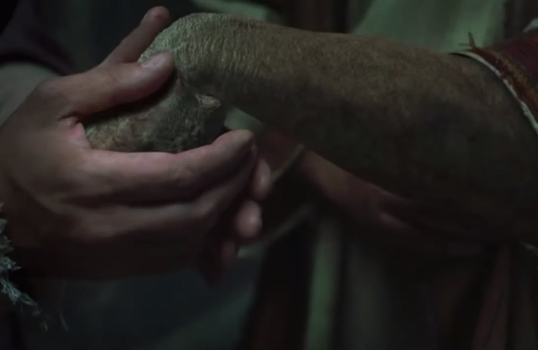
Luke 6:10-11
¹⁰ He looked around at them all, and then said to the man, “Stretch out your hand.” He did so, and his hand was completely restored. ¹¹ But the Pharisees and the teachers of the law were furious and began to discuss with one another what they might do to Jesus.

Slide 26
Test: What are God’s laws for?
[ ] Obey them or be damned?
[ ] To gain wisdom?
[ ] For our own good?
[ ] Show loyalty to Yahweh?
[ ] To know God better?
[ ] To earn our way to heaven?
[ ] Facilitate civil society?
X
√
√
√
√
X
√

Slide 27
Summary
● What truths will you affirm?
● What promises will you claim?
● What commands will you obey?
Assignment
● Read: Luke 6:20–7:35
● Visit: www.luke.currah.download
● Compile: insights, queries & observations.

