Slide 1
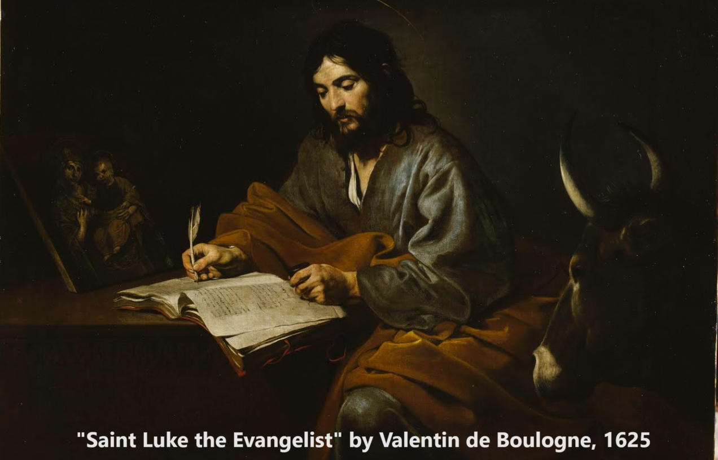
The Gospel of Luke 7:36–8:25
Messiah astonishes everyone
02 November 2023

Slide 2
Structure of Luke’s Gospel
1 Preface: Sponsor, method and purpose.
2 Birth narratives: Dawn of the promised new era.
3 John’s mission: Introduce the Messiah.
4 Jesus’ mission: Messiah’s message and work.
5 Journey: Messianic signs and teaching. Luke 9:51
6 Jerusalem: Confront Israelite and Roman rulers.
7 Crucifixion: Last supper, arrest, trials, death.
8 Resurrection: Alive, appearance, and proofs.
9 Ascension: Gives Holy Spirit, mission to nations.

Slide 3
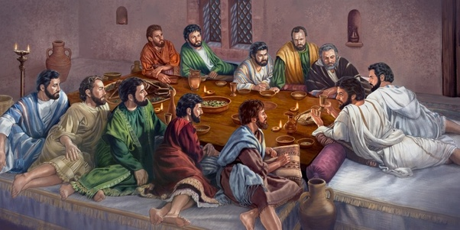
Luke 7:36-37
³⁶ When one of the Pharisees invited Jesus to have dinner with him, he went to the Pharisee’s house and reclined at the table. ³⁷ A woman in that town who lived a sinful life learned that Jesus was eating at the Pharisee’s house, so she came there with an alabaster jar of perfume.

Slide 4
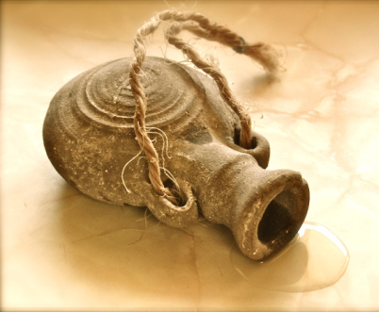
Luke 7:36-37
● Why ‘recline’ at table?
● How did that woman get into the house?
● What was an alabaster jar of perfume for?

Slide 5
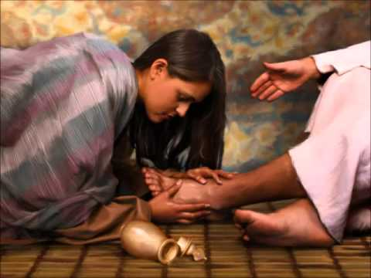
Luke 7:38
³⁸ As she stood behind him at his feet weeping, she began to wet his feet with her tears. Then she wiped them with her hair, kissed them and poured perfume on them.

Slide 6
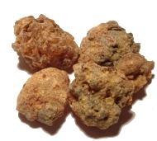
Myrrh
A gum-resin extracted from a number of small, thorny tree species of the genus Commiphora. Myrrh resin has been used throughout history as a perfume, incense and medicine. Myrrh mixed with posca* or wine was widely used in many ancient cultures to produce pleasurable feelings and as an anti-inflammatory and analgesic [pain relief]. —Wikipedia
* Mixture of water, vinegar, and wine

Slide 7
Luke 7:39-40
³⁹ When the Pharisee who had invited him saw this, he said to himself, “If this man were a prophet, he would know who is touching him and what kind of woman she is—that she is a sinner.”
⁴⁰ Jesus answered him, “Simon, I have something to tell you.”
“Tell me, teacher,” he said.

Slide 8
Prophets
● Pagan: Soothsayers, philosophers, poets.
● Hebrew: Reliable seers who receive and deliver messages and miracles from God.
● Popular: Anyone who can reveal secrets.
● Christian: Fallible foretellers and forthtellers animated by the Holy Spirit.
● Charlatan: Performers who say whatever comes to mind, in a loud or falsetto voice.

Slide 9
Luke 7:41-43
⁴¹ “Two people owed money to a certain moneylender. One owed him five hundred denarii, and the other fifty.
⁴² Neither of them had the money to pay him back, so he forgave the debts of both. Now which of them will love him more?”
⁴³ Simon replied, “I suppose the one who had the bigger debt forgiven.”

Slide 10
Forgive debts
“Although debts were to be forgiven in the seventh year, experts in the law had found ways to get around that requirement.
“Creditors could have debtors imprisoned, temporarily enslaved, or have certain goods confiscated.
“This creditor goes beyond the letter of the law and extends mercy.” (IVPbbc)

Slide 11
Luke 7:43-44
“You have judged correctly,” Jesus said.
⁴⁴ Then he turned toward the woman and said to Simon, “Do you see this woman? I came into your house. You did not give me any water for my feet, but she wet my feet with her tears and wiped them with her hair.

Slide 12
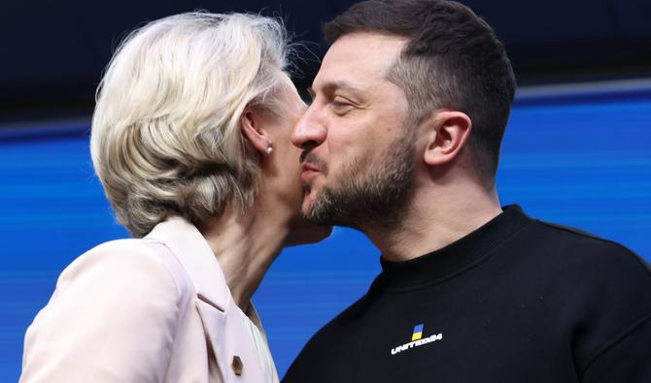
Luke 7:45
⁴⁵ You did not give me a kiss, but this woman, from the time I entered, has not stopped kissing my feet.
La présidente de la Commission européenne, Ursula von der Leyen (à gauche), embrasse le président ukrainien Volodymyr Zelensky à la suite d'une conférence de presse lors d'un sommet de l'UE à Bruxelles, le 9 février 2023. (AFP)

Slide 13
Luke 7:46-48
⁴⁶ You did not put oil on my head, but she has poured perfume on my feet. ⁴⁷ Therefore, I tell you, her many sins have been forgiven—as her great love has shown. But whoever has been forgiven little loves little.” ⁴⁸ Then Jesus said to her, “Your sins are forgiven.”
How could Jesus forgive sins, before he died to forgive sins?
Romans 3:25

Slide 17
Luke 7:49-50
⁴⁹ The other guests began to say among themselves, “Who is this who even forgives sins?”
⁵⁰ Jesus said to the woman, “Your faith has saved you; go in peace.”
Faith
● Believe truth Believe in God
● Trust promises Trust Jesus to save
● Loyalty to someone Remain faithful

Slide 18
Intensity levels of ‘faith’
● Worldview: assumptions
● Authority: official doctrines
● Logic: pre-suppositions
● Evidence: logical deductions
● Experiment: credible proofs
● Emergency: practical help
● Commitment: personal trust
● Abandonment: risking all
Everybody
Religions
Philosophers
Scientists
Seekers
Desperate
Evangelicals
Radicals

Slide 19
Directions of faith

Slide 20
Directions of faith

Slide 21
Directions of faith

Slide 22
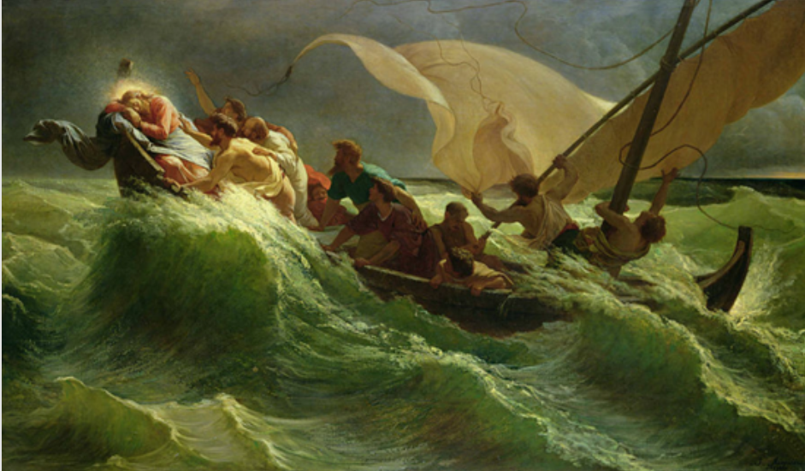
Luke 8:22-23
²² One day Jesus said to his disciples, “Let us go over to the other side of the lake.” So they got into a boat and set out.
²³ As they sailed, he fell asleep. A squall came down on the lake, so that the boat was being swamped, and they were in great danger.

Slide 23
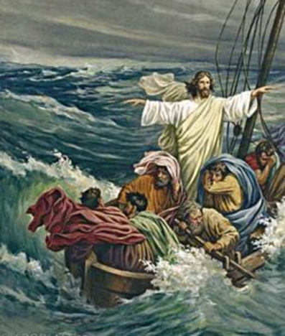
Luke 8:24-25
²⁴ The disciples went and woke him, saying, “Master, Master, we’re going to drown!”
He got up and rebuked the wind and the raging waters; the storm subsided, and all was calm. ²⁵ “Where is your faith?” he asked his disciples.

Slide 24
Luke 8:25
²⁴ In fear and amazement they asked one another, “Who is this? He commands even the winds and the water, and they obey him.”
● Atheism: Nobody. He never existed.
● New age: One of the great masters.
● Cults: The angel Michael.
● Islam: A dead, secondary prophet.
● Academia: An itinerate Jewish rabbi.
● Mormonism: A created man become a god.

Slide 25
Jesus’ miracles What did they show?
● Healing: Mercy + divine power.
● Exorcism: Mercy + divine authority.
● Revive the dead: Mercy + life source.
● Command nature: Deity.
● Multiply food: Mercy + creative power.
● Coin in fish’s mouth: Arrange coincidence.
● Resurrection: Creative power.
Jesus never operated magical tricks or illusions, nor did he make living creatures.

Slide 26
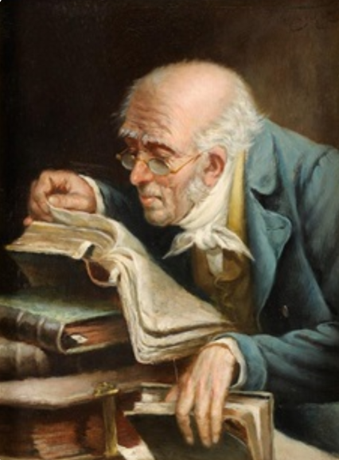
Summary
● What truths will you affirm?
● What promises will you claim?
● What commands will you obey?
Assignment
● Read: Gospel of Luke 8:26–9:9
● Visit: www.luke.currah.download
● Compile: insights, queries and observations.

