Slide 1
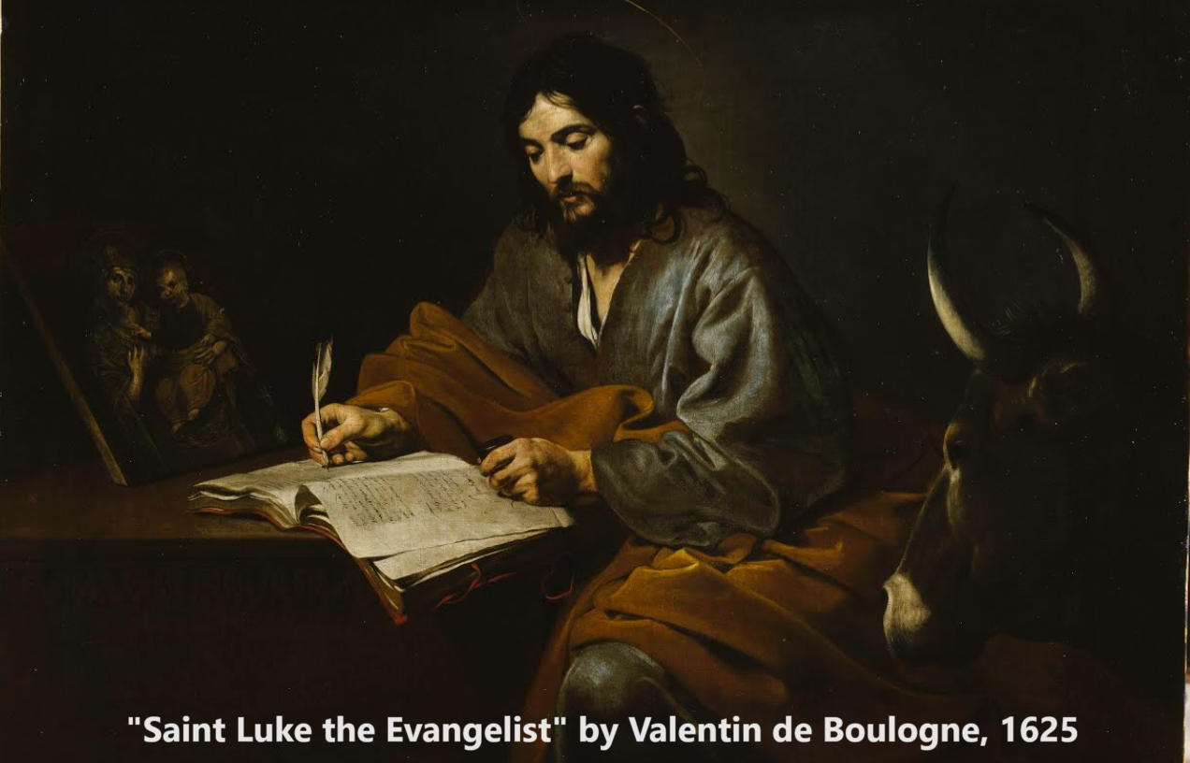
Gospel of Luke 9:10-62
Messiah’s Authority
16 & 19 November 2023

Slide 2
Structure of Luke’s Gospel
1 Preface: Sponsor, method and purpose.
2 Birth narratives: Dawn of the promised new era.
3 John’s mission: Introduce the Messiah.
4 Jesus’ mission: Messiah’s message and work.
5 Journey: Messianic signs and teaching. Luke 9:51
6 Jerusalem: Confront Israelite and Roman rulers.
7 Crucifixion: Last supper, arrest, trials, death.
8 Resurrection: Alive, appearance, and proofs.
9 Ascension: Gives Holy Spirit, mission to nations.

Slide 3
Messiah’s authority Luke 9:10-62
1. Authority over the natural. 9:10-27
He feeds 5000. 10-17
Recognized by humans. 18-21
Foretells his demise. 22
Calls for radical followers. 23-27
2. Authority over the supernatural: 9:28-62
He is transfigured. 28-36
Recognized by God. 18-20
Foretells his demise. 43-45
Calls for radical followers. 57-62

Slide 4
Messiah’s authority over the NATURAL world:
Luke 9:10-27

Slide 5
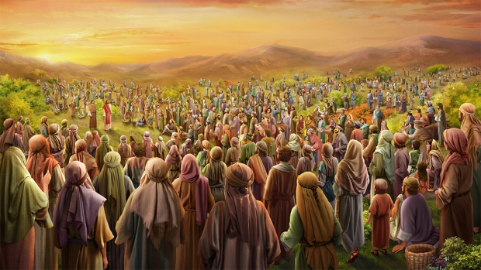
Messiah feeds 5000 Luke 9:10-17
¹⁰ When the apostles returned, they reported to Jesus what they had done. Then he took them with him and they withdrew by themselves to a town called Bethsaida,* ¹¹ but the crowds learned about it and followed him. He welcomed them and spoke to them about the kingdom of God, and healed those who needed healing. * Some mss read, “to a lonely place.”

Slide 6
Messiah feeds 5000 Luke 9:10-17
● “He sent them to preach the kingdom of God and to heal the sick” (9:2).
● “The kingdom of God” = wherever and whenever the king reigns.
● “He spoke (message) … and healed (demonstrated).
● “The kingdom of God is in your midst” (17:21).

Slide 7
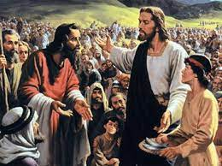
Messiah feeds 5000 Luke 9:10-17
¹² Late in the afternoon the Twelve came to him and said, “Send the crowd away so they can go to the surrounding villages and countryside and find food and lodging, because we are in a remote place here.”
¹³ He replied, “You give them something to eat.”

Slide 8
Messiah feeds 5000 Luke 9:10-17
● Farmers usually had excess food that they were willing to sell, or to share with relatives.
● Middle-eastern societies were usually hospitable towards travellers.

Slide 9
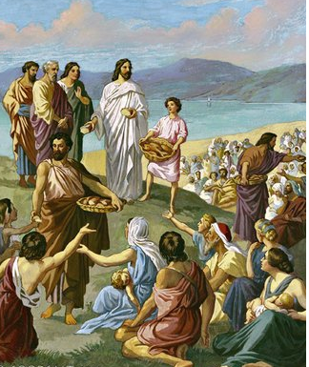
Messiah feeds 5000 Luke 9:10-17
¹³ They answered, “We have only five loaves of bread and two fish—unless we go and buy food for all this crowd.” ¹⁴ (About five thousand men were there.)
But he said to his disciples, “Have them sit down in groups of about fifty each.” ¹⁵ The disciples did so, and everyone sat down.

Slide 10
Messiah feeds 5000 Luke 9:10-17
● Bread: Farmers usually grew ancient wheat for sale, and barley for consumption.
● Fish: From Lake Galilee, dried to preserve.
● “There is a boy here who has five barley loaves and two fish, but what are they for so many?” (John 6:9).

Slide 11
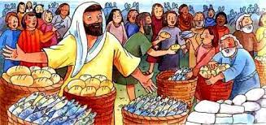
Messiah feeds 5000 Luke 9:10-17
¹⁶ Taking the five loaves and the two fish and looking up to heaven, he gave thanks and broke them. Then he gave them to the disciples to distribute to the people. ¹⁷ They all ate and were satisfied, and the disciples picked up twelve basketfuls of broken pieces that were left over.

Slide 12
Messiah feeds 5000 Luke 9:10-17
● How do you explain Jesus’ “Nature miracles”?
● Did Jesus violate any ‘laws of nature’?
● What did they do with the 12 baskets full of left-overs?
● What about Jesus’ share? Who fed him?

Slide 13
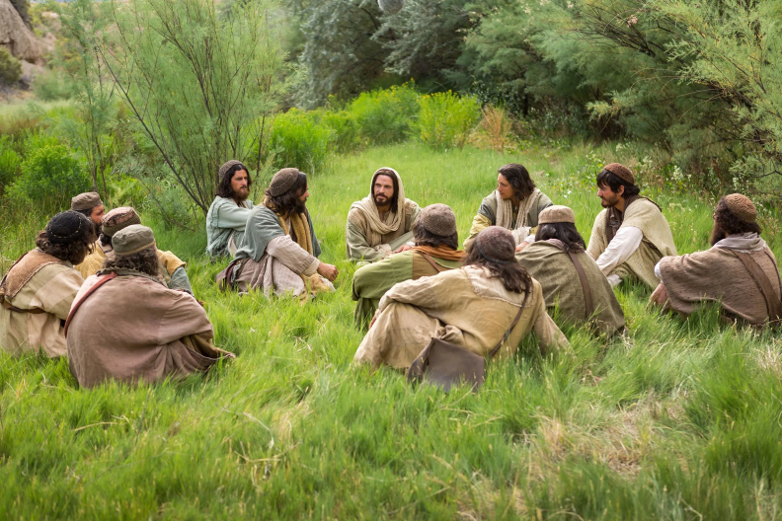
Recognized by men Luke 9:18-21
¹⁸ Once when Jesus was praying in private and his disciples were with him, he asked them, “Who do the crowds say I am?”
¹⁹ They replied, “Some say John the Baptist; others say Elijah; and still others, that one of the prophets of long ago has come back to life.”

Slide 14
Recognized by men Luke 9:18-21
● John: Recently beheaded by king Agrippa.
● Elijah: Never died. Malichai predicted that he would return before Messiah arrived.
● Ancient prophets: Some had predicted a future resurrection of the dead.
● “Your dead will live, LORD; their bodies will rise—let those who dwell in the dust wake up and shout for joy—your dew is like the dew of the morning; the earth will give birth to her dead.” Isaiah 26:19

Slide 15
Recognized by men Luke 9:18-21
²⁰ “But what about you [plural]?” he asked. “Who do you say I am?”
Peter answered, “God’s Messiah.”
²¹ Jesus strictly warned them not to tell this to anyone.
● Why did Jesus pose this query?
● Why not tell anyone?
● Why not tell everybody?

Slide 16
Titles given in Bible to a coming one
● Messiah = Christ = Anointed one
● Son of David = David the king
● Messenger of the covenant
● The Righteous one
● The Servant of the Lord
● The Son of Man
See a list of 21 titles at luke.currah.download

Slide 17
Foretells his demise Luke 9:22
²² And he said, “The Son of Man must suffer many things and be rejected by the elders, the chief priests and the teachers of the law, and he must be killed and on the third day be raised to life.”
● Son of Man: Aramaic, בַר אֱנָשׁ bar ^{ʔ}enaš = ‘human being’.
● The Son of Man ➔ Daniel 7:13-14.

Slide 18
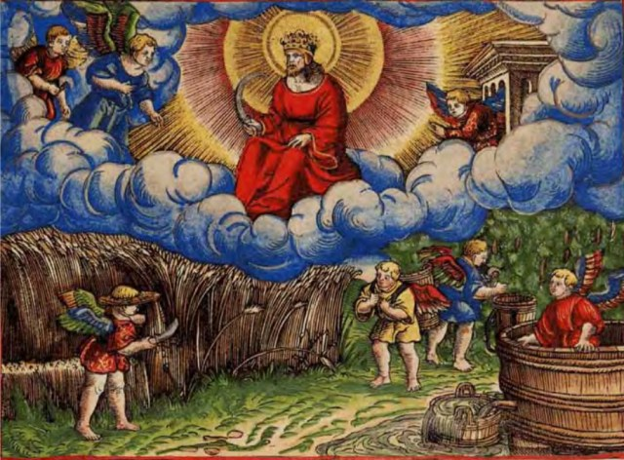
Son of Man Daniel 7:13-14
¹³ “In my vision at night I looked, and there before me was one like* a son of man, coming with the clouds of heaven. He approached the Ancient of Days and was led into his presence. ¹⁴ He was given authority, glory and sovereign power; all nations and peoples of every language worshiped him. His dominion is an everlasting dominion that will not pass away, and his kingdom is one that will never be destroyed. * Aramaic כְּ ke = “like” (if fake) or “as” (if real).

Slide 19
foretells his demise Luke 9:22
● In the OT, “Messiah” does not suffer.
● In the OT, “Son of Man” does not suffer.
● So, how can Jesus/Luke say that the Son of Man must suffer? Luke 9:22
● So, how can Jesus/Luke say that the Messiah/Christ must suffer? Luke 24:26
● It was “The Righteous One, the Lord’s Servant” who had to suffer. Isaiah 53:11

Slide 20
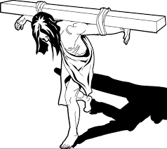
Radical discipleship Luke 9:23-27
²³ Then he said to them all: “Whoever want to be my disciples must deny themselves, take up their cross* daily and follow me. ²⁴ For whoever want to save their life will lose it, but whoever lose their life for me will save it. *crossbeam

Slide 21
Radical discipleship Luke 9:23-27
●“3 to disclaim association with a person … deny, repudiate, disown.” BDAG, Gk-En Lex.
● Deny self ≠ deny Christ.
● Start each day affirming Jesus as Lord, willing to lose anything to gain everything.
● “Others who were tortured, refusing to be released so that they might gain an even better resurrection.” Hebrews 11:35

Slide 22
Messiah’s authority over the SUPERNATURAL world Luke 9:28-62

Slide 23
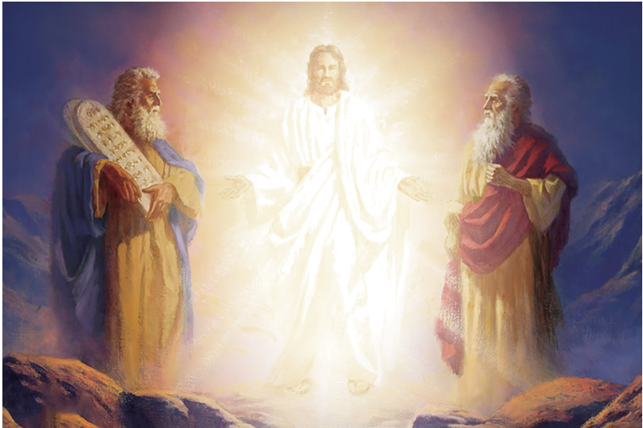
Messiah is transfigured Luke 9:28-33
²⁸ About eight days after Jesus said this, he took Peter, John and James with him and went up onto a mountain to pray. ²⁹ As he was praying, the appearance of his face changed, and his clothes became as bright as a flash of lightning. ³⁰ Two men, Moses and Elijah, appeared in glorious splendor, talking with Jesus.

Slide 24
Messiah is transfigured Luke 9:28-33
● This was Mount Hermon, believed to be a dwelling place of gods and spirits.
● How did they know that these were Elijah and Moses?
● What were those two prophets informing Jesus about?

Slide 25
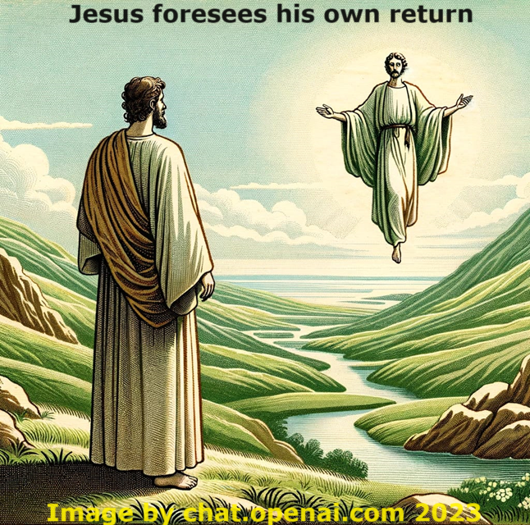
Messiah is transfigured Luke 9:28-33
³¹ They spoke about his departure, which he was about to bring to fulfilment at Jerusalem.
³² Peter and his companions were very sleepy, but when they became fully awake, they saw his glory and the two men standing with him.

Slide 26
Messiah is transfigured Luke 9:28-33
● When and how did Jesus later ‘depart’?
● Why was Jesus’ ‘departure’ an important subject for Messiah to understand?
● Recall what Daniel had said about ‘the Son of Man’?
● How will Jesus connect his identity as the Son of Man with a departure, instead of with receiving an everlasting kingdom?

Slide 28
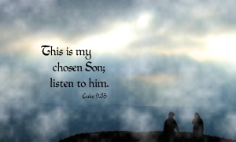
Recognized by God Luke 9:33-36
³³ As the men were leaving … ³⁴ a cloud appeared and covered them, and the [apostles] were afraid as they entered the cloud.
³⁵ A voice came from the cloud, saying, “This is my Son, whom I have chosen*; listen to him.” ³⁶ When the voice had spoken, they found that Jesus was alone. * Some mss read, “my beloved one” (Lk 3:22).

Slide 29
God spoke audibly to Jesus in public
● Jesus’ baptism: “You are my beloved Son.” Luke 3:22
● His transfiguration: “This is my beloved Son …; listen to him.” Luke 9:35
● Before his death: “I will glorify [my name] again.” John 12:28-30

Slide 30
foretells his demise Luke 9:43-45
⁴³ [Jesus] said to his disciples, ⁴⁴ “Listen carefully to what I am about to tell you: The Son of Man is going to be delivered into the hands of men.”
⁴⁵ But they did not understand what this meant.
● ‘Into the hands’ = put under the power.
● Why was this so hard to understand?

Slide 31
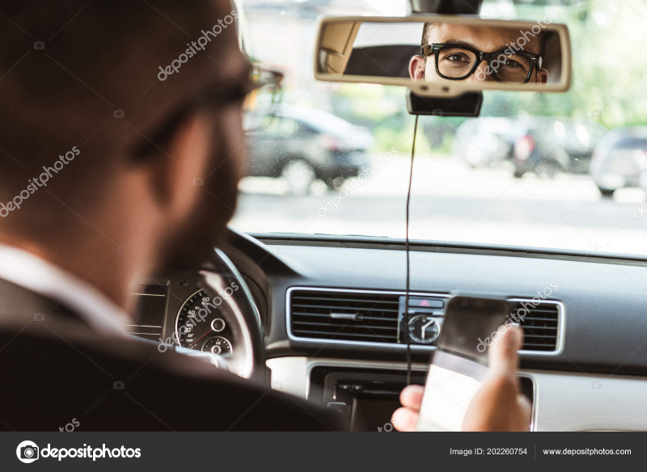
Radical discipleship Luke 9:57-62
⁵¹ As the time approached for him to be taken up to heaven, Jesus resolutely set out for Jerusalem…
⁵⁷ As they were walking along the road, a man said to him, “I will follow you wherever you go.”
⁵⁸ Jesus replied, “Foxes have dens and birds have nests, but the Son of Man has no place to lay his head.”

Slide 32
Radical discipleship Luke 9:57-62
● Jesus ‘departure’: “to be taken up to heaven.” Acts 1:9-11
● Until: Jesus will arrive back from heaven to become king of the whole world.
● Follow: Learn from, obey instructions, imitate, even die young unjustly.
● Lay (klinō) head: ‘He said, “It is finished.” Then he bowed [klinō] his head and gave up his spirit.’ John 19:30

Slide 33
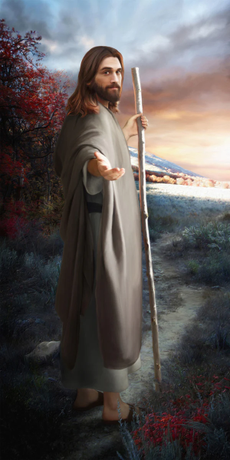
Radical discipleship Luke 9:57-62
⁵⁹ He said to another man, “Follow me.” But he replied, “Lord*, first let me go and bury my father.” * Some mss omit “Lord” due to a scribal error.
⁶⁰ Jesus said to him, “Let the dead bury their own dead, but you go and proclaim the kingdom of God.”

Slide 34
Radical discipleship Luke 9:57-62
African brothers explained this text to me:
● Bury parents: “This remains a filial duty. One who did not care for his aging parents would be shamed by his community.”
● Go proclaim: “This must be an important task, worth risking an inheritance and one’s reputation.”

Slide 35
Radical discipleship Luke 9:57-62
⁶¹ Still another said, “I will follow you, Lord; but first let me go back and say goodbye to my family.”
⁶² Jesus replied*, “No one who puts a** hand to the plow and looks back is fit for service in the kingdom of God.” * Some mss insert “to him”. ** Some mss read “his”.

Slide 36
Radical discipleship Luke 9:57-62
● What will family members say to dissuade you from risking health and wealth to go carry the Gospel to an unreached people?
● What is a modern trope that means “to put a hand to a plow and look back”?
● Have you made a vow to the Lord that you have not yet fulfilled?
● Could you give a year or two, serving a Christian ministry, before too late?

Slide 37
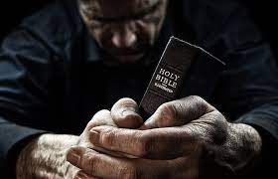
Discover
● Truths to affirm?
● Promises to claim?
● Commands to obey?
Assignment
● Read: Luke 10:1–11:13
● Visit: luke.currah.download
● Compile: insights, queries & observations.

