Slide 1
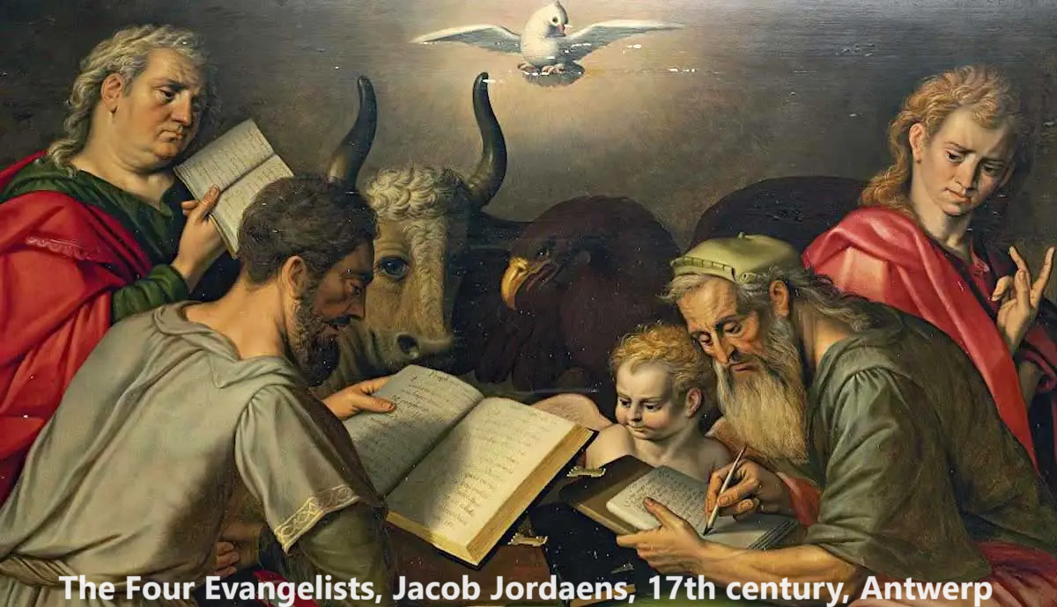
Deep Dive into Luke
Overview of the Gospel Canon (2)
September 2023

Slide 2

Learning objectives
● Test: traditional tests of Canonicity
● Compare: non-canonical ‘gospels’
● Defend: The four canonical Gospels
● Trace: traditional gospel lineages
● Introduce: The Gospel of Luke

Slide 3
Traditional criteria for NT canonicity
1. Apostolicity: ‘historical succession’.
Jesus remains our sole authority, and his apostles’ writings remain our best access to the historical Jesus.
“The Advocate, the Holy Spirit, whom the Father will send in my name, will teach you everything and remind you of all that I have said to you.” John 12:26

Slide 4
Traditional criteria for NT canonicity
1. Apostolicity
Critique: There are books in the NT canons of all denominations that were certainly not written by an apostle. For examples: Gospel of Luke and Epistle to the Hebrews.
Reply: Associates to apostles wrote with apostolic oversight and approval. “Apollos and myself … learn through us what ‘Not beyond what is written’ means.” 1 Cor. 4:6

Slide 5
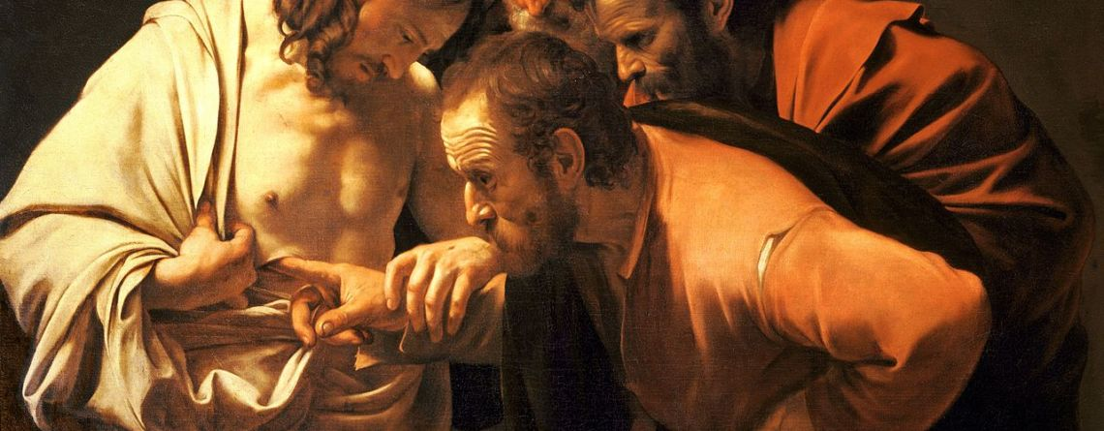
Traditional criteria for NT canonicity
2. Orthodoxy: ‘normative doctrine/teaching’.
The apostles’ teaching is true doctrine. Many later doctrines diverge from the truth.
“Concerning the word of life—this life was revealed, and we have seen it and testify to it and declare to you the eternal life that was with the Father and was revealed to us.”
1 John 1:2-3

Slide 6
Traditional criteria for NT canonicity
2. Orthodoxy
Critique: There was no doctrinal standard common to all apostles and to NT writings. Even the Gospels have distinctive features and apply the OT differently.
Reply: Apostles themselves recognized unique teachings in each other’s writings. “Our brother Paul wrote to you according to the wisdom given to him.” 2 Peter 3:15-16

Slide 7
Traditional criteria for NT canonicity
3. Antiquity: ‘The period of the incarnation’.
The apostles’ “rule of faith” was a criterion by which the early churches judged truth.
“I find it necessary to write and appeal to you to contend for the faith that was once and for all handed on to the saints.” Jude 1:3

Slide 8
Traditional criteria for NT canonicity
3. Antiquity
Critique: There were non-canonical gospels or ‘sayings of Jesus’ circulating before the appearance of the canonical Gospels. Luke 1:1
Reply: Canonicity allows for both the period of the incarnation and the lifetimes of Jesus’ apostles.

Slide 9
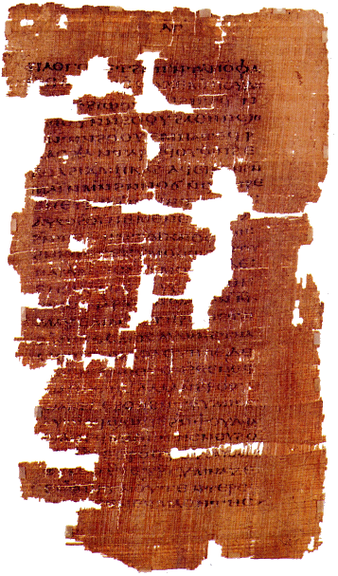
Sample 1st & 2nd century gospels
● Egerton papyrus: Miracles and sayings of Jesus, some extra-canonical.
● Ebionite Gospel: Denies the virginal conception of Jesus.
● Shepherd of Hermas: Visions & commands supposedly given by Jesus.
● Gospel of Judas: Written in Coptic translated from Greek, teaching Gnostic doctrines.

Slide 10
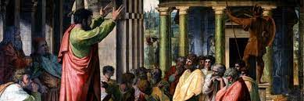
Traditional criteria for NT canonicity
4. Inspiration: ‘Moved by the Holy Spirit’.
The apostles’ “rule of faith” was a criterion for the early churches’ acceptance of a book.
“Understand this, that no prophecy of scripture is a matter of one’s own interpre-tation, because no prophecy ever came by human will.” 2 Pet. 1:16

Slide 11
Traditional criteria for NT canonicity
4. Inspiration
Critique: Early church leaders believed that their unique canon of books was divinely inspired, including disputed books that were later rejected. E.g., the Book of Enoch.
Reply: A book’s inspiration is inferred from its authoritative, apostolic source, since we do not know directly what is inspired.

Slide 12
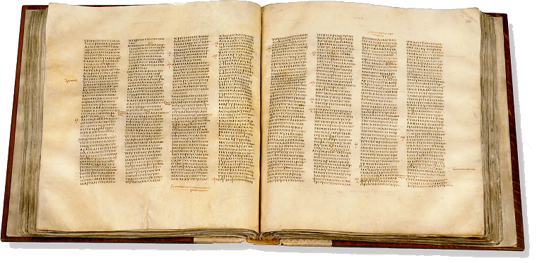
Traditional criteria for NT canonicity
5. Usage: ‘Widespread recognition’.
Books that all or most of the churches accepted as authoritative should be in the canon of scripture.
“When this letter has been read among you, have it read also in the church of the Laodiceans, and see that you read also the letter from Laodicea.” Col. 4:16

Slide 13
Traditional criteria for NT canonicity
5. Usage
Critique: Some books did not arrive at all the churches, and not all those that arrived in a church survived or proved edifying.
Reply: Over time, most churches came to approve the most useful books. These form the common canon to which some churches add other books.

Slide 14
Linages of the Canonical Gospels
● Matthew ➔ Gospel of Matthew
● Peter & Mark ➔ Gospel of Mark
● Paul & witnesses ➔ Gospel of Luke
● John ➔ Gospel of John
“The apostles, in the memoirs composed by them, which are called Gospels, have thus delivered unto us what was enjoined upon them.” Justin Martyr (b. 100 in Judea).
Robert L Thomas, Charts of the Gospels, Zondervan (2000), 81

Slide 15
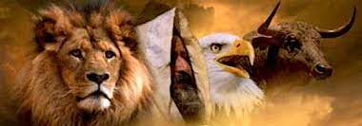
Supposed Gospel Emphases
● Matthew ➔ Messiah as King, 1:1
● Mark ➔ Messiah as Servant, 10:45
● Luke➔ Messiah as Human, 2:40-42
● John ➔ Messiah as Divine, 1:1, 14
● Matthew ➔ Lion
● Mark ➔ Bull
● Luke➔ Man
● John ➔ Eagle, Ezekiel 1:10

Slide 16
Gospel ethnic focus
● Matthew ➔ Jews, ‘He is King of the Jews’
● Mark ➔ Romans, ‘immediately’
● Luke➔ Gentiles, ‘Christ the Lord’
● John ➔ Christians, ‘I AM’
Gospel language focus: Jesus’ titulus
● Matthew ➔ Aramaic: “This he Jesus King Jews-the”
● Mark ➔ Greek: Ο ΒΑΣΙΛΕΥΣ ΤΩΝ ΙΟΥΔΑΙΩΝ ΟΥΤΟΣ
● Luke➔ Latin: IESUS NAZARENUS REX IVDAEORVM
● John ➔ Latin: (shortened) REX IVDAEORVM

Slide 17

Conclusion
● Most Christian churches have in their NT canon the same 27 books.
● Some Christian churches include other books in their OT and NT canons.
● All Christian churches have the same four Gospels in their canon.
● All Christian churches recognize the authority and inspiration of the Gospel According to Saint Luke.

Slide 18
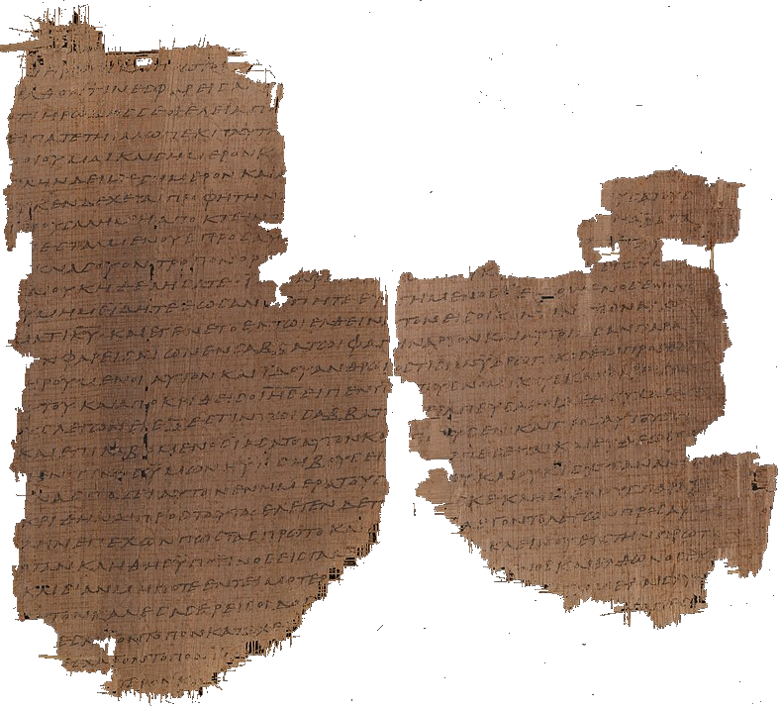
Earliest ‘witnesses’ to Luke’s Gospel
Papyrus 𝔓4 2nd century. Luke 1:58-59; 1:62-2:1; 2:6-7; 3:8-4:2; 4:29-32, 34-35; 5:3-8; 5:30-6:16.
Possibly from 𝔓64+67. Agreement with 𝔓75 in 93% of variants.

Slide 19
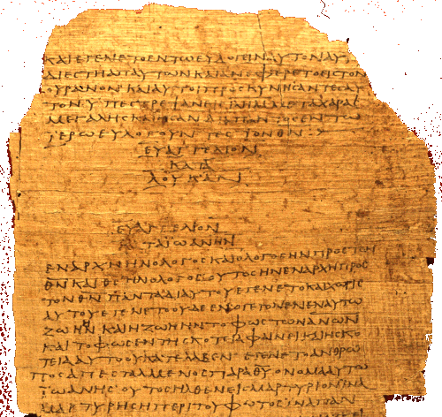
Earliest ‘witnesses’ to Luke’s Gospel
Papyrus 𝔓75
2/3rd century.
Luke 3:18–24:53.
Agreement with Codex B Vaticanus in 93% of variants.

Slide 20
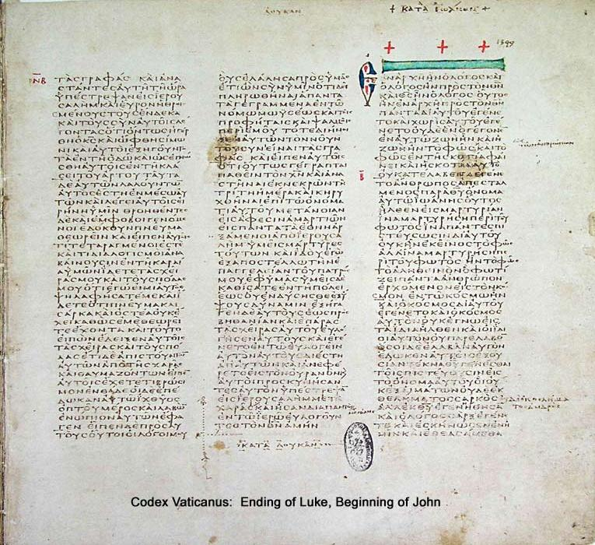
Earliest ‘witnesses’ to Luke’s Gospel
Greek Codex א‎ [Aleph] Sinaiticus or 01.
4th century CE.
Written in uncial letters on parchment.
Includes Epistle of Barnabas and the Shepherd of Hermas.

Slide 21
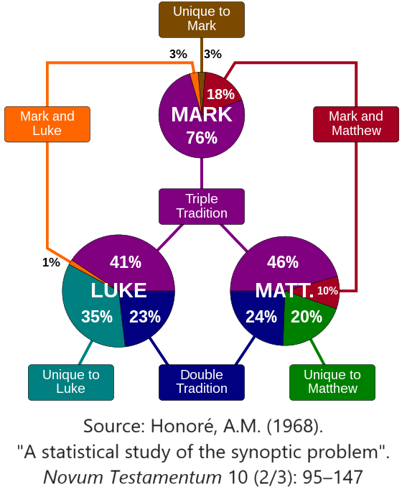
Luke, a ‘synoptic’ gospel
Scholars debate
● Priority
● Dependence
● Written sources
● Oral sources
● Translation
● Redaction

Slide 22
Origin of Luke’s Gospel
Conservative view
● Composed between
59 and 63 CE.
● Author: Luke, Paul’s missionary companion.
● Widely known and copied by 2nd century.
Liberal view
● Composed between 80 and 110 CE.
● Author: Unknown, contradicts Paul.
● Still being revised in 2nd century.

Slide 23
Origin of Luke’s Gospel
¹¹ Only Luke is with me. Get Mark and bring him with you, because he is helpful to me in my ministry. ¹² I sent Tychicus to Ephesus. ¹³ When you come, bring the cloak that I left with Carpus at Troas, and my scrolls, especially the parchments. 2 Tim. 4
Luke was either a literate Gentile or a Hellenized Jew, maybe a physician.

Slide 24
Theology of Luke’s Gospel
‘Salvation History’
● The Law, the Prophets and the Psalms.
● The Kingdom of God came with John and Jesus.
● The Holy Spirit abides in believing communities.
● We await Jesus’ return as ‘the Son of Man’.
‘Personal salvation’
● Repent of disbelief and of disobedience.
● Alive with Jesus when our body dies.
● Hope of resurrection and Jesus’ reign as King.

Slide 25
Structure of Luke’s Gospel
1 Preface: Sponsor, method and purpose.
2 Birth narratives: Dawn of the promised new era.
3 John’s mission: Introduce the Messiah.
4 Jesus’ mission: Resist temptation and hostility.
5 Journey: Messianic signs and teaching.
6 Jerusalem: Confront Israelite and Roman rulers.
7 Crucifixion: Last supper, arrest, trials, death.
8 Resurrection: Alive, appearance, and proofs.
9 Ascension: Gives Holy Spirit, mission to nations.

Slide 26
In this course, we shall seek …
● To believe Jesus’ teaching
● To claim Jesus’ promises
● To obey Jesus’ commands
● To defend Jesus’ deity
● To hope for Jesus’ return
● To experience Jesus’ power
● To proclaim Jesus’ Good News

