Slide 1
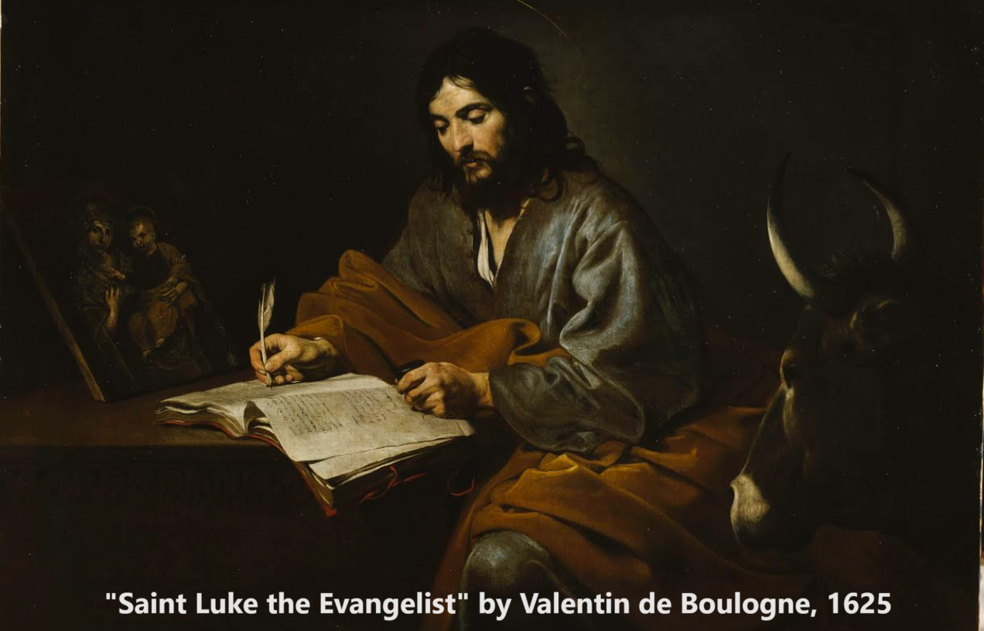
The Gospel of Luke
Origin and Introduction
September 2023

Slide 2

Learning objectives
● Define: Gospel
● Identify: Luke
● Introduce: Gospel of Luke
● Defend: Luke’s place in our ‘canon’
● Suggest: Luke’s themes
● Set: Some study goals

Slide 3
Luke’s prologue (introduction)
Acts 1 ¹ Many have undertaken to draw up an account of the things that have been fulfilled among us, …
● Many: other ‘gospels’ or ‘sayings’ were circulating. See luke.currah.download
Session 1, “Early Christian Gospels”
● ‘the things’: Foretold and fulfilled

Slide 4
Luke’s prologue (introduction)
Acts 1 ² just as they were handed down to us by those who from the first were eyewitnesses and servants of the word.
● Eyewitnesses: Jesus’ disciples.
● Servants: Jesus’ apostles.
● Word: not from angels, dreams, myths or imagination.

Slide 5
Luke’s prologue (introduction)
Acts 1 ³ With this in mind, since I myself have carefully investigated everything from the beginning, …
● Investigated: Visited Judea.
● Everything: See Acts 1:1-3.
● Beginning: Interviewed witnesses? John’s and Jesus’ birth narratives?

Slide 6
Luke’s prologue (introduction)
Acts 1 ³ I too decided to write an orderly account for you, … ⁴ so that you may know the certainty of the things you have been taught.
● Orderly: Chronology, travels, words and deeds of the historical Jesus.
● Certainty: The best documentary evidence that we possess.

Slide 7
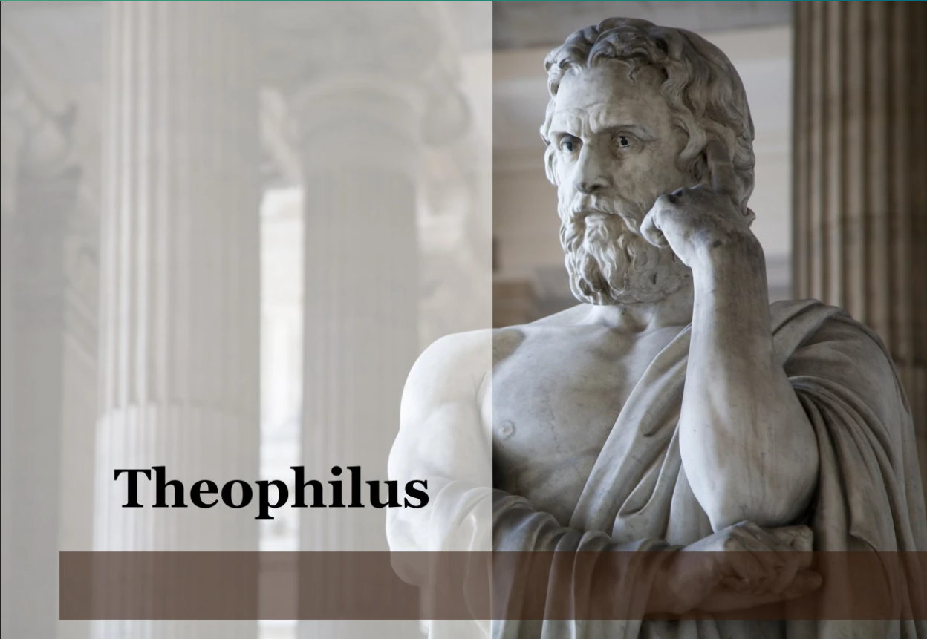
Luke’s epilogue (summary)
Acts 1 ¹ In my former book, Theophilus, I wrote about all that Jesus began to do and to teach …
● All: The Greek term often relates to all kinds of something, thus a wide sample of Jesus’ deeds and ideas.
● Began: “until” (verse 2).

Slide 8
Luke’s epilogue (summary)
Acts 1 ² until the day he was taken up to heaven, after giving instructions through the Holy Spirit to the apostles he had chosen.
● Heaven: (1) Through the physical sky (2) into the invisible realm.
● Holy Spirit: Still present with us.
● Apostles: Delegated authority.

Slide 9
Luke’s epilogue (summary)
³ After his suffering, he presented himself to them and gave many convincing proofs that he was alive. He appeared to them over a period of forty days and spoke about the kingdom of God.
● Suffering: death by crucifixion
● Appeared: resurrection from death
● Proofs: visible, audible, tactile

Slide 10
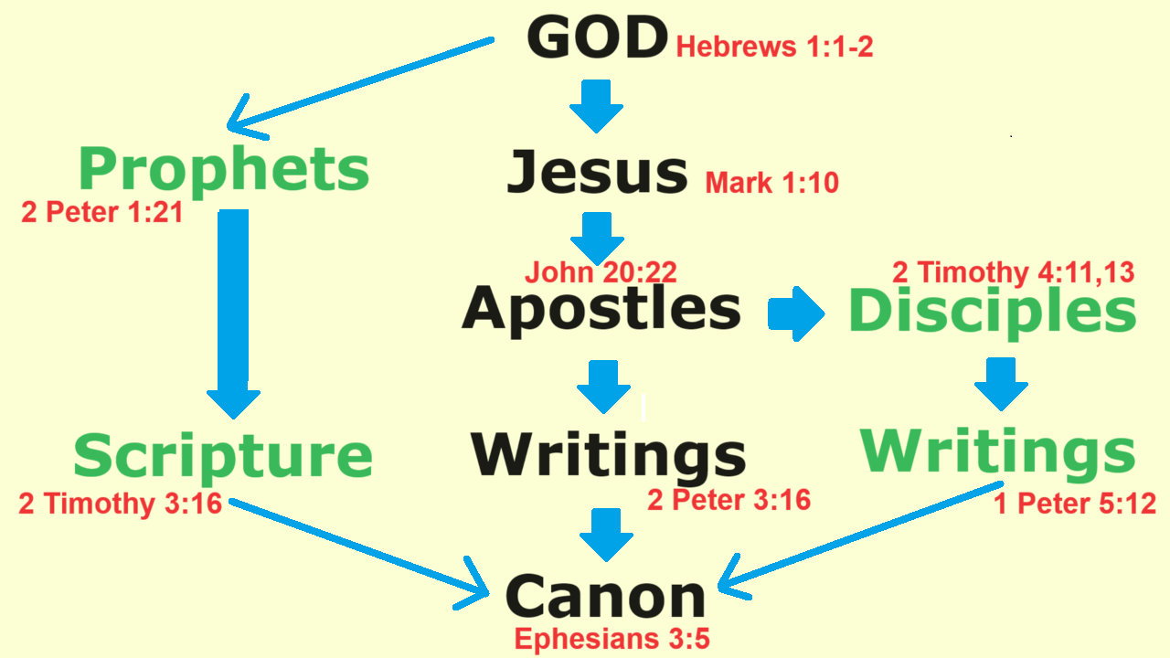

Slide 11
In the past God spoke to our ancestors through the prophets at many times and in various ways, but in these last days he has spoken to us by his Son. Hebrews 1:1-2

Slide 12
Prophecy never had its origin in the human will, but prophets, though human, spoke from God as they were carried along by the Holy Spirit. 2 Peter 1:21

Slide 13
All Scripture is God-breathed and is useful for teaching, rebuking, correcting and training in righteousness. 2 Timothy 3:16

Slide 14
Jesus … saw heaven being torn open and the Spirit descending on him like a dove. And a voice came from heaven: “You are my Son!” Mark 1:10-11

Slide 15
Jesus said, “Peace be with you! As the Father has sent me, I am sending you.” And with that he breathed on them and said, “Receive the Holy Spirit!”
John 20:21-22

Slide 16
Our Lord’s patience means salvation, just as our
dear brother Paul also wrote you with the wisdom
that God gave him. 2 Peter 3:15

Slide 17
Luke is with me. Get Mark and bring him with you… When you come, bring … my scrolls, especially
the parchments. 2 Timothy 4:11-13

Slide 18
With the help of Silas, whom I regard as a faithful brother, I have written to you briefly, … testifying that this is the true grace of God. 1 Peter 5:12

Slide 19
You will be able to understand my insight into
the mystery of Christ … as it has now been revealed by the Spirit to God’s holy apostles and prophets. Ephesians 3:4-5

Slide 20
What are ‘gospels’?
Historical biographies that:
● Preserve truth (scripture)
● Inform seekers (evangelism)
● Teach newcomers (catechism)
● Train disciples (life style)
● Defend beliefs (apologetics)
● Build communities (theology)

Slide 21
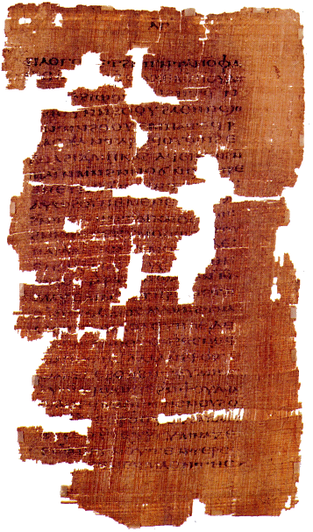
Sample 1st & 2nd century gospels
● Egerton papyrus: Miracles and sayings of Jesus, some extra-canonical.
● Ebionite Gospel: Denies the virginal conception of Jesus.
● Shepherd of Hermas: Visions & commands supposedly given by Jesus.
● Gospel of Judas: Written in Coptic translated from Greek, teaching Gnostic doctrines.
Read or download
“Early Christian Gospels” (4 pages)
at Luke.Currah.Download

Slide 22
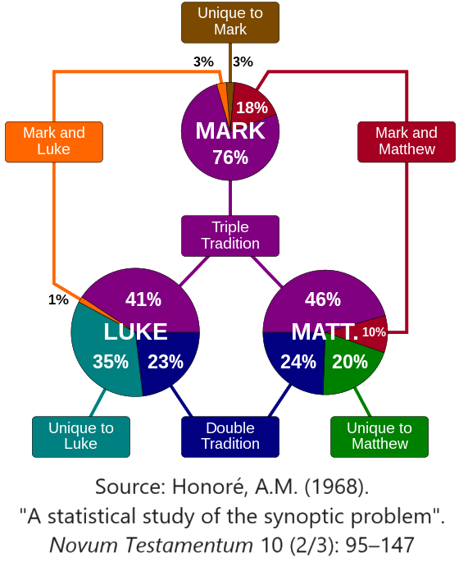
Luke, a ‘synoptic’ gospel
Scholars debate
● Priority
● Dependence
● Written sources
● Oral sources
● Translation
● Redaction

Slide 23
Who was Luke?
● Paul’s companion (Col 4:14; Phlm 24)
● Gentile believer (Col 4:10-11)
● Trained physician (Col 4:14)
● Author of the Acts (Acts 1:1-2)
● Itinerate church planter (Acts 20:6)
● Author of a Gospel? (2 Tim 4:11-13)

Slide 24
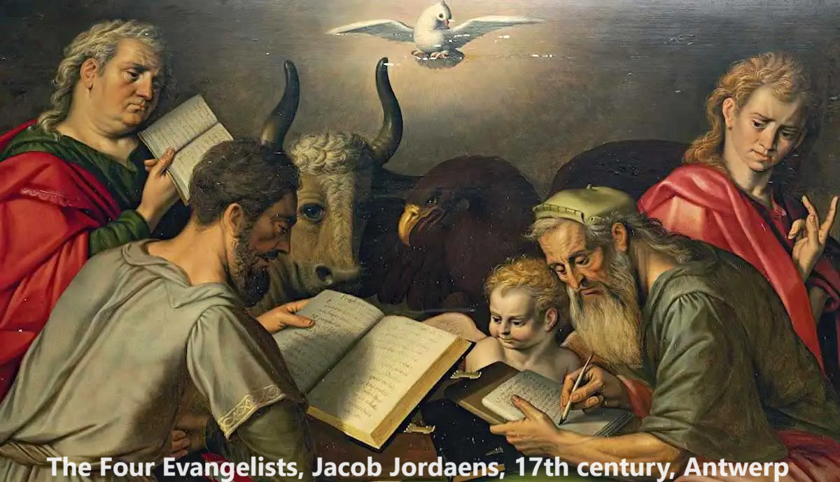
Who wrote Luke’s gospel?
2 Tim 4 ¹¹ Only Luke is with me. Get Mark and bring him with you, because he is helpful to me in my ministry.
¹² I sent Tychicus to Ephesus. ¹³ When you come, bring the cloak that I left with Carpus at Troas, and my scrolls, especially the parchments.

Slide 25
When was Luke’s Gospel written?
● Gospel of Luke was widely known and quoted early in the 2nd century.
● It was written before “the Acts,” which tracks Paul’s mission until his imprisonment in Rome in 64 CE.
● Therefore, it was likely written sometime before 70 CE.

Slide 26
Origin of Luke’s Gospel
Conservative view
● Composed between
59 and 63 CE.
● Author: Luke, Paul’s missionary companion.
● Widely known and copied by 2nd century.
Liberal view
● Composed between 80 and 110 CE.
● Author: Unknown, contradicts Paul.
● Still being revised in 2nd century.

Slide 27
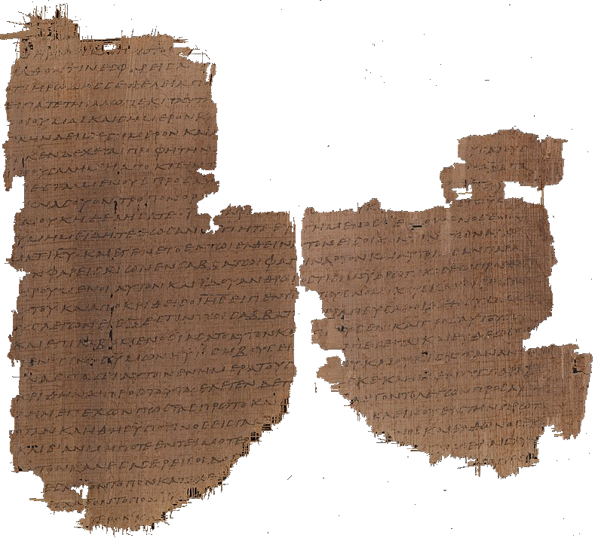
Earliest ‘witnesses’ to Luke’s Gospel
Papyrus 𝔓4 2nd century. Luke 1:58-59; 1:62-2:1; 2:6-7; 3:8-4:2; 4:29-32,
34-35; 5:3-8; 5:30-6:16.
Possibly from 𝔓64+67. 93% Agreement with 𝔓75.

Slide 28
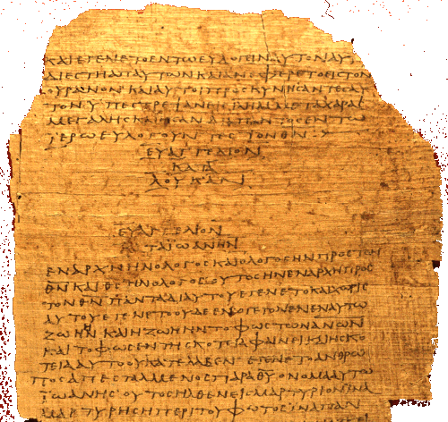
Earliest ‘witnesses’ to Luke’s Gospel
Papyrus 𝔓75
2/3rd century.
Luke 3:18–24:53.
94% agreement with 4th century Codex B Vaticanus.

Slide 29
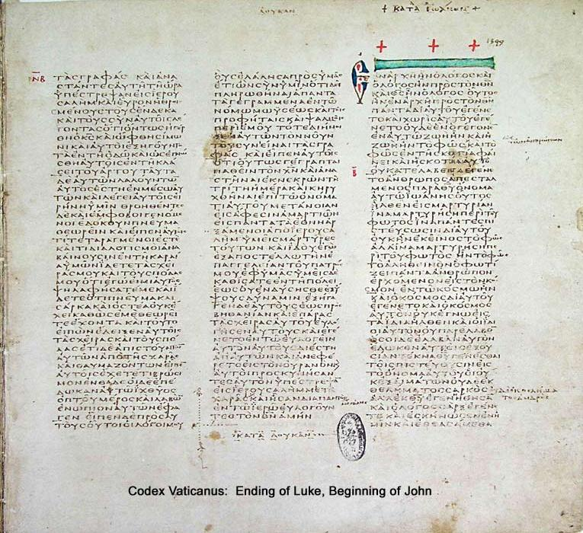
Earliest ‘witnesses’ to Luke’s Gospel
Greek Codex א‎ [Aleph] Sinaiticus or 01.
4th century CE.
Written in uncial letters on parchment.

Slide 30
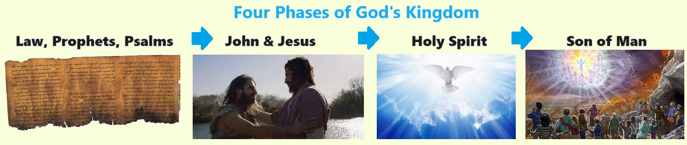
Theology of Luke’s Gospel
‘Salvation History’
● The Law, the Prophets and the Psalms.
● The Kingdom of God came with John and Jesus.
● The Holy Spirit abides in believing communities.
● We await Jesus’ return as ‘the Son of Man’.
‘Personal salvation’
● Repent of disbelief and of disobedience.
● Alive with Jesus when our body dies.
● Hope of resurrection and Jesus’ reign as King.

Slide 31
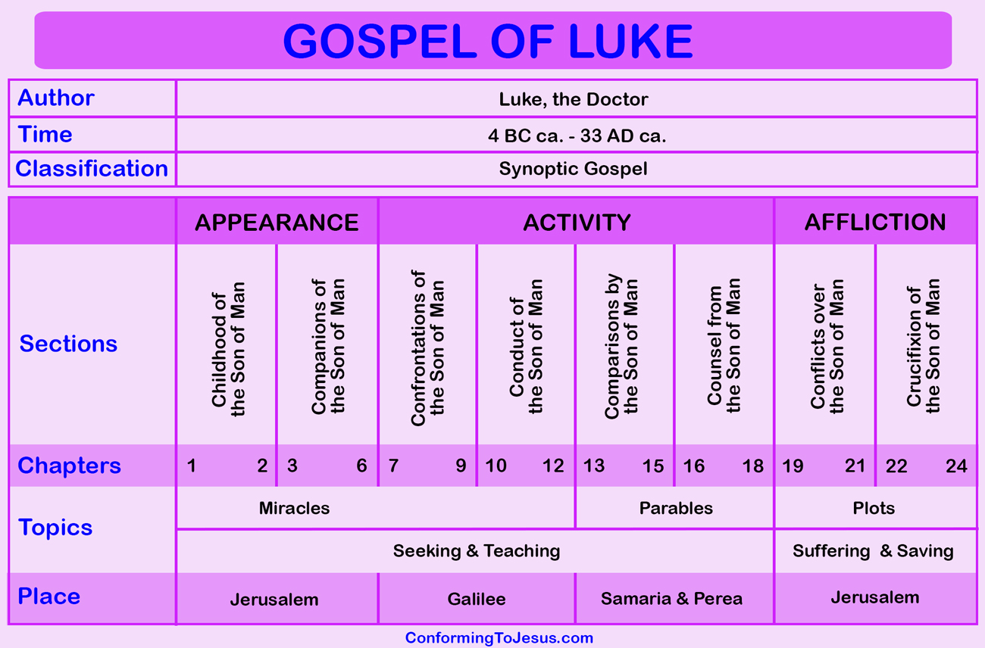
Structure of Luke’s Gospel
1 Preface: Sponsor, method and purpose.
2 Birth narratives: Dawn of the promised new era.
3 John’s mission: Introduce the Messiah.
4 Jesus’ mission: Resist temptation and hostility.
5 Journey: Messianic signs and teaching. Luke 9:51
6 Jerusalem: Confront Israelite and Roman rulers.
7 Crucifixion: Last supper, arrest, trials, death.
8 Resurrection: Alive, appearance, and proofs.
9 Ascension: Gives Holy Spirit, mission to nations.

Slide 32
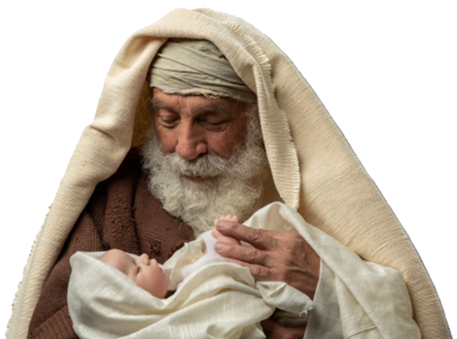
Luke’s inclusivism
1. Angel: “to people of good will.” 2:14
2. Simeon: “a light … to Gentiles.” 2:32
3. Isaiah: “all flesh shall see.” 3:6
4. Samaritans portrayed as good. 10:33
5. Story: the widow of Zaraphath. 4:26
6. “Compel them to come in.” 14:23
7. Commission to ‘all nations’. 24:47
Donald Gutherie

Slide 33
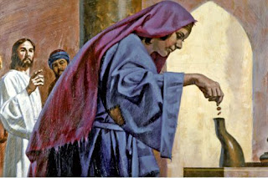
Luke’s humanism
1. Jesus’ interaction with individuals.
2. Jesus’ interest in outcasts.
3. Luke’s portrayal of 13 women.
4. Luke’s interest in children.
5. Jesus’ social relations.
6. Jesus’ warnings to the rich.
7. Jesus’ hope for the poor.
Donald Gutherie

Slide 34
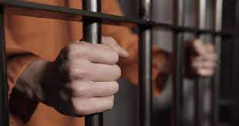
In this course, we shall seek …
● To believe Jesus’ teaching
● To claim Jesus’ promises
● To obey Jesus’ commands
● To defend Jesus’ deity
● To experience Jesus’ power
● To proclaim Jesus’ Good News
● To hope for Jesus’ return

Slide 35
Assignment
VISIT LUKE.CURRAH.DOWNLOAD
● View Bible Project videos (8 min)
● View videos overviews on ‘canon’.
● Read Luke chapter 1 in different translations on separate days.
● Read the notes in a study Bible.
● Consult a Bible dictionary.
● Compile queries and comments.

