Slide 1
Genesis 32: 9-12
I am unworthy of all your “gifts”
  I crossed north with a staff
  I’m crossing south with two camps! (Mahanaim)
Deliver me from my brother’s hand
  I fear Esau
Yet, you are the God Who promised me
  Health, wealth, and innumerable descendants

Slide 2
Genesis 32: 13-21
Jacob remains in place and refines his plan
  Builds his “present” for Esau
    Term is used for gifts given; lesser to greater
Five separate groups
  550+ animals – A staggering tribute payment
He staggers the departures
  Hopes to overwhelm Esau with constant flow

Slide 3
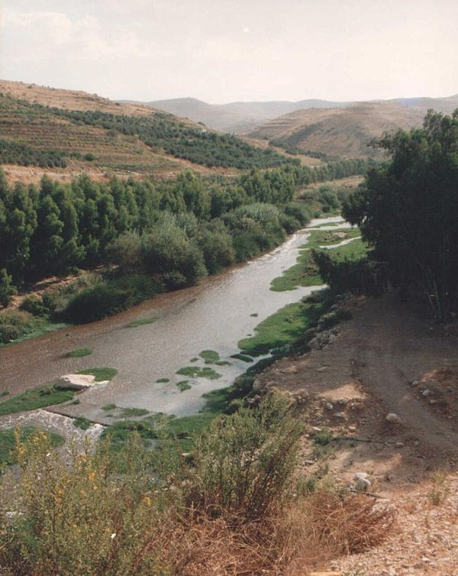
Genesis 32: 21-24
The message sent with each group is identical
  These are appeasement gifts
  To atone for all prior grievances
Jacob remains “above” the Jabbok
  Once darkness falls, he moves slightly
    Diplomacy is good
    Prudence is better

Slide 4
Genesis 32: 21-24
He sends his family across, but remains
  When alone, a “man” comes and wrestles
Until now, Jacob has survived on strength
  Strength of body
  Strength of his wits
All night, they are equally matched

Slide 5
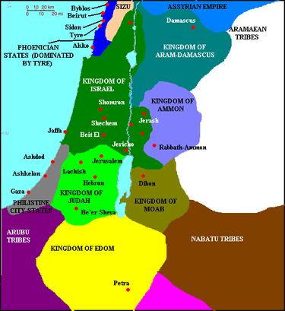

Slide 6
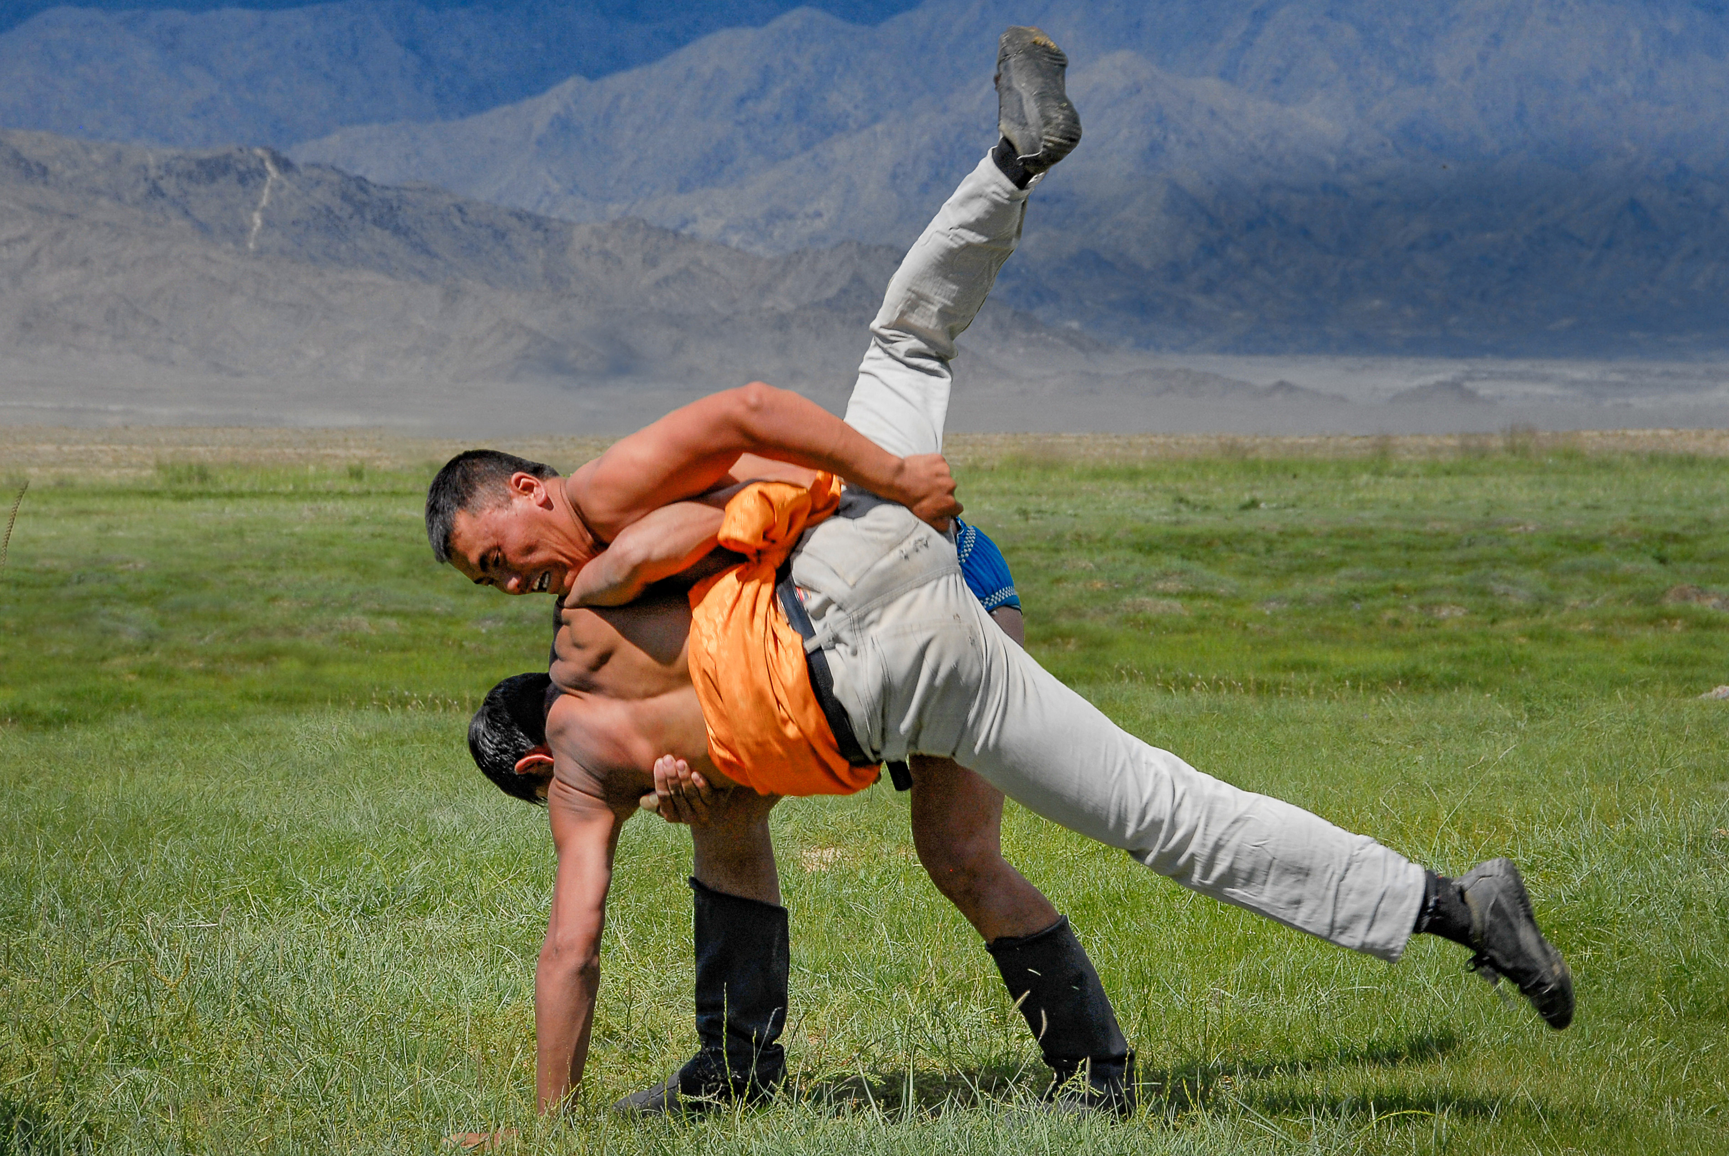
Genesis 32: 22-32
As dawn breaks, the “Man” breaks Jacob
  A single touch dislocates Jacob’s hip
The lesson? Your ‘strength’ is pretty good
  My STRENGTH is infinite
  You are insignificant in this light
Jacob holds on – One more blessing?

Slide 7
Genesis 32: 22-32
A curious lesson in persistent “prayer”
  Jacob ‘struggled’ all night
  This was a physical form of prayer
    He wrestled God for answers
Even under defeat, he held for another blessing
  Finally, understanding dawns re: SOURCE of all

Slide 8
Genesis 32: 22-32
God asks Jacob for his name
  Didn’t He already know?
  Of course He did – this was to make a point
  Jacob – Grasper, deceiver
No longer – You are now Israel – Prince of God
  You have striven with God and men and prevailed
  A ‘prince’ is NOT the king, but the SON of the king

Slide 9
Genesis 32: 22-32
God places Israel fully into his new identity and role into the future
Jacob asks after “The Name”
  Culturally significant to the day/times
  Knowing the “true name” was to hold power
  Common belief – Use the “true name” = the power of the god must be granted
  Many cultures still hold this belief
  Culturally and religiously

Slide 10
Genesis 32: 22-32
Jesus often demanded the names of spirits
  It was part of the authority to command
  He then exercised explicit authority to exorcise
“God” asks Jacob – Why would you know this?
  Even so, He blesses him
A commemorative name – Peni-El (Penu-El)
  “Face of God”
  I have been face-to-face with God, yet delivered

Slide 11
Genesis 32: 22-32
Dawn rises as Jacob crosses the Jabbok
  Literal – it gets lighter as day begins
  Spiritual – Israel – has learned his new “place”
  A passing reference is made to a dietary change
    ONLY reference found in Scripture
    Not to eat the sciatic tendon – the hip muscle
    All other references come from Rabbinic literature

Slide 12

Genesis 33:1-7
The Grand Reunion
  The sun rises onto a portentous meeting
Jacob looks up and sees
  Esau and his 400 men
  Gulp – Time to redeploy
Newly changed relationship with God
Still unsure if it will protect him from Esau

Slide 13
Genesis 33:1-7
Jacob remains “Jacob” for a bit longer
  He splits his family by preference
  The concubines and their children
  Leah and her children
  Rachel and Joseph
Jacob then crosses to Esau ALONE
  If Esau intends revenge, let it fall to him, only

Slide 14
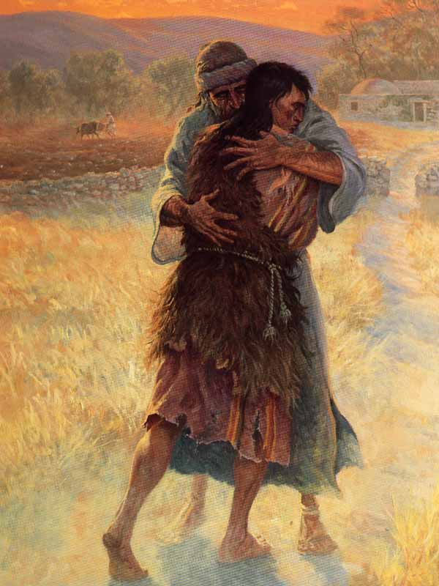
Genesis 33:1-7
Jacob bows seven times as he nears Esau
  This is the proper protocol when before your “Lord”
Esau didn’t “play along” – He ran to embrace him
The women and children come next
  Again, formal suzerain/vassel roles displayed – bowing
Esau questions the whole prior procession
  What’s with all the critters and servants?

Slide 15
Genesis 33:8-11
Jacob’s answer is revealing
  To find favor in the sight of my lord
  Again – the practice of meeting a sovereign
Jacob identifies to Esau
  Your servant
  My lord
  Abundance of gifts (tribute)

Slide 16
Genesis 33:8-11
Interaction is a full and formal negotiation of reconciliation
  Seven bows
  Terms of submission – servant, lord, gifts
  Sequence of introductions
    Petitioner, subordinates, women and children
  Jacob remains the humble supplicant

Slide 17
Genesis 33:8-11
Esau responds as is proper
  No, no, I have plenty – Keep your things
Jacob plays his part
  Of course not! Please, accept it all
  My blessing to you, as God has blessed me
Esau “relents” and accepts the “tribute”
All formalities have been properly handled

Slide 18
Genesis 33:8-11
Jacob has correctly submitted to his brother
  The gifts to “replace” the stolen birthright
  Restored the “honors” due the firstborn
    Your servant, bowing, granting Esau lordship title
  All the wealth of the animals
    To replace the stolen “Blessing”
By accepting, Esau has granted pardon
  Relationship is “restored”

Slide 19
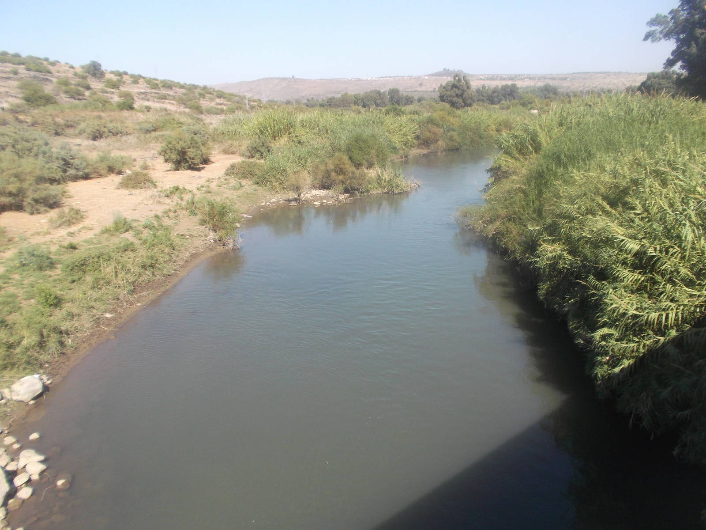
Genesis 33:12-17
Esau suggests proceeding together
  Hints at Jacob becoming his vassel
  Not merely de jure, but de facto ??? 😳🥺
Jacob replies carefully, but unequivocally
  That won’t happen!
  Phrases it all about the livestock and younglings
  Your pace cannot be ours

Slide 20
Genesis 33:12-17
Great diplomacy maintains the agreement
  We are reconciled, but not foolish
Esau – Shall I leave some “help”
Jacob – Thanks, but we’re all good
Esau heads home to Seir
  East of the Jordan
SE of the Dead Sea

Slide 21
Genesis 33:12-17
Jacob returns north of the Jabbok
  Stays, temporarily, east of the Jordan
He builds a “house” and animal shelters
The shelters (booths) name the area
  Succoth – Booths/Shelters
Shelter for Jacob and all after two fraught encounters with family

Slide 22
Genesis 33:18-20
Jacob moves on after the interlude
He crosses the Jordan
  Thus, re-entering the PROMISED land
Pitches his tent
Buys some land
Builds an altar
El Elohe Israel – God, the God of Israel

