Slide 1
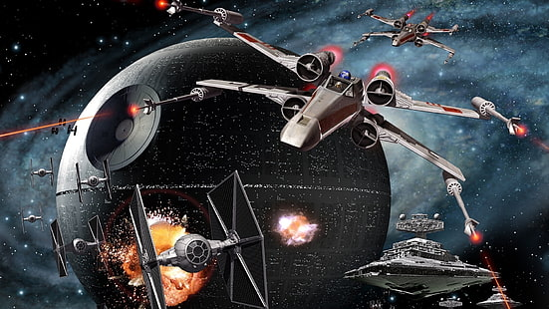
HAPPY THTAR WARTH DAY!
May the fourth be with you

Slide 2

Genesis 26:1-5
Another famine
  Isaac moves a bit NW toward the coast
  Back into the territory of Abimelech
  Follows his father’s pattern
Tri-partite Blessing reiterated
  I will be with you
  Land and manifold blessings
  All nations blessed through your seed (descendants)

Slide 3
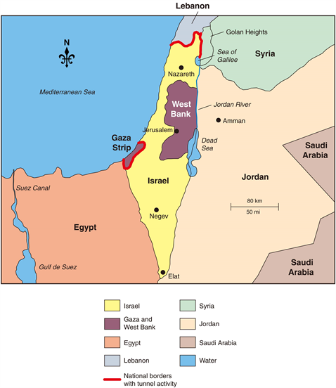

Slide 4
Genesis 26:1-5
PROMISE includes a reminder
  Obey as your father
  Keep the faith
  Keep my commands
  Keep the “charge”
    The line of the PROMISE shall remain faithful

Slide 5
Genesis 26:6-11
Amazing parallel with Abraham
  Locals inquire about the “beautiful woman”
  SAME sister ploy – Not wife, but sister
The deceit is discovered and challenged
  Again, FEAR created the lie
Abimelech lays down the law
  Keep away from this pair on pain of death

Slide 6
Genesis 26:12-32
God blesses Isaac, abundantly
  Increase creates envy in the Philistines
  An aside tells us they had already negated their non-aggression pact from Abraham
  All Abraham’s wells filled in
Abimelech – Leave you are too mighty
  So, Isaac left that territory

Slide 7
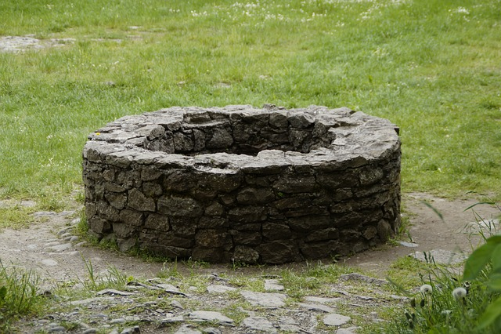
Genesis 26:12-32
Isaac moves to former childhood area
  Reopens all his father’s wells
  Honors all the ‘old’ names’
  Discovers a new artesian well
  Creates a quarrel with the locals
  Names the well, Esek – quarrel

Slide 8
Genesis 26:12-32
Isaac moves again, a little further
  Another artesian spring opened
  Another conflict from the neighbors
  Another new name – Sitnah
    Hebrew root for Satan, as well
Isaac moves … again
  He is attempting to prevent war by moving

Slide 9
Genesis 26:12-32
Isaac moves again, a little further
  Another artesian spring opened
This time, nobody argues
  New name – Rehoboth – Spaciousness
  Plenty of room for everyone
Now, we shall be fruitful in the land
EVERY move guided by God’s Spirit

Slide 10
Genesis 26:12-32
Now, to Beersheba
God appears to him that night
  PROMISE reiterated
  I am the God of your father
  I am with you
  I will bless you
  I will multiply you – for Abraham’s sake

Slide 11
Genesis 26:12-32
Isaac worships God
Abimelech and crew show up
  Isaac – Why on earth are YOU here?
  You hate me
We aren’t blind – GOD is with you
  Therefore, we want a treaty

Slide 12
Genesis 26:12-32
Isaac throws a party – Well, a feast
  Celebrates the pending peace treaty
The next morning, oaths are given
  Everything now returns to “normal”
Another “new” well – reopened well
  Isaac names this one “Shibah”
    A restatement of the original “Well of Seven/Oaths

Slide 13
Genesis 26:12-32
God reaffirms the PROMISE
  Structure of this treaty matches that of Abraham
This shows the continuity of the LINE
  The PROMISE now continues with Isaac
Esau takes TWO local wives
  Embitters BOTH parents

Slide 14
Genesis 27
Currents of dysfunction
Full family fracture fulminating
  Esau already “sold” his birthright
  Jacob ran the “scam” to get those rights
  Esau – favorite of Isaac
  Jacob – favorite of Rebekah

Slide 15
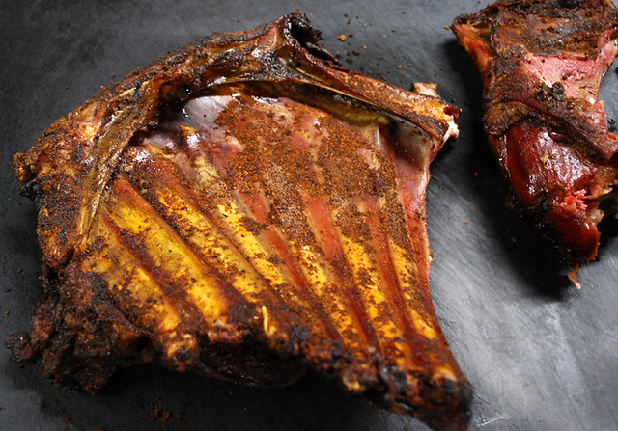
Genesis 27:1-17
Machiavellian Moves
  Esau – Commissioned by Isaac to “earn” blessing
  Jacob – Rebekah plots for Jacob, instead
Elaborate scheme centered on deception
  Food + Fur + Finery = Fooled
Ensuing mess has permanent fall-out

Slide 16
Genesis 27:18-29
Manipulation succeeds
  Isaac is fooled by this ruse
  Eats of Jacob’s (Rebekah’s) gift
Blesses Jacob
  Dew of Heaven
  Fatness of Earth
  Brethren to be subservient – ANY more in line
  Curses for ‘cursers’ – Blessings for ‘blessers’

Slide 17
Genesis 27:30-40
Jacob – Exit stage right
Esau – Enter stage left
Father, arise and eat
  Who are YOU?!
  Your son, your firstborn son
  Wait! Who was just here?!

Slide 18
Genesis 27:30-40
Full realization sets in
  I ate and blessed the first one here
  Indeed, he SHALL be blessed
Bitterness roots, deeply
  What about ME?!
  Demonstrates continuing focus on SELF
Brother deceived – Just as he was named

Slide 19
Genesis 27:30-40
Underhanded, but Jacob “won”
  Shows Isaac’s wish to avoid God’s PLAN
  Isaac clearly intended Esau as his heir
  God sovereignly blocked that move
Esau’s portion
  He begs for ANYTHING he can get
  Isaac gives a prophetic “blessing”

Slide 20
Genesis 27:30-40
Esau’s “blessing”
  Live “from” (away from) fatness of the land
  Live “from” (away from) the dew
  Live by the sword
  Serve your brother
  Eventually you will ‘throw’ his yoke from you

Slide 21
Genesis 27:41-46
Esau swears murder
  AFTER his father dies, of course
Rebekah hears of this oath
  Sends Jacob north – to her brother’s family
  Stay there until Esau “calms down”
  I will send for you
Rebekah tells Isaac of her despair about a wife for Jacob

Slide 22
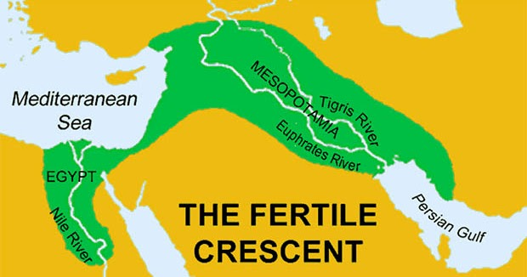
Genesis 28:1-5
Rebekah’s heart-sickness alerts Isaac
  Summons Jacob and formally charges him with a duty
  Do not take a local wife
  Go to Paddan Aram, your uncle’s family
  Marry a cousin – What?!
    Still an acceptable practice

Slide 23
Genesis 28:1-5
Isaac finally “buys in” to God’s PLAN
  Restates the Tri-partite blessing over Jacob
God Almighty bless you
Fruitful and multiply
Blessing of Abraham to offspring (all nations)
Possess the LAND as PROMISED

Slide 25
Principles
God is SOVEREIGN
HIS plans WILL happen
Our plans MUST align with HIS

Slide 26
Points
Are we OPEN to HIS plans?
Do we TRUST HIS plans?
How do we demonstrate our TRUST in HIS plans?

