Slide 1
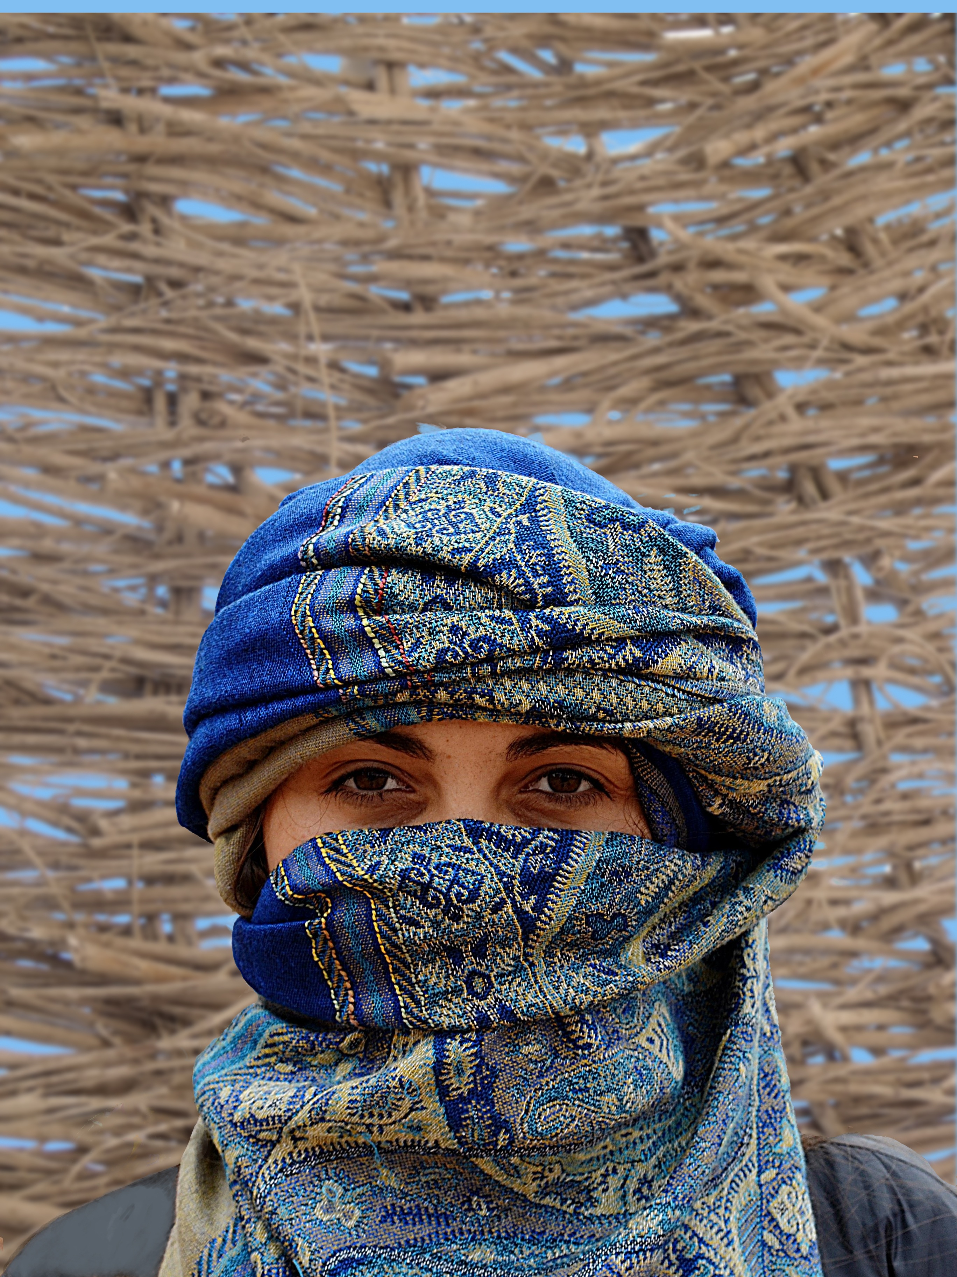
Genesis 34:A new “Chapter”
The Jacob Chronicles continue
  “Dynasty”, “Desperate Housewives”, Now …
  The Dinah (not Shore) Show
As the family settles, Dinah goes out to meet the women of the area
Then … Gen. 2:6 and 6:2 replayed

Slide 2
Genesis 34:1-4
The local prince, Shechem, sees Dinah
  Sees, Takes, Rapes
  Language is clear – A forcible rape
  Matches Eve’s sin; Saw, desired, took
  The same as the “sons of God” Saw/Took
    The daughters of men

Slide 3
Genesis 34:5-12
Shechem, completely smitten
  Dad, I MUST have this woman as wife
  Ugly start, yet wants to “do right”
Jacob hears of this event
  Angry, holds his peace
  His sons return

Slide 4
Genesis 34:5-12
Hamor, Shechem’s dad comes to Jacob
  Jacob’s sons? NOPE! Not having this
  Indignant and very angry
Hamor – My son is “Struck” to the soul
  Please, give her as a wife to him
  We will return all the same privileges

Slide 5
Genesis 34:5-12
Hamor offers a “good deal”
  Peace, prosperity, and “Dwell” together
  Son pipes in – I will give ANYTHING
    No price too high to have her as my wife
  Both men offer “great things”
At the cost of completely absorbing Jacob/Israel

Slide 6
Genesis 34:13-24
Dinah’s brothers emptied the “sign”
  Circumcision, yet NO covenant significance
  Left it as purely cultural
The locals leave to present this to town
  Here is the deal – One little thing, and …
We OWN them!
All their “stuff”, and they become one with us

Slide 7
Genesis 34:13-24
Shechem presses for the agreement
  Apparently, he truly wanted Dinah as wife
  In his own way, attempting to “do right”
The whole city agrees to circumcision
Then – the third day comes
Apparently, the height of “post-op” discomfort

Slide 8
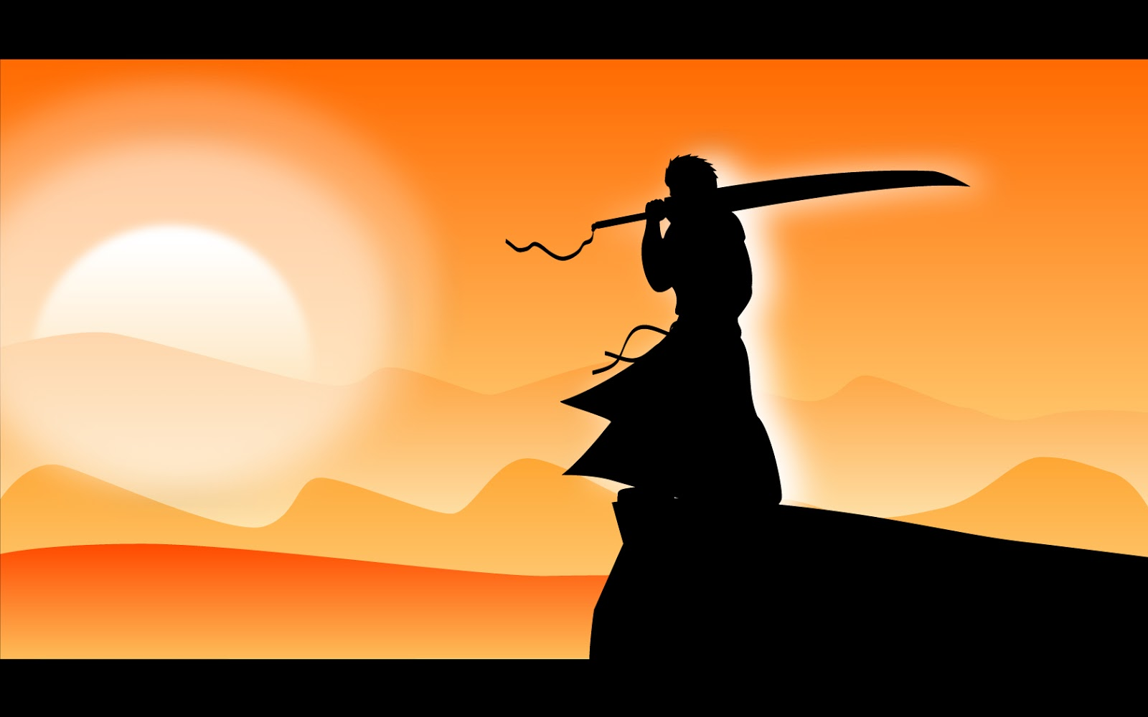
Genesis 34:25-31
Simeon and Levi – Dinah’s brothers
  Fall upon the whole town
  Kill EVERY male
They then plunder and enslave ALL the rest
  Crops, animals, wealth, women and children
Jacob – You boys have brought TROUBLE
  Everyone will now be against me

Slide 9
Genesis 34:25-31
Simeon and Levi answer their father
  What, we were supposed to allow that?!
  Overlook her being treated like a harlot?!
  Unspoken – Over our dead bodies!
  Of course, God has noted all of this
HE will give recompense at HIS timing
God appears to Jacob again.

Slide 10
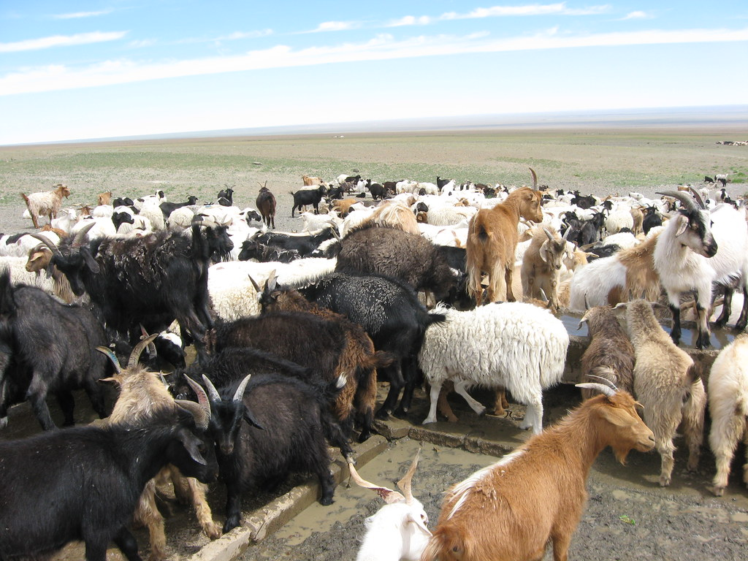
Genesis 35
Jacob is sent back to the beginning
  God tells him, flat out
Go to Beth-El, build an altar, dwell there
  Return to our first meeting place
Jacob “remembers” his ‘commissioning’
Instructs his household
  Remove idols, purify yourselves, change clothes

Slide 11
Genesis 35:1-8
Jacob tells all the new task
We go to Beth-El, to build an altar
  GOD met me there in my distress
  He has been with me ever since
Jacob collects all the “terebim” and earrings
  He hides them away near Shechem
  They leave all that behind (mostly)

Slide 12
Genesis 35:1-8
Great fear falls on all peoples
  God ‘terrifies’ the surrounding people
  They travel unhindered, without pursuit
  They arrive, safely
Jacob builds a new altar – El-Beth-El
  God, the House of God
  Rebekah’s old handmaid dies and is buried (?)

Slide 13
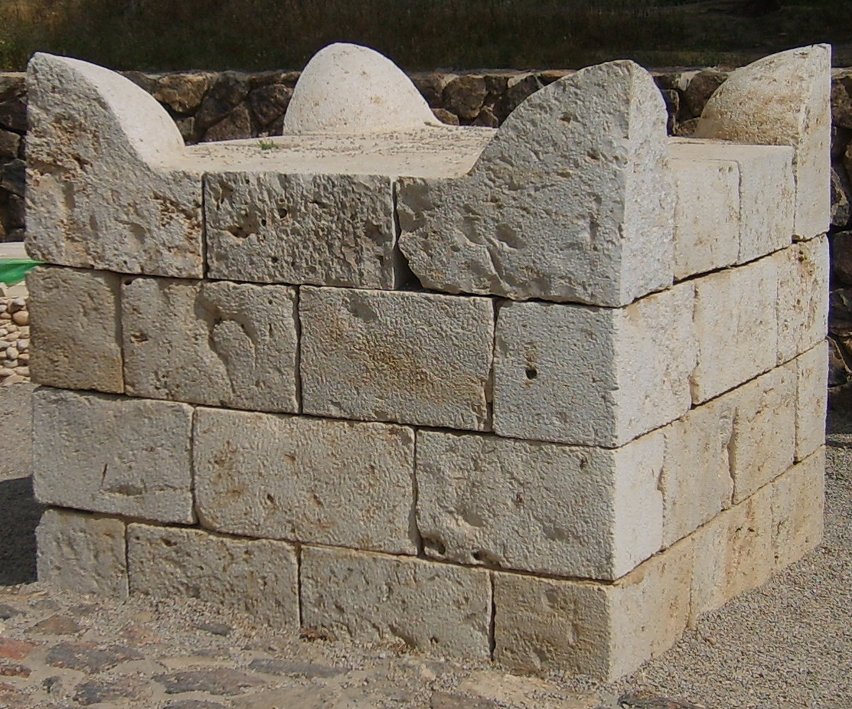
Genesis 35:9-15
Again, God meets with Jacob
  Reminds him of his new name - ISRAEL
Reminds him of ALL His promises
I AM God
  Be fruitful and multiply
  A ‘Nation’, and Nations, will come from you
  Kings will come “out of” you

Slide 14
Genesis 35:9-15
The Land will be given to you
  The land that I gave to Abraham
  The land that I gave to Isaac
  This Land I will give to YOU
  This Land I will give to your descendants
Then, God departed – “Went up” from him
  Jacob grabbed MORE rocks – Anointed a pillar

Slide 15
Genesis 35:16-20
They moved on toward the south
  As they approached Ephrath (Bethlehem)
  Rachel went into labor – HARD labor
  The midwife assures her, she WILL have a son
Rachel delivers … and dies
  With her last breath – Ben-Oni
  Son of my Sorrow (Pain)

Slide 16
Genesis 35:16-20
Jacob prefers his son not remind him
  All the sorrows of his journey
  Of the death of his beloved wife
  Renames the boy – Ben-Jamin
  Son of the South – Son of the Right Hand
  Sublime irony , Benjaminites often left-handed
Rachel buried near Bethlehem - Pillar

