Slide 1
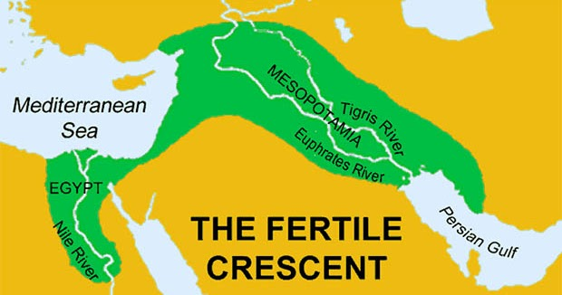
Genesis 28:1-5
Isaac finally “buys in” to God’s PLAN
Restates the Tri-partite blessing over Jacob
God Almighty bless you
Fruitful and multiply
Blessing of Abraham to offspring (all nations)
Possess the LAND as PROMISED

Slide 2
Genesis 28:1-5
Isaac SENDS Jacob north
Isaac had been forbidden such a trip
Jacob is now commanded to go
The chosen family will remain in the chosen LAND
Nothing will be lost
A “proper” wife will be gained
The LINE of PROMISE will endure

Slide 3
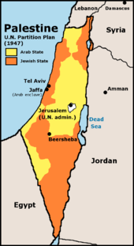
Genesis 28:6-9
Esau looks at the “situation”
Jacob is ordered north
Jacob obeys and is now out of reach
Esau attempts to return to favor
Takes a daughter of Ishmael – “direct line”/family – That should work, right?
Problem: This wife is from outside the LINE
He remains spiritually blind

Slide 4
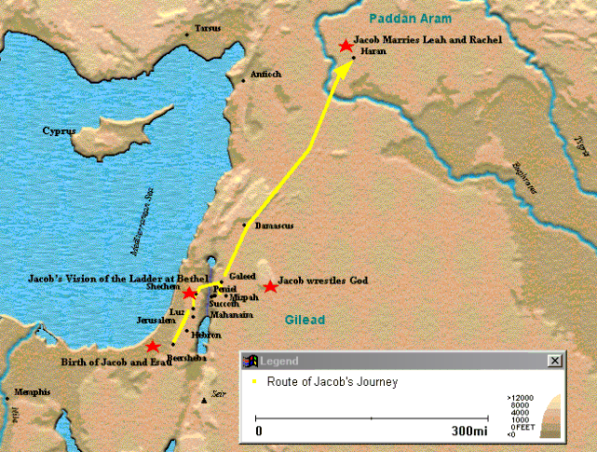
Genesis 28:10-22
Jacob heads north
During an overnight stop
Dreams the “Stairway/Ladder to Heaven”
At the top? The LORD
I AM the God of Abraham and Isaac
A formal ratification of PROMISE follows

Slide 6
Genesis 28:10-22
I will give you the land on which you lie
Descendants as numerous as the dust
They will spread in all directions
Through them, ALL families of earth will be blessed
A restating of the main PROMISE

Slide 7
Genesis 28:10-22
Guarantee given
I will be with you
I will protect you
Anywhere you go
Direct contrast to the gods of area
They were restricted to the local region
I will not leave you until ALL is done

Slide 8
Genesis 28:10-22
Ever the negotiator, Jacob offers God a “deal” 🤣😂🤪
You uphold your end?
I will be “yours”
I will tithe of everything you provide for/to me

Slide 9
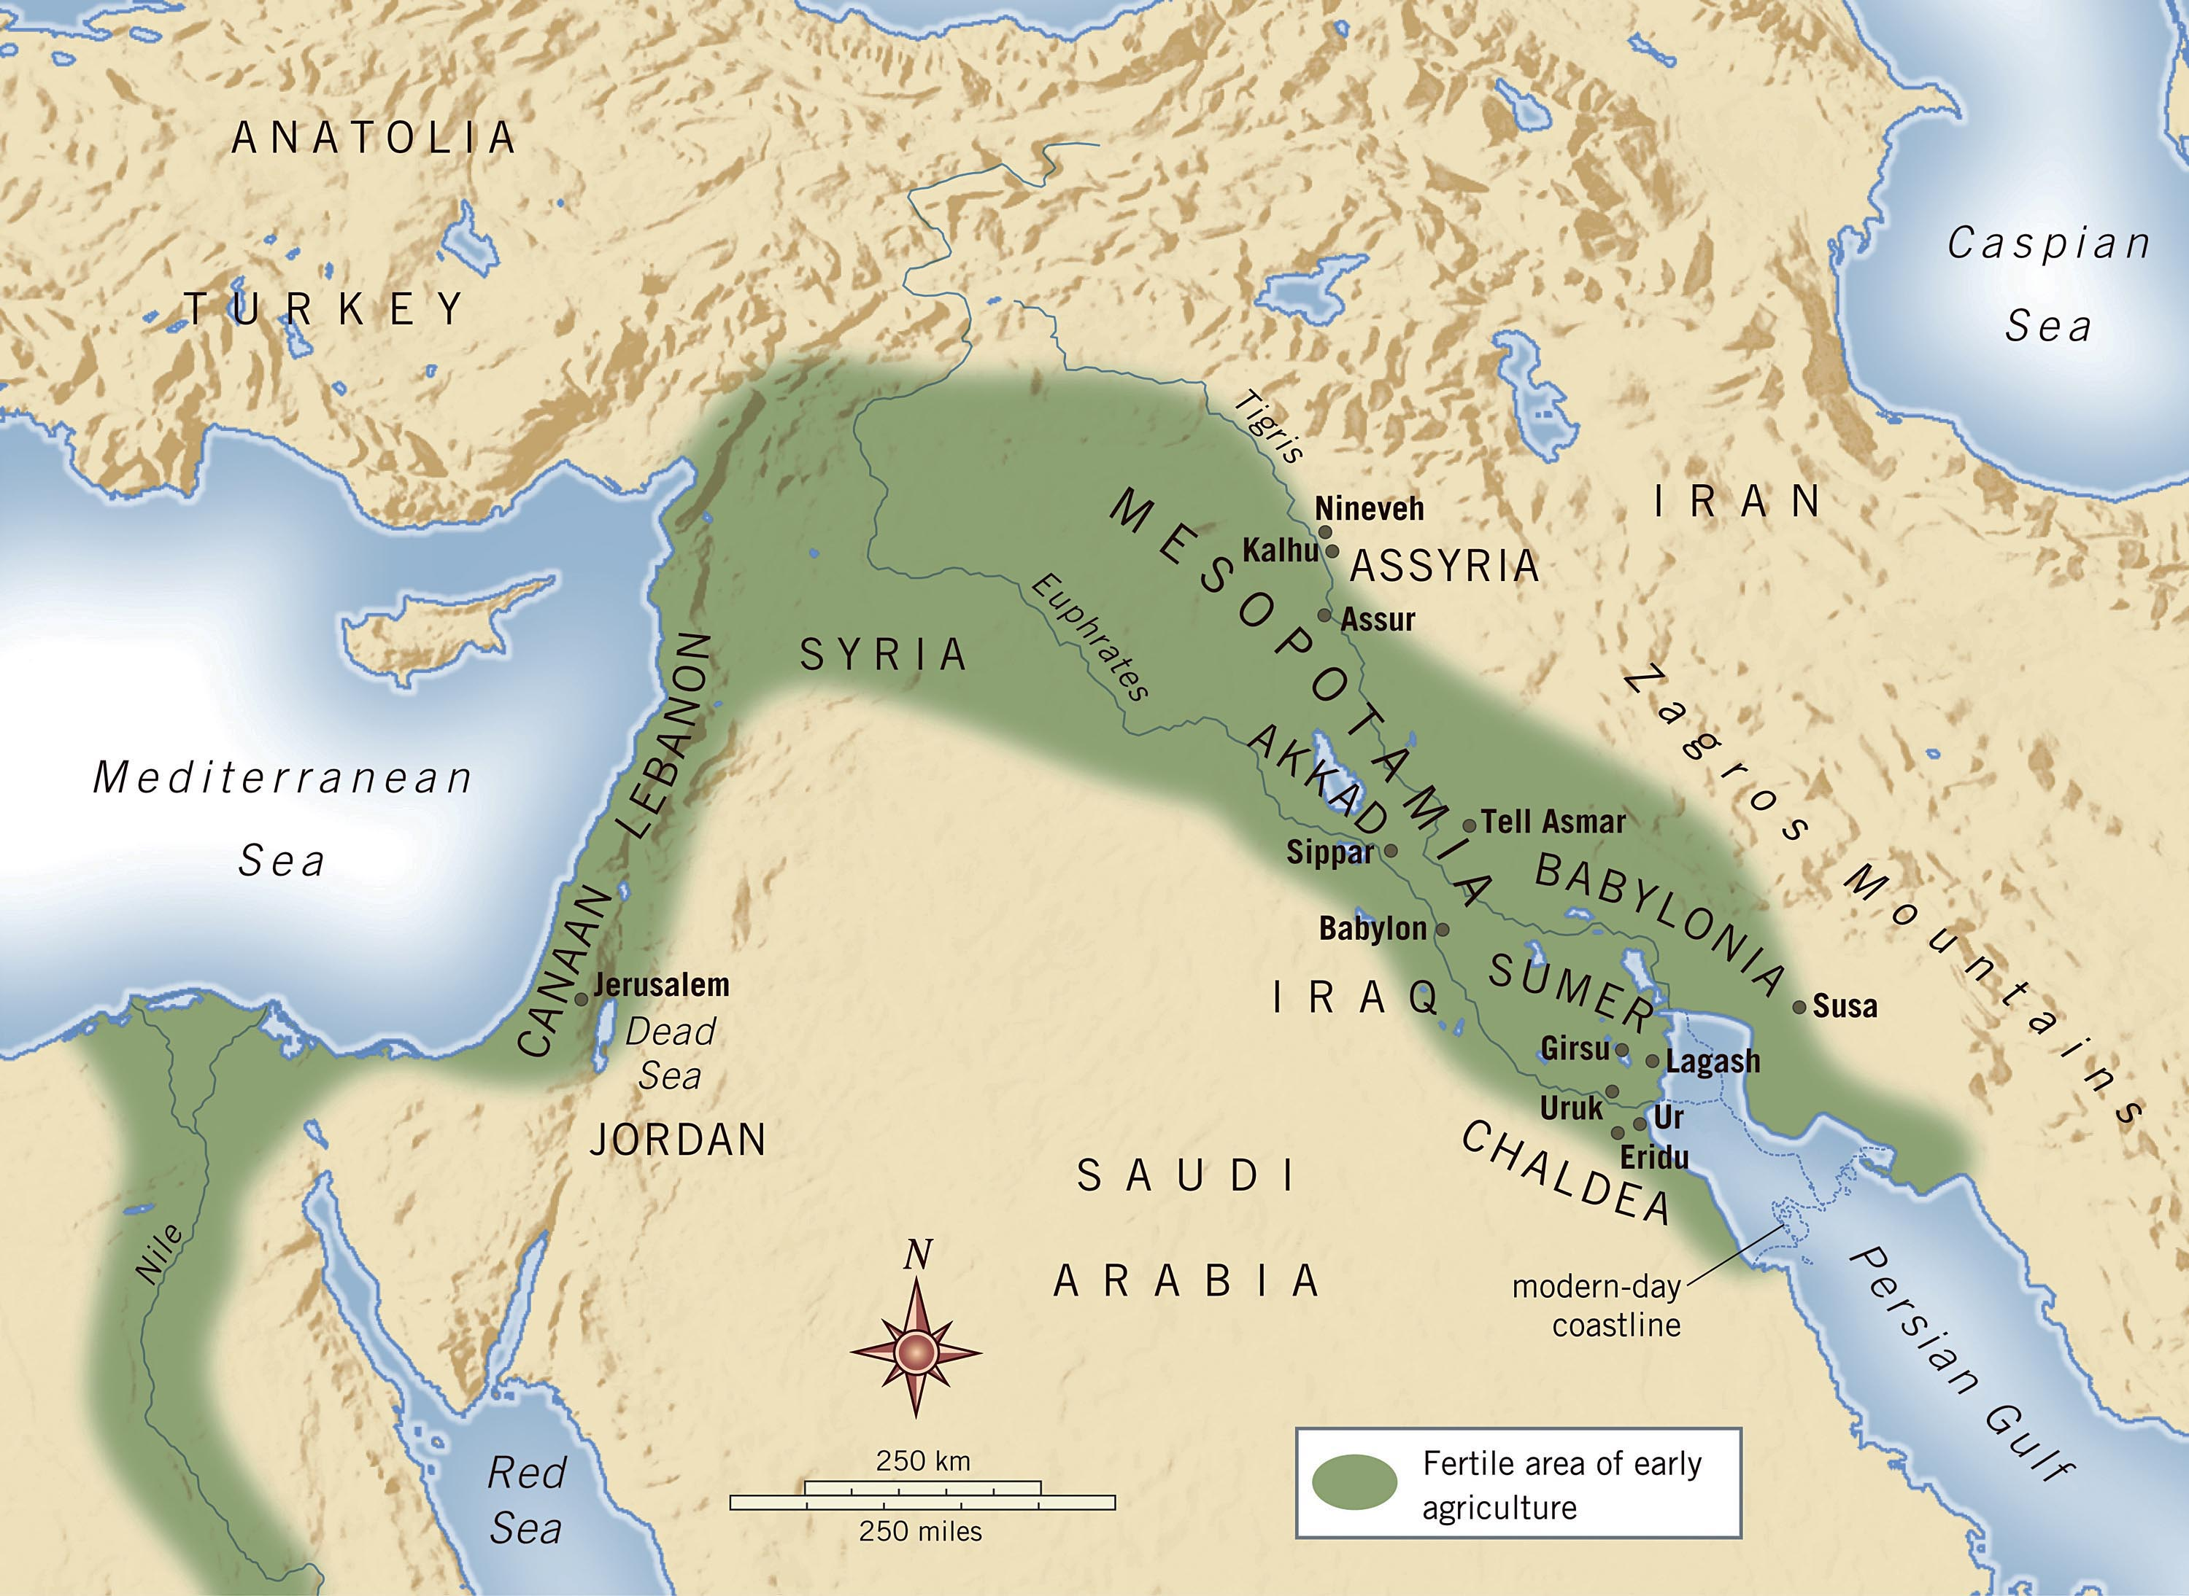

Slide 10
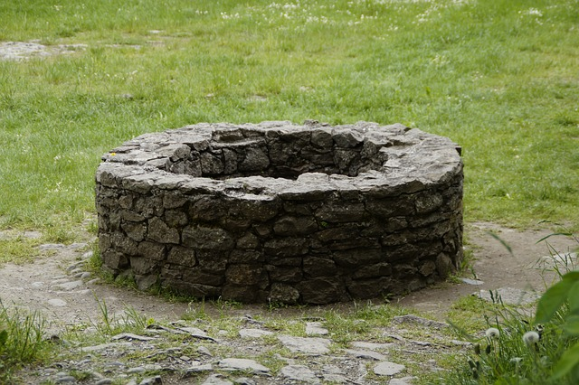
Genesis 29:1-14
Jacob finally reaches family region
At the communal well, conversation ensues
Where are you from?
Haran
Really? Do you know Laban?
Yep – quite well

Slide 11
Genesis 29:1-14
So, how’s Laben doing?
Quite well – and that’s his daughter approaching
What’s the deal with this gathering?
Shouldn’t you be watering the sheep and heading out to the pastures?
We need to wait for everyone
Jacob - 👀 – Rachel the shepherdess – Yowza!

Slide 12
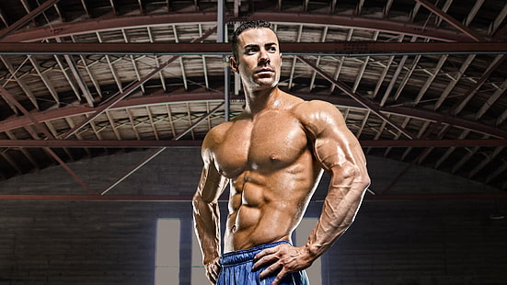
Genesis 29:1-14
Jacob is “inspired” – Allow me

Slide 13
Genesis 29:1-14
Oh yeah! I’ll take care of that stone
Jus’ fer you, li’l lady!
Moves the stone cover
Waters her flock
Greets her with a kiss … and tears?
Was the kiss that bad?
Nope – just great emotion – Success nears

Slide 14
Genesis 29:1-14
Jacob confirms the family ties
Rachel runs home with the news
Parallels Abe’s steward meeting Rebekah
This time, it’s Rebekah’s SON
Laban runs out to greet his kinsman
The family kiss and hospitality extended
Remains there a month

Slide 15
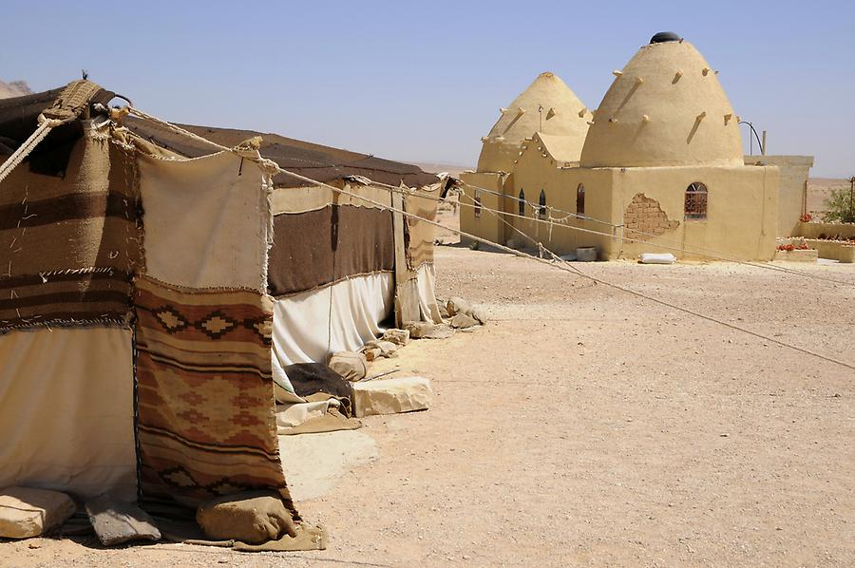
Genesis 29:15-30
Precise arrangement unknown
Jacob is assisting with Laban’s flocks’
Laban – as kin you shouldn’t work for free
What wages can I offer?
Our text gives us details on Laban’s girls
Leah – oldest, “weak eyes” - ???
Rachel – youngest, BEAUTIFUL, form and appearance

Slide 16
Genesis 29:15-30
Jacob makes a deal
I’ll give you 7 years for Rachel
Laban agrees
Better you than anyone else
Jacob serves the 7 years
They “fly by” because his love for her

Slide 17
Genesis 29:15-30
A GREAT romance story
An all-clan wedding feast is set up
Now, God’s “poetic justice” arrives
Laban uses the darkness to his advantage
Jacob had already done this
Used the darkness of Isaac’s blindness
Pulled the deception of the blessing

Slide 18

Genesis 29:15-30
A veil + dark = deception complete
Leah is substituted for Rachel
Morning arrives
WHAT?! I’ve got the wrong girl!
Jacob plays the “injured party” tile
Laban – Plays the primogeniture tile
Not the way we do things in these parts

Slide 19
Genesis 29:15-30
A sublime irony
Jacob used similar deception to AVOID the provisions of primogeniture
Prophecy or no, the method was deceitful
Ever wonder if Jacob ever “caught on”?
I worked for RACHEL, not Leah
A new deal is made

Slide 20
Genesis 29:15-30
Laban – Fulfill the bridal week
After that, you may have Rachel
For another 7 years!
The Deceiver was himself outmaneuvered!
So, it was done
Jacob gets Rachel
Leah gets the short straw

Slide 21
Genesis 29:15-30
As Jacob’s parents played favorites
So too, does he
Text states flat out
[Jacob] loved Rachel more
Now, God steps in – Directly
Opens Leah’s womb
Closes Rachel’s

Slide 22
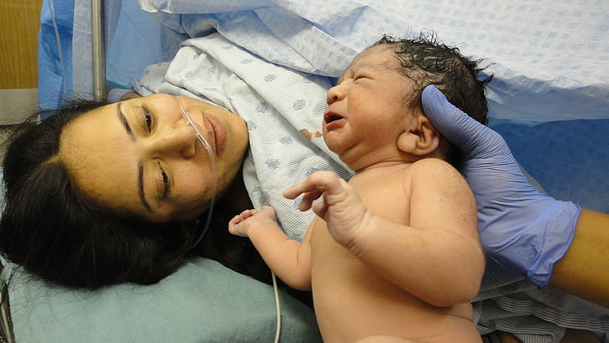
Genesis 29:31-35
Leah begins having sons
Still bitter about her sister
First three names are direct shots at Rachel
Reuben – See? A son! Rubs it in Rachel’s face
Also, hopes this will make Jacob love her more
Simeon – Heard – Mocking Rachel
See? God hears ME, not you (still barren)

Slide 23
Genesis 29:31-35
Leah still bearing sons
Levi – Attached – NOW, my husband will be attached to ME (instead of Rachel)
Fourth son changes the pattern
Judah – Praise, finally acknowledges God’s Hand
THIS time, I will praise the LORD
Note: This son’s line will bring the Messiah

Slide 24
Genesis 30:1-4
Rachel pitches a fit
Give me children or I’ll die!
Ironically prophetic – She dies in childbirth
Jacob – Who am I, God?
Isaac prayed, but Jacob gets angry
Rachel – Take my maid - Kids through her
Sarai and Hagar?

Slide 25
Genesis 30:5-8
Bilhah & Jacob – Two boys
Rachel names them
Dan – Judge – God heard and judged in my favor
Naphtali – My wrestling - I wrestled with my sister and prevailed
Really? The “score” is 4-2, Leah

Slide 26
Genesis 30:9-13
Leah sizes up the competition
Oh yeah?! I’ve got a maid, too
Zilpah & Jacob
Gad – Troop/Fortune – I have a troop (5)
Asher – Happy – I’m happy with the renown I will earn
Essentially, “I’m still winning!”

Slide 27
Genesis 30:14-21
Leah’s son, Reuben finds mandrakes
Believed to be a powerful aphrodisiac
Also, a conception aid
Rachel negotiates a deal
Some mandrakes for bed-mate
Jacob comes back in
Leah – You’re mine tonight, I hired you

Slide 28
Genesis 30:14-21
More sons for Leah
Issachar – Wages – Earned with Zilpah’s “service”
Zebulun – Dwelling – Now, my husband MUST dwell with me (6 boys!)
Daughter – Dinah – judgment (prophetic)
Shares the root for Dan - Judge

Slide 29
Genesis 30:22-24
Finally, God ‘remembers’ Rachel
A son of her own
Joseph – He will add
Expresses her hope that God will grant her more children
Family nearly complete
12 children, 7 years, 11 boys, 1 girl

Slide 30
Patterns
God uses ALL circumstances to HIS purposes
Human motives never circumvent God’s purpose
God’s purpose WILL be carried out

Slide 31
Points
What is God’s purpose for US – Collectively and individually?
What can we do to align ourselves with HIS purpose?
Why should we so align?

