Slide 1
Genesis 36
The end of Isaac’s tale
An account of Esau
Jacob has been set in context
Esau is now completed
A demonstration of God and His promise(s)
Esau and main family
His “people” moved SE for space from Jacob
As Abram & Lot, so to, Jacob & Esau

Slide 2
Genesis 36:1-14
Lines of descent from Esau
Intermarried with Ishmaelites
Sons and daughters
All chattel and possessions
Moved SE of the Dead Sea
Spread east and west in the region
Principal descendants are listed

Slide 3
Genesis 36:15-43
The lines of the Chief Sons
Focus is on the 12 sons of the tribal group
As Jacob became Israel, Esau becomes Edom
Family into Tribe, Tribe into Nation
Many names and families listed
The Nation of Edom
As promised by Isaac’s “non-blessing”
Kings, Tribal Chiefs, Leaders of city-states

Slide 4
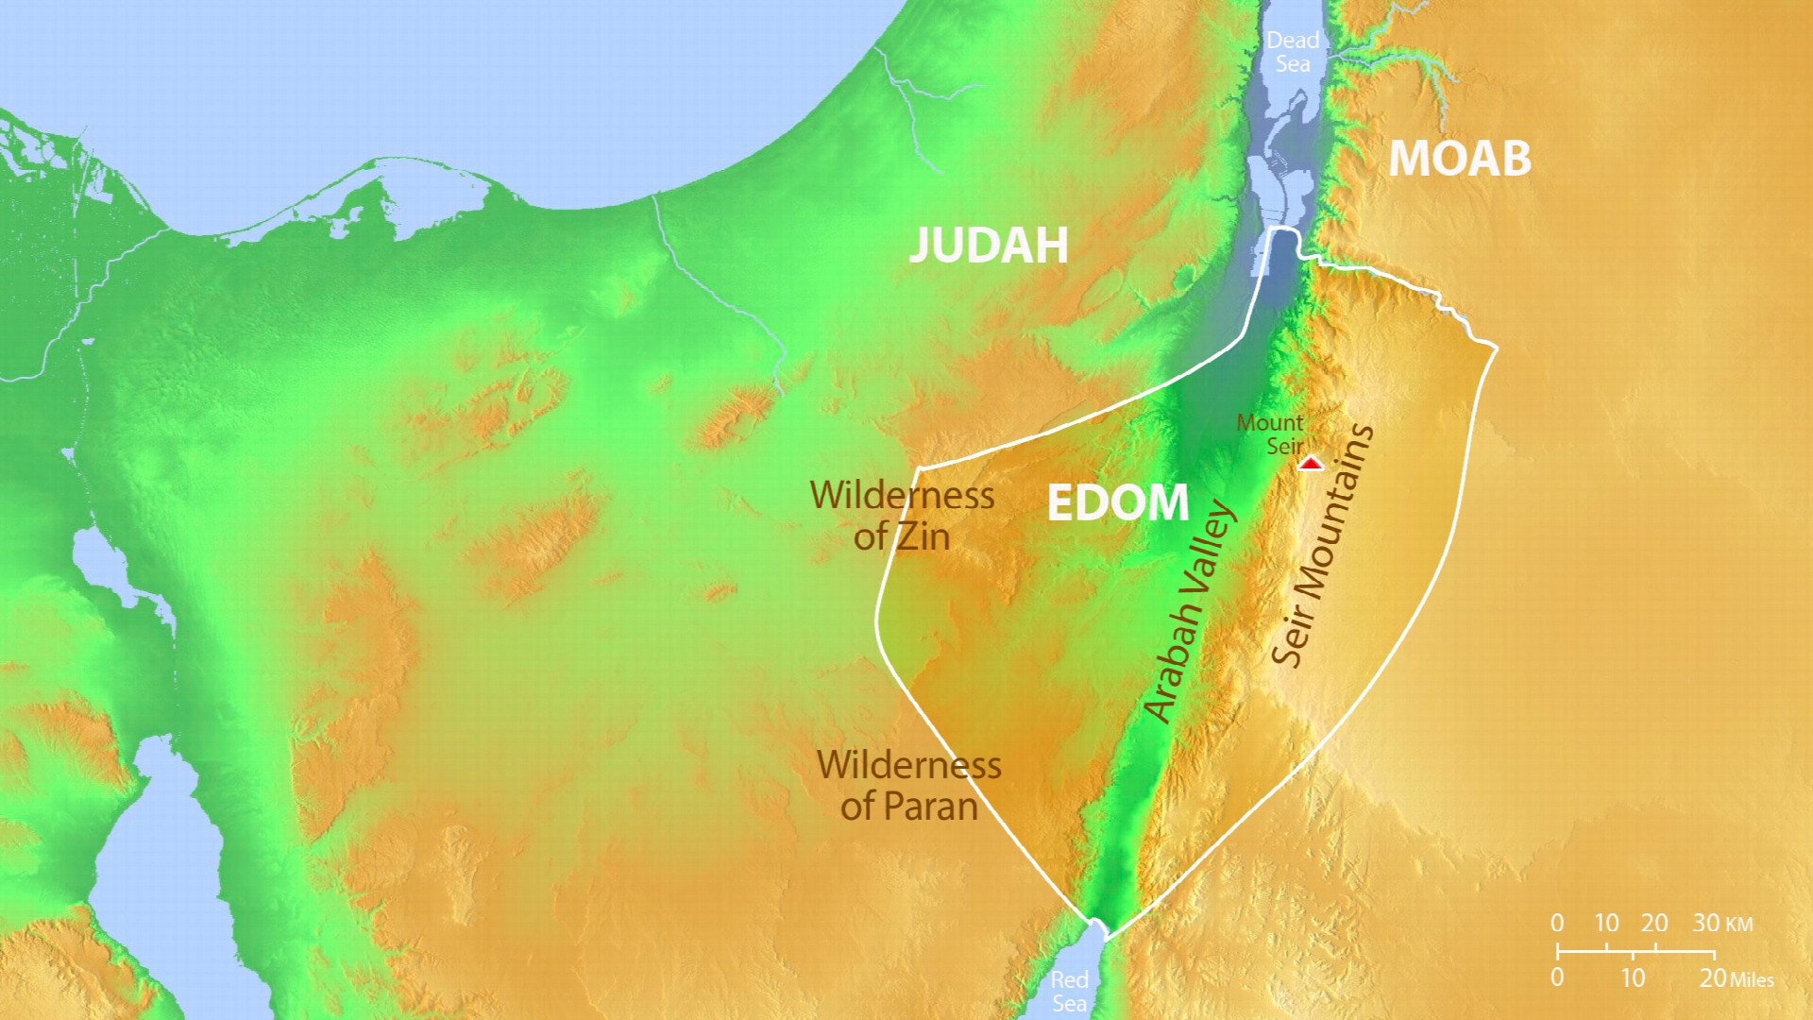
Notes:
Locations of Wilderness of Zin, Wilderness of Paran, Arabah Valley, the Seir Mountains and Mount Seir.

Slide 5
Genesis 37
The final “Chapter” of Genesis - Joseph
Focus moves the family into protection
A colophon of/for Jacob (vv. 1-2)
The focus will now be on Joseph
Tending the flocks with Bilha’s sons
(Leah’s maid)
Joe tattles – Not given how or what content
Wins no points

Slide 6
Genesis 37:1-4
Joseph is THE favorite
Given Jacob’s birth family, are we surprised?
Two factors
First-born of Rachel – THE beloved wife
Child of his “old age” – 60-ish
Jacob bestows a Significant Robe on Joseph
Creates obvious “Special Status” on Joseph
Brothers HATE him for that
Cannot even speak to him ‘peacefully’ (v. 4)

Slide 7
Genesis 37:5-11
God begins communicating with Joseph
Late teens, Joseph dreams
Dream #1
Boys are harvesting grain
Tying off the sheaves as they go
Joe’s sheaf stands upright
Brothers’ sheaves gather and bow to Joe’s
No longer hate him - Now? DESPISE

Slide 8
Genesis 37:5-11
Dream #2 is worse
Sun, moon, and 11 stars are bowing to Joseph
Wasn’t THAT a fun family meal
Hey y’all, Ah’m agonna rule ALL Y’ALL
Jacob – Really?! You will rule us all?
Text is clear
Brothers = Jealousy
Jacob = Hmmm, I’ve seen this before

Slide 9
Genesis 37:12-36
The oldest 11 are out with the flocks
Jacob sends Joe to them
Go up to Shechem and bring back word
Joseph – “Here I am” – A common reply … to God
Heads up to Shechem and “wanders”
Does not find them
Delay is necessary for the other “pieces”
Herds/brothers and Midianite caravan

Slide 10
Genesis 37:12-36
Joseph finally finds a local
Have you seen my brothers and a huge flock?
Yeah, they said something about Dothan
10-15 miles north
Joseph catches up near Dothan
Significance? Dothan is the “railhead”
A trading stop for the caravan route

Slide 11
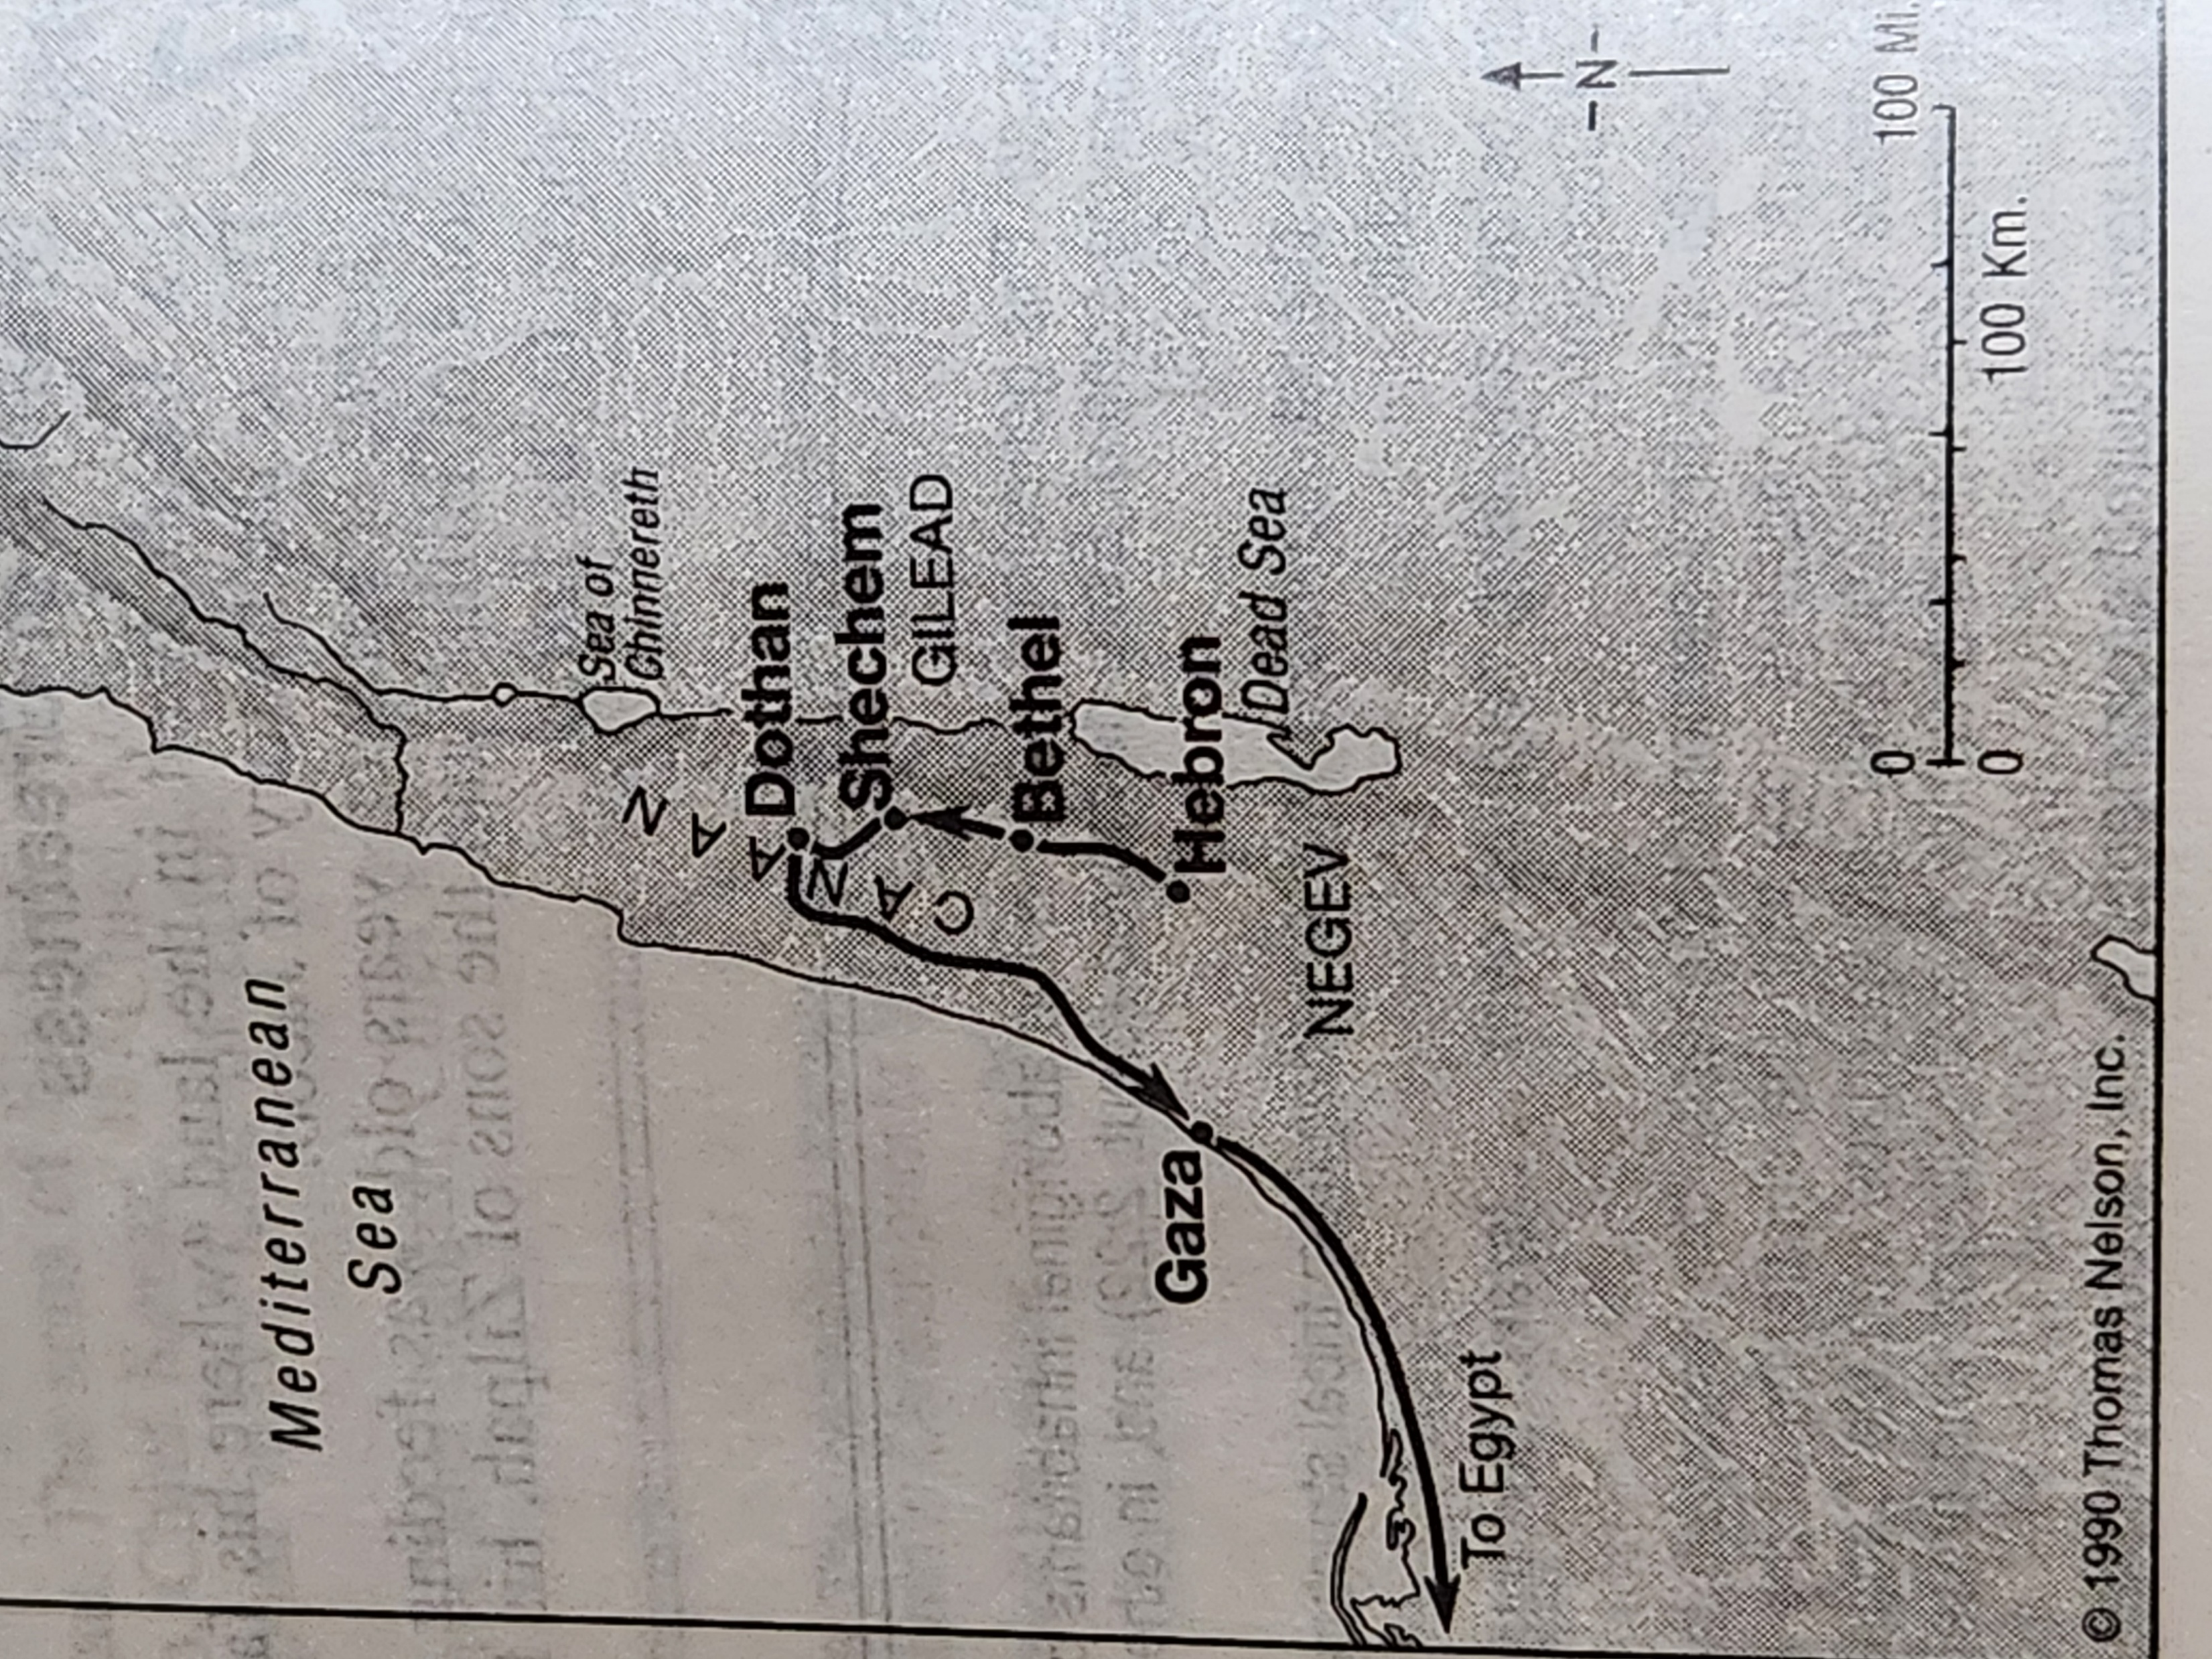
Notes:
Locations of Wilderness of Zin, Wilderness of Paran, Arabah Valley, the Seir Mountains and Mount Seir.

Slide 12
Genesis 37:12-36
Joseph’s brothers see him coming
Special robe/cloak made that easy
Excellent! If we act fast, we can kill him
Remove this inconvenient pest from our lives
Reuben – Oldest “responsible” one
Let’s not kill, merely capture
Text tells us he plans to release Joseph. Later
Joe is dumped into an empty cistern

Slide 13
Genesis 37:12-36
During dinner, a caravan arrives
Judah – Hey, we can sell Joseph! (v.27)
Two birds, one stone
Profit and solve the “problem” of Joseph
No one dies
No “blood” on our heads
Besides, he is our blood
So, that’s what they did
No mention is made of where Reuben was

Slide 14
Genesis 37:29-30
Reuben returns to release Joseph
He is gone!
Ahhh! Now, what do I do? Tears his robe
Brothers – Easy, watch this
Kill a kid, rip/tear the cloak
Splash the cloak with the blood
There, all fixed
We tell dad Joseph was killed by a wild beast

