Slide 1
Genesis 30:25-30
Jacob wishes to leave Laban
  Send me away
  Wives, children and all
  My service time is complete
Laban – Stay – I have divined that you are the cause of all my recent prosperity
Your God has blessed me, too

Slide 2
Genesis 30:25-30
Jacob agrees
  You know what you had
  You see what you have, NOW
  God has blessed you “at my foot”
  When then, shall I establish my OWN house?

Slide 3
Genesis 30:31-35
Laban
  What can I offer you to remain?
Jacob - Nothing
  Although … I’ll stay … IF
  You give me the irregular sheep and goats
    Normal animals were usually a single color
    Give me the oddly colored animals

Slide 4
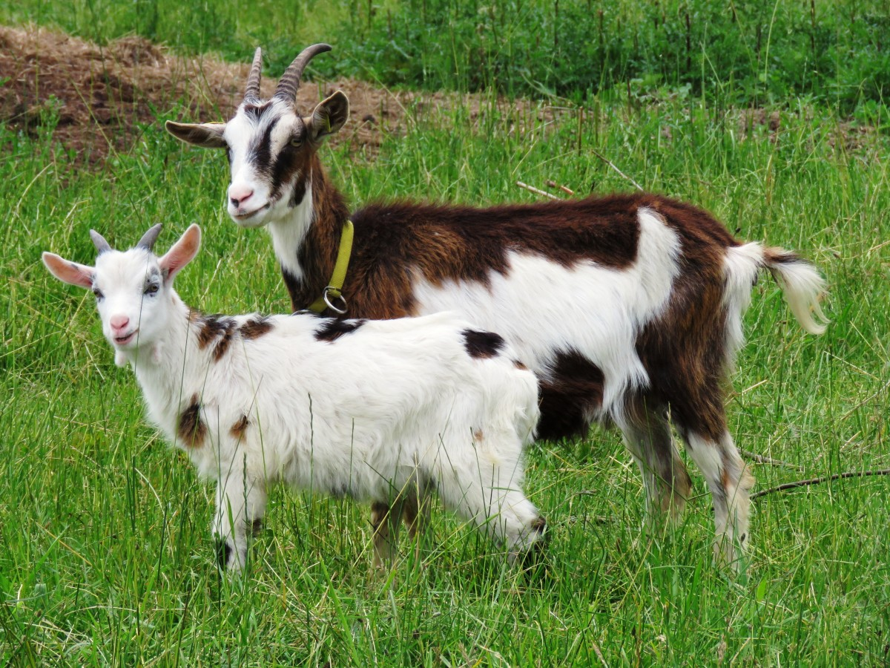
Genesis 30:31-35
This agreement is easily enforced
  Any “normal” animal is (clearly) stolen
Laban agrees, then pulls a ‘fast one’
  The irregulars were to be Jacob’s
  A “starter” group of animals
Laban strips all such critters
  He removes them 3 days away

Slide 5
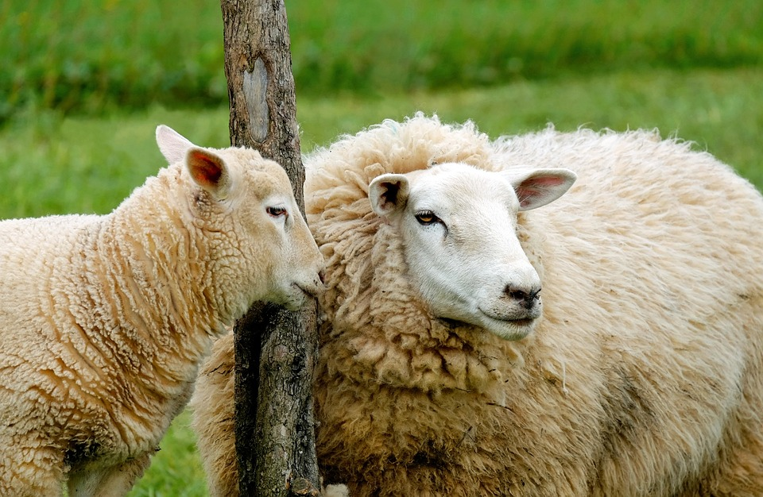
Genesis 30:31-35

Slide 6
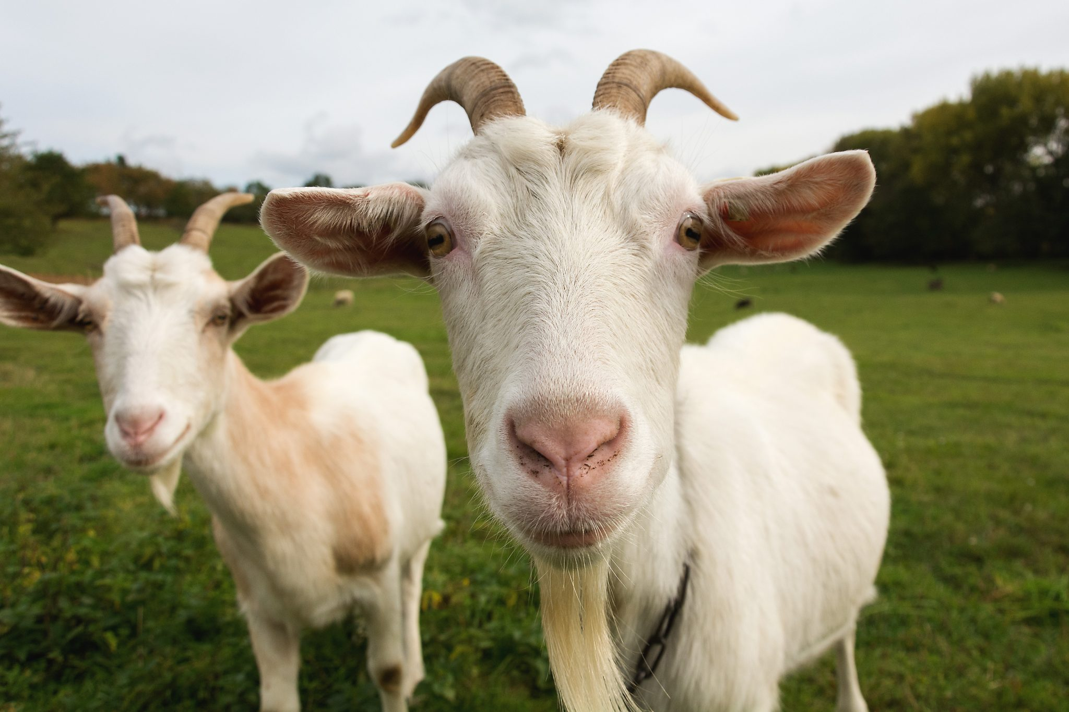
Genesis 30:31-35

Slide 7
Genesis 30:31-35

Slide 8
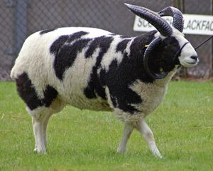
Genesis 30:31-35

Slide 9
Genesis 30:37-43
God’s blessing remains with Jacob
  The agreed upon animals become numerous
  NOT because of the sticks
  Because God’s purpose was to bless Jacob
Net effects
  Jacob is enriched
  God’s glory is, unfortunately, deflected

Slide 10
Genesis 30:37-43
Giving the appearance of “piety”
  Jacob culls all the odd animals
  Thus, preventing mating between the types
Jacob also uses his “sticks tricks” when the stronger animals are breeding
  Uses the sticks for the strong
  Removes the sticks for the weak

Slide 11
Genesis 30:37-43
Regardless of method
  Jacob’s flocks are robust and healthy
  Laban’s flocks become weaker
Result? Jacob is exceedingly wealthy
  Laban was also enriched
  Nowhere close to that of Jacob

Slide 12
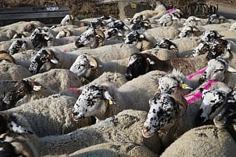
Genesis 31:1-15
God restates His PROMISE
I will be with you
  Jacob knows Laban is not happy with him
Jacob calls his wives together
  Reminds them of the last 20 years
  14 for you two, 6 more for “wages”
    Flocks and herds

Slide 13
Genesis 31:1-15
Your ‘dad’ doesn’t like this situation
I have done all he asked
  Yet he still tries to scam me
  Ten times he has changes my “wages”
  Yet, God has not allowed him to harm me
If I said spotted, that’s what happened
If I said striped, that’s what happened

Slide 14

Genesis 31:1-15
Rachel and Leah understand, also
  [Laban] regards us as foreigners
  We no longer have any “portion” here
  He has sold us (out)
  All that you have taken from our father
It is all ‘OURS” now

Slide 15
Genesis 31:16-21
Rachel and Leah agree, Obey God
  [Laban] regards us as foreigners
  We no longer have any “portion” here
  He has sold us (out)
  All that you have taken from our father
It is all ‘OURS” now

Slide 16
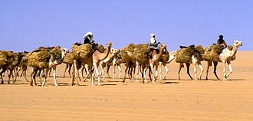
Genesis 31:16-21
Jacob loads up and leaves
  All his family
  All his herds and flocks
  All his servants and retainers
Rachel takes one more step
She steals the family “gods”
  If the household “gods” leave, Laban is unprotected

Slide 17
Genesis 31:22-42
Jacob flees and crosses the river
Three days later, Laban pursues
  Seven days out, he catches up
  Hill country of “Ephraim” name known to the readers
The night before they got to Jacob
  God sends Laban a dream
  Warning him to “tread carefully” with Jacob

Slide 18
Genesis 31:22-42
Laban
  You were improper
  Left w/o notification
  I was denied the proper farewells
  Instead, you “stole” away
You know I could wipe you out
  Alas, your God warned me not to do that

Slide 19
Genesis 31:22-42
Laban
  I get it that you wanted to go home
  Why did you have to “steal” my gods, too?
Jacob – I was afraid of your might
  gods? What are you talking about?
Go ahead and search – Anything yours, take
  If your gods found, that thief shall die

Slide 20
Genesis 31:22-42
Laban
  Searches everything
Rachel pulls a major deception, too
  She hides the idols in her saddle
  She sits on them
Laban enters to search
  Sorry “dad” I can’t rise – the “way of women”

Slide 21
Genesis 31:22-42
Laban
  Searches everything
Rachel pulls a major deception, too
  She hides the idols in her saddle
  She sits on them
Laban enters to search
  Sorry “dad” I can’t rise – the “way of women”

