Slide 1
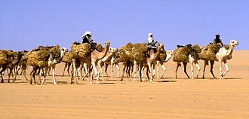
Genesis 31:22-42
Quick review
  Jacob had left Laban w/o notice
Laban pursues to “recover” his things
  Plan included the use of force
  God warned Laban that was “unwise”
Laban accuses Jacob of theft
  You stole all my kin, AND my gods

Slide 2
Genesis 31:22-42
Laban
  Searches everything
Rachel pulls a major deception, too
  She hides the idols in her saddle
  She sits on them
Laban enters to search
  Sorry “dad” I can’t rise – the “way of women”

Slide 3
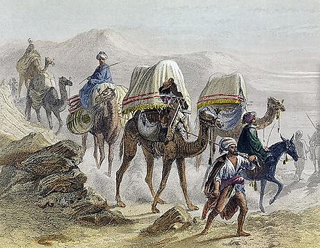
Genesis 31:22-42
Relatively insignificant event
  Mocks the complete powerlessness of idols
  In contrast, God’s power IS absolute
  The “gods” were sat upon by a woman
  Not only ‘subservient’, but she was “unclean”
A clear demonstration of the futility of following after ANYthing but the One God

Slide 4
Genesis 31:22-42
Jacob
  Finally confronts the real issue
What do you have against me?
  I’ve given you 20 years!
  Throughout, no disasters, no miscarriages
  I took all the “losses”
  Anything lost to beasts or breaks, I bore it

Slide 5
Genesis 31:43
Jacob
  Fourteen years for your daughters
  Six more years for my “wages”
  Yet you come after me and go through all my things like I am a common thief?
Finally, God has rebuked YOU for me
  And you have a problem with that?!

Slide 6

Genesis 31:43-44
Laban KNOWS his hands are tied
Totally helpless before the TRUE God
  Even though all of this is mine
  There is nothing I can do
We better make a treaty
  Similar to the non-aggression pacts of earlier
  Abraham/Abimelech & Isaac/Abimelech

Slide 7
Genesis 31:44-55
Jacob grabs a rock
  They ALL grab rocks
  A “monument” is made
  Laban – Aramaic – Jegar Sahadutha
    Heap of Witness
  Jacob – Hebrew - Galeed
    Heap of Witness (Amazing, yeah?) 🤣😂

Slide 8

Genesis 31:22-42
Laban calls the place Mizpah
  Watch - That God watch us
  To keep us APART
  To maintain the integrity/accountability of BOTH
The marker “guarantees”
  Neither will pass it to harm the other

Slide 9
Genesis 31:45-55
Laban recognizes God is “different”
  God of Abraham
  God of Nahor
  God of their father
  Still lumps God in with the “regional” gods
Let THAT God be the judge between us

Slide 10
Genesis 31:45-55
Jacob swears by the “Fear of his Father”
  Jacob recognizes GOD
  Not fully onboard, but KNOWS what had been promised to him at Beth-El
A sacrifice and formal meal seal the deal
Laban, unhappy but a realist, leaves
No more will he figure into the narrative

Slide 11
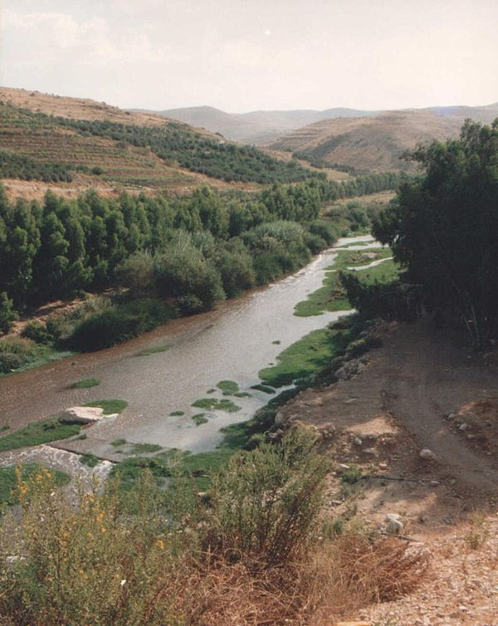
Genesis 32
The journey continues
  Jacob meets angels - Again
  As at Beth-El, a new step forward
Second meeting is East of the Jordan
  Along the Jabbok river
Jacob recognizes God in this “place”
  Mahanaim – Two Camps

Slide 12
Genesis 32: 1-5
Jacob breaks his travel here
  Knows that Esau will be waiting for him
  He does some pre-planning
Messages are prepared and sent south
  To: My lord, Esau
  From: Jacob, your servant
I’m returning wealthy and seeking favor

Slide 13
Genesis 32: 1-5
The messages and reveal a “new” Jacob
  Wiser
  More humble
  Looking for restoration
Jacob presents the facts
  The rest, he leaves in God’s Hands

Slide 14
Genesis 32: 6-8
Then, the messengers return
  Um, yeah, Jacob?
  We were going south
  Your brother was coming north
  With 400 men 😳🥺
Didn’t we just do this with Laban?!
  What next?

Slide 15
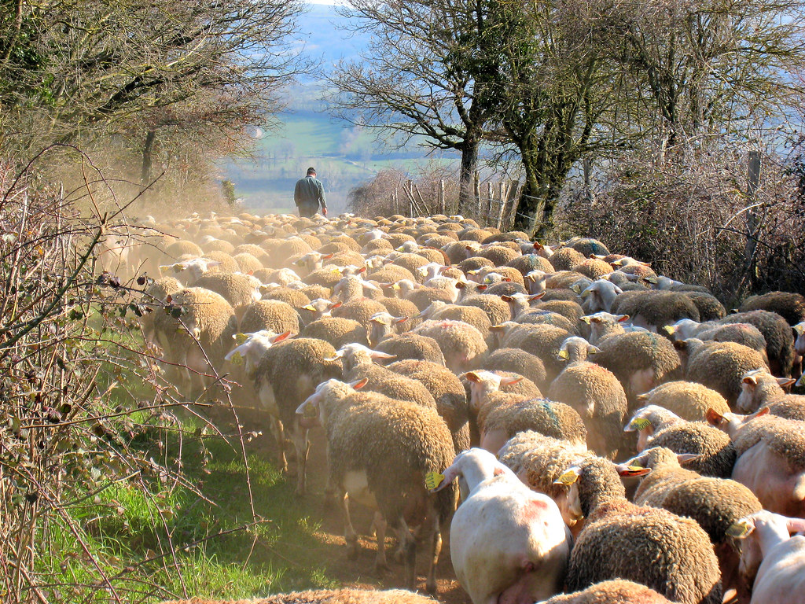
Genesis 32: 6-8
Emotions
  Fear and distress
Plans
  Business as usual – work the situation
Jacob splits most of his mobile holdings
  Two main groups heading south

Slide 16
Genesis 32: 9-12
First recorded prayer of Jacob
  He HAS learned something
God of Abraham
God of Isaac
The LORD Who spoke to ME
  The final “patriarch” is now in place
“Return” to your home

Slide 17
Genesis 32: 9-12
I am unworthy of all your “gifts”
  I crossed north with a staff
  I’m crossing south with two camps! (Mahanaim)
Deliver me from my brother’s hand
  I fear Esau
Yet, you are the God Who promised me
  Health, wealth, and innumerable descendants

Slide 18
Genesis 32: 1-5
Jacob remains in place and refines his plan
  Builds his “present” for Esau
    Term is used for gifts given; lesser to greater
Five separate groups
  550+ animals – A staggering tribute payment
He staggers the departures
  Hopes to overwhelm Esau with constant flow

Slide 19
Genesis 32: 1-5
The message sent with each group is identical
  These are appeasement gifts
  To atone for all prior grievances
Jacob remains “above” the Jabbok
  Once darkness falls, he moves slightly
    Diplomacy is good
    Prudence is better

Slide 20
Genesis 32: 1-5
He sends his family across, but remains
  When alone, a “man” comes and wrestles
Until now, Jacob has survived on strength
  Strength of body
  Strength of his wits
All night, they are equally matched

