Slide 1
WEEK 1
1 – Our Bible
2 – Definition
3 – Structure
4 – Beginnings

Slide 2
DEFINED
The Protestant Canon
The collection of writings that encompass the divinely inspired record of God’s direct interactions and interventions with humanity
It represents written accounts from approximately 40 different authors over a period of roughly 5 millennia before Christ up to near the end of the 1st century A. D.
How do we reach this envelope of time? There exists sufficient evidence to suggest that the earliest portions of Genesis (Gen. 1-4) were assembled from the surviving written material from ADAM.

Slide 3
DEFINED
The Protestant Canon
We have other writings from this era that help fill in our understanding of genealogical data and many of the pertinent events.
REMINDER: Always keep in mind the Sovereignty of God throughout the entire process of writing, preserving, collecting, and transmitting HIS-Story from the beginning until the present.

Slide 4
STRUCTURE
Common divisions in our Bible, traditional Hebrew sections
The LAW (Torah)
The first five books – Genesis thru Deuteronomy
The Prophets
Joshua thru II Chronicles, Isaiah, Jeremiah, Ezekiel, Daniel
The Writings
Everything else

Slide 5
STRUCTURE
Common divisions in our Bible, traditional evangelical sections
The LAW (Torah)
The first five books – Genesis thru Deuteronomy
The Histories
Joshua thru Job
The Major Prophets
Isaiah, Jeremiah, Ezekial, Daniel

Slide 6
STRUCTURE
Common divisions in our Bible, traditional evangelical sections
The Minor Prophets
Hosea thru Malachi
The Wisdom Writings
Psalms through Song of Solomon, Lamentations

Slide 7
BEGINNINGS
The first 11 chapters of Genesis
Without these chapters, NOTHING else in the Bible will stand
Pretty radical statement – Hence, our starting point for understanding

Slide 8
Genesis 1
THE Beginning of the beginning
The foundation of understanding for ALL that follows!
God declares HIS right of sovereignty
Genesis 1:1-2
God sets two patterns with this chapter
1 – The WEEK
2 – The WORK

Slide 9
Genesis 1
The WEEK
Seven days: Six for labor, one for rest
Genesis 1:3-27
Each day, He did one specific task in a specific order
He also revealed more of His own nature to/for us
His perfection, symmetry, “set apartness” (Holiness)
His own integrity and character

Slide 10
Genesis 1
The WORK
All His creative acts, Part I
The Globe, and the diurnal cycle
Gen. 1:3-5
The separation of Globe and Heavens
Gen. 1:6-8
The separation of water and dry land
Gen. 1:9-10

Slide 11
Genesis 1
The WORK
All His creative acts, part II
The Vegetation on the land
Gen. 1:11-13
The Universe – Sun, Moon, and Stars
Gen. 1:14-19
The Creation of all water creatures and all creatures of the air
Gen. 1:20-23
The Creation of all land creatures, including humans
Gen. 1 24-27

Slide 12
The Creation Pattern
Day 1: The creation of Light
Day 2:The Separation of Globe and the Heavens/Waters
Day 3: The Separation of Land and Water
Day 4: Filling of the Heavens (read, The Universe)
Day 5: The Filling of the Waters
Day 6: The Filling of the Land

Slide 13
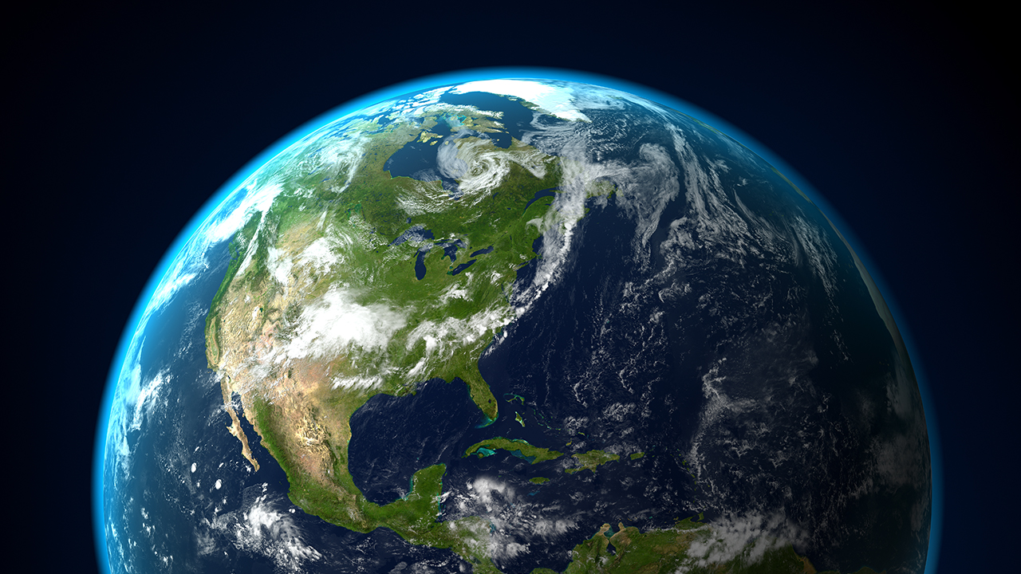
And God blessed them. And God said to them, “Be fruitful and multiply and fill the earth and subdue it, and have dominion over the fish of the sea and the birds of the heavens and over every living thing that moves on the earth.”

