Slide 1
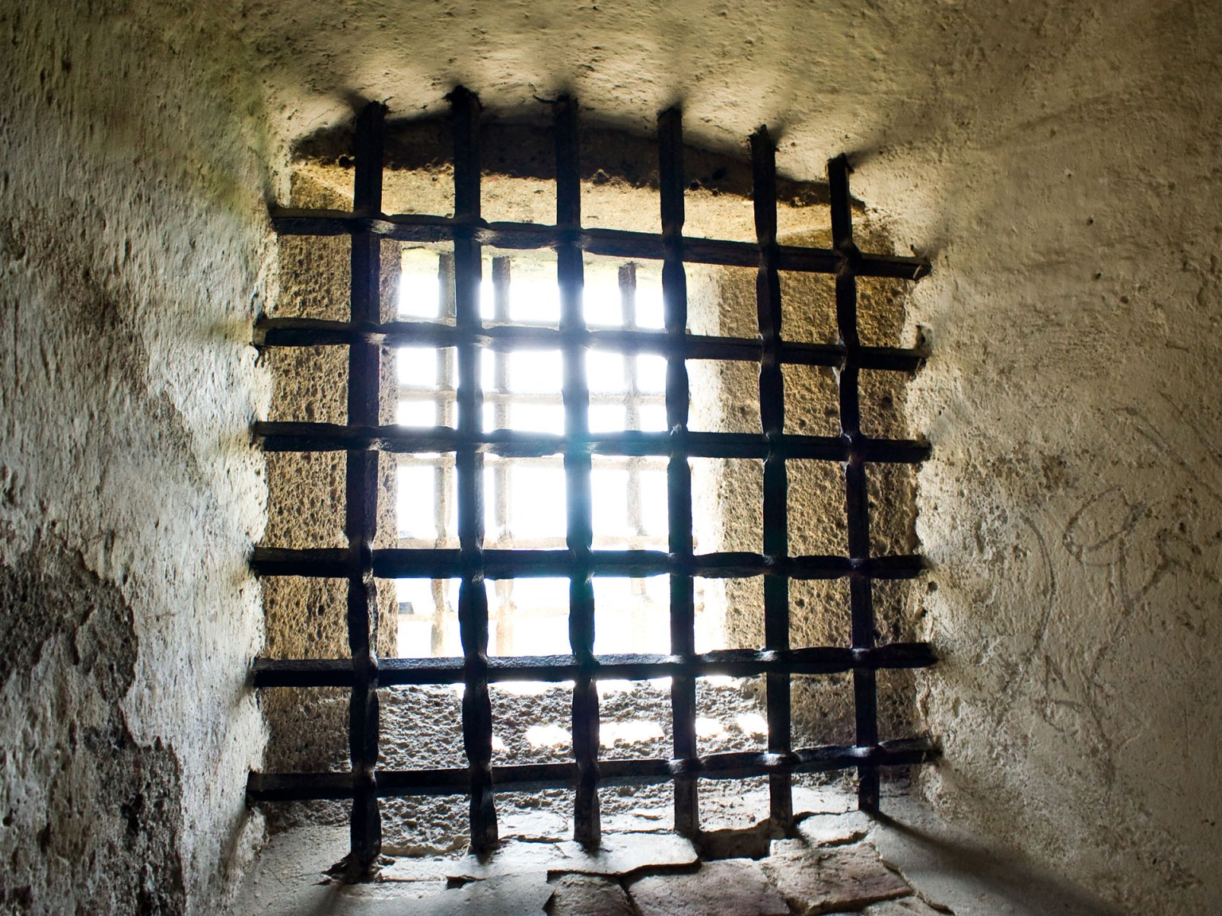
Genesis 39:21-23
The LORD was with Joseph
  Found favor in the sight of the GIC
  Head jailor puts Joseph in charge
    One step below the guy getting paid!
Two of Pharoah’s officials offend
  Given to Captain of the Guard – Potipher
  Placed in Joseph’s “care”
  Both with their own story

Slide 2
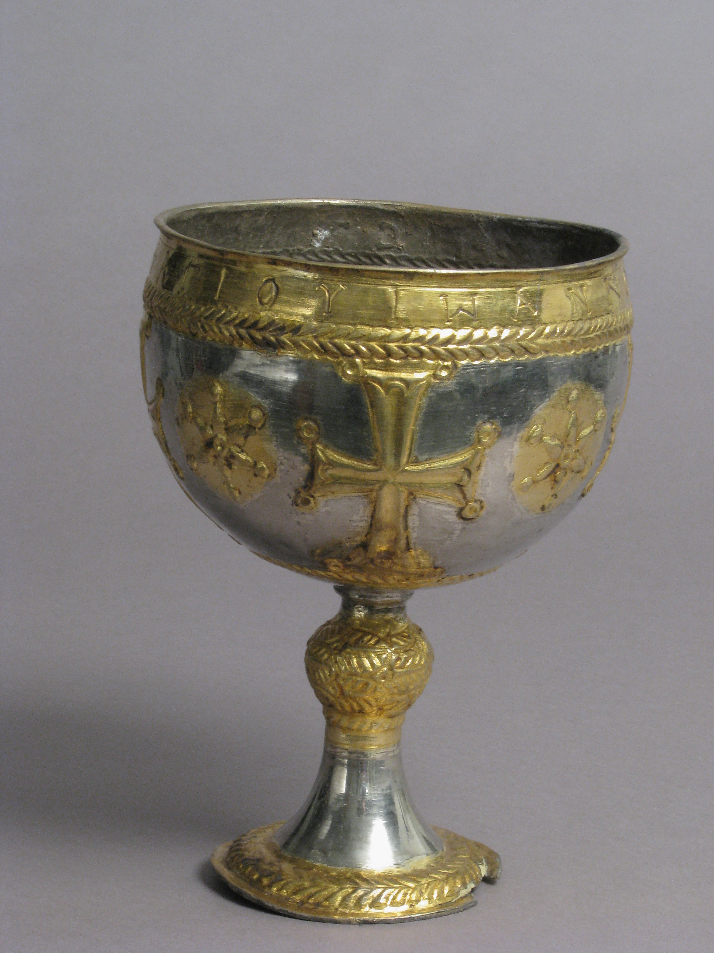
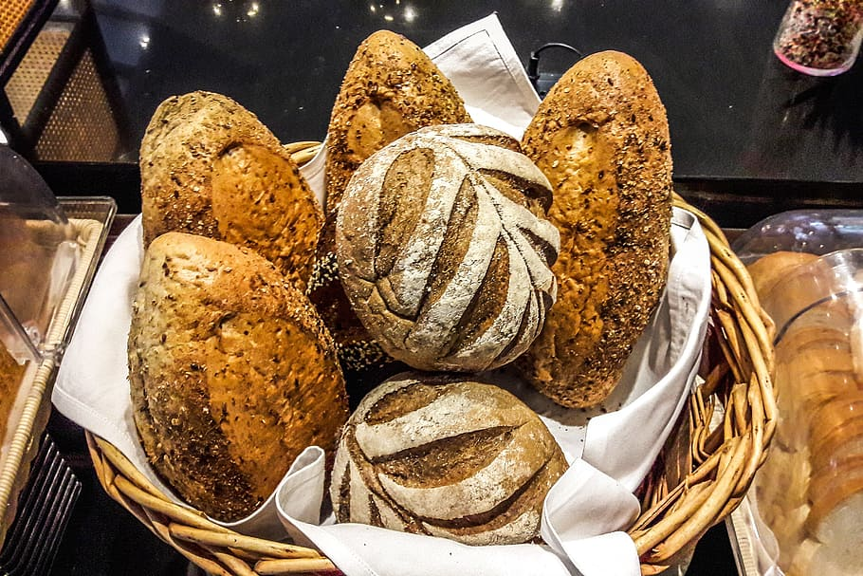
Genesis 40:1-8
The Butler
  Also, Cupbearer
The chief “taster”
  In charge of food
  Assure safety in ALL the Pharoah eats or drinks
  Critical position
The Baker
  A kitchen worker
  Head Baker
Provided breads
  Pharoah’s table
  All at that table
Non-Critical position

Slide 3
Genesis 40:1-8
Both of the “new” inmates dream
Same night – Role specific
Dreams were believed to be divine
  The gods wanted one to know something
They had no access to “seers” = bummed out
Morning comes, as does Joseph
  Why the long faces?

Slide 4
Genesis 40:1-8
Dreams were portents for Egyptians
  No current access to the palace seers
  At a loss because no one to interpret
Joseph’s reply is a bold statement
  Do not all interpretations belong to God?
  Radical in Egypt – Multiple deities
Please tell me your dreams

Slide 5

Cupbearer
I saw a vine
  3 branches
As I watched
  Budded
  Blossomed
  Fruited
I pressed them into Pharoah’s cup

Slide 6
Genesis 40:9-14
Joseph interprets
Three branches are three days
In three days:
  Pharoah will lift up your head
  Fully restore to your former position
One favor to ask
  Remember me to Pharoah when you get back

Slide 7
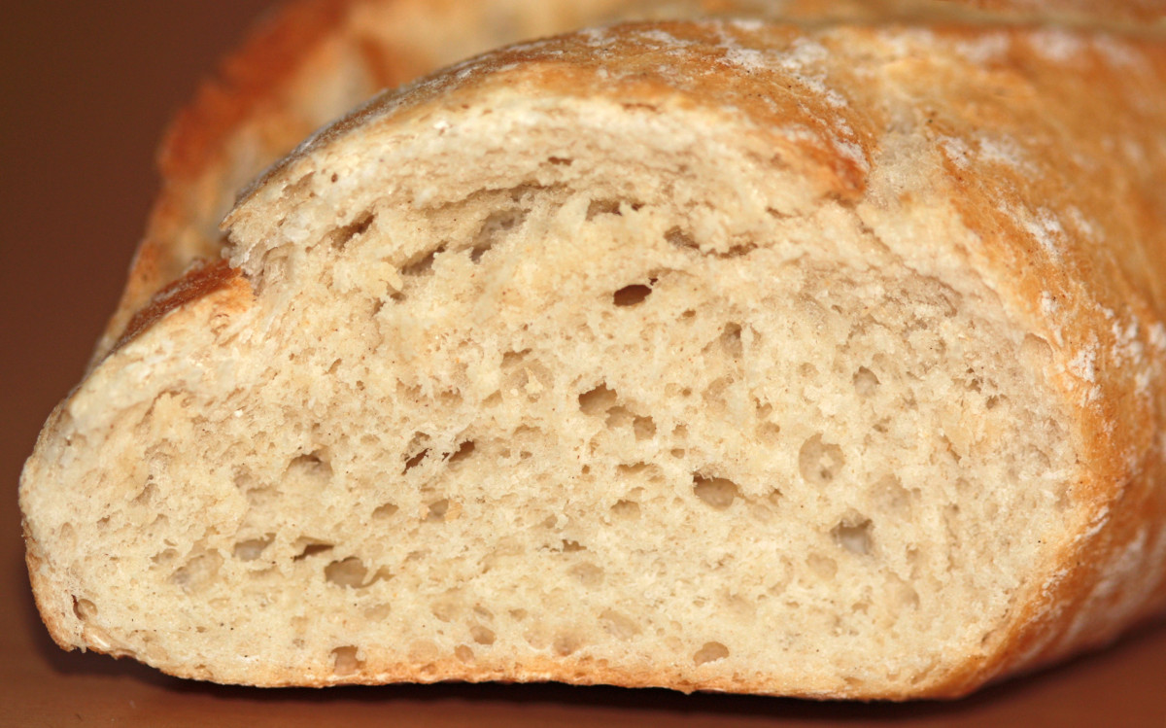

Baker
Three baskets full of bread
Carrying them on my head
For Pharoah
All good stuff
Birds came down and ate the bread out of the top layer

Slide 8
Genesis 40:16-19
Joseph interprets
Three baskets are three days
In three days:
  Pharoah will lift off your head
You will be beheaded
Your body will then be hung on a tree
  The birds will come down and eat your flesh

Slide 9
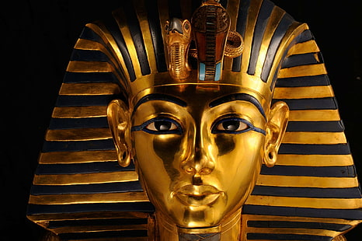
Genesis 40:20-23
Three days later – Pharoah’s birthday
EVERY-thing happened … Precisely as told
Cupbearer was fully restored
Baker was beheaded and publicly hung
Alas, Joseph was “forgotten” by cupbearer
  Truly forgotten? OR …
  Timing was not correct in God’s Plan?

Slide 10
Genesis 41 - Pharoah Dreams
Two years after the events of Ch. 40
  Pharoah has two dreams
Fat kine, wasted kine 😊
  Well fed cows rise from the Nile
  Emaciated cows follow
  Skinny cows devour the fat cows
Fat ears of grain – Wasted ears of grain
  Same pattern – Wasted consume the full

Slide 11
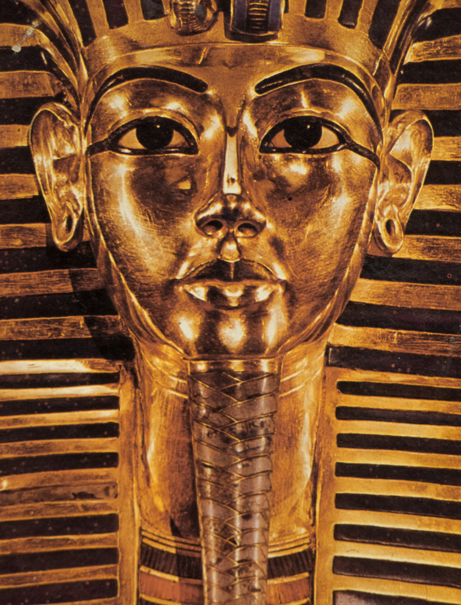
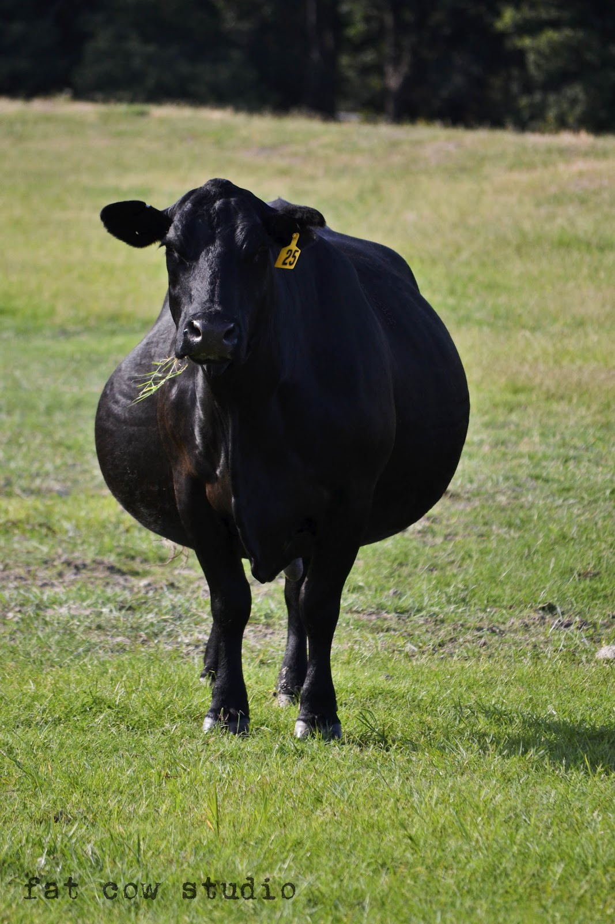
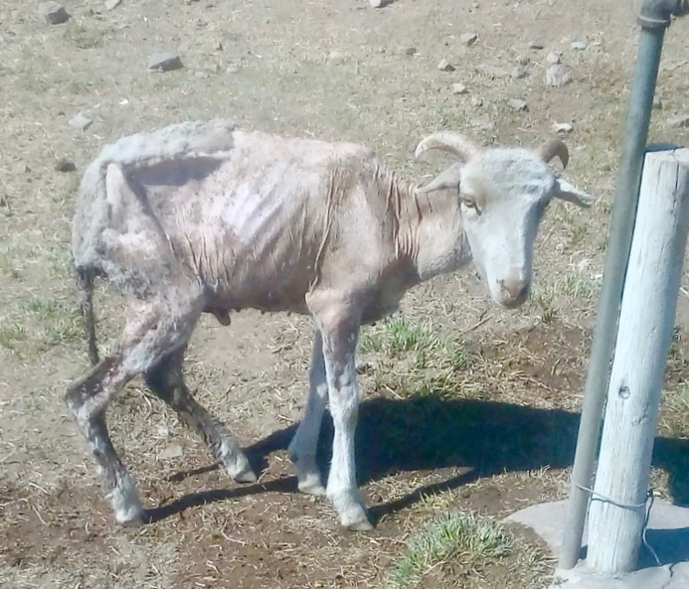
Dream A
This Photo by Unknown Author is licensed under CC BY-NC-ND
This Photo by Unknown Author is licensed under CC BY-ND

Slide 12
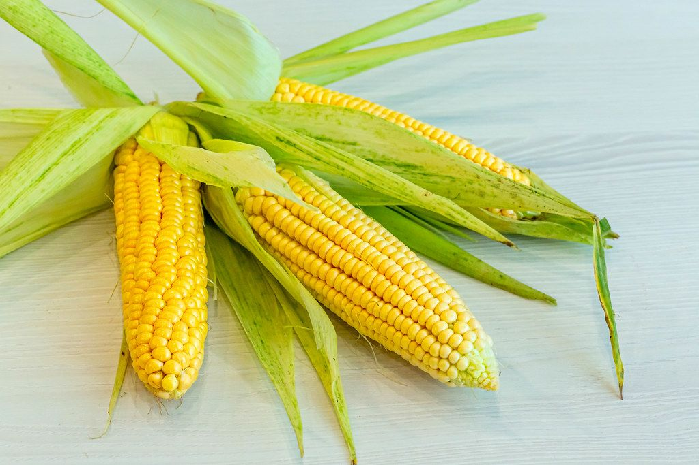
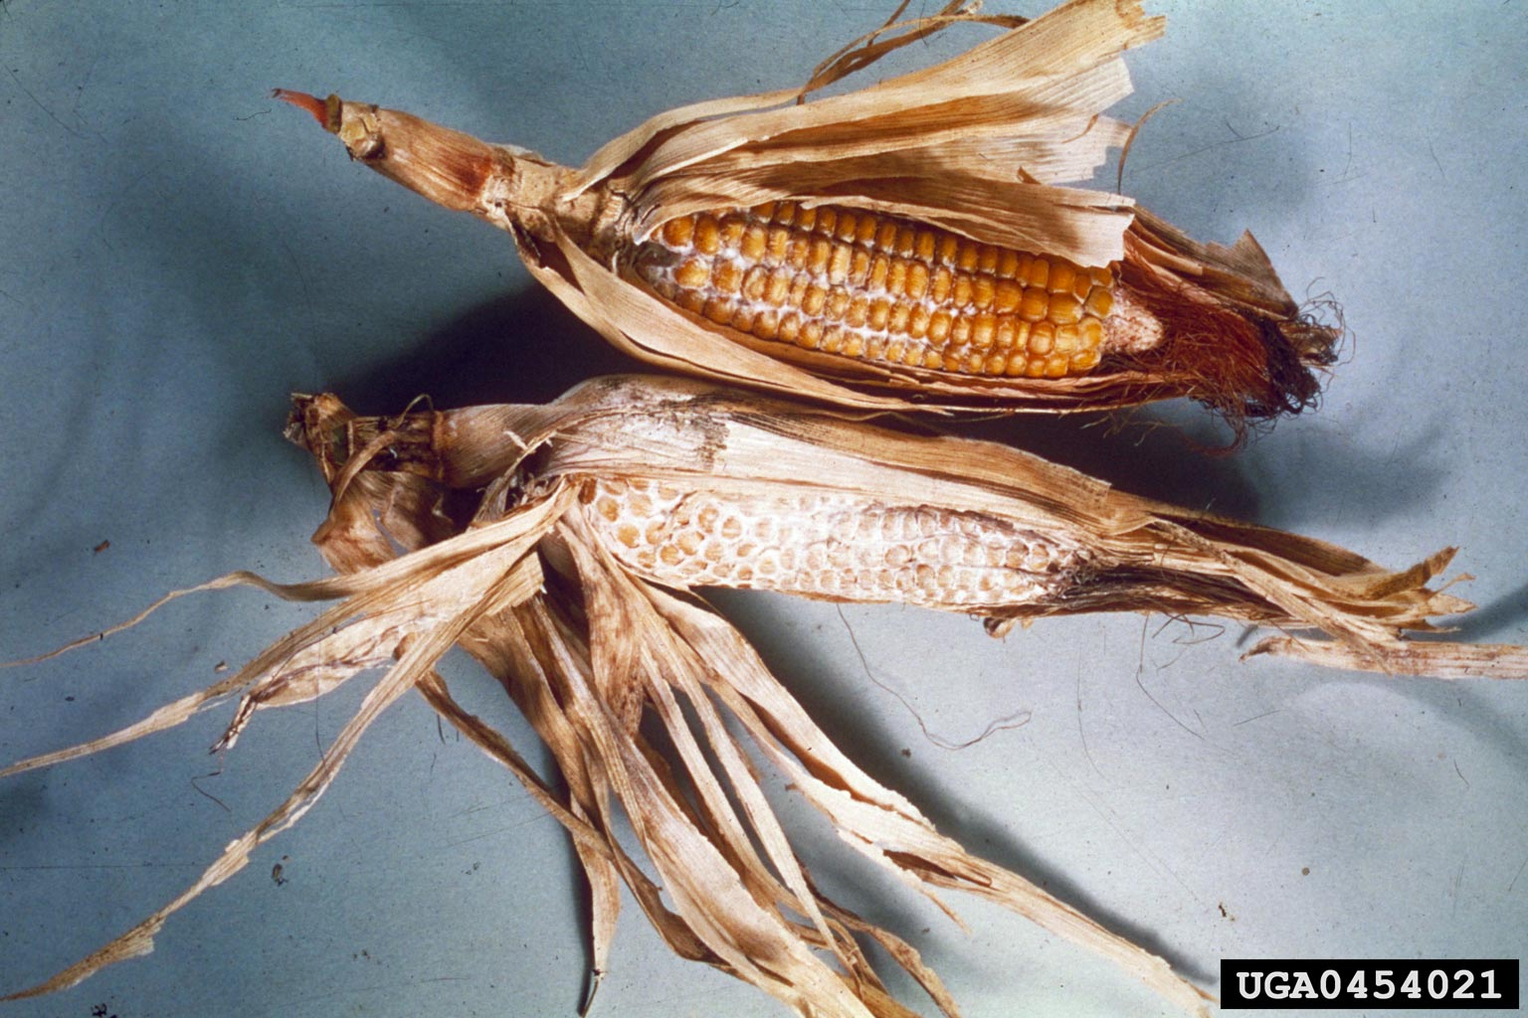
Dream B
This Photo by Unknown Author is licensed under CC BY
This Photo by Unknown Author is licensed under CC BY-NC

Slide 13
Genesis 41:8-13
Pharoah awakes – Troubled in his spirit
  He summons all the wise guys of the kingdom

Slide 14
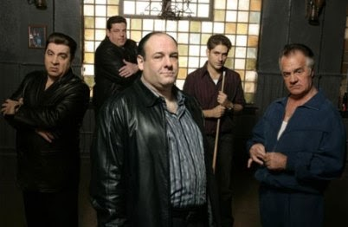

Slide 15
Genesis 41:8-13
Pharoah awakes – Troubled in his spirit
  He summons all the wise guys of the kingdom
    Maybe not
Diviners, seers, occult practitioners
  Anyone with “skills” in the arcane
No one could help render any sense of his dreams to Pharoah
Cupbearer – Ooo, Ooo, Pick me, Pick me!

Slide 16
Genesis 41:8-13
Now, the Cupbearer remembers Joseph
  We had dreams – the Baker and I
  A young man serving the prisoners interpreted
Everything he told us, happened
  Precisely as he told us it would
Joseph is summoned – Royal, but also Divine
  Shaved, dressed, and presented to Pharoah
    Cleaned up for court

Slide 17
Genesis 41:8-13
Pharoah
  I’ve had dreams that no one can interpret
  I’m told you can give me the interpretation(s)
Joseph is quick to clarify things
  It is not in me, to interpret
  GOD can give Pharoah peace in the matter
So, Pharoah relates the dreams as stated

Slide 18
Genesis 41:14-32
Pharoah tells of the dreams
Full cows – Devoured by wasted cows
Full ears of grain – Devoured by the blighted
Joseph interprets – Fully
Your two dreams are ONE
GOD is revealing what HE is about to do

Slide 19
Genesis 41:14-32
The fat cows/full ears of grain
  Seven years of great plenty are coming
  Animals and crops will produce abundantly
The wasted cows/ears of grain
  Seven years of famine will follow
  So severe, they will consume ALL excess
  Nothing from the prior seven years will be left
    All the good years will be forgotten

Slide 20
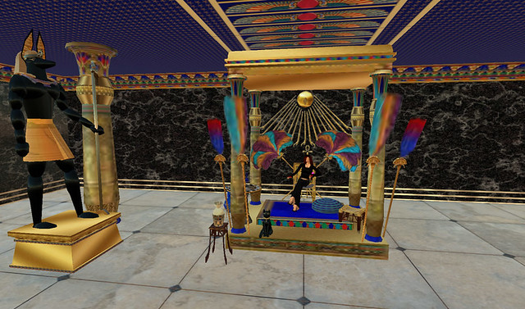
Genesis 41:14-32
This Double-Dream is important
  This is God telling you that it is “fixed”
  These events WILL happen … soon
Still speaking on behalf of GOD
  Let Pharoah take wise steps … NOW
Choose one of wisdom and discernment
  Place overseers under him
  Collect one fifth (20%) of all the bounty years

Slide 21
Genesis 41:33-43
Set up great storehouses
  Bring in all the collected foodstuffs
  Protect the land from starvation
    The famine years WILL happen, too
This “pleased” Pharoah and whole court
  A crisis foretold
  Precise instructions for dealing with it
  Chose the one who told them to be the COO

Slide 22
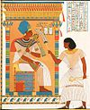
Genesis 41:33-43
Pharoah – States the effect for Joseph
  You have The GOD within you
  You shall be raised to the highest office
  Only my throne (me) shall be higher
Honors given
  Royal signet ring
  Fine clothing
  Gold chain of office – Very ornate = privileged

Slide 23
Genesis 41:44-45
Pharoah also grants the Second Chariot
  The second place in any royal procession
    Chariot OR foot
    Includes heralds running before him – BOW!
No one acts w/o YOUR permission
  All are subservient to YOU
New name – Zaphenath-Paaneah
  Revealer of secrets, or, One to whom secrets are revealed

Slide 24
Genesis 41:44-45
The name about “Secrets”
  Recognition that GOD resides w/in Joseph
Given a wife – Highest born
  Daughter of a Priest of ON
  The group that served the primary deity, On
  On – The sun-god – Highest in the pantheon
Joseph is atop his corner of the world
  Because of DREAMS

Slide 25
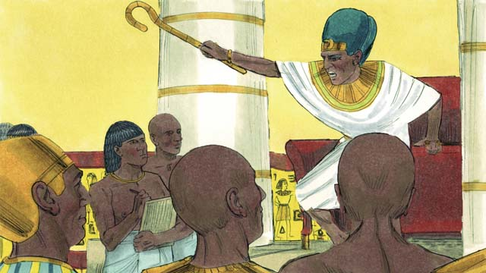
Genesis 41:46-49
Joseph is 30 when he assumes this office
  Second in command of all Egypt
He immediately surveys the kingdom
  Planning for managing the bumper-crop years
He commissioned large storehouses
  Began collecting the foodstuffs
  Maintained it all by the regions of origin

Slide 26

Genesis 41:50-52
During the seven years of plenty
  Children are born to Joseph and his wife
The first: Manasseh – Forgetting
  God has made me forget my troubles
The second: Ephraim – Doubly fruitful
  God has made me fruitful in the land of my affliction

