Slide 1
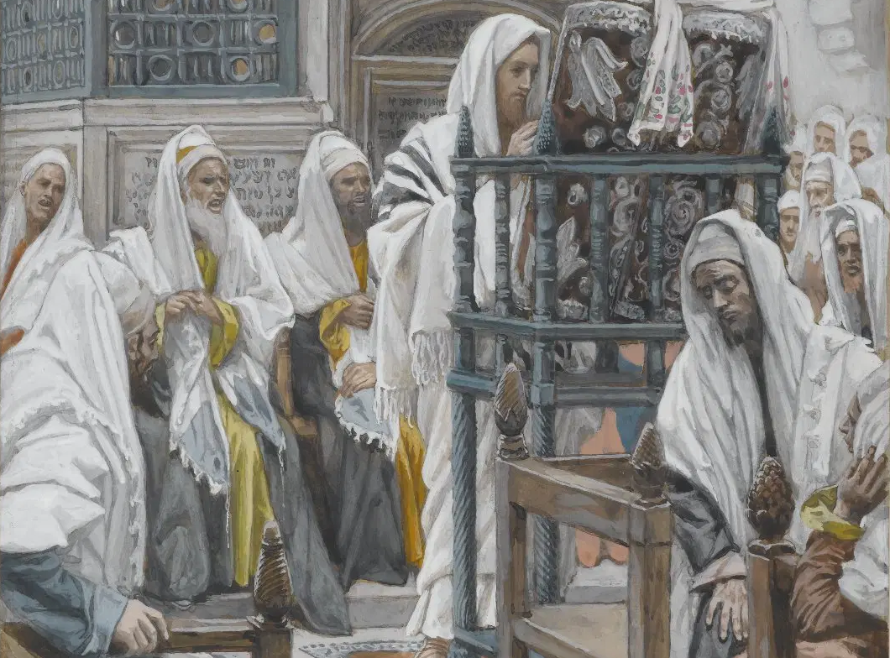
Messiah in the Tanach, 01
A Short Course for Men

Slide 2
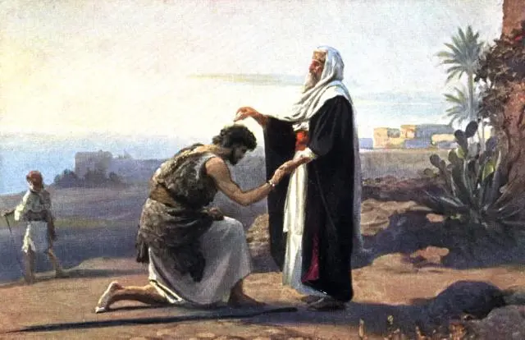
What is a ‘messiah’?
The LORD! His adversaries will be shattered; the Most High will thunder in heaven. The LORD will judge the ends of the earth;
he will give strength to his king and exalt the power of his anointed.” 1 Samuel 2:10
● Anointed:
● Whom:
Mašîaḥ (מָשִׁיחַ), Christ (χριστός).
Kings, priests, prophets.

Slide 3
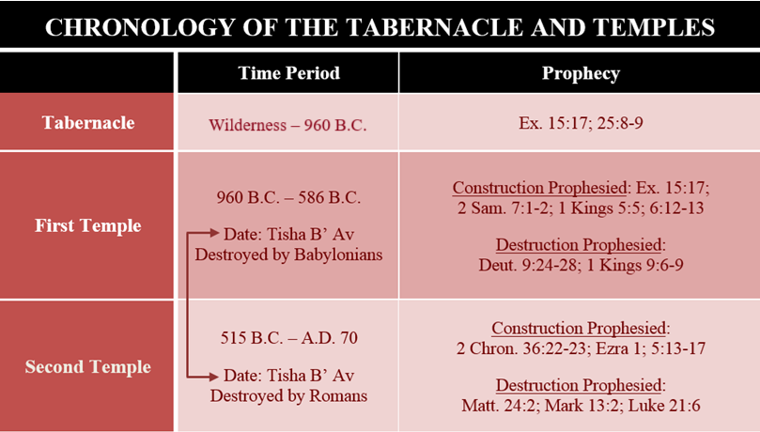
Messiah in the Tanakh (Rydelnik)
● The origin of Jewish messianic (hope) speculation in the 2nd temple period.
● A biblical apologetic for Messiah Jesus.
● To assure Christians that the Tanakh (OT) is the inspired Word of God.
● To identify Jesus as the true Messiah.
● To affect how we understand inspiration and interpretation of the Bible.

Slide 4
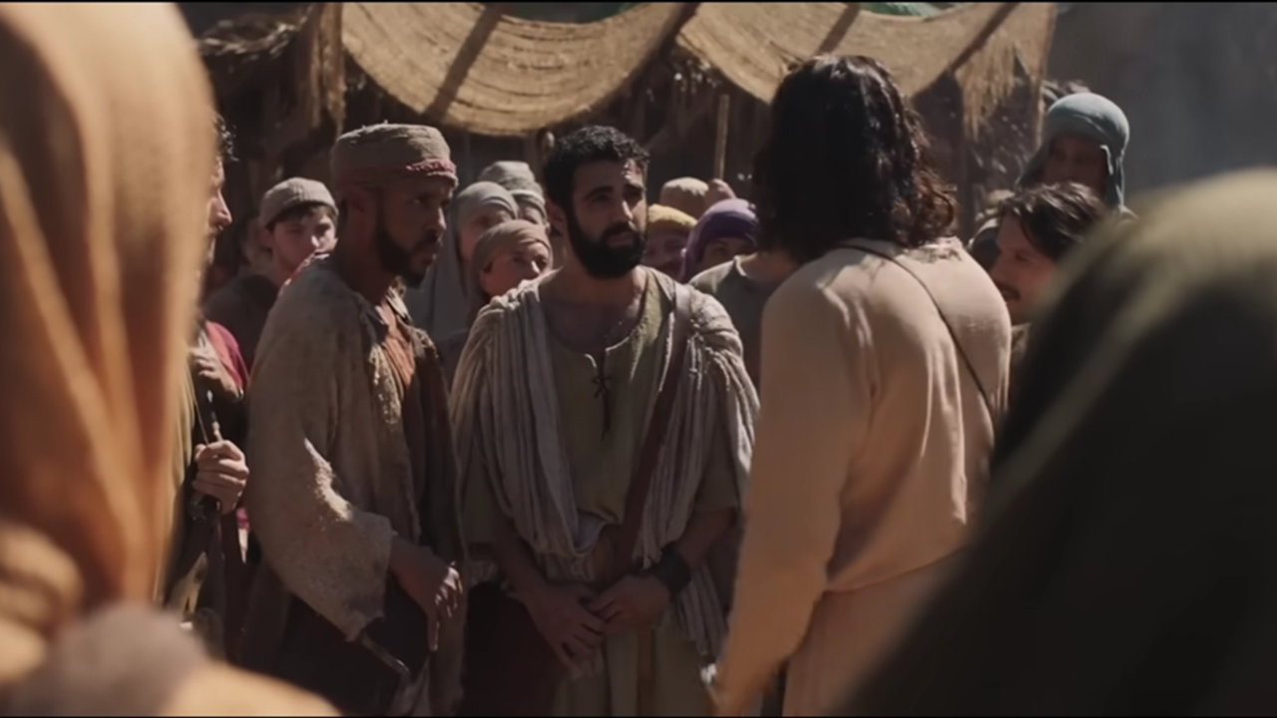
Matthew (NRSVue)
3⁴ “Are you the one who is to come, or are we to wait for another?”
Jesus answered them, “Go and tell John what you hear and see…”
● One to come:
● Another:
● See & hear:
Malachi 3:1.
Popular expectation.
Eye-witness evidence.

Slide 5
Matthew (NRSVue)
11¹⁰ It is written, ‘See, I am sending my messenger ahead of you, who will prepare your way before you.’
… ¹³ All the Prophets and the Law prophesied until John came.
● Written:
● Messenger:
● Prophesied:
Malachi 3:1
Referring to John B.
Fulfillment time has come.

Slide 6
Malachi 3 (NRSVue)
¹ I am sending my messenger to prepare the way before me, and the Lord [’adôn] whom you seek will suddenly come to his temple.
The messenger of the covenant in whom[/which] you delight—indeed, he is coming, says the LORD of hosts.
● ’adôn:
‘YHWH said to my lord’ Ps 110¹

Slide 7
Luke (NRSVue)
24⁴⁴ “These are my words that I spoke to you while I was still with you—
that everything written about me in the law of Moses, the prophets, and the psalms must be fulfilled.”
● Written:
● About me:
● Fulfilled:
Formula = Scripture
Messianic claim
Past, present, future?

Slide 8
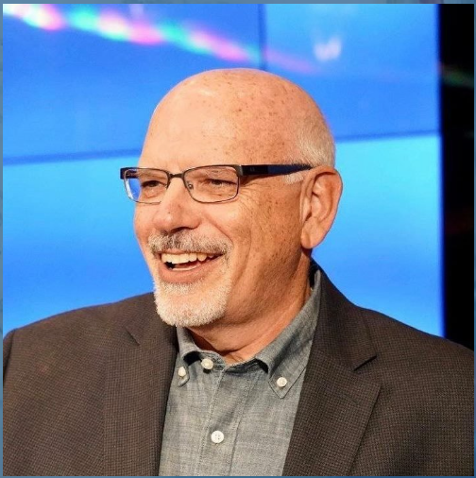
Dr. Michael Rydelnik
Professor of Jewish Studies and Bible at Moody Bible Institute.
Basic approaches to messianic prophecies. Pages 27-33
The Messianic Hope: Is the Hebrew Bible Really Messianic? (NAC Studies in Bible & Theology, 2010 ). by Michael Rydelnik (Author), E. Ray Clendenen (Series Editor)

Slide 9
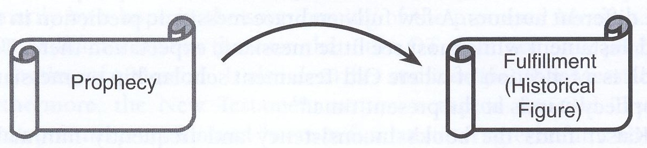
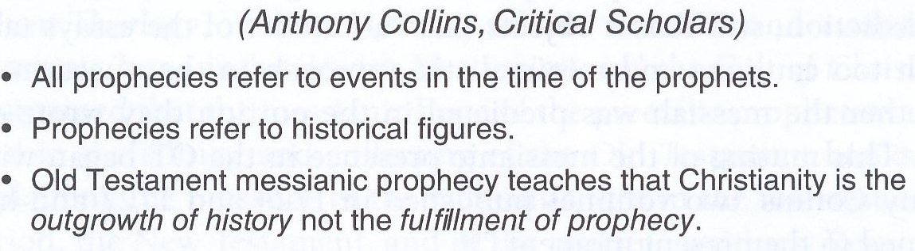
Historical Fulfilment

Slide 10
Isaiah 7
¹⁴ The LORD spoke to Ahaz … “Behold, the virgin shall conceive and bear a son, and shall call his name Immanuel…
¹⁶ Before the boy knows how to refuse the evil and choose the good, the land whose two kings you dread will be deserted.
● Son:
Born to Ahaz & a young woman.

Slide 11
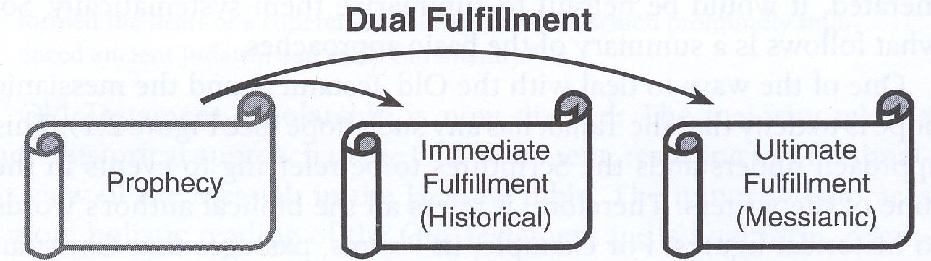
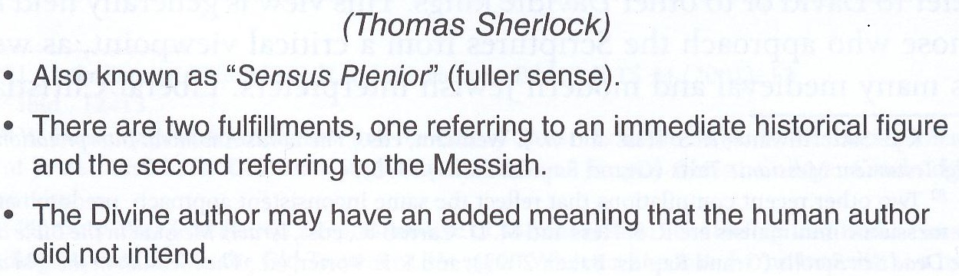

Slide 12
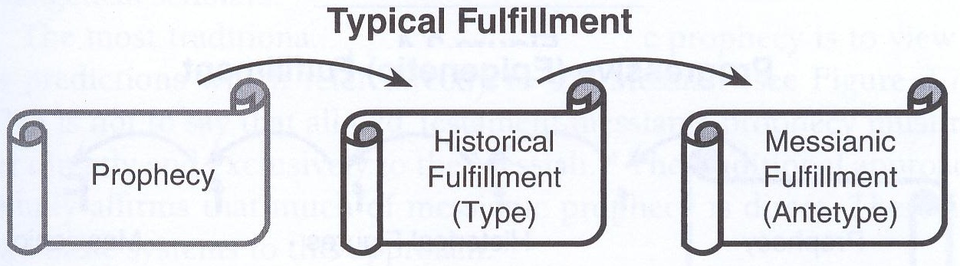
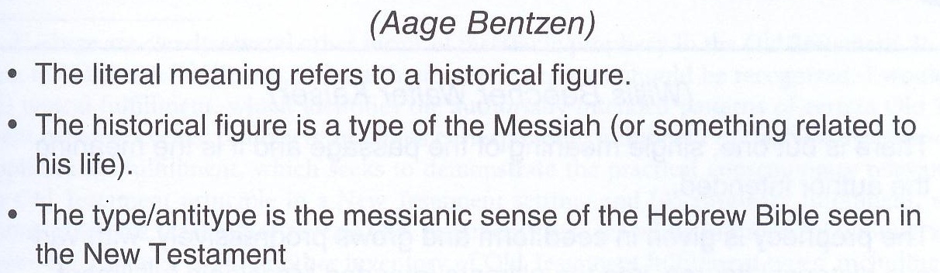

Slide 13
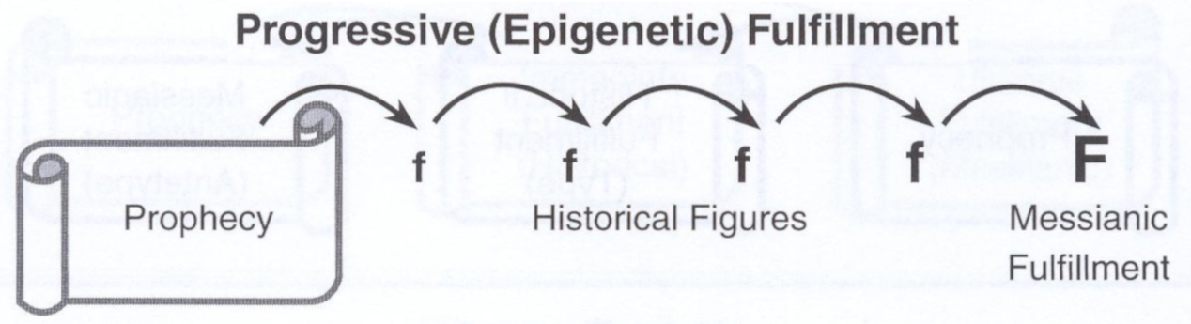
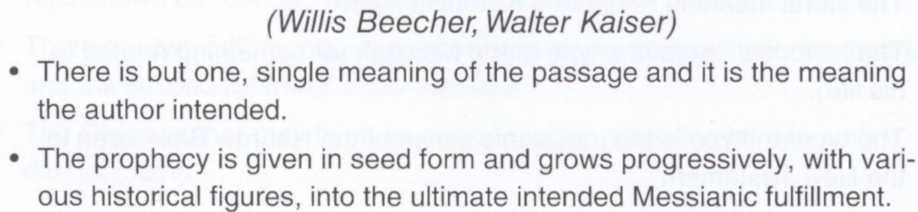

Slide 14
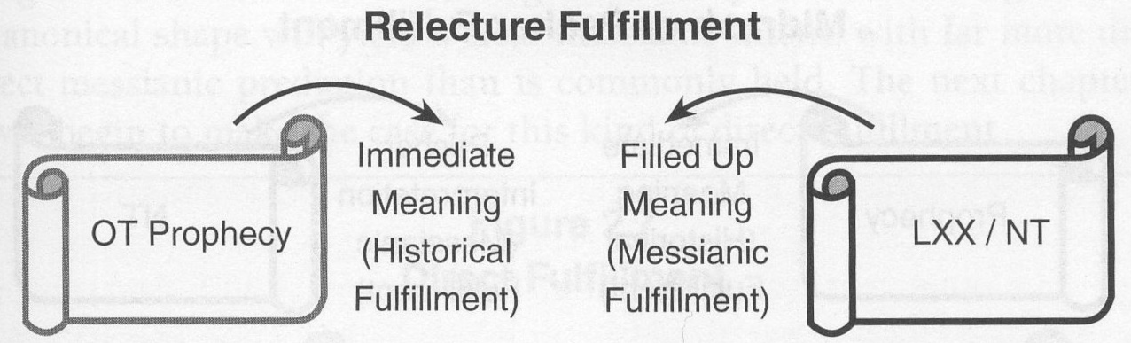
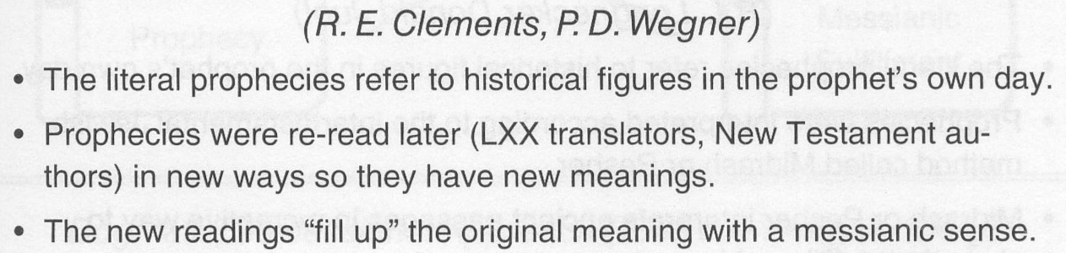

Slide 15
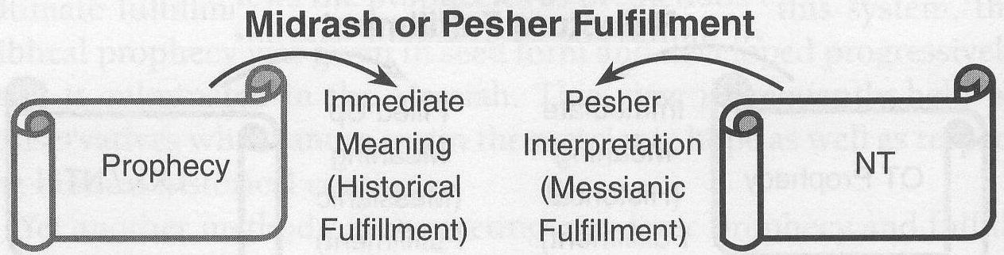
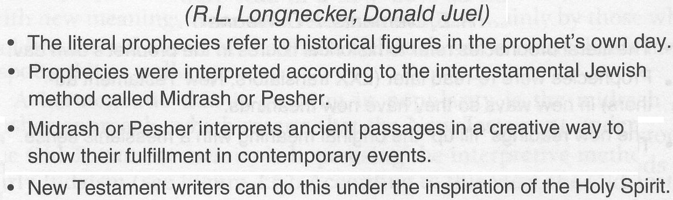

Slide 16
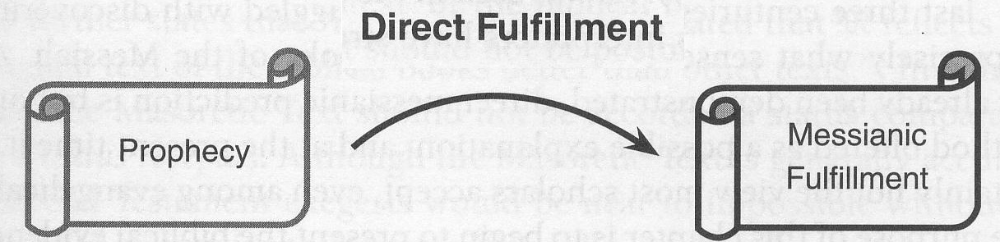
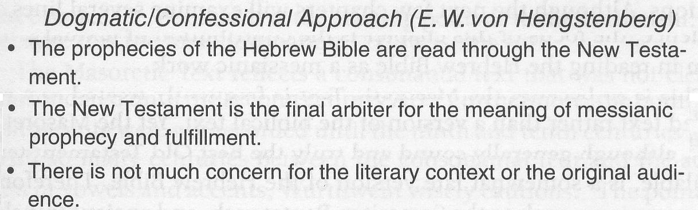

Slide 17
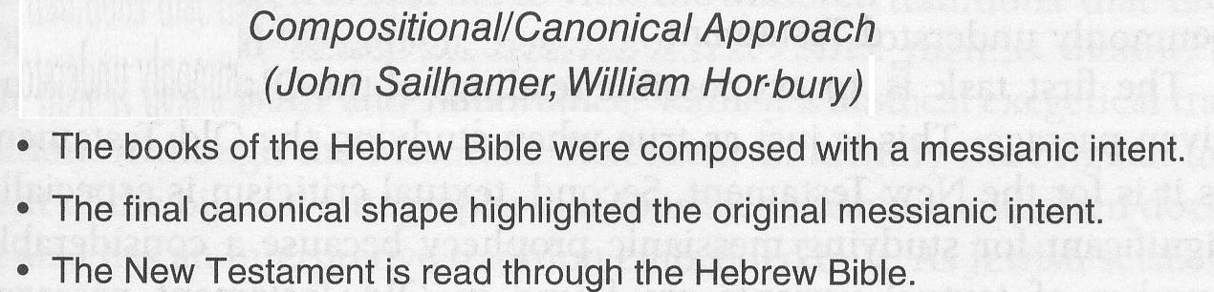

Slide 18
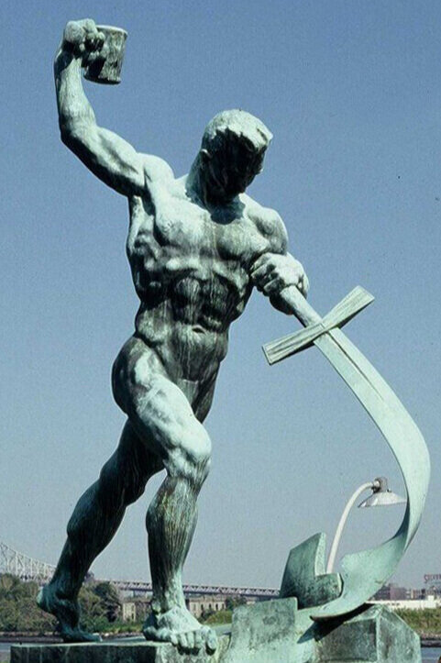
Isaiah 9
⁶ For to us a child is born, to us a son is given; and the government shall be upon his shoulder…
⁷ Of the increase of his government and of peace there will be no end, on the throne of David and over his kingdom…
● Peace:
● No end:
How things ought to be.
No borders.

Slide 19
21 Names and titles of Messiah
1 Anointed: Specially chosen.
2 Branch: Descended from Jesse/David.
3 Cornerstone: A political leader.
4 Counselor: Wise & understanding.
5 David: Returned from death.
6 God: Spiritual being.
7 Holy One: From heaven, incorruptible.

Slide 20
21 Names and titles of Messiah
8 King: In David’s lineage.
9 Light: Truth bearer.
10 Lord: Superior status.
11 Messenger: Enforces the covenant.
12 Prince: Right to rule.
13 Righteous One: Completely obedient.
14 Root: Source of divine authority.

Slide 21
21 Names and titles of Messiah
15 Ruler: Sovereign over Israel.
16 Scepter: Right to rule.
17 Seed: Descended from Eve, Abraham.
18 Servant: Accomplishes God’s will.
19 Shepherd: Provider of needs.
20 Son: Inherits all things.
21 Star: A divine being.

Slide 22
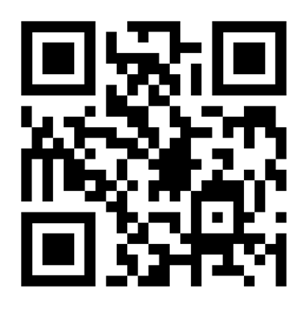
http://tanach.site

Slide 23
…
¹ …
¹ …
● …:
● …:
● …:
…
…
…

Slide 24
¹ Verse
¹ Verse
● Text: …

Slide 25
Titre
● …
● ...
● ...
● ...
● ...

Slide 26
Titre
● …: …
● …: …
● …: …
● …: …
● …: …
● …: …
● …: …
● …: …

Slide 27
Discuss
?
● …
● …
● …
● …

Slide 28
?

