Slide 1
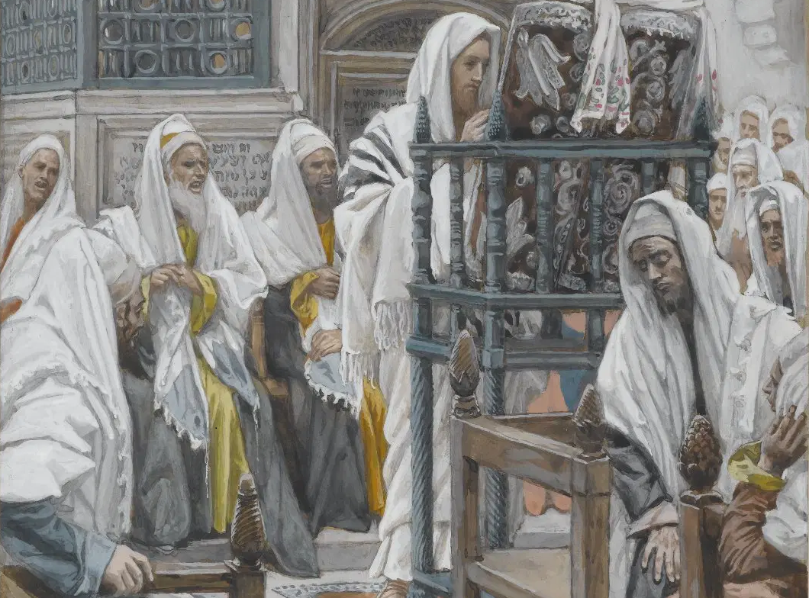
Messiah in the Tanach, 02
A Short Course for Men

Slide 2
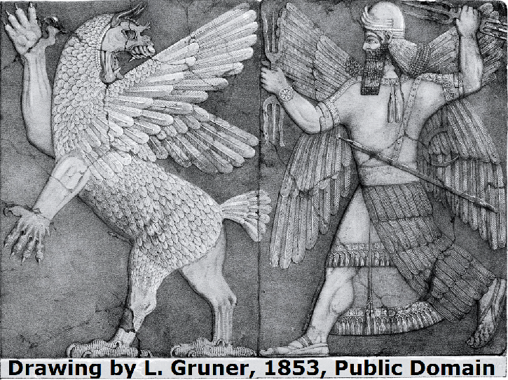
Versions of the Tanach
Hebrew versions
● Judean (from before 12th cent BCE)
● Samaritan (from 8th cent BCE)
● Babylonian (From 6th cent BCE)
● Essene (Qumran, from 1st cent BCE)

Slide 3
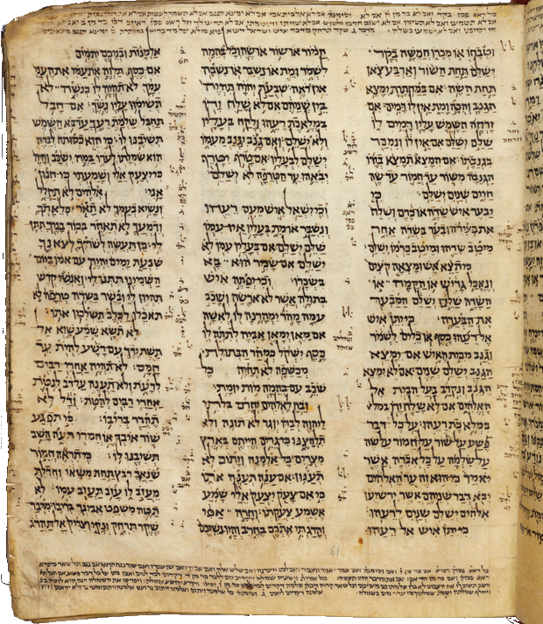
Versions of the Hebrew Bible
Hebrew scribes (copyists)
● Kings and priests (from 10th cent BCE)
● Scribes (51x, from 10th cent BCE)
● Sons of the prophets (from 8th cent BCE)
● Synagogues (from 6th century BCE)
● Masoretes (from 7th century CE)
Codex Sassoon, a Masoretic codex comprising all 24 books of the Hebrew Bible, dated to the 10th century CE

Slide 4
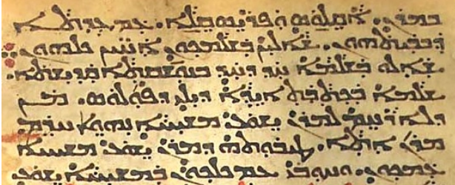
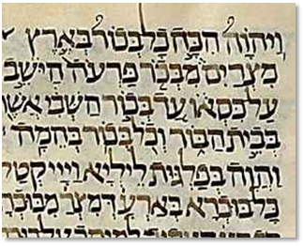
Language versions
Other language translations
● Syrian Aramaic (from 7th cent BCE)
● Judean Aramaic (from 5th cent BCE)
● Common Greek (from 3rd cent BCE)
● Classical Latin
(from 5th cent CE)

Slide 5
Oldest extant copies
● Inscriptions (from 10th century BCE)
● Dead Sea Scrolls (from 1st century BCE
to 2nd century CE)
● Greek codices (from 4th century CE)
● Aramaic Targums (from medieval CE)
● Masoretic scrolls (from 10th century CE)
● Critical editions (20th century CE)
Biblia Hebraica Quinta, Genesis, 2015.

Slide 6
In this module
● Christian=Jewish, not Gentile ‘church’.
● MT (Masoretic text) from 10th cent. CE.
● 1st task = establish the (original) text.
● Greek LXX 1000 years before the MT.
● All versions have variant ‘readings’.
● MT still overall the best Tanakh text.
● MT post-Christian, anti-Christian bias.
● MT treats prophetic texts as historic.

Slide 7
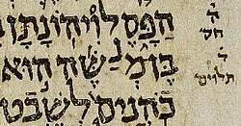
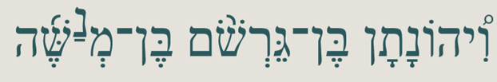
Sample MT variant
¹ Jonathan, the son of Gershom son of Manasseh, and his descendants served as priests. Jud. 18:30 Tanach (JPS 1985)
● Manasseh: In some mss = Moses.
MT inserts a raised nun (‘n’). Rabbis commented that it were unseemly for Moses to have an ungodly ‘son’.

Slide 8
Numbers 24:7
Their boughs drip with moisture.
Their roots have abundant water.
Their king shall rise above Agag.
Their kingdom shall be exalted. NJPS
● Agag: All versons read ‘Gog’ = Ezekiel 38:3, an end-time (messianic) scenario.
If Agag, then the king = David.
If Gog, then the king = Messiah.

Slide 9
Numbers 24
⁹ They crouch, they lie down like a lion, like the king of beasts…
● An allusion to Genesis 49:9-10, an apparent messianic prophecy.
¹¹ What this people will do … in days to come. (1985)
● Literally, ‘in the end of days’ (1917), the messianic age to come.

Slide 10
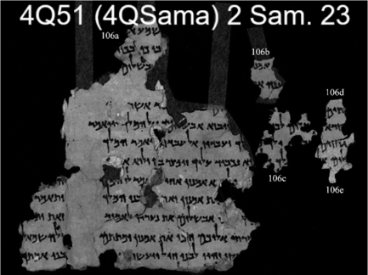
2 Samuel 23:1
The utterance of David son of Jesse,
The utterance of the man set on high,
The anointed of the God of Jacob,
The favorite of the songs of Israel.
● ‘Set on high” (MT, ‘âl) = David.
● ‘God raised up’ (4QSamª) = David?
● ‘utterance … about the man whom the Lord anointed’ (LXX, epi, ’al) = messiah.

Slide 11
Psalm 72:5
¹ O God, endow … the king's son with Your righteousness;
² that he may judge Your people rightly…
⁵ Let them fear You as long as the sun shines, ⁶ Let him be like rain…
● Let them: LXX reads, ‘Let him fear…’
● Context: Singular ‘he/him’.
● Context: Future: ¹¹ ‘nations serve him.’

Slide 12
Isaiah 9:6 [Heb. 9:5]
⁶ For a child has been born for us, a son given to us; … and he is named Wonderful Counselor, Mighty God, Everlasting Father, Prince of Peace. NRSV
⁵ … He has been named “The Mighty God is planning grace, The Eternal Father, a peaceable ruler.” NJPS 1985
● …:
● …:
● …:
…
…
…

Slide 13
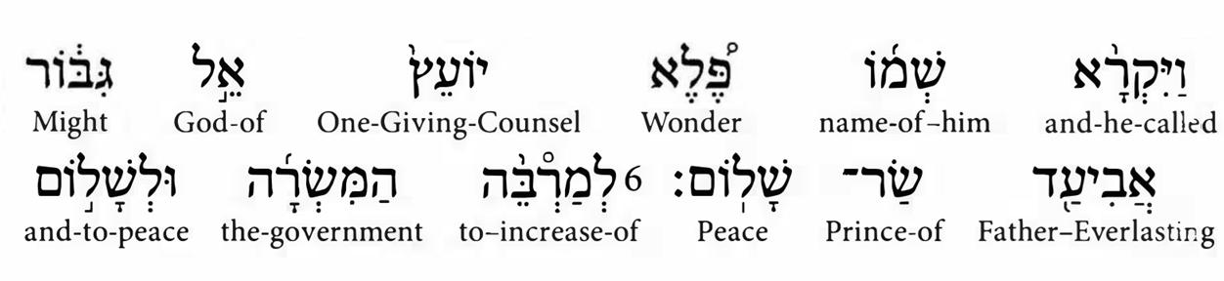
Isaiah 9:6 [Heb. 9:5]
● Paštâ:
● Called:
● The:
● Belief:
Disjunctive accent (= comma).
Assumed ‘theophoric’ names.
Names take no definite article.
No human child a divine Being.

Slide 14
9⁷ … Upon David’s throne and kingdom,
That it may be firmly established
In justice and in equity
Now and evermore. Isaiah NJPS 1985
1³² You will … bear a son…. He will be great and will be called the Son of the Most High, and the Lord God will give to him the throne of his ancestor David… ³³ forever… Gospel of Luke, NRSVue

Slide 15
Isaiah 9:6 [Septuagint]
⁶ A child was born for us, a son also given to us… He is named Messenger of Great Counsel, for I will bring peace upon the rulers, … upon the throne of Dauid and his kingdom … forevermore.
● Named:
● I will:
● Forevermore:
Actor not identified.
Actor not certain.
Messianic future.

Slide 16
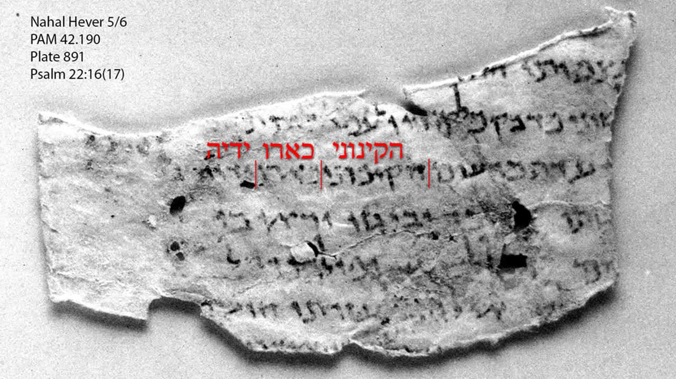
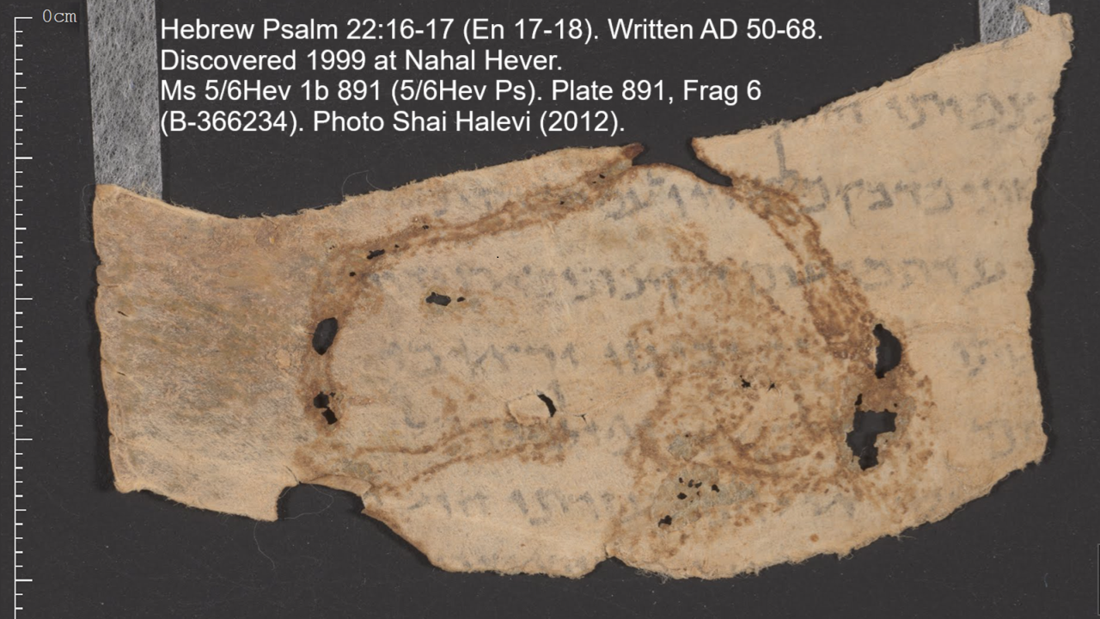
Psalm 22:16 [Hebrew 22:17]
¹⁶ Dogs surround me;
a pack of evil ones closes in on me,
like lions [they maul] my hands and feet.
● Lions:
● [Maul]:
● Nahal Hever:
MT ‘as a lion’ ka-’arî.
Versions have ‘pierced’.
Discovered 1999, from AD 50-68, reads k’rû ‘pierced’.

Slide 17
‘Pierced my hands and feet’
● Probable original reading of Isa. 9:6.
● Is not cited as messianic in the NT.
● John 19:34 ‘soldiers pierced his side.’
● John 19:37 ‘Scripture says “They will look on him whom they have pierced”’.
● Same Gk verb used in LXX Zech. 12:10.
● ‘My Hands and feet’ (Psa. 22:16) ≈ “my hands and my feet’ (Luke 24:39).

Slide 18
Conclusion
● Bible interpreters’ first task remains to ascertain the original text.
● Post-Christian Masoretes rendered some possible predictions as historical.
● Masoretic Hebrew manuscripts date from circa the 10th century CE.
● Samaritan, Greek, Syriac, and Latin versions may preserve older texts.

Slide 19

http://tanach.site

Slide 20
…
¹ …
¹ …
● …:
● …:
● …:
…
…
…

Slide 21
…
¹ …
¹ …
● …:
● …:
● …:
…
…
…

Slide 22
¹ Verse
¹ Verse
● Text: …

Slide 23
Titre
● …: …
● …: …
● …: …
● …: …
● …: …
● …: …
● …: …
● …: …

Slide 24
Discuss
?
● …
● …
● …
● …

Slide 25
?

